Slide 1
Emotion & Toxicity Detection in Reddit Communities
Presented By: Parth Maniar
Course: Data Mining II
Analyzing public reaction and behavior through sentiment trends

Slide 2
Project Overview
🎯 Goal:
Analyze sentiment and detect toxicity to understand community behavior and emotional shifts.
🔧 Approach:
Collected 10,000 Reddit posts using PRAW API
Applied VADER for sentiment scoring
Used custom keyword-based logic for toxicity detection
Performed event-based analysis to track public reactions (e.g., "war", "AI")
💡 Innovation:
Focused on solving real problems, not just labeling sentiment
Mapped real-time emotional and toxic trends across communities
Applications: Journalism, content moderation, and behavioral research

Slide 3
Key Research Questions & Their Purpose
Research Question | Why It Matters / What It Helps Solve
1. How does sentiment vary across Reddit posts over time? | Detects community mood swings and tracks how public opinion evolves.
2. Are certain topics or communities more toxic? | Identifies which subreddits need moderation or display extreme behavior patterns.
3. How do emotions shift around global events (e.g., war, AI, inflation)? | Helps measure real-time public reactions to world events — useful for media/policy.
4. Can we build tools to detect and visualize toxic or emotional spikes? | Enables proactive content moderation or alert systems for sudden emotional surges.

Slide 4
Data Collection
Component | Details
Tool | PRAW (Python Reddit API Wrapper)
Script Used | reddit_scraper.py
Subreddits | Worldnews, news, politics, AskReddit, technology, Economics Science, TodayILearned, UpliftingNews, explainlikeimfive
Filters Applied | Top 10,000 posts (sorted by score), Time filter: past 1 year
Fields Collected | title, text, score, comments, created, url, subreddit
Output File | reddit_combined_10k.csv

Slide 5
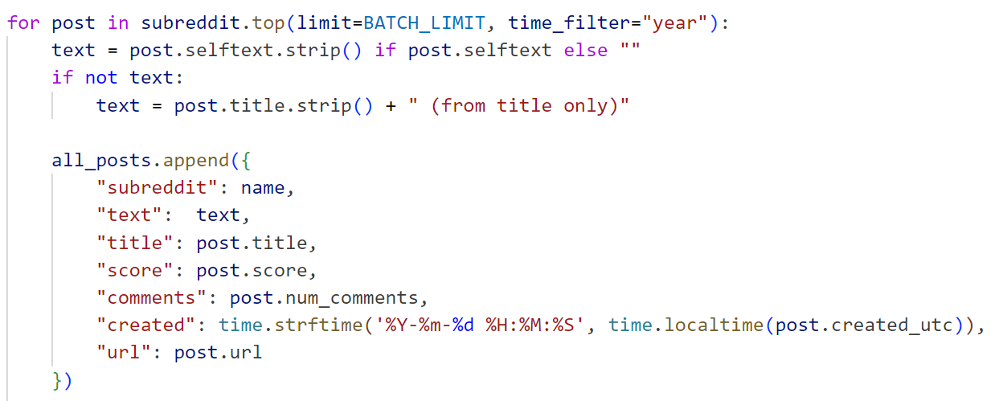

Slide 6
Sentiment Analysis (Step 1)
Element | Details
Tool Used | VADER (Valence Aware Dictionary and sEntiment Reasoner)
Why VADER? | Designed for social media — handles slangs, emojis, punctuation emphasis
Sentiment Score Range | Compound score from -1 (most negative) to +1 (most positive)
Classification | Thresholds: • ≥ +0.05 → Positive • ≤ -0.05 → Negative • Else → Neutral
Applied On | Combined title + selftext of each Reddit post
Output Column | vader_score + sentiment (generate reddit_sentiment.csv)

Slide 7
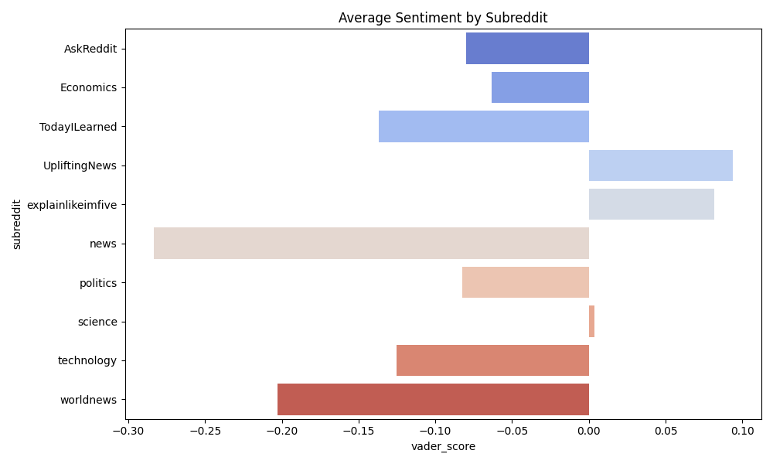
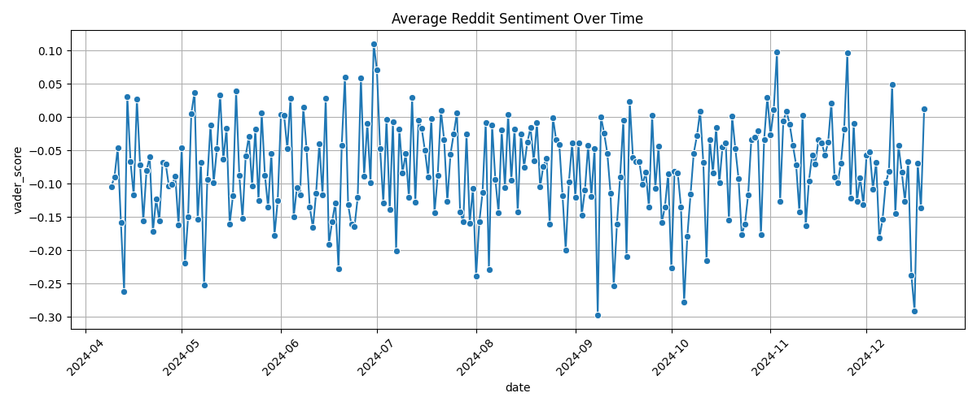

Slide 8
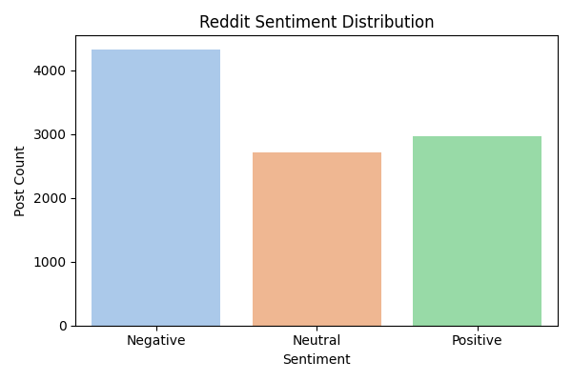

Slide 9
Analyzed Reddit posts using a custom list of toxic words (50+ keywords)
Matched words using keyword lookup logic (no external model required)
Counted the frequency of each word across all posts
Identified the 10 most commonly occurring toxic terms
Helps understand patterns in harmful language and its prevalence
Toxic Word Frequency Analysis

Slide 10
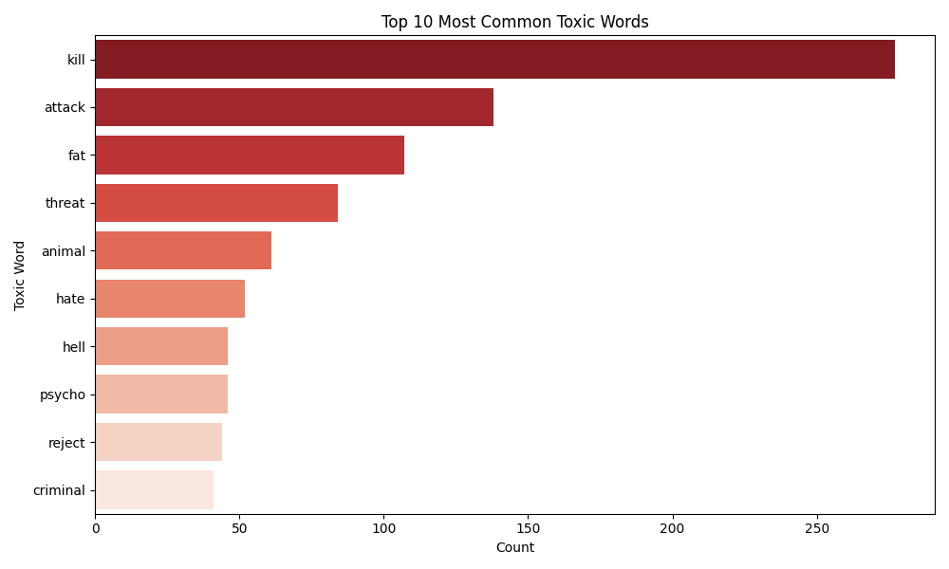
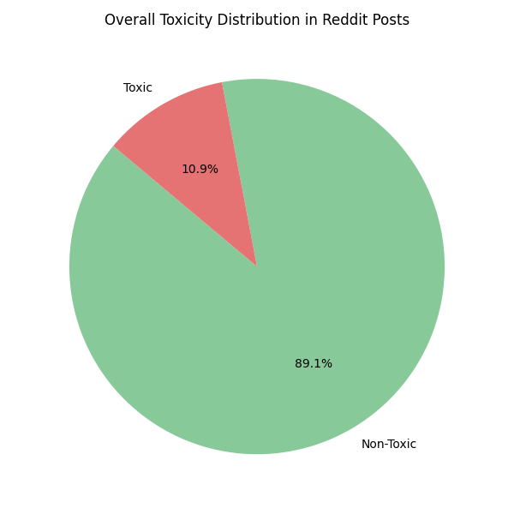

Slide 11
Event-Based Sentiment Mapping (Step 3)
Section | Content
Keyword Used | “War”
Goal | Analyze how Reddit users emotionally react to real-world events
Method | - Filtered posts containing the keyword - Grouped by date - Calculated average sentiment and toxicity
Tool Used | Python (pandas, seaborn, matplotlib)
Output | Line chart: event_sentiment_trend_<keyword>.png
Insight | Shows spikes/dips in emotion & toxic tone over time related to event

Slide 12
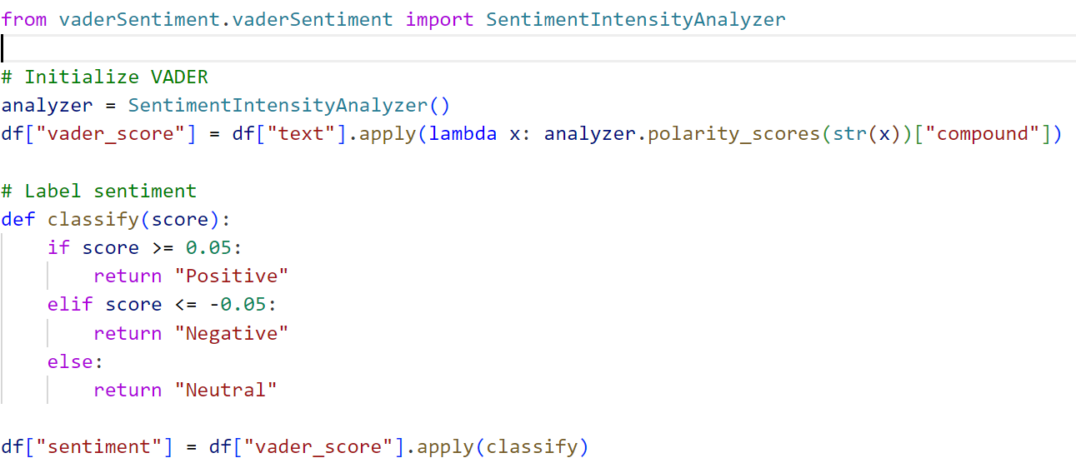

Slide 13
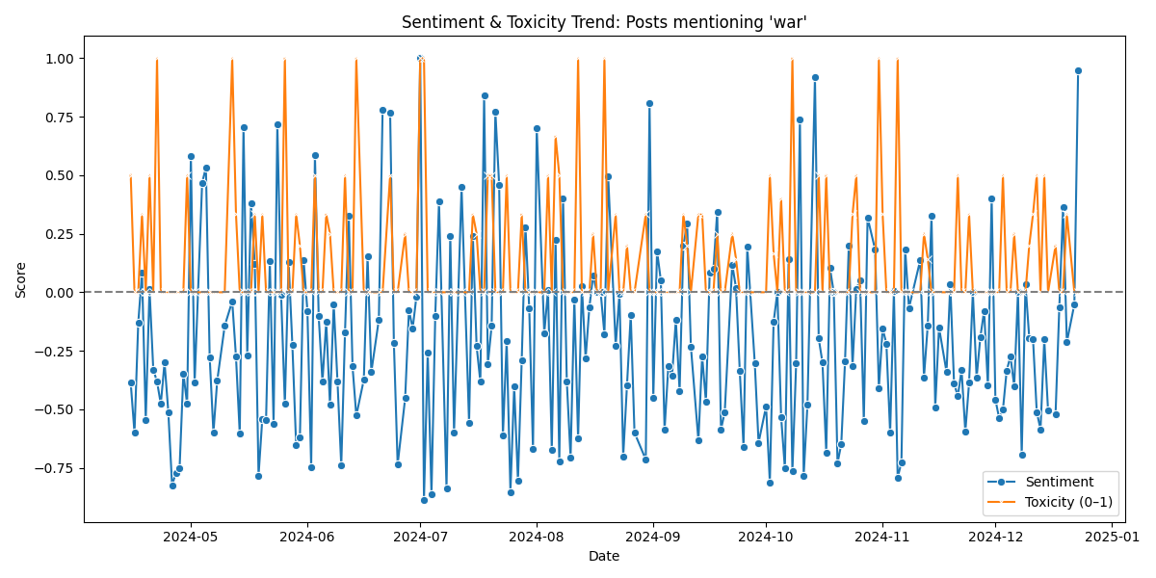

Slide 14
Key Findings
💡 Finding | 🔍 Insight / Interpretation
🟥 1. Toxic Posts = More Negative Sentiment | Posts flagged as toxic had consistently lower VADER scores — shows strong overlap between emotional negativity and toxic language.
🌍 2. Current Events Communities Were More Toxic | Subreddits like r/worldnews and r/politics showed higher toxicity — likely due to the emotionally charged nature of global/political topics.
😊 3. Casual Subreddits Are More Positive | Communities like r/AskReddit and r/TIL had higher average sentiment — reflects their lighthearted or curiosity-based tone.
⚠️ 4. Event Tracking Captured Mood Shifts | Posts filtered by keywords like "war" showed dips in sentiment and spikes in toxicity during major events — proves Reddit reflects real-time public emotion.

Slide 15
Future Work
🚀 Opportunity | 🔍 What It Will Add to the Project
🔄 Use Google Perspective API for toxicity scoring | Adds industry-grade toxicity scores with nuanced metrics (e.g., insult, threat, profanity)
🧪 Cross-platform Analysis (Reddit + Twitter + News) | Correlate how different platforms react to the same events
🌐 Add Real-Time Dashboard (e.g., using Streamlit) | Make it interactive and usable by moderators, journalists, or researchers

Slide 16
Reddit is a powerful platform for understanding real-time public emotion and toxic discourse.
VADER + keyword-based models offer lightweight, explainable sentiment tracking — suitable for fast, scalable analysis.
Event-based filtering revealed emotional shifts during major global topics, proving Reddit reflects public mood.
Toxicity and sentiment often correlate — giving insight into how communities respond emotionally and behaviorally.
This project shows how simple NLP tools can solve real-world problems like moderation, media analysis, and crisis monitoring.
Conclusion

Slide 17

THANK YOU
Alok Kumar Jha

