Slide 1
Names:
Parth Bharatkumar Maniar
Brajeshwari Raj
Dadhaniya, Deep Chandubhai
Venegas Ataca, Alejandro
Venegas Ataca, Alessandra
VAST Challenge 2018 MC1 Progress - 3

Slide 2
Contributions
Alessandra Venegas Ataca: Developed a line chart of the distribution of Rose Crested Blue Pipits over the years using D3.(Slide :- 4)
Parth Maniar: Developed Bar Graph of the birds overs the years and total birds by quality using D3.(Slide :- 5, 3)
Alejandro Venegas Ataca: Scatterplot describes the number of Rose-crested Blue Pipit per year. The scatterplot shows different sizes and color intesity according the number of birds.
Brajeshwari Raj: The bar graph compares the levels of vocalization and quality in the provided dataset. It provides a visual representation of the frequency of different vocalization and quality categories. The pie graph refers to the presence or absence of vocalizations, while quality refers to the perceived quality of those vocalizations.
Dadhaniya, Deep Chandubhai: Created area chart count of all birds type over the years. Also implemented map chart using x and y coordinate.

Slide 3
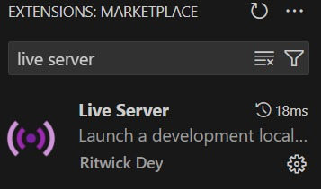
Used Tool
We have used Live server to run this code as all charts data are in one csv file.
You may view the changes instantly and immediately when you save your work or make changes to your code since the browser will automatically refresh itself after saving. You may open an HTML page on the live server, which opens a browser window with the file and starts a server on your behalf.

Slide 4
Our Hypothesis:
Kasios Furniture is a primary contributor to the reduction of the Rose Crested Blue Pipit. We have evidence that:
The location patterns of pipits indicate a massive relocation since 2017.
The number of Pipits started reducing drastically since 2017.
From the audios reported by Kasios only 1 out of 15 belong to our specie of interest.

Slide 5
Future With This Investigation?
Conduct independent recordings across the entire Preserve over a few months.
Take recordings at regular intervals (daily or weekly) in mornings or evenings.
Determine the true migration patterns of the Pipit species.
Use video analytics technologies to capture visual proofs of birds at different locations.
Apply transfer learning approach to extend audio classification methodology to video surveillance methods.

Slide 6
Thank You

