Slide 1
Healthcare Data Analysis Using MEPS 2020
AMS 597 Statistical Computing
  Instructor: Dr. Silvia Sharna
Group 5
  Junsung Rhee 116740814
  Keun Young Yoon 116517818
  Dhananjay Sharma 116740841
  Parth Pidadi 116237374

Slide 2
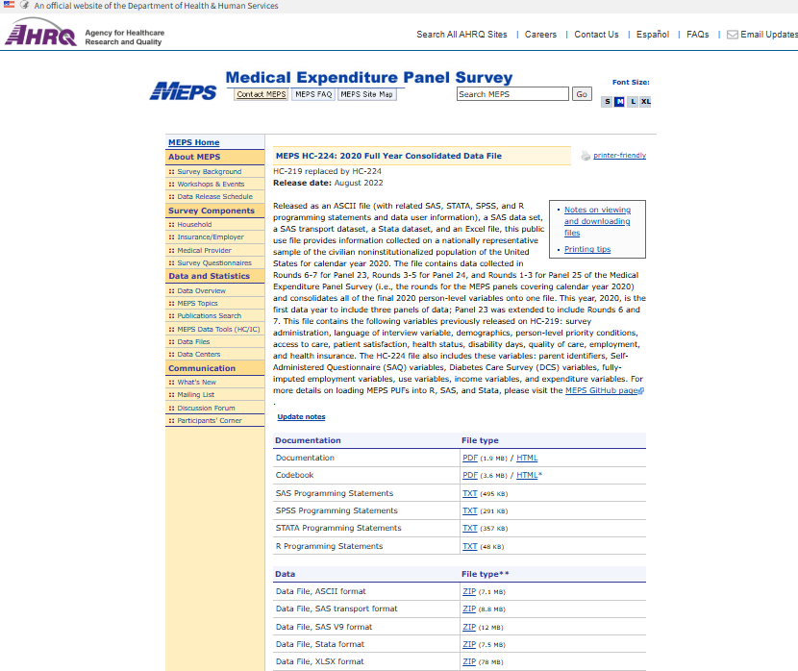
Dataset and Variable Overview
Project Objective:
To identify risk factors linked to high healthcare costs, chronic illness, and mental distress
— with the goal of supporting preventive care strategies that help reduce insurance costs
and expand access to coverage.
Dataset: MEPS HC-224 (2020) – a nationally representative U.S. healthcare survey
with 27,805 individuals and 1,451 variables covering expenditures, insurance, chronic
conditions, and demographics.
RQ1 – Expenditure Analysis
Objective: Identify which medical service categories (e.g., inpatient, emergency, prescriptions)
most drive total healthcare expenditures.
RQ2 – Chronic Disease and Demographics
Objective: Examine whether demographic characteristics are associated with the likelihood of having a chronic condition.
RQ3 – Lifestyle and Psychological Distress
Objective: Determine which behavioral patterns (e.g., sleep, alcohol use, smoking) predict high psychological distress.

Slide 3
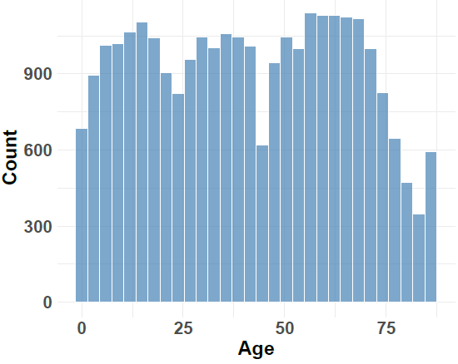
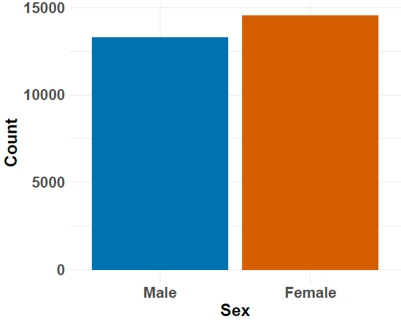
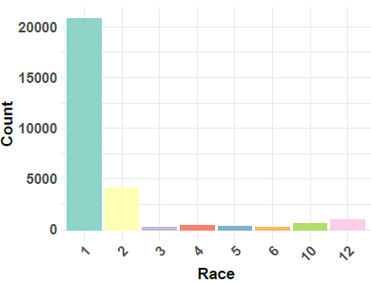
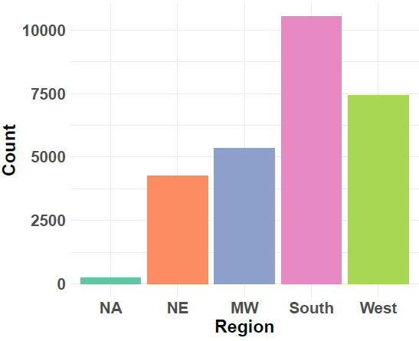
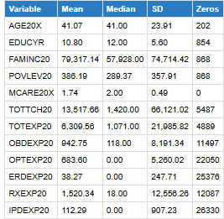
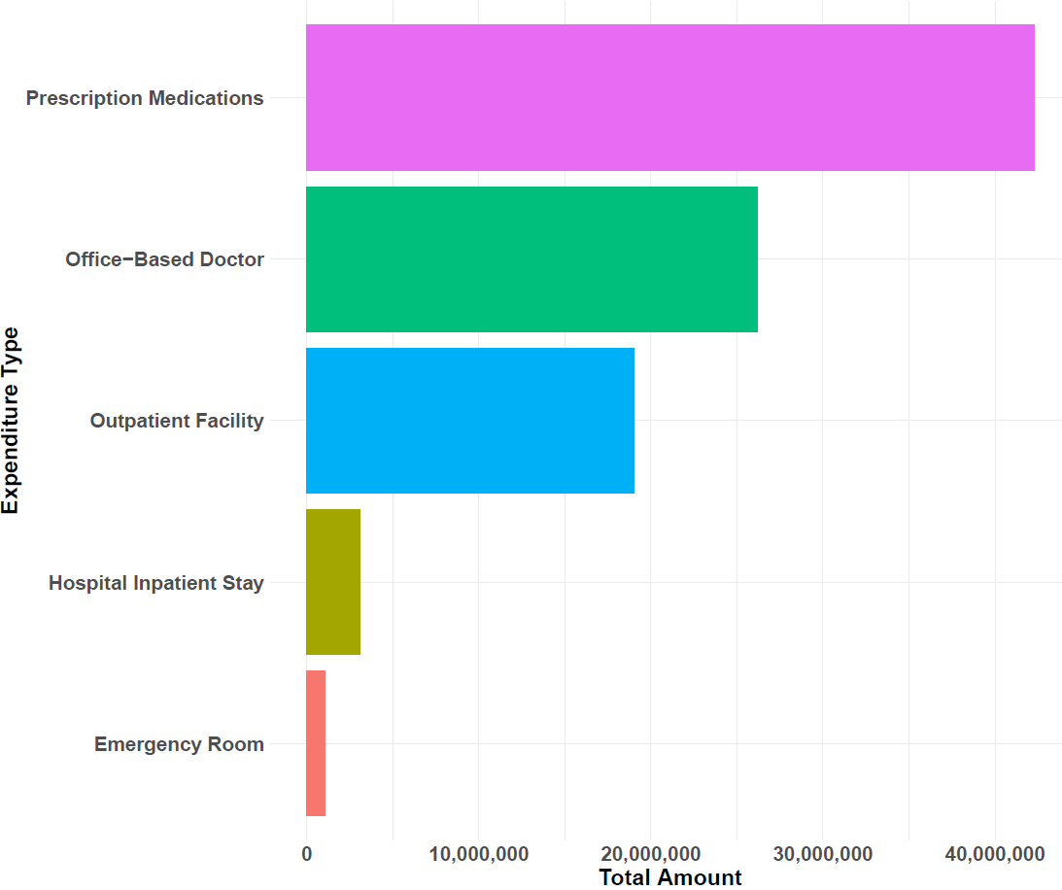
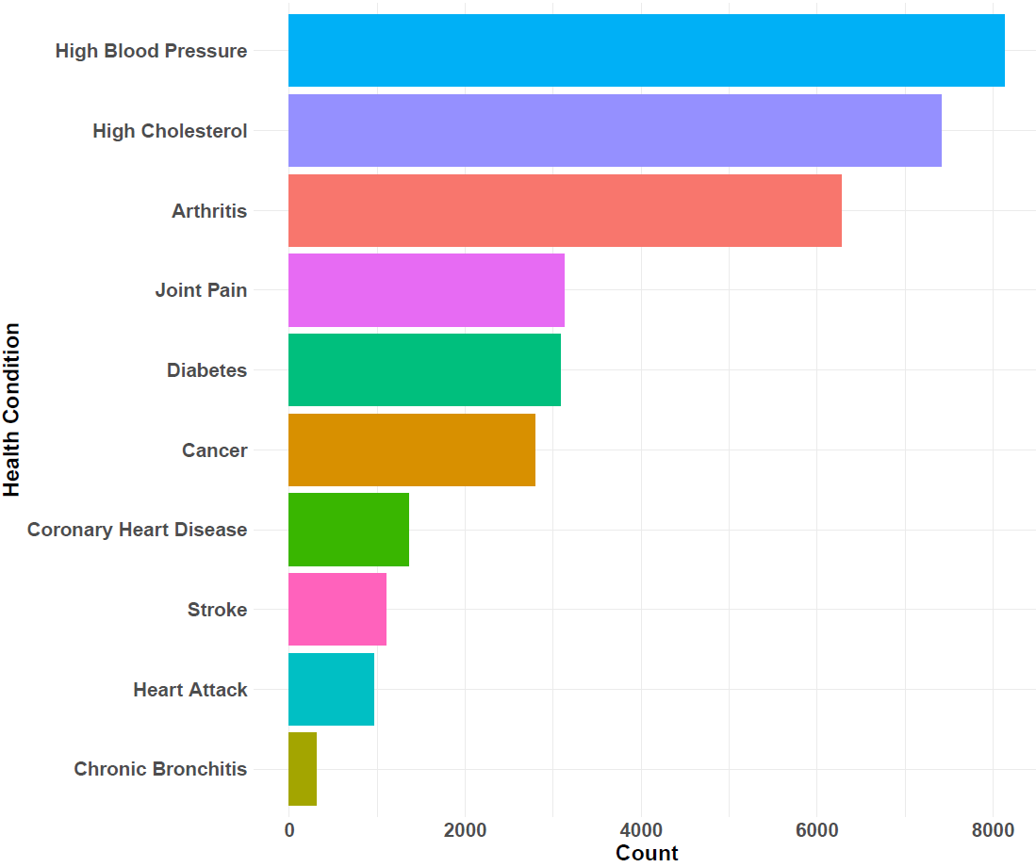
Distribution & Summary of Expenditures
[Demographic Distribution]
[Expenditure Split]
[Prevalence of Health Conditions]
[Statistical Summary of Continuous Variables]

Slide 4
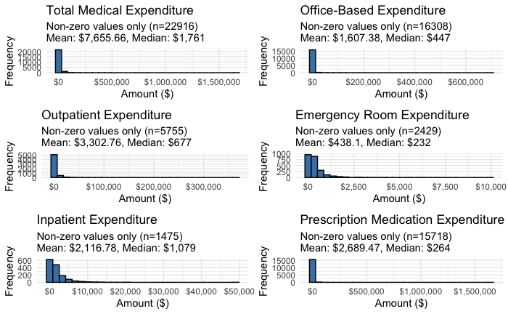
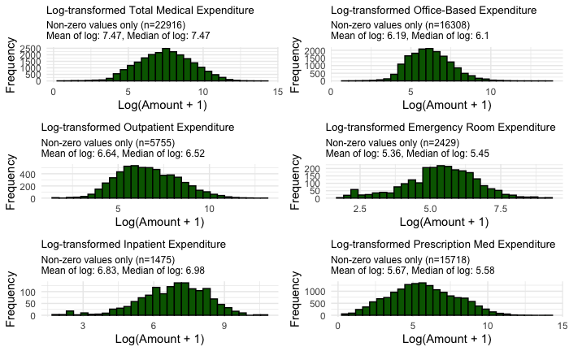
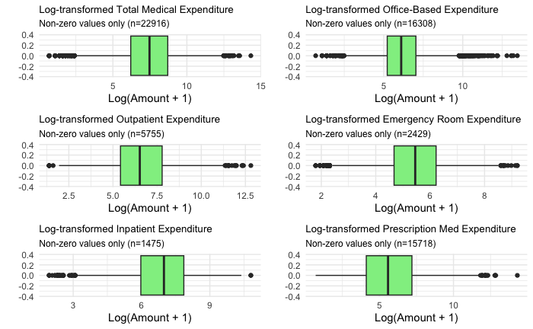
RQ1: What drives healthcare costs?
Dependent Variable | Total Expenditure (TOTEXP20)
Independent Variables | Expenditures: Office-Based Doctor Visits (OBDEXP20), Outpatient Therapist Visits(OPTEXP20), Emergency Room(ERDEXP20), Inpatient Hospital(IPDEXP20), Prescription Drugs(RXEXP20)
[Raw Distributions of Expenditures]
[Log-Transformed Distributions]
[Boxplots of Log-Transformed Data]

Slide 5
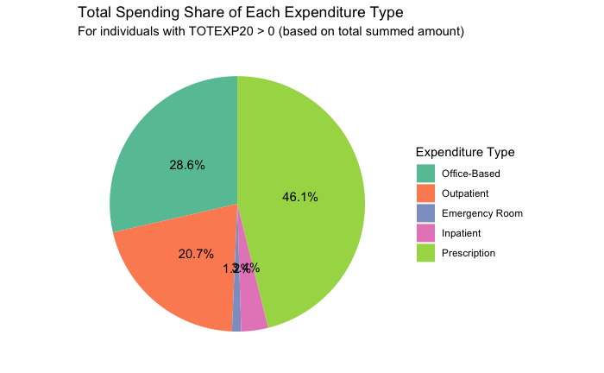
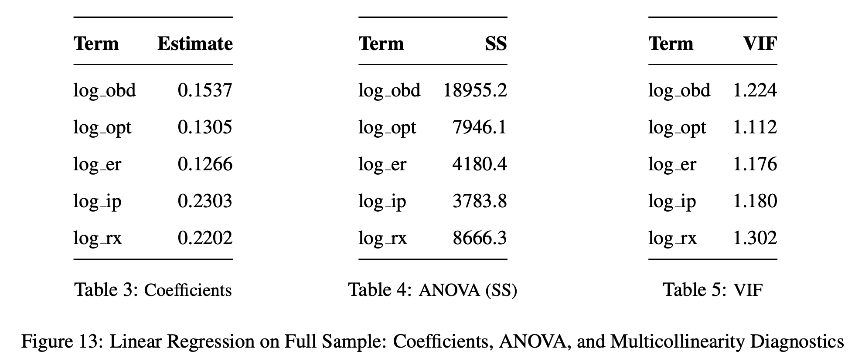
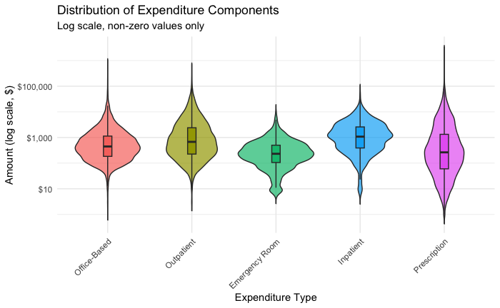
RQ1: ANOVA and Linear Regression
[How Medical Costs Are Distributed Across Categories]
Prescription (log_rx) appears most consistently across all tables
log_ip and log_rx had the strongest marginal effects in the linear model,
while log_obd explained the largest share of variance in ANOVA.
All VIF values were low, indicating no multicollinearity concerns.

Slide 6
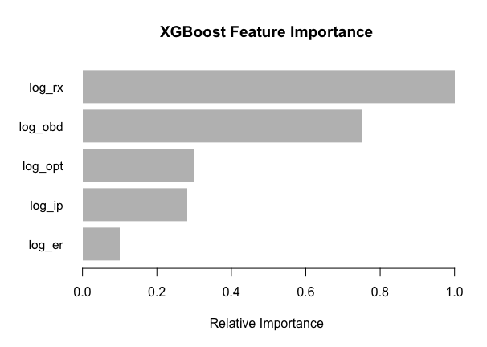
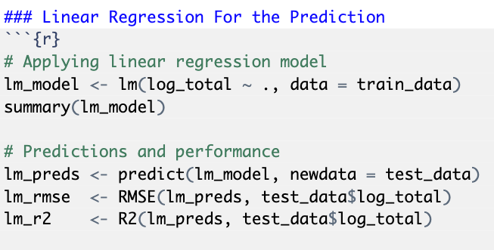
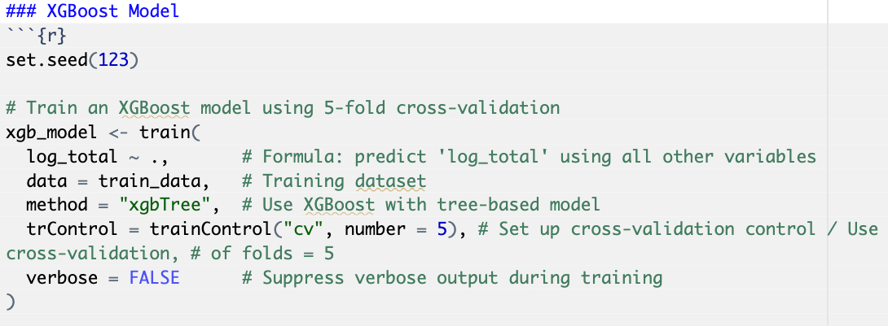
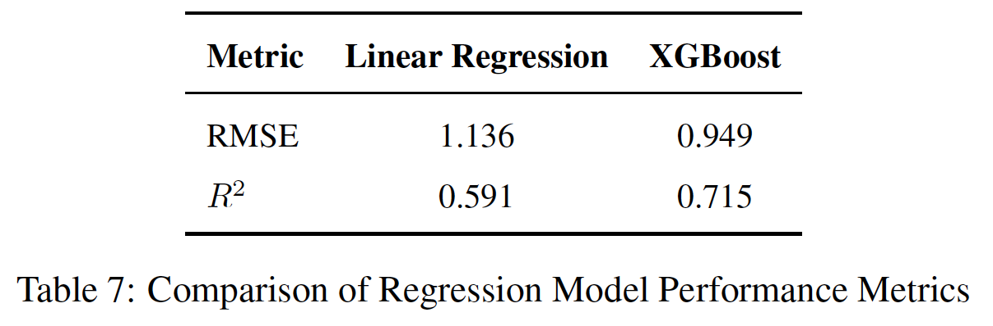
RQ1: Predictive Modeling: Linear Regression vs. XGBoost
XGBoost outperformed linear regression achieving higher accuracy (R² = 0.715 vs. 0.591) and lower RMSE (0.95 vs. 1.14).
Prescription costs (log_rx) were consistently the most predictive feature in the XGBoost model,
highlighting their strong influence across the population.

Slide 7
RQ1: Interpretation & Policy Implication
Prescription drugs, inpatient care, and office-based visits are key cost drivers in U.S. healthcare.
Drugs are costly and widely used, while inpatient care is rare but expensive per case.
Office visits are low-cost but drive spending due to high frequency.
Cost-control strategies must target both high-frequency, low-cost services and low-frequency, high-cost events.
Could managing chronic conditions and identifying at-risk individuals early help reduce overall healthcare costs?
Q2
Q3

Slide 8
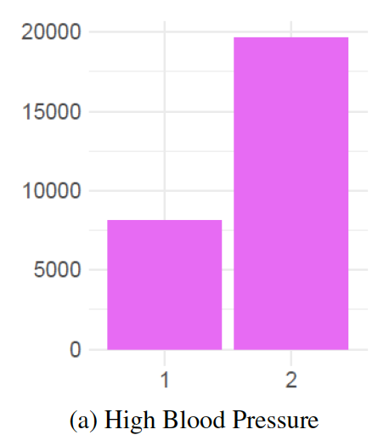
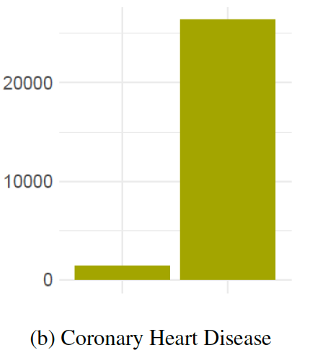
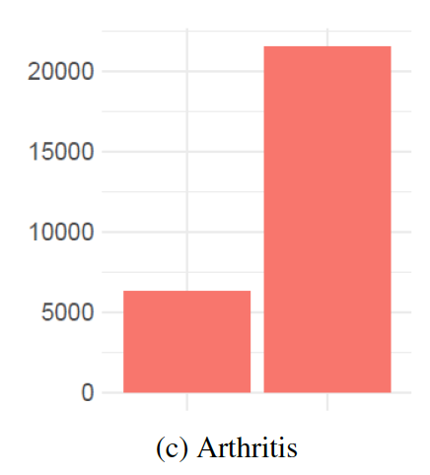
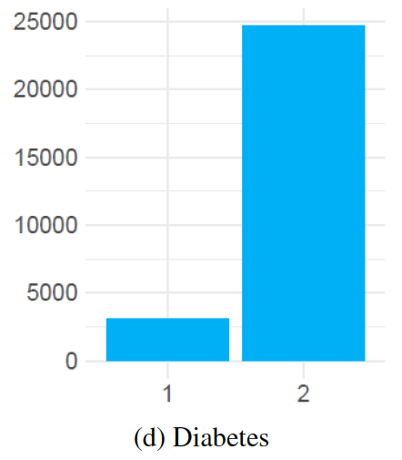
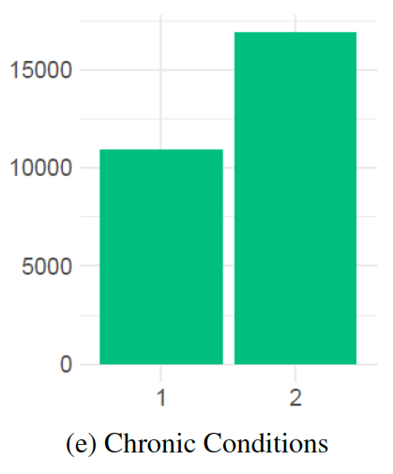
RQ2: Who is at risk of chronic illness?
Dependent Variable | A binary indicator (CHRONIC) representing whether an individual had at least one of the following chronic conditions: High Blood Pressure(HIBPDX) / Coronary Heart Disease(CHDDX) / Arthritis(ARTHDX) / Diabetes(DIABDX M18)
Independent Variables | Family Size (FCSZ1231), Census Region (REGION20: Northeast=1, Midwest=2, South=3, West=4), Age (AGE20X), Sex (SEX), Race (RACEV2X)

Slide 9
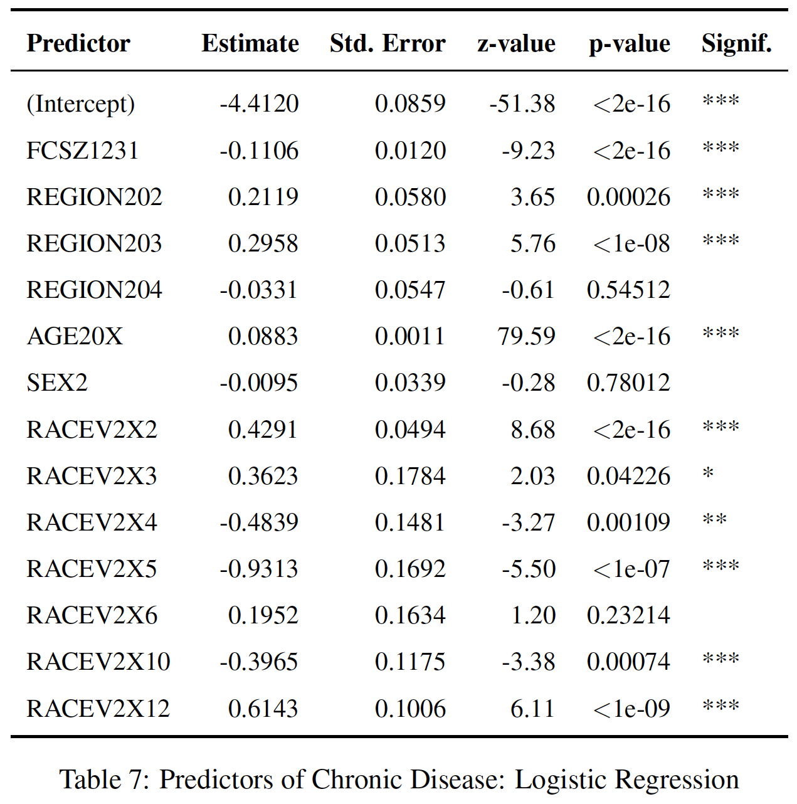
RQ2: Logistic Regression & Random Forest
Age: Strongest predictor — chronic disease risk increases with age.
Family Size: Inversely associated — larger households linked to lower risk.
Sex: No significant association with chronic illness.
Conclusion: Age and family structure are key demographic risk factors.

Slide 10
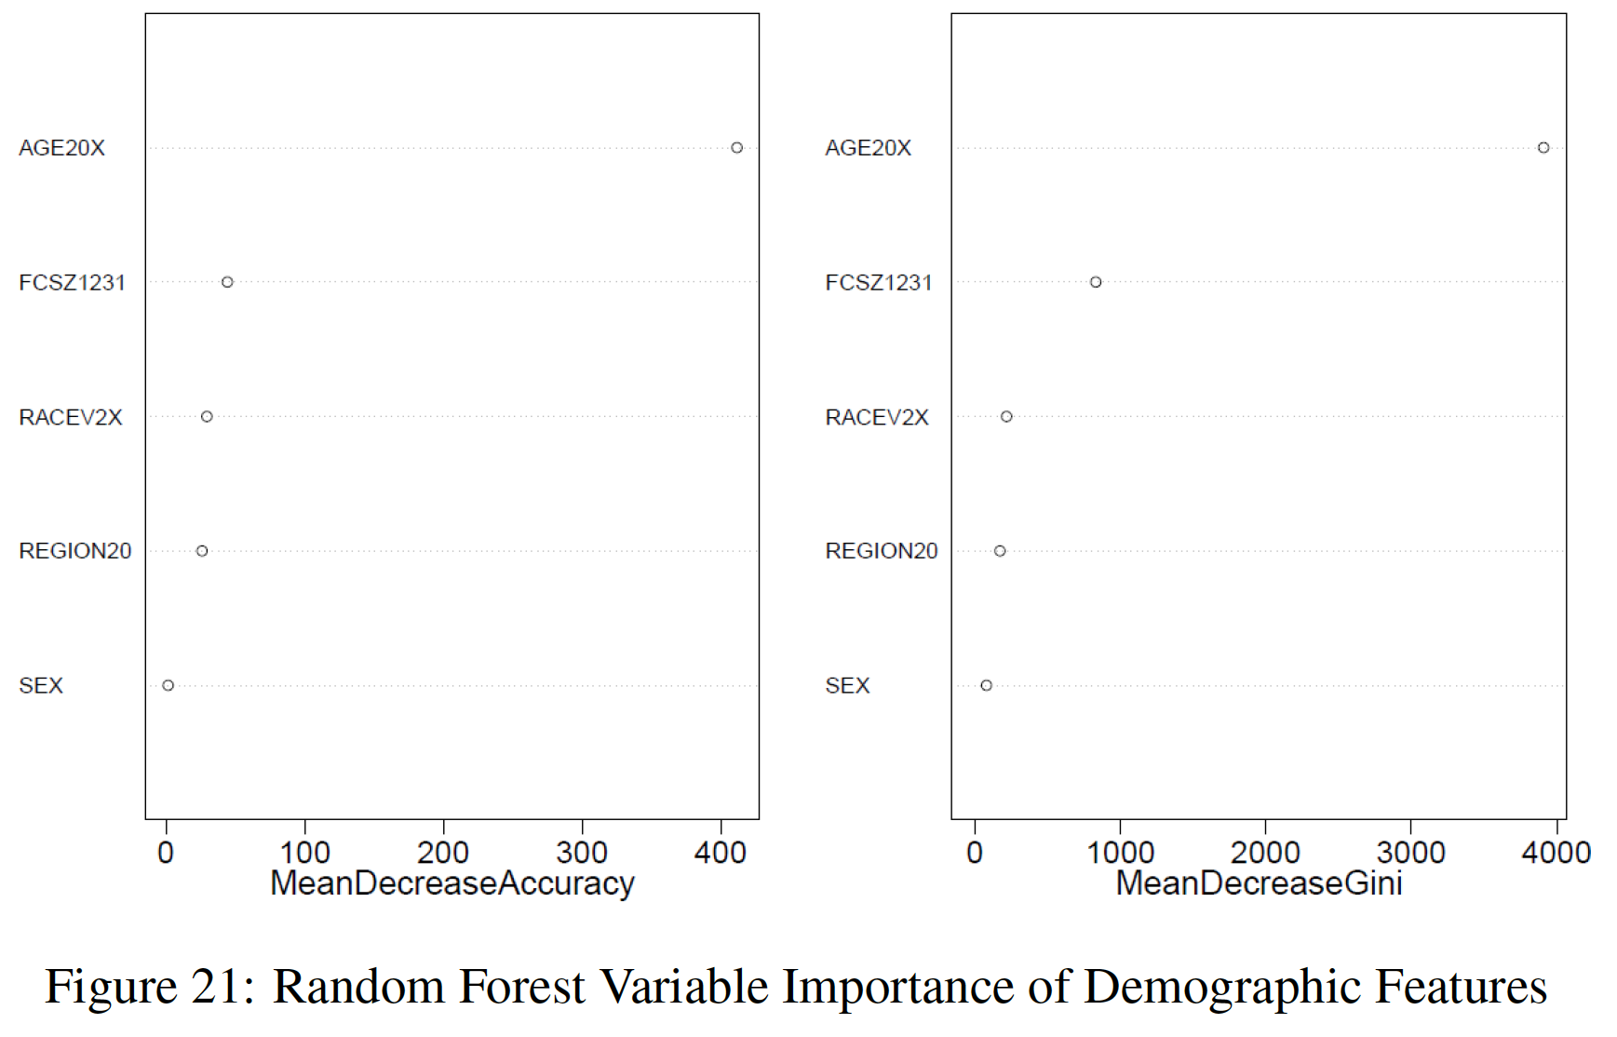
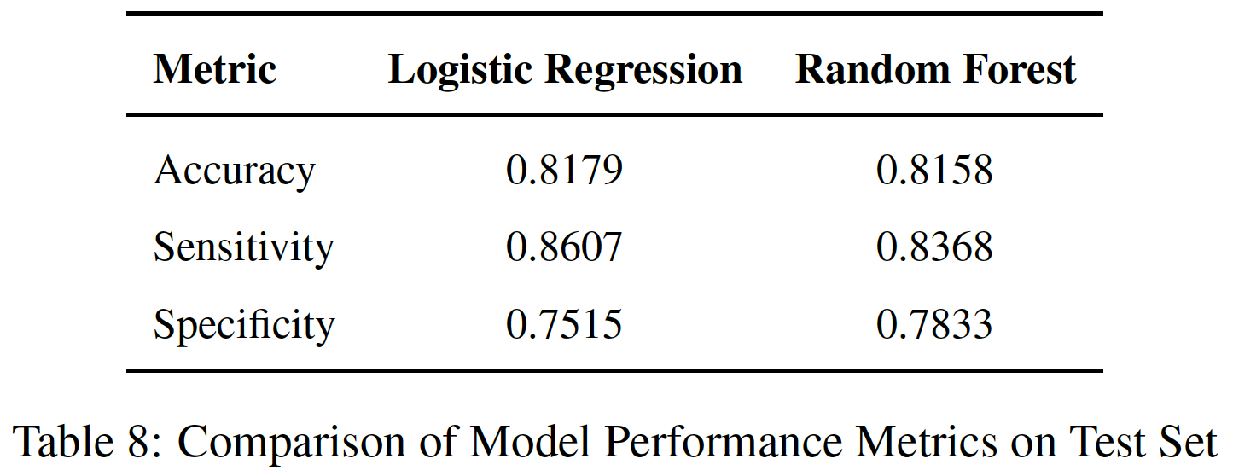
RQ2: Key Findings and Implications
The Main Key Factor: Age, Family Size
Demographic screening can help identify high-risk groups before conditions worsen
Strategic prevention reduces long-term costs and improves overall quality of care

Slide 11
RQ3: Behavioral Patterns & Mental Health
Dependent Variable | Psychological Distress (K6SUM42)
Independent Variables | Sleep Disturbance (ADSLEEP42), Physical Activity (PHYEXE53), Smoking Frequency (OFTSMK53), Alcohol Use (ADKALC42, ADNUMDRK42), Doctor’s Advice Against Smoking (NOSMOK42)
This analysis explores the relationship between lifestyle factors, health behaviors, and psychological distress through multiple analytical approaches:
Principal Component Analysis (PCA) to identify underlying patterns in lifestyle behaviors (excluding the outcome variable)
Cluster analysis to identify distinct lifestyle pattern groups among individuals
Regression modeling to examine how these lifestyle patterns predict psychological distress
Classification methods to identify individuals at risk for high psychological distress

Slide 12
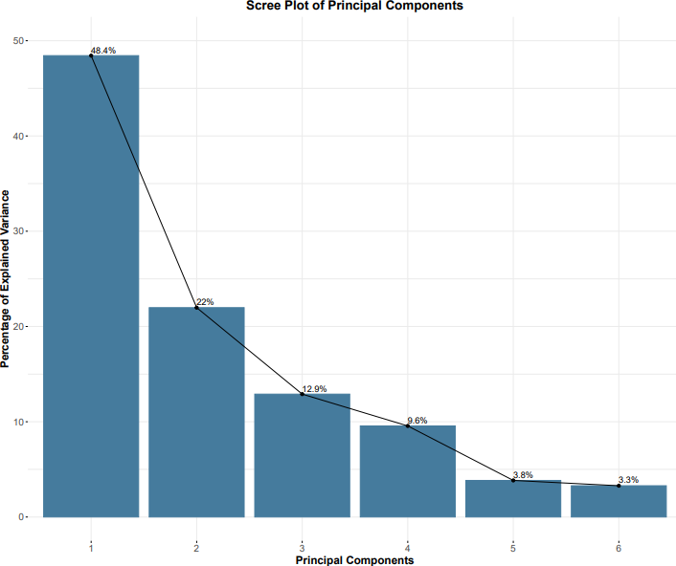
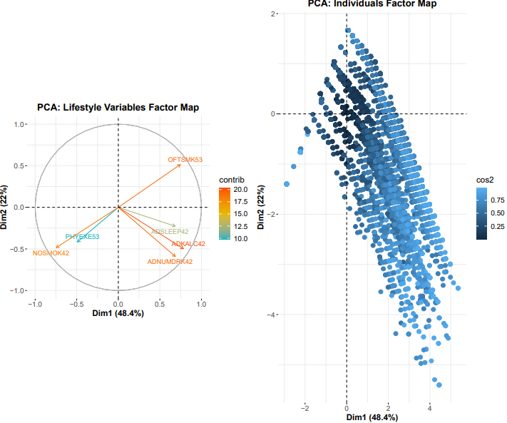
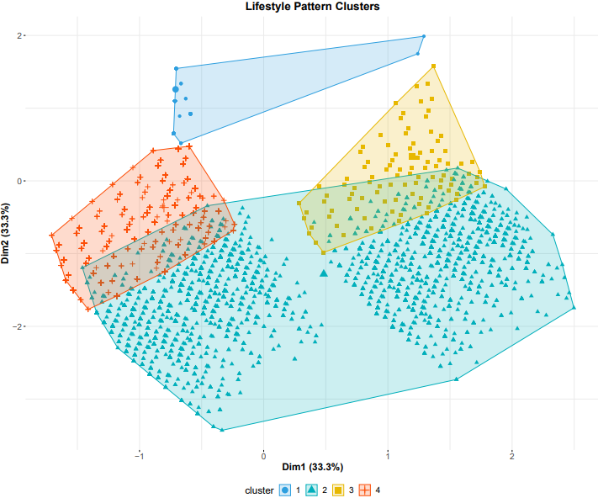
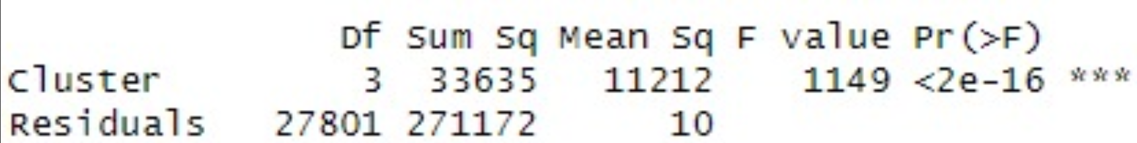
RQ3: PCA & Clustering
The PCA identified three main lifestyle dimensions: Substance Use / Activity Level / Sleep Patterns
Together, they explain ~65% of the variance, highlighting major behavioral trends
K-means clustering identified four distinct lifestyle profiles:
ANOVA results confirm significant differences in psychological distress levels across these clusters.
Active, Low Substance Use Cluster
Sedentary, Moderate Substance Use Cluster
Heavy Substance Users Cluster
Poor Sleep Quality Cluster

Slide 13
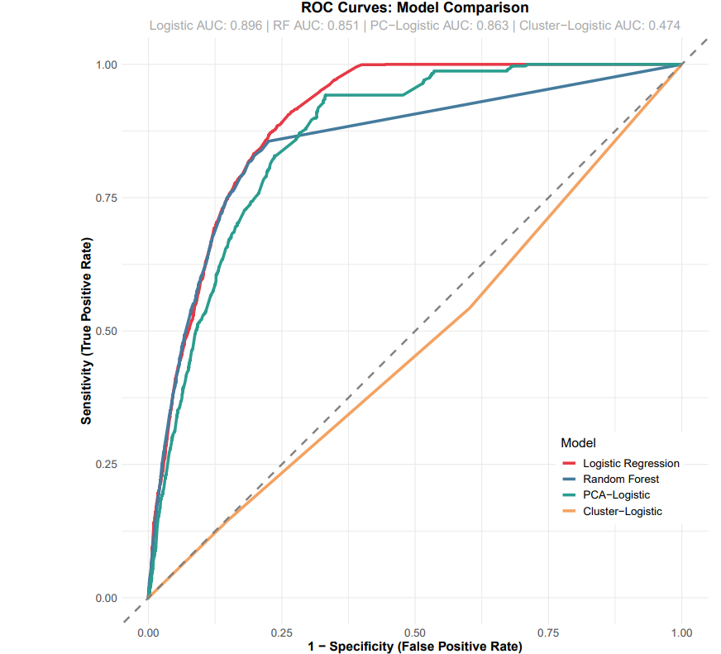
RQ3: Predictive Modeling Performance
Model Comparison | AUC | Accuracy | Sensitivity | Specificity
Logistic Regression | 0.8962 | 0.8457 | 0.9368 | 0.4605
Random Forest | 0.8511 | 0.8445 | 0.9121 | 0.5589
PCA-Logistic | 0.8634 | 0.8295 | 0.9386 | 0.3684
Cluster-Logistic | 0.4738 | 0.8086 | 1.0000 | 0.0000
Logistic Regression outperformed PCA- and Cluster-based models, by directly leveraging individual behavioral predictors.
Sleep quality and physical activity showed strong, linear associations with psychological distress.
Random Forest had slightly higher specificity, but logistic regression provided better overall performance.
Logistic Regression achieved high sensitivity (93.7%) with minimal model complexity.
The model offered strong interpretability, making it a robust and practical baseline for identifying high-risk individuals.

Slide 14
RQ3: Interpretation & Policy Implications
Key Insights
Psychological distress is strongly linked to poor sleep quality, substance use, and low physical activity.
Principal component and regression analyses consistently identified sleep as the most influential behavioral factor, followed by smoking and physical inactivity.
Cluster-Based Behavioral Targeting
K-means clustering revealed four distinct lifestyle profiles with significantly different distress levels.
These clusters offer an opportunity to tailor interventions:
Policy & Screening Implications
Behavioral screening tools can be enhanced by incorporating lifestyle patterns, not just individual behaviors.
Public health efforts should prioritize sleep improvement and physical activity as cost-effective targets for reducing psychological distress.
Findings support a move toward personalized mental health strategies grounded in lifestyle segmentation.
Promote active lifestyles with sleep hygiene in low-risk groups.
Prioritize substance use reduction and sleep interventions for high-risk clusters.

Slide 15
Conclusion & Limitations
Conclusion
Prescription drugs, inpatient care, and office-based visits are top drivers of total healthcare cost
— driven by both per-case expense and high frequency (RQ1).
Age and family size are key demographic predictors of chronic disease presence,
supporting targeted early intervention (RQ2).
Lifestyle behaviors (sleep, alcohol, smoking, activity) are strongly linked to psychological distress;
clustering revealed clear high-risk profiles (RQ3).
Limitations
Based on self-reported survey data — possible recall and response bias.
Uses 2020 data only — reflects behaviors during COVID-19, not typical patterns.
Some variables simplified (e.g., race, K6 distress thresholds); may overlook deeper trends.
Future Scope
Extend analysis using multi-year MEPS panels for trend analysis.
Integrate external data (e.g., claims, EHRs) for richer insights.

