Slide 1

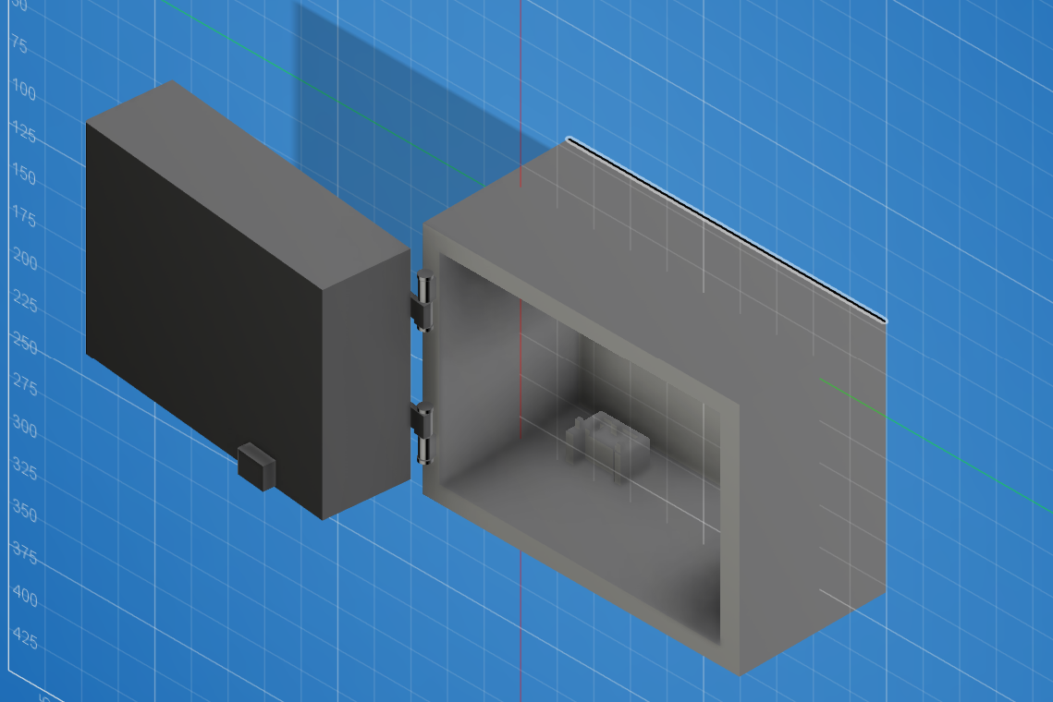
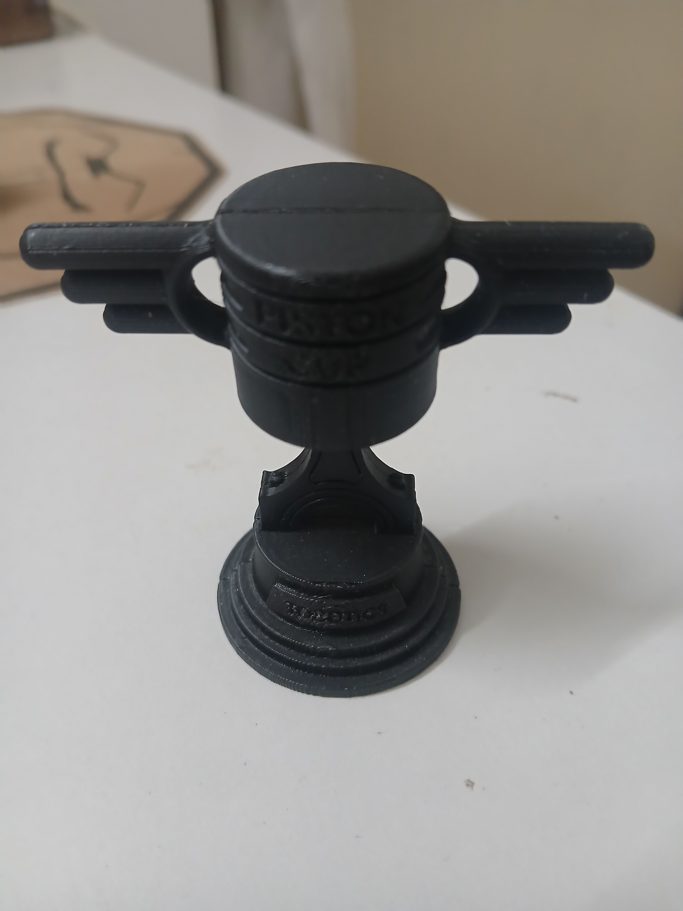
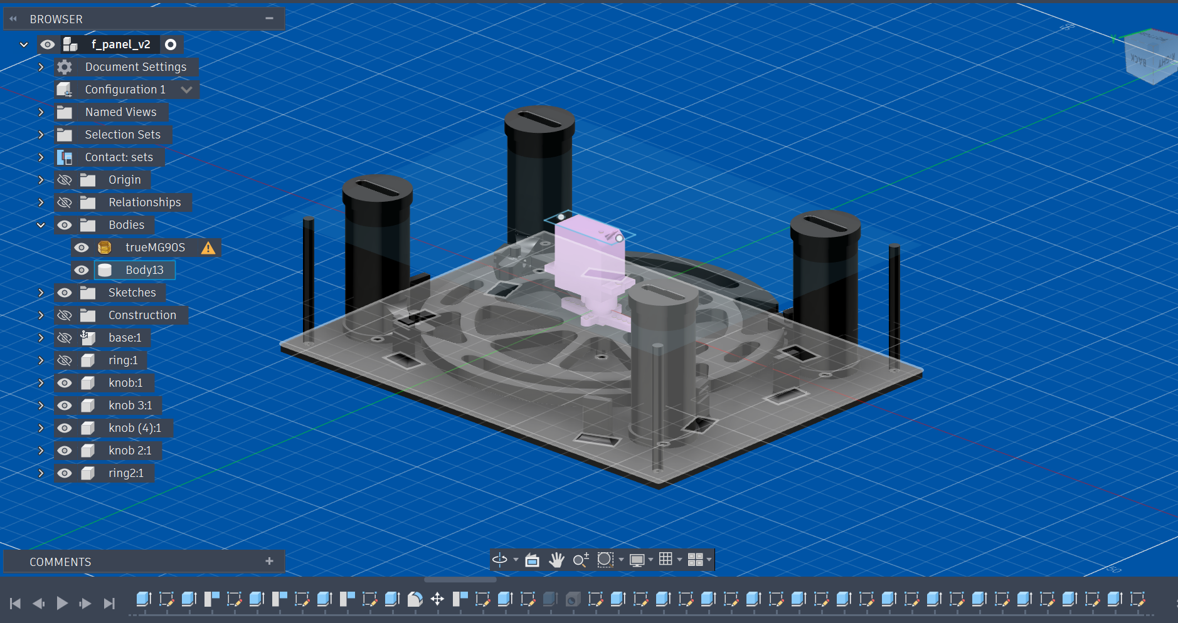
MECHATRONIC INTERNSHIP
at Tobotics Pvt. Ltd.
Industrial Training Presentation
PARTH
B.Tech. Electronics & Communication Engineering
ROLL NO.
24EJCEC078
COORDINATOR
Ashish Kumar Sharma — Assistant Professor
45-Day Industrial Training • Academic Year 2026–27
Mechatronic Internship at Tobotics Pvt. Ltd. | Parth | 24EJCEC078
01

Slide 2
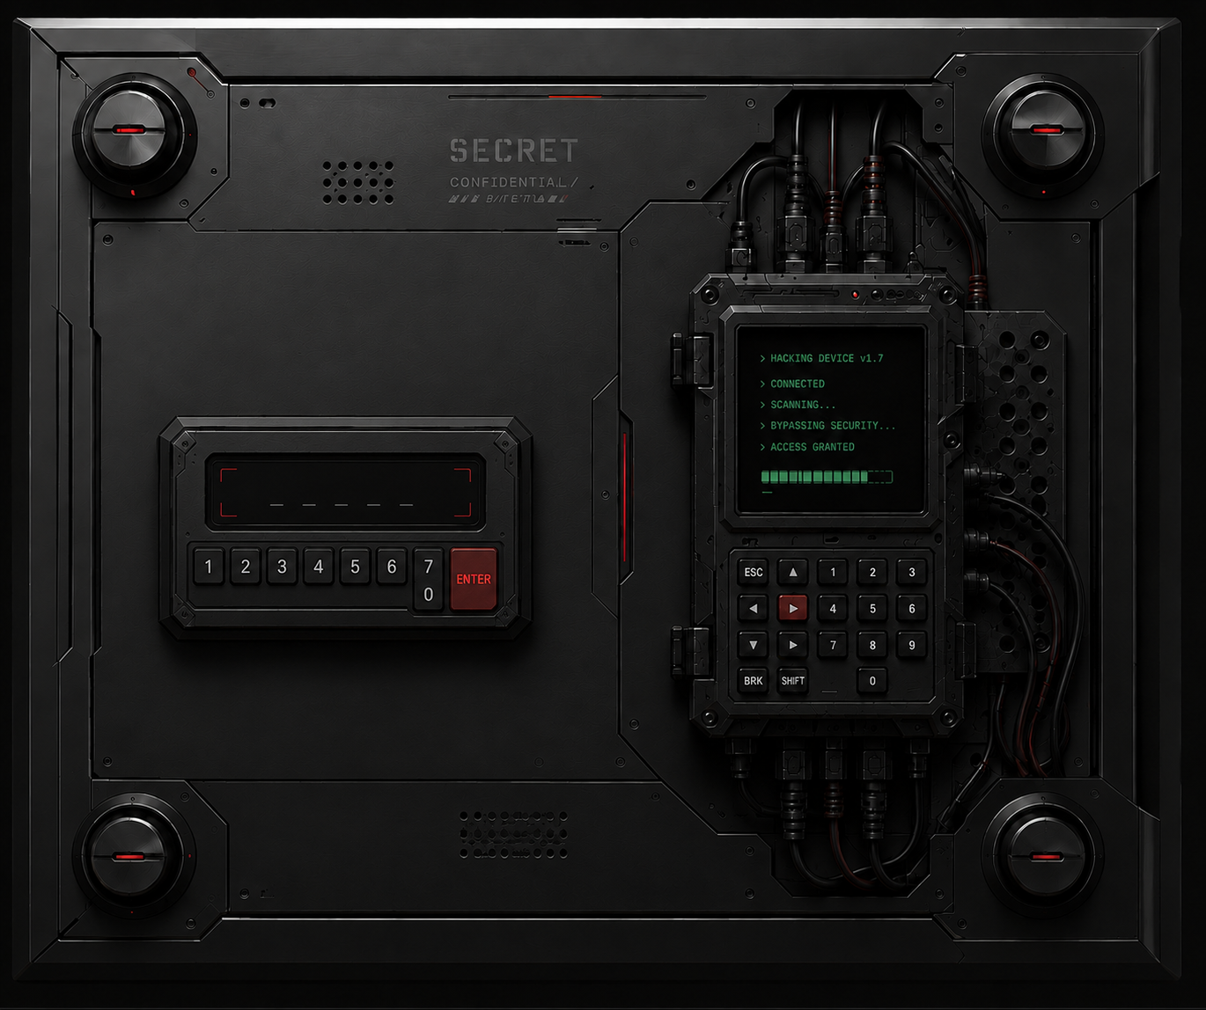
Training Overview
Practical exposure across electronics, programming, mechatronics and mechanical prototyping
TRAINING CONTEXT
MAIN FOCUS
MAJOR PROJECT
45-day industrial training in a practical, project-oriented environment with mentors and fellow trainees.
Arduino-based electronics, embedded programming, CAD modelling, 3D design, simulation and prototyping.
Hackable Vault — an interactive security-vault concept combining keypad input, feedback and servo-controlled mechanical movement.
Training objectives
• Understand Arduino programming and input/output interfacing
• Control actuators and test electronic behaviour through simulation
• Create mechanical models using CAD and understand CAD-to-print workflow
• Develop an integrated project through experimentation and design iteration
Mechatronic Internship at Tobotics Pvt. Ltd. | Parth | 24EJCEC078
02

Slide 3
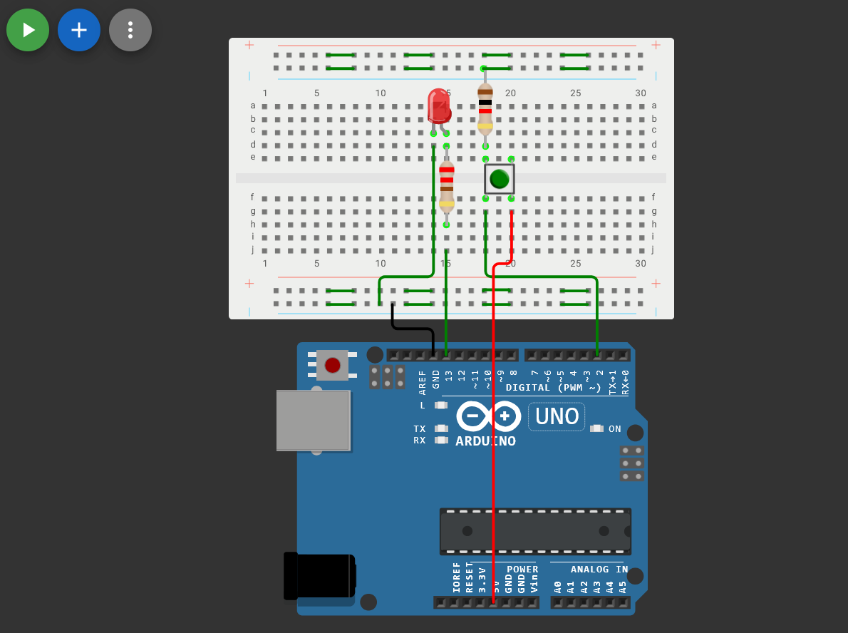
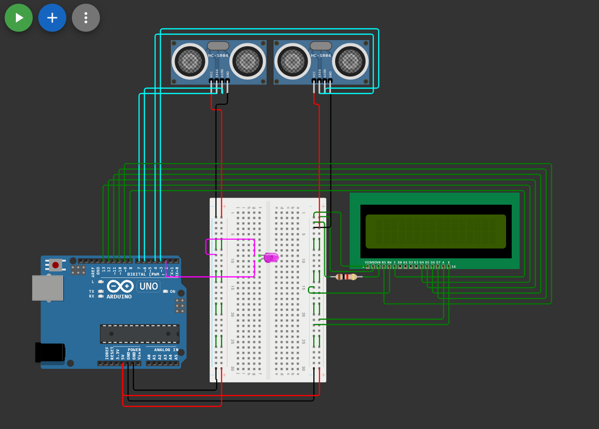
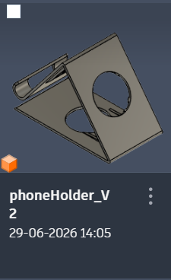
Training Journey
The work progressed from small electronics exercises to an integrated mechatronic prototype
01
02
03
04
05
Arduino
& Electronics
Programming
& Interfacing
CAD
Modelling
3D Printing
& Physical Parts
Hackable Vault
Development
Debouncing
Gate-In / Gate-Out
CAD exercises
Physical print
Vault design
Mechatronic Internship at Tobotics Pvt. Ltd. | Parth | 24EJCEC078
03

Slide 4
Arduino & Electronics Work
Early exercises built the programming and interfacing foundation used later in the vault
Debouncing circuit
Gate-In / Gate-Out project
DEBOUNCING
GATE-IN / GATE-OUT
KEY SKILLS
Reliable handling of mechanical button/switch input.
State-based counting and automation using Arduino.
Inputs • conditions • functions • outputs • testing
Mechatronic Internship at Tobotics Pvt. Ltd. | Parth | 24EJCEC078
04

Slide 5
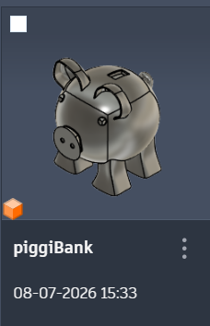
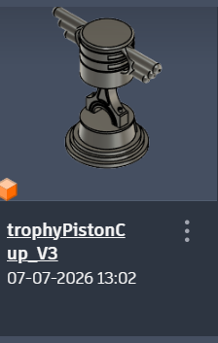
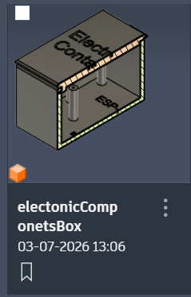
CAD & 3D Design
The training moved from simple models toward functional mechanical components and assemblies
Phone-holder CAD
Piggy bank CAD
Piston cup CAD
Component-box CAD
Vault front panel
Overall vault enclosure
Design progression
CAD → Prototype
• Sketching and modelling → assemblies → moving mechanisms
• Increasing focus on buildability, space and interaction between parts
Digital design became the basis for physical prototyping.
Mechatronic Internship at Tobotics Pvt. Ltd. | Parth | 24EJCEC078
05

Slide 6
3D Printing: Piston Cup
A clear CAD-to-physical example from the training
1 DESIGN
Modelled the piston cup in CAD.
2 FABRICATION
Converted the design into a printable part and 3D printed it.
3 RESULT
Obtained a physical part and experienced the complete digital-to-physical workflow.
The physical print demonstrated that the CAD model was not just a drawing — it could be translated into a tangible component.
Mechatronic Internship at Tobotics Pvt. Ltd. | Parth | 24EJCEC078
06

Slide 7
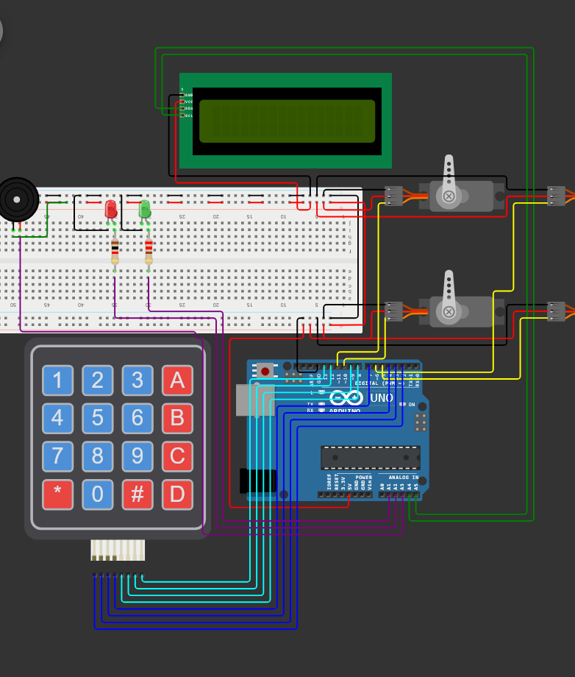

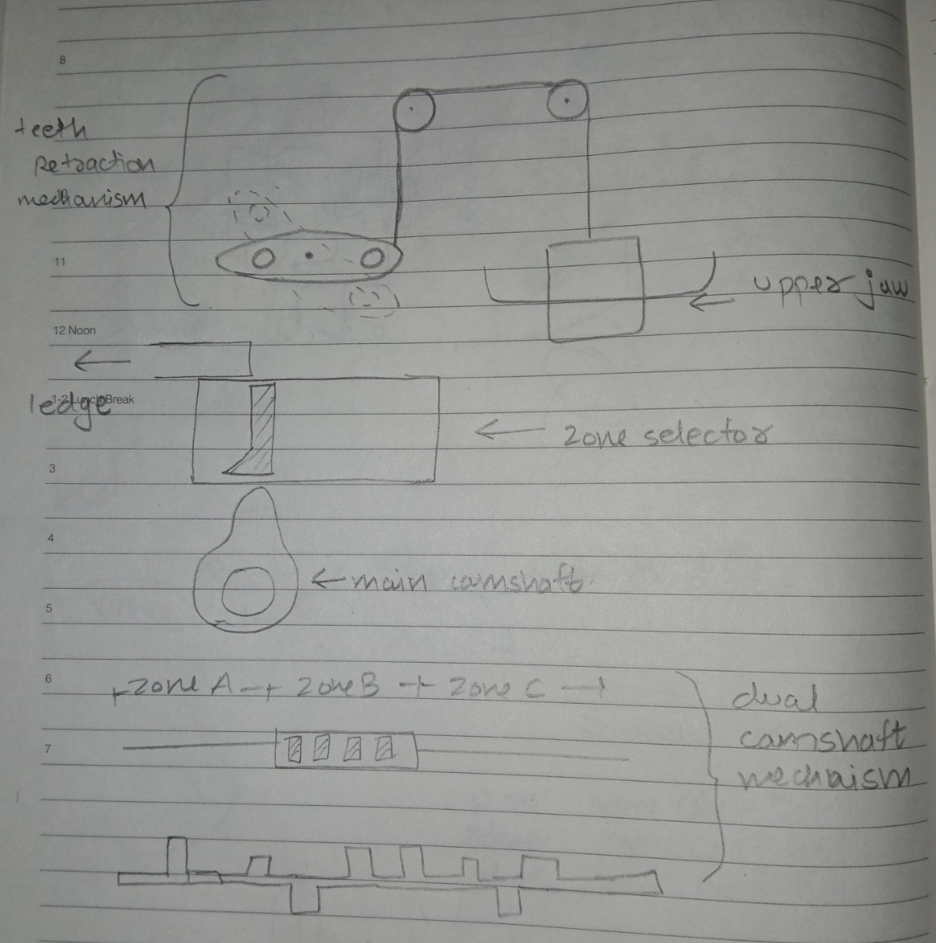
Project Evolution
The main project changed as mechanical complexity and practicality were evaluated
Art Thief Vault
Syblin Concept
Mechanical Study
Hackable Vault
Initial password-guessing game
Monster character with moving teeth
Explored cam / follower concepts
Simplified integrated security-vault concept
Design decision
The project was redirected toward a more buildable vault concept while retaining the core idea of password-driven physical unlocking.
Mechatronic Internship at Tobotics Pvt. Ltd. | Parth | 24EJCEC078
07

Slide 8
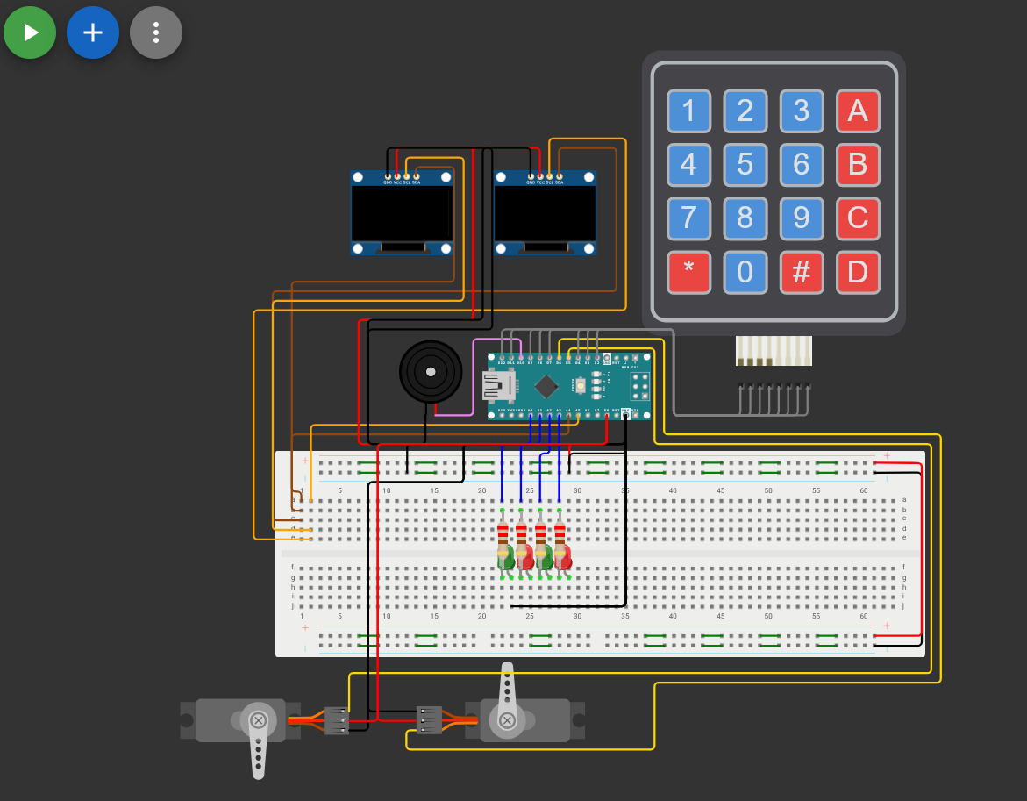
Hackable Vault — System Design
Electronics, software and mechanical output are connected as one user interaction
User interaction
Game logic
KEYPAD
ARDUINO
NANO
OLED
LED
BUZZER
SERVO
SOFTWARE FLOW
MECHANICAL OUTPUT
Generate / present a level → accept numerical guess → compare input → provide feedback → trigger win action → advance / reset.
A successful interaction is intended to produce physical movement through the servo-controlled front-panel and locking mechanism.
Wokwi electronic connection
Vault enclosure CAD
Mechatronic Internship at Tobotics Pvt. Ltd. | Parth | 24EJCEC078
08

Slide 9
Hackable Vault — Mechanical Design
CAD work focused on the front panel, cam-ring mechanism, enclosure and door/hinge studies
Four-knob front-panel / cam-ring concept
Internal mechanism study
Overall enclosure
Mechanical principle
The design explored how a limited number of actuators could create visible mechanical movement while fitting inside the enclosure.
SERVO
CAM
RING
FOLLOWER /
KNOB
PHYSICAL
MOVEMENT
Mechatronic Internship at Tobotics Pvt. Ltd. | Parth | 24EJCEC078
09

Slide 10
Results, Challenges & Learning
The training produced working exercises and substantially developed project designs, while leaving clear integration work
ACHIEVED
CHALLENGES
LEARNING
• Arduino programming and interfacing
• Simulation of the first vault electronics
• CAD models and mechanical studies
• 3D-printed piston cup
• Hackable Vault front-panel and enclosure design
• Integrated system concept
• Mechanical complexity
• Limited internal space
• Servo and mechanism constraints
• Alignment and fabrication considerations
• Balancing visual appeal with buildability
• Full software/mechanical integration remained unfinished
• Prototyping and debugging
• Electronic interfacing
• CAD and 3D modelling
• CAD-to-physical workflow
• Design iteration and problem solving
• Thinking about electronics and mechanics as one system
Current status: development-stage prototype/design with clear scope for further implementation and validation.
Mechatronic Internship at Tobotics Pvt. Ltd. | Parth | 24EJCEC078
10

Slide 11
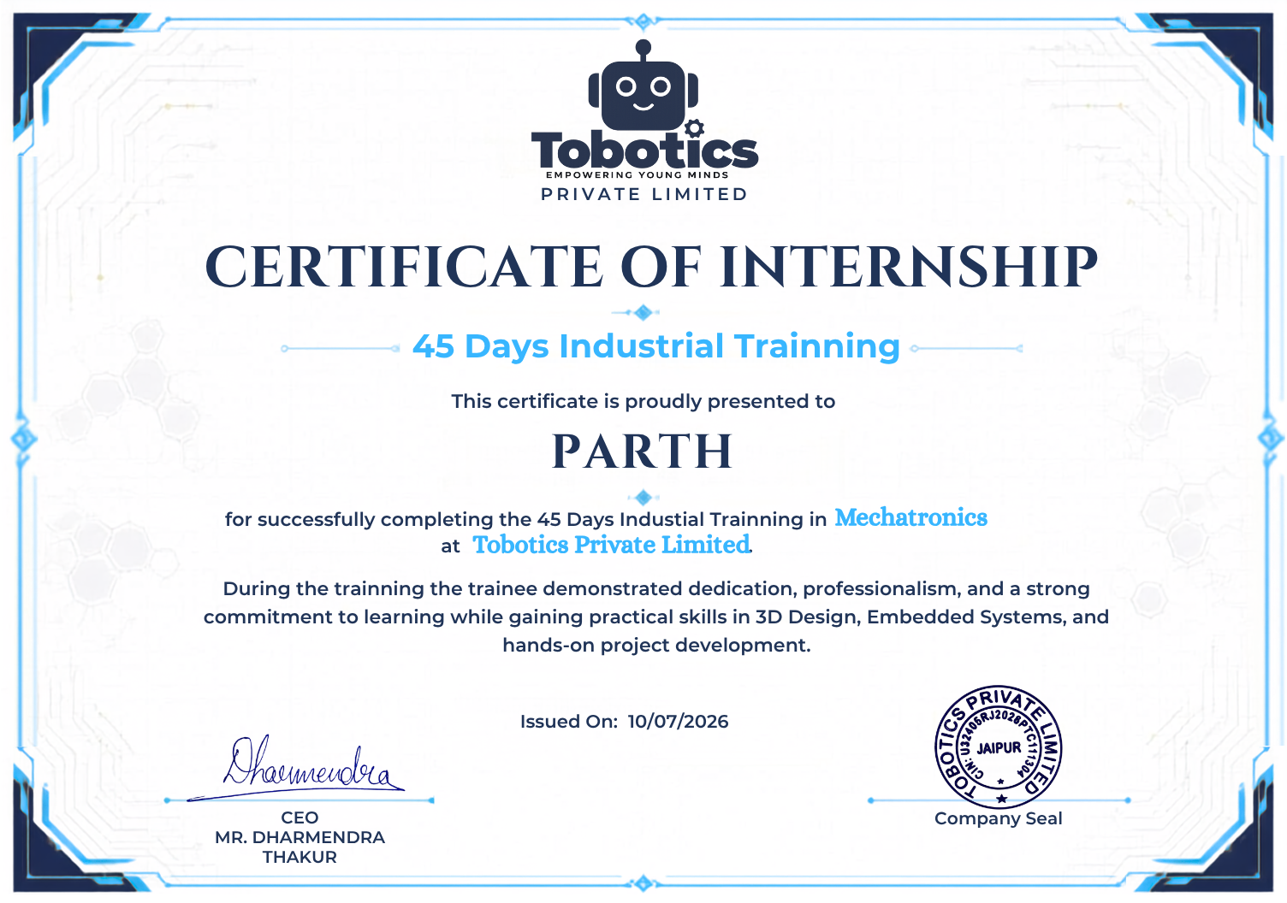
KEY TAKEAWAY
From electronics to mechatronic prototyping
Arduino
Electronics
Programming
CAD
3D Printing
Integration
The training connected classroom concepts with practical development — writing code, testing circuits, modelling mechanisms, printing parts and iterating toward an integrated project.
THANK YOU
Parth • 24EJCEC078
B.Tech. ECE • JECRC
Mechatronic Internship at Tobotics Pvt. Ltd. | Parth | 24EJCEC078
11

