Slide 1





Nextech Mind
S2P Robotic
INNOHACK 2.0
Presented By Bot Buddies

Slide 2


AI-Powered Resume & Career Analyzer Platform
Team Name :
CodersSpace
Team member :
1.Nayan Pawar 2.Parth Mahale
3.Jayendrasing Girase 4.Danyal Ahmed
Institution :
Vishwakarma Institute Of Information Technology, Pune

Slide 3
TEAM & ROLES
Parth and Nayan :
Frontend devlopment
Jayendra :
Database management, sqlite
Danyal :
Backend devlopment and data scraper

Slide 4

WHY THIS PROBLEM MATTERS
PROPOSED SOLUTION
AI-powered career guidance based on resume analysis and market trends
Personalized, real-time recommendations using Gen AI
Skill gap analysis with targeted upskilling suggestions
Accessible, unbiased tools for equal career opportunities
Job Seekers Are Often Lost
Traditional Career Advice Is Generic
Recruitment is AI-Driven, But Applicants Aren’t
There's a Skills Gap Problem
Inequality in Career Opportunities
Resume Quality is Inconsistent

Slide 5
INNOVATION & IMPACT
Innovation:
AI-powered resume parsing and job matching using NLP and ML
Personalized career path suggestions based on real-time job market data
Resume optimization for ATS (Applicant Tracking Systems)
Automated job and skill market scraping for live insights
Scalable, accessible career guidance without human intervention
Real-Life Impact:
Helps job seekers get more interviews by improving resume visibility
Saves time by focusing on the most relevant job opportunities
Guides career changers with clear, data-driven transition paths
Reduces education waste by recommending high-impact skills
Promotes equal opportunity by removing bias from career advice

Slide 6
TECH STACK
1
6.Database And web scraping
.Frontend
4.Authentication And Security
React.js
Tailwind CSS
passlib
itsdangerous
authlib
bcrypt
python-dotenv
SqLite
beautifulsoup4
selenium
lxml
urllib3
requests
webdriver-manager
2.Backend
Python
Fast API
3.Resume Parsing
pdfminer.six
python-docx
5. Testing & Debugging
pytest
ipython

Slide 7
Data Scraping
🤔?
Q. Is DataScraping Illegal?
Court case between hiQ Labs and Linkedin
The court’s reasoning, influenced by the Van Buren precedent, was that “unauthorized access” under the CFAA(Computer Fraud and Abuse Act) does not apply to websites open to the public. Since anyone could view a public LinkedIn profile without bypassing authentication.
The ruling on the CFAA in the hiQ v. LinkedIn case established a precedent confirming that the anti-hacking law cannot be used to stop the scraping of data that a website makes openly available. This provides legal clarity for data analytics companies, academic researchers, and journalists who rely on collecting public data.

Slide 8
Focused Features of Our Project
Resume Analysis with ATS Score
Our system intelligently analyzes uploaded resumes, assigning an ATS (Applicant Tracking System) score, and highlights both strengths and weaknesses to improve the chances of selection.
Course & Skill Recommendations via Coursera
Suggests industry-relevant courses and skills from platforms like Coursera, enabling users to bridge gaps and upskill efficiently.
Dynamic Resume Builder with History Tracking
Users can generate a professional resume in real-time using their provided data. All generated resumes are securely stored in a database for future access and downloads.
Personalized Job Role/Internship Recommendations
Based on the user's skills and experience, the system suggests relevant job roles tailored to their profile. We fetch live job listings from LinkedIn that align with the recommended job roles, helping users discover opportunities without manual searching.

Slide 9
Additional Features
Manual Job, Internship, and Course Search
Users can manually search for jobs, internships, or courses, just like on LinkedIn or Coursera, for added flexibility and exploration.
Career Path Analysis
A unique feature where users input their current position and their target career goal.Using generative AI, we provide a personalized roadmap outlining the steps needed to achieve that transition—displayed in a clean, card-based format on the frontend.

Slide 10
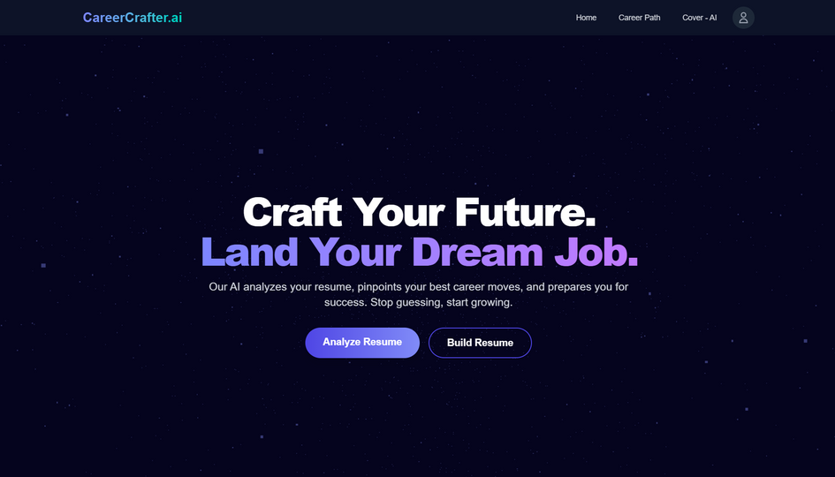
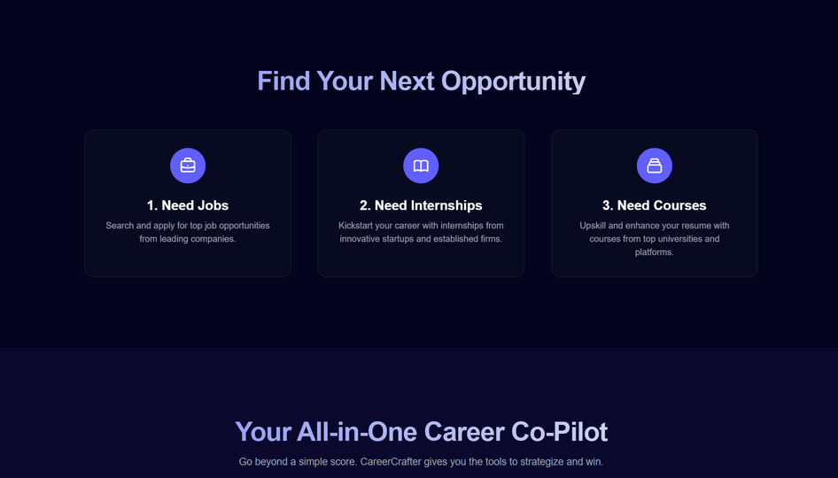
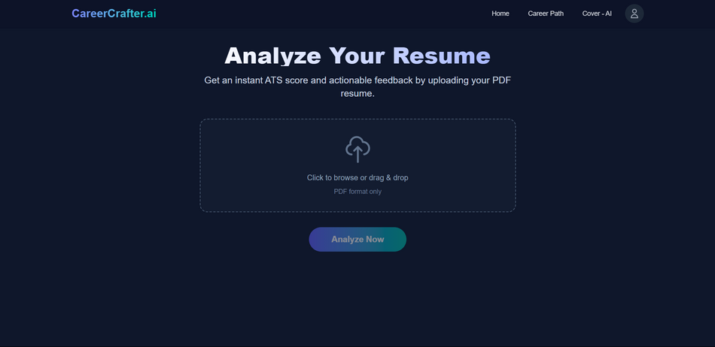
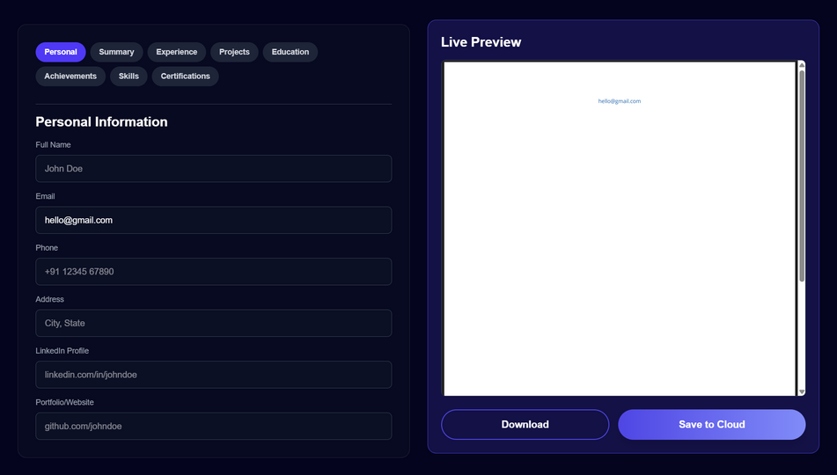
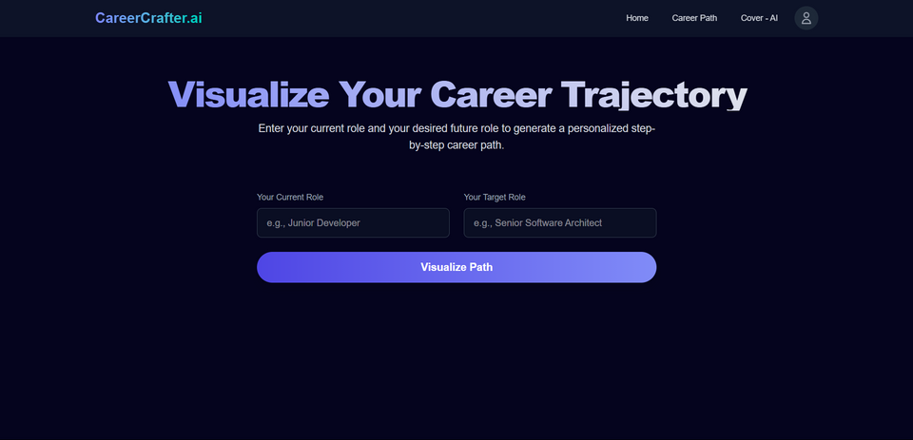
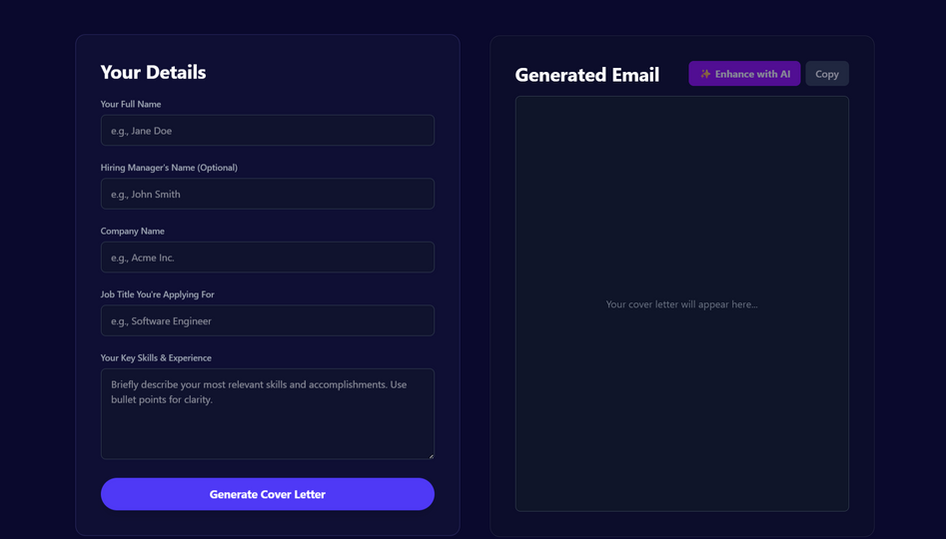
PROTOTYPE / SCREENSHOTS
Home Page
Opportunities Page
Analyze Resume Page
Build Resume Page
Carrier Path Page
Cover - AI Page

