Slide 1

COD-A-FESTX 2.0
TITLE PAGE
Problem Statement Title – Develop a system that uses basic image processing to identify empty parking slots in crowded area and guide towards them.
Team ID- 24
Team Name- Hydra

Slide 2
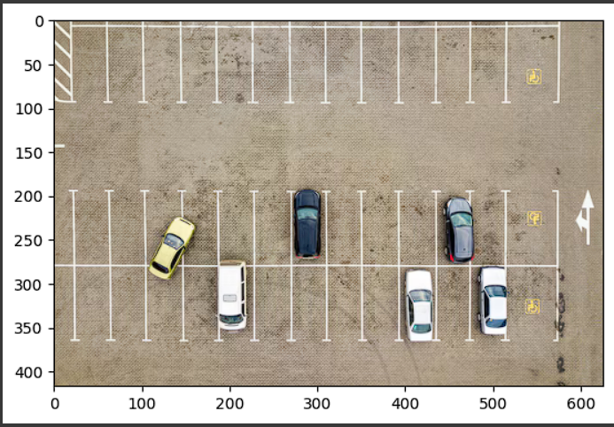
Image Processing for finding Parking Slots
Team Hydra
Proposed Solution
The primary goal is to alleviate parking challenges in busy locations, such as shopping malls, airports, or city centers, where finding an available parking space can be time-consuming and frustrating.
How it addresses the problem - Image Acquisition , Image Processing , Slot Detection.
Unlike traditional parking management systems that rely on physical sensors installed at each parking spot, this solution uses camera-based monitoring combined with image processing algorithms.

Slide 3
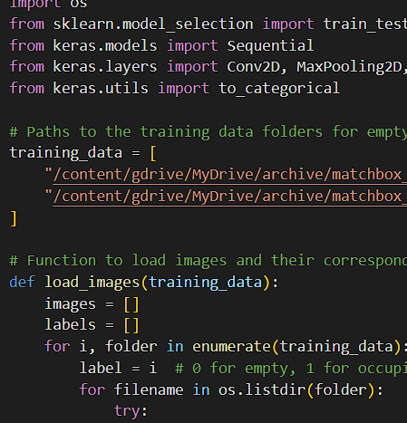
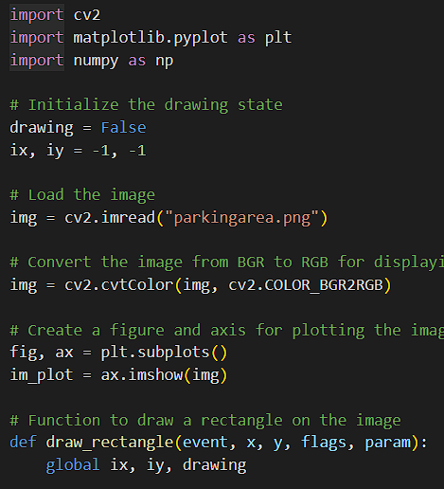
TECHNICAL APPROACH
Team
Hydra
Technologies used: Python, OpenCV (Python), NumPy / Pandas , Local Server or Cloud Service .
Methodology : Data preparation- Downloaded dataset from Kaggle. Model Training- Open CV,CNN(Keras library), os library, load_model. Visual Representation- Green Box for available , Red for Occupied. Advanced features- Finds the nearest empty slot and directs towards it.

Slide 4
FEASIBILITY AND VIABILITY
Team Hydra
Feasibility: Availability of Technology, Ease of Deployment, User Training.
Potential challenges and risks: Scaling the system for large and complex parking areas with numerous vehicles.
Strategies for overcoming these challenges: Can be trained with more dataset of different locations and complex situations for better output.

Slide 5
IMPACT AND BENEFITS
Team Hydra
Reduced Time and Stress: Helps drivers quickly find available parking spots, saving time and reducing the stress associated with searching for parking.
Improved Traffic Flow: Reduces congestion within parking areas, as drivers are guided directly to empty slots.
Optimized Space Utilization: Enhances the overall utilization of parking facilities by efficiently managing available spaces.

Slide 6
RESEARCH AND REFERENCES
Your Team Name
Dataset and Notebook- Empty car parking spot by Riwan Rizwan.

