Slide 1
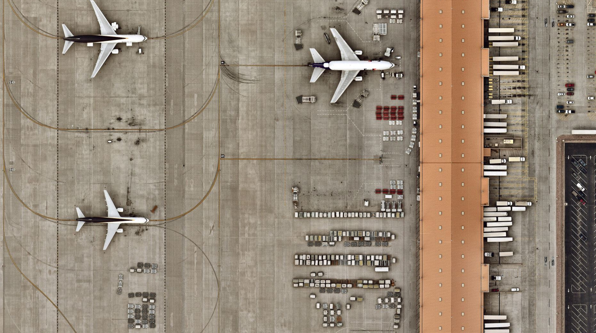
AIRPORT-Adaptive Queuing
Rajnandini Bhutada
Tejaswi Dunuka
Parthasarathy Singh Samanta

Slide 2

Outline:
Goal
Scenario
Implementation
Results
Conclusion

Slide 3

Goal
To implement adaptive queuing in an Airport model.

Slide 4
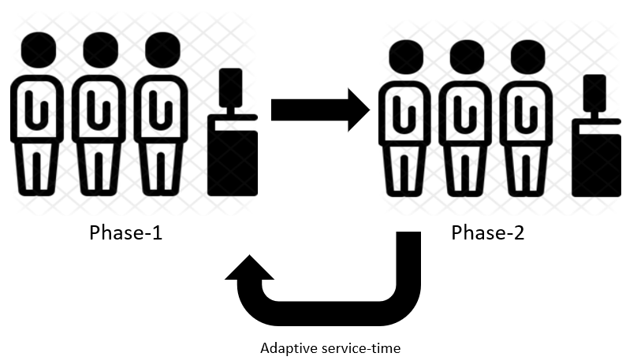
Scenario

Slide 5
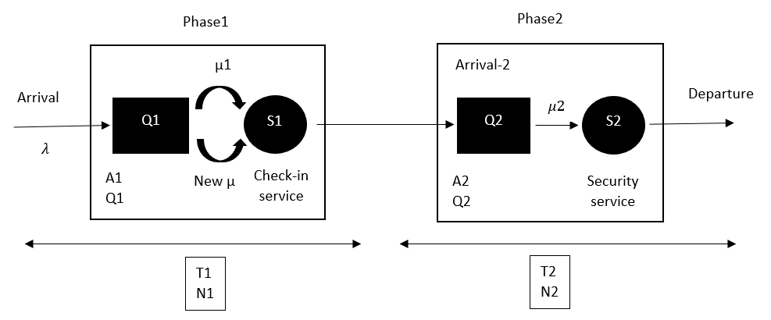

Slide 6
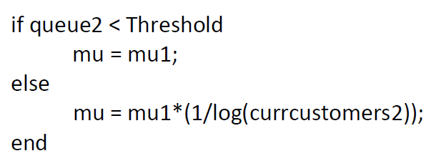
Service-rate modification

Slide 7
Implementation
It is divided into 3 parts:
1. Initialization
2. Generating Events
3. Execution

Slide 8
1.Initialization
lambda=7 % arrival rate
mu1=10 % service rate of PHASE 1
mu2=9 % service rate of PHASE 2
Threshold=7 % Threshold of QUEUE 2
endtime=100 % Simulation length (seconds)

Slide 9
Generation of Events
event(1) = time for arrival in Phase-1
event(2) = service-time in Phase-1
event(3) = Service-time in Phase-2
event(4) = time for measurement

Slide 10
Execution
It is divided into two parts:
1. Stage-1
2. Stage-2

Slide 11
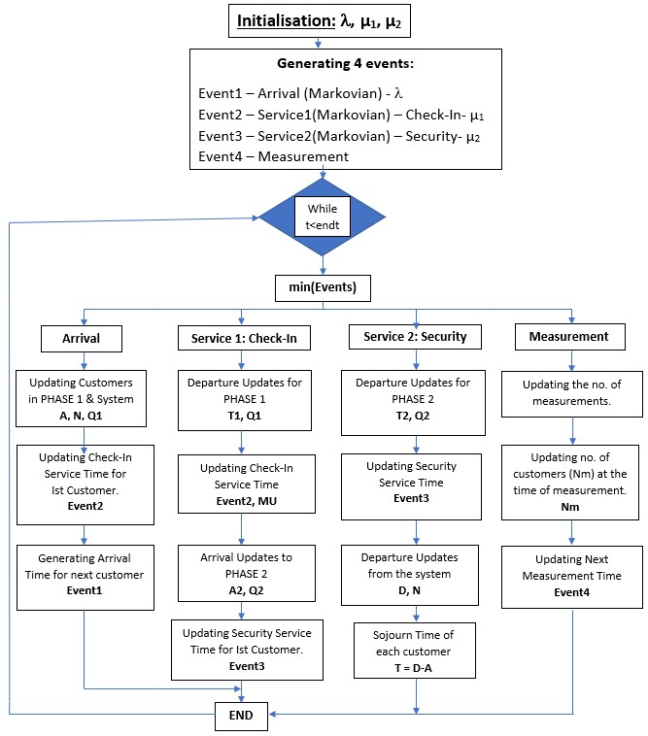
Stage-1

Slide 12
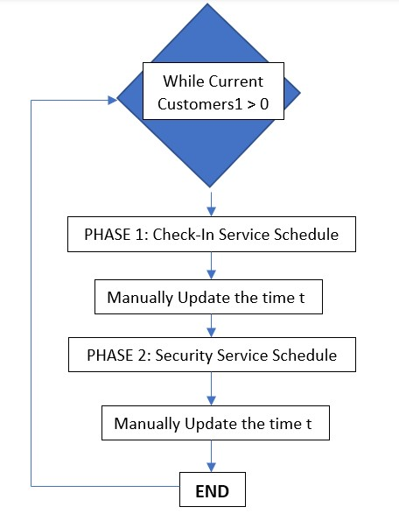
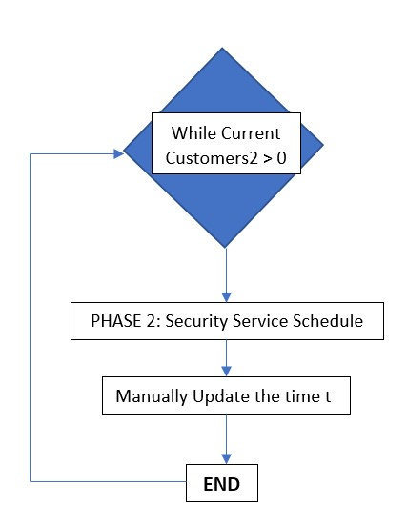
Stage-2

Slide 13
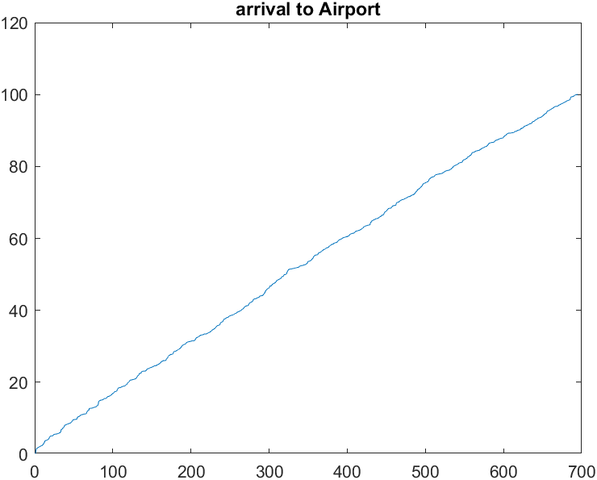
Results

Slide 14
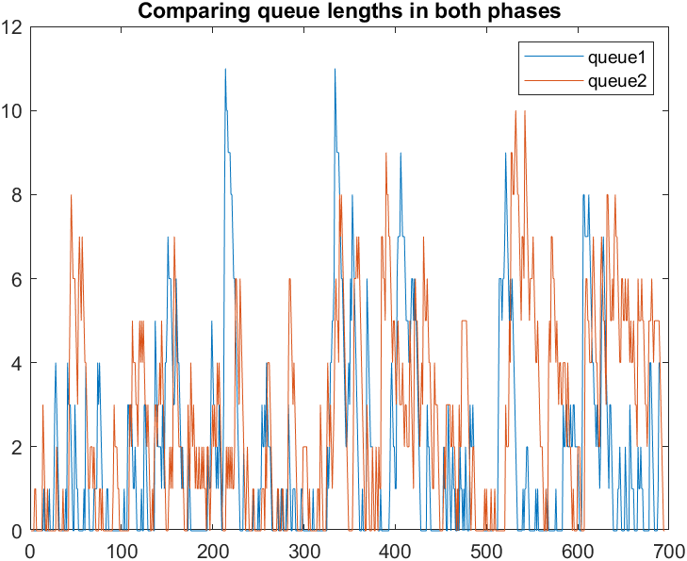
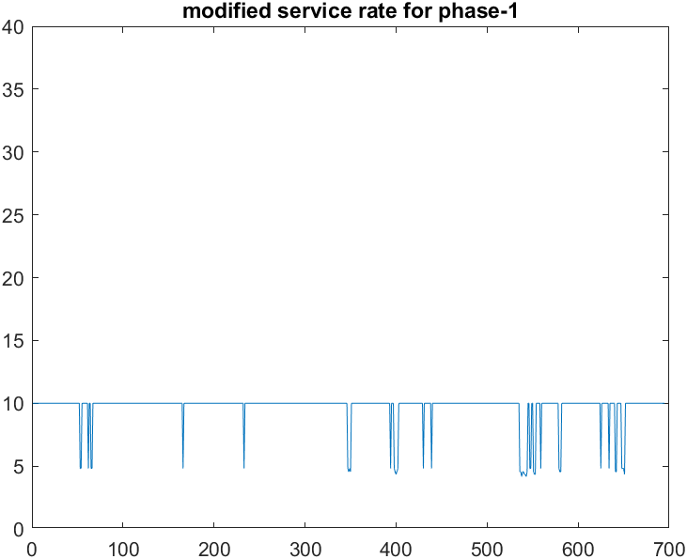

Slide 15
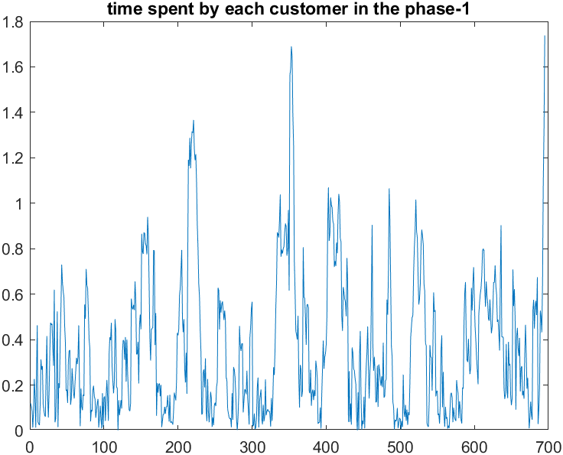
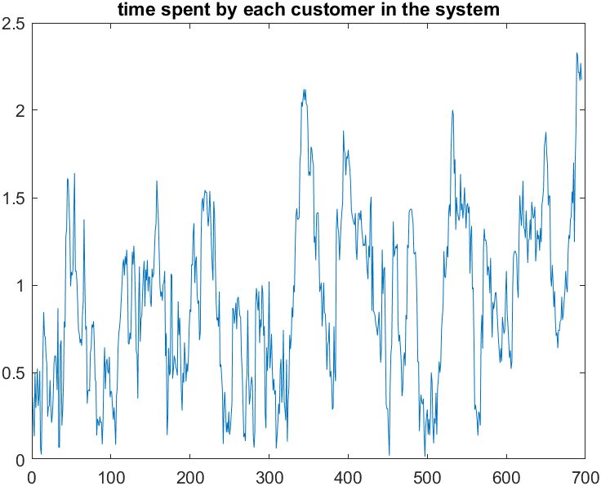
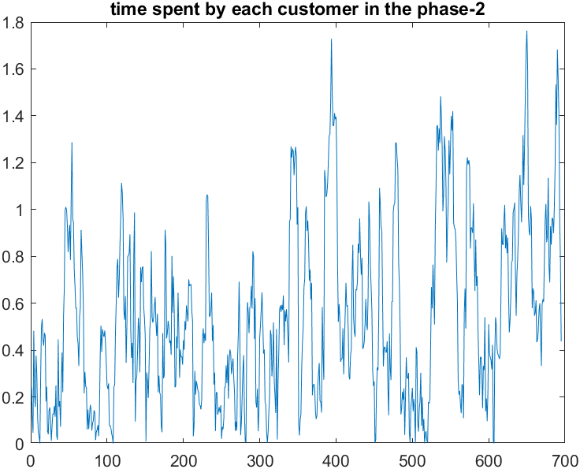

Slide 16
Effect of Adaptive Queuing

Slide 17
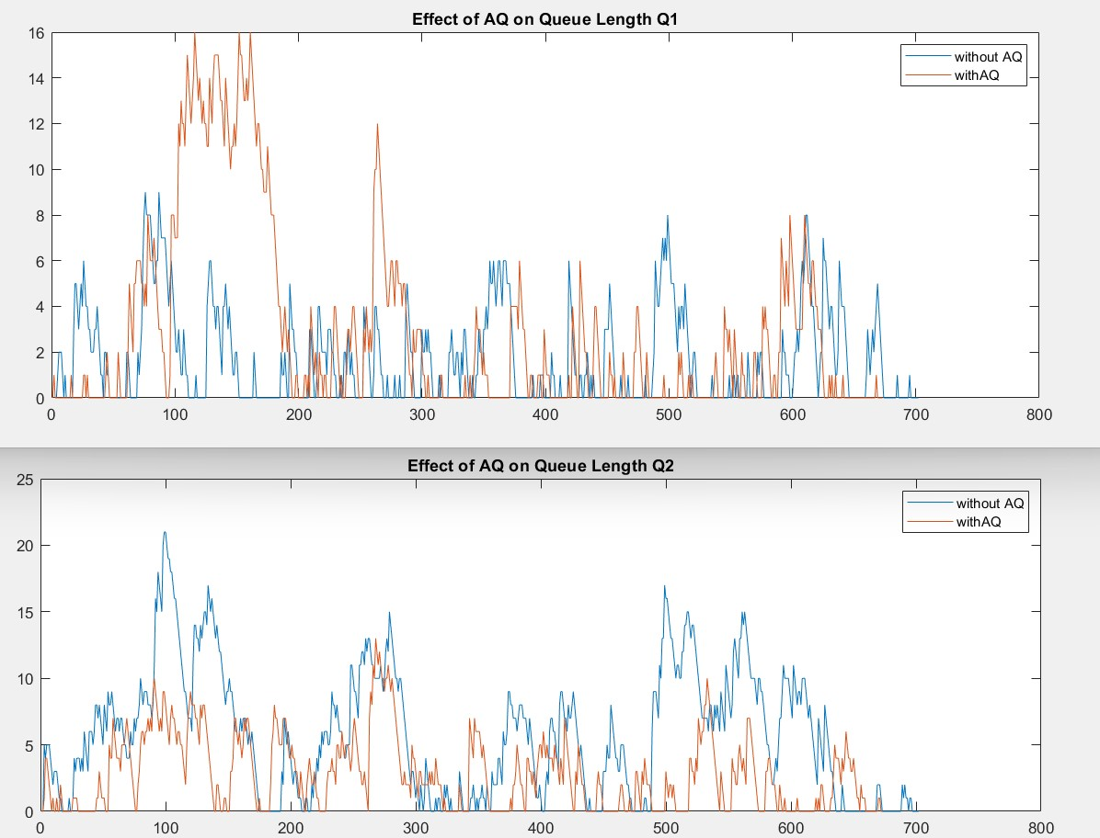

Slide 18
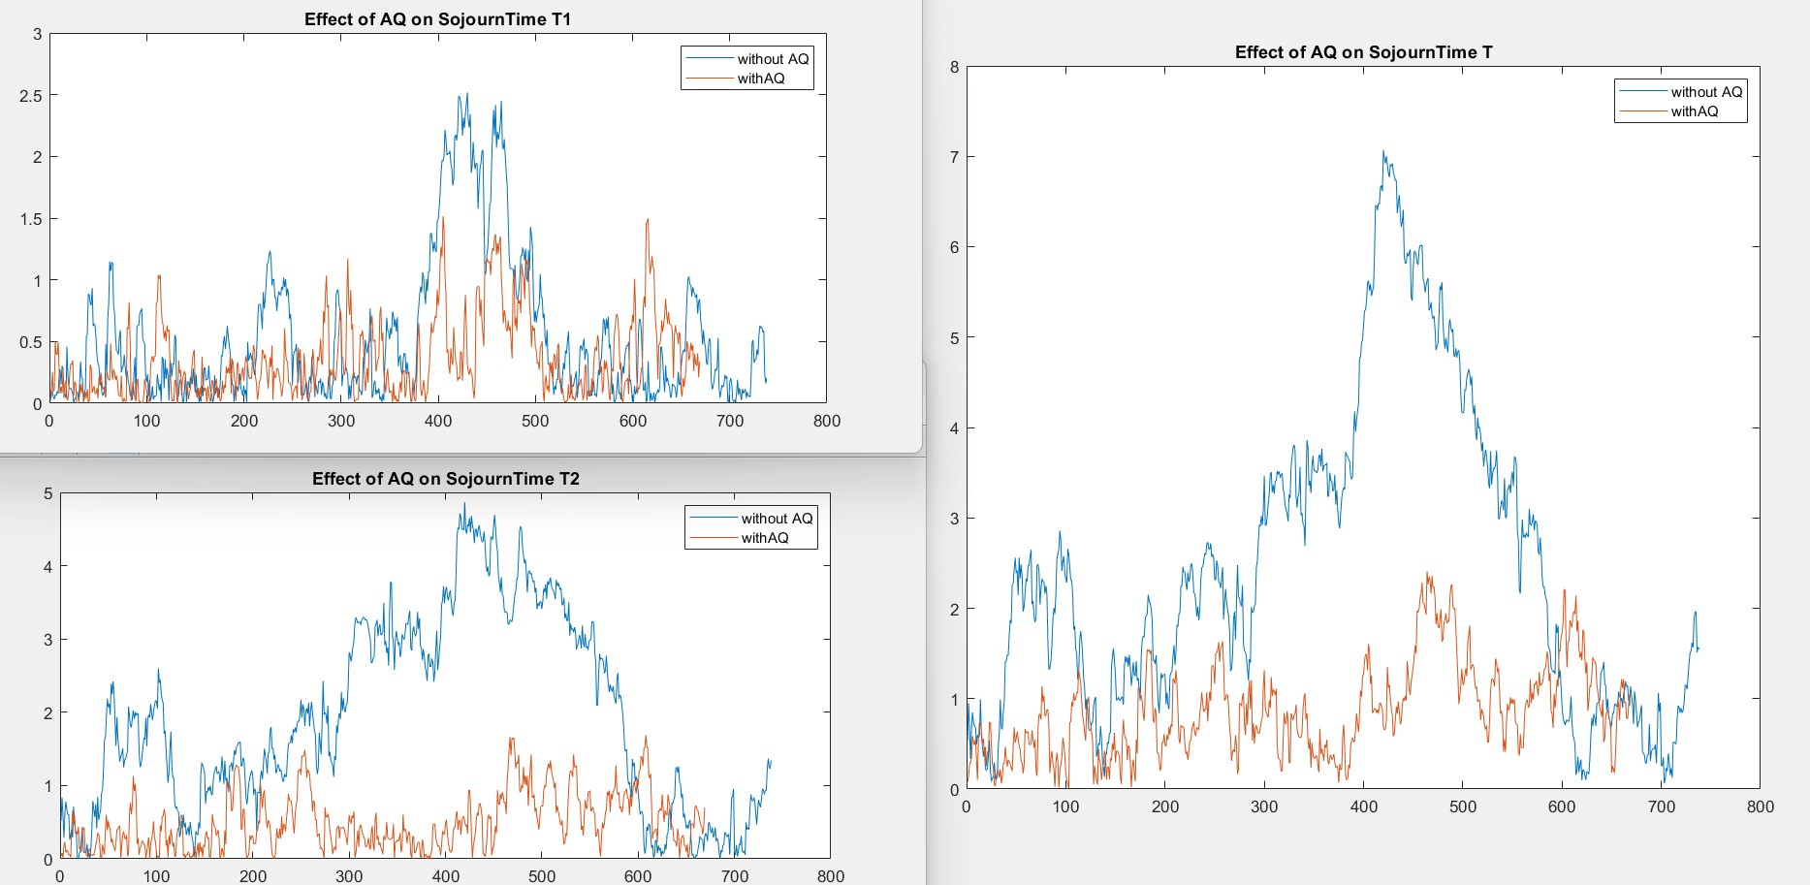

Slide 19
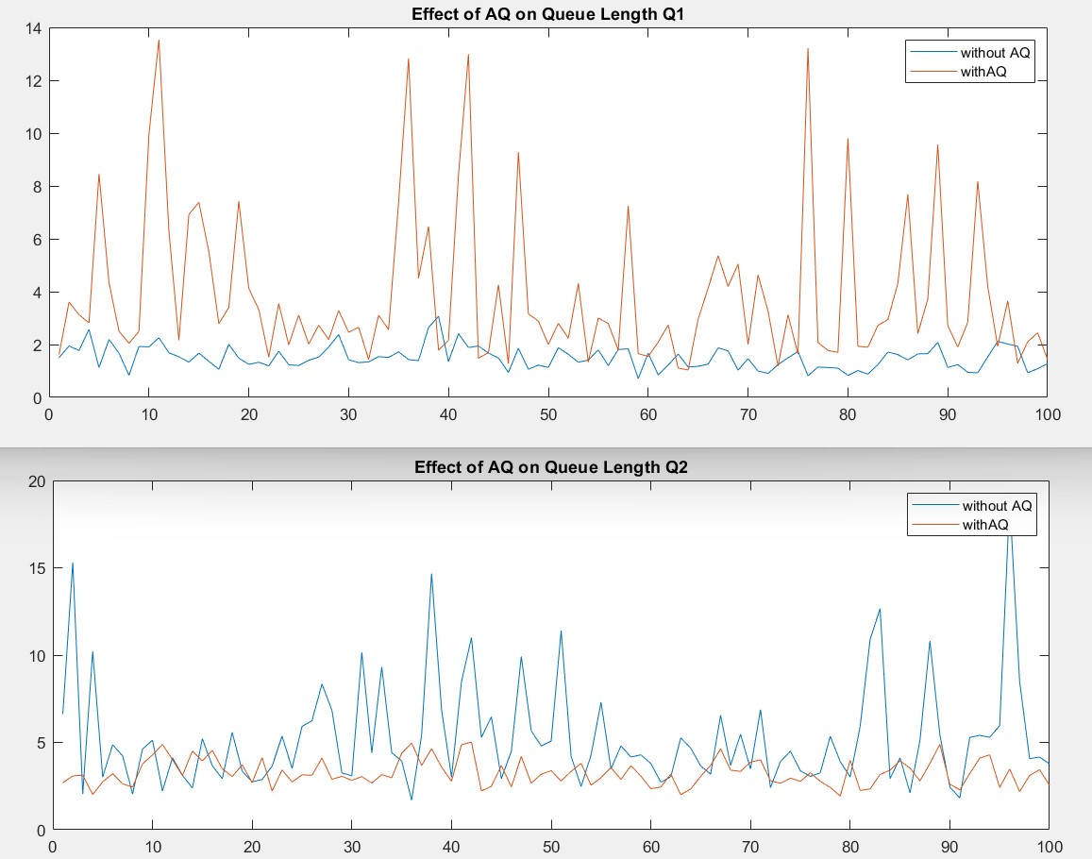
Effect of AQ on mean Queue Lengths

Slide 20
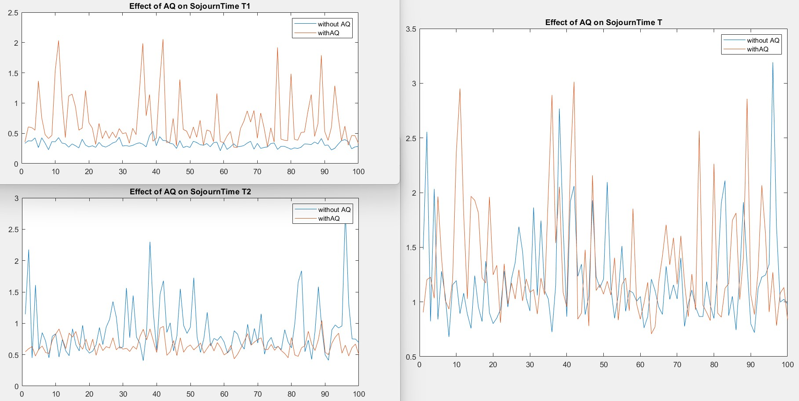
Effect of AQ on mean Sojourn Time

Slide 21
Conclusion
Hence, from the simulated results we can relate to a real-life scenario, where more number of customers are in queue and are waiting for security check at an airport. Hence, this can be tackled by implementing the adaptive queuing for different service counters present in the airport.

