Slide 1
Group-Rubicx ET2596 TASK-2
Rajnandini Bhutada Parthasarathy Singh Samanta

Slide 2
Simulation Parameters:
Arrival | Server | Length of batches | Number of arrivals per batch | Queue length
M | M | 200 | 100 | 10
Seed | E[Ta] | E[Ts] | Warm-up
2002 | 100 | 80 | 1

Slide 3
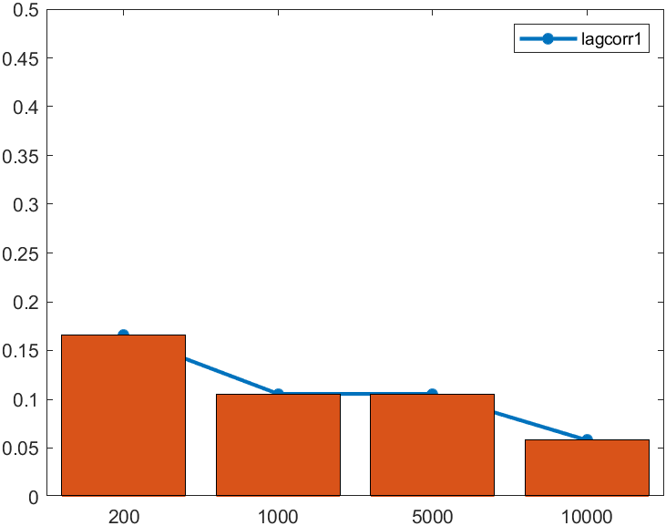
Effect of varying number and length of batches
1. Autocorrelation:
Number of batches | Lag-1 Autocorrelation
200 | 0.1655
1000 | 0.1056
5000 | 0.1056
10000 | 0.0581

Slide 4
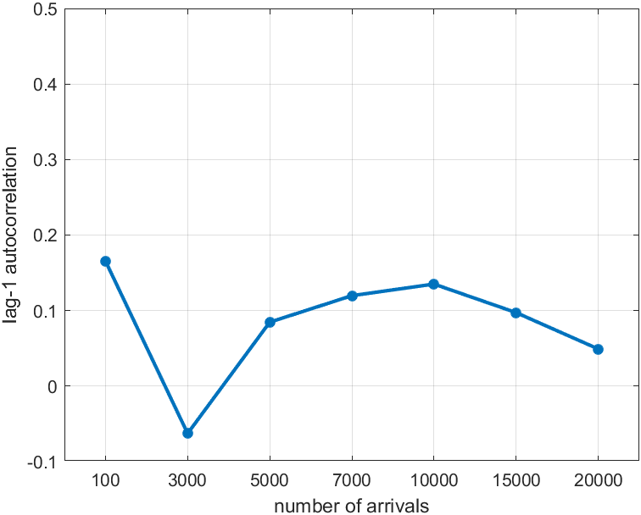
Number of Arrivals | Lag-1 Autocorrelation
100 | 0.1654
3000 | -0.0627
5000 | 0.0846
7000 | 0.1197
10000 | 0.1350
15000 | 0.097
20000 | 0.049

Slide 5
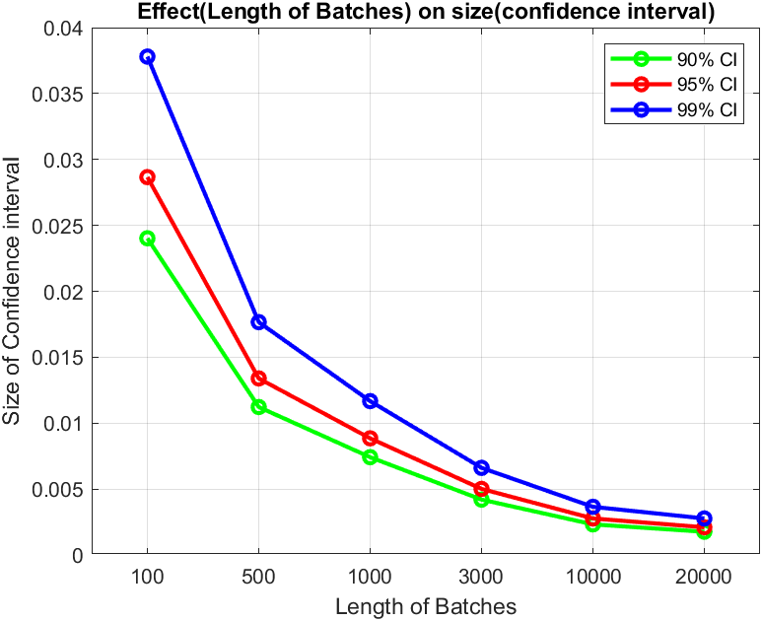
2. Confidence Interval:
length of batches | 90% CI | 95% CI | 99% CI
100 | 0.024 | 0.028 | 0.037
500 | 0.011 | 0.013 | 0.017
1000 | 0.0074 | 0.0088 | 0.011
3000 | 0.0041 | 0.0050 | 0.0066
10000 | 0.0023 | 0.0027 | 0.0036
20000 | 0.0018 | 0.0021 | 0.0028

Slide 6
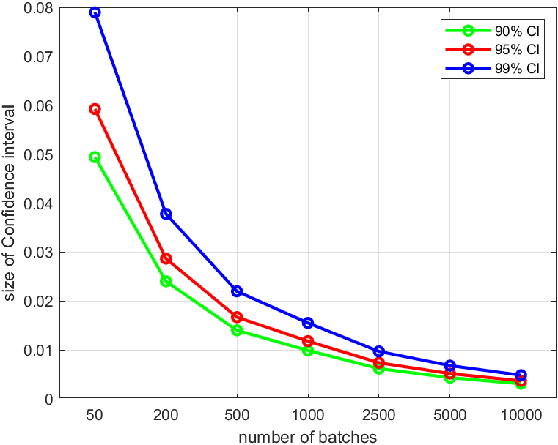
Number of batches | 90% CI | 95% CI | 99% CI
50 | 0.049 | 0.059 | 0.078
200 | 0.024 | 0.028 | 0.0377
500 | 0.014 | 0.0166 | 0.0219
1000 | 0.0098 | 0.0117 | 0.0155
2500 | 0.0062 | 0.0073 | 0.0096
5000 | 0.0043 | 0.0051 | 0.0067
10000 | 0.0031 | 0.0036 | 0.0048

Slide 7
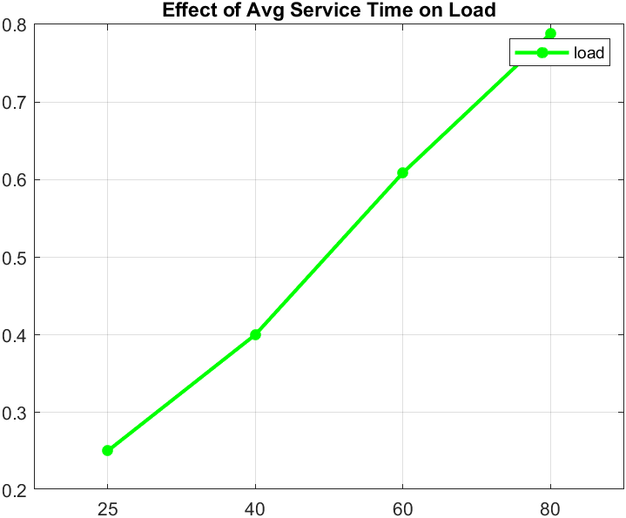
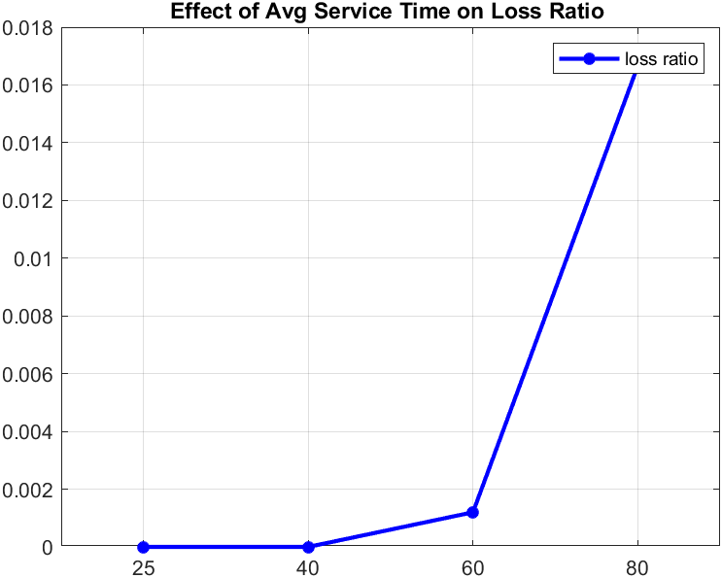
Effect of changing Average Service Time
1. On load, loss ratio and queuing ratio

Slide 8
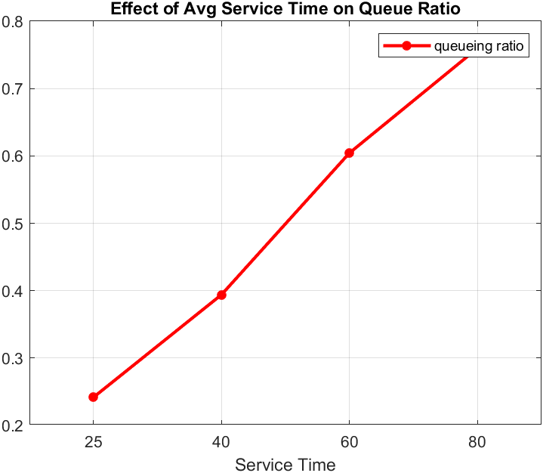

Slide 9
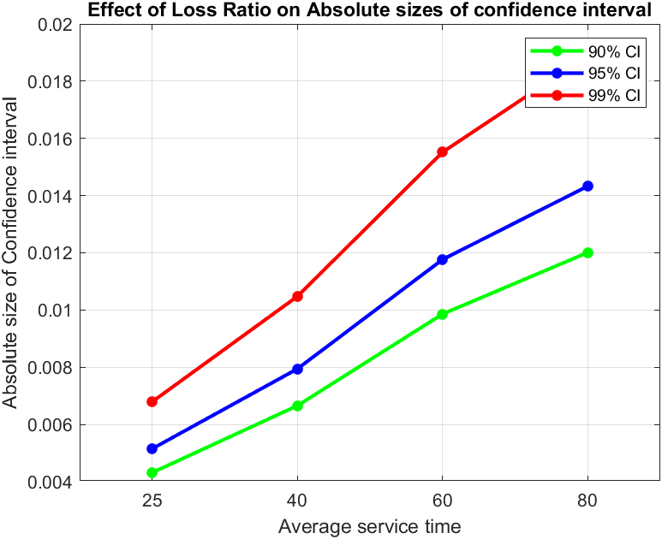
2. Confidence Interval:
E[Ts] | 90% | 95% | 99%
25 | [-0.0043 0.0043 ] | [-0.005 0.005] | [-0.0067 0.0067]
40 | [-0.0066 0.0066 ] | [-0.0079 0.0079] | [-0.010 0.010]
60 | [-0.0098 0.0098] | [-0.011 0.011] | [-0.0155 0.0155]
80 | [-0.012 0.012] | [-0.014 0.014] | [-0.0188 0.0188]

Slide 10
Impact of the size of loss ratio:
1. On the absolute sizes of the confidence intervals
E[Ts] | 90% | 95% | 99%
25 | [-0.0043 0.0043 ] | [-0.005 0.005] | [-0.0067 0.0067]
40 | [-0.0066 0.0066 ] | [-0.0079 0.0079] | [-0.010 0.010]
60 | [-0.0098 0.0098] | [-0.011 0.011] | [-0.0155 0.0155]
80 | [-0.012 0.012] | [-0.014 0.014] | [-0.0188 0.0188]

Slide 11
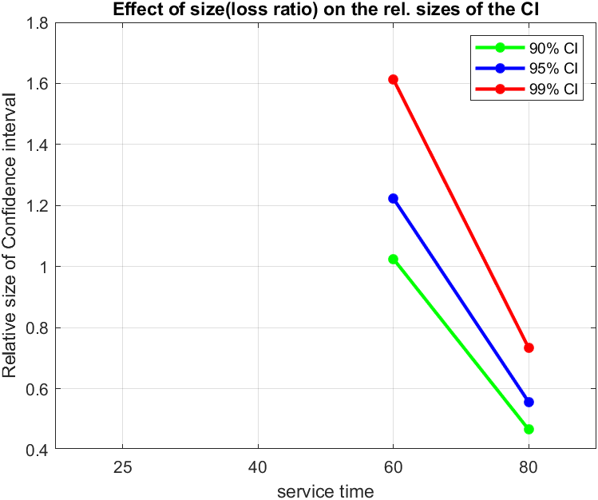
2. On the Relative sizes of the confidence intervals
Service-time | 90% CI | 95% CI | 99%CI
25 | 0 | 0 | 0
40 | 0 | 0 | 0
60 | 1.024 | 1.223 | 1.613
80 | 0.4656 | 0.5557 | 0.7329

Slide 12
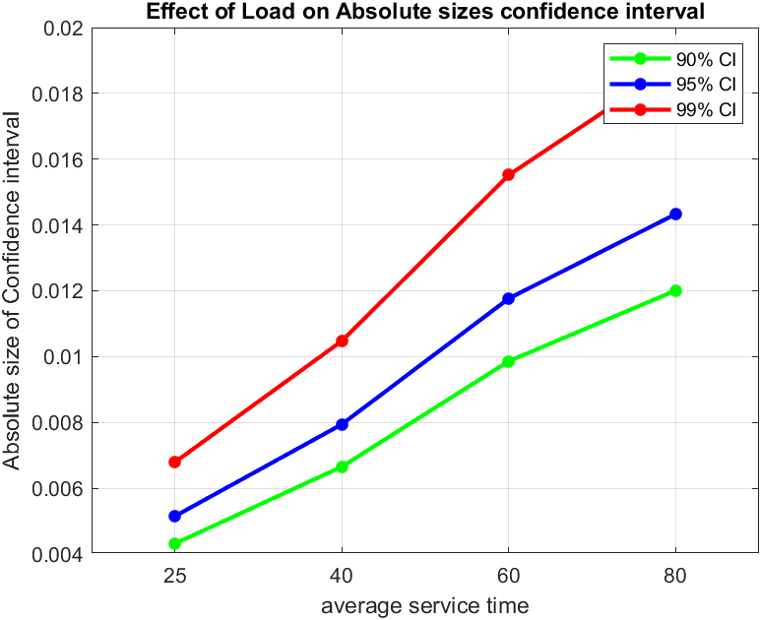
Impact of the size of load
1. On the absolute sizes of the confidence intervals
Service-time | 90% CI | 95% Ci | 99%CI
25 | [-0.0043 0.0043] | [-0.0051 0.0051] | [-0.0067 0.0067]
40 | [-0.0066 0.0066] | [-0.0079 0.0079] | [-0.0104 0.0104]
60 | [-0.0098 0.0098] | [-0.0117 0.0117] | [-0.0155 0.0155]
80 | [-0.0120 0.0120] | [-0.0143 0.0143] | [-0.0188 0.0188]

Slide 13
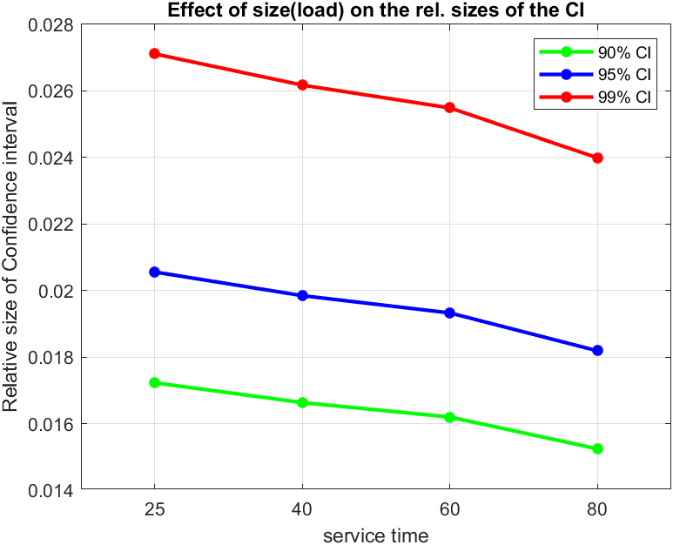
2. On the Relative sizes of the confidence intervals
Service-time | 90% CI | 95% Ci | 99%CI
25 | [-0.0172 0.0172] | [-0.0205 0.0205] | [-0.0271 0.0271]
40 | [-0.0166 0.0166] | [-0.0198 0.0198] | [-0.0261 0.0261]
60 | [-0.0161 0.0161] | [-0.0193 0.0193] | [-0.0254 0.0254]
80 | [-0.0152 0.0152] | [-0.0181 0.0181] | [-0.0239 0.0239]

Slide 14
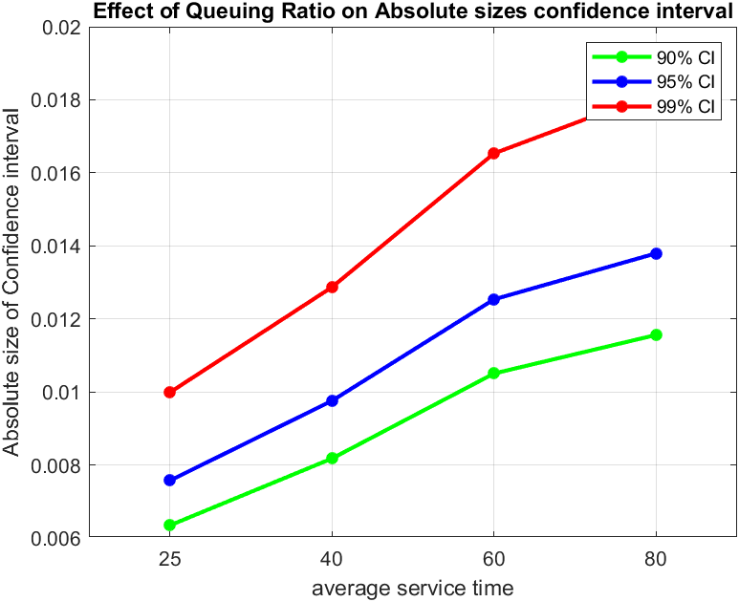
Impact of the size of queuing ratio
1. On the absolute sizes of the confidence intervals
Service-time | 90% CI | 95% Ci | 99%CI
25 | [-0.0063 0.0063] | [-0.0075 0.0075] | [-0.0099 0.0099]
40 | [-0.0081 0.0081] | [-0.0097 0.0097] | [-0.0128 0.0128]
60 | [-0.0105 0.0105] | [-0.0125 0.0125] | [-0.0165 0.0165]
80 | [-0.0115 0.0115] | [-0.0137 0.0137] | [-0.0181 0.0181]

Slide 15
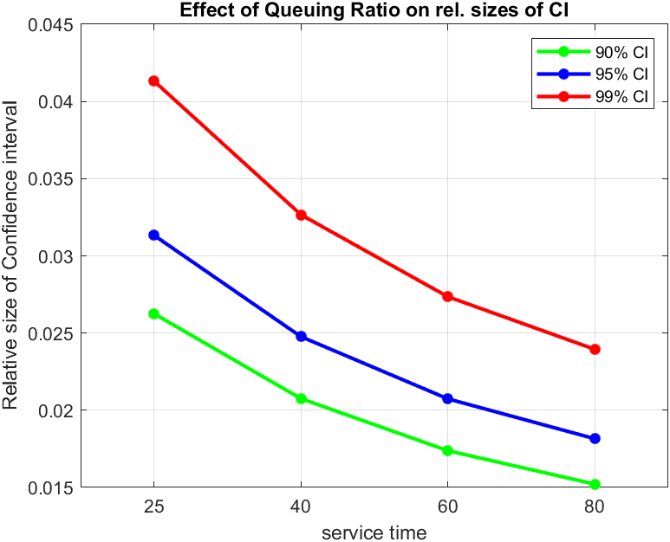
2. On the Relative sizes of the confidence intervals
Service-time | 90% CI | 95% Ci | 99%CI
25 | [-0.026 0.026] | [-0.031 0.031] | [-0.0413 0.0413]
40 | [-0.0207 0.0207] | [-0.024 0.024] | [-0.032 0.032]
60 | [-0.0173 0.0173] | [-0.0207 0.0207] | [-0.027 0.027]
80 | [-0.01 0.0115] | [-0.0181 0.0181] | [-0.023 0.023]

Slide 16
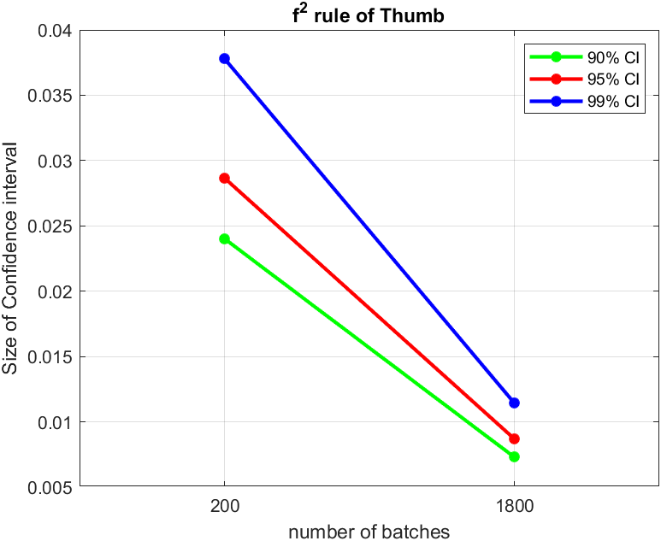


$f^{2}$ rule-of-thumb
${"f}^{2}$ rule-of-thumb” states that reduction of Confidence interval by factor ‘f’ means $f^{2}$ the effort.
Number of batches | 90% CI | 95% CI | 99% CI
200 | [0.0240] | [0.0286] | [0.0377]
1800 | [0.0072] | [0.0086] | [0.0114]

Slide 17
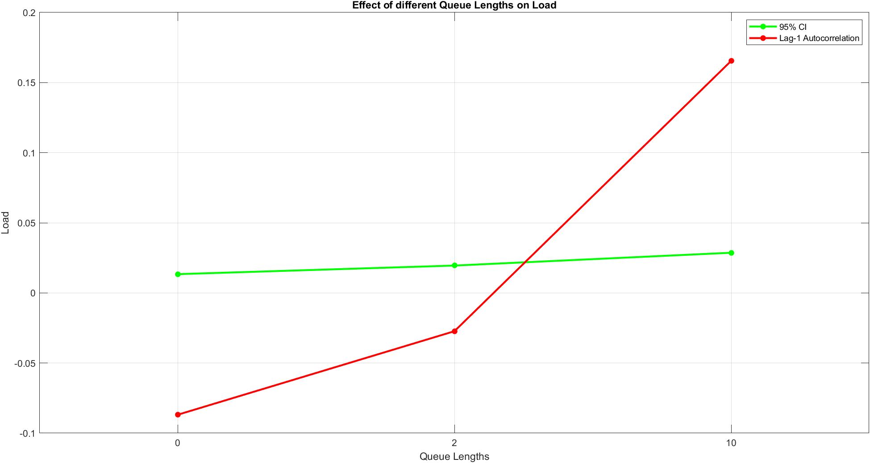
Impact of changing Queue Size
1. On load:
Queue-length | 95% CI | Lag-1 autocorrelation
0 | 0.0133 | -0.0868
2 | 0.019 | -0.027
10 | 0.028 | 0.165

Slide 18
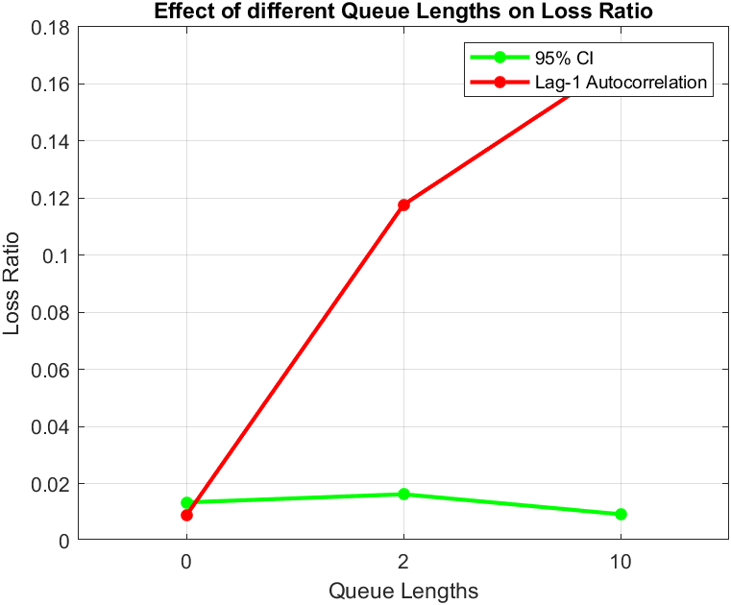
2. On loss ratio:
Queue-length | 95% CI | Lag-1 autocorrelation
0 | 0.0134 | 0.0088
2 | 0.0163 | 0.1176
10 | 0.0093 | 0.1679

Slide 19
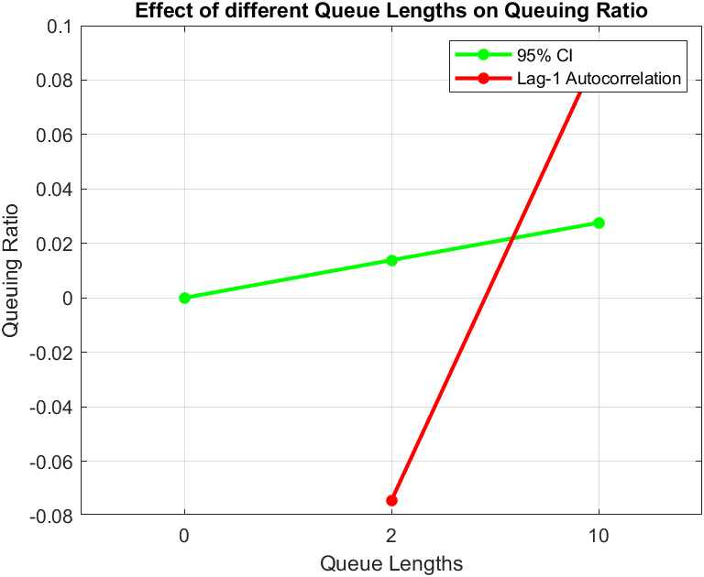
3. Queuing Ratio:
Queue-length | 95% CI | Lag-1 autocorrelation
0 | 0.0 | 0
2 | 0.0139 | -0.0744
10 | 0.0276 | 0.0901

Slide 20
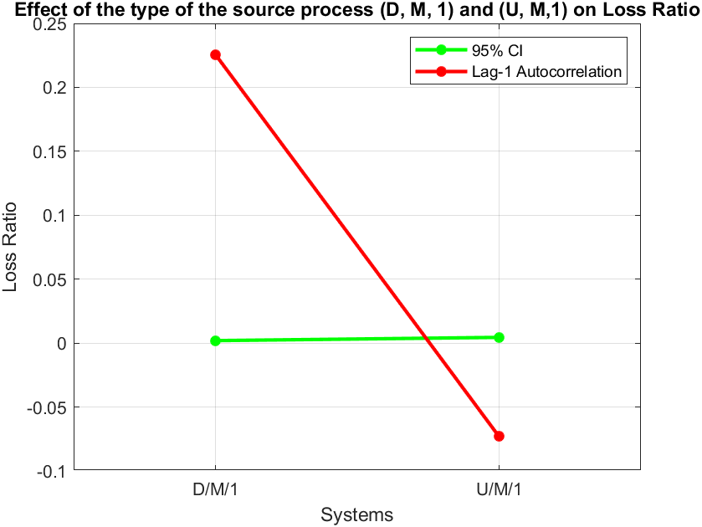
Impact of the type of the source process
1. Loss Ratio:
System | 95% CI | Lag-1 autocorrelation
D/M/1 | 0.0019 | 0.225
U/M/1 | 0.0046 | -0.0731

Slide 21
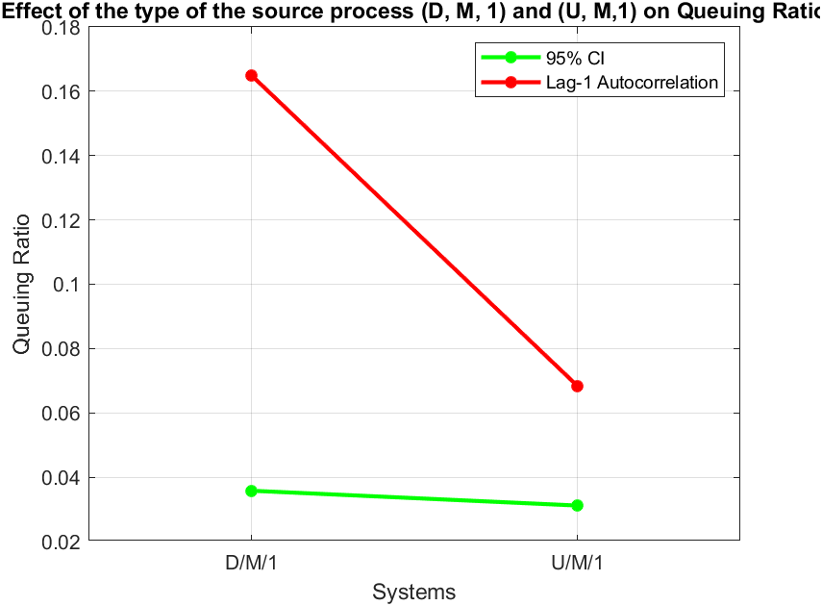
2. Queuing Ratio:
System | 95% CI | Lag-1 autocorrelation
D/M/1 | 0.0358 | 0.1650
U/M/1 | 0.0312 | 0.0684

Slide 22
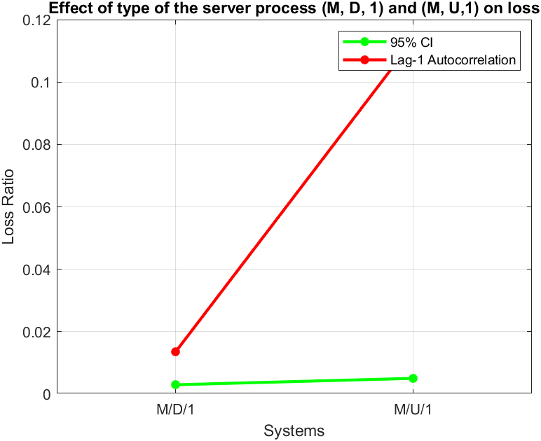
Impact of the type of the server process
1. Loss Ratio:
System | 95% CI | Lag-1 autocorrelation
M/D/1 | 0.0030 | 0.0135
M/D/1 | 0.0050 | 0.1133

Slide 23
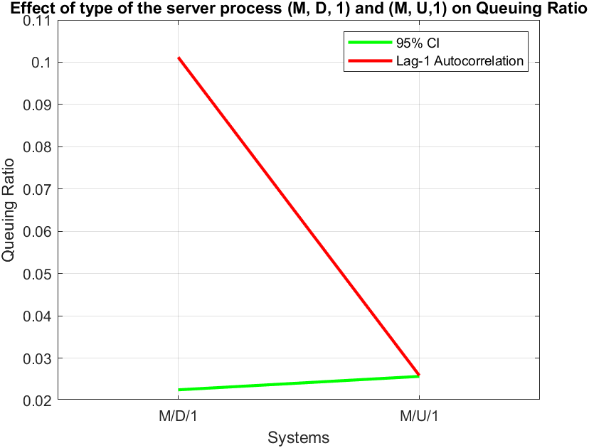
2. Queuing Ratio:
System | 95% CI | Lag-1 autocorrelation
M/D/1 | 0.0225 | 0.0259
M/U/1 | 0.0257 | 0.1012

Slide 24
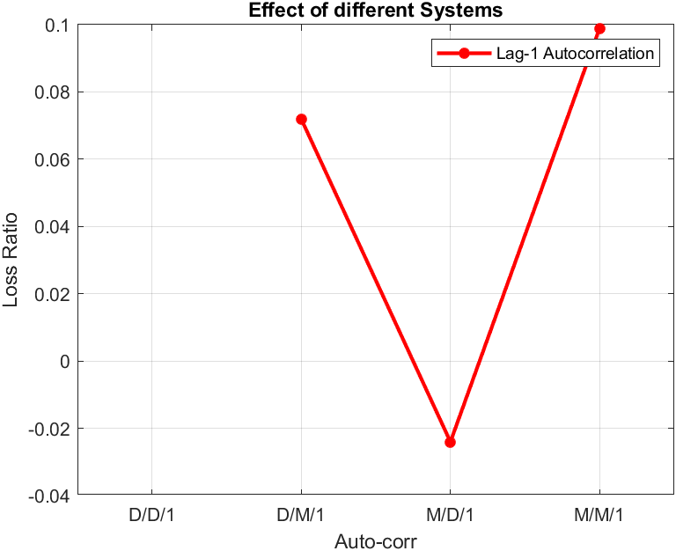
Compare the loss ratios for the M/M/K’’=10 system with those obtained for the M/D/K’’ and D/M/K’’ systems at 80 % load, and motivate your observations. (Why is the D/D/K’’ case trivial?)
System | Lag-1 Autocorrelation
D/D/1 | 0
D/M/1 | 0.0719
M/D/1 | -0.240
M/M/1 | 0.989

Slide 25
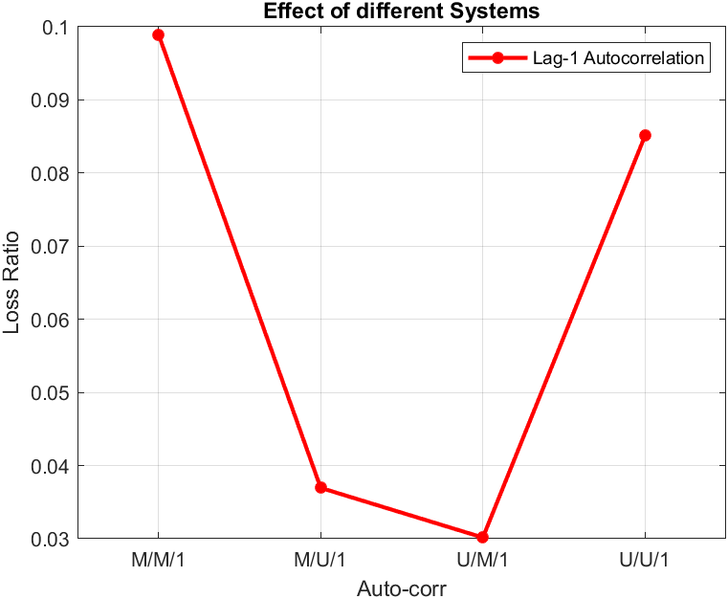
Compare the loss ratios for the M/M/K’’=10 system with those obtained for the M/U/K’’, U/M/K’’ and U/U/K’’ systems at 80 % load
System | Lag-1 Autocorrelation
M/M/1 | 0.0989
M/U/1 | 0.0369
U/M/1 | 0.0302
U/U/1 | 0.0851

Slide 26
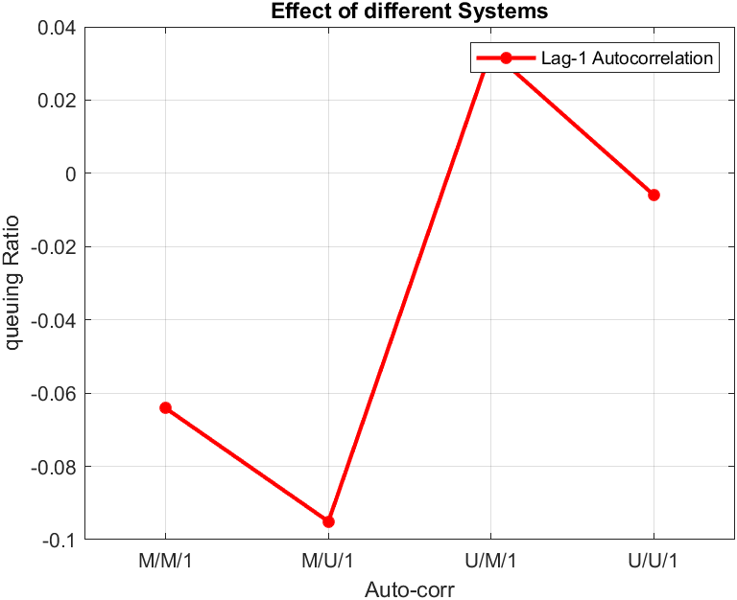
Compare the queuing ratios for the M/M/K’’=10 system with those obtained for the M/U/K’’, U/M/K’’ and U/U/K’’ systems at 80 % load
System | Lag-1 Autocorrelation
M/M/1 | -0.0641
M/U/1 | -0.0951
U/M/1 | 0.0335
U/U/1 | -0.0059s

