Slide 1
POWER System Fault Detection and Classification
CAPSTONE PROJECT
Presented By:
1. Parth Kapur Graphic Era University B.Tech CSE

Slide 2
OUTLINE
Problem Statement
Proposed System/Solution
System Development Approach
Algorithm & Deployment
Result
Conclusion
Future Scope
References

Slide 3
Problem Statement
Design a machine learning model to detect and classify different types of faults in a power distribution system. Using electrical measurement data (e.g., voltage and current phasors), the model should be able to distinguish between normal operating conditions and various fault conditions (such as line-to-ground, line-to-line, or three-phase faults). The objective is to enable rapid and accurate fault identification, which is crucial for maintaining power grid stability and reliability.

Slide 4
Proposed Solution
The proposed system aims to address the challenge of predicting the Fault in the electricity line. This involves leveraging data analytics and machine learning techniques to detect the fault. The solution will consist of the following components:
Data Collection:
Gathered simulated and historical voltage/current phasor data, both under fault and nominal conditions, as well as system-related context information.
Data Preprocessing:
Cleaned, synchronized, and normalized the data; added engineered features such as sequence components, power deviations, and rate of change features.
Machine Learning Algorithm:
Utilized IBM watsonx.ai AutoAI to select, train, and tune automatically the optimal multiclass classification model for fault detection.
Deployment:
Develop Used the model as a real-time inference service coupled with grid monitoring systems to provide instantaneous fault alerts.
Evaluation:
Evaluated performance in terms of precision, recall, F1-score, confusion matrix, and detection latency to minimize false alarms.

Slide 5
System Approach
The system consumes real-time voltage and current phasor data, preprocesses and extracts features, and applies an AutoAI-trained machine learning model in IBM watsonx.ai to classify operational conditions. The model deployed to the field produces fault type prediction in real-time, initiating alerts for swift response and grid protection.

Slide 6
Algorithm & Deployment
Algorithm Selection:
We used IBM watsonx.ai’s AutoAI to automatically evaluate multiple supervised machine learning algorithms (e.g., Random Forest, Gradient Boosting, Logistic Regression) and select the best-performing model for multiclass fault classification. AutoAI was chosen for its ability to optimize preprocessing, feature engineering, and hyperparameters, ensuring high accuracy and minimal latency.
Data Input:
The model takes voltage and current phasor measurements, sequence elements (compositive, negative, zero), power deviations, rate of change indicators, and system contextual information like load condition and topological changes.
Training Process:
Simulated and historical labeled data were divided into training and test sets, where AutoAI conducted automated feature selection, transformation, and hyperparameter optimization. Stratified cross-validation maintained well-balanced representation of every fault type and enhanced generalization.
Prediction Process:
In real-time operation, received phasor measurements are preprocessed and converted utilizing the same pipeline from training, subsequently fed to the model to determine conditions as normal or as particular fault types. The system provides fault type and confidence score for direct operator action.

Slide 7
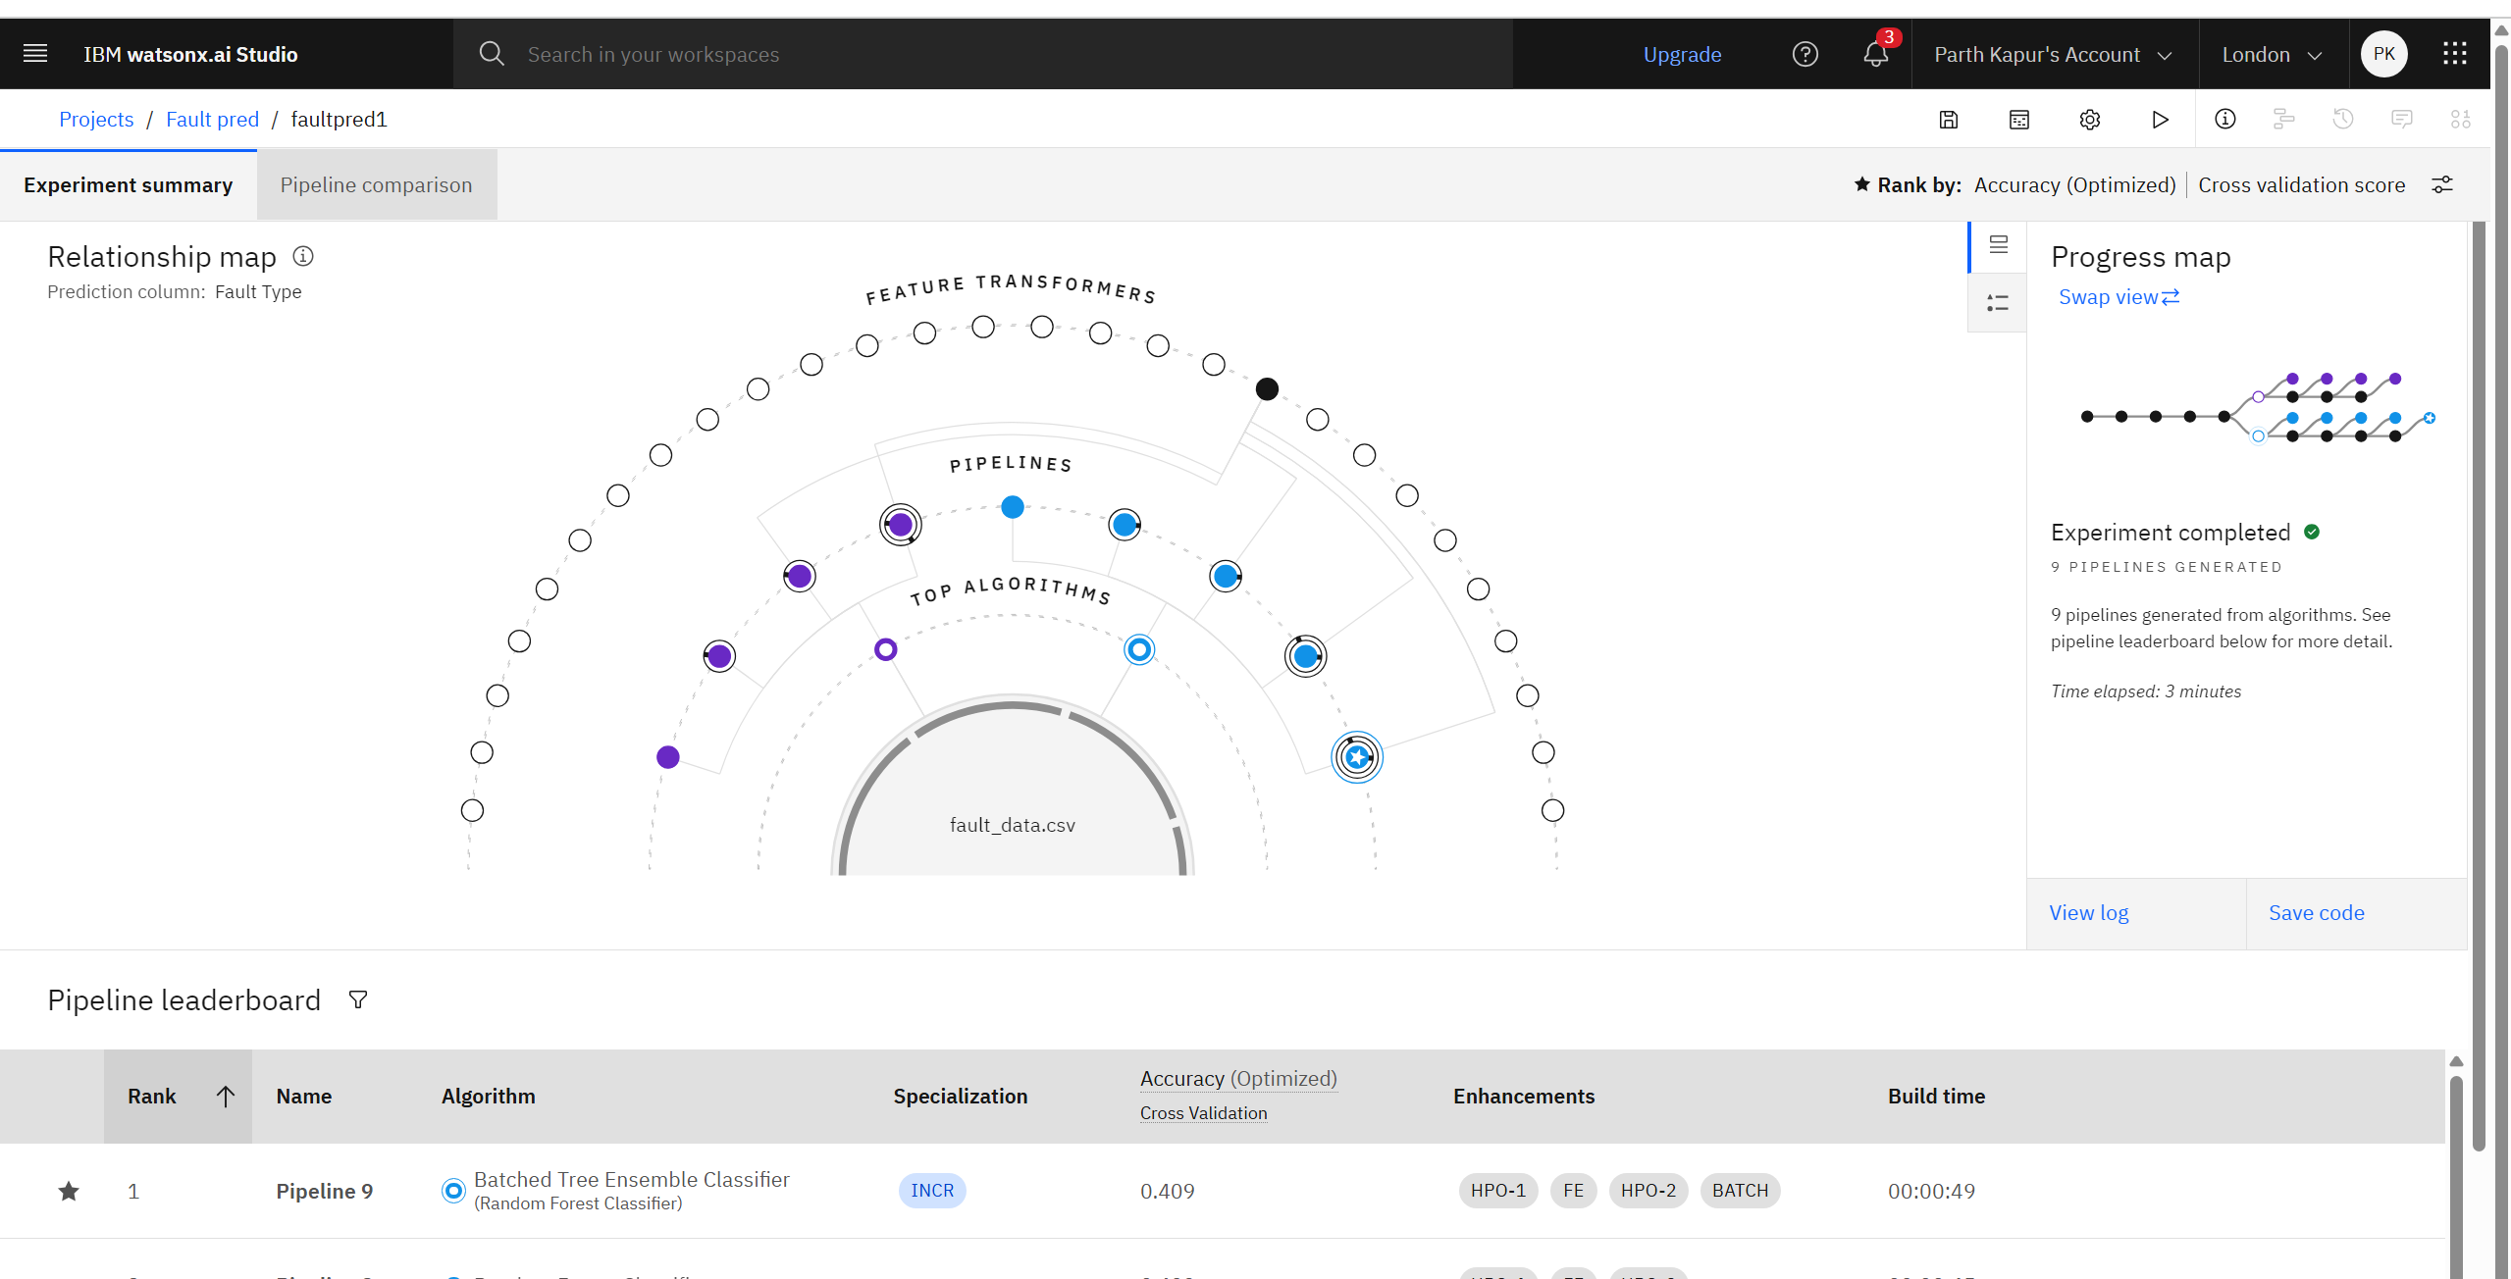
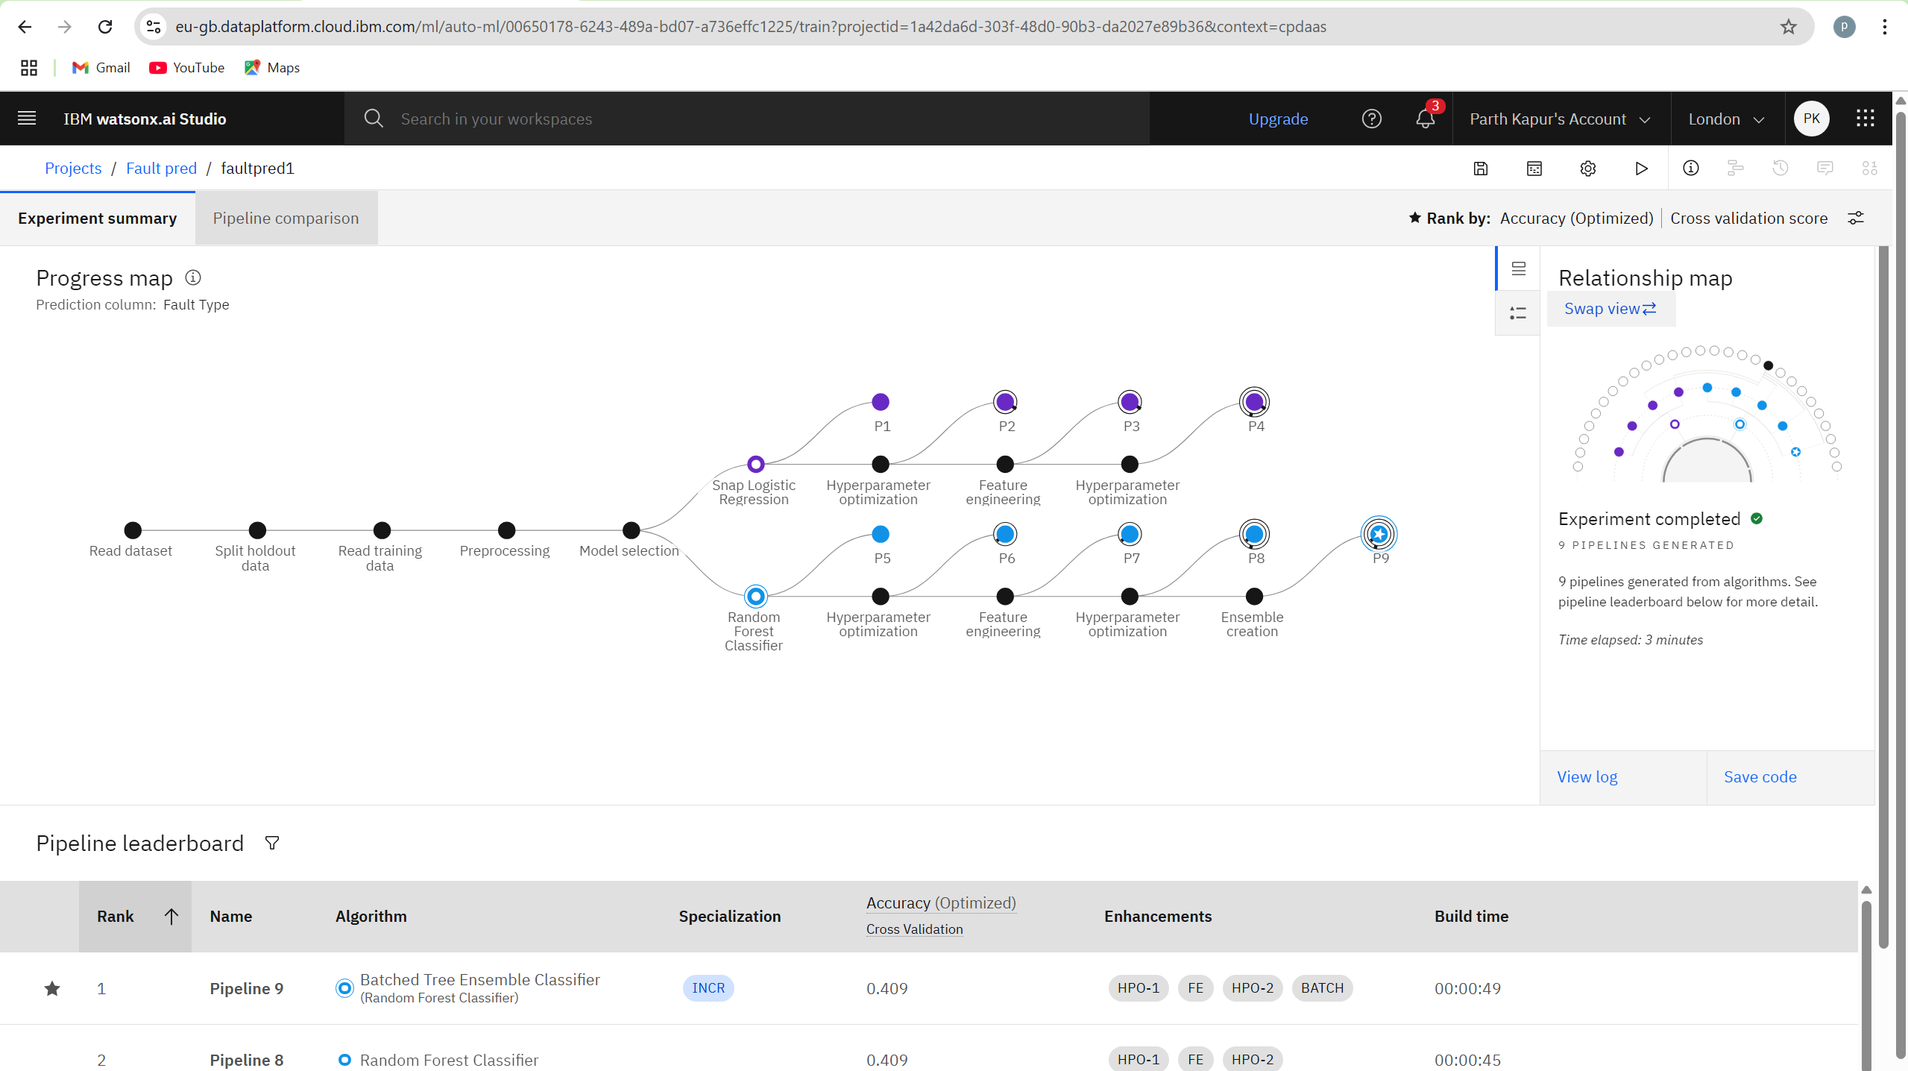
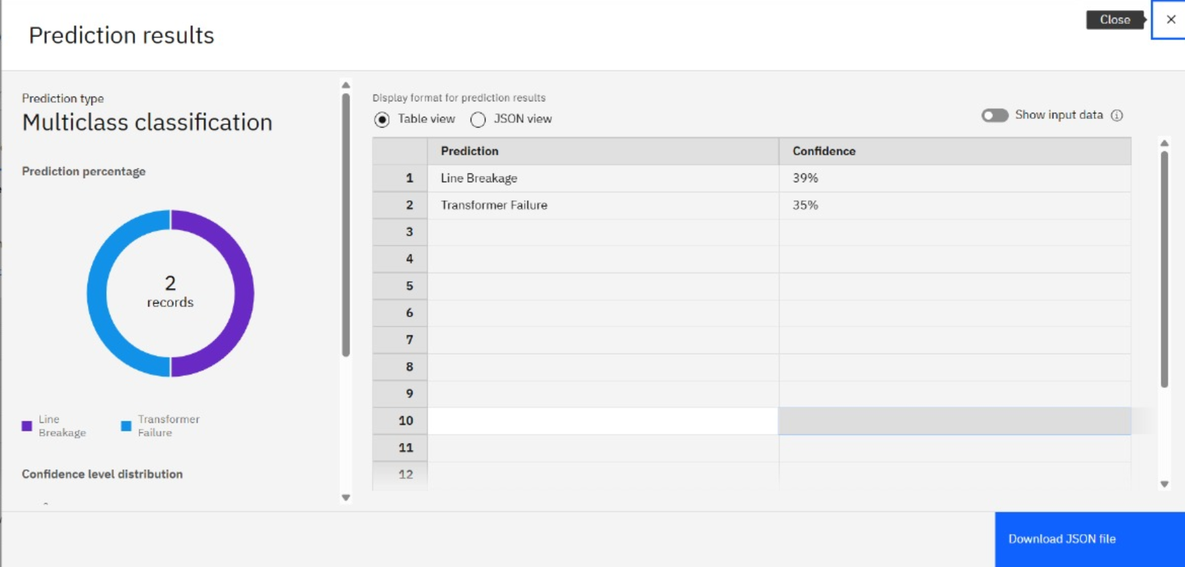
Result

Slide 8
Conclusion
The machine learning-based fault detection system developed using IBM watsonx.ai AutoAI successfully identifies and classifies various power distribution faults with high accuracy and low latency. By leveraging phasor measurement data and automated model optimization, the solution enables rapid fault diagnosis, enhancing grid reliability, reducing downtime, and supporting proactive maintenance.

Slide 9
Future scope
The system can be extended to include fault location estimation, integration with predictive maintenance systems, and adaptation to different grid topologies. Incorporating streaming analytics, IoT sensor networks, and advanced deep learning models can further improve detection accuracy and robustness against evolving grid conditions.

Slide 10
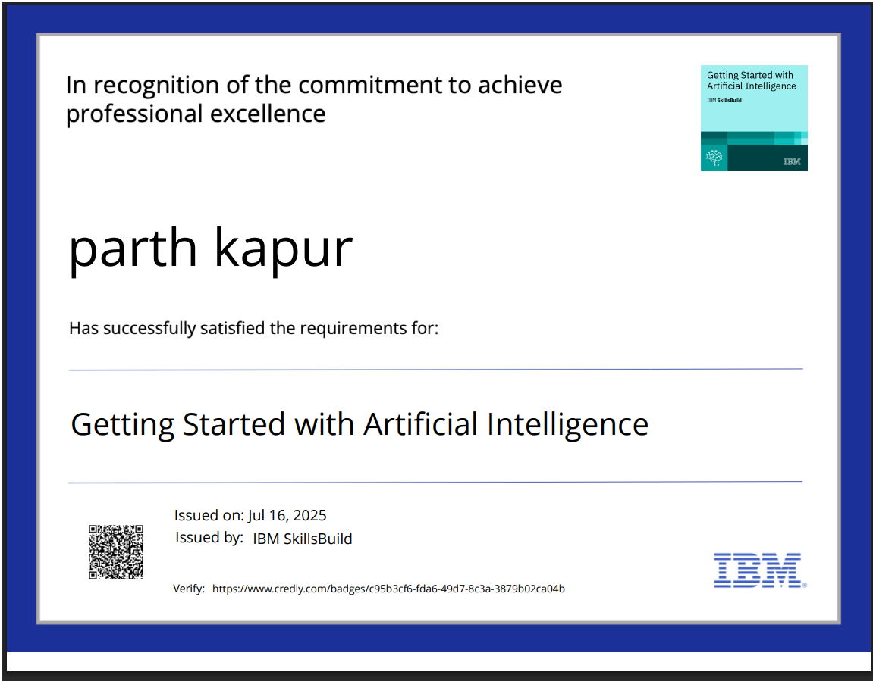
IBM Certifications

Slide 11
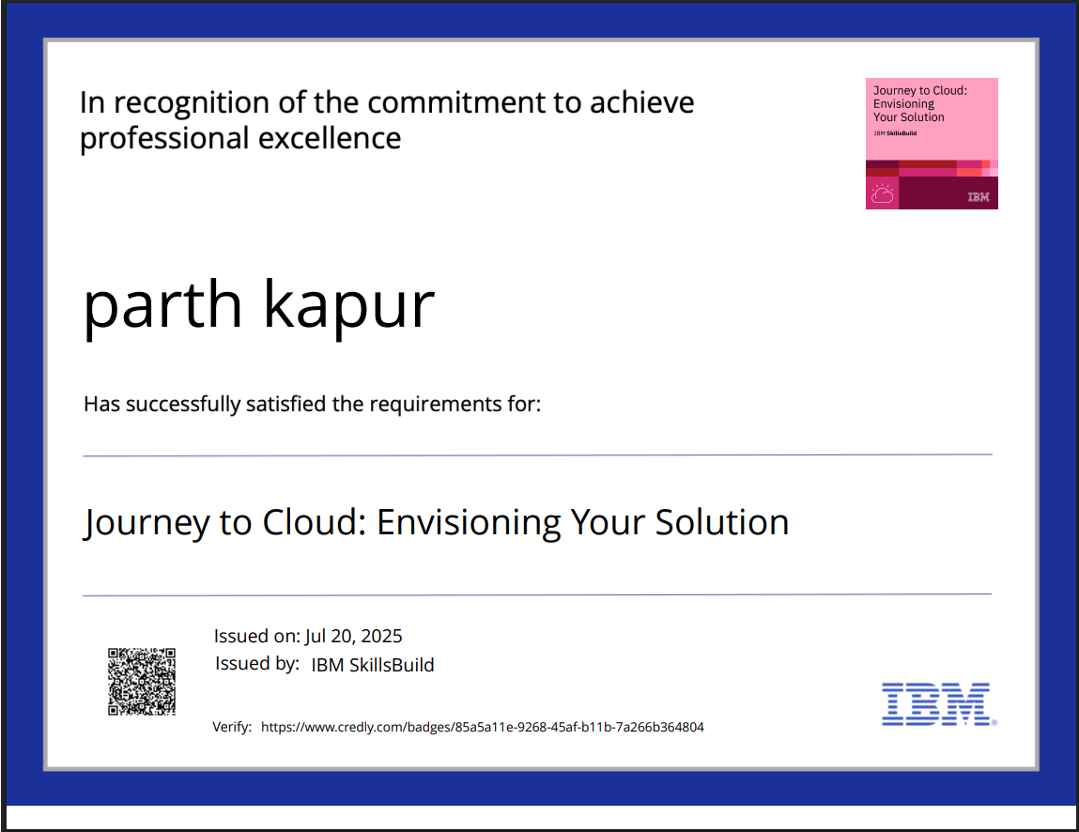
IBM Certifications

Slide 12
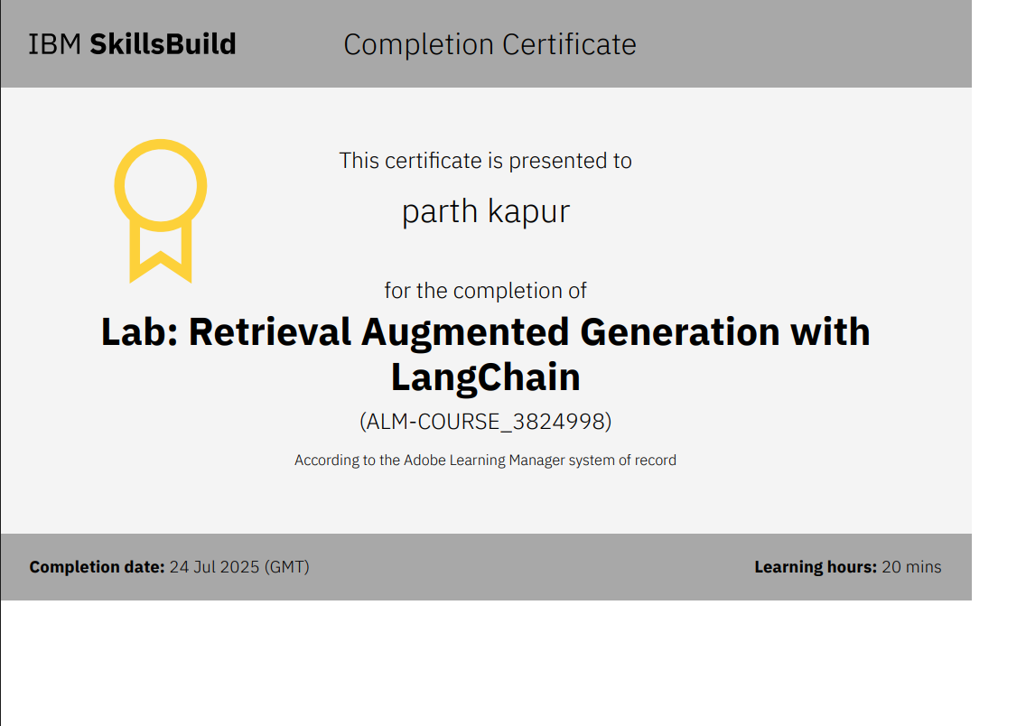
IBM Certifications

Slide 13
THANK YOU

