Slide 1
World before and during Covid-19
Catherine Sarah Sunil (5019108)
Brian Mendes (5019138)
Parth Phalke (5019147)
Guide: Prof. Lakshmi Gadhikar

Slide 2
Contents
ABSTRACT
INTRDUCTION
LITERATURE SURVEY
EXISTING SYSTEM
ARCHITECTURAL DIAGRAM
DESIGN FLOWHCART
EXPERIMENTAL RESULTS
CONCLUSION
FUTURE SCOPE

Slide 3
ABSTRACT
Data Analysis is the process of bringing order and structure to collected data. It turns data into information teams can use. Data visualization is the process of putting data into a chart, graph, or other visual format that helps inform analysis and interpretation. Analysis and Visualization of datasets has always been a helpful for various reasons whether it’s for improvement of customer experience or business plans, etc. These all aspects require the analysis of the data.
In 2020, the world has seen a paradigm shift across many industries, businesses, climate and to human life itself due to the COVID pandemic.The Government and many private organizations need to know the damage caused by the pandemic for reasons ranging from public welfare to business strategies. These calculations are very important for the growth and robustness of the National economy.

Slide 4
To calculate and analyze the effects, we need data regarding the damage. Data is available as clusters in the many nooks and crannies of the internet. This data is then collected as a whole and then merged into a data-set. Even when data is amassed into data sets, it is still an enormous task to sort and make meaning out of it. This data can be simplified and visualized using various Python libraries like matplotlib, NumPy, pandas, etc.
In this project the main goal is to implement the Python tools to simplify, analyse, visualize and predict different aspects under the banner “Impact of COVID - 19 on industries, climate and population.”

Slide 5
Industries
Profits and Losses faced by the different types of Industries
Unemployment rates
Stock Market analysis
Climate
Temperature comparison for the years 2019 and 2020 (Mumbai).
Air Quality Index parameters for 6 cities in India.
Population (area wise)
Death rate
Total cases.

Slide 6
INTRODUCTION

Slide 7
Back ground/Motivation
In the United States, the proportion of people out of work hit a yearly total of 8.9%, according to the International Monetary Fund (IMF), signaling an end to a decade of jobs expansion.
Millions of workers have also been put on government-supported job retention schemes as parts of the economy, such as tourism and hospitality, have come to a near standstill.The numbers of new job opportunities are still very low in many countries.
Globally, as of 14 May 2021, there have been 160,813,869 confirmed cases of COVID-19, including 3,339,002 deaths, reported to WHO. As of 11 May 2021, a total of 1,264,164,553 vaccine doses have been administered.

Slide 8
Back ground/Motivation
NASA’s satellite images have evidenced the pollution reduction in China right after the carbon emissions had dropped by 25% in four weeks of lockdown.
Out of many projects which contained the effects of Covid-19, our project focusses on multiple variables (climate, population, industries, etc.) integrated into a single entity.
Hence, we decided to choose this problem statement to visualize and interpret the difference that this pandemic has brought into the world.

Slide 9
Problem Definition
Our project is helpful in visualizing several differences brought about at industrial, climatic and public level due to the pandemic by comparing historical data (before 2020) to that of the years 2020-21.
We also plan to implement machine learning module to interpret post pandemic stock prices and performance of different industries based on the current data.

Slide 10
Scope
Public health:
Over the first 6 weeks of the new decade, the novel coronavirus, known as COVID-19, has spread from the People’s Republic of China to 20 other countries. On 30 January 2020 following the recommendations of the Emergency Committee, the WHO Director General declared that the outbreak constitutes a Public Health Emergency of International Concern (PHEIC).
Climatic changes:
Scientists have confirmed that air quality in certain regions has improved in recent weeks. As industries, aviation, and other means of transportation stop, air pollution is reduced countries severely affected by the virus, such as China, Italy, and Spain. A reduction in commuting due to work from home policies has also played its part in reducing carbon emissions.

Slide 11
Scope
Economic effects:
The outbreak of COVID-19 brought social and economic life to a standstill. In this study the focus is on assessing the impact on affected sectors, such as aviation, tourism, retail, capital markets, MSMEs, and oil. International and internal mobility is restricted, and the revenues generated by travel and tourism, which contributes 9.2% of the GDP, will take a major toll on the GDP growth rate.

Slide 12
Literature Survey
Models used for Time-Series Prediction
Name of the model | Advantages | Disadvantages
ARIMA ^{[10]} | The main advantage of ARIMA forecasting is that it requires data on the time series in question only. First, this feature is advantageous if one is forecasting a large number of time series. Second, this avoids a problem that occurs sometimes with multivariate models. | Some major disadvantages of ARIMA forecasting are: first, some of the traditional model identification techniques for identifying the correct model from the class of possible models are difficult to understand and usually computationally 10 expensive.
Exponential Smoothing ^{[11]} | Exponential smoothing is very simple in concept and very easy to understand.Exponential smoothing is very powerful because of its weighting process. | Exponential smoothing will lag. In other words, the forecast will be behind, as the trend increases or decreases over time.Exponential smoothing will fail to account for the dynamic changes at work in the real world, and the forecast will constantly require updating to respond new information.
LSTM(RNN) ^{[12]} | The principal advantage of RNN over ANN is that RNN can model a collection of records (i.e., time collection) so that each pattern can be assumed to be dependent on previous ones. | LSTMs take longer to train. LSTMs require more memory to train.

Slide 13
EXISTING SYSTEM

Slide 14
Comparison with Existing Systems
Sector | Existing System | Outcome of the Existing System. | Difference between the existing system and our system.
Industrial | “Covid-19 PANDEMIC INIDA”- M.Sc. (Data Science) – SEM II Department of Computer Science.FERGUSSON COLLEGE (AUTONOMOUS). ^{[8]} | Visualization of the affected population numbers and India’s GDP during the pandemic. The system only shows the effects of Covid-19 on India. | The existing system visualizations are static from limited data sources; our system makes use of several data sources for dynamic visualizations on world map.
2.Industrial | Analysing the Impact of Coronavirus on the Stock Market using Python, Google Sheets and Google Finance- adilmoujahid.com ^{[9]} | Data gathering and visualization of S&P 500 companies (USA) and how they were affected during the pandemic. | Our system visualizes not just the S&P 500 companies but also the NIFTY-50 companies’ data and the trend of NIFTY and SENSEX over the years.
Industrial | Unemployment, total (% of total labor force) (modeled ILO estimate) -worldbank.org ^{[6]} | Visualizes Unemployment rates of different countries and the World as a whole over the years 1991-2020. | Our system visualizes a comparison between the unemployment rates of India and the World on a single line graph over the years 1991-2020.
4.Public/Industrial/Climate | www.covidexplore.com GitHub:github.com/mayukh18/covidexplore - Mayukh Bhattacharyya ^{[7]} | Website showcases effects of Covid-19 on Stock markets, AQI and the population affected by the disease. | The website is very similar to that of our project, just that it doesn’t analyze many parameters as we do in our project in all three sectors: Financial, Climatic and Public levels.

Slide 15
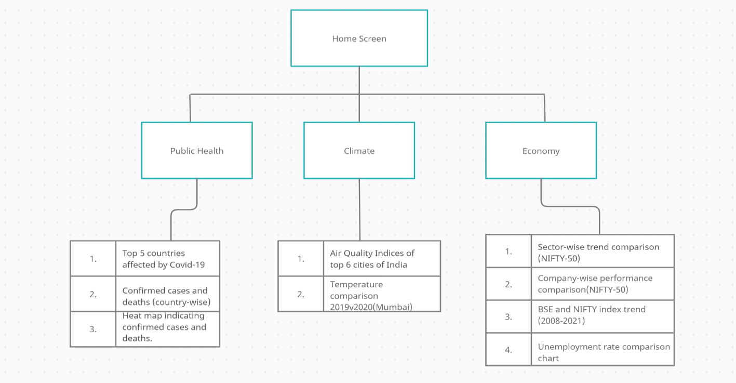
Architectural block diagram

Slide 16
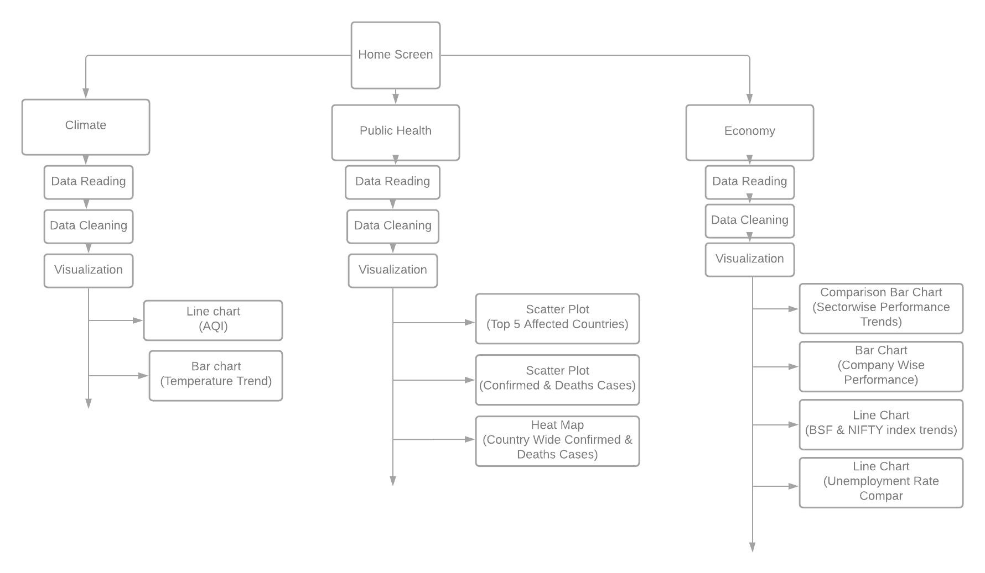
Design- Flowchart

Slide 17
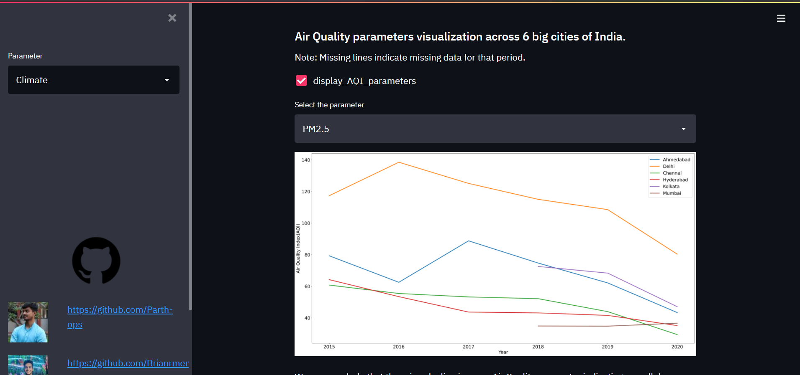
Experimental results 1) Climate Screen

Slide 18
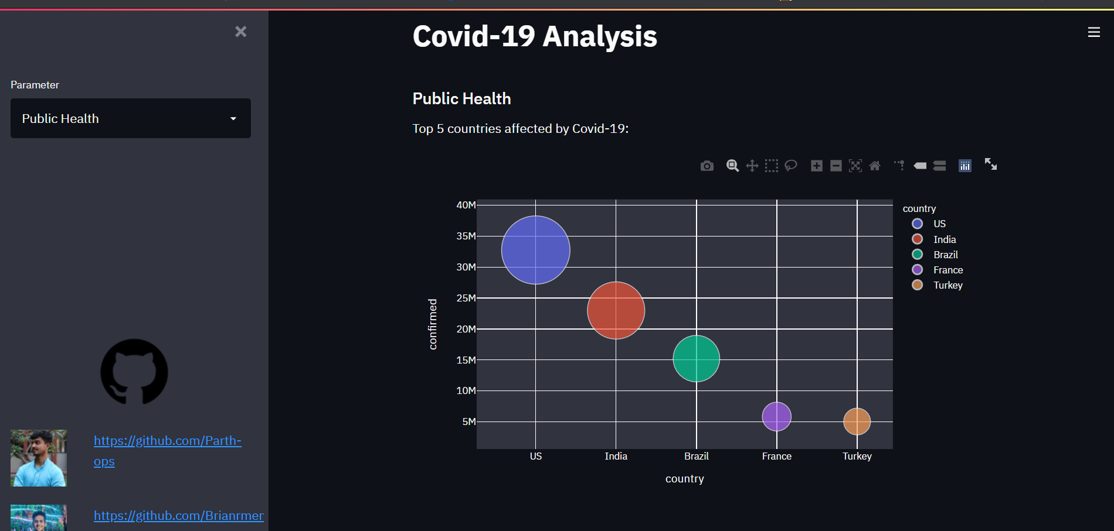
Experimental results 2) Public Health Screen

Slide 19
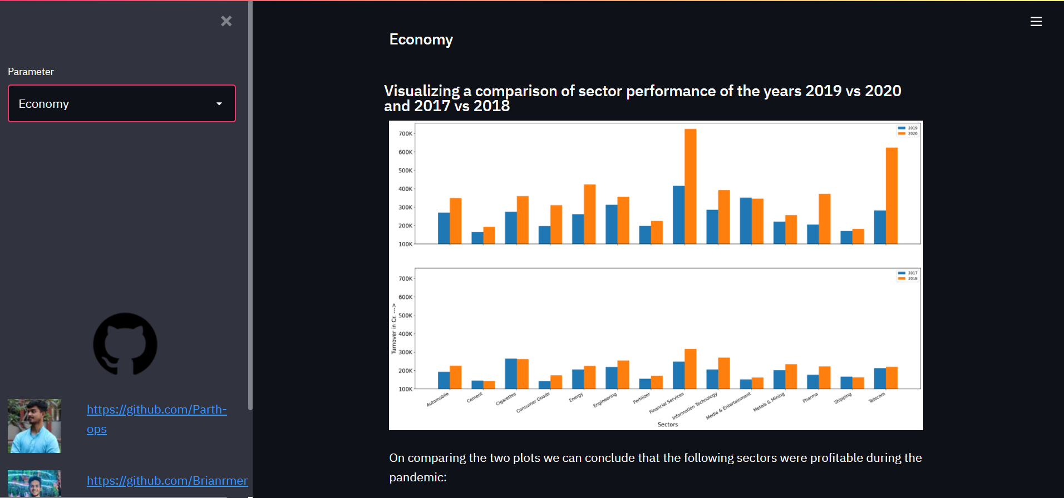
Experimental results 3) Economy Screen

Slide 20
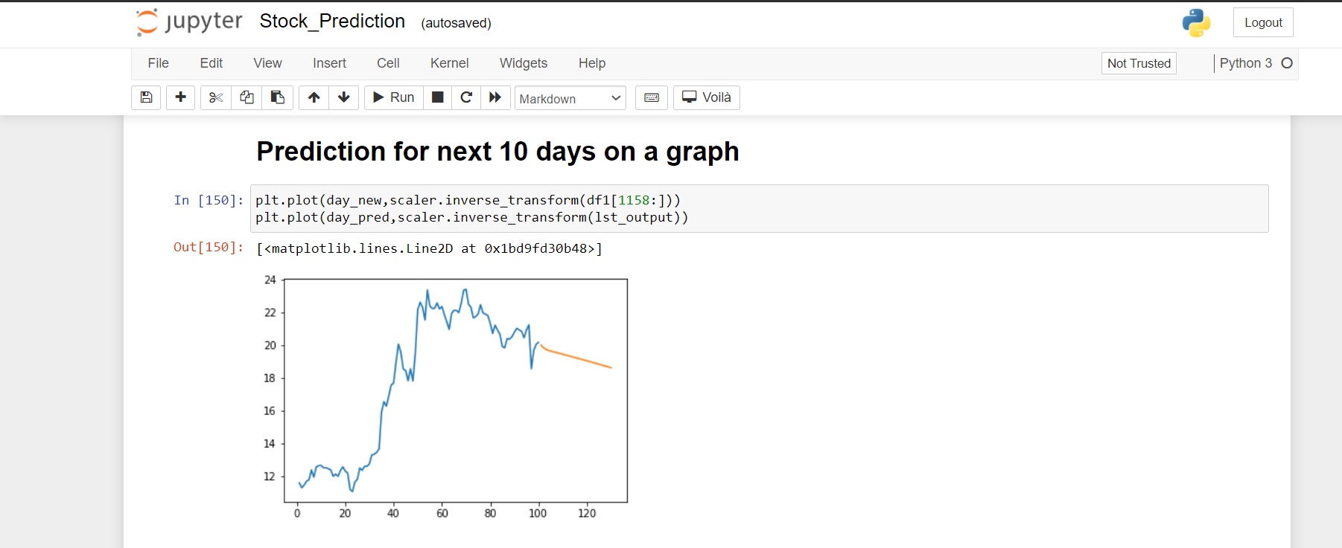
Experimental results 4) Stock Prediction Screen

Slide 21
Conclusion
We were successful in visualizing the three major parameters affected due to the pandemic namely Climate, Public Health and Economy.
This analysis can prove to be useful for the government to carry out vaccination drives and to impose stricter restrictions towards the adversely affected areas.
The economic analysis can be useful for the companies to understand the losses/profits they are making in order to change their marketing strategies.
The climatic analysis helps us to understand the difference brought about by halting the industrial practices (resulting in much lower air pollution.

Slide 22
Future Scope
Machine Learning module can be integrated with the Streamlit app.
Realtime data analysis for temperature and AQI analysis.
Data can be stored into a database.
Results can be stored into a database.
Caching can be done for the graphs so that on interaction with any of the widgets, the entire script is not re-run and only the part of the script which has changed will run.

Slide 23
REFERENCES
Front. Public Health, 28 May 2020, https://doi.org/10.3389/fpubh.2020.00216
Cyranoski D, “Did pangolins spread the China coronavirus to people?” - Nature. (2020), https://www.nature.com/articles/d41586-020-00364-2Data can be stored into a database.
“COVID-19: Emergence, Spread, Possible Treatments, and Global Burden”, https://www.frontiersin.org/articles/10.3389/fpubh.2020.00216/full#B13
https://covid19.who.int
https://www.mohfw.gov.in
Unemployment, total (% of total labour force) (modelled ILO estimate) -worldbank.org
Mayukh Bhattacharyya, www.covidexplore.com, github.com/mayukh18/covidexplore

Slide 24
REFERENCES
Akash Kundu, Akshay Kale, Shubham Rajput, Siddhant Fulzele, Tejas Akadkar, Vinay Kumar Kushwaha, “Covid-19 PANDEMIC INIDA”- M.Sc. (Data Science) – SEM II Department of Computer Science. FERGUSSON COLLEGE (AUTONOMOUS).
Adil Moujahid, “Analysing the Impact of Coronavirus on the Stock Market using Python, Google Sheets and Google Finance”, adilmoujahid.com, 12/04/2020.
S. Mehrmolaei and M. R. Keyvanpour, "Time series forecasting using improved ARIMA," 2016 Artificial Intelligence and Robotics (IRANOPEN), 2016, pp. 92-97, doi: 10.1109/RIOS.2016.7529496.
C. A. G. d. A. Júnior, F. A. T. de Carvalho and A. L. S. Maia, "Exponential smoothing methods for forecasting bar diagram-valued time series," 2012 IEEE International Conference on Systems, Man, and Cybernetics (SMC), 2012, pp. 1361-1366, doi: 10.1109/ICSMC.2012.6377923.
Y. Wang, S. Zhu and C. Li, "Research on Multistep Time Series Prediction Based on LSTM," 2019 3rd International Conference on Electronic Information Technology and Computer Engineering (EITCE), 2019, pp. 1155-1159, doi: 10.1109/EITCE47263.2019.9095044.

Slide 25
thank you

