Slide 1
KumbhNavigate
By IIT -

Slide 2
Abstract
Dynamic Mobile-First :
KumbhNavigate is a mobile-first web application, designed specifically for the Mahakumbh attendee's’s navigation.
With KumbhNavigate our focus is to elevate the experience of each attendee's through innovative features and user-friendly design.
Multilingual :
KumbhNavigate allows attendee's to instantly access the essential information about facilities , amenities and vital information and features in their own desired language.
KumbhNaviagte provides information in diverse languages, catering to the needs of a attendee's through every corner of the globe.
Real-Time Navigation :
KumbhNavigate is a real-time tour guide which will guide as a human does , locating all the important areas of the kumbh mela , including : Toilets , Rest Areas , Cultural Events , Stays and attendees own sleeping pods as well as their own custom places.
KumbhNavigate is capabale of providing seamless accommodations browsing, which can gift them discounts for nearby local stays as well as motels, contributing to a smoother and more enjoyable event experience and uplifting the overall ambience.

Slide 3
Architecture
Frontend : ReactJs, Tailwind CSS , CSS
- React for dynamic user interfaces.
- Tailwind CSS for efficient styling.
Backend : MongoDB, Express, Node.js
- MongoDB for flexible data storage.
- Express for robust API creation.
- Node.js for efficient server-side execution.
Additional Tools :
- Axios for HTTP requests.
- Google Translate API for real-time translation.
- Google Maps API and Leaflet.js for mapping and routing.

Slide 4
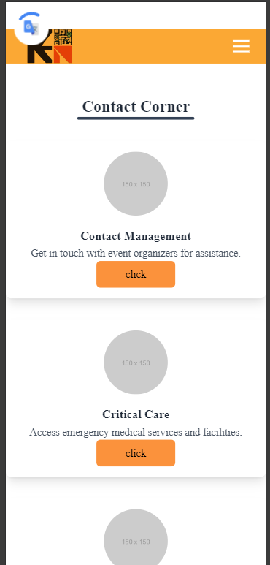
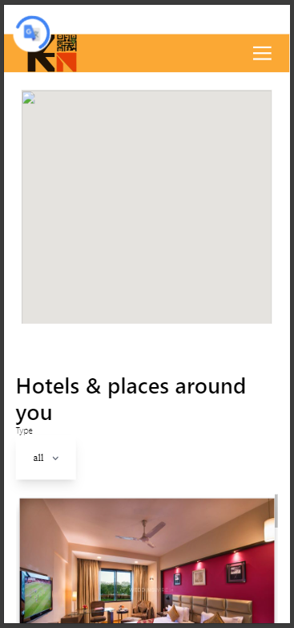
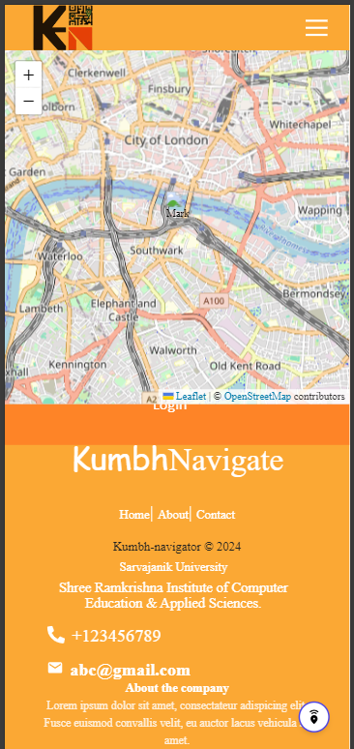
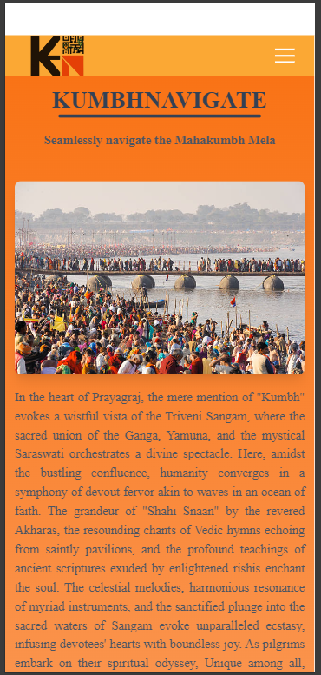
Design

Slide 5
Home Page:
User can discover everything happening at the Mahakumbh Mela in present time , including checking out the event schedule, familiarizing themselves with the dos and don'ts, and stay updated with real-time announcements as they dive into the Mela experience.
About Page:
Curious to learn more about this project and the team driving it , Explore the About Page to uncover the significance of our initiative and get acquainted with the passionate individuals dedicated to making your Mahakumbh journey unforgettable.
Navigate:
Feeling a bit disoriented amidst the vastness of the Mela grounds ? Navigate is your guiding compass. Click here to access the interactive map, effortlessly locating facilities, attractions, and event venues to ensure you never miss a moment of the action.
Translate Dropdown:
Language barriers shouldn't hinder your Mela experience. With the Translate Dropdown, choose your preferred language for real-time translation powered by Google Translate. Now, connect with fellow attendees and immerse yourself in the festivities with ease.
Place Route:
Ready to embark on an adventure within the Mela grounds? Place Route has got you covered. Simply select your desired destination, and I'll map out the quickest route to get you there, ensuring your exploration is as seamless as possible.
Workflow

Slide 6
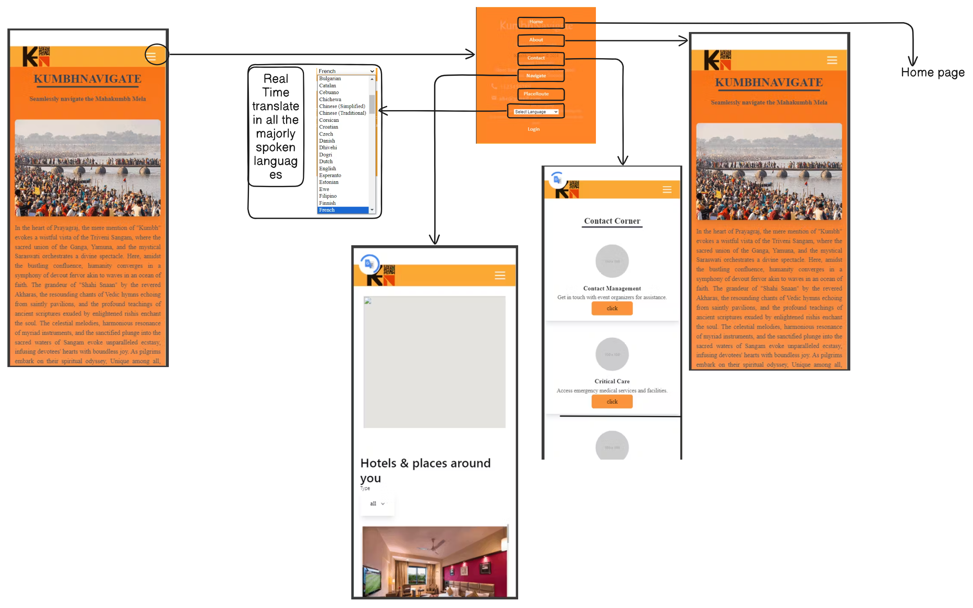
Model View

Slide 7
Write Conclusion……

Slide 8
Thank you!

