Slide 1

Benford’s Law Analysis on AQI Data of Indian Cities
Fundamentals of AI project
Submitted by: Sirex(A N Pavan Sai, Patel Parthkumar, Vidhit T S, Patel Harikrushn)
Date: 4th May 2025
Notes:
1

Slide 2
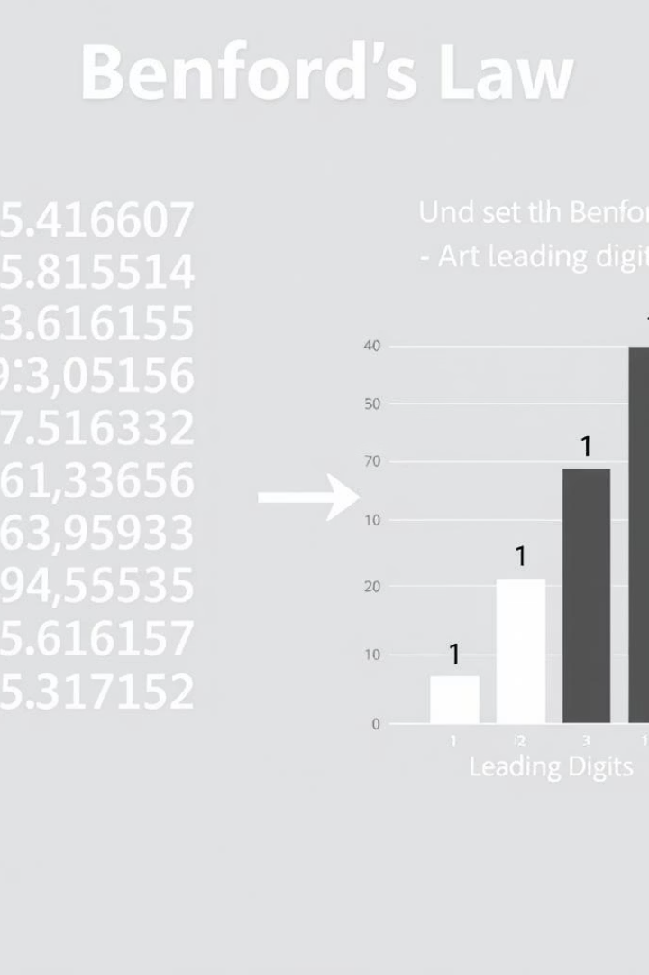
What is Benford’s Law?
Benford’s Law is a mathematical principle that predicts the frequency distribution of leading digits in naturally occurring datasets. According to this law, smaller digits occur as the first digit more often than larger ones.
Key Points:
The number 1 appears as the first digit about 30.1% of the time. Higher digits like 9 appear much less frequently, around 4.6%. It applies to datasets like population numbers, financial data, air quality, and more. Formula:
P(d) = log₁₀(1 + 1/d) where P(d) is the probability of digit d (1-9) appearing as the first digit.
Why It Matters: Benford’s Law is useful for:
Identifying natural data patterns Detecting anomalies or possible fraud Verifying authenticity in large datasets
Notes:
2

Slide 3
About the Dataset
📄 Dataset Overview:
📊 Attributes Used
Total Records: 3,168
📌 Focused Attribute:
Total Columns: 11 (including location data, pollutant measurements, and timestamps)
AQI values collected across various Indian cities
🌍 Geographic Coverage:
📄 Dataset Attributes (11 Columns):
Covers 255 unique cities
📍 Location Attributes:
Spans across 532 unique states
Data collected from 7 monitoring stations across India
country: Single value (India)
state: Geographic state location
💨 Pollutant Information:
city: City name
Tracks multiple pollutants such as NO₂, SO₂, and others
station: Monitoring station name
Contains min, max, and average pollutant values
latitude: Geographic coordinate
Includes 471 unique pollutant measurements
longitude: Geographic coordinate
📍 Location Data:
🕑 Time Attribute:
Records latitude and longitude coordinates for each monitoring station
last_update: Timestamp of measurements
Each station mapped to specific geographic locations
💨 Pollutant Measurements:
✅ Data Quality:
pollutant_id: Type of pollutant measured
All columns contain 3,168 non-null values after handling missing data
pollutant_min: Minimum reading
pollutant_max: Maximum reading
pollutant_avg: Average reading
Notes:
3

Slide 4





Methodology
Data Preparation & Cleaning
Selected AQI columns: pollutant_min, pollutant_max, pollutant_avg
Converted values to integers for consistency
Feature Extraction – First Digit
Extracted the first digit from each AQI value
Created new columns to store these first digits
Frequency Analysis – Observed Distribution
Calculated how often each digit (1–9) appears as the first digit
Normalized the frequencies for comparison
Theoretical Benchmark – Benford’s Distribution
Used the formula: log ⁡ 10 ( 1 + 1 d ) log 10 ​ (1+ d 1 ​ ) to compute expected frequencies for each digit
Visualization – Comparing Observed vs. Expected
Created grouped bar charts to visually compare observed vs. expected values
Tools: Python with NumPy,Pandas, Plotly
Notes:
4

Slide 5
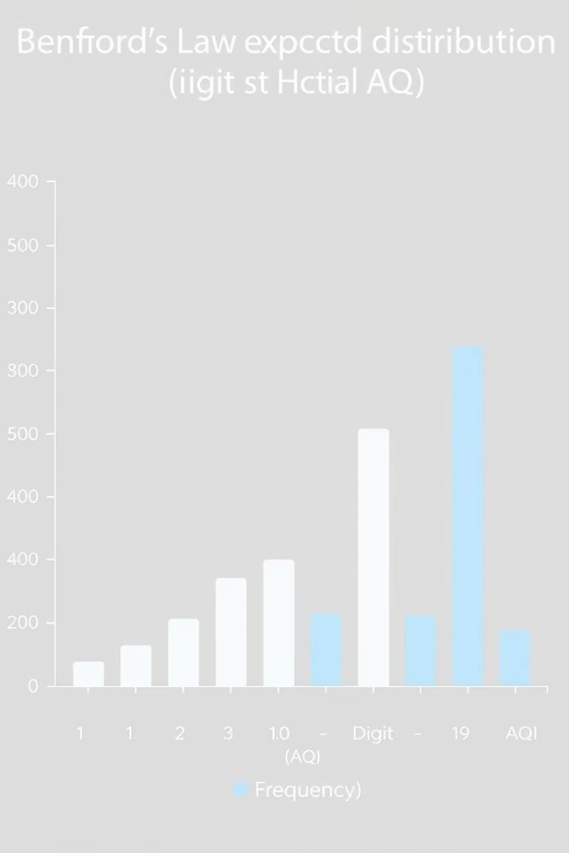
Expected vs Actual Distribution
Digit
Expected %
Actual %
1
30.1%
24.25%
2
17.6%
19.58%
3
12.49%
14.64%
4
9.69%
11.27%
5
7.92%
8.98%
6
6.69%
7.65%
7
5.80%
5.93%
8
5.12%
4.38%
9
4.58%
3.32%
Notes:
5

Slide 6
Insights & Interpretation
📊 Overall Fit
📊 Deviations & Observations
🔍 Fit Assessment:
⚠️ Moderate Deviations:
Moderate deviation overall — data isn’t a perfect fit but follows recognizable, systematic patterns
Data shows systematic deviations from Benford’s Law
📉 Key Deviations:
First Digit (1):
Digit 1: Largest under-representation (-5.85%)
Under-represented by -5.85%
Middle digits (2–6): Consistently over-represented
Expected: 30.10%, Actual: 24.25%
Digit 7: Nearly perfect fit (+0.13%)
Possible cause: Measurement thresholds or rounding practices
Digits 8 & 9: Slight under-representation
Middle Digits (2–6):
📌 Overall Summary:
Consistently over-represented
Moderate fit to Benford’s Law
Largest in digit 3 (+2.15%)
Systematic deviations suggest structured data collection
Suggests clustering in measurements
Some natural alignment, especially with digit 7
✅ Minor Deviations:
Digit 7:
Closest to expected value
Deviation: +0.13%
Indicates natural occurrence at this level
📊 Possible Causes
📊 Significance & Insights
🏙️ Data Collection Methods:
📍 Dataset Coverage:
Measurement equipment calibration ranges
3,168 records across 255 cities and 532 states
Rounding or truncation practices
Data from 7 monitoring stations, up to 2025
Standardized measurement protocols
📊 Data Quality:
🌿 Environmental Factors:
Complete, well-structured data with 11 attributes
Pollution level reporting thresholds
Consistent formats and accurate geographic coverage
Natural limits in pollutant concentrations
💨 Measurement Patterns:
Regulatory compliance targets
Tracks multiple pollutants (NO₂, SO₂, etc.)
⚙️ Technical Reasons:
Standardized min, max, avg readings at regular intervals
Instrument precision limits
📈 Benford’s Analysis Insights:
Systematic measurement intervals
Systematic deviation in digit 1 (24.25% vs 30.10%)
Data processing and cleaning methods
Middle digits over-represented
📌 Other Factors:
Digit 7 naturally aligned
Urban pollution clustering
🌏 Environmental & Analytical Value:
Seasonal variations affecting pollutant levels
Supports policy decisions and air quality monitoring
Enables trend analysis, geographic and temporal insights
Notes:
6

Slide 7
📊 Conclusion
AQI data shows a moderate fit with Benford’s Law, with systematic deviations
Highlights consistent measurement patterns likely due to reporting practices, environmental thresholds, and instrument constraints
Confirms hidden trends in air quality data distribution behavior
Demonstrates potential for using Benford’s analysis as a diagnostic tool for data quality assessment and anomaly detection in environmental monitoring
Notes:
7

Slide 8




Individual contributions
A N Pavan Sai
Patel Parthkumar
Patel HariKrushn
Vidhit T S
Data Preparation & Cleaning
Feature Extraction & Frequency Analysis
Benford’s Law Calculation & Visualization
EDA, Insights, Interpretation & Conclusion
Understand the dataset structure
Create a function to extract the first digit from each numeric value
Compute theoretical Benford’s Law distribution (log10(1 + 1/d))
Perform additional EDA:
Handle missing values / NaNs
Summary statistics of AQI data (min, max, avg values)
Convert data types as required
Calculate frequency of each first digit (1–9)
Compare observed vs expected frequencies
Ensure data is in clean, numeric format for analysis
City/state-wise AQI distribution
Normalize frequencies using relative proportions
Create grouped bar charts (e.g., with Plotly/Matplotlib)
Most/least polluted cities
Delivered: Cleaned, structured dataset ready for feature extraction
Identify key deviations and patterns from Benford’s analysis
Delivered: Observed frequency distribution of first digits
Highlight deviations
Delivered: Visuals comparing AQI data with Benford’s expected pattern
Create final PPT slides and compile the report/notebook
Delivered: EDA visualizations, insights summary, conclusion, and final presentation
Thank You*
Notes:
8

