Slide 1


ITMD 522 DATA MINING
FINAL PROJECT PRESENTATION

Slide 2
HEART DISEASE INDICATION USING CLASSIFICATION
By:
Group Number 389
Jay Gupta [A20499851]
Parth Nitin Ghatpande [A20501209]

Slide 3
ABSTRACT
Heart disease is one of the most common chronic diseases in the US, affecting millions of people annually and placing a heavy financial strain on the economy. Heart disease is the leading cause of death in the United States, taking around 647,000 lives each year. Larger coronary arteries becoming clogged with plaque, aging-related molecular changes, chronic inflammation, high blood pressure, and diabetes are all causes and risk factors for heart disease.
While there are various forms of coronary heart disease, most people don't become aware of their condition until they have symptoms like chest pain, a heart attack, or a sudden cardiac arrest. This information emphasizes the significance of preventative strategies and diagnostic procedures that can reliably identify heart disease in the population before adverse events like myocardial infarctions (heart attacks) occur.
Three major risk factors for heart disease have been recognized by the Centers for Disease Control and Prevention: smoking, high blood pressure, and high blood cholesterol. These three risk factors are present in at least half of all Americans. For doctors to employ in diagnosing coronary heart disease, the National Heart, Lung, and Blood Institute highlights a larger range of characteristics including age, environment and occupation, family history and genetics, lifestyle habits, other medical conditions, race or ethnicity, and sex. An initial review of these prevalent risk factors, followed by bloodwork and other diagnostics, usually serves as the basis for the diagnosis.
The aim of this project is to analyze this dataset to determine what factors and various health conditions of a patient would lead to heart attack.

Slide 4
DATASET INFORMATION
The dataset is related to the health care industry. A URL link that points to the Kaggle webpage from where dataset originates from, is shown below.
https://www.kaggle.com/datasets/alexteboul/heart-disease-health-indicators-dataset
The dataset consists of 253680 observations and 22 attributes.
HighBP, HighChol, Smoker, Stroke, Diabities, GenHealth,PhysHealth, DiffWalk, Age, and Income are some of the attributes to predict the label.
HeartDiseaseorAttack is the target variable and it has two classes for prediction within the target variable.
Within the target variable HeartDiseaseorAttack, where 0 represents that a person doesn’t have a heart disease or didn’t have an attack, and 1 represents that a person has a heart disease or had a heart attack.

Slide 5
RESEARCH PROBLEM
With diabetes being one of the most prevailing diseases amongst humans, We have considered our research problem to identify which individual is more likely to get diabetic based on various attributes such as HighBP, HighChol, Smoker, Stroke, Diabities, GenHealth,PhysHealth, DiffWalk, Age, Income, etc.
In order to achieve the expected results, we have applied five Data Mining tasks associated with supervised learning and one with unsupervised learning.
We have made use of classification techniques like KNN, Naïve Bayes, and SVM to identify and predict the label based on the observations we have made from the training data set and Naïve Bayes because of its advantages in a medical fields. We have used hold-out method for evaluation.
We have also made use of techniques like Decision Tree since it runs on every instance perfectly calculating the entropy resulting in intuitive classification and Logistic Regression since it helps find relationships between variables.

Slide 6
DATA PREPROCESSING
Initially we started by eliminating null values within all the attributes. Since the dataset that we have chosen consists of numeric attributes. Null values are replaced by the mean value of the attribute.
Since some attribute values have greater values and this would affect the result and the accuracy of the algorithms, we have normalized the data and organized the data in the scale of 0 to 1, also because most of the features ranged from 0 to 1.
Later, we encoded the data for the label and then performed feature selection to find the best features that can cause a heart attack.
Then we performed splitting on the dataset using train test split so that we can perform all the selected models using hold-out evaluation.

Slide 7
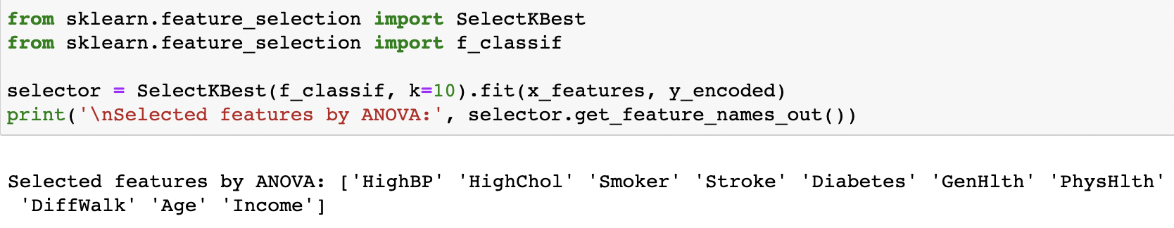
FEATURE SELECTION
We have used feature selection to find out the most relevant and import features which can lead to a heart attack.
After finding the best features, we created a new dataframe with the top 5 features out of all the features we got as a result of feature selection.

Slide 8
LOGISTIC REGRESSION
Logistic Regression model is a concept of linear classification model associated with supervised learning.
Logistic Regression is useful in finding relationships between variables. And is mainly used for this dataset to classify whether a patient is not diabetic, patient is prone to be diabetic, patient is diabetic.
This technique is also very beneficial in medical diagnostics.
In order to achieve the results once logistic regression is applied, we have Preprocessed, normalized and converted nominal data into numeric data which is required for logistic regression.

Slide 9
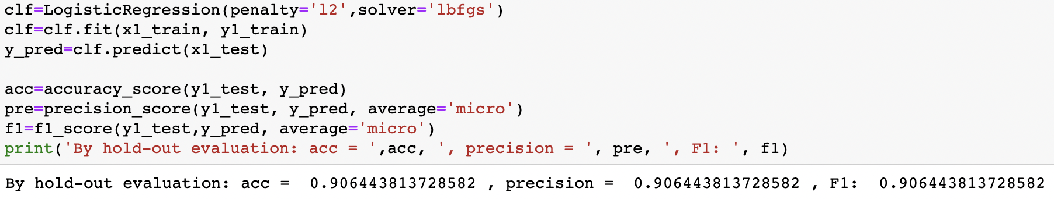
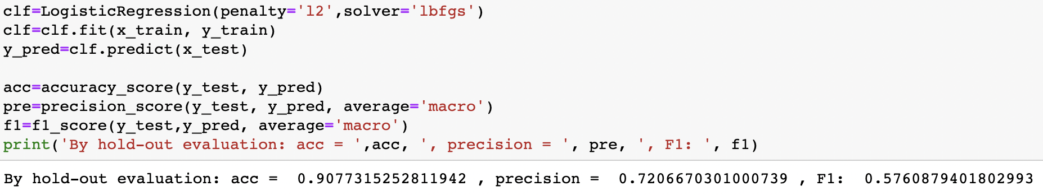
LOGISTIC REGRESSION OUTPUTS
With Feature Selection:
Without Feature Selection:

Slide 10
SVM
Support Vector Machine, sometimes known as SVM, is a linear model used to solve classification and regression issues. It works well for many real-world issues and can solve both linear and non-linear problems. The SVM concept is straightforward: A line or a hyperplane that divides the data into classes is produced by the algorithm.
Finding a dividing line (or hyperplane) between the data of two classes is, in general, what SVMs perform. The SVM algorithm takes the data as input and, if it is possible, outputs a line that divides the classes.
We locate the points from both classes that are closest to the line using the SVM technique. Support vectors are the names for these points. The distance between the line and the support vectors is now calculated. The margin refers to this separation. Maximizing the margin is our aim. The best hyperplane is the one for which the margin is greatest.
As a result, we can categorize data by giving it an additional dimension so that it can be linearly separated, and then using mathematical transformation to project the decision boundary back to the original dimensions. But it's not always simple to identify the right transformation for a particular dataset. Thankfully, sklearn's SVM implementation allows us to accomplish this using kernels.

Slide 11
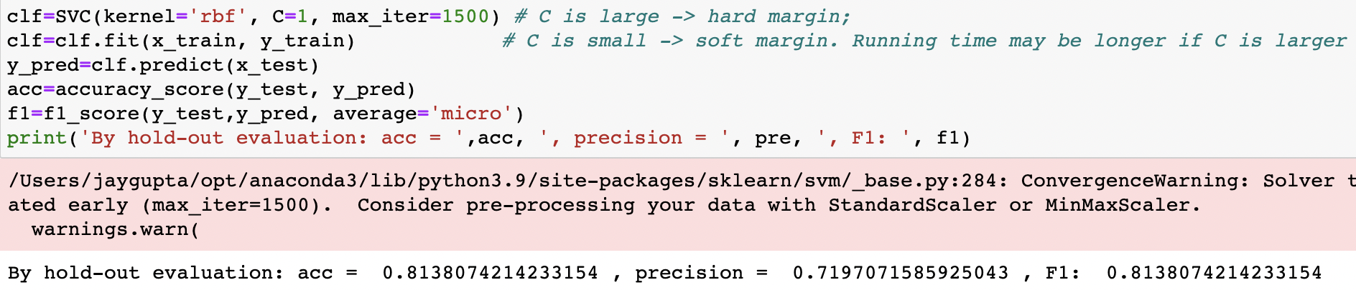
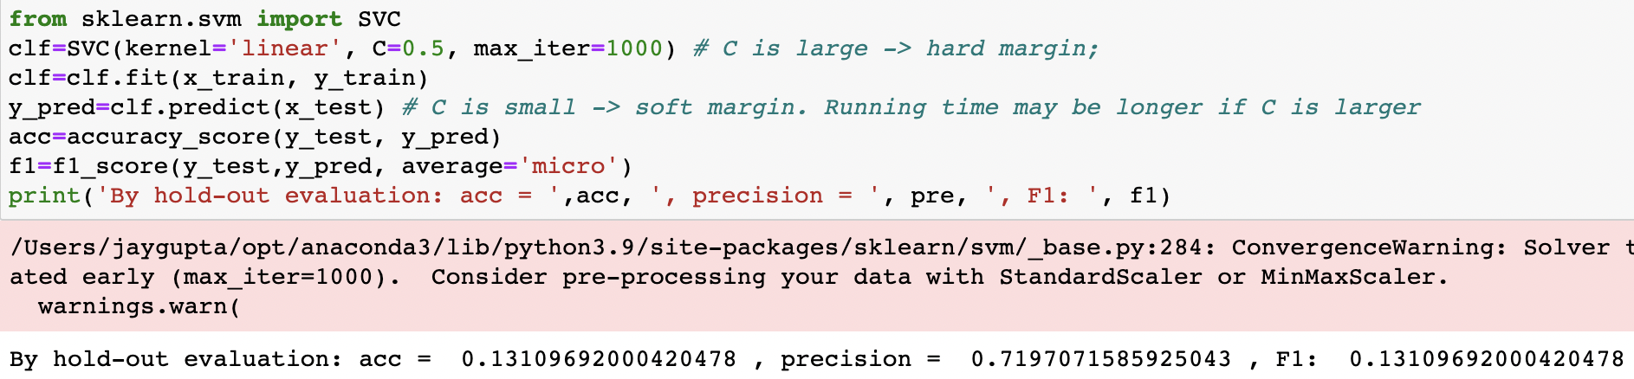
SVM OUTPUTS
With Feature Selection:
Without Feature Selection:

Slide 12
KNN CLASSIFICATION
K-Nearest Neighbor (KNN) classification is a data mining task used for supervised learning where in the minimum distance of object can be found by making use of the objects in the training dataset to predict the label. Odd numbers are recommended to be given as the values for K to arrive at the most accurate results.
Since conversion of nominal data to numeric data is required for KNN classification we have preprocessed and normalized the data.
KNN classification is used to predict the label of the observation data with the observations present in the training dataset which has minimum distance.
After various evaluations we observe that K=9 with metrics like weights='distance’, p = 2, algorithm = 'kd_tree’ is giving the best accuracy for N-fold evaluation.

Slide 13
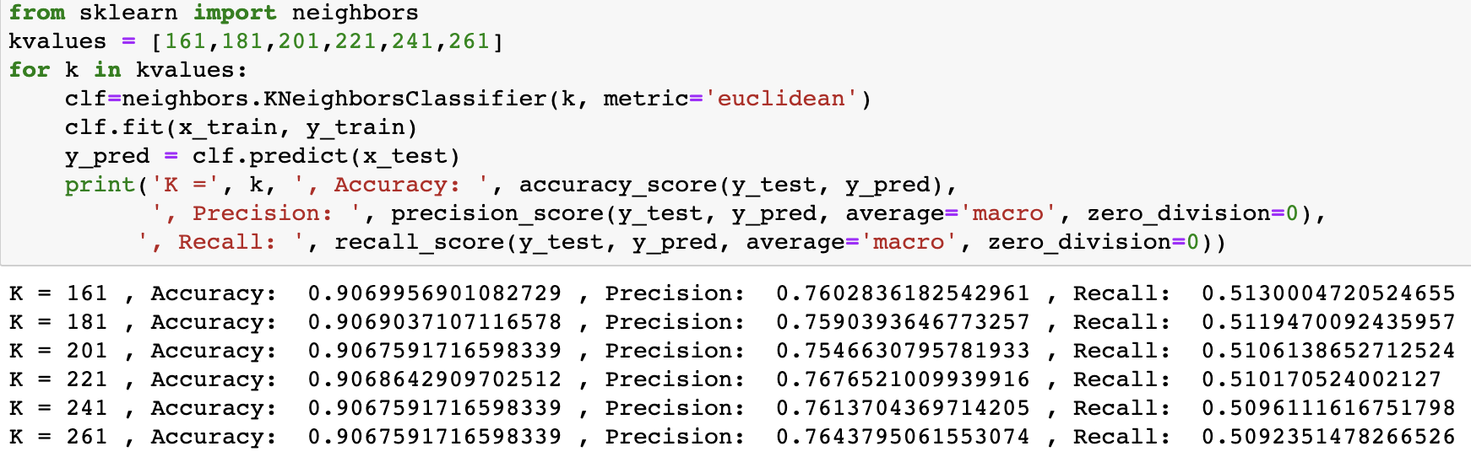
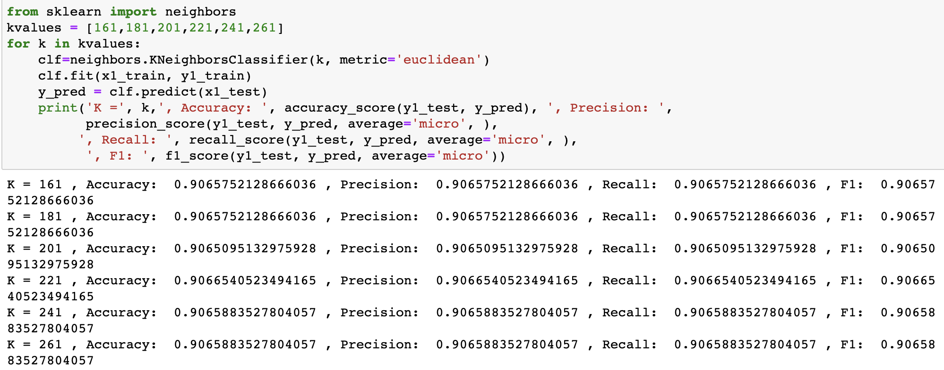
KNN OUTPUTS
With Feature Selection:
Without Feature Selection:

Slide 14
DECISION TREE
Decision Tree classification are the techniques in which we build a tree structure based on Training Data set and then we can predict the label based on the tree. Information Gain and Entropy were the key components for forming the tree because using these we will be able to decide Root Node and Branches.
Preprocessing and conversion of numeric data to nominal Data is required for Decision Tree.
We used Decision Tree classification to predict the label of the observation with the observations present in the training dataset.

Slide 15
DECISION TREE
After evaluations we observe that with metrics like criterion='entropy', max_depth=2500000, ccp_alpha = 0.01, random_state = 1 is giving the best accuracy for Hold-out evaluation.
As we are getting best accuracy in hold-out evaluation in comparison to all the algorithms, we tried to gain more accuracy by applying hyper parameter tuning to check more parameters which can give better accuracy.
However, once hyper parameters was applied to the data, tuning the accuracy of the hold-out decreased.

Slide 16
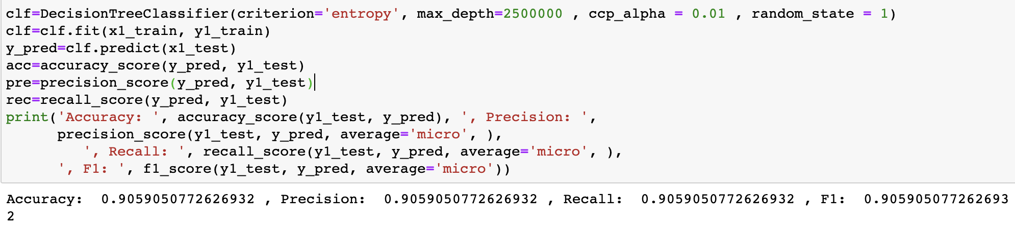
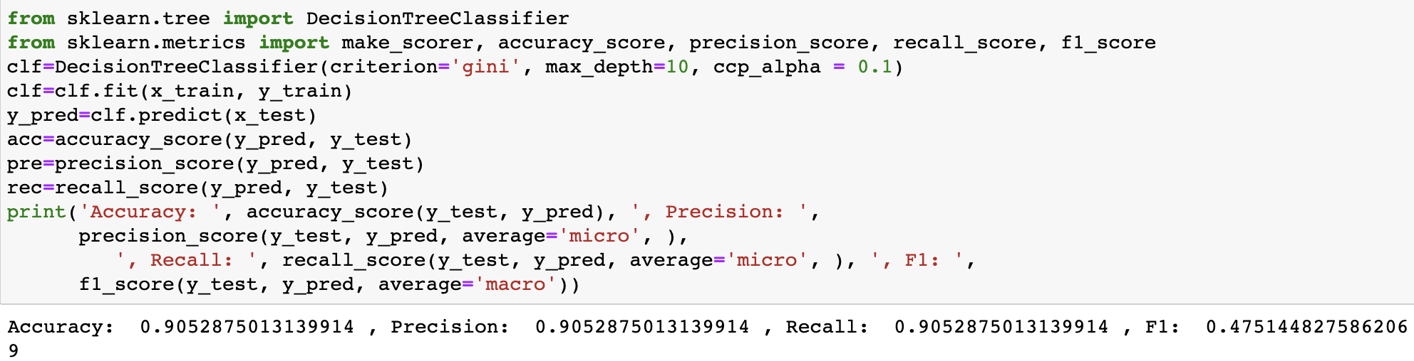
DECISION TREE OUTPUTS
With Feature Selection
Without Feature Selection

Slide 17
NAIVE BAYES CLASSIFICATION
Naïve Bayes classification is a technique which is primarily based on Probability. It works based on conditional probability to predict the label and Naïve Bayes is very useful for medical detection.
Preprocessing and conversion of numeric data to nominal data is required for Naïve Bayes classification.
We used Naive Bayes classification to predict the label of the observation with the observations present in the training dataset which has maximum probability.
After evaluations we observe that Multinomial Naïve Bayes gives the best results.

Slide 18
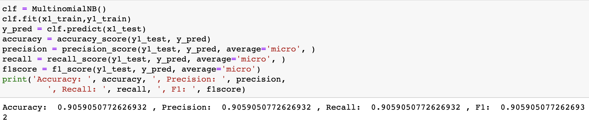
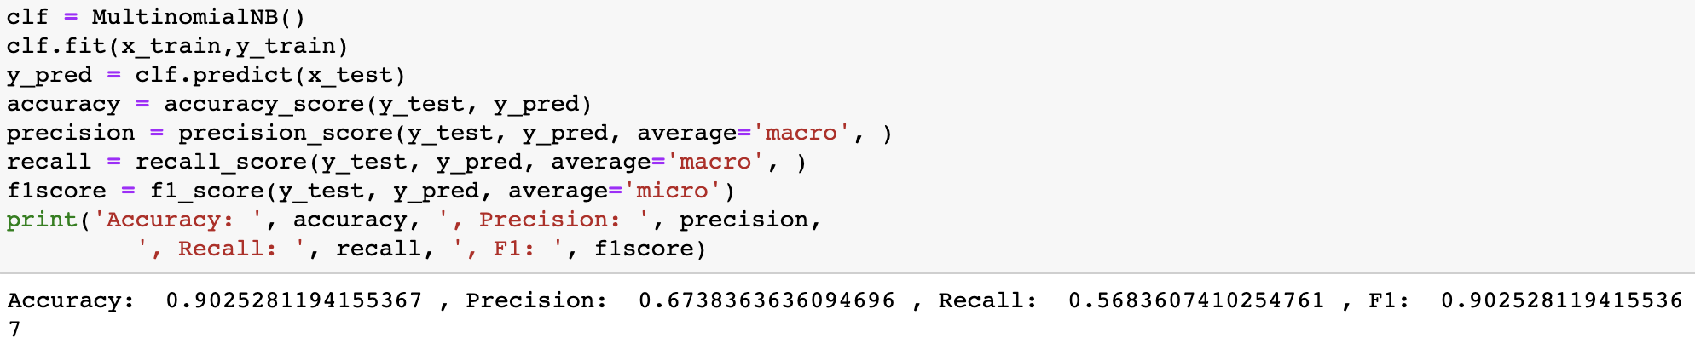
NAÏVE BAYES OUTPUTS
With Feature Selection
Without Feature Selection

Slide 19
NEURAL NETWORKS
A neural network is a collection of algorithms that aims to identify underlying links in a set of data using a method that imitates how the human brain functions. In this context, neural networks are systems of neurons that can be either organic or synthetic in origin.
Deep learning algorithms use neural networks that have multiple process layers, or "deep" networks. Doctors can use artificial neural networks as a potent tool to model, evaluate, and make sense of complex clinical data in a variety of medical applications. Artificial neural networks are used in medicine primarily to solve classification issues.
A computational model known as an artificial neural network (ANN) aims to explain the human brain's parallel structure. It is a network of parallel, densely interconnected processing units (neurons). The biological nerve systems are the inspiration for these elements.
Artificial neural networks and computer-aided diagnosis with deep learning are particularly active research areas in medicine right now, and it's anticipated that these systems will be employed more frequently in biomedical systems. Since they are excellent at identifying disorders from scans, evolving neural network techniques for medical diagnostics are frequently taken into consideration. For instance, using ANN models based on deep learning helps with the sensitive and specific early diagnosis of stomach cancer. Deep learning-based ANN model improvements enable diagnosis with efficacy, accuracy, and dependability. The use of other developing technologies in this area is essential for better diagnosis and has a big impact on treatment and preventive actions.

Slide 20
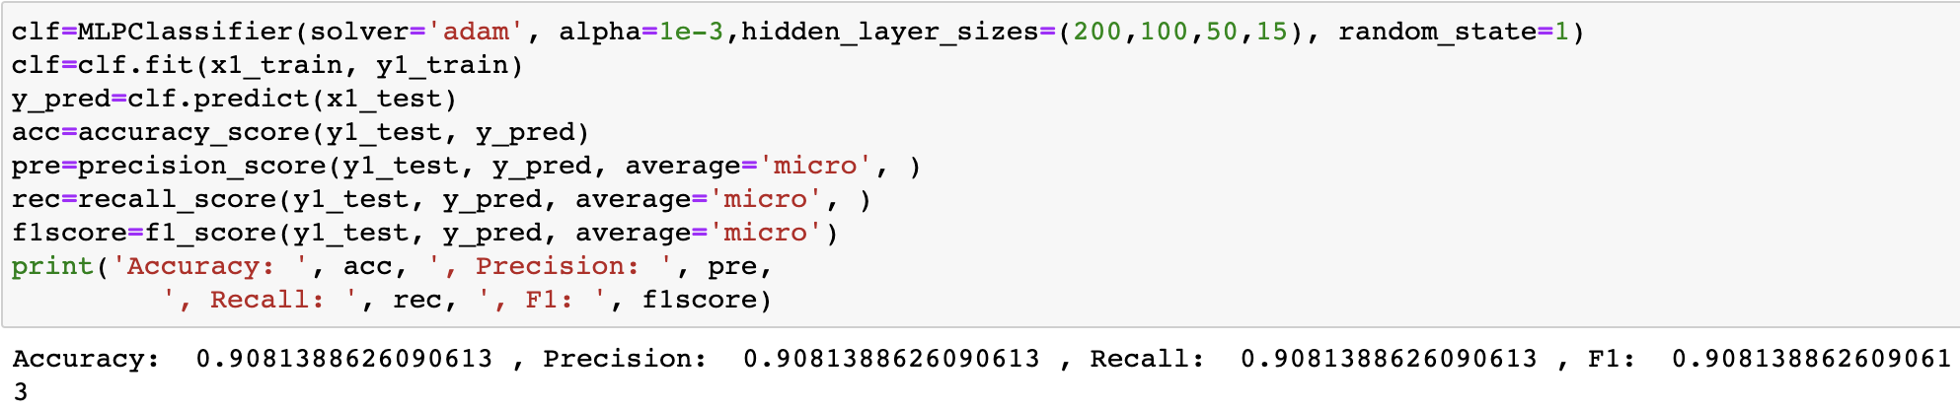
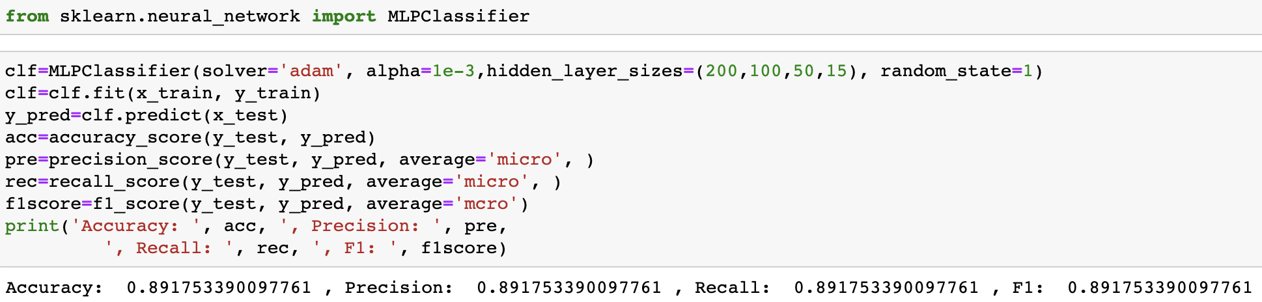
NEURAL NETWORKS OUTPUTS
With Feature Selection
Without Feature Selection

Slide 21
EVALUATION RESULTS
S NO | Method | Accuracy | Precision | Recall | F1 Score
1 | Logistic Regression | 90.8% | 90.8% | 90.8% | 90.8%
2 | SVM | 81.8% | 54.2% | 55.6% | 81.8%
3 | KNN | 90.8% | 79.6% | 51.5% | 90.2%
4 | Decision Tree | 90.5% | 90.5% | 90.5% | 90.5%
5 | Naïve Bayes | 90.5% | 67.3% | 56.8% | 90.5%
6 | Neural Networks | 90.8% | 90.8% | 90.8% | 90.8%

Slide 22
CONCLUSION
We are getting higher accuracy for each classification model after using the best selected features.
After comparison with all the classifiers Neural networks is giving the highest accuracy for predicting the label of the target variable.

Slide 23
FUTURE WORK
We would also what to collect data and apply the data mining tasks to look at the adverse effects of diabetic drugs on patients since, drugs prescribed vary from patient to patient.
With heart attack being a genetic disease, It is also important that we also consider genomic data.
In future, we can expand this project to collecting and performing extensive analysis on genomic data of patients with this project to generate insights on the various relatable attributes and lifestyles of a patient’s family.

Slide 24
THANK YOU

