Slide 1
Codificación De Riot
Prepared By:
Parth Parmar
Renish Antala
Bhargav Vasani

Slide 2
Index
Abstract
Advantage of Riots
Limitation of Riots
Images of Riots
Conclusion

Slide 3
Introduction
‘Riots’ is an android application. The purpose of the project is to develop an application which will enable user to view news details, images, and video of World.
That what type of things are happening and what is the reason behind that outcomes. What are the actual government step are taken related that News.
This application helps the local public to keep themselves up to date about the happenings around their vicinity or locality or in Different Countries.
Riots app will display the current situation in World. It also display the list of different activities held in World ‘Categories’.

Slide 4
Advantage of Riots
‘Riots’ application is most usefully for the Locals to get aware about the current situation are going around them.
The user is updated with every News going around Countries.
Application is developed for the youth to acknowledge the role of them to take parts in different activities e.g., Protests, Donations, Get-together's etc .
User can also insert their point of view for things happening around ‘News’.

Slide 5
Limitation of Riots
It requires an active internet connection.
The user can view the news with limited Categories.
The application is only for local to aware about current affairs. It will not display any detailed News.

Slide 6
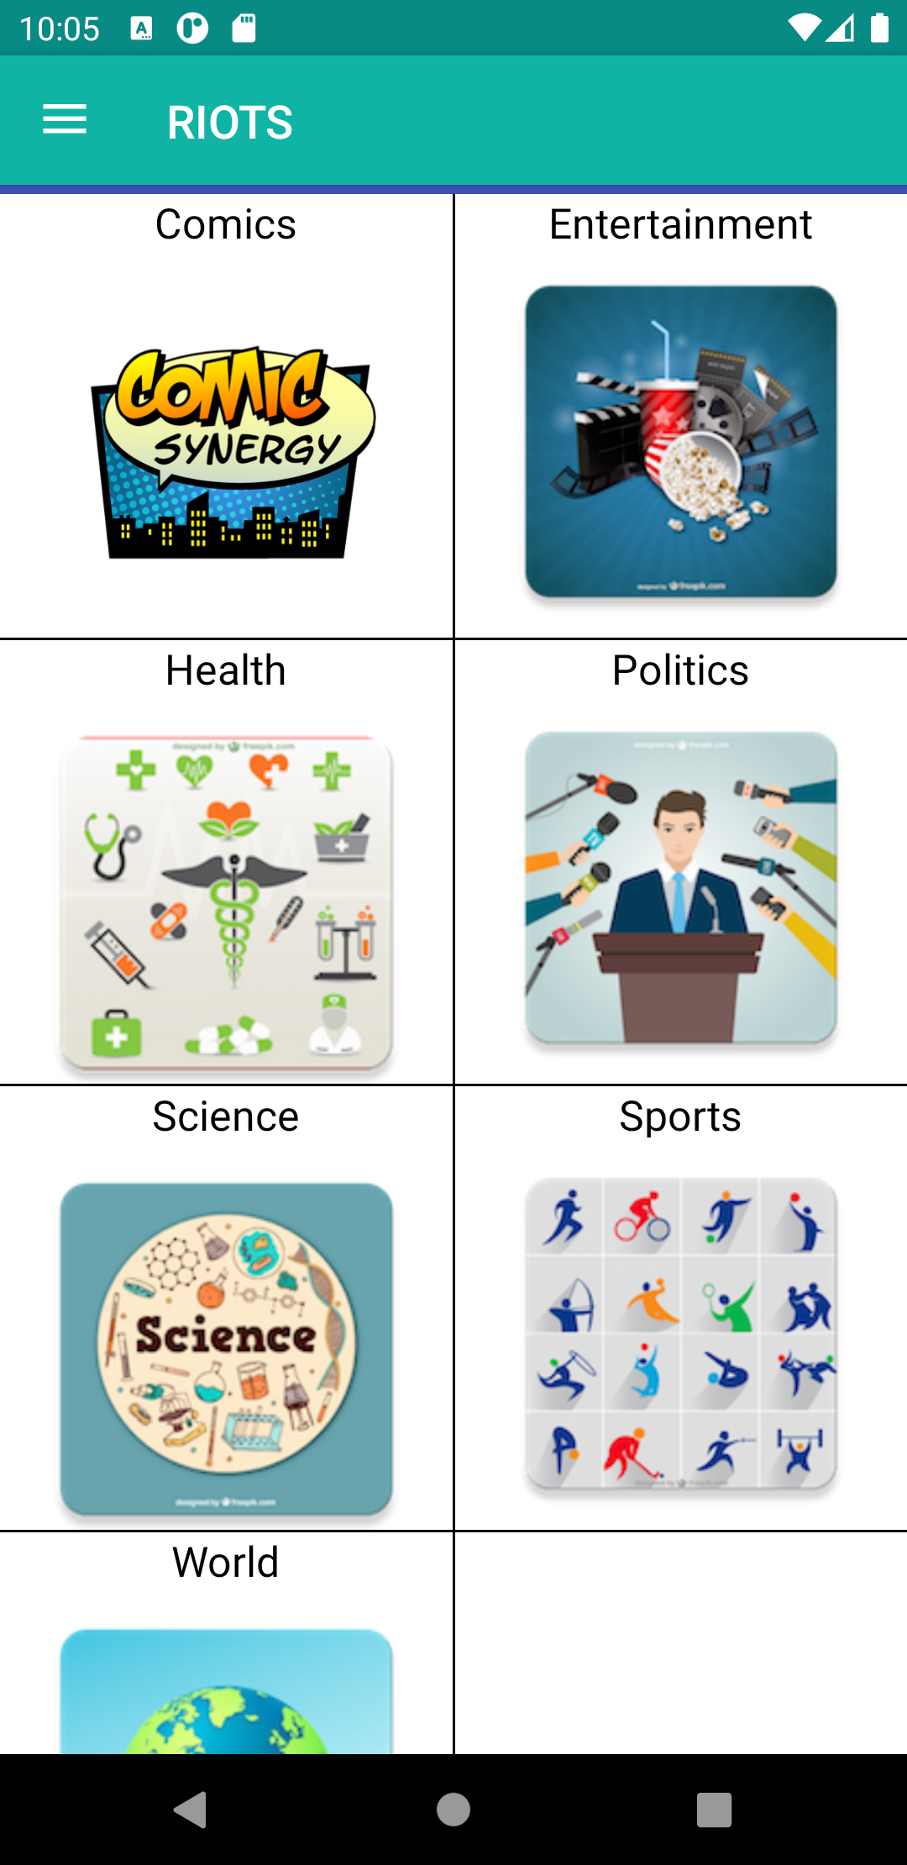
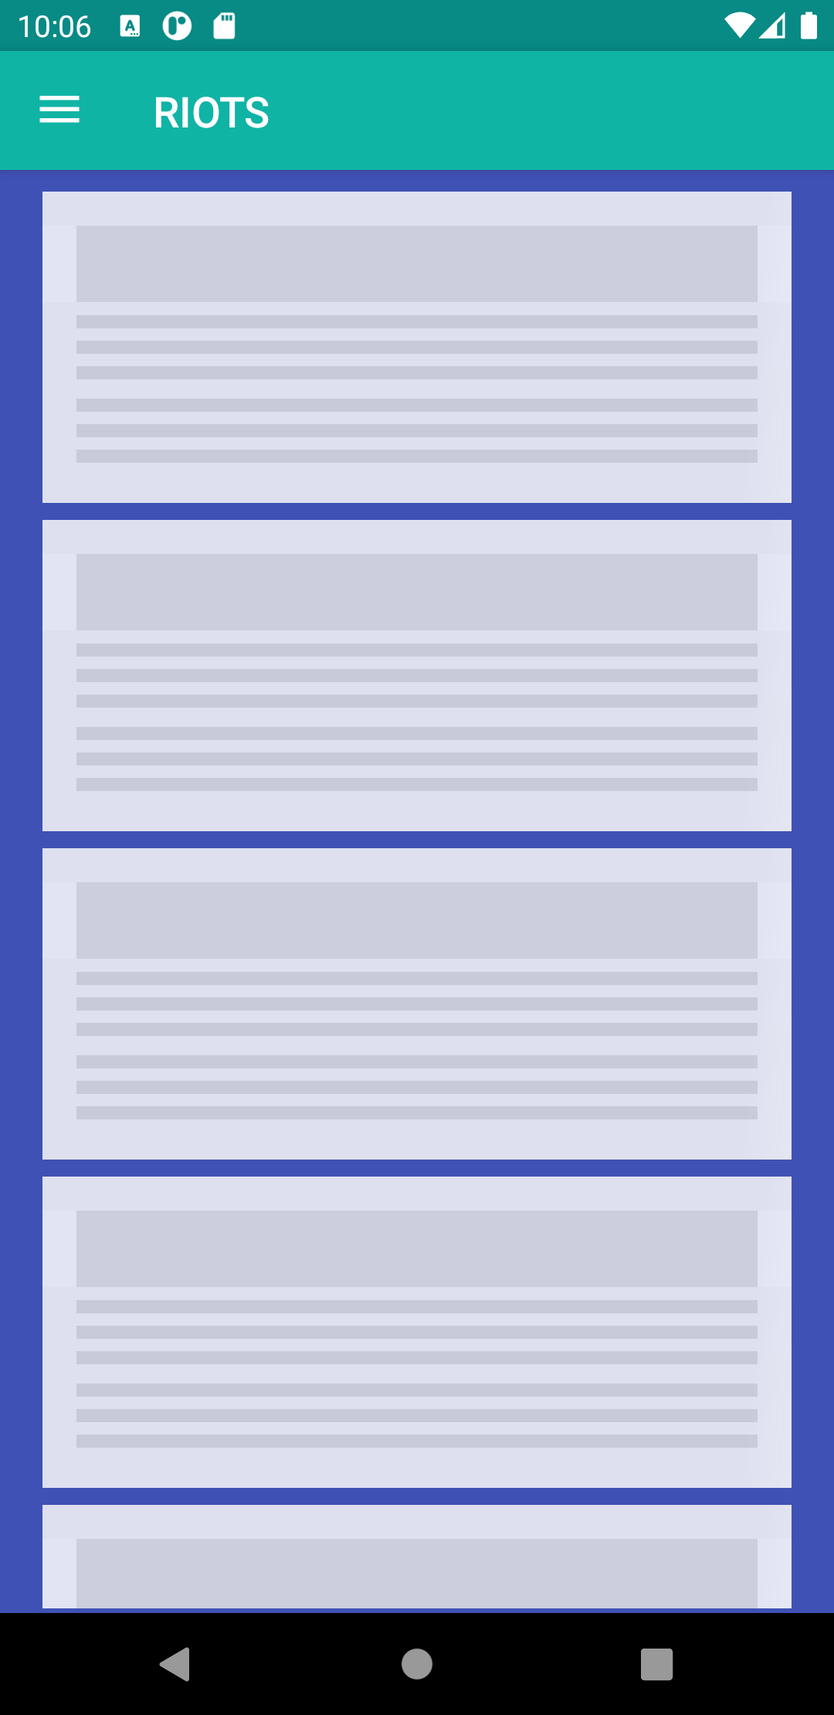
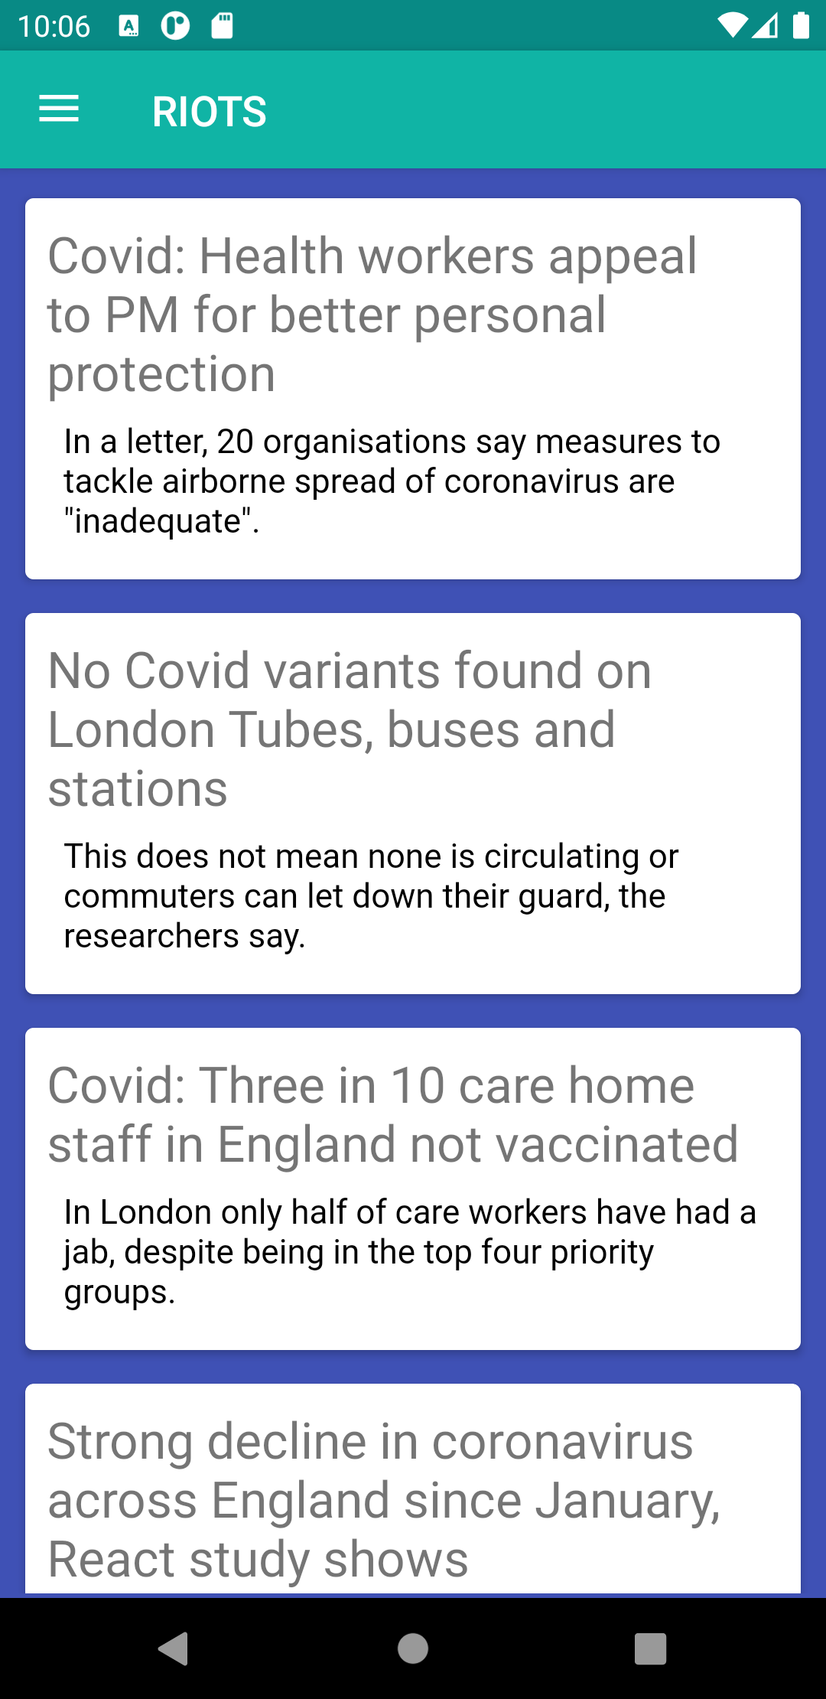
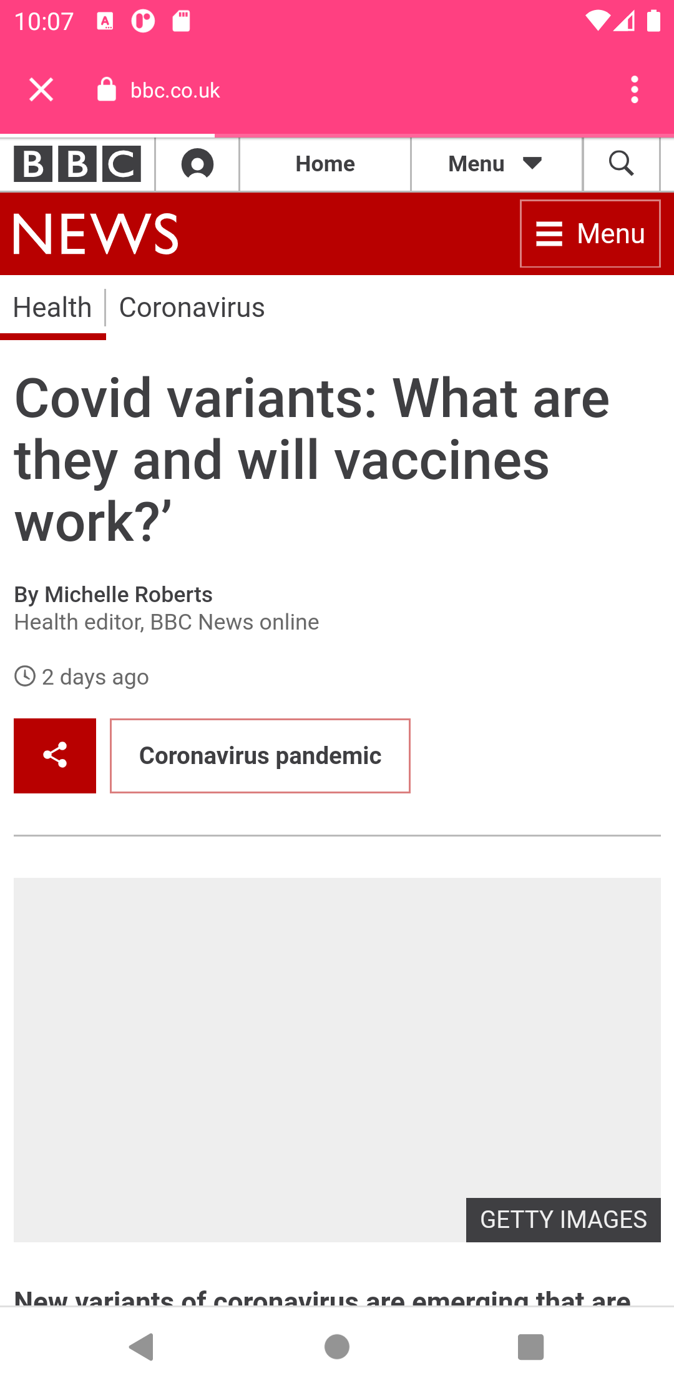
Images

Slide 7
Conclusion
Basically, the main purpose of behind the application for to do awareness in their countries. People know what happing in the countries and what is the role of them. And it also give their view about the affaires held in World.

Slide 8
THANKYOU

