Slide 1

FraudShield AI
Financial Fraud Detection Web Application
IBM Project Evaluation Presentation
Presented by
Core Idea
Parth S. Mishra
Analyze transaction behavior, score fraud probability with LightGBM, and combine it with balance-consistency rules for a practical decision.
Roll No: BT24DSL25
Guide: Dr. Manisha Bharati
Evaluation focus: Overview, methodology, output, conclusion
Tools used: Python, Streamlit, Scikit-learn, LightGBM, Plotly
FraudShield AI | IBM Project Evaluation Deck
01

Slide 2




PROJECT OVERVIEW
The project addresses a real fraud detection problem where fraud cases are rare, but the cost of missing them is high.
FraudShield AI combines analytics, machine learning, and rule validation into one local web application.
Why this project matters
What FraudShield AI delivers
Digital payment systems generate huge transaction volumes every day.
Interactive analytics dashboard
Model diagnostics and feature importance
Traditional rule-based systems miss new fraud patterns or create too many false alarms.
Manual verification is slow and does not scale well.
Real-time single-transaction scoring
CSV fraud report export for review
Fraud screening needs both high sensitivity and understandable output.
FraudShield AI | IBM Project Evaluation Deck
02

Slide 3
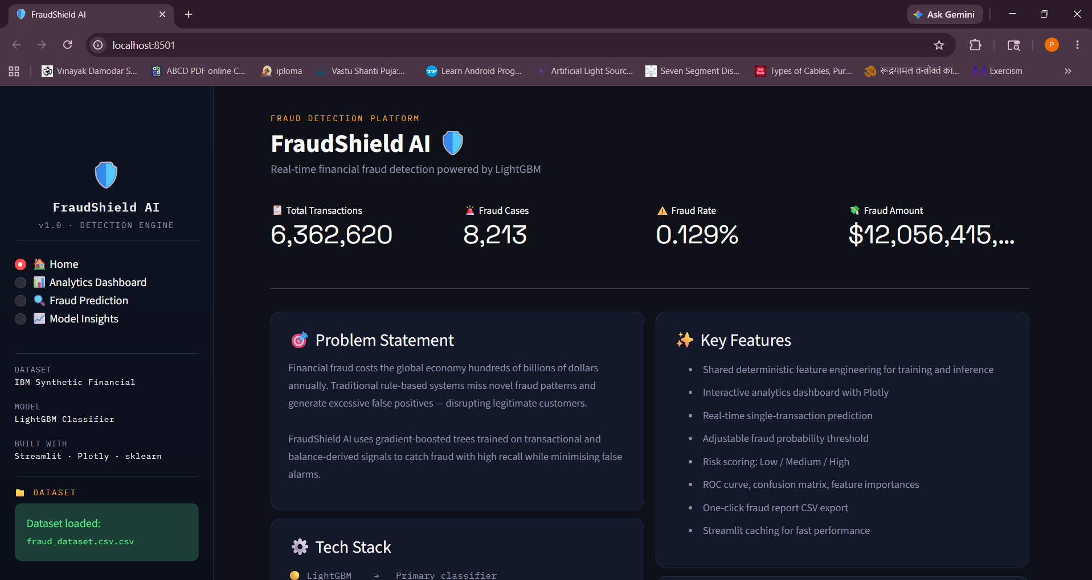
SYSTEM ARCHITECTURE
The system follows a clean flow from dataset to prediction output.
Source code is now separated into src/, data/, models/, and docs/ for a professional project structure.
Execution flow
1. Load CSV transaction data from data/fraud_dataset.csv
2. Clean records and engineer fraud-sensitive features
3. Preprocess data using scaler + encoder pipeline
4. Score transactions using calibrated LightGBM model
5. Apply rule-based balance consistency checks
6. Show dashboard, insights, and live prediction result
FraudShield AI | IBM Project Evaluation Deck
03

Slide 4
METHODOLOGY
The methodology is an end-to-end ML pipeline with shared preprocessing between training and inference.
This reduces mismatch between what the model sees during training and what the app sends during prediction.
01
02
03
04
05
Data Cleaning
Feature Engineering
Preprocessing
Model Training
Decision Policy
Remove duplicates, handle missing values, drop unused flag column.
Create time, balance, ratio, discrepancy, and log-amount features.
Scale numeric fields and encode transaction type using a unified transformer.
Train LightGBM with class imbalance handling and calibration split.
Use recommended threshold and hard rule checks before final verdict.
Important engineered features
hour_of_day | day_of_week | is_weekend | is_night | orig_balance_ratio | dest_balance_ratio | balance_discrepancy_orig | balance_discrepancy_dest | log_amount
FraudShield AI | IBM Project Evaluation Deck
04

Slide 5



MODEL LOGIC
The project does not rely on a model alone; it combines ML scoring with calibrated probability and rule-based validation.
This makes the output more practical for fraud review because impossible balance transitions can be flagged directly.
Model
Probability
Rule Engine
LightGBM classifier
Sigmoid probability calibration
Checks sender and receiver balance consistency
Handles nonlinear fraud patterns
Recommended threshold: 0.4917
Flags impossible transaction states
Trained with class imbalance weighting
Review band for borderline cases
Overrides model when hard rules trigger
FraudShield AI | IBM Project Evaluation Deck
05

Slide 6

APPLICATION OUTPUT
The web application turns the model into an interactive project that is easy to demonstrate during evaluation.
The app is built in Streamlit and organized into four pages for analysis, prediction, and interpretation.
Home
Analytics Dashboard
Project summary, KPIs, tech stack, and navigation overview.
Filtered charts, fraud trends, heavy-chart lazy loading, and CSV export.
Fraud Prediction
Model Insights
Manual transaction entry, fraud probability, risk level, and rule-trigger details.
Accuracy, recall, ROC-AUC, confusion matrix, threshold, and feature importance.
Demo flow in evaluation: open dashboard -> explain filters and charts -> enter sample transaction -> show final fraud decision -> open model insights for metrics.
FraudShield AI | IBM Project Evaluation Deck
06

Slide 7
RESULTS / OUTPUT
The current saved model strongly prioritizes recall, which is suitable for fraud screening where missing fraud is expensive.
All values below are taken from the current models/metrics.pkl artifact in this project.
0.9988
0.5198
0.9586
0.6741
0.9858
0.4917
Accuracy
Precision
Recall
F1-score
ROC-AUC
Threshold
Confusion Matrix
Key Interpretation
True Negative
1,269,426
False Positive
1,455
• High recall means the system catches most fraudulent transactions.
• Precision is lower, so some legitimate cases may still be flagged.
• This tradeoff is acceptable in fraud screening because false negatives are riskier than false positives.
• The review band and hard rules improve practical decision-making in the live app.
False Negative
68
True Positive
1,575
FraudShield AI | IBM Project Evaluation Deck
07

Slide 8
CONCLUSION
FraudShield AI demonstrates a complete and practical fraud detection workflow from raw data to explainable decision support.
It is an academic prototype, but the design is modular enough to extend toward real-world deployment.
Final conclusion
Future scope
The project integrates analytics, machine learning, and a usable front end.
• Connect to live banking or payment APIs
• Add authentication and analyst workflows
• Support batch scoring and alert generation
• Add SHAP-based explainability
• Add automated retraining and drift monitoring
It uses feature engineering and calibrated LightGBM scoring for fraud prediction.
It improves practicality by adding hard rule checks for impossible transactions.
The updated folder structure makes the project easier to maintain and present.
Thank you
Questions and discussion
FraudShield AI | IBM Project Evaluation Deck
08

