Slide 1
Movie Ticket Booking Management system
BY : -
Parth Makwana(202219004)
Ganesh (20221927)

Slide 2
Modules
Movies
Product Of The System
User
Admin
User Is The Targeting Audience
Operator or Administrator

Slide 3
Topics Covered
While Loop
DDL(Postgresql)
Files
Class
Python API
For Loop
DML(Postgresql)
Function

Slide 4
Admin Interface components
1
3
See User Info.
Change Seat layout
2
Statistics About Ticket booking

Slide 5
User Interface components
User Id Creation By Signup
1
Password Protected Login
2
Chack Released Movies
3
Hall Seating Arrangements
4
Book Tickets
5
Conformation Of Ticket
With Ticket Number
6
Ticket Cancellation
7

Slide 6
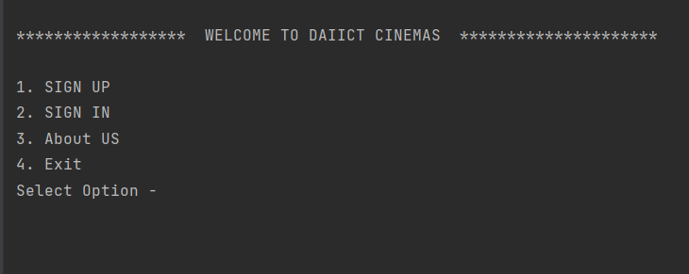
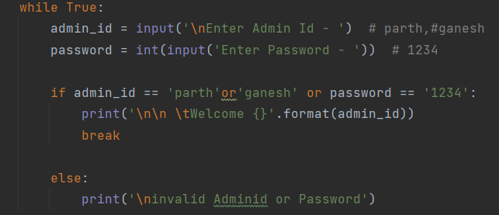
Opening Interface

Slide 7
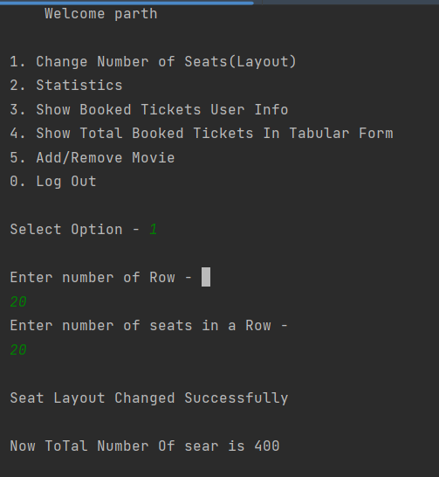
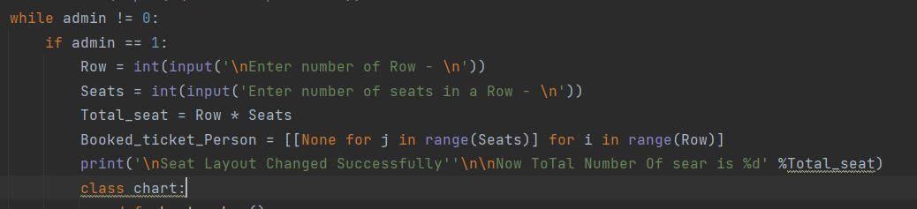
Admin Interface(Layout Change)

Slide 8
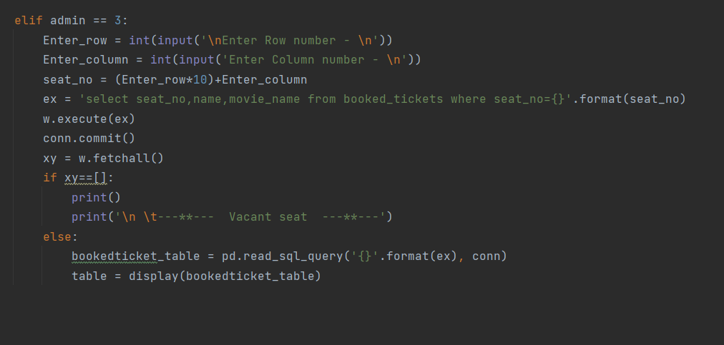
Admin Interface(Booked Ticket Info)

Slide 9
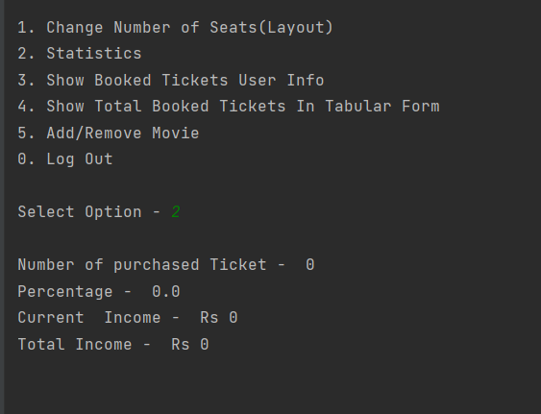
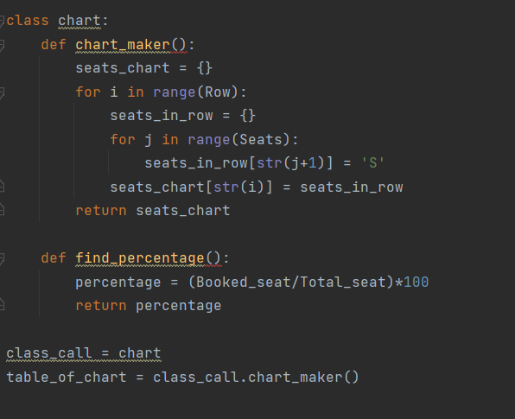
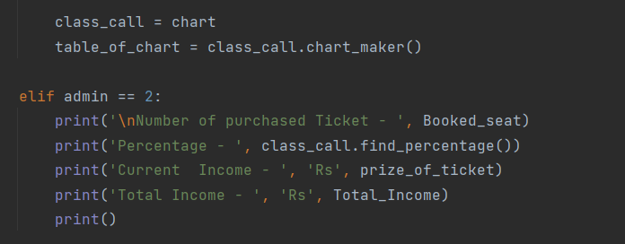
Admin Interface(Ticket Statistics)

Slide 10
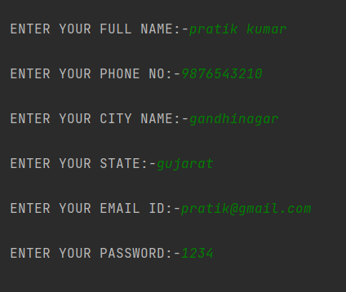
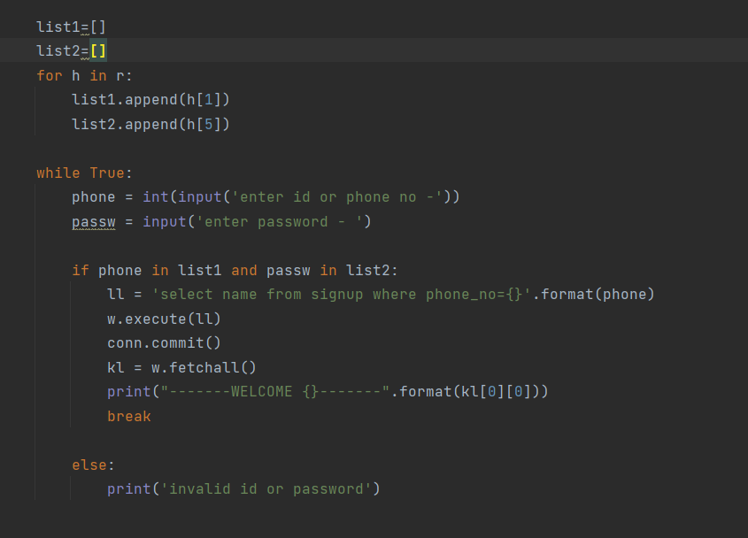
User signup

Slide 11
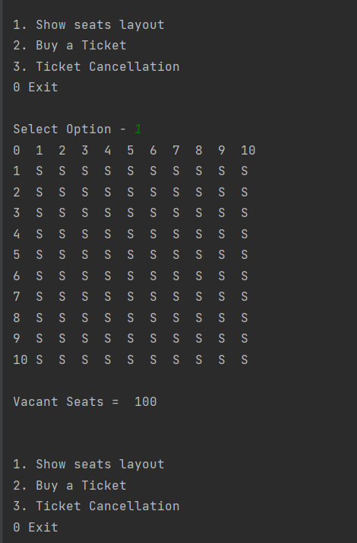
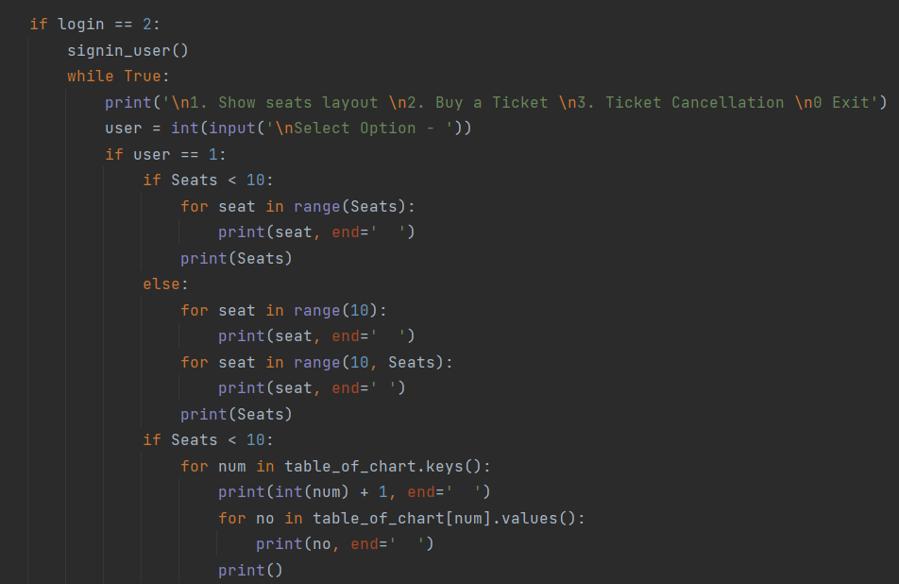
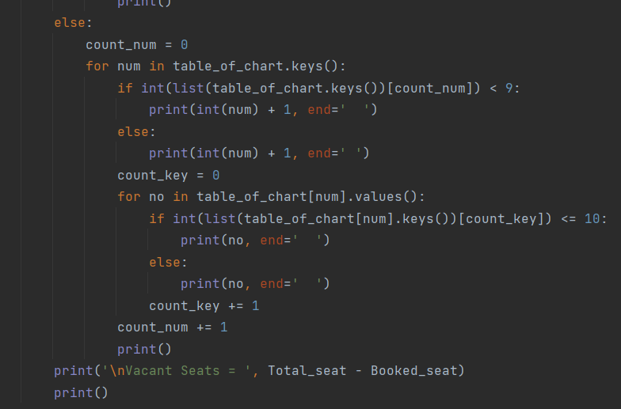
User Interface (Seat Layout )

Slide 12
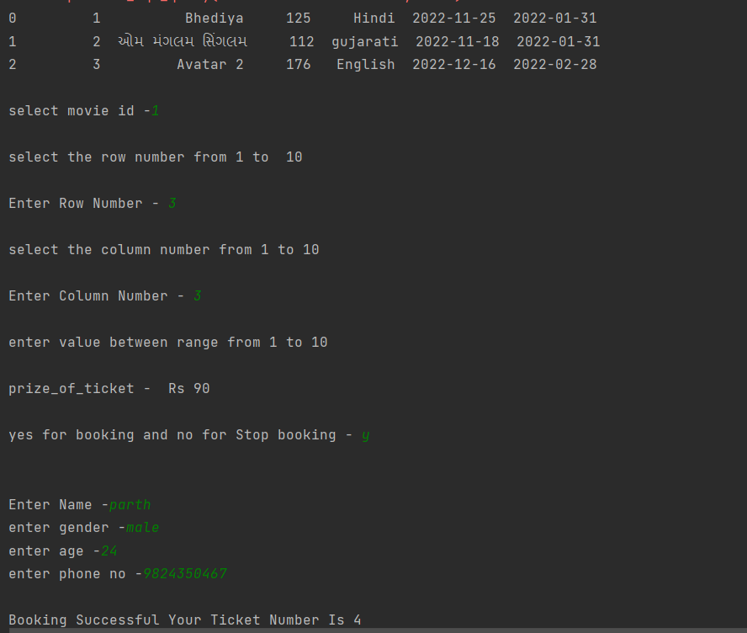
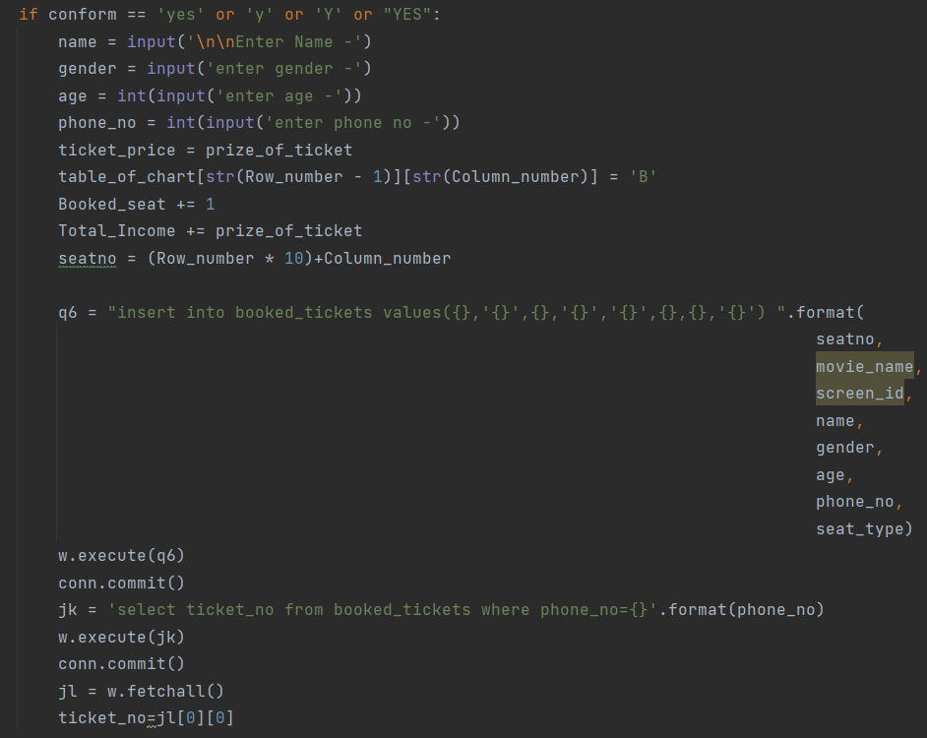
User Interface (ticket booking )

Slide 13
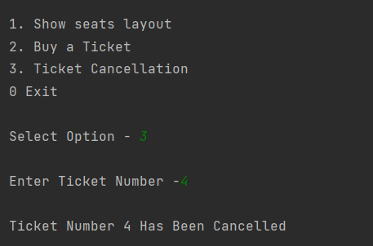
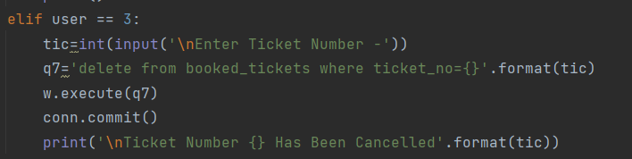
User Interface (Seat Layout )

Slide 14
Thank you

