Slide 1
Incorporating Failure Knowledge into Design Decisions for IoT Systems: A Controlled Experiment on Novices
Dharun Anandayuvaraj | Pujita Thulluri | Justin Figueroa
dananday@purdue.edu | sthullur@purdue.edu | figuero0@purdue.edu
Harshit Shandilya | James C. Davis
hshandil@purdue.edu | davisjam@purdue.edu
Notes:
Author list – one PhD student and 3 MSC students, plus me. This was a course project

Slide 2





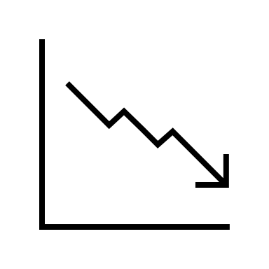

Motivation
IoT → increasingly interactive w/ physical world
Faults & defects are often safety critical
Example: Diabetes Monitor Failure^{[1]}
Server Outage
Glucose Monitor
User Not Notified
[1] A. O’Connor, “In Weekend Outage, Diabetes Monitors Fail to Send Crucial Alerts,” The New York Times, Dec. 02, 2019.
Notes:
Our motivation for the study is that Internet of Things have become pervasive and increasingly interactive with the physical world.
And since, they enable software to directly interact with the physical environment, their faults & defects can be dangerous or safety-critical.
[Click]
For example, recently, an IoT diabetes monitoring service had a cloud outage.
This system is supposed to monitor blood sugar levels, and alert users if it reaches a critical level.
And in the case of this outage, the kids and adults that relied on this service were not notified of the outage through the app, and were under a false sense of safety.
The company failed to design a fail-safe for this scenario, even though this had been a recurring incident!
Similarly, in our previous study we illustrated that recent IoT failures involved recurring failure patterns.
For example, as in this case, there were multiple cases at multiple companies where IoT systems did not enter a failsafe state when they experienced network failures.

Slide 3






Prior work: Recurring kinds of IoT failures^{[2]}
Failure trends within application domains
Failure trends across application domains
Server Outage
Monitor
Not Notified
Non-Critical Software
Critical Software
Improper Isolation
[2] D. Anandayuvaraj, J. C. Davis, “Reflecting on Recurring Failures in IoT Development,” in ASE-NIER, 2022.
Notes:
Recent SE failures exhibit recurring failure trends^{[2]}
In part work, we observed failure trends within application domains.
For example, a common failure within the consumer healthcare domain was due to the lack of fail-safe systems, especially during network loss.
In one case, a baby monitoring system failed similar to the diabetes monitor example I shared earlier.
In addition, we also observed failure trends across application domains.
For example, a common failure across the automotive and critical infrastructure domains was improper isolation between non-critical vs safety critical software, which exposed safety critical software to attackers.
We observed this across cars, oil pipelines, and powerplants.

Slide 4

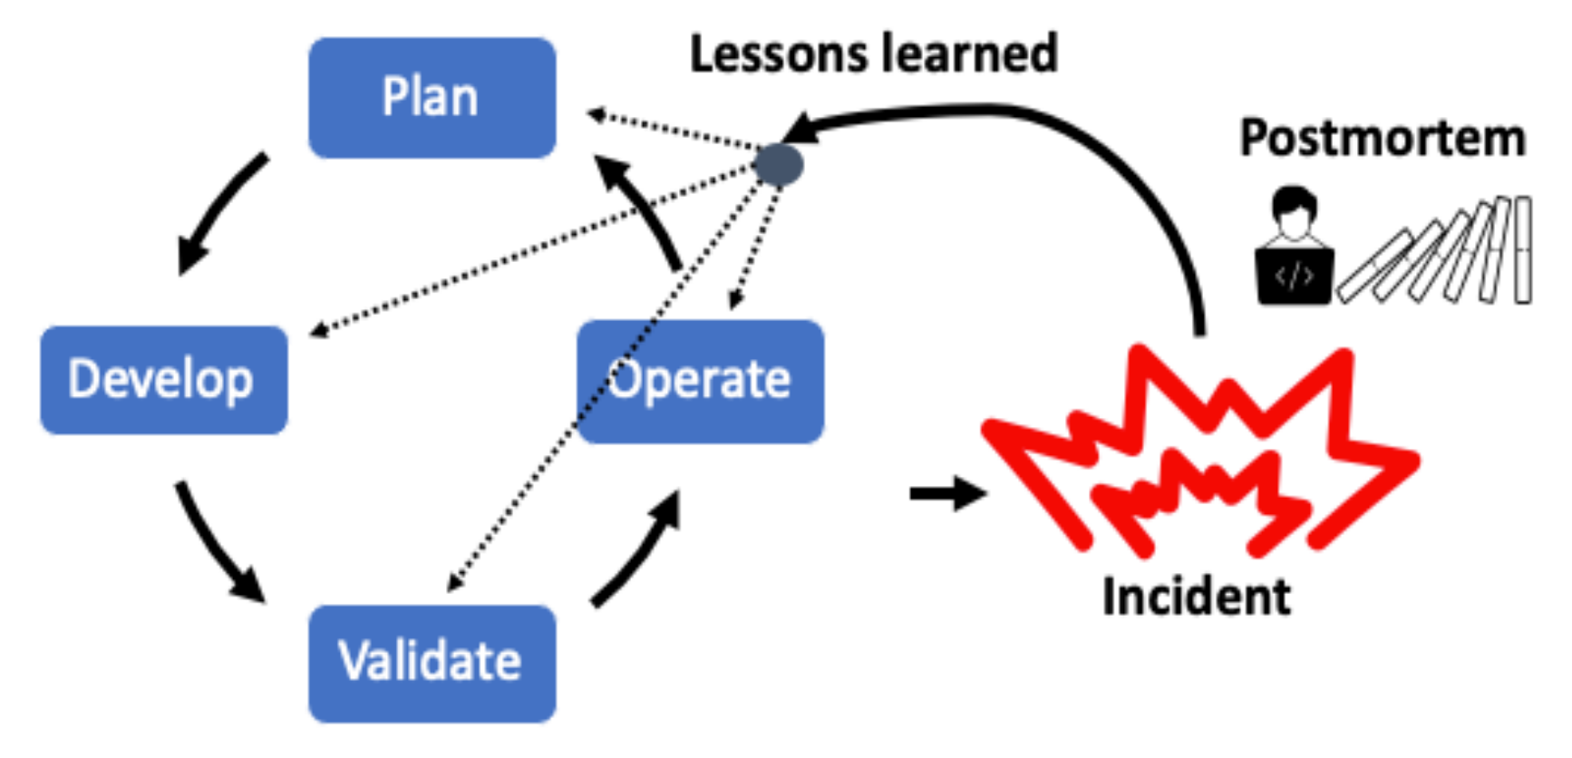
Idea
Past failures could (and should!) provide design insight
Lesson Learnt
HOW?
Failure Knowledge
Failure
Stories about failed designs → Improved design decisions?
Notes:
So, naturally we wonder how could we remediate recurring failures.
In an effort towards preventing recurring failures, we explore how past failures could provide design insight.
We investigate how software design decisions could be improved by using design failures as a learning treatment.

Slide 5
We investigated one Research Question
RQ: How does the awareness of failed design stories influence:
design decisions
rationale?
Notes:
Specifically, we conducted an experiment to investigate how failed design stories influence (1) design decisions and (2) their rationales.

Slide 6
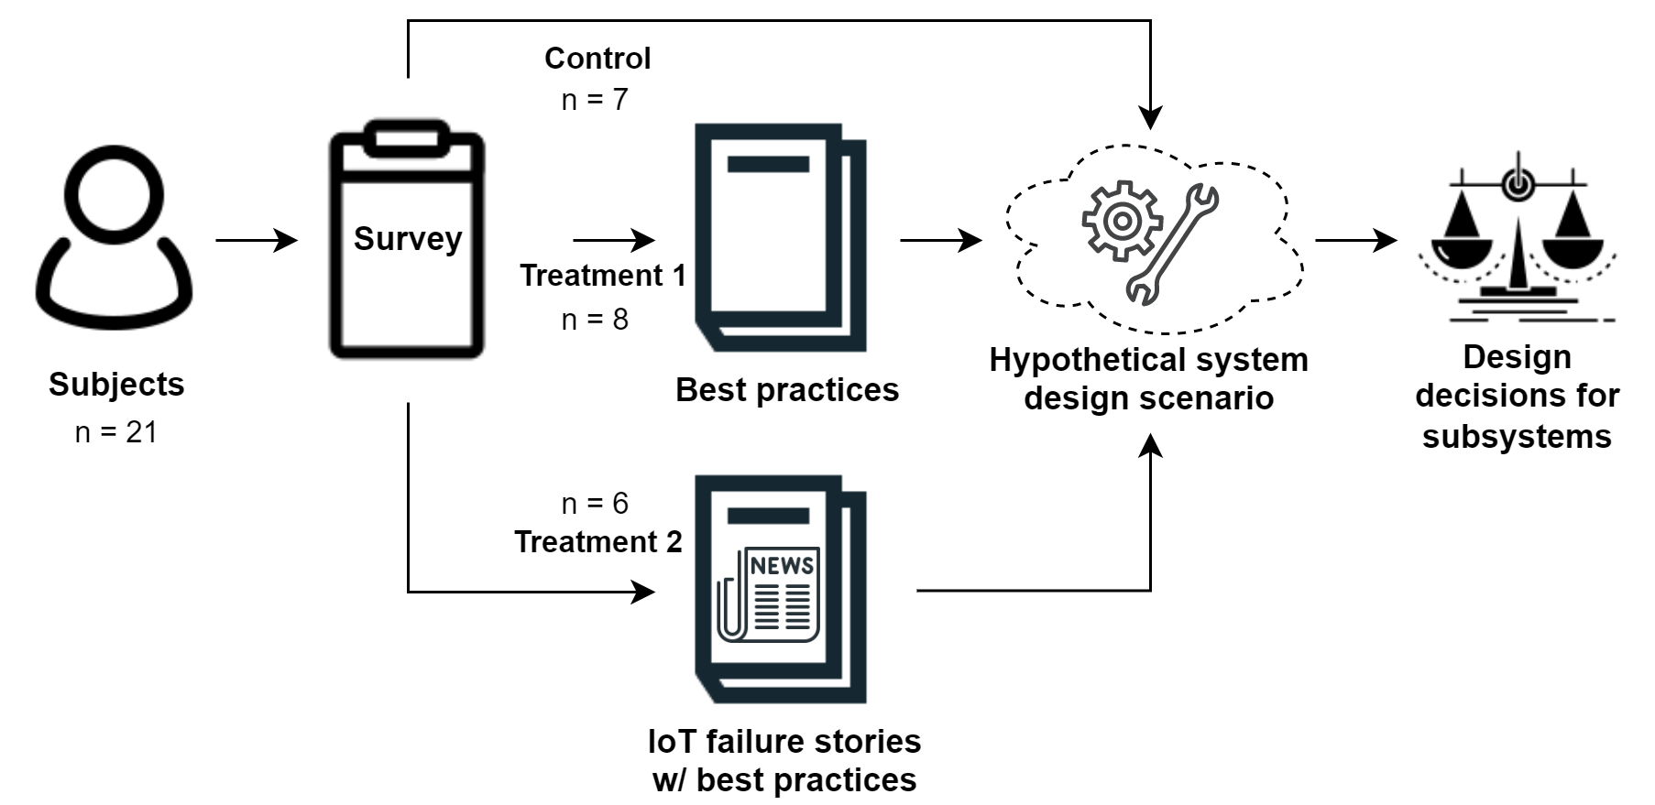
Methods | Experimental design
Notes:
Our experiment was based on novices, or 21 computer engineering students from various stages of the undergraduate and graduate levels, inclusive of students with internship and full-time work experience.
Our protocol was approved by our Purdue’s Institutional Review Board (IRB)
The subjects were split into 3 groups.
We had a control group, a treatment 1 group, and a treatment 2 group.
First:
The treatment 1 group were given 2 best practices – which we use as a proxy for the current state of practice.
Whereas the treatment 2 group were given 2 IoT failure stories along with the best practices – which is the treatment we propose.
Then, all groups were provided with a survey consisting of an IoT design scenario with binary design decisions.
Then for each design decision, the subjects were tasked to choose between two design choices and to provide an open-ended rationale for their choices.
---
The questionnaire was distributed in a between-subjects
design. There were three treatment groups:
1) Control: Perform 8 subsystem design decisions.
2) Treatment 1 (current practice): Read 2 design guidelines
(from the 2 failure stories) and perform 8 subsystem design
decisions.
3) Treatment 2 (proposed): Read 2 failure stories + guidelines
and perform 8 subsystem design decisions.
Now let me tell you a little more about the treatments and hypothetical design scenario

Slide 7
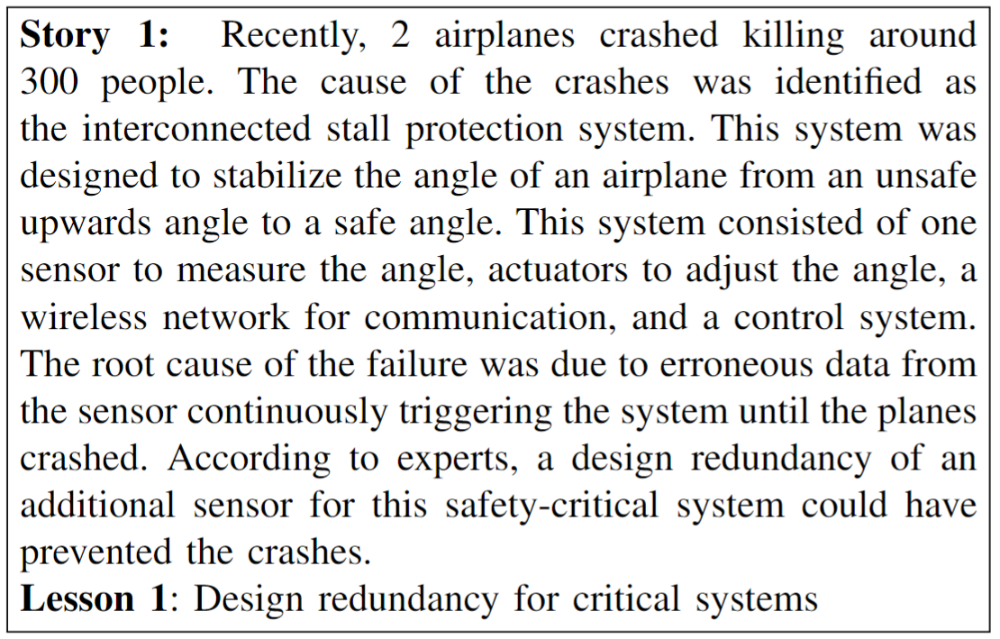
Methods | Experiment – Treatments
Treatment 1 (SoA):
Treatment 2 (Proposed):
Notes:
Treatment 0 – Control – Just filled out the research instrument
Treatment 1 – SOTA “best practice” for critical system design
Treatment 2: Proposed – need failure stories. For our proposed treatment, we selected 2 failure stories from our ASE-NIER paper in 2022.
The first story, shown here, narrated a fatal plane crash due to a lack of redundancy in a critical IoT system. This is a simplified version of the full story – note that we call this “the root cause”, and there are many interpretations of this event and many causal factors.
The second story described smart-car hacks that allowed access to driving functions due to improper segmentation of the driving systems.
We identified the context, the cause, and the impact of the failures from news articles.
Then we presented this information as a short paragraph in Treatment 2’s questionnaire (same structure for both).
We also articulated the corresponding ”best practice” that would mitigate such a failure, similar to what you would see…
These design practices were presented in Treatment 2’s questionnaire as “lessons” — which is a common postmortem practice.

Slide 8
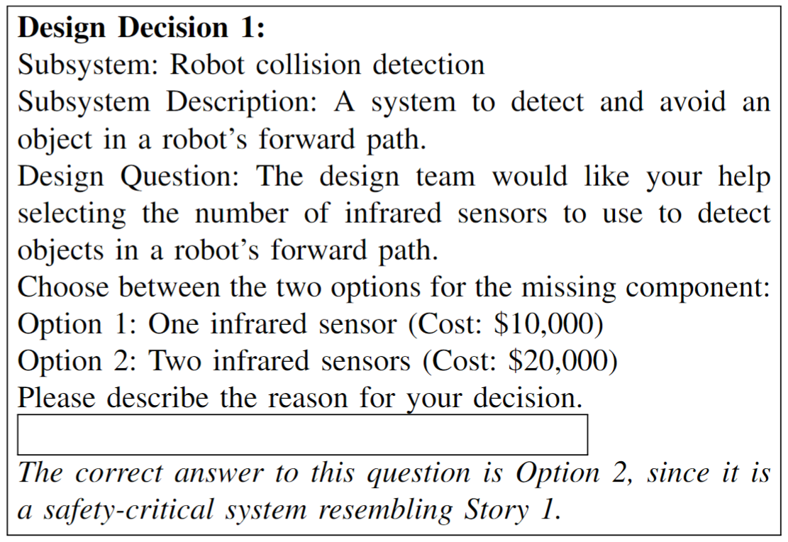
Methods | Experiment – Design scenario
Notes:
Then, we created a hypothetical system design scenario to study the subjects’ decision-making. The scenario depicted an IoT-enabled robotic e-commerce warehouse.
We created 8 design decisions for subsystems in the warehouse.
For each of the 2 failure stories, there were 4 design decisions that resembled the lesson outlined by the story, for a total of 8 design decisions.
Also, 4 design decisions were for critical subsystems, whereas the other 4 design decisions were for non-critical subsystems.
Each design decision consisted of two choices — a “correct” choice and an “incorrect” choice with respect to the criticality of the component and the lesson of a failure story.
However, we note that these decisions are rarely binary, but rather ranked by criticality since any subsystem could be justified as critical. In order to account for this complexity, we also provided an open response field for the subjects to state their rationale for each of their decisions. In addition, we included a budget for the overall system design scenario as a realistic constraint on design decisions. The cost of each decision correlated with the criticality of the decision, and critical decisions necessitated a costlier choice.

Slide 9
Participants
Computer engineering department
Convenience sampling (undergraduate + graduate programs)
Category | Count
PhD student | 7
Senior undergraduate | 6
MSc student | 6
Junior undergraduate | 1
Professional | 1
Experience | Count
Only Internship(s) | 10
1-5 years professional | 9
16+ years | 1
None | 1
Notes:
We recruited computer engineering students at our university
through convenience sampling. Students were recruited
at various stages of the undergraduate and graduate levels,
inclusive of students with internship and full-time work experience.

Slide 10
Limitations
Internal: Size, limited controls
External: Intentions vs. actions; students vs. professionals
Construct: Design decisions as proxy for design processes
Notes:
Internal threats
Our limited sample size and nonequivalent groups could have had confounding effects on experiment results [45].
Additionally, our experiment did not control for expertise.
External threats:
Our sample size limits our findings to conjectures.
Our questionnaire surveyed for intentions rather than actions, and did not incorporate a full design cycle.
Our subjects were students and their responses might not reflect industry practices.
Construct threats:
We use design decisions and their rationale as proxy for design processes, which might not reflect industry practices

Slide 11
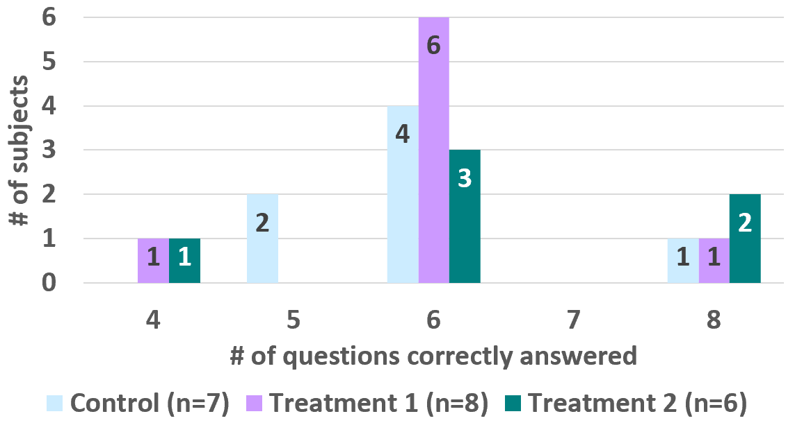
Results | Binary decisions – do not vary
Notes:
We compared results of the design decisions between the three groups to evaluate the influence of the failure stories.
This figure illustrates the decisions broken down by group. You can see that in each group, decisions visuall follow a similar distribution.
We performed a quantitative comparison of the decisions with a statistical test.
Since our sample size was limited, we utilized the Kruskal-Wallis Rank Sum test.
We tested with a null hypothesis that the decisions are the same between the two conditions (α = 0.5).
We found no reason to reject the null hypothesis – in this experiment, subjects made similar decisions.
However, things changed a bit when we look at their rationales

Slide 12
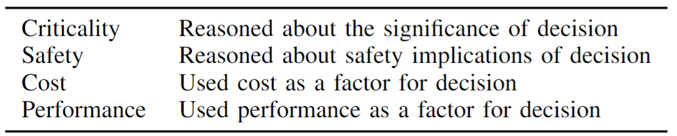
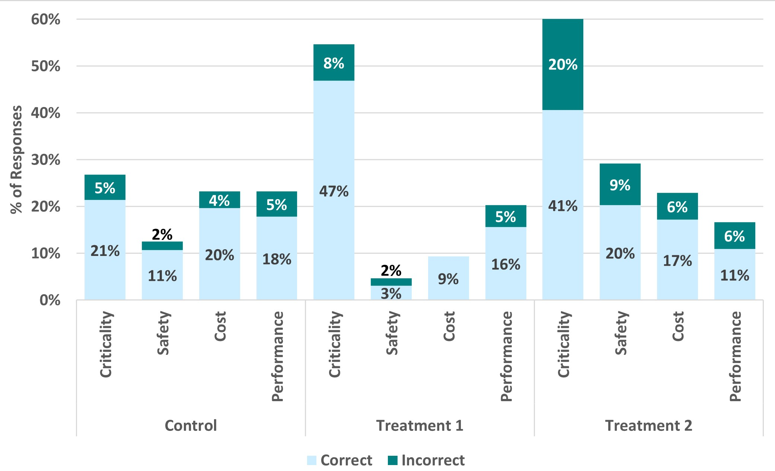
Results | Rationales – varying rationales
Codebook
Treatments ↑ criticality reasoning
Treatment 2 ↑ safety reasoning
Control group more concerned w/ cost & performance
Notes:
Since design decisions are complex, we also studied their rationales.
[Click]
With the qualitative data collected from the open response fields, we first performed open coding on a sample set of the data to establish the coding scheme above.
This coding scheme was used to perform closed coding on all of the data, and the distribution of responses labeled by the scheme is presented below.
Two authors conducted the qualitative analysis independently and the results were discussed to resolve conflicts.
We observed differences in decision rationales by group, notably in criticality and safety.
The Control group had similar frequency of cost/performance as the two treatment groups did.
The Treatment 1 and the Treatment 2 groups reasoned more about the criticality of the subsystems than the Control group did.
The Treatment 2 group reasoned more about safety than the Control group, with Treatment 1 mentioning this the least.
It’s also worth noting the Treatment 2 group seemed to become more concerned with criticality and safety – perhaps excessively so. Note the proportion of reasoning that was attributed to what we defined as INCORRECT responses.

Slide 13
Results | Design Rationale – Criticality
Percent of Responses
 | Control | Treatment 1 | Treatment 2
Criticality | 26% | 55% | 61%
Control: “[it is] unlikely for multiple robots to...crash. Immediate human intervention can save $$”
Treatment 1: “robot crashes are critical”
Treatment 2: “In case that a robot crashes, it would be important for other robots in its vicinity to know so they can avoid the crash. Otherwise, there could be more crashes...”
Notes:
First, we found that both treatments helped subjects reason about the criticality of their design decisions.
Almost twice the amount of responses from Treatment 1 and Treatment 2 groups reasoned about criticality compared to responses from Control group.
We conjecture that this might be due to the mention of criticality in the treatments – remember, this scenario said “Use redundancy for critical systems”.
It is also noteworthy that a larger amount of responses incorrectly judge criticality from Treatment 2 than from Treatment 1 with respect to our assessment.
We conjecture that this might be due to an over-precaution for criticality, due to the catastrophic impacts of bad design detailed in the stories, as a result of a priming effect.
To illustrate these findings, a question asked the subjects to make a decision about a crash alert system for robots with the option of only alerting the central warehouse management software or alerting the software as well as other nearby robots.
We classified this subsystem as critical, necessitating redundancy with both alerts.
[click]
A subject from Treatment 1 reasoned about criticality by identifying that “robot crashes are critical.”
[click]
Likewise, a subject from Treatment 2 said: “In case a robot crashes, it would be important for other robots in its vicinity to know so they can avoid the crash. Otherwise, there could be more crashes...”
[click]
In contrast, a Control subject was more concerned about cost: “[It is] unlikely for multiple robots to...crash. Immediate human intervention can save $$.”
Thus, we conjecture that failure stories are effective at helping engineers reason about the criticality of design decisions.

Slide 14
Results | Design Rationale – Safety
Percent of Responses
 | Control | Treatment 1 | Treatment 2
Safety | 13% | 5% | 29%
Control: “Attack on one can save the other…”
Treatment 1: “Separation of core devices, Better security”
Treatment 2: “If a worker clicks on malicious link or gets virus…on personal device, this could be dangerous if industrial controls are on same network. It is double the price, but safety should be higher concern”
Notes:
Next, we found that Treatment 2 subjects more frequently reasoned about safety.
It is also worth noting that the responses from the Control group considered safety more than the responses from Treatment 1.
We conjecture this is due to the lack of constraints for the Control group subjects, enabling them to brainstorm factors (such as safety) to guide their decisions.
This is consistent with prior findings about decision making in SE.
To illustrate these findings, a question asked subjects to make a decision about segmenting networks between personal and industrial devices, which could have safety implications under malicious circumstances.
[click]
A Treatment 2 subject identified safety impacts of the decision: “If a worker clicks on malicious link or gets virus. . . on personal device, this could be dangerous if industrial controls are on same network. It is double the price, but safety should be higher concern.”
[click]
A Control subject identified a malicious scenario — “Attack on one can save the other” — implying that they recognize the safety measure to isolate the critical subsystem.
[click]
In contrast, the rationale of a Treatment 1 subject was limited to the design guidelines provided and did not consider safety: “Separation of core devices, Better security.”

Slide 15
Results | Design Rationale – Anecdotal Logic
Control: “I’m pretty sure all of the devices at [university] share one or two connections so given that, it’s probably good enough here as well”
Treatment 1: “believe this is what swarm means, to have all the robots be controlled under a single connection”
Treatment 2: “As we learned from the plane crash...design redundancy can help avoid terrible consequences. If the robots have only one sensor that becomes compromised, it could be hazardous for workers”
Notes:
Additionally, we found that across all groups, 8 of the 21 subjects used anecdotal logic as design rationales.
[click]
For example, a Treatment 2 subject correctly cited the failure story we provided to choose redundancy for a safety-critical subsystem: “As we learned from the plane crash...design redundancy can help avoid terrible consequences. If the robots have only one sensor that becomes compromised, it could be hazardous for workers.”
[click]
A Control subject incorrectly cited the university network as a basis to not segment personal and industrial networks: “I’m pretty sure all of the devices at [our university] share one or two connections so given that, it’s probably good enough here as well.”
[click]
A Treatment 1 subject likewise incorrectly cited the concept of robot swarms as a justification for maintaining a single communication channel for all robots in the warehouse: “I believe this is what swarm means, to have all the robots be controlled under a single connection.”
We know that anecdotal logic is part of human nature; and if engineers use anecdotal logic, then failure stories provide relevant anecdotes.

Slide 16
A Failure-Aware Engineering Process for IoT
Lesson Learnt
Experimental methods to measure & understand design rationales
Investigate: Are current guideline-based practices effective?
Investigate: Processes for learning from design failures
HOW?
Failure Knowledge
Failure
Notes:
First, motivated by our difficulty studying design decisions at a binary level, we advocate for experimental methods to measure and understand design rationales.
We suggest that qualitative analysis of rationales seems an appropriate path. A taxonomy of rationales could be a useful aid in experimental design.
Measuring rationale in the context of the more systematic engineering techniques used in IoT design (e.g., FMEA [42], STAMP [43]) is an open problem.
Second, we propose an investigation into the effectiveness of guideline-based practices at enabling developers to reason
about holistic (e.g., safety, security, performance) implications of their design decisions.
While we compared the influence of a guideline-based design practice against a failure-aware design practice, there is limited knowledge on the effectiveness of guideline-based design processes in the first place.
As a step toward this insight, we plan a larger experiment using guideline-based treatments focused on safety-critical design decisions with constraints such as time, cost, and performance, again considering the design process and rationale.
Third, we take for granted the existence of “best practices” and design guidelines. For example, ENISA, NIST, etc. publish lengthy guidelines for safe IoT systems, for secure IoT systems, and so on. Where do these come from? What are the current processes for learning from design failures? How effective are they?
If failure-based learning treatments are effective at instilling good design practices, then we need research into how industry identifies failures and applies the knowledge.
Many unknowns:
Whether and how organizations currently document and learn from system failures.
The knowledge transfer processes used to share system postmortems across teams and organizations
How effectively do teams generalize from a specific failure to the broader class?
What are the limits of generalization?
The use of these failure stories in internal training (e.g., during onboarding). When and why are failure stories shared to team members? What is learned, and how effective is it?

Slide 17


Conclusion
Failure stories influence design – rationales, not decisions?
Failure-Aware Engineering Process
(for IoT development)
Thank you for your attention!
Notes:
We investigated the influence of failure stories on design decisions.
We found that failure stories were as effective as design guidelines at guiding developers reason about the criticality of design decisions.
We found that design guidelines alone constrained developers’ ability to reason about the safety implications of design decisions.
Adding failure stories was conducive.
Our observations about failure-aware design decisions motivate new research directions into failure-aware design processes.
We hope that this direction improves the safety of IoT systems!
Our questionnaire and data are available on Zenodo.
Thank you! That concludes my presentation, and I would be happy to answer any questions you may have.

Slide 18
Bonus slides

Slide 19
Artifacts
The following artifacts:
Questionnaire
Raw data
Coding
Are available at:

