Slide 1




Signing in Four Public Software Package Registries: Quantity, Quality, and Influencing Factors
Taylor R. Schorlemmer
Kyung Myung Ko
Santiago Torres-Arias
Kelechi G. Kalu
Eman Abu Ishgair
James C. Davis
Luke Chigges
Saurabh Bagchi
Supported by:
Notes:
Hello
My name is
Today I’m presenting
Part of my MSc
Thanks Dr. James C. Davis
Combined effort with my co-authors from Purdue
Made possible from the support of

Slide 2
Contributions
Introduction
Up-to-date measurements of software signing practices in four major package registries
Quantity – how many?
Quality – how good?
Quasi-experiment to estimate effect of factors on signing practices
Policies have a notable effect on quantity
Tooling has a notable effect on quality
Getting started is the hard part
Cybersecurity events seem to have little impact
Notes:
My contributions are as follows:
Measurements for signing
A technique for SSC security
4 registries
GAP: These measurements haven’t been compiled before
Quantity
Quality
Quasi-experiment for factors
GAP: why don’t people use signatures?
Provide some explanation
Key findings

Slide 3
Background

Slide 4
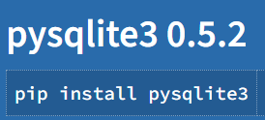


Provenance in Software Supply Chains
Background
Provenance?
Upstream Software
Your
Software
Downstream
Software
Notes:
Important part of SSC: provenance
Provenance – origin of artifacts
How does this look in a SSC?
First – Upstream software
Typically, something someone else made
Example: package on PyPI
Allows user to interact with SQLite3 DB
Pip install to include
Your software
Project you/your org creates
Example: code I wrote to collect data
Python import
Use to connect db
Downstream software
You may publish/someone could use your software
Example: someone may use my code/tools
How can we provide provenance between these steps?

Slide 5
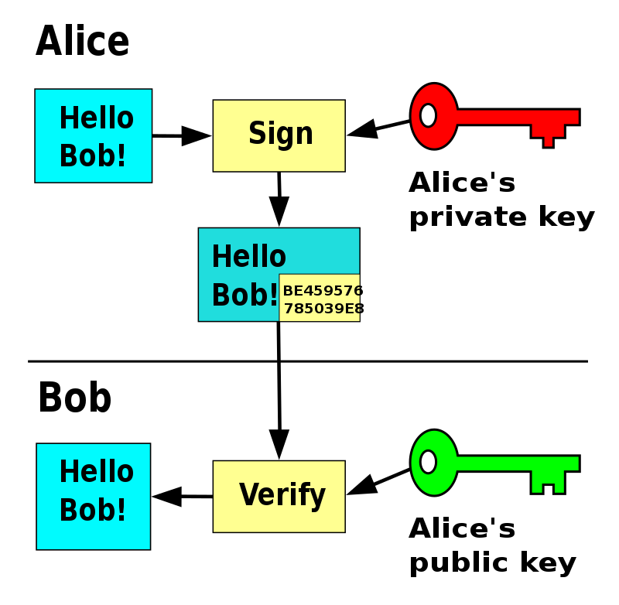
What is Signing?
Background
Cryptographic proof of origin
Provides two guarantees
Signed artifact created by identity
Signed artifact has not changed
Does not guarantee good software
https://en.wikipedia.org/wiki/Digital_signature
Notes:
Signing is an established way to provide provenance
Cryptographic proof of origin – see diagram
Two guarantees:
Created by actor
Artifact hasn’t changed
Doesn’t mean good SW

Slide 6
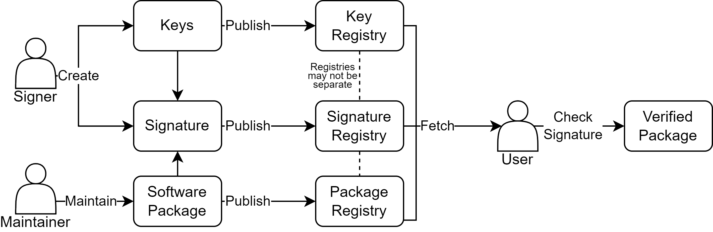
Signing Process & Failures
Background
Notes:
I’ll walk through how this process works in practice and how it can go wrong
First, maintainer creates/maintains SW package
Next signer (could also be maintainer) creates keys + signature
They could fail to do so – creating a signature isn’t always required
Keys might be bad (wrong key, corrupted, etc)
Signature might be bad (incorrect or unverifiable, signed wrong artifact, unsupported alg, incompatible format)
Next, published
They may fail to publish the key/signature
Sometimes no requirement
Things sit on registries (may be the same)
Key may be revoked (theft/key rotation)
Key may expire (associated signatures no longer valid)
Signature may expire
User fetches things
May fail to discover
User validates signature
Note: all orange failure modes are indistinguishable from the user
Cant tell if discover failure or it doesn’t exist

Slide 7
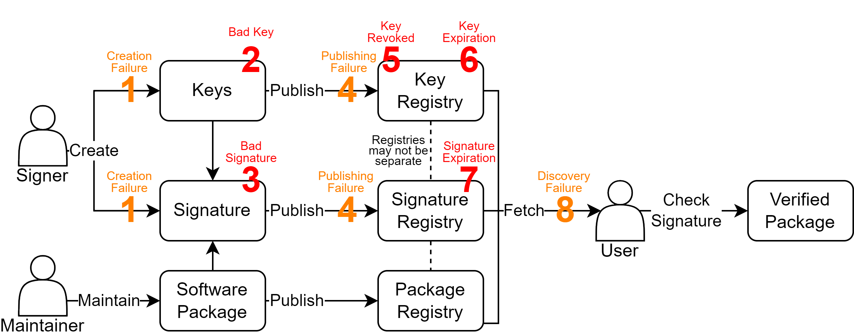
Signing Process & Failures
Background
Notes:
I’ll walk through how this process works in practice and how it can go wrong
First, maintainer creates/maintains SW package
Next signer (could also be maintainer) creates keys + signature
They could fail to do so – creating a signature isn’t always required
Keys might be bad (wrong key, corrupted, etc)
Signature might be bad (incorrect or unverifiable, signed wrong artifact, unsupported alg, incompatible format)
Next, published
They may fail to publish the key/signature
Sometimes no requirement
Things sit on registries (may be the same)
Key may be revoked (theft/key rotation)
Key may expire (associated signatures no longer valid)
Signature may expire
User fetches things
May fail to discover
User validates signature
Note: all orange failure modes are indistinguishable from the user
Cant tell if discover failure or it doesn’t exist

Slide 8
Signing Adoption Theory
Notes:
Using existing literature, we devised a theory to explain a maintainers decision to sign

Slide 9
Influence of Incentives
Signing Adoption Theory
Notes:
Based on behavioral economics
Dev theory of influence of incentives on signature adoption
Incentives influence maintainers

Slide 10
Incentives Considered
Signing Adoption Theory
Registry Policies
Policies that explicitly encourage or discourage software signing
Dedicated Tooling
Tools which simplify the signing workflow
Signing Events
Cybersecurity events such as cyberattacks or the publication of government/industry standards
High Startup Cost
The first signature might be the hardest
Notes:
We consider these four
Others likely exist, but we did not explore them

Slide 11
Research Questions

Slide 12
Theme 1: Measuring Signing in Four Package Registries
Research Questions
RQ1: What is the current quantity and quality of signing in public registries?
RQ2: How do signing practices change over time?

Slide 13
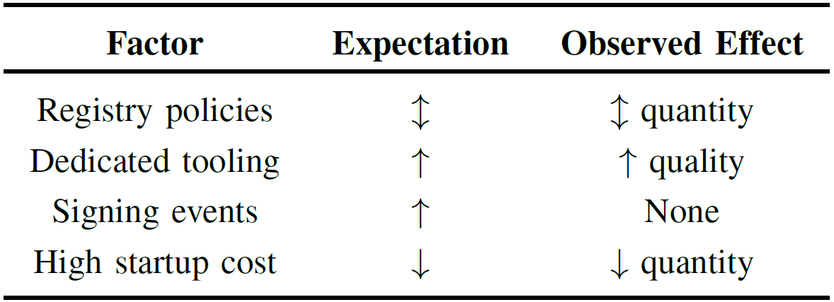
Theme 2: Signing Incentives
Research Questions
RQ3: How do signing incentives influence signature adoption?
Hypothesis 1: Registry policies that explicitly encourage or discourage software signing will have the corresponding direct effect on signing quantity.
Hypothesis 2: Cybersecurity events such as cyberattacks or the publication of relevant government or industry standards will increase signing adoption (quantity and quality).

Slide 14
Methodology

Slide 15
Methods Overview
Methodology
Select Registries
Collect Packages
Filter Packages
Measure Signatures
Evaluate Adoption

Slide 16
Results

Slide 17
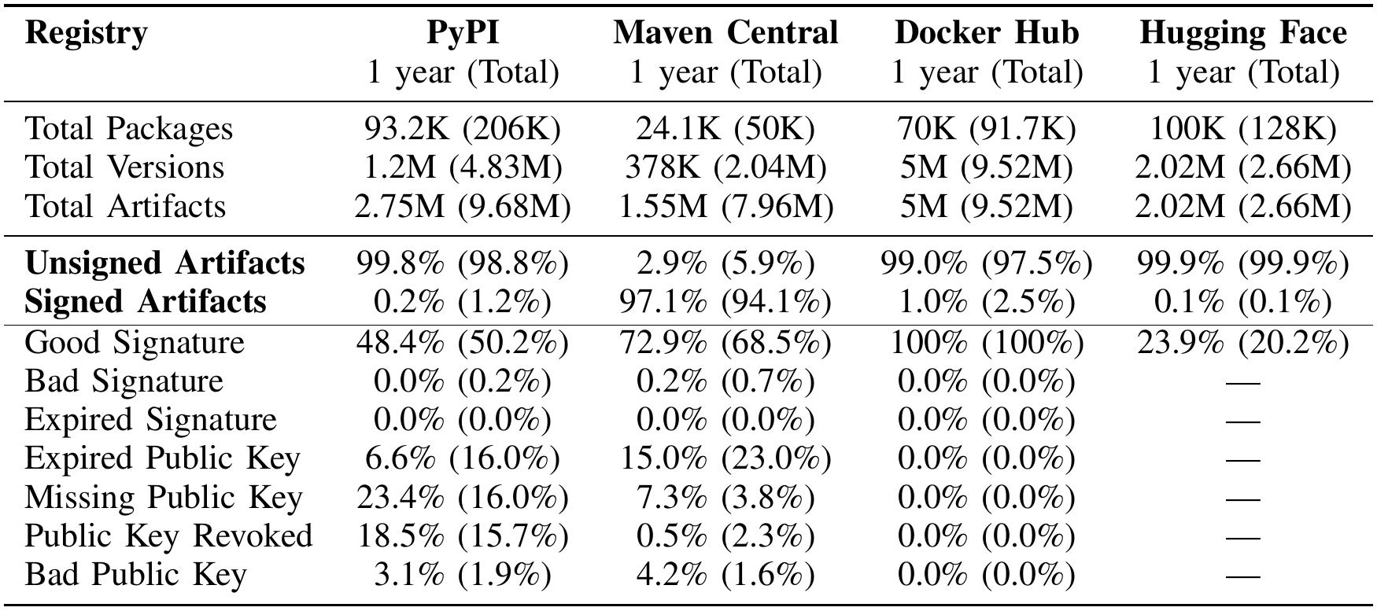
RQ1: Current Quantity and Quality of Signatures
Results
Notes:
Between OCT 2022 and SEP 2023 all registries (except Maven Central) had less than 2% of artifacts signed
Maven had 95.3% of artifacts signed in the same time period (mandated signing)
Signing failures are common
24.0% of Maven Central signatures invalid
53.1% of PyPI signatures invalid
77.5% of Hugging Face signatures invalid
None of Docker Hub signatures invalid (dedicated tooling)

Slide 18
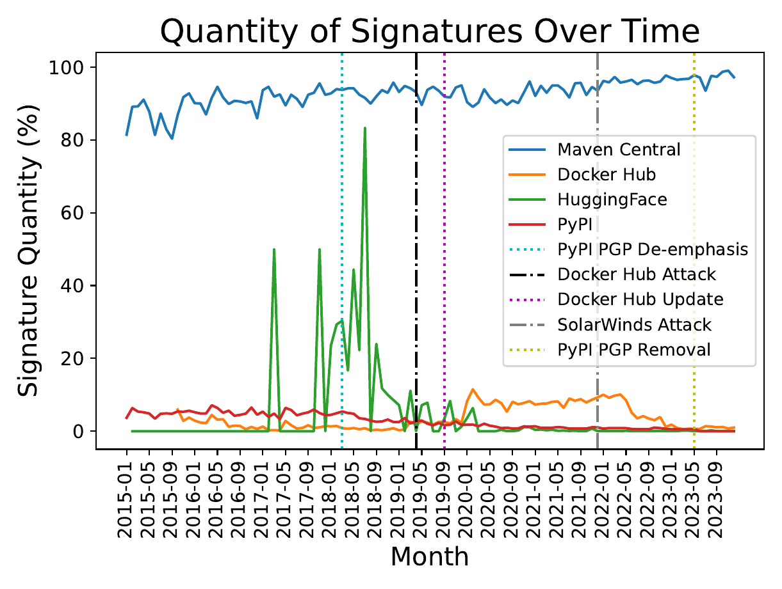
RQ2: Change in Signing Over Time
Results
Notes:
Explain axes
Maven higher over entire period
Docker slight bump
HF spikey
PyPI decreases till remoed

Slide 19
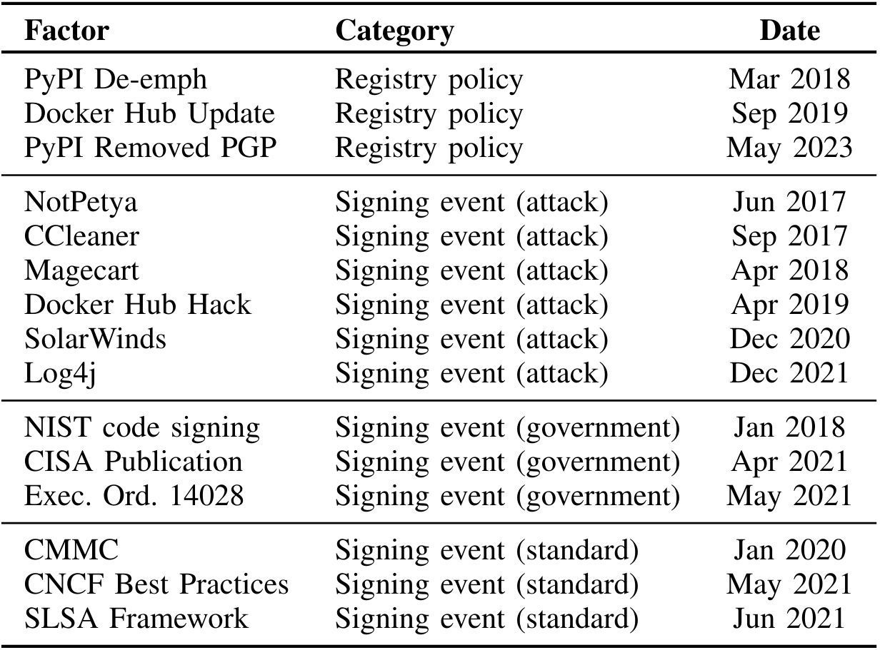
RQ3: Influence of Incentive
Results
H1: Registry Policies
H2: Cybersecurity Events
Notes:
Recall our hypotheses & the events we used to test them.

Slide 20
RQ3: Influence of Incentive (H1 - Registry Policies)
Results
Notes:
PyPI deemp
Docker Update
Maven way higher

Slide 21
RQ3: Influence of Incentive (H2 – Signing Events)
Results
Notes:
Docker Hack Apr 2019
Solar Winds Dec 2020
Other attacks

Slide 22
Key Takeaways

Slide 23
Key Takeaways
Signing practices vary widely
Registry operators can influence signing with policies
Events don’t seem to affect maintainers
Emerging tools look promising
Thank You!
Taylor R. Schorlemmer
tschorle@purdue.edu
Notes:
Practices vary widely – signing isn’t in a great state if we want to use this technology
But, there is hope.
All empirical research has limitations
Quasi-experiment -> correlation
Suggests:
Registry operaters have a big influence w/ policies
Events don’t seem to affect
Emerging tools look promising -

