Slide 1



Experience Paper: A First Offering of Software Engineering
James C. Davis
Paschal Amusuo
Joseph R. Bushagour
DREE 2022
Notes:
Hello.

Slide 2
Talk outline
Instructional context
Course goals
The project
Assessment
Experiences and lessons learned
Accessing the course and project

Slide 3

Instructional context
ECE @
Almost-new offering
72 students
1 instructor, 1 GTA, 1 UTA
Notes:
Purdue University is a large, public, R1 institution.
72 students with fairly homogeneous background. 2 intro programming courses and one course in data structures, data science, OOP. Mostly seniors, some juniors.
GTA: 20 hours/week
UTA: 5 hous/week

Slide 4
The course and its goals
Learning outcomes
Understanding models of the software engineering process
Conducting the software engineering process
Understanding the social aspects of software engineering
60% Projects, 25% homework, 15% final exam

Slide 5
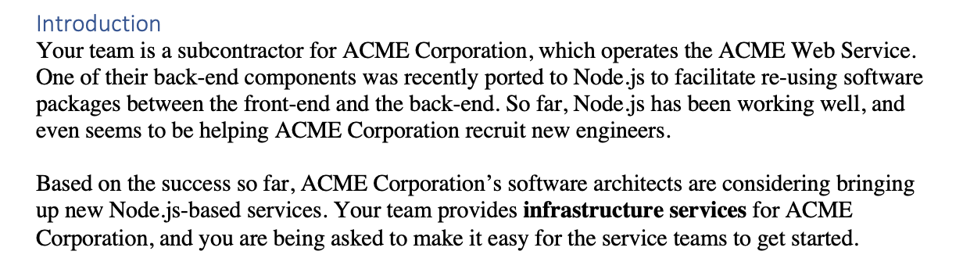
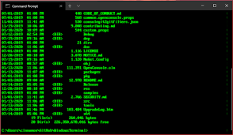



The project: Theme and Technologies
Part 1: CLI for scoring dependency candidates
Part 2: OpenAPI-compliant REST API for module hosting
Notes:
PART 1:
./run install
./run test
./run URL_FILE
Customer’s concerns included:
OSS documentation quality? Low ramp-up time
- Enough maintainers to handle high-priority patches.
Responsive to fixing bugs that ACME Corp. encounters
Additional requirements:
“Extensible” – Support new metrics
At least one must hit the GitHub REST API – commonly, counting issue responsiveness
At least one metric must analyze the source code in some way – commonly, measuring documentation by counting # comments
Report must analyze the potential shortcomings of the way they defined each metric
No language or tech constraints, so long as it offers a CLI
PART 2:
Goal is to build an internal module registry that ACME Corporation can use to manage their dependencies, without needing to rely on (potentially flaky) npm. The LeftPad incident was not good.
The spec describes a wide range of feature requests:
Upload, update, rate, and download packages as zip files
Support a notion of “package groups” (e.g. more than one upload at once, to be rendered atomically) with a multi-REST request-transactional semantic
Support for queries over package versions, with a DSL including exact, ranged, and approximate range
Support a new metric: degree of pinned dependencies to major+minor version
Fetch history of a package
Fetch a paginated listing of all packages
Request ingesting a public npm package via a URL to npm. The package in question must score high enough using the scoring algorithm from Part 1
Support a “debloat” to reduce storage costs, removing (unspecified) unnecessary bloat from a package – e.g. removing documentation
Request a security audit of a package, by delegating to npm’s “audit” mechanism
Reset the system to a “default” state
Supporting a notion of “sensitive” modules with a custom scanner that executes in order to approve a download
Users and groups
Authentication tokens limited to 1K interactions or 10 hours
ADA compliant up to Web Content Accessibility Guidelines/WCAG 2.1 at level AA (with pointer to Microsoft’s accessibility checking tool)
Complete a STRIDE analysis
Two interesting twists:
The project spec begins with the following statement: “Warning: This project spec is designed to be far more work than I think you can reasonably do in the time allowed. In your design, your team must identify…and JUSTIFY…a reduced scope…”
“Customer” has an expected time commitment of 6-9 hours/week outside of class
Baseline requirements covered a few API endpoints and the STRIDE analysis.
Teams had to swap projects with one another, and build on top of that existing project. For some teams this meant inheriting non-working code, and investing substantial initial time into triage. This affected their time estimates.

Slide 6
The project: Logistics and Assignments
Week | Event
3 | Part 1 published
4 | Plan
5 | Milestone 1 (self-defined)
6 | Milestone 2 (self-defined)
7 | Delivery
8 | Postmortem; Part 2 published
9 | Plan
10 | Milestone 1 (self-defined)
11 | Milestone 2 (self-defined)
12 | Milestone 3 (self-defined)
13 | Milestone 4 (prescribed)
14 | Milestone 5 (self-defined)
15 | Milestone 6 (self-defined)
16 | Delivery
17 (Finals) | Postmortem
Part 1
Part 2
Notes:
Discuss milestones
Plans:
Tool selection
Communication mechanisms
Team contract
Team synchronous meeting times
Organized list of requirements (project specs were deliberately a bit convoluted)
Preliminary design in UML, with activity diagrams and data flow diagrams
Timeline and planned milestones (features, sub-tasks, owners, estimated time, task interactions, how to measure success)
Validation and assessment plan
Milestones
Design changes, justification, and ripple effects into design docs, security analysis, test plan, etc.
Progress relative to plan
Changes to plan to address being ahead or behind
Record of teammate contributions (trying to provide peer pressure to contribute; a helpful paper trail for non-contributing teammates)
Part 2: One prescribd milestone to keep them on track. By week 13 (4 weeks in), they had to be using github actions to perform:
Autoamted tests (CI/continuous integration) on pull requests
Capability of Autoated service deployment to GCP on successful PR merge (CD/continuous deployment)
Postmortems

Slide 7
Assessment
30% Design, planning, and milestone docs
50% working delivery
30% auto-grader
10% “reasonable-looking” test suite
10% “manual check for code quality”
20% postmortem

Slide 8
Experiences and lessons learned (instructor)
The structure of the projects was one of the most helpful things at Purdue
Weekly milestones were helpful
The project swap: Pros and cons
Auto-grading cloud services is hard
Continuous deployment = security risk
The code we got was pretty poorly designed…[we had to] refactor it
Notes:
On the whole, we think the weekly milestones were helpful
Project swap: Many students felt this was a great experience, but it left some with an impression of unfairness. I think helping students think about time estimates and project scope would help for next time.
The CLI was OK, but students’ cloud services were not stable. In order to avoid failing the class, we opted to conduct one scan each day for several days, with a final grading pass about 1 week after we began the initial scans. Students were encouraged to actually USE the logs they were generating in order to figure out what was causing their issues. This gave them enough time to diagnose and repair the crashes that our auto-grader was finding.
In Part 2, project requirements caused inadvertent GCP token theft.
This certainly met the aspect of learning outcome 2 related to
cybersecurity, but we see opportunities to improve.
GCP Token Storage.We required students to implement continuous
deployment (CD) to their GCP services. Some students chose
to store GCP access tokens directly in their repositories, enabling a
fully automated CD process. While we advised them not to do so,
this decision was not immediately problematic because we required
teams to use private GitHub repositories to discourage plagiarism.
GitHub Action Threshold. We required teams to use GitHub
Actions to implement their CI/CD pipeline. Unfortunately, GitHub
Classroom limits the number of GitHub Actions that can be made
by private repositories, and students began to experience errors.
We therefore asked the teams to convert their repositories to public,
which removed the Actions cap.
Result: Theft. Upon converting their repositories to public, the
teams that stored GCP access tokens insecurely had now leaked
them publicly. Three teams informed us that they had been affected.
Fortunately, GCP automatically detects anomalous resource usage
consistent with Bitcoin mining, and disables accounts before too
many resources are exhausted.
Discussion. The students got real-world experience in cybersecurity,
but we are unsure whether to celebrate this experience.
Following the “Swiss Cheese” failure model [12], students saw how
a fault (unsound GCP token storage) led to an error (public disclosure
of tokens) and subsequent failure (break-in and Bitcoin mining).
This is a desirable lesson for students to learn. However, we would
prefer to design the lesson to educate students without emotional
distress or temporary financial impact, e.g., as a game [11].
In the next offering, we will explore a homework assignment
with a “honeypot” repository. This assignment will demonstrate
token theft in a controlled manner.

Slide 9


Experiences and lessons learned (students)
Postmortem | Improved | Recurred
Requirements | 4 | 1
Design | 4 | 1
Implementation | 5 | 6
Validation | 5 | 6
Process | 17 | 10
Notes:
The 24 undergraduate teams completed a mid-semester postmortem analysis and articulated lessons for themselves. At the end of the semester, the teams reported on how they applied those lessons. I wrote memos about their reports and coded them according to aspects of the software design lifecycle.
Table 1 summarizes the results by the number of teams that mentioned each code: teams generally reported improvements earlier in the engineering cycle (e.g. spending more time mapping requirements to design), but experienced recurring issues in implementation and validation (e.g. deferring tests and using “big bang” integration [24])
Following an unstructured postmortem analysis process, teams learn from some – but not all – kinds of failures. How can we help them do better?

Slide 10
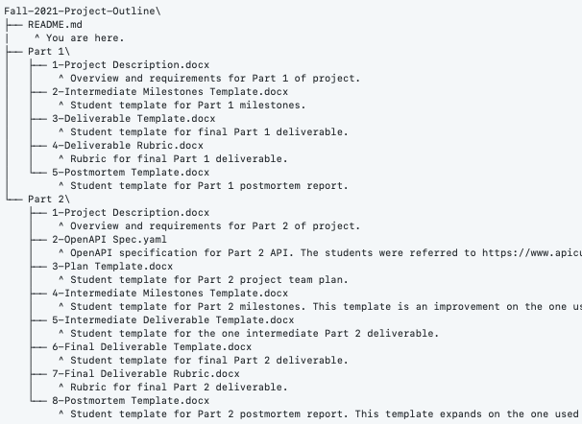


Accessing the course content
https://github.com/PurdueDualityLab/Fall-2021-ProjectDocs/tree/v1.0.0
https://zenodo.org/record/5828087#.YnnZDC-B1hE
Notes:
Excerpts from the first document here: “Project Description”.
NB: No auto-grader is included. Test cases remain secret.

Slide 11
Summary
Experiences from a first offering of a senior-level course in software engineering
15-week team-based project
CLI + REST-based API
Resources
https://github.com/PurdueDualityLab/Fall-2021-ProjectDocs/tree/v1.0.0
https://zenodo.org/record/5828087#.YnnZDC-B1hE
Notes:
What did we do?
Project details
2 parts
Theme is “building a tool to support another software engineering team”
5 weeks + 10 weeks, with a project swap after part 1
GCP
Resources
Project specification;
Templates for project milestones, submissions, and postmortems
Assessment rubrics

Slide 12
The project: Theme and Technologies
Part 1: CLI for scoring dependency candidates
Part 2: OpenAPI-compliant REST API for module hosting
Notes:
PART 1:
./run install
./run test
./run URL_FILE
Customer’s concerns included:
OSS documentation quality? Low ramp-up time
OSS standard of correctness? Is it “high quality”?
- Enough maintainers to handle high-priority patches.
Responsive to fixing bugs that ACME Corp. encounters
Due to Acme Corp.’s product model, they plan to open-source the software and distribute it with its dependencies. They’d like their dependencies to be compatible with LGPL v2.1.
Additional requirements:
“Extensible” – Support new metrics
At least one must hit the GitHub REST API – commonly, counting issue responsiveness
At least one metric must analyze the source code in some way – commonly, measuring documentation by counting # comments
Support logging with tunable verbosity
Report must analyze the potential shortcomings of the way they defined each metric
No language or tech constraints, so long as it offers a CLI
PART 2:
Goal is to build an internal module registry that ACME Corporation can use to manage their dependencies, without needing to rely on (potentially flaky) npm. The LeftPad incident was not good.
The spec describes a wide range of feature requests:
Upload, update, rate, and download packages as zip files
Support a notion of “package groups” (e.g. more than one upload at once, to be rendered atomically) with a multi-REST request-transactional semantic
Support for queries over package versions, with a DSL including exact, ranged, and approximate range
Support a new metric: degree of pinned dependencies to major+minor version
Fetch history of a package
Fetch a paginated listing of all packages
Request ingesting a public npm package via a URL to npm. The package in question must score high enough using the scoring algorithm from Part 1
Support a “debloat” to reduce storage costs, removing (unspecified) unnecessary bloat from a package – e.g. removing documentation
Request a security audit of a package, by delegating to npm’s “audit” mechanism
Reset the system to a “default” state
Supporting a notion of “sensitive” modules with a custom scanner that executes in order to approve a download
Users and groups
Authentication tokens limited to 1K interactions or 10 hours
ADA compliant up to Web Content Accessibility Guidelines/WCAG 2.1 at level AA (with pointer to Microsoft’s accessibility checking tool)
Complete a STRIDE analysis
Two interesting twists:
The project spec begins with the following statement: “Warning: This project spec is designed to be far more work than I think you can reasonably do in the time allowed. In your design, your team must identify…and JUSTIFY…a reduced scope…”
“Customer” has an expected time commitment of 6-9 hours/week outside of class
Baseline requirements covered a few API endpoints and the STRIDE analysis.
Teams had to swap projects with one another, and build on top of that existing project. For some teams this meant inheriting non-working code, and investing substantial initial time into triage. This affected their time estimates.

