Slide 1
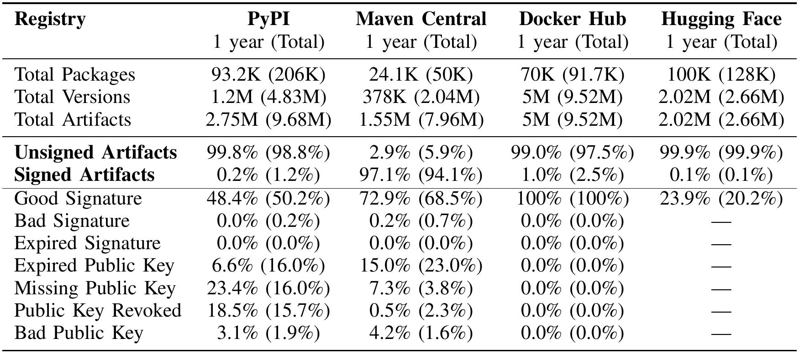

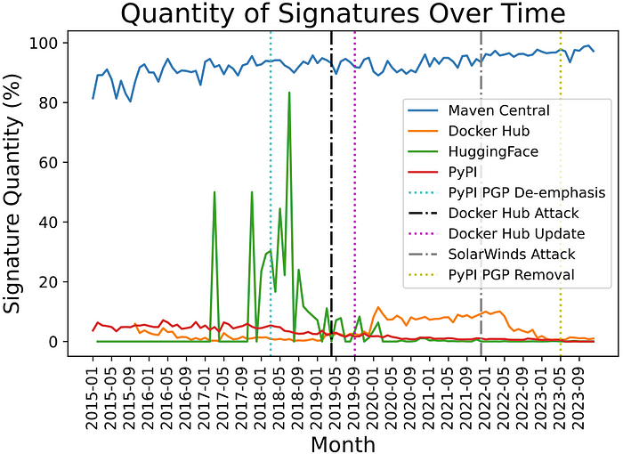
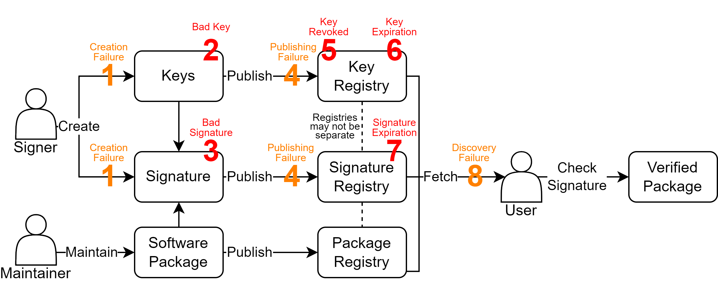
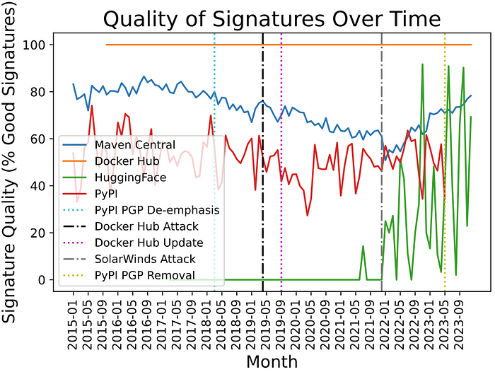
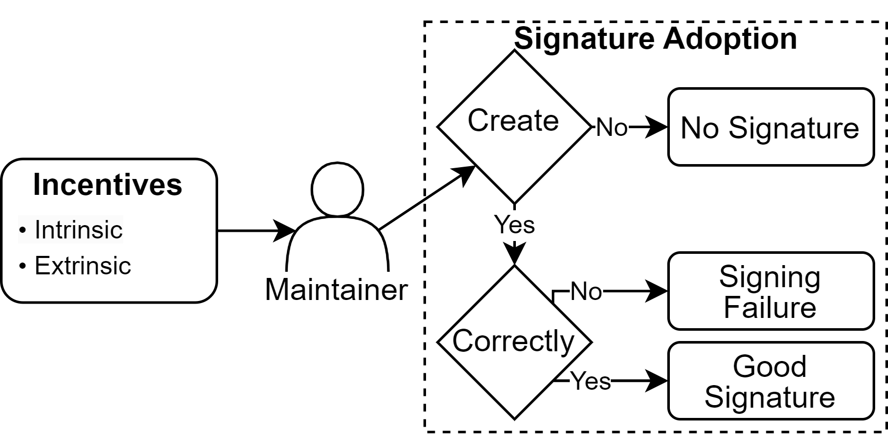
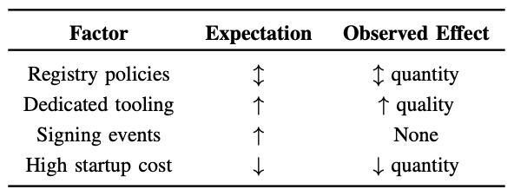
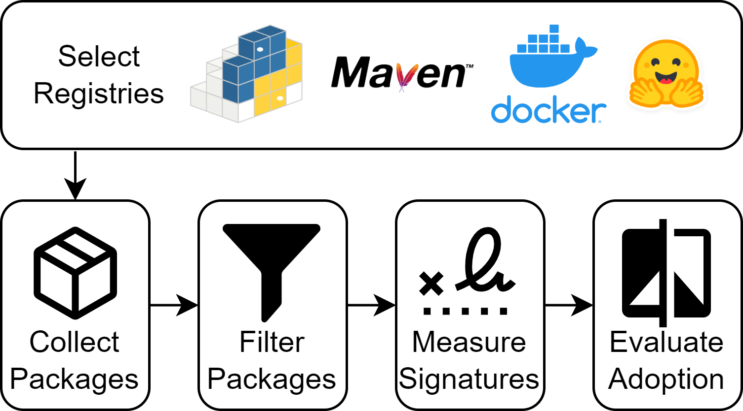




Signing practices vary widely in public software package registries. Some factors affect adoption, others do not.
Signing in Four Public Software Package Registries: Quantity, Quality, and Influencing Factors
RESULTS
Schorlemmer, Kalu, Chigges, Ko, Ishgair, Bagchi, Torres-Arias, & Davis
PRESENTER
Taylor R. Schorlemmer
tschorle@purdue.edu
BACKGROUND
Current state of adoption is poor:
Signing is a tool used to establish provenance in software supply chains.
Low quantity
Quality lacking
Policies affect quantity
Tools affect quality
Cybersecurity events have little effect
Getting started is hard
THEORY
METHODOLOGY
Registry operators hold power.
New tools can aid adoption.
SUPPORTED BY

