Slide 1

Node.fz
Fuzzing the Server-Side
Event-Driven Architecture
James Davis, Arun Thekumparampil*, Dongyoon Lee
Department of Computer Science
(*Electrical and Computer Engineering)
Notes:
Good afternoon, my name is James Davis, from Virginia Tech. My advisor is Dr. Dongyoon Lee.
Today I’m going to present work we did with Arun Thekumparampil
on fuzzing the Server-Side Event-Driven Architecture.

Slide 2
This talk will answer three questions
Why should you should care about the EDA?
What kinds of bugs happen in EDA programs?
How can we more effectively catch EDA bugs?

Slide 3
Two Main Contributions
Concurrency bug study
Node.fz
Notes:
Concurrency bug study: to the best of our knowledge, the first of server-side event-driven programs
Our findings informed the development of our test tool, Node.fz, and should also guide future test tools for the server-side EDA.
Node.fz: The first concurrency fuzz testing tool tailored to server-side event-driven applications
Evaluated using a diverse set of real-world Node.js applications
Our evaluation shows that, among other things, Node.fz increases the manifestation rate of concurrency errors. We believe Node.fz will help Node.js developers more rapidly identify and fix these errors in their applications.
To understand our bug study and Node.fz, we first need to understand the event-driven architecture.

Slide 4
What is the Event-Driven Architecture?
Notes:
For an example, let’s see two possible implementations of a web server.

Slide 5
The One Thread Per Client Architecture (OTPC)
Handle request
Handle request
Dispatcher
Many threads
Notes:
+
In the OTPC architecture, each client’s request is assigned its own thread on which to compute the response.
Each client’s thread proceeds in parallel.

Slide 6
The Event-Driven Architecture (EDA)
Event Loop
Worker Pool
Pending events
offloads
returns
completed work
Notes:
+
In the EDA architecture, all activities related to clients are performed by the same threads:
the event loop, the principal work horse
a small, fixed-size worker pool (e.g. 4 threads), used for example for file I/O
Applications are structured using callbacks that respond to events, e.g. “new network traffic” or “the work I offloaded to the worker pool has completed”.
----------
This architecture is used in popular EDA frameworks in JavaScript (Node.js), Python (Twisted), Ruby (EventMachine), C (libuv), Java (Reactor), etc.
This architecture is also known as the Asymmetric Multi-Process Event-Driven (AMPED) arch. (Pai 1999’s Flash paper).
NB NOT A SALES PITCH. Explain that Lauer 197X argues that these are “duals” – equivalent in their expressive power.
The issue at hand is what does the technology – threading libraries, event-driven frameworks – enable, and whether the EDA enables more scalability than the OTPC.

Slide 7
The key difference is multiplexing
OTPC: Clients get dedicated resources
Preemptive multi-tasking
EDA: Clients share resources (multiplexing)
Cooperative multi-tasking
Tradeoff: efficiency vs. reliability
Notes:
The key difference between the OTPC and the EDA is whether clients should share resources, also known as multiplexing.
In the OTPC, we dedicate resources to each client, and rely on preemptive multi-tasking to share.
In the EDA, clients share the same resources (small number of threads), and sharing is done cooperatively (aka cooperative multi-tasking).
+
The essential trade-off between the OTPC and the EDA is efficiency vs. reliability.
In the OTPC, we have to dedicate resources to each client.
This incurs both space and time overheads, like context switching.
The EDA is comparatively efficient, since it multiplexes the same resources among many clients.
Now, sharing these resources puts extra demands on EDA developers: they must implement sharing correctly, which can be pretty tricky.

Slide 8
Why should you care about the Event-Driven Architecture?
Notes:
Let me emphasize: I’m not here to argue that the EDA is “the right way” to build server-side applications.
However, I do want you to understand that the EDA is an increasingly popular way to build server-side applications, and these developers need our help.

Slide 9





Node.js: A Server-Side JavaScript EDA Framework
“Full stack JavaScript” (Ryan Dahl, 2009)
3.5M+ developers (April 2016)
450K+ modules (March 2017)
2B+ module downloads/week (March 2017)
Notes:
If you are not already acquainted, let me introduce you to Node.js, a server-side JavaScript EDA framework.
Node.js is aka “full stack JavaScript” and was introduced in 2009 by Ryan Dahl.
It consists of:
A JavaScript engine
An event library
Built-in C++ and JavaScript libraries for system calls like file system APIs
It has a large, active developer community.
Developers benefit from the 450,000 open-source modules in its package ecosystem
→ The largest of any language.
Node.js has made impressive inroads into industry, with adoption at major companies including IBM and Microsoft.
-------------
3.5M+ developers as of April 2016
450K+ modules as of March 2017
2B+ module downloads/week (up 250M/wk since January 2017)
SO survey of 64K developers: JS most commonly used language, Node.js most commonly used framework
Other EDAs: Desktop (Electron), Mobile (Android), IoT (Cylon.js)
Developer statistics: https://nodejs.org/en/blog/announcements/nodejs-foundation-survey/
Module / download statistics: https://www.npmjs.com/
StackOverflow survey: https://stackoverflow.com/insights/survey/2017/?utm_medium=email&utm_campaign=dev-survey-2017&utm_content=em-features&utm_source=so-owned
Companies: IBM, Microsoft, Netflix, Walmart, eBay, PayPal, …

Slide 10
What can go wrong in the EDA?
Notes:
Well, it turns out that programming in the EDA looks a lot different from programming in the OTPC.

Slide 11
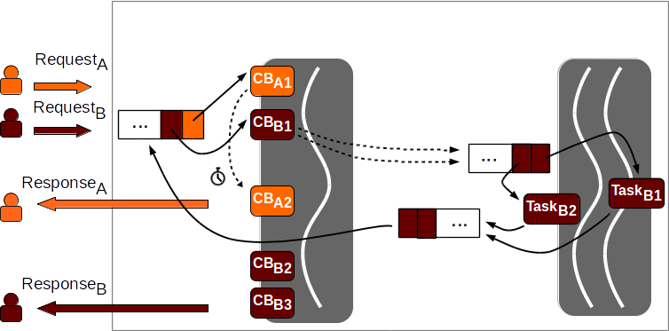
Programming in the EDA is different
Event loop
(single-threaded)
Worker pool
(k threads)
Event
queue
Task queue
Done queue
Notes:
This illustration shows a snapshot of what an event-driven program might look like as it runs.
Two requests arrive, from an orange client and a red client.
The orange callback starts working on a response, then yields to let another event happen.
It defers the rest of its work with a timer, then returns a response to the user.
The red callback submits two asynchronous requests to the worker pool.
When these requests complete, they are put in the “done queue”.
Eventually the event loop sees pending “task done” events and invokes the corresponding callbacks.
The major difference in the EDA is the need to implement cooperative multi-tasking.
Since only one user can have something executing on the event loop at a time
The golden rule is “Don’t block the event loop”.
Instead, offload I/O-bound tasks to the worker pool, and use the event loop to respond asynchronously once the I/O completes.
This requires developers to partition the creation of responses into bite-sized chunks connected using “callback chains”.
Developers must ensure their code correctly accounts for
Atomicity: because other events can be interleaved
Ordering: many possible orders for asynchronous operations
If “atomicity” and “ordering” sound familiar, they should – these are the ingredients for race conditions.
These “evented race conditions” occur due to alternative event orderings rather than racing threads.

Slide 12

Research Question 1 What are race conditions like in the server-side EDA?
The bug study
Notes:
TIME 6:00
What we don’t know, however, is “What do these race conditions actually look like in the server-side EDA?”
EDA race conditions have been studied on the client side, e.g. client-side JavaScript, but not on the server side.
To the best of our knowledge, this is the first bug study of its kind: server-side EDA programs.
I’ll first give you an example of an atomicity violation and of an ordering violation.
----------
Related: multithreaded programming bug studies (“Learning from our mistakes”), distributed concurrency studies (TaxDC), etc.
There have also been previous studies on client-side bugs in the EDA.

Slide 13
Example: Atomicity Violation
var NEXT_ID = 0;
function onConnect (client) {
client.id = NEXT_ID;
setTimeout(nextStep, 1);
}
function nextStep () {
NEXT_ID++;
}
0
0
1
Notes:
An AV occurs when the author intends two pieces of code to run without interruption but fails to enforce it.
This is similar to failing to acquire a lock while in a critical section.
In this example, the developer’s goal is to assign a unique ID to each client based on the global NEXT_ID variable.
When a client connects, the onConnect callback assigns it an ID.
It then yields (to provide cooperative multitasking), incrementing NEXT_ID after a timeout.
This means that the “read” and “increment” steps on NEXT_ID are not performed atomically.
In this illustration, orange and red have both connected.
+ Orange callback runs onConnect, gets ID 0
+ Red request runs onConnect, and also gets ID 0!
+ Only then does the orange nextStep run to increment nextID
So, the orange and red clients got the same ID.

Slide 14
Example: Ordering Violation
var done = 0;
fs.readFile(f1, afterRead);
fs.readFile(f2, afterRead);
function afterRead (f) {
if (f === f2)
done = 1;
}
start
f2
f1
Task queue
Done ?= 1
Done queue
Notes:
An OV occurs when operation A should always be executed before operation B, but this order is not enforced.
In this example, the code has a “done” flag to indicate when these two asynchronous “readFile” requests have finished.
When each completes, it runs the afterRead callback.
Let’s walk through one possible execution.
+ We start
+ We asynchronously read each file in the worker pool
+ If the read of the second file finishes first, we set the “done” flag too early!
The code incorrectly enforces the ordering.
-------------
Using the task queue can lead to OVs.
The more workers in the worker pool, the higher the probability that tasks will “leapfrog” each other.
In principle, if there are at least two workers, any two independent tasks can occur in either order.
Now, the order in which they complete affects the order in which they enter the worker pool’s “Done queue”,
which in turn tells us the relative order in which their respective “done” callbacks will be executed by the event loop.

Slide 15
Bug study overview
12 bugs from GitHub
From Node.js applications and npm modules
Patterns, manifestations, and fixes
Races on many kinds of events
→ Tools must span entire Node.js framework, not just JavaScript
Races on shared memory and system resources
→ Not like the client-side EDA
Races can have severe consequences
Affect all clients, not just one
Much more in the paper
Notes:
Three big takeaways
The events involved in race conditions stem from diverse sources including network traffic, timers, and the relative timing of worker pool tasks.
→ This means that tools that help trigger race conditions must span the entire Node.js framework, both the JavaScript and C++ components.
2. Race conditions are not only on shared memory, but also on system resources (e.g. queries to a database).
→ This is unlike the client-side setting, where most or all classes of accesses are well defined.
3. Race conditions may result in severe consequences including server crashes and inconsistent database states.
While this is not particularly surprising on the server-side
- This is much worse than previous major uses of the EDA, which were on the client side.
- Raises the stakes for the EDA community: can they make their code reliable enough for the server side?
More on the bug study in the paper.
Unfortunately, the Node.js community (and the server-side EDA community in general) is lacking tools to help them trigger these and other bugs, which brings us to the second research question.
-------
> on the client side, a crash affects one person, and they can easily reload the webpage.
> here, a failure can affect every user of the service, not just one.
- In other words, “full stack JavaScript” raises the stakes for the EDA – and JavaScript – community.

Slide 16
Research Question 2 How can we more easily identify race conditions in Node.js applications?
Node.fz
Notes:
TIME 10:00

Slide 17
Node.fz scales to the server
Thousands or millions of events
Random, not exhaustive, schedule exploration
“Schedule fuzzing”
Notes:
Server-side EDA applications encounter thousands or millions of events just while running a test suite.
This introduces a problem of scale: we don’t have enough time to explore all possible schedules.
So, let’s review the ingredients for a race condition:
Race conditions arise because of non-determinism in the system.
Non-determinism results in multiple possible schedules, one or more of which might be buggy.
→ If we can explore more schedules, we’ll expose more race conditions.
+
Inspired by the success of similar approaches in the multi-threaded software community, we decided to try a simple idea:
Force the application onto new schedules by randomly perturbing each run of the application.
This “schedule fuzzing” approach has been explored in the multi-threaded setting, but we are not aware of work that has tried it in the EDA.
-------
Catching concurrency errors on the server-side is hard for two reasons.
1. There are thousands or millions of events, making a search for races expensive and prone to false positives.
2. It’s hard to label accesses as racy in the “open system” – not just memory races, but also on external systems.
Fuzzing
While random schedule exploration offers no concrete guarantee of schedule coverage, it does let you try a lot of different schedules and see if any of them cause a crash.
This approach is also known as “schedule fuzzing”.

Slide 18
Original Node.js (libuv) architecture
Event loop
(single-threaded)
Worker pool
(k threads)
Event
queue
Task queue
Done queue
Notes:
This is the original Node.js architecture.
The non-determinism here arrives from two major sources:
The order in which external events arrive.
The arrival order of Request_A and Request_B affects the order in which their callbacks execute
The order in which “internal events” are processed.
These internal events are the result of partitioning algorithms into multiple steps to achieve cooperative multi-tasking.
So, next I’ll show you what changes we made to control this non-determinism.
----------
In the OTPCA, the schedule is almost completely determined by the (non-deterministic) thread schedules.

Slide 19
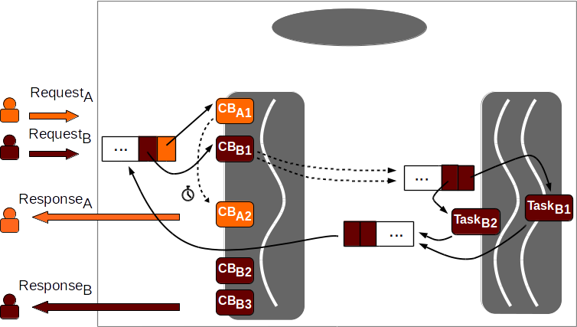
1: Add a scheduler
Scheduler
1
Event loop
(single-threaded)
Worker pool
(k threads)
Event queue
Task queue
Done queue
Notes:
First of all, we added a scheduler that will choose which event to handle next.

Slide 20
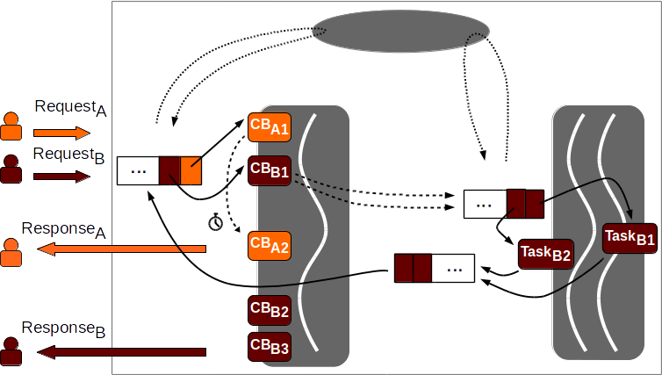
2: Add scheduling hooks
Scheduler
2
Event loop
(single-threaded)
Worker pool
(k threads)
2
Event queue
Task queue
Done queue
Notes:
We also identified places to add scheduler hooks, for example:
- before the event loop chooses an event from the event queue
- before a worker selects a task from the task queue
Using these hooks, these threads can query the scheduler to determine which pending event or task it should handle next.

Slide 21
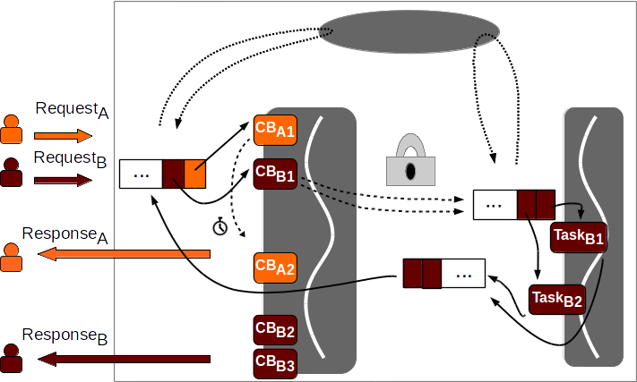
3: Serialize callbacks
Scheduler
Event loop
(single-threaded)
Worker pool
(1 thread)
3
Event queue
Task queue
Done queue
Notes:
Serializing event callbacks allows us to accurately record schedules.
This in turn enables us to measure how effectively Node.fz expands the schedule space explored by a given input.
------
This is represented by ensuring that as time progresses (in the figure, from top to bottom), no two callbacks overlap.
It also effectively reduces the worker pool size to 1.

Slide 22
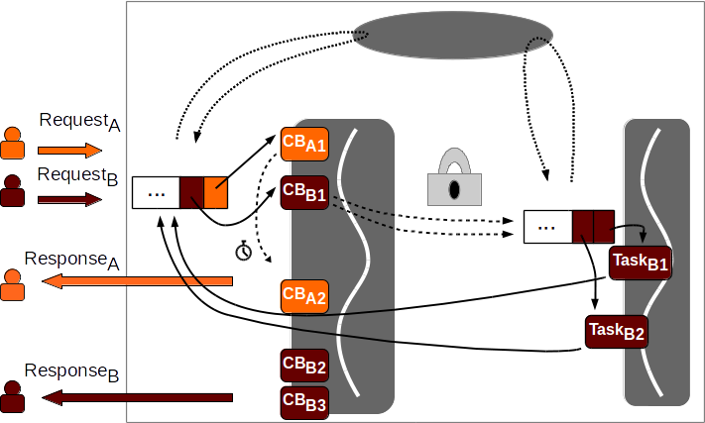
4: Remove done queue
Scheduler
Event loop
(single-threaded)
Worker pool
(1 thread)
Event queue
Task queue
4
Notes:
Removing the done queue causes the “completion” notifications to go directly to the event queue, instead of being batched together.
This allows us to fuzz the task completion order in the same way we fuzz other input events.

Slide 23
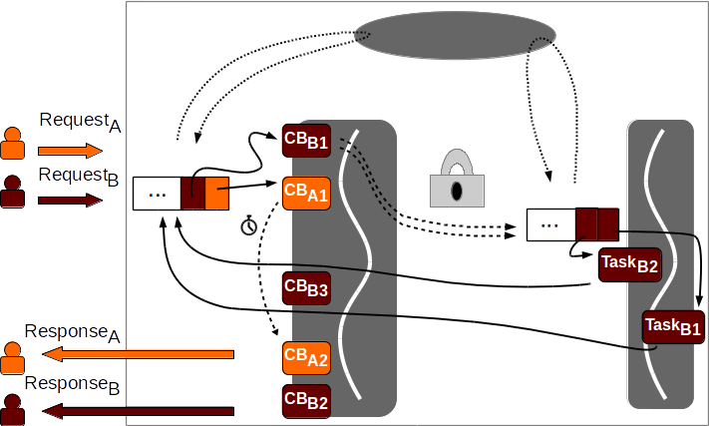
5: Fuzz! – node.fz
Scheduler
5
5
Event loop
(single-threaded)
Worker pool
(1 thread)
Event queue
Task queue
Notes:
Our fuzzing scheme allows us to change the order of events in all legal ways.
We can fuzz the external non-determinism arising from alternative input orders.
+ We can flip the arrival order of orange and red.
We can also explore the internal non-determinism arising from partitioning algorithms.
+ We can change the worker pool task ordering
+ And completion ordering
+ As well as the relative timer expiration time
You can see that Node.fz is not a race detector; it is rather a race exposer.
It expands the set of schedules explored by the application, so if there are races, they become more likely to occur.
Our scheduler can be extended to support detecting and trying to schedule possible races, but we’ve left that for future work.
-----------------
Another way to think about the effect node.fz has:
External non-det: turns one test case into many – e.g. testing different orders of requests
Internal non-det: explores all the ways a given input order can resolve
Although Node.fz gives us complete control over the Node.js schedule, we don’t try to steer the schedule in any particular direction, e.g. with a record-perturb-and-replay approach.
Problem: black box, semantic gap at the libuv level

Slide 24
Node.fz improves bug reproduction rates
node.js
node.fz (no fuzzing)
node.fz (fuzzing)
Bug reproduction rate
Notes:
This chart shows one way in which we evaluated Node.fz.
On the X axis we have different applications from our bug study.
The first part of this study was to reproduce known bugs
For the first 9 sets of results, we ran each application 100 times against a test case designed to trigger the race condition from the bug study.
These cases were modeled after those included in the GitHub bug reports, but we made them less targeted: more like realistic functional tests.
The Y axis shows the bug reproduction rate using three different frameworks:
- Node.js (blue column)
- Node.fz w/o fuzzing (just architectural changes) (pink column)
- Node.fz w/ fuzzing (red column)
Higher reproduction rates are better.
We see here that in most cases:
- the bug does not manifest using Node.js
- it does so rarely using Node.fz without fuzzing
- the bug regularly manifests using Node.fz with fuzzing
The second part of this study was to search for new bugs.
We ran the test suites for each application from our bug study 50 times and looked for crashes.
We found 3 different crashes, with reproduction rates in the final three sets of columns.
We found:
- one bug in Socket.io. We submitted a pull request and it has been accepted.
- two bugs in KUE, one of which had already been fixed.
----------------
Details
RST also manifests 100% using node.js, so we omitted it. These are due to the tests still being too bug-centric.
EPL: couldn’t automate, web browser interactions
WPT (CoffeeScript, we couldn’t transpile it to JavaScript to analyze the case more carefully)
GHO: no reproduction case, so this is a mock test case based on the description: GHO’
Final 3: 50 trials b/c test suites take longer to run
New bugs
Kue: one fixed already, the other we have a bug report but don’t know the root cause.

Slide 25
Stuff I didn’t talk about
The details of the bug study
“Commutative” Ordering Violations
In-depth discussion of how Node.js is implemented
and all the sources of non-determinism
Node.fz is a legal, viable alternative to Node.js
Node.fz’s parameters
Node.fz measurably increases schedule exploration
Node.fz exposed two new bugs
Tuning Node.fz parameters can increase bug reproduction rate
“Guided fuzzing”
Evaluation of performance overhead
Notes:
Of course, we have more to say about our bug study, and we evaluated Node.fz in other ways.
We talk about all this in the paper, which I hope you’ll read.

Slide 26
Closing thoughts
You should care about the EDA.
EDA race conditions are due to multiplexing.
Schedule “fuzzing” is simple and effective.
Notes:
EDA: it is an increasingly important architecture on the server-side
Race conditions: fundamentally due to multiplexing
→ and incorrect implementation of cooperative multitasking
Fuzzing: simple and effective
→ though I anticipate that race detectors for the server-side EDA are not far off.
Thank you for your attention.
I would be happy to answer any questions you have, both now and offline.

Slide 27
Additional material

Slide 28
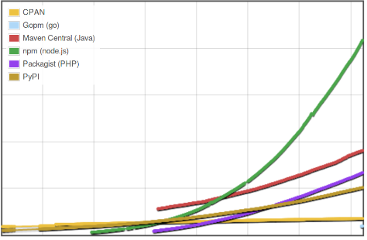
Node.js (and the EDA) is booming
Module counts for different languages
500K
400K
300K
200K
100K
0
CPAN
Gopm (go)
Maven Central (Java)
npm (node.js)
Packagist (PHP)
PyPI
2011 2012 2013 2014 2015 2016 2017
www.modulecounts.com, 27 March 2017
Notes:
Introduce X axis, Y axis.
To give you a sense of the popularity of Node.js:
- Bottom up: Go, Perl, Python, PHP, Java…and Node.js’s npm
Clearly, the EDA – and Node.js -- is an increasingly popular way to build server-side applications.
-------
These figures are taken from Erik DeBill’s modulecounts website, which scrapes the relevant websites once a day.
This is counting separate modules, so a module with multiple versions is still counted only once.

Slide 29
Bug study in the server-side EDA
npm modules, Node.js applications
Patterns, manifestations, and fixes
Searched GitHub: race, JavaScript, closed bugs
Studied 12 well-documented bugs (hard to come by)
Name | Abbr. | LoC | Dl/mo | Descr.
cinovo-logger-file | CLF | 0.9K | 111 | Logging
mkdirp | MKD | 0.5K | 23.3M | mkdir -p
agentkeepalive | AKA | 1.9K | 194K | HTTP keepalive agent
kue | KUE | 6.6K | 69K | Priority job queue (Redis)
restify | RST | 5.5K | 232K | Help building RESTful APIs
… | … | … | … | …
Notes:
XXX TODO Details about search, applications, etc.

Slide 30
Selected Findings from Bug Study
Abbr. | Type | Racing Events | Race on | Impact | Fix
CLF | AV | FS-Call | Variable | Duplicate file | R/W in same callback
AKA | AV | NW-Timer | Variable | Throws error | R/W in same callback
MKD | AV | FS-FS | File system | No mkdir | Check error code
KUE | OV | NW-NW | Database | Job repeats | Order async calls
RST | (C)OV | FS-X | Array | Incomplete response | Use an async barrier
… | … | … | … | … | …
Notes:
TODO XXX Some interesting details
e.g. relative proportion of AVs and OVs
Three big takeaways
Events involved in race conditions stem from diverse sources such as network traffic, timers, user method calls, and the timing of worker pool work processing (FS, potentially X) and “done” events.
This means that tools that help trigger race conditions must span the entire Node.js framework,
including both JavaScript (application code and libraries) and C/C++ (which interacts with the worker pool -- FS, crypto, etc.)
Can’t just sit in JavaScript (like Jalangi).
2. Race conditions are not only on shared memory (e.g. writes to variables and arrays), but also on system resources (e.g. queries to database, I/O to file system).
This is unlike the client-side setting -- web browser: racy accesses to the DOM, perhaps, but all classes of accesses are well defined.
This class of “open system” races defeats client-side JavaScript tools, which only target memory races.
3. Race conditions may result in severe consequences including server crashes and inconsistent database states.
This is not particularly surprising, because Node.js apps are server-side.
These issues have been happening in the multi-threaded software community for a long time.
However, this is much worse than previous uses of the EDA – client-side JS (reload the web page), Android (reload the app)
Here, a failure can affect every user of the service, not just one.
Unfortunately, the Node.js community (and the server-side EDA community in general) is lacking tools to help them trigger these and other bugs, which brings us to the second research question.

Slide 31
“Commutative” Ordering Violations
Goal
Code
Result
var fs = require('fs');
var N = 4;
var i;
for (i = 1; i <= N; i++)
start(i);
function start (i) {
fs.readFile('/tmp/f', function () {
if (i === N) {
/* BUG -- not finished! */
nextStep();
}
});
}
1
2
3
4
1
2
3
4
2
2
2
Notes:
Anti-pattern when launching several asynchronous requests.
The misconception is this: “The finish order is not the same as the start order”.
Not previously reported. Presumably more common in a server setting b/c more complex control flow for requests.
The ordering constraint is not between the async requests, but rather in ensuring that they can execute in any order (i.e. commutatively).
Observed in 2 of the 12 original bugs, and in one of the novel bugs we identified.
Suggests it’s a common error.
This code is based on the Mongoose bug (#2992).
Correct is to use an async barrier, a promise.thenAll, etc.

Slide 32
Node.js Architecture
Application
Node.js
Bindings
(Node APIs)
libuv
.
.
.
V8
JavaScript
Engine
JS libs
C++ libs
C++ addons
Based on http://stackoverflow.com/q/36766696
Notes:
Green: Node.js itself
Orange: Part of application
Grey: Other software projects

Slide 33
Libuv’s event loop
Update loop time
End
Loop
alive?
Timers 1
Pending callbacks
Idle callbacks
Prepare handles
Poll for I/O (epoll)
Check handles
Close callbacks
Timers 2
http://docs.libuv.org/en/v1.x/design.html
Notes:
NB: Node maintains its own event loop, which:
which runs the libuv loop once
calls V8’s “PumpMessageLoop” which takes care of misc. V8 tasks
e.g. garbage collection
JIT code optimization, etc.

Slide 34
Sources of Non-Determinism in Node.js Programs
External – input
Network traffic
Timers (global clock)
UNIX signals
Internal – due to cooperative multitasking (partitioning algos.)
Partitioning on I/O-bound activities
Network traffic (for remote services like database queries)
FS responsiveness
Worker pool thread schedule
Partitioning on CPU-bound activities
CPU speed (compression, crypto, etc.)
Notes:
The effect of all this non-determinism is to make the relative timing of events highly variable, whether externally or internally generated.

Slide 35
Node.fz is a legal, viable replacement for Node.js
Legal: Compliant with Node.js documentation
Viable: Matches internal assumptions about libuv behavior
Node.fz passes the Node.js test suite*
Notes:
TODO XXX Any other notes.
Doesn’t pass tests that require multiple libuv loops, e.g. the VM module. Happily these modules seem to be rarely used in practice.
We tried fuzzing timers, since the docs don’t require FIFO order on timers.
This caused some test suites to fail. Coding against an unwritten standard, hmm…

Slide 36
Fuzzing parameters
Parameter | Description | Default
EL: epoll DoF | epoll queue shuffle distance | -1
EL: epoll deferral % | Probability of deferring a ready epoll item until the next loop | 10%
EL: Timer deferral % | Probability of deferring a ready timer until the next loop | 20%
EL: closing deferral % | Probability of deferring a ready “close” until the next loop | 5%
WP: DoF | Work queue shuffle distance | -1
WP: Max delay | Time to wait for full task queue | 0.1 ms
WP: epoll threshold | Time to wait when EL also waits | 0.1ms
EL: Event Loop | WP: Worker Pool | DoF: Degrees of Freedom
Notes:
XXX TODO

Slide 37
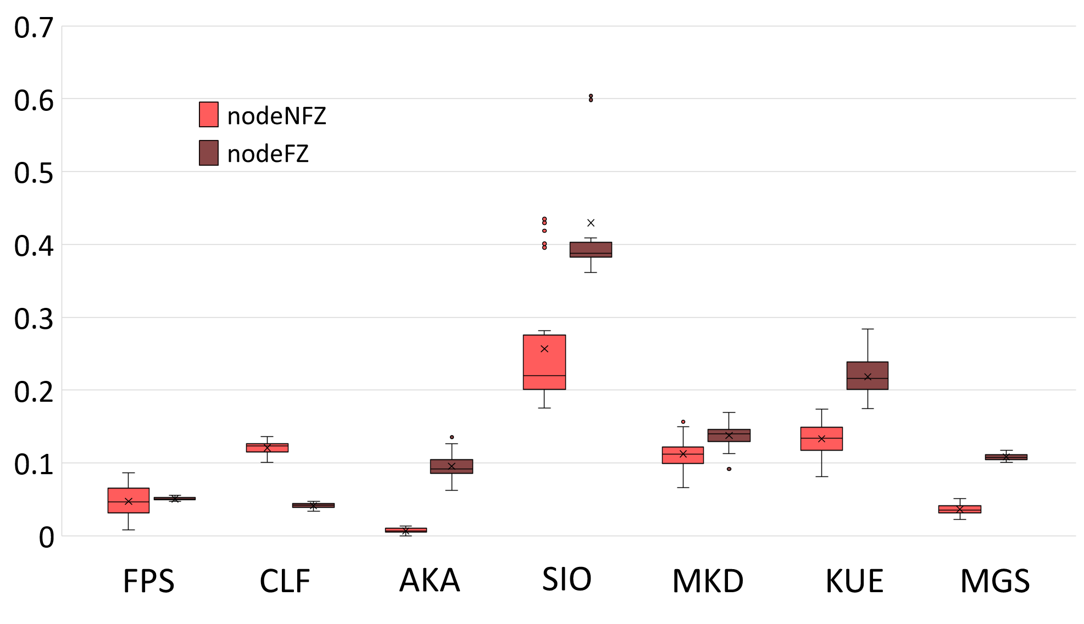
Schedule variation induced by fuzzing
Normalized Edit Distance
Notes:
Define the type schedule: “libuv-level” schedule.
Approximates the JavaScript-level schedule because from libuv we can’t tell which callbacks we are executing.
We ran the test suites of these modules 10 times using Node-NFZ and Node-FZ and obtained type schedules.
We then computed the normalized Levenshtein Distance (LD) (string edit distance: substitution, insertion, deletion) between these type schedules
We truncated the type schedule to the first 20K events as needed (two schedules had ~60K events, one had 210K events) due to computational complexity of the LD algorithm.
Note that a normalized LD of 1.0 will occur when the two type schedules are wildly divergent, and the shortest distance from one to the other is a token-by-token substitution a -> b – in other words, they have little in common.
Not something we expect to see here.
In every case but CLF, node FZ increased the schedule variation, in most cases appreciably or significantly.
We believe the significant truncation of the CLF schedule (210K -> 20K) led to the surprising decrease in schedule variation for that test.

Slide 38
We found two new bugs
Socket.io: PR 2721
Test case fails to clean up repeating temp socket
“Temp” socket connects to server during later test
Steals resource from subsequent tests → timeout
Kue: Issue 967
Fails on NodeNFZ and NodeFZ
Timeout while acquiring lock from Redis
Suggests atomicity violation

Slide 39
“Guided fuzzing” increases repro. rate
Assert failed on 3/50 trials using “standard parameterization”
Assert referred to a timer going off early
Tuned parameters to improve timer accuracy
E.g. defer worker pool tasks and event loop events
The event loop spends most of its time spinning
→ and timers are identified quickly
New parameter values improved repro rate to 13/50.
Notes:
You can choose fuzzing parameters to increase bug reproduction rate.
This was for a bug in KUE that has since been fixed.
We identified it independently.

Slide 40
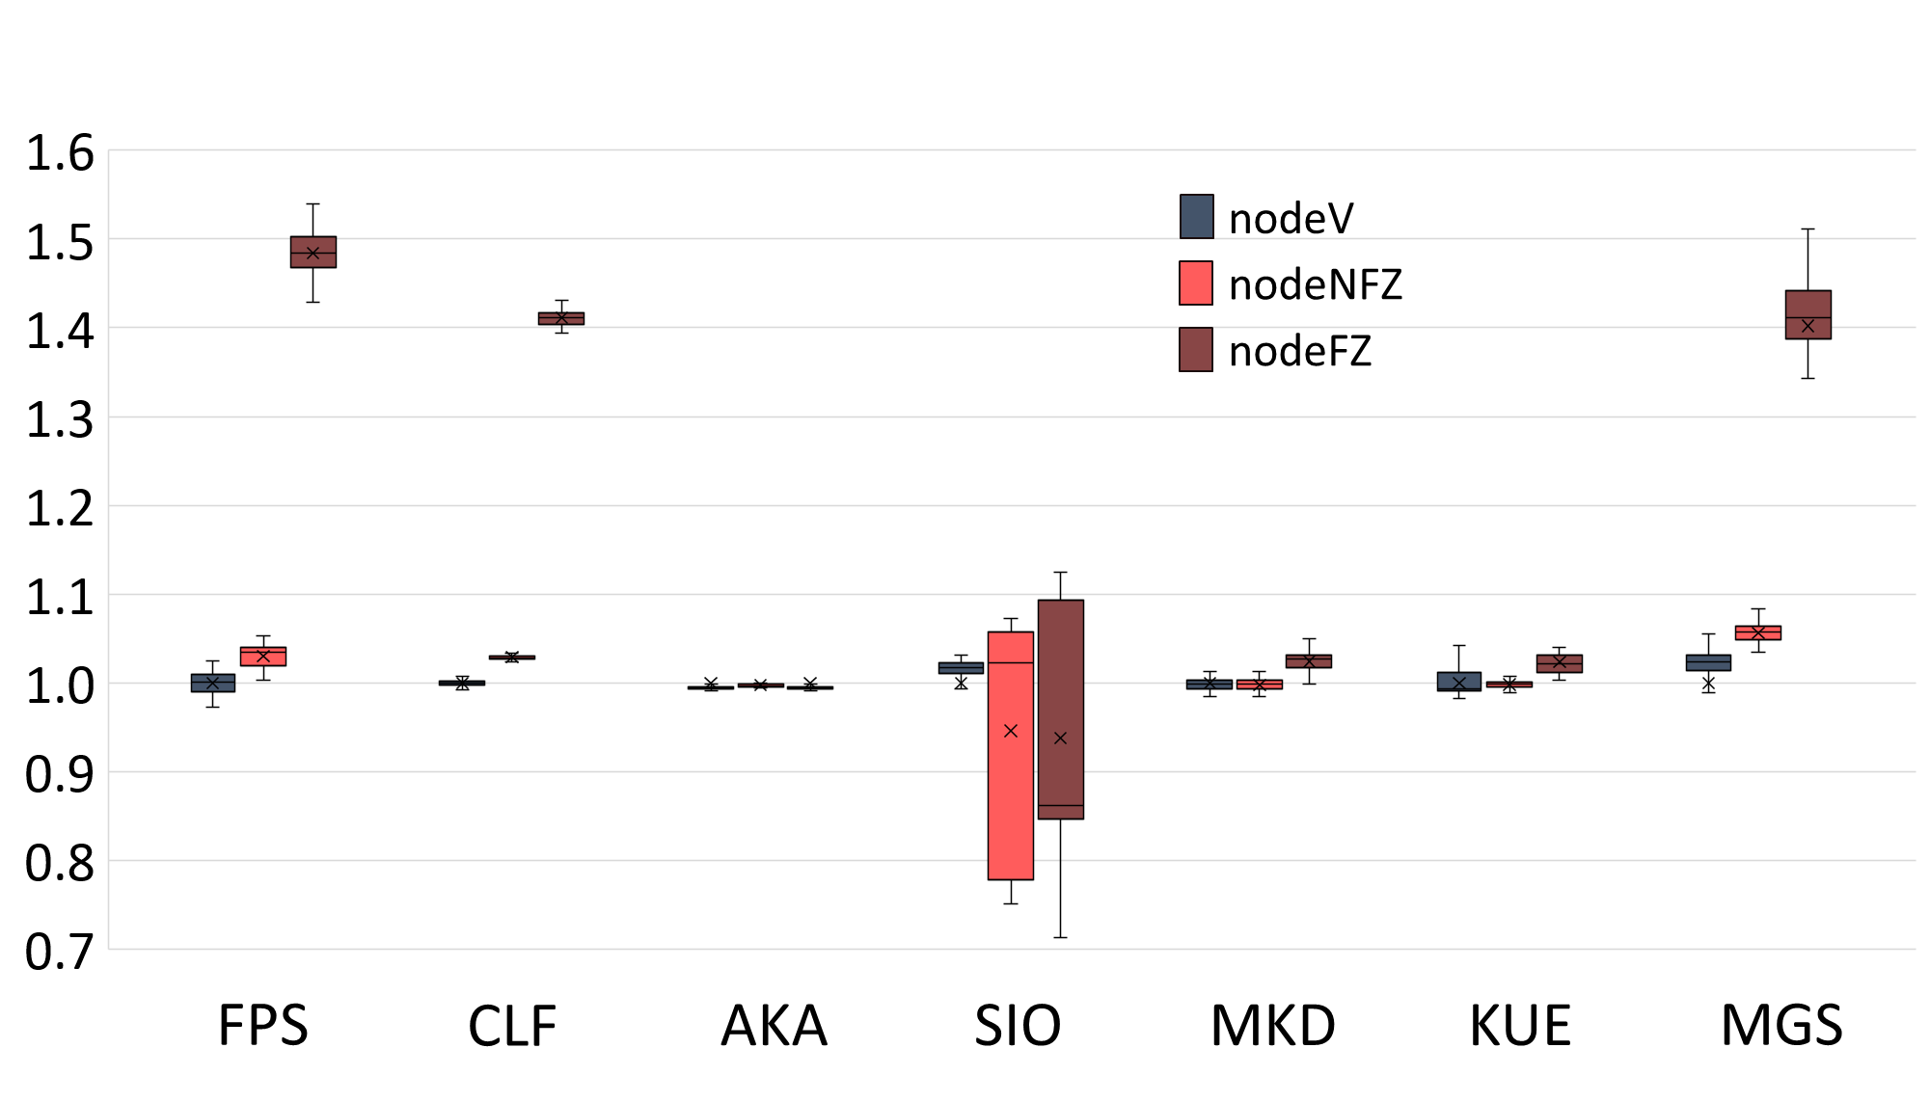
Node.fz Performance Overhead
Normalized time to run test suite
Notes:
Times were taken while running the test suite of the indicated modules using Node-Vanilla, Node-NFZ, and Node-FZ.
Each suite was run 50 times on an otherwise idle system.
Note that Node-NFZ has similar overhead to Node-Vanilla in these examples.
So the overhead of Node-FZ here is due to the timing changes we inject (configurable by user), and not due to inefficiencies in the implementation.
User can tune as needed.

Slide 41
Experimental slides

Slide 42
The One Thread Per Client Architecture (OTPC)
Evaluate input
against RegEx pattern
Get RegEx from DB
Assigned to thread
Prepare response
Send response
Request arrives
Handle request
Handle request
Request arrives
Dispatcher
Many threads
Send response
Get RegEx from DB
Prepare response
Evaluate input
against RegEx pattern
Assigned to thread
Notes:
Same as the earlier slide, but has labels.
I think they don’t add anything I can’t say out loud, and it’s hard to decide when and where the label should appear.

Slide 43
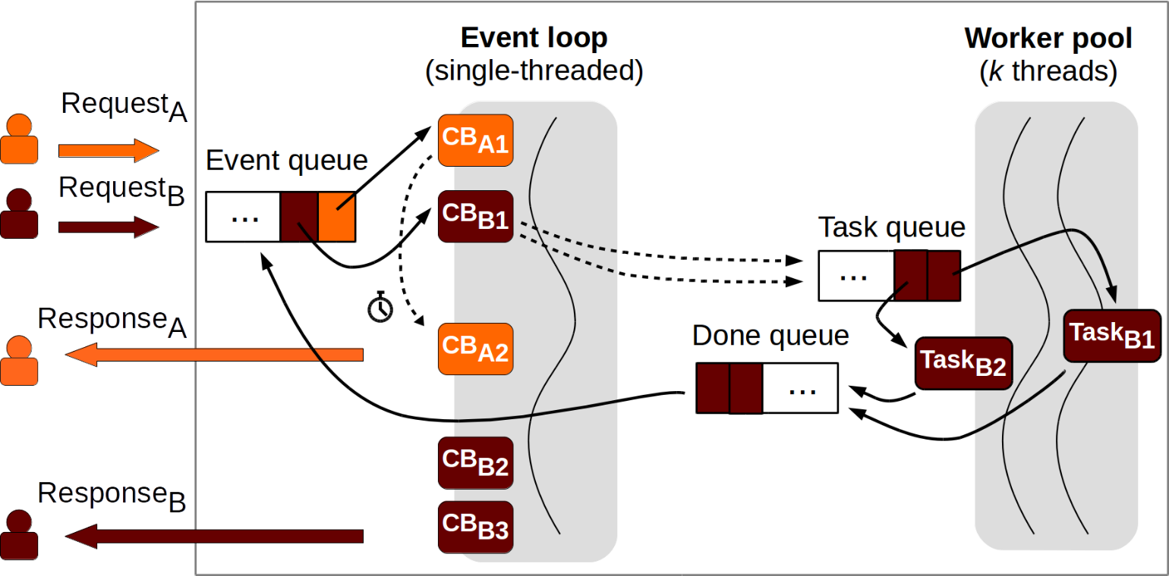
Example: Ordering Violation (KUE 483)
Job.prototype.markFailed () {
...
if (...) {
this.update().delayed();
}
...
}
Asynchronous
Notes:
This is the OV from kue.
However, it doesn’t SHOW the use of the “done callback”, which was confusing in my practice presentation.
An OV occurs when operation A should always be executed before operation B, but this order is not enforced.
This example is taken from the bug we studied in the kue module (bug 483).
Kue uses the Redis database to persistently store each job’s state.
When we enter the “markFailed” function, we schedule two database operations “update” and “delayed” (nodes 2 and 3).
“update” will mark the job failed in the database, while “delayed” will mark it delayed.
The code looks correct, because update() is called, and then delayed() is called.
However, both of these functions are actually asynchronous; each changes the state only after completing some I/O.
Since there is no ordering defined between them, they can complete in either order.
In consequence, the job’s final state is not defined: it could end up in “failed” state if update() finishes last, or in “delayed” state if delayed() finishes last.
Let’s look at an example from our snapshot of a running Node.js server.
Using the task queue can lead to OVs.
CB_B1 (e.g. markFailed) submits Task_B1 and Task_B2 to the task pool. Once in the task pool, they can run concurrently and finish in any order.
The more workers in the worker pool, the higher the probability that tasks will “leapfrog” each other.
In principle, if there are at least two workers, any two independent tasks can occur in either order.
Now, the order in which they complete affects the order in which they enter the worker pool’s “Done queue”,
which in turn tells us the relative order in which their respective “done” callbacks will be executed by the event loop.
In this case, Task_B1 and Task_B2 represent communicating with the database.
CB_B2 and CB_B3 represent the subsequent JavaScript code that updates the state to “failed” and “delayed” respectively.
Since there is no ordering enforced between these callbacks, they can occur in either order.

