Slide 1
An Empirical Study of GraphQL Schemas
Erik Wittern, Alan Cha, James C. Davis, Guillaume Baudart, Louis Mandel

Slide 2
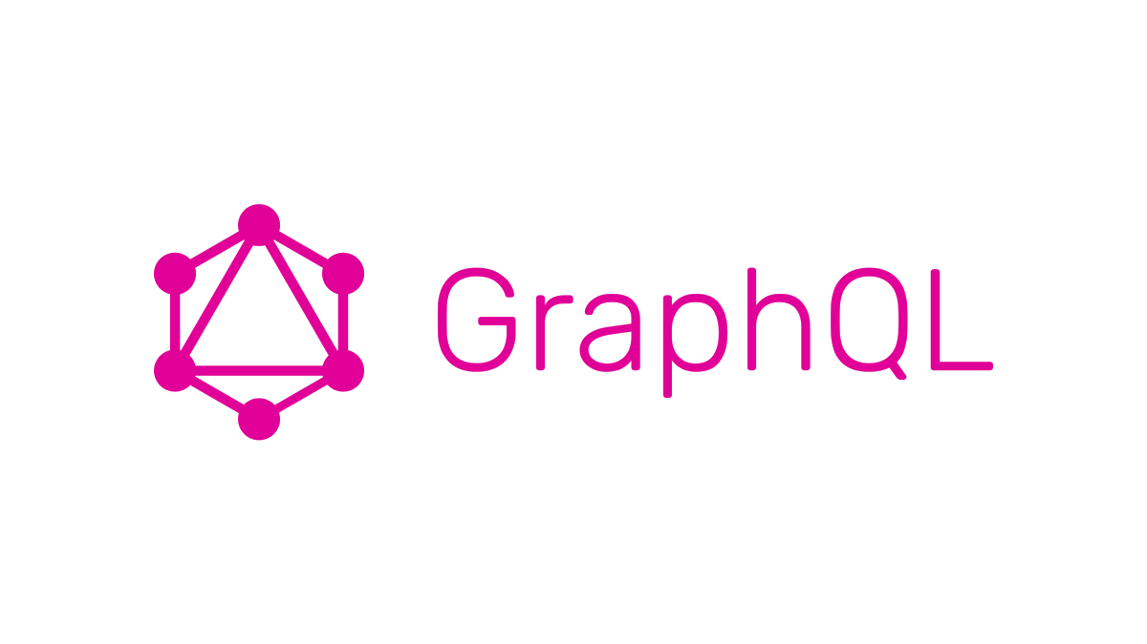
Notes:
For the last two decades or so, there has been debate over what is the best approach to designing web APIs
Some contenders are RPC, REST, SOAP
In January 2015, Facebook announced a new contender in this debate: GraphQL
-----
It is maintained by the GraphQL Foundation under the aegis of the Linux Foundation. (https://medium.com/@davisjam/29038c48da5)
GraphQL is a query language for data that can be represented as a graph. (https://medium.com/@davisjam/29038c48da5)
In January 2015 Facebook announced that its internal client APIs were being built on a new technology called GraphQL (though it had been in development in one shape or another since 2011). This is an API framework which owes a little to the RPC model, a little to REST and its use of web protocols, but also strikes out in its own direction. (https://dev.to/mikeralphson/a-brief-history-of-web-apis-47k4)

Slide 3
GraphQL is a query language for APIs and a runtime for fulfilling those queries...
Notes:
GraphQL defines itself as: “is a query language for APIs and a runtime for fulfilling those queries”
You can think of GraphQL as a query language for data that can be represented as a graph. (https://medium.com/@davisjam/29038c48da5)
Instead of having fixed resources like in REST, GraphQL allows clients to request just the data they needs to perform a task (https://dev.to/mikeralphson/a-brief-history-of-web-apis-47k4)
---
Instead of having fixed functions like RPC, or fixed resource representations accessible via URLs like in REST, GraphQL is a query language similar in concept to Structured Query Language (SQL), which allows the client to request just the data it needs to perform a task, and sometimes to avoid multiple API calls to fetch all of the data required. (https://dev.to/mikeralphson/a-brief-history-of-web-apis-47k4)

Slide 4
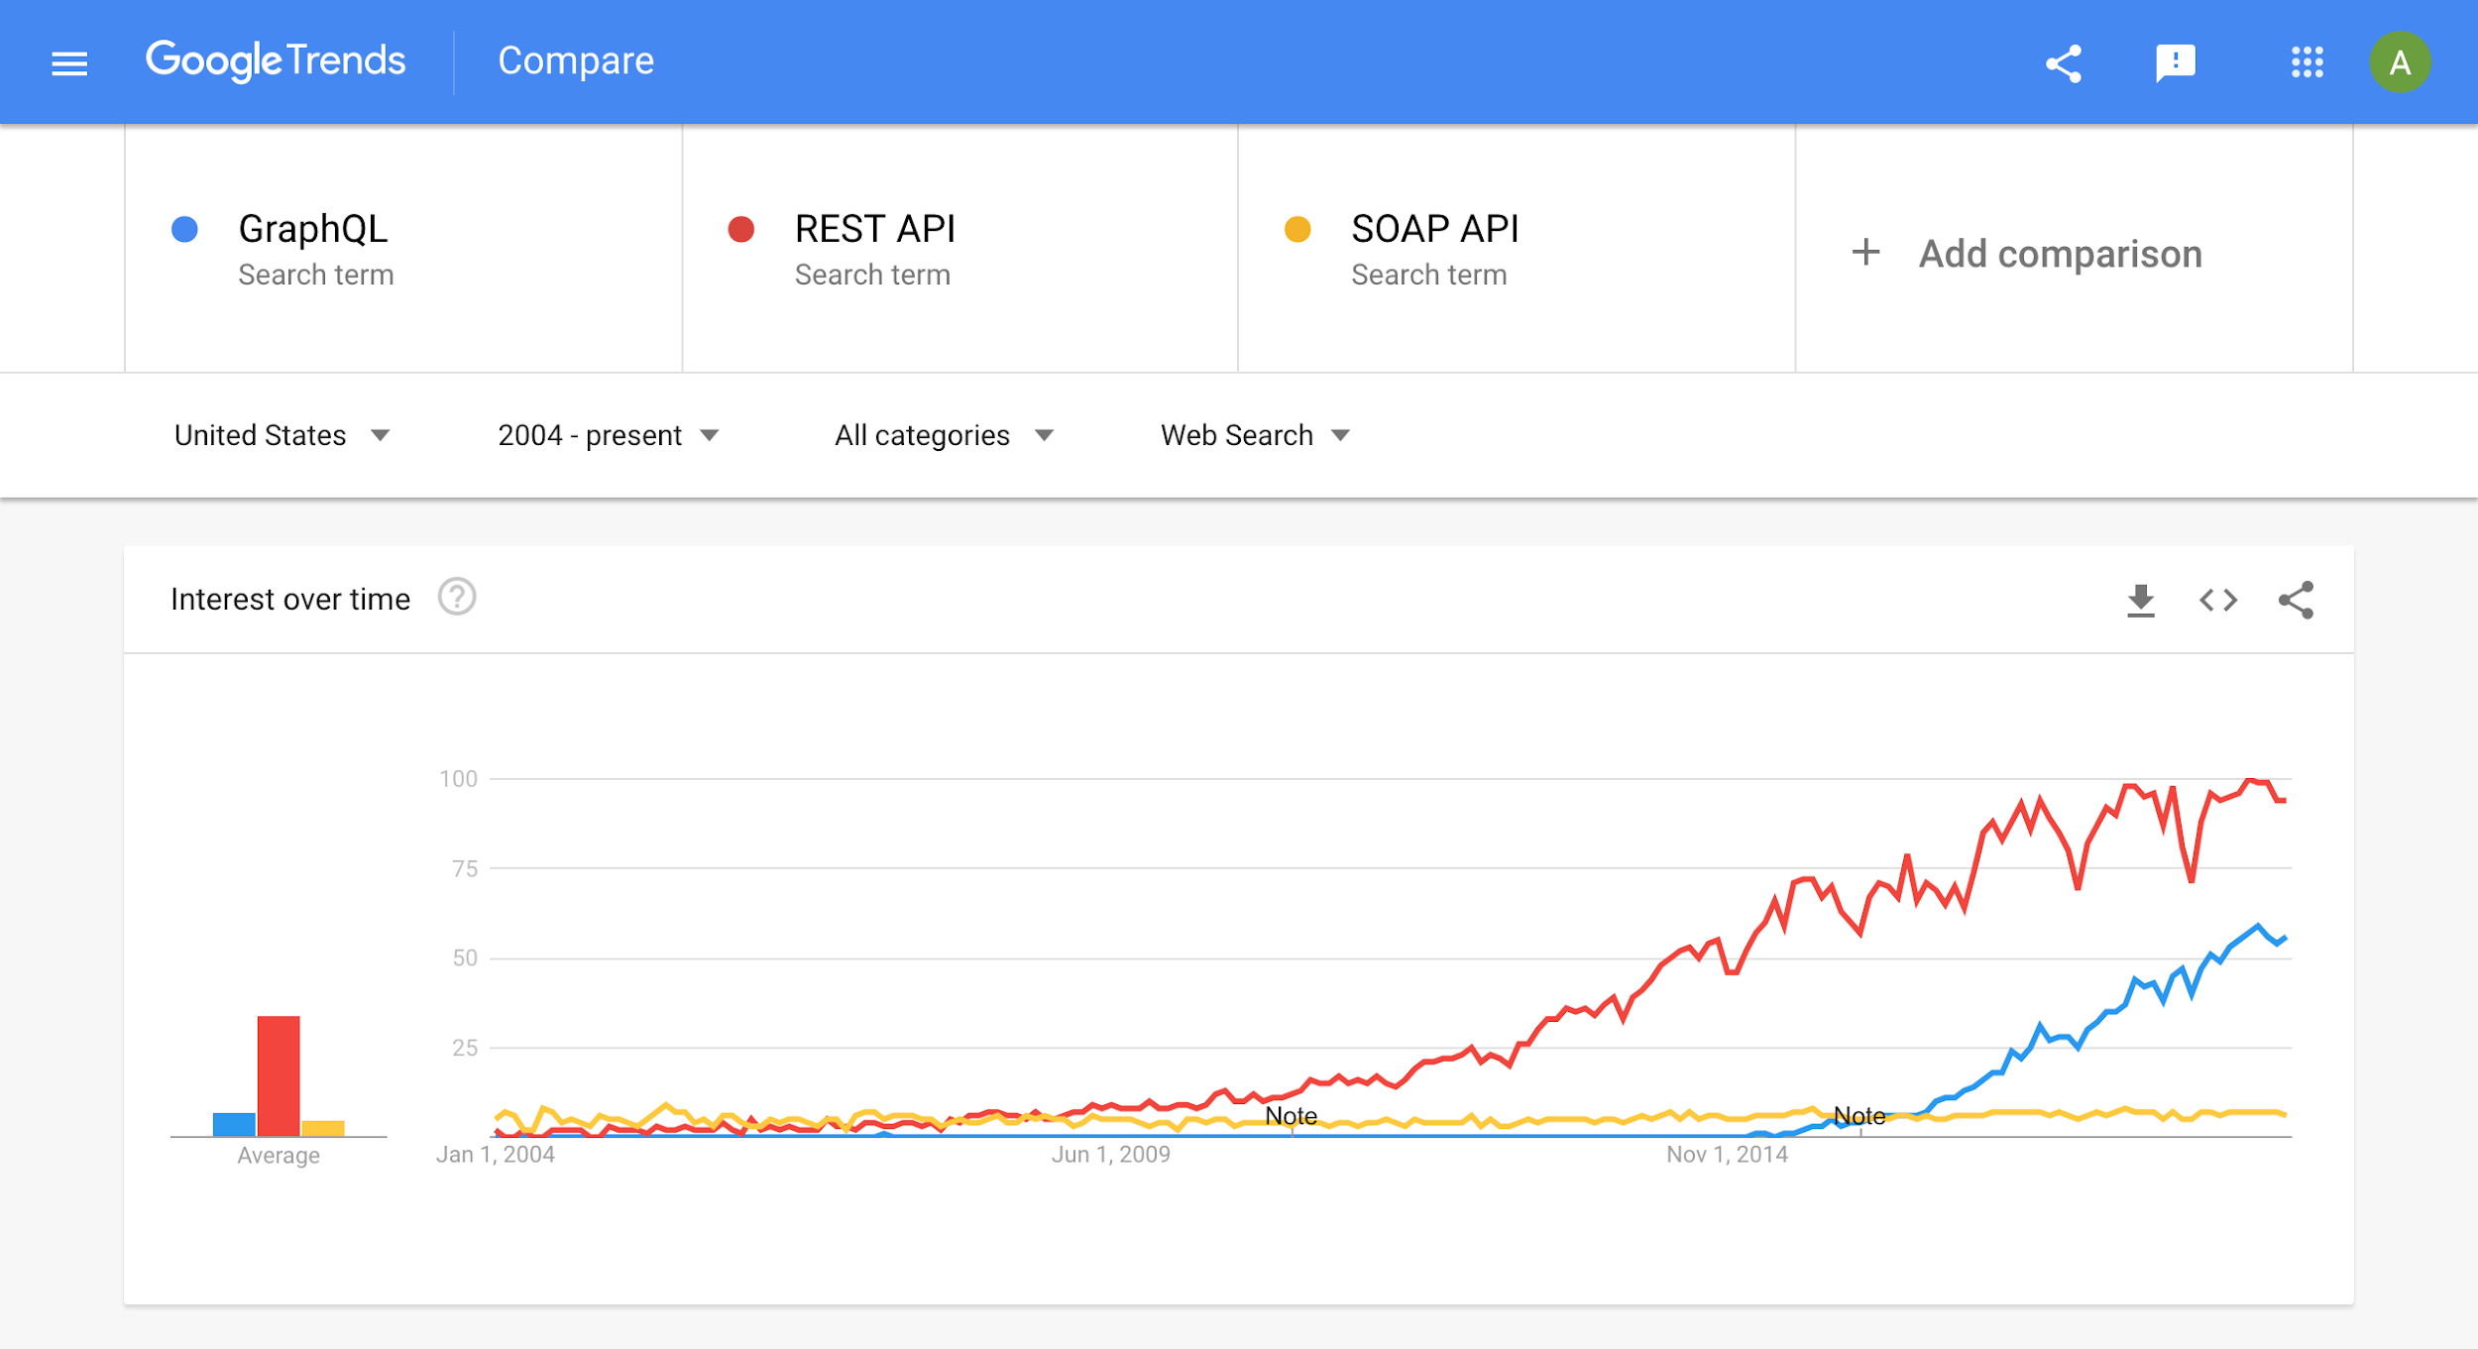
Notes:
https://trends.google.com/trends/explore?date=all&geo=US&q=GraphQL,REST%20API,SOAP%20API
As you can see, GraphQL is a hot topic.
It has yet to overtake REST APIs in popularity, but there is certainly growing interest
---
In the late 1990’s and early 2000’s, the predominant use of distributed APIs over the HTTP protocol involved the exchange of Extensible Markup Language (XML) formatted documents in a relatively simple remote procedure call (RPC) fashion.
Protocols such as XML-RPC evolved into the Simple Object Access Protocol, or SOAP, giving birth to the approach widely known as Web Services.
REST is not "the new SOAP", they address radically different styles of APIs, and do this in a fundamentally different way. The REST style, when applied to HTTP also leverages this underlying protocol to its fullest, and thus can be very performant when well implemented, though this was not its original focus.

Slide 5
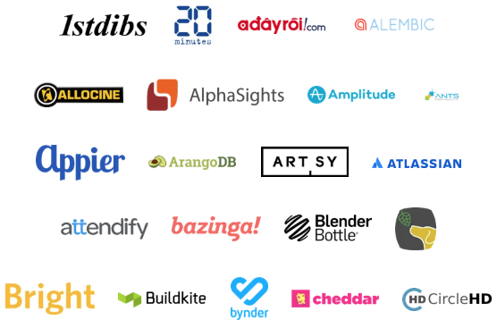

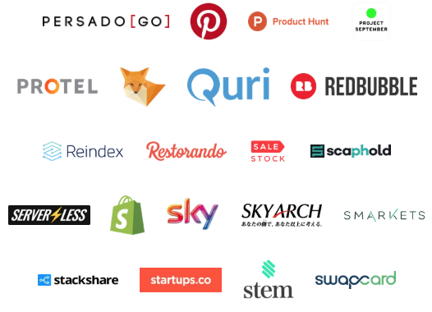
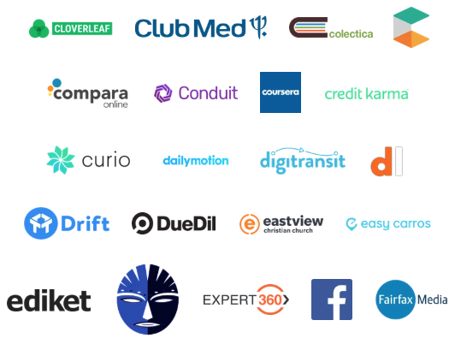
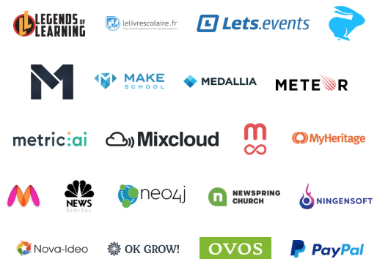

Notes:
Over a hundred of companies have adopted GraphQL.
Some notable ones are Facebook, who first invented GraphQL, GitHub, Twitter, PayPal, Yelp, and Shopify
---

Slide 6
With GraphQL…​
Providers define data at design time
Clients send queries at runtime
Servers respond with data at runtime
type Query {
user(username: ID!): User
}
type User {
name: String
address: String
}
query {
user(username: “ac3805”) {
name
}
}
{
“data”: {
“user”: {
“name”: “Alan Cha”
}
}
}
Notes:
So here’s what GraphQL typically looks like.
Providers define data that users can query for at design time
What we’re seeing here is a GraphQL schema, which contains type definitions
It says that you can query for a user, which returns a User object, and on a User object, you can access the name and address fields.
Clients can send queries at runtime
This is a query for a user’s name, based on his or her username.
And finally, servers respond with data at runtime
Here we learn that the user’s name is Alan Cha
----
When a company offers a “web API” they usually mean they offer a REST-ful API. In the REST paradigm, the API provider publishes a set of endpoints corresponding to the data the client can obtain. Each endpoint returns a fixed set of information about the entity the client requested. If a client wants to collate information about several entities, they must issue a request for each entity, and potentially additional queries to explore additional objects. Some companies document a REST-ful API in an ad hoc manner, while others specify REST-ful APIs using more rigorous approaches like an OpenAPI (Swagger) specification.
The REST-ful API paradigm leads to performance inefficiencies [2] and management headaches, motivating migration from the REST-ful paradigm to the GraphQL paradigm [3].

Slide 7
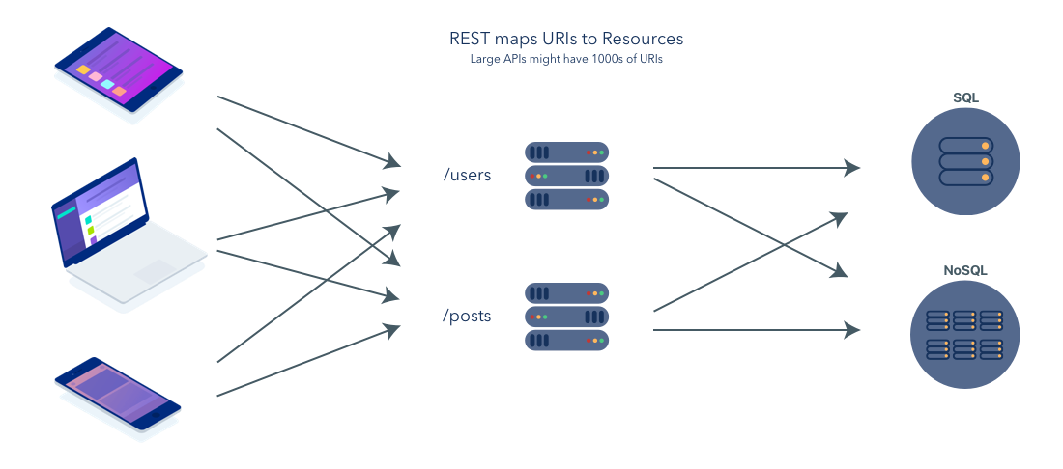
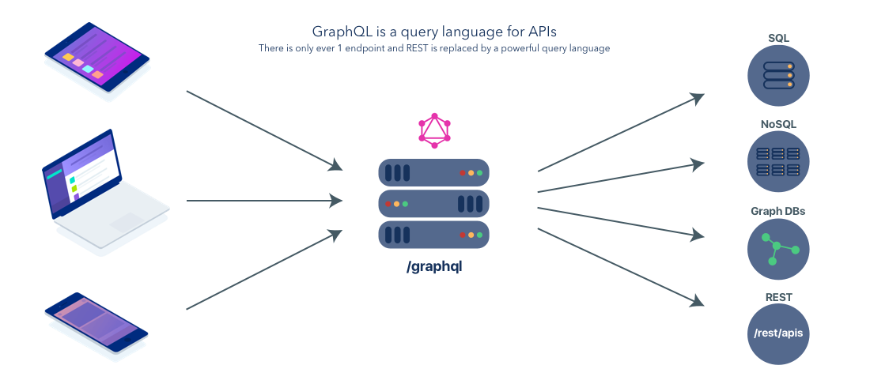
GraphQL Versus REST
Notes:
So, how is it different from other web API architectures?
Let’s compare GraphQL with REST.
In REST, resources are mapped to URIs and large APIs might have thousands of URIs.
In GraphQL, there is only ever 1 endpoint. You use the query language to specify the data that you need.
GraphQL can solve a number of problems that REST APIs carry.
---
For example, in REST, each endpoint returns a fixed set of information. This often leads to overfetching, querying for more data than is needed.
This means that the server is wasting resources to marshal the unused data, the client is wasting resources parsing the unused data, and the network operator is wasting resources transferring the unused data.
Imagine trying to query for a user’s address and instead of getting just the address, you also receive data about the user’s latests posts, favorite movies, and profile pictures.
In GraphQL, clients can specify exactly the data they need and will receive.
Additionally, clients often need to make multiple REST calls to get the data they need. When they do, they have to wait for network roundtrips to determine the next query to issue.
Imagine trying to query for a user’s friends. First you have to make a call for that specific user, which might return references to his or her friends. Then you need to send additional query for each of those users.
In GraphQL, clients can often replicate all of this behavior in a single query.

Slide 8
Overfetching
Goal: Get a user’s name
REST
GraphQL
GET /users/ac3805
query {
user(username: “ac3805”) {
name
}
}
{
"user": {
"name": "Alan Cha",
"username": "ac3805",
"posts": ["Learn GraphQL Today!"],
"friendsUsernames": [
"acj2343",
"pl9283",
"mm8883"
]
}
}
Request
Response
{
“data”: {
"user": {
"name": "Alan Cha",
}
}
}
Response
Notes:
For example, in REST, each endpoint returns a fixed set of information. This often leads to overfetching, querying for more data than is needed.
Let’s say you wanted to get a user’s name
In REST, you get all this extra data like username, posts, friendsUsernames, etc.
This means that the server is wasting resources to marshal the unused data, the client is wasting resources parsing the unused data, and the network operator is wasting resources transferring the unused data.
In GraphQL, your response matches your request and you get exactly the data you queried for

Slide 9
Overfetching
Goal: Get a user’s friends’ name
REST
GraphQL
query {
user(username: “ac3805”) {
friends: {
name
}
}
}
GET /users/ac3805
…
“friendUsernames”: ["acj2343", "pl9283", "mm8883"]
...
Request
GET /users/acj2343
GET /users/pl9283
GET /users/mm8883
…
“name”: “Alfred”
...
…
“name”: “Pat”
...
…
“name”: “Morris”
...
Notes:
Additionally, clients often need to make multiple REST calls to get the data they need. When they do, they have to wait for network roundtrips to determine the next query to issue.
Imagine trying to query for a user’s friends. First you have to make a call for that specific user, which might return references to his or her friends. Then you need to send additional query for each of those users.
A total of four users!
In GraphQL, clients can often replicate all of this behavior in a single query.

Slide 10
GraphQL enables computational taxing queries...
…so can we determine the extent of this problem?
Notes:
However, GraphQL’s expressiveness is both a strength and a weakness
A single GraphQL query can be worth thousands of REST API calls.
With REST APIs, you have a general sense of how many resources an operation will consume.
But with GraphQL, because it’s this flexible language, it’s a lot harder to tell.
Queries resulting in huge responses may be computationally taxing, so practitioners have to face the challenge of throttling such queries
In this research project, we wanted to know to what extent is this a problem.
---
By giving you all that context, hopefully, you can see that GraphQL is a popular emerging technology and hopefully, you can understand why.
So, what we wanted to do in this research project is to take a look at how people are using GraphQL.
Are they making use of all the features that are available to them?
Are they following naming conventions?
Additionally, with all the flexibility that GraphQL provides, are there any potential problems?
If there are problems, are GraphQL providers mitigating those threat vectors?
In this presentation, we will focus on the last two questions. We’ll touch upon the other findings but the main focus is on potential problems that GraphQL APIs may have.

Slide 11
Client
GraphQL Server
Schema
Type
Type
Type
Resolvers
Resolver function
Resolver function
Resolver function
API
Notes:
This is what a typical GraphQL architecture looks like
A GraphQL API is composed of two main components, the schema and the resolvers.
The schema specifies the data that a user can query for.
This takes place in the form of type definitions.
The main type definitions you will see in a GraphQL interface are object type definitions, which contains a number of fields.
Resolvers specify how to retrieve data for each field.
Creating a query is simply a matter of composing fields, which the GraphQL API will resolve one field at a time.
What we really want to do is to see if we can determine a GraphQL API’s worst-case response size by analyzing it’s schema.

Slide 12
Example Schema
Query
One of…
type Query {
company(id: ID!): Company
}
type Company {
address: String
employees: [FTE]
}
type FTE {
name: String
interns: [Intern]
coworkers: [FTE]
}
type Intern {
name: String
}
List of…
company(id)
Object
Primitive
Company
address
employees
String
FTE
coworkers
name
interns
String
Intern
name
Notes:
Here is an example of a schema.
This is written in SDL (Schema Description Language) which is a well-described syntax and a part of the official GraphQL Specification
You can also express schemas programmatically
In this schema, we have three object type definitions, one for Query (the entry point to the GraphQL API), one for Company, and one for User.
We can query for a company with a company ID. This field returns a Company object.
On a Company object, we can access the address field and the employees field.
The address field simply returns a string whereas the employees field returns a list of User objects.
Finally, on a User object, we can access the user’s name and papers.
The name is a string and papers is a list of strings.
On the right, we can see the interface represented graphically.
Blue circles are object types while grey circles are scalar types.
The arrows are fields.
Skinny arrows are one-to-one relationships while bold ones are one-to-many relationships.
---
Here we have a schema...
This schema is expressed using SDL (Schema Description Language) which is a well-described syntax and a part of the official GraphQL Specification
You can also express schemas programmatically
At the top, we have the schema object, which lists the ways you can interact with the data
There are three ways, query, which simply retrieves data, mutation, which can change data, and subscription, which will give live updates to changes in the data
This particular schema only employs query and mutation.
Following with have a number of object type definitions and one input object definition.
You can query for a company by providing an ID
This will return a Company object
The company has a number of fields, including the id, name, address, and age.
There is also offices field, which will give you a list of Office objects, each containing an ID and a name
You can a create an office by providing an Office input object
Input objects are most often used for mutations, which allow you to bundle a number of arguments together
In this case, the OfficeInput input object type is used to create an Office object type

Slide 13
Example Query
Query
Response
query {
company(id: “w4...”) {
address
employees {
name
papers
}
}
}
{
company: {
address: “100 Elk Street”,
employees: [
{
name: “Jane Doe”,
papers: [“A study on...”, “A solution for...”]
},
{
name: “John Doe”,
papers: [“Are hotdogs sandwi...”]
}
]
}
}
Notes:
With the previous schema, we can create queries like the following.
Here we are querying for a company and getting its address and its employees.
For each employees, we are querying for their names and their papers.
Remember, employees returns a list of user objects
---
Here, we can see an example query using the previously shown schema.
We are querying for a company through a given ID
And for that company, we are querying for each of its offices
And for each office, we are getting the name
Notice how the shape of the response matches the shape of the query.
This is one of GraphQL’s biggest advantages.
We can limit overfetching and in some cases, also reduce the number of roundabout trips.

Slide 14
Linear-size query: O(n)
Query
One of…
type Query {
company(id: ID!): Company
}
type Company {
address: String
employees: [FTE]
}
type FTE {
name: String
interns: [Intern]
coworkers: [FTE]
}
type Intern {
name: String
}
List of…
company(id)
Object
Primitive
Company
address
String
query {
company(id: “IBM”) {
address
}
}
Notes:
Here is an example of a schema.
This is written in SDL (Schema Description Language) which is a well-described syntax and a part of the official GraphQL Specification
You can also express schemas programmatically
In this schema, we have three object type definitions, one for Query (the entry point to the GraphQL API), one for Company, and one for User.
We can query for a company with a company ID. This field returns a Company object.
On a Company object, we can access the address field and the employees field.
The address field simply returns a string whereas the employees field returns a list of User objects.
Finally, on a User object, we can access the user’s name and papers.
The name is a string and papers is a list of strings.
On the right, we can see the interface represented graphically.
Blue circles are object types while grey circles are scalar types.
The arrows are fields.
Skinny arrows are one-to-one relationships while bold ones are one-to-many relationships.
---
Here we have a schema...
This schema is expressed using SDL (Schema Description Language) which is a well-described syntax and a part of the official GraphQL Specification
You can also express schemas programmatically
At the top, we have the schema object, which lists the ways you can interact with the data
There are three ways, query, which simply retrieves data, mutation, which can change data, and subscription, which will give live updates to changes in the data
This particular schema only employs query and mutation.
Following with have a number of object type definitions and one input object definition.
You can query for a company by providing an ID
This will return a Company object
The company has a number of fields, including the id, name, address, and age.
There is also offices field, which will give you a list of Office objects, each containing an ID and a name
You can a create an office by providing an Office input object
Input objects are most often used for mutations, which allow you to bundle a number of arguments together
In this case, the OfficeInput input object type is used to create an Office object type

Slide 15
Linear-size query: O(n x D)
Query
One of…
type Query {
company(id: ID!): Company
}
type Company {
address: String
employees: [FTE]
}
type FTE {
name: String
interns: [Intern]
coworkers: [FTE]
}
type Intern {
name: String
}
List of…
company(id)
Object
Primitive
Company
address
employees
String
FTE
query {
company(id: “IBM”) {
address
employees
}
}
Notes:
Here is an example of a schema.
This is written in SDL (Schema Description Language) which is a well-described syntax and a part of the official GraphQL Specification
You can also express schemas programmatically
In this schema, we have three object type definitions, one for Query (the entry point to the GraphQL API), one for Company, and one for User.
We can query for a company with a company ID. This field returns a Company object.
On a Company object, we can access the address field and the employees field.
The address field simply returns a string whereas the employees field returns a list of User objects.
Finally, on a User object, we can access the user’s name and papers.
The name is a string and papers is a list of strings.
On the right, we can see the interface represented graphically.
Blue circles are object types while grey circles are scalar types.
The arrows are fields.
Skinny arrows are one-to-one relationships while bold ones are one-to-many relationships.
---
Here we have a schema...
This schema is expressed using SDL (Schema Description Language) which is a well-described syntax and a part of the official GraphQL Specification
You can also express schemas programmatically
At the top, we have the schema object, which lists the ways you can interact with the data
There are three ways, query, which simply retrieves data, mutation, which can change data, and subscription, which will give live updates to changes in the data
This particular schema only employs query and mutation.
Following with have a number of object type definitions and one input object definition.
You can query for a company by providing an ID
This will return a Company object
The company has a number of fields, including the id, name, address, and age.
There is also offices field, which will give you a list of Office objects, each containing an ID and a name
You can a create an office by providing an Office input object
Input objects are most often used for mutations, which allow you to bundle a number of arguments together
In this case, the OfficeInput input object type is used to create an Office object type

Slide 16
Polynomial-size: O(n x D²)
Query
One of…
type Query {
company(id: ID!): Company
}
type Company {
address: String
employees: [FTE]
}
type FTE {
name: String
interns: [Intern]
coworkers: [FTE]
}
type Intern {
name: String
}
List of…
company(id)
Object
Primitive
Company
address
employees
String
FTE
query {
company(id: “IBM”) {
address
employees {
interns
}
}
}
interns
Intern
Notes:
Here is an example of a schema.
This is written in SDL (Schema Description Language) which is a well-described syntax and a part of the official GraphQL Specification
You can also express schemas programmatically
In this schema, we have three object type definitions, one for Query (the entry point to the GraphQL API), one for Company, and one for User.
We can query for a company with a company ID. This field returns a Company object.
On a Company object, we can access the address field and the employees field.
The address field simply returns a string whereas the employees field returns a list of User objects.
Finally, on a User object, we can access the user’s name and papers.
The name is a string and papers is a list of strings.
On the right, we can see the interface represented graphically.
Blue circles are object types while grey circles are scalar types.
The arrows are fields.
Skinny arrows are one-to-one relationships while bold ones are one-to-many relationships.
---
Here we have a schema...
This schema is expressed using SDL (Schema Description Language) which is a well-described syntax and a part of the official GraphQL Specification
You can also express schemas programmatically
At the top, we have the schema object, which lists the ways you can interact with the data
There are three ways, query, which simply retrieves data, mutation, which can change data, and subscription, which will give live updates to changes in the data
This particular schema only employs query and mutation.
Following with have a number of object type definitions and one input object definition.
You can query for a company by providing an ID
This will return a Company object
The company has a number of fields, including the id, name, address, and age.
There is also offices field, which will give you a list of Office objects, each containing an ID and a name
You can a create an office by providing an Office input object
Input objects are most often used for mutations, which allow you to bundle a number of arguments together
In this case, the OfficeInput input object type is used to create an Office object type

Slide 17
Exponential-size: O(D^{n})
Query
One of…
type Query {
company(id: ID!): Company
}
type Company {
address: String
employees: [FTE]
}
type FTE {
name: String
interns: [Intern]
coworkers: [FTE]
}
type Intern {
name: String
}
List of…
company(id)
Object
Primitive
Company
employees
coworkers
query {
company(id: “IBM”) {
employees {
coworkers {
coworkers {
name
}
}
}
}
}
FTE
coworkers
name
String
Notes:
Here is an example of a schema.
This is written in SDL (Schema Description Language) which is a well-described syntax and a part of the official GraphQL Specification
You can also express schemas programmatically
In this schema, we have three object type definitions, one for Query (the entry point to the GraphQL API), one for Company, and one for User.
We can query for a company with a company ID. This field returns a Company object.
On a Company object, we can access the address field and the employees field.
The address field simply returns a string whereas the employees field returns a list of User objects.
Finally, on a User object, we can access the user’s name and papers.
The name is a string and papers is a list of strings.
On the right, we can see the interface represented graphically.
Blue circles are object types while grey circles are scalar types.
The arrows are fields.
Skinny arrows are one-to-one relationships while bold ones are one-to-many relationships.
---
Here we have a schema...
This schema is expressed using SDL (Schema Description Language) which is a well-described syntax and a part of the official GraphQL Specification
You can also express schemas programmatically
At the top, we have the schema object, which lists the ways you can interact with the data
There are three ways, query, which simply retrieves data, mutation, which can change data, and subscription, which will give live updates to changes in the data
This particular schema only employs query and mutation.
Following with have a number of object type definitions and one input object definition.
You can query for a company by providing an ID
This will return a Company object
The company has a number of fields, including the id, name, address, and age.
There is also offices field, which will give you a list of Office objects, each containing an ID and a name
You can a create an office by providing an Office input object
Input objects are most often used for mutations, which allow you to bundle a number of arguments together
In this case, the OfficeInput input object type is used to create an Office object type

Slide 18
Schema Topology
Query
One of…
Possible queries
List of…
query {
company (id: “W4..”) {
address
employees {
coworkers {
coworkers {
coworkers {
coworkers {
name
papers
}
}
}
}
}
}
}
Object
query {
company(id: “w4...”) {
address
employees {
name
salary
}
}
}
company(id)
+1
Primitive
Company
+1
+10
+1
+100
address
employees
+1000
+1
+10000
coworkers
String
User
name
salary
String
Integer
Notes:
Recall that queries are composed of fields and each field is associated to some resolver function which will fetch some data.
Intuitively, the resources that a query will consume, in basic cases, is directly related to the number of resolvers that the query will call.
There are some reservations, however. The data for a field can also be provided by the parent object.
For example, a User object probably contains the name and the papers.
If that is the case, the API provider does not need to create resolvers to fetch the name and papers, they are part of the User object.
To summarize, we make the assumption that leaf nodes on object types do not call resolver functions.
So in the previously provided query, we can see that two resolvers are being called.
One for company and one for employees.
Now, consider what happens when we add a cyclical relationship on the User type.
A User can now query for its coworkers.
Now, we can create queries like the following, where a User can get all of his or her coworkers, and each coworker can get all of their coworkers, and so on.
This becomes an exponentially expensive query.
Pretend that each User on average has ten coworkers.
Each additional level of coworkers essentially multiplies the number of resolvers the query will call by ten.
From 2, to 12, to 112, to 1112, etc.
You can see that the key to large worst-case response sizes is the number of nested lists of objects that you can call in a single query.
---
GraphQL’s expressiveness is a strength and a weakness. A REST-ful API limits the information that can be queried in a single request by limiting the expressiveness of an endpoint. A GraphQL API supports arbitrary queries over the data, and so a single query can request a great deal of data.
Queries resulting in huge responses may be computationally taxing, so practitioners point out the resulting challenge for providers to throttle such queries.
The size of a response depends on three factors: the schema, the query, and the underlying data.
We analyze each schema in our corpuses for the worst-case response size it enables with pathological queries and data.
Here we show a representation of a schema.
The circles represent types.
The blues are object types and the grey ones are primitives.
The arrows represent fields.
Thin arrows are one to one relationships and the bold ones are one to many relationships.
For example, a company can only have one address but can have many employees.
Likewise, an employees can have multiple patents.
Maximum nesting
Infinite nesting can result in huge exponentially sized response sizes.
Imagine if each user has around 10 coworkers
10 times 10 times 10 times 10 times...

Slide 19
Schema Topology Classification
Linear
Polynomial
Exponential
Q
Q
Q
One of…
List of…
Primitive
List
Notes:
We introduce a novel (?) way of categorizing schemas based on this fact (the number of nested lists of objects that a user can query for).
Linear schemas do not contain any nested lists of objects.
Polynomial schemas contains a finite number of nested lists of objects.
Exponential schemas contain an infinite number of nested lists.
To clarify, what you’re looking for is a blue circle with a bold arrow pointing to another blue circle.
This represents a nested list of objects.
---
For example, in both linear worst-case response size schemas, no lists of objects can be queried for.
In the polynomial worst-case response size schema, a maximum of two lists of objects can be queried for.
In the exponential worst-case response size schema, an unbounded number of nested lists can be queried for.
For exponential worst-case response sizes, the schema must have some kind of type cycle that has at least one nested list of objects.

Slide 20


Schema Spaces
All GraphQL Schemas
Defined using SDL
Commercial
16 schemas
On GitHub
8,399 schemas
Notes:
To see the extent of schemas that allow for computationally expensive queries, we created two corpuses of schemas, one from introspecting publicly accessible commercial GraphQL APIs and one from mining GitHub for GraphQL schema definitions
If you can imagine the set of all GraphQL Schemas
A subset of those are ones defined using SDL (as opposed to programmatically)
And a subset of those are ones that are on GitHub
Another subset of schemas lay across the previous circles. This is our commercial corpus.
The reason why they are here is that we do not know how these commercial schemas are implemented because we accessed them using an introspection query, which allows us to get the schema directly from the GraphQL API.
---
To gain a better understanding of how people use GraphQL, we created two corpuses, one from introspecting publicly accessible commercial GraphQL APIs and one from mining GitHub for GraphQL schema definitions

Slide 21

Commercial Corpus
33 listed schemas
-17 toy, demo, invalid schemas
16 valid, unique schemas
Notes:
To give you some more information...
On May 1st 2019, we collected 33 schemas from APIs.guru, a directory for web APIs, and after doing manual inspection to remove toy, demo, and invalid schemas, we came up with 16 valid, unique schemas.
The corpus includes, among others, schemas of prominent GraphQL APIs like GitHub, Shopify, Yelp, and BrainTree.

Slide 22
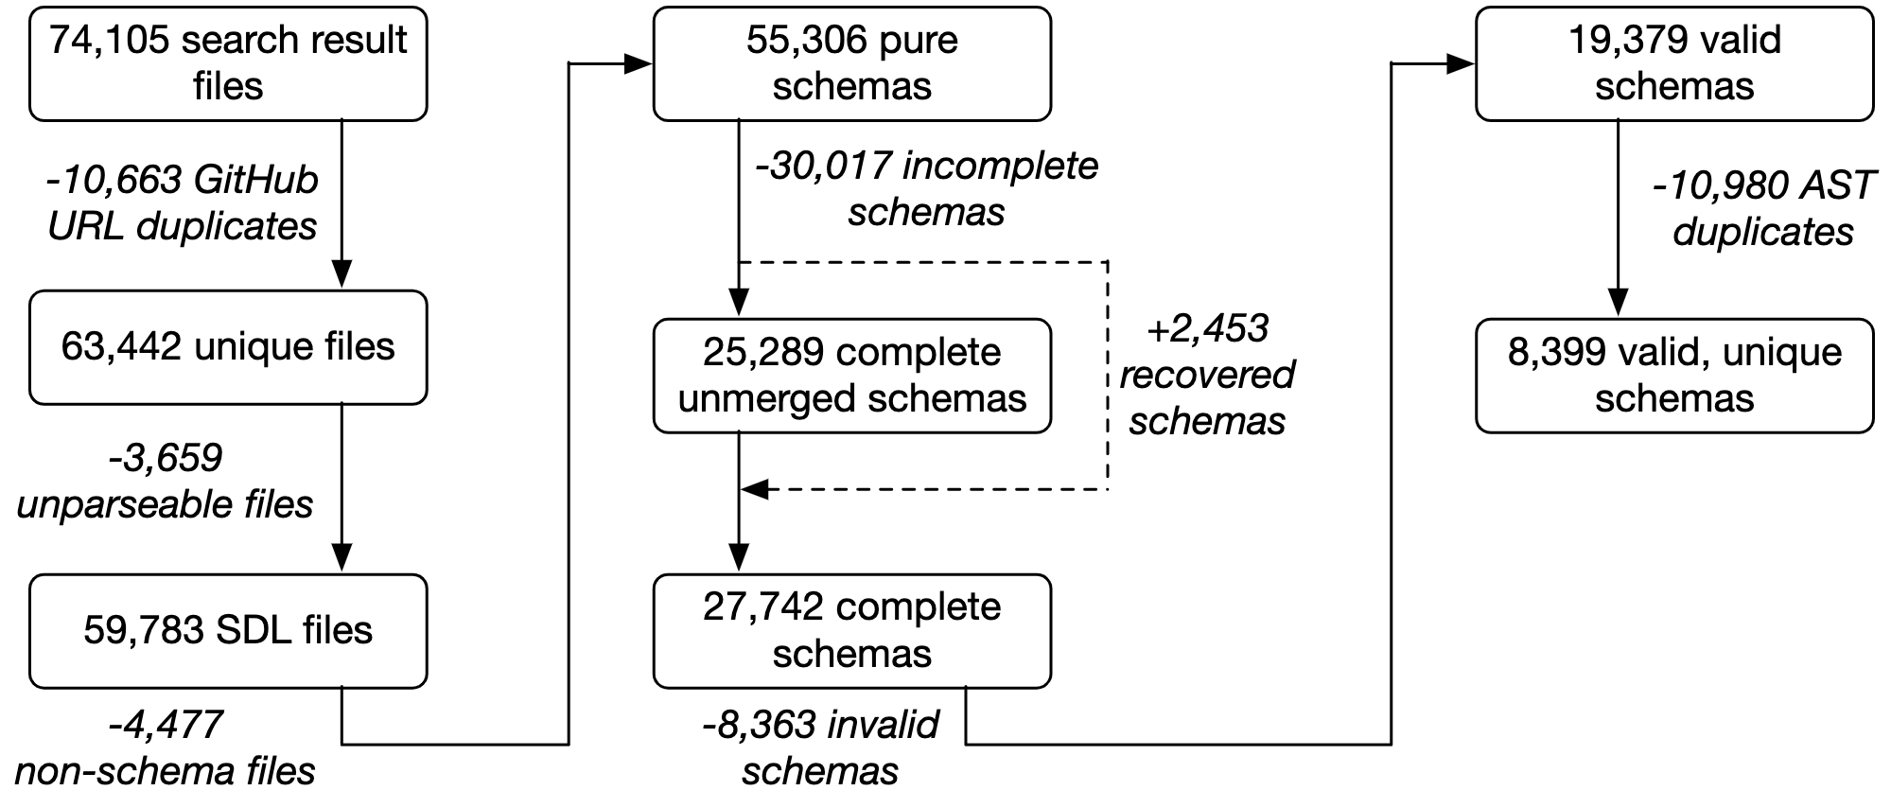
GitHub Corpus
Notes:
Creating the GitHub corpus was much more involved.
Long story short, we started with 74,105 search result files and we ended up with 8,399 valid unique schemas.
A particularly interesting part of this data collection is recovering partitioned schemas.
We found that some schemas had missing references.
Under the assumption that the schema has been broken up and could be pieced together by concatenating other schema documents that exist in the GitHub repository, we were able to recover a portion of these.
---
On May 21st 2019, we collected 74,105 search result files.
We searched for the term “type”, which is used to define object type definitions and used in any non-trivial schema.
We searched for the extensions .graphql and .gql are common file suffixes for SDL files.
GitHub’s limit on code search query results so we had to partition the search space by file size.
Lastly, we omitted project forks to avoid duplicates.
One of the more interesting parts of creating the GitHub corpus was trying to reconstruct incomplete schemas, meaning that the schema references definitions that are not part of the file.
Supposing that a repository’s complete schema(s) can be produced through some combination of its GraphQL files, we used heuristics to try to reconstruct these partitioned schemas, thus adding recovered schemas back to our data.
For every schema that contains a query operation but also reference errors, we searched for the missing definitions in the repository’s other GraphQL files.
When we found a missing type in another file, we appended that file’s contents to the current schema and we repeated this process until we obtained either a complete schema or an unresolvable reference.
We were able to recover 2,453 schemas out of the 5,603 which is a 43.8% success rate.
This success rate suggests that distributing GraphQL schema definitions across multiple files is a relatively common practice.
Our final GitHub schema corpus contains 8,399 valid, unique GraphQL Schema Definition files, 1,127 of which were recovered through merging.

Slide 23
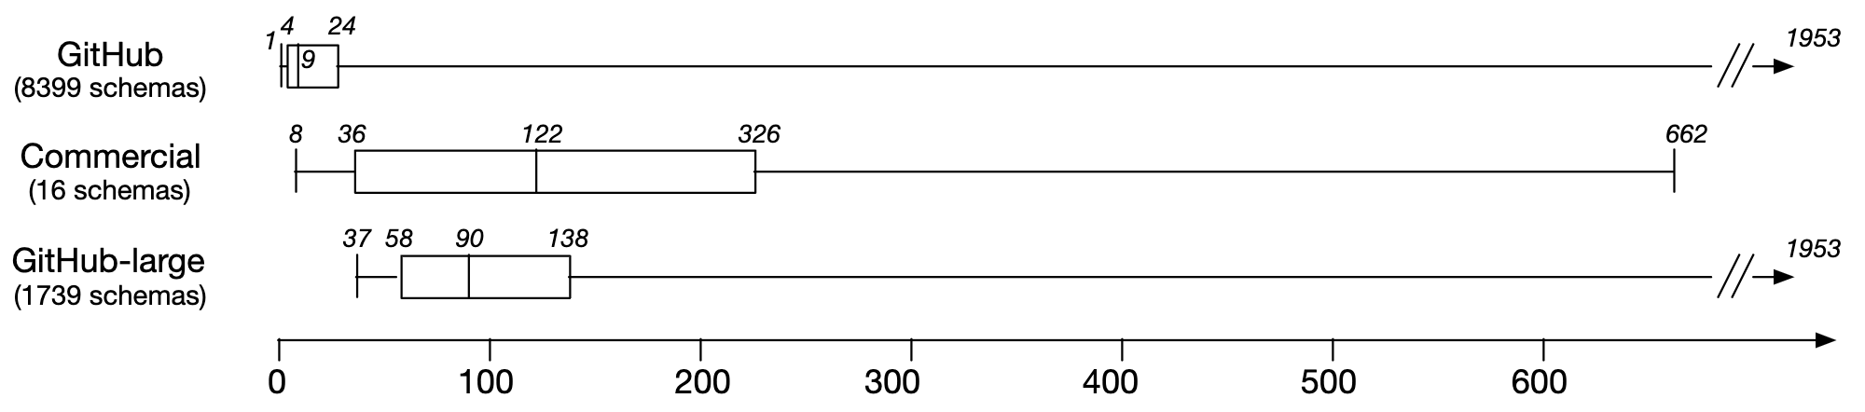
Schema Complexity
Notes:
We did some basic analysis of the corpuses that we collected, based on the number of definitions in the schemas.
The first thing we noticed was that the schemas from our GitHub corpus are generally much smaller than those in the commercial corpus.
We believe a number of these schemas are just test, demo, or toy schemas.
Under the assumption that larger schemas are more likely to be serious schemas rather than demo ones, we extracted a subset of the GitHub corpus called the “GitHub-large” (GH-large) corpus to allow for more reasonable comparisons between open source and commercial schemas
We created the GitHub-large corpus based on the first-quartile of commercial schemas sizes
This new corpus contains 1,739 schemas (20.7% of the GitHub corpus, 10 of which were recovered through merging)
In future analysis, we can use other measure of quality such as the number of stargazers of the associated GitHub repository.
Hopefully this will allow for more reasonable comparisons.
---
We conservatively define a GitHub schema as large if it is at least as complex as the first quartile of the commercial corpus (i.e., has more than 36 definitions)
This distinction is useful for measurements that are dependent on the “quality” of the schema, e.g., worst-case response sizes and defenses, though for studies like trends in naming conventions we think it is appropriate to also consider the full GitHub corpus.
In future analyses, other measures of quality could be considered to segment the data, for example the number of stargazers of the associated GitHub repository

Slide 24
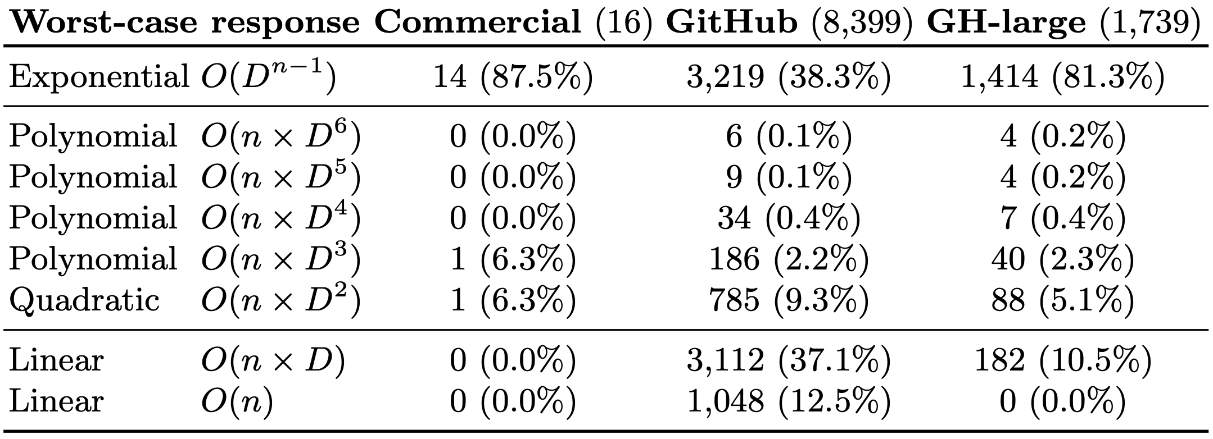
Worst-Case Response Sizes
100.0%
50.5%
89.5%
Notes:
The majority of commercial (100.0%), GitHub (50.5%), and GitHub-large (89.5%) schemas have super-linear worst-case response sizes
Furthermore, a majority of commercial and GitHub-large schemas allow for exponential response sizes
---
However, the implication is that GraphQL providers and middleware services should plan to gauge the cost of each query by estimated cost or response size, or otherwise limit queries.
It seems to be very easy to create computationally taxing queries and GraphQL providers should protect against it… leading to our current stake in GraphQL API Management

Slide 25
Many commercial and open-source GraphQL schemas enable superlinear worst-case response sizes.
Notes:
This finding is of course not altogether surprising, as the key to large response sizes is this one-to-many schema structure that GraphQL naturally expresses.
In any case, it seems that it is very easy to create computationally taxing queries for many GraphQL APIs.
Is there anything GraphQL providers can do to limit response sizes?

Slide 26
Pagination
None
Slicing
Connections
query {
company(id: “w4...”) {
employees {
name
papers
}
}
}
query {
company(id: “w4...”) {
employees(limit: 5) {
name
papers
}
}
}
query {
company(id: “w4...”) {
employees(limit: 5) {
edges {
nodes {
name
papers
}
}
}
}
}
Notes:
Yes! They can employ pagination.
Pagination is a way for schemas to use of numeric arguments to index a subset of the data.
By employing pagination, at least API providers can give users some control over the worst-case response sizes.
Here we show the two main methods of pagination in GraphQL.
The slicing pattern example uses a limit argument that reduces the maximum number of employees that can be returned by that field.
The connections pattern employs an additional layer of indirection to enable more complex pagination.
The final behavior is largely the same, where this query can only obtain a maximum of five employees.
So, are these pagination methods widely implemented?

Slide 27
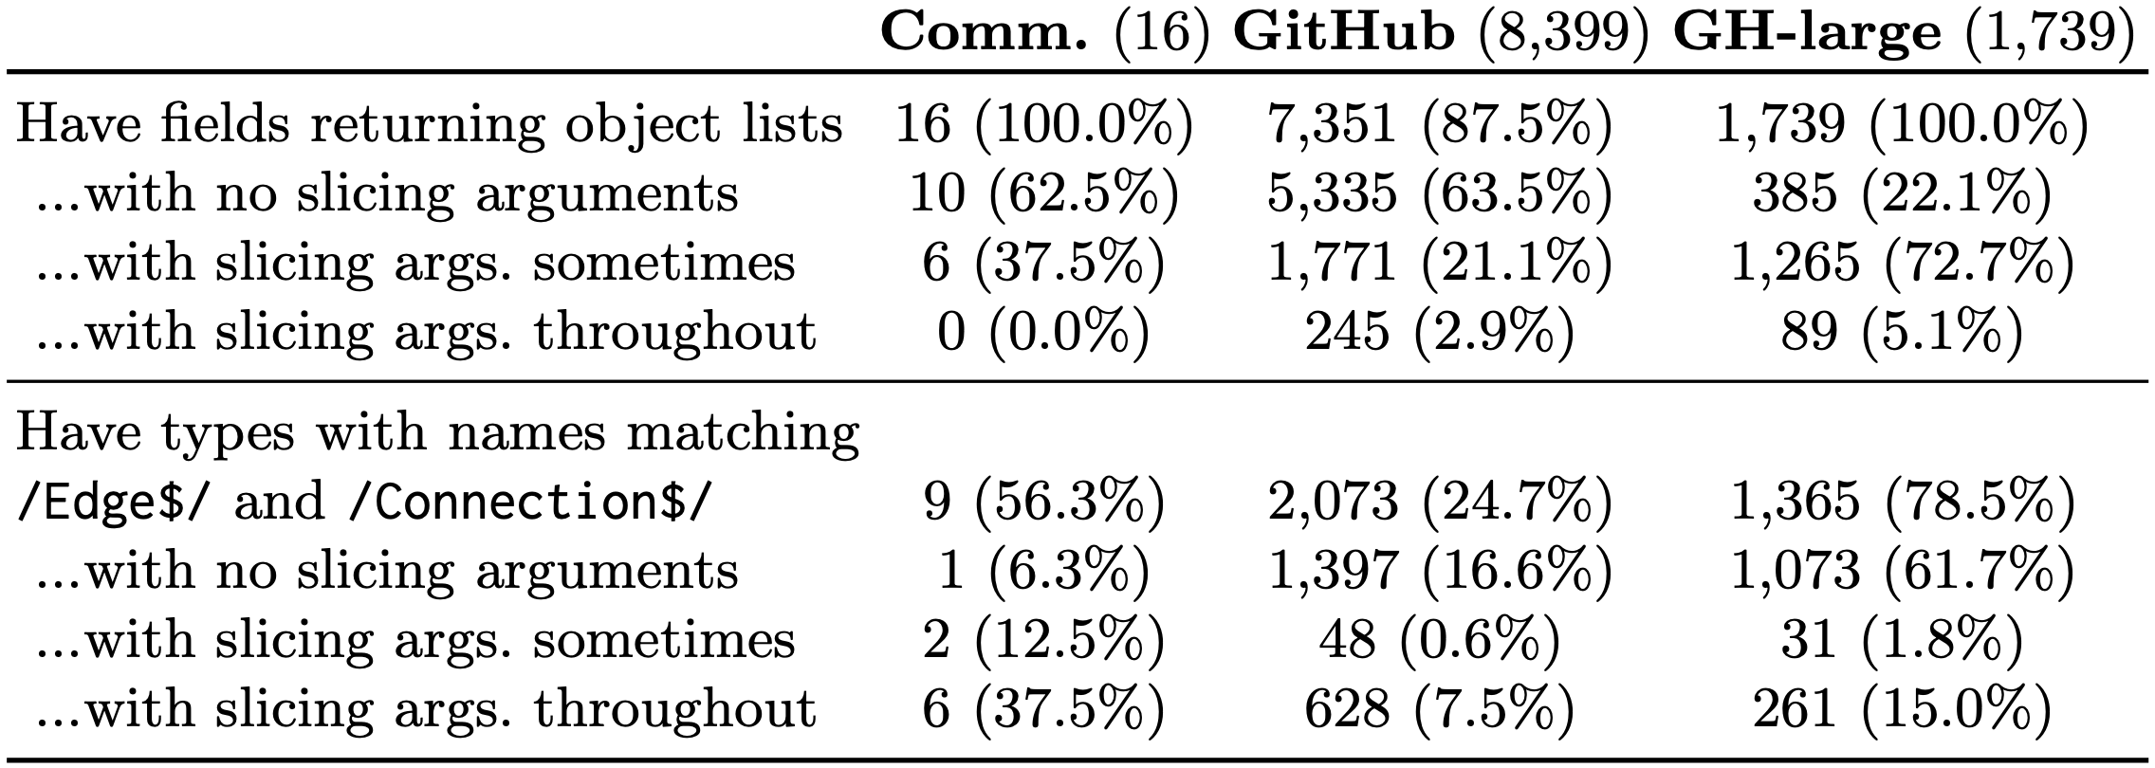
Delimiting Worst-Case Response Sizes through Pagination
Notes:
Unfortunately, we found that very few schemas employ slicing or connections pattern pagination consistently.
In the top half of this chart, we are looking for the slicing pattern and in the bottom half, we are looking for the connections pattern.
A majority of GitHub large schemas do employ slicing arguments but not consistently throughout the schema.
---
Queries with super-linear response sizes can become security threats, overloading APIs or even leading to denial-of-service.
For commercial GraphQL providers, exponential response sizes pose a potential security risk (denial of service).
Even polynomial response sizes might be concerning — e.g., consider the cost of returning the (very large) cross product of all GitHub repositories and users.
As mentioned previously, there exists certain pagination patterns that allow users to use numeric arguments to index a subset of the full response set.
These are the slicing pattern and the connections pattern that I showed earlier.
We wanted to find out, given that a majority of schemas are super linear, how many of these schemas at least provide some control over the amount of data that can be returned.
For slicing, we identify fields that return object lists and accept numeric slicing arguments.
In our corpuses these arguments are commonly named first, last, and limit, or size.
For the connections pattern, we check for the same but we also looked for types whose names end in Connection or Edge as proposed in the official GraphQL docs.
No corpus consistently uses pagination patterns, raising the specter of worst-case response sizes.

Slide 28
The majority of commercial and open-source GraphQL schemas do not delimit response sizes through pagination.
Notes:
API providers should consider employing pagination to give more control over what is accessible.
Pagination is considered a best practice and we urge more API providers to consider it.

Slide 29
Closing remarks

Slide 30
Findings Summarized
Lesson:
Many GraphQL APIs are at risk of uncontrolled performance problems and DDOS attacks
Supporting evidence:
(1) Many commercial and open-source GraphQL APIs have super-linear worst-case response sizes. The more sophisticated the schema is, the more likely it is it have exponential behavior.
(2) Most commercial and open-source GraphQL APIs do not employ pagination, which means users have limited control over the resources that will be consumed when fulfilling the queries.
Future research:
Coupled schema-query analysis to estimate response sizes in middleware
Notes:
What we learned from our studies, among other things, is that many GraphQL APIs are at risk of uncontrolled performance problems and DDOS attacks
This is backed by the fact that many commercial and open-source GraphQL APIs have super linear worst-case response sizes and that most commercial and open-source GraphQL APIs do not employ pagination.
For future research, we are currently looking into how we can run a static query analysis in order to estimate the response sizes.
By having a sense of how many resources a query will consume, GraphQL API management system could warn the user and stop a potentially problematic query from running in the first place.

Slide 31
Bonus slides

Slide 32
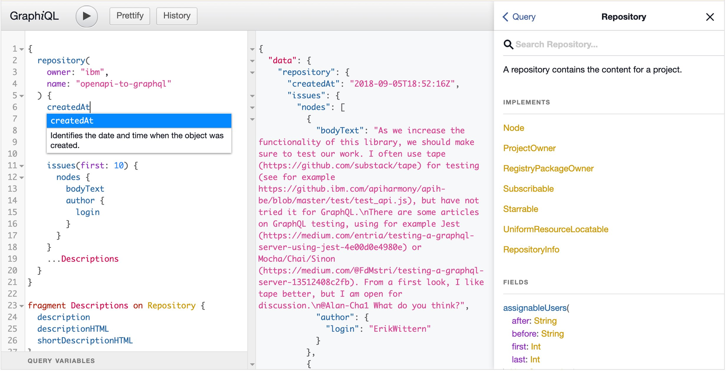
Client perspective
Predictable responses
In-sync documentation
Static typing
Fewer roundtrips
No over-fetching
Notes:
GraphiQL is a graphical interactive in-browser GraphQL IDE.
It highlights some of the advantages that GraphQL provides.
Some companies document a REST-ful API in an ad hoc manner, while others specify REST-ful APIs using more rigorous approaches like an OpenAPI (Swagger) specification.

Slide 33
Provider perspective
Simplified maintenance​
Serve clients with diverse, changing requirements with a single endpoint​
GraphQL API self-documents
Improved performance and operations​
Avoid loading/caching/exposing unneeded data​
Understand data-use on a per-field level​
Opportunity to compose heterogenous backend resources​
Notes:
The provider of a REST-ful API must manage an ever-growing set of endpoints to return the data requested by clients. As an API matures, more endpoints are added, and endpoints may become versioned to accommodate older and newer views into the data. Left unchecked by a strong engineering process, the result can be an unmanageable spaghetti of endpoints [4].
As an API matures, more endpoints are added, and endpoints may become versioned to accommodate older and newer views into the data.

Slide 34
With any new technology, users begin to follow useful patterns...
… so what are some emerging GraphQL best practices and anti-patterns?
Notes:
By giving you all that context, hopefully, you can see that GraphQL is a popular emerging technology and hopefully, you can understand why.
So, what we wanted to do in this research project is to take a look at how people are using GraphQL.
Are they making use of all the features that are available to them?
Are they following naming conventions?
Additionally, with all the flexibility that GraphQL provides, are there any potential problems?
If there are problems, are GraphQL providers mitigating those threat vectors?
In this presentation, we will focus on the last two questions. We’ll touch upon the other findings but the main focus is on potential problems that GraphQL APIs may have.

Slide 35
GraphQL 101
Notes:
So before we get started, I’m going to run down some of the basics of GraphQL.

Slide 36
Example Schema
type Office {
id: ID!
name: String
}
input OfficeInput {
name: String!
}
schema {
query: Query
mutation: Mutation
}
type Query {
company(id: ID!): Company
}
type Mutation {
createOffice(input: OfficeInput!): Office
}
type Company {
id: ID!
name: String
address: String
age: Int @deprecated(reason: "No longer relevant.")
offices: [Office]
}
Notes:
Here we have a schema...
This schema is expressed using SDL (Schema Description Language) which is a well-described syntax and a part of the official GraphQL Specification
You can also express schemas programmatically
At the top, we have the schema object, which lists the ways you can interact with the data
There are three ways, query, which simply retrieves data, mutation, which can change data, and subscription, which will give live updates to changes in the data
This particular schema only employs query and mutation.
Following with have a number of object type definitions and one input object definition.
You can query for a company by providing an ID
This will return a Company object
The company has a number of fields, including the id, name, address, and age.
There is also offices field, which will give you a list of Office objects, each containing an ID and a name
You can a create an office by providing an Office input object
Input objects are most often used for mutations, which allow you to bundle a number of arguments together
In this case, the OfficeInput input object type is used to create an Office object type

Slide 37
Example Query
Query
Response
query {
company(id: "n3...") {
offices {
name
}
}
}
}
{
company: {
offices: [
name: “Bob”,
name: “Jim”,
name: “Sam”,
name: “Tim”,
name: “Tom”
]
}
}
Notes:
Here, we can see an example query using the previously shown schema.
We are querying for a company through a given ID
And for that company, we are querying for each of its offices
And for each office, we are getting the name
Notice how the shape of the response matches the shape of the query.
This is one of GraphQL’s biggest advantages.
We can limit overfetching and in some cases, also reduce the number of roundabout trips.

Slide 38
Example Schema with Slicing
type Office {
id: ID!
name: String
}
input OfficeInput {
name: String!
}
schema {
query: Query
mutation: Mutation
}
type Query {
company(id: ID!): Company
}
type Mutation {
createOffice(input: OfficeInput!): Office
}
type Company {
id: ID!
name: String
address: String
age: Int @deprecated(reason: "No longer relevant.")
offices(limit: Int!): [Office]
}
Notes:
At this point, I would also like to introduce the concept of pagination, which will be discussed later in the talk
The official GraphQL documentation recommends that schema developers use one of two pagination techniques to bound response sizes
In this schema, I have modified the previous one so that it employs the slicing pattern
Slicing refers to the use of numeric arguments to index a subset of the full response set
In this case, the limit argument on the offices field will delimit the number of office objects return in the list

Slide 39
Example Query with Slicing
Query
Response
query {
company(id: "n3...") {
offices(limit: 2) {
name
}
}
}
}
{
company: {
offices: [
name: “Jim”,
name: “Sam”
]
}
}
Notes:
Here we have an example.
As you can see, we are querying for office names but because we have provided a limit argument, we only receive two of them.
This is in contrast to the previous query, which would return as many offices as there are in the data.

Slide 40
Example Schema with Connections
type Office {
id: ID!
name: String
}
input OfficeInput {
name: String!
}
type OfficeConnection {
totalCount: Int
nodes: [Office]
edges: [OfficeEdge]
}
type OfficeEdge {
node: Office
cursor: ID
}
schema {
query: Query
mutation: Mutation
}
type Query {
company(id: ID!): Company
}
type Mutation {
createOffice(input: OfficeInput!): Office
}
type Company {
id: ID!
name: String
address: String
age: Int @deprecated(reason: "No longer relevant.")
offices(limit: Int!, after: ID): OfficeConnection
}
Notes:
The second method of pagination is the connections pattern, which introduces a layer of indirection to enable more complex pagination
The connections patterns employs Connections and Edges types (OfficeConnection and OfficeEdge), which provide metadata on the number of nodes (totalCount) as well as a cursor (cursor) which can be used to influence selection.
---
The addition of Edge and Connection types allows schema developers to indicate additional relationships between types, and to paginate through a concurrently updated list.

Slide 41
Example Query with Connections
Query
Response
query {
company(id: "n3...") {
offices(limit: 10, after: "mY...") {
edges: {
cursor
node {
name
}
}
}
}
}
{
company: {
offices: {
edges: [
{
cursor: “s6…”,
node: {
name: “Tim”
}
},
{
cursor: “cB…”,
node: {
name: “Tom”
}
}
]
}
}
}

Slide 42
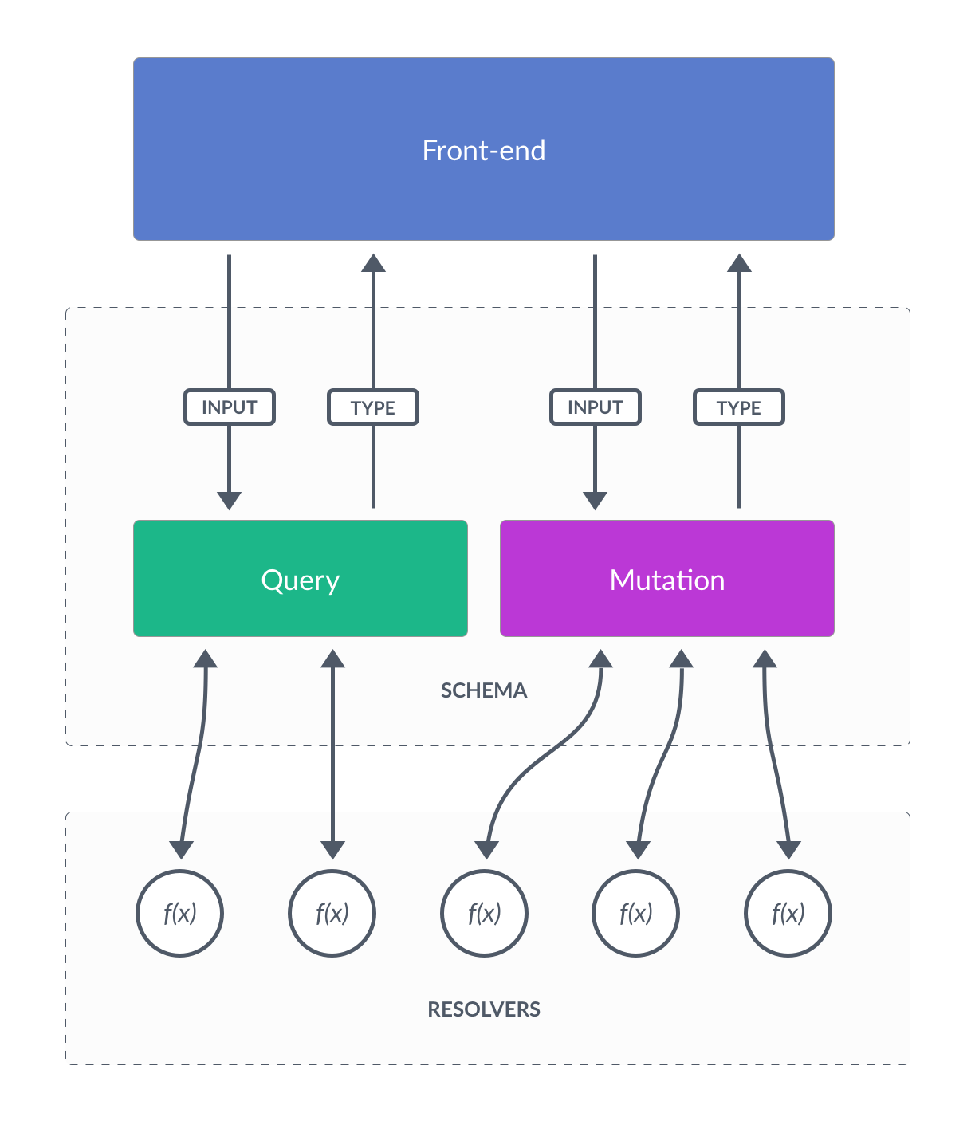
Notes:
So… how does GraphQL work?
To create a GraphQL API, you need to provide two things: the schema and the resolvers
GraphQL has a clear separation between structure and behaviour. (https://www.prisma.io/blog/graphql-server-basics-the-schema-ac5e2950214e)
The structure corresponds to the schema, which contains type definitions, describing all the data that you can query for and what that data looks like
The behavior corresponds to the resolvers, which describe how each field in the query should fetch its data
For this talk, we are strictly focusing on the schema
---
In its most basic form, a GraphQL server will have one resolver function per field in its schema. Each resolver knows how to fetch the data for its field. Since a GraphQL query at its essence is just a collection of fields, all a GraphQL server actually needs to do in order to gather the requested data is invoke all the resolver functions for the fields specified in the query. (This is also why GraphQL often is compared to RPC-style systems, as it essentially is a language for invoking remote functions.) (https://www.prisma.io/blog/graphql-server-basics-the-schema-ac5e2950214e)

Slide 43
Study

Slide 44
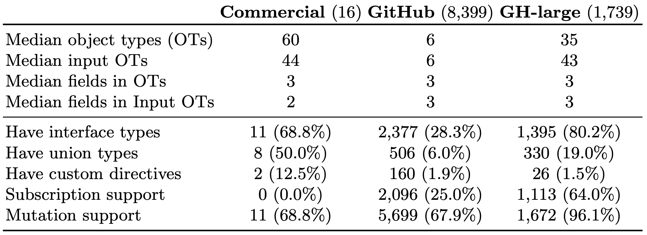
Schema Characteristics
Notes:
Not surprisingly, commercial and GitHub-large schemas are larger, containing more object and input object types than the regular GitHub schema.
Generally more MOTs and MIOTs
The sizes of the OTs and the IOTs seems to be largely consistent throughout the corpuses
In terms of feature use, commercial schemas apply interface types, union types, and custom directives most frequently, followed by GitHub-large schemas and then GitHub schemas.
These are more special definitions that can express more complex relationships between different types and fields.
Conversely, GitHub-large schemas support mutations and subscriptions most frequently, followed by GitHub schemas and then commercial schemas.
No commercial schemas have any subscription support and few have mutation support.
This is strange because we expect commercial schemas to be the most well-developed, fully-fledged schemas.
In general, reliance on different GraphQL features (e.g., unions, custom directives, subscription, mutation) varies widely by corpus.
---
Commercial and GitHub-large schemas are generally larger than GitHub schemas.

Slide 45
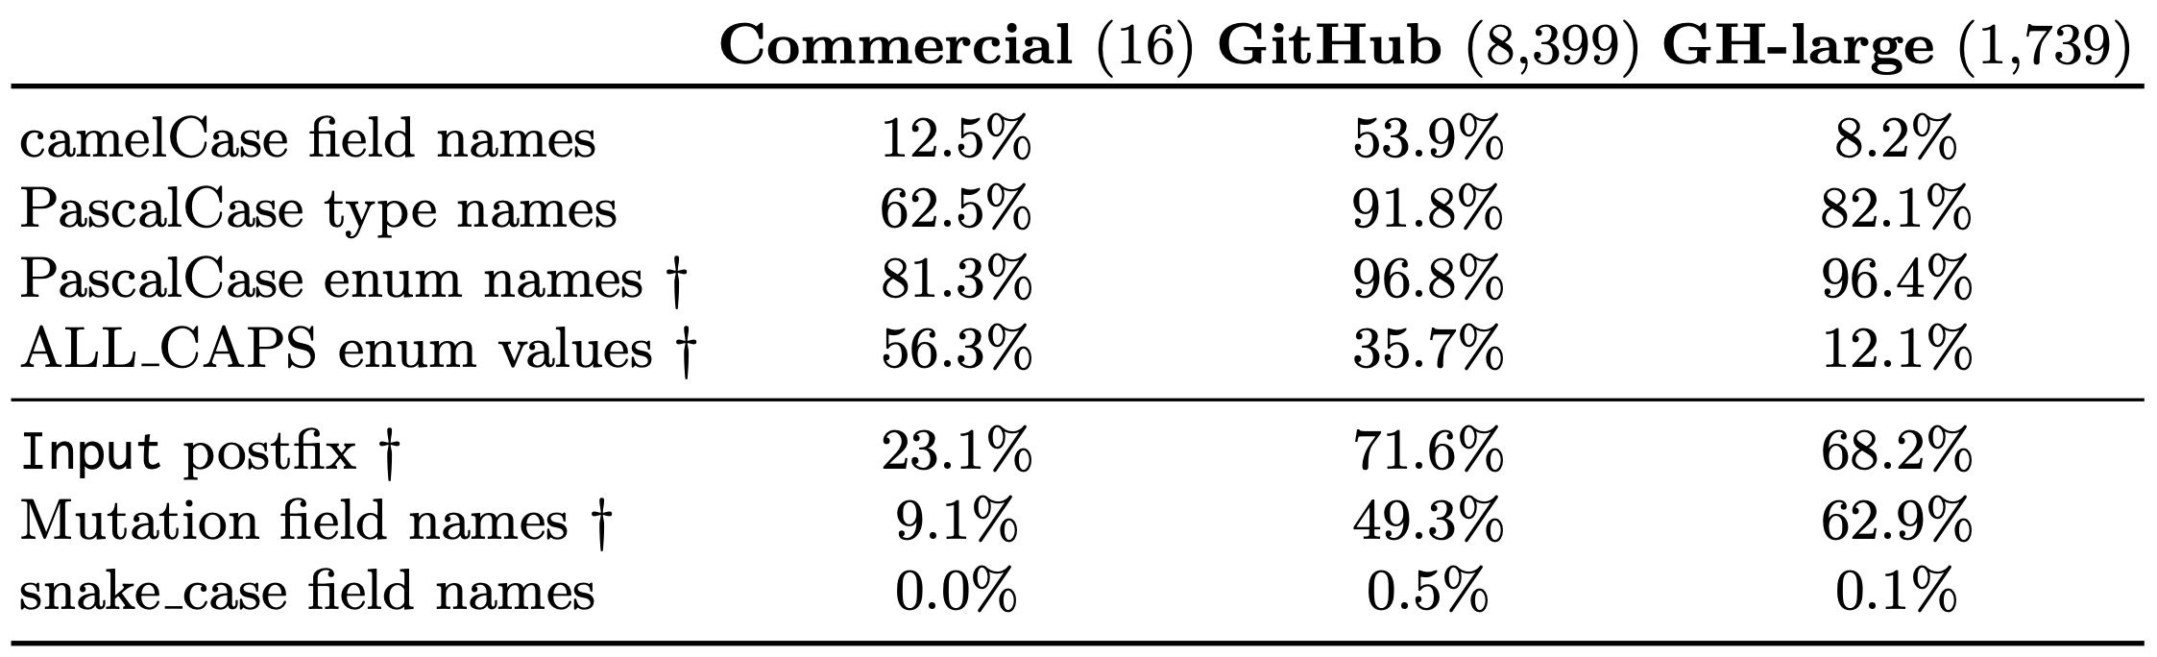
Naming Conventions
Notes:
Something else we explored were naming conventions
There are prescribed conventions and informal conventions for GraphQL
Some of the prescribed conventions are
(1) Fields should be named in camelCase; (2) Types should be named in PascalCase; and (3) Enums should be named in PascalCase with (4) values in ALL_CAPS.
The only prescribed convention that is frequently used in all three corpuses is (3) PascalCase enum names, exceeding 80% of schemas in each corpus and over 95% in the GitHub and GitHub-large corpuses.
In contrast, (1) camelCase field names are only common in GitHub schemas, (2) PascalCase type names are common in GitHub and GitHub-large schemas and less so in commercial schemas, and (4) ALL CAPS enum values appear in more than half of commercial schemas, but are unusual in the GitHub and GitHub-large schemas.
Some of the informal conventions are Input postfix for input object types, CRUD mutation field names, and snake case field names.
Input postfix for input object types:
Schemas in our corpuses commonly follow the convention of ending the names of input object types with the word Input.
If you recall in the schemas that I showed earlier in the talk, we saw an input object type called OfficeInput.
This is what the first convention is referring to.
This convention is used by examples in the official GraphQL documentation, but the general GraphQL naming convention recommendations do not remark on it [4].
In GraphQL, type names are unique, so the Input postfix is often used to associate object types with related input object types (e.g., the object type User may be related to the input object type UserInput).
This follows the example schemas that we showed earlier in the talk.
CRUD mutation field names.
Developers commonly indicate the effect of the mutation by including it as part of the field name.
These names are similar to those used in other data contexts: update, delete, create, upsert, and add.
We saw this as createOffice in the example schemas at the beginning of the talk.
snake_case field names.
Of the non-camelCase field names in the GitHub corpus, 90.3% follow snake case (determined by the presence of an underscore: “ ”), covering 30.6% of all field names and used in 37.3% of all schemas in the GitHub corpus.
However, barely any schema uses this convention consistently.

Slide 46
Worst-Case Response Sizes
Linear responses
Polynomial responses
Exponential responses
O(n x D)
O((n − K) × D^{K})
O(D^{n-1})
n, size of query
K, the maximum number of nested object lists that can be achieved in a query
D, worst polynomial in the length of the object list
Notes:
So we can up with these worst-case response sizes.
Polynomial responses refer to the first case, where there does not exist a loop of types
Exponential responses refer to the second case, where they do exist
Explain variables
The idea is that D is the size of the list, the 10 times 10 times 10 times… from the previous slide
n-k is the maximum number of fields you have on the last most nested field
The product is the worst case response size for polynomial responses
For exponential responses, the idea is similar, except the only thing limiting the size of the query is the amount of nesting

Slide 47
Threats to Validity
Construct validity: We assume that response size is the primary measure of query cost
Internal validity: Our name-based analyses depend on heuristics which could be inaccurate
External validity: Our corpuses may not be representative of the true state of GraphQL schemas

Slide 48
Majority of commercial and GitHub schemas…
Have super-linear worst case response sizes
Do not employ pagination
Are at risk from DDOS attacks

