Slide 1

Introducing Systems Thinking as a Framework for Teaching and Assessing Threat Modeling Competency
Siddhant S. Joshi, Preeti Mukherjee, Kirsten A. Davis, James C. Davis

Slide 2



Background
Massive losses can take place due to cybersecurity threats
US Gov Executive Order and NIST* emphasize the need for Threat Modeling (TM) skill to improve nation’s cybersecurity
Cybersecurity threats arise due to flaws in software
*2021 US Executive Order (14028) and NIST (NISTIR 8397)

Slide 3
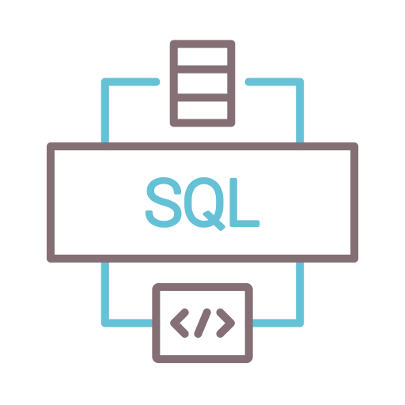



Background- Why we need threat modeling skills?
Damage: Unauthorized access to sensitive information, username and passwords personally identifiable information intellectual property, or trade secrets, etc. Massive fines for data breach
SQL injection: Attacker inserts malicious code into database servers
Template/automated approaches for TM provide a baseline defense for SQL injection, but TM helps secure as per unique properties of a system
Continuous Threat Modeling: TM helps update model for technical software changes and new vulnerabilities.
Notes:
A Threat modeled systems enables easier identification of system vulnerability and faster response to attacks

Slide 4
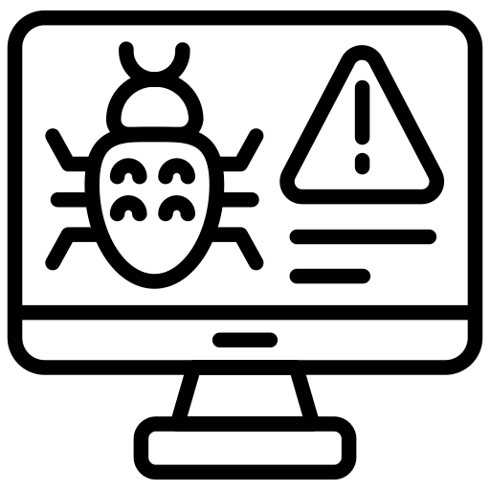
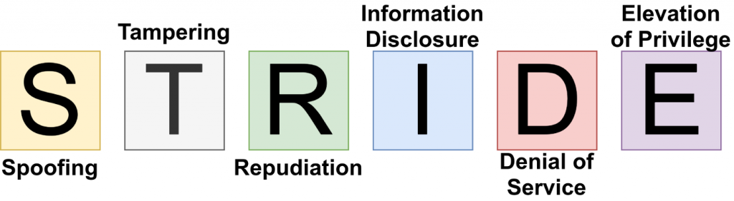


Threat Modeling
Threat Modeling (TM) is a software security analysis approach to identifying, mapping, and mitigating design-level security problems.
STRIDE is a popular and mature TM framework used in the industry and for teaching TM
Gaps in Teaching Threat Modeling
Purpose
Current TM frameworks do not focus on system-level and emergent threats arising due to connection between components
Using systems thinking approach in conjunction with STRIDE may help account for system and emergent threats. Need a rubric that can assess STRIDE and Systems thinking performance

Slide 5




Gaps and state of knowledge
Many current TM approaches do not emphasize threats arising due to interconnections
Systems research suggests that designing for component threats limits the ability to design for emergent system level behaviors
Many current TM approaches can be prone to threat explosion when a new component is added to the system. Rework maybe necessary
A systems approach to TM can help anticipate component level threats, threats due to interconnections, and system-oriented threats

Slide 6




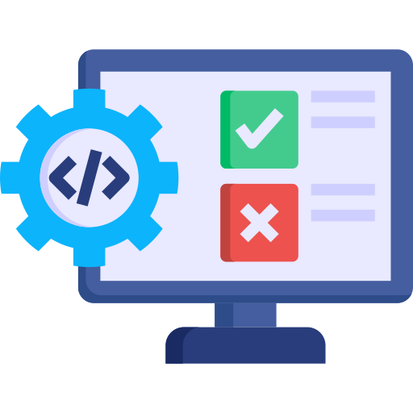

Context
3 credit Software Engineering (SWE) Course offered to 3rd and 4th Year ECE students at Purdue University.
Learning outcomes: Software design techniques, SWE methodologies, cybersecurity design
Semester long SWE project: 3 to 4 students per group (75 – 90 students per offering)
Systems thinking intervention – Fall 2021, Spring 2023
Systems thinking intervention - Fall 2023
Differences in ST intervention vs No intervention
Instructor included a learning module on Threat Modeling that integrated both STRIDE and Systems thinking
Students had access to ThreatModeler platform (https://threatmodeler.com/) to build their system models, identify threats, and suggest mitigations.
Assessment: Updated project assessment on security analysis to include rationale for TM steps
Notes:
Mention that TM provided access to the tool but did not sponsor the project.

Slide 7
Research Question
To what extent do upper-level software engineering students with and without systems thinking instruction practice systems thinking while applying the STRIDE threat modeling framework?

Slide 8



Methods
Data collection
Data Analysis
Results
Data: Security analysis deliverable from course project
Data Flow Diagram (DFD) with Trust Boundaries
STRIDE Threats
Threat Model
Mitigations
Threats not mitigated + rationale
Developed two analytical rubrics (1) STRIDE TM and (2) Systems thinking
Used the rubrics to score security analysis deliverable for STRIDE TM and systems thinking performance
Scores on a scale of 0 - 3
Highlight qualitative and quantitative differences for ST intervention vs no intervention
STRIDE TM
Systems thinking performance
Identify trends and blind-spots in teams’ threat modeling
Participants: 5 teams Fall 2021, Spring 2023, and Fall 2023 each.
Junior and Seniors from ECE

Slide 9
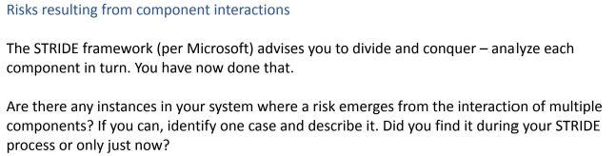

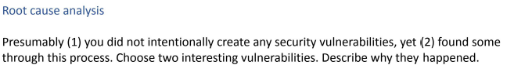
Methods: Data Collection
New Prompt for Fall 2023 assignment
Prompts to evaluate if teams' performed systems thinking during STRIDE Threat Modeling.
Threats relationship between components
Threats from multiple attacker perspectives
System-level threats

Slide 10

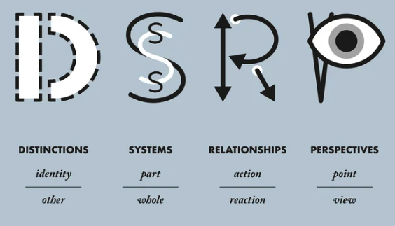
Rubric Development
Constructs of the rubric
STRIDE:
Link to the rubric
Modeling phase: Defining DFD, threats, security req., doc
Threat Analysis phase: Threat Analysis for each S-T-R-I-D-E
Systems thinking:
D: Identifying and analyzing threats and scenarios
S: Understand component and system level threats
R: Understand how component threats interact and contribute to system
P: Understand how threats from multiple attacker perspectives impact component/system

Slide 11
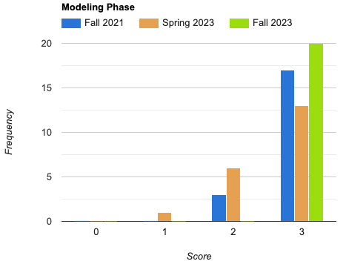
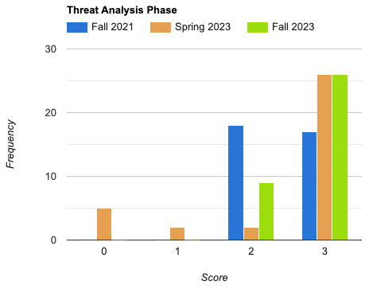
Results: Quant. Diff STRIDE – Both with ST vs No ST performed well
Average scores during modeling and threat analysis phases of STRIDE
Modeling: Defining DFD, threats, security req., doc
Analysis: Threat Analysis for each S-T-R-I-D-E
Modeling Phase
Threat Analysis Phase
F’21
S’23
F’23
F’21
S’23
- No ST Intervention
F’23
- ST Intervention
Frequency
Frequency
Score
Score
Average scores of all three groups in the modeling and threat analysis phases of STRIDE (Figure 3) are close by and consistent (ranging from 2.6 to 3)
All three groups (with and without systems thinking instruction) performed well on STRIDE: Modeling and Threat Analysis

Slide 12
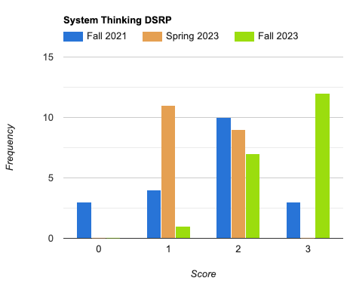
Results: Quant. Diff. – ST group had better component and system-level TM
- No ST Intervention
- ST Intervention
Systems Thinking
F’21
S’23
F’23
Average scores on systems thinking constructs
Frequency
Fall 2023 shifted their focus toward system level Threat Modeling
Score
Although Fall 2021 and Spring 2023 students performed well on STRIDE, they had beginner to intermediate-level system thinking performance

Slide 13
Results: Qualitative Differences – ST group recognizes how component threats lead to system level threats
No ST Intervention
With ST Intervention
Non-intervention teams recognize and mitigate only basic component-level threats for Spoofing
ST intervention teams recognize multiple threats, vulnerable components, and how their vulnerability can cause issues to the system during Spoofing
“Risk: Weak Identity, Credential, and Access Management
Mitigations applied: Mitigations applied: Use of strong authentication mechanisms (MFA), centralized identity management (AWS IAM), adherence to least privilege principle, AWS CloudWatch monitoring. encryption of data in transit and at rest, and Role-Based Access Control (RBAC).
Degree of risk resolution: All team members are required to enable multi-factor authentication with their AWS account. We use AWS IAM to assign roles to users to give them access to specific components within the system. We adhere to a least privilege principle along with RBAC to make sure that all components have access to the minimum needed levels. AWS DynamoDb and 53 automatically encrypt data at rest and utilize AWS KMS to make sure data is secure. Finally, through AWS Amplify we use HTTPS methods to transfer our data in an encrypted manner. With these mitigations in place, it greatly reduces the chances of unintended user access.
Suggestions for additional mitigations, if needed: If we were not limited to AWS free tier, we could implement AWS X-Ray to view, filter, and gain insights into that data to identify issues and opportunities for optimization or could use AWS Shield advanced to protect our registry better”
“Risk: Intruder gets access to our repository’s files.
Mitigations applied: only authenticated users like team members and people who were given access to the repo can view the repo content.
Degree of risk resolution: High
Suggestions for additional mitigations, if needed: N/A.”

Slide 14
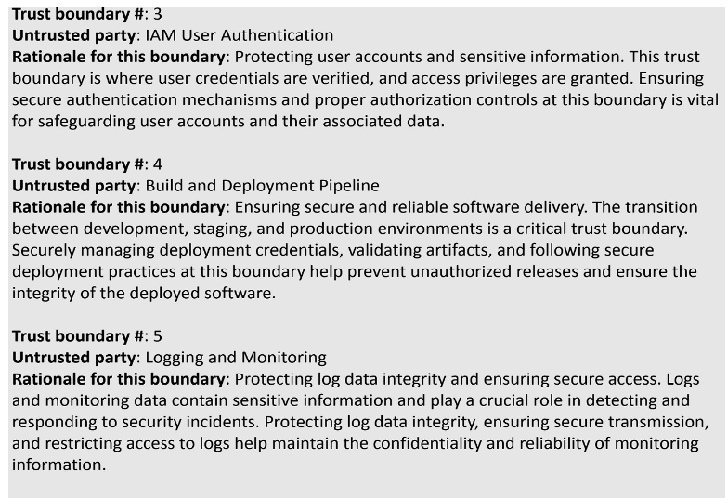
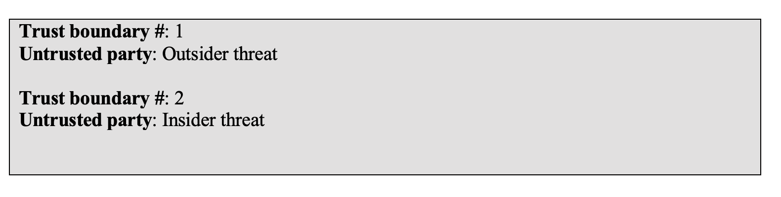
Trends and Blind spots during STRIDE - DFD
ST Intervention teams exhaustively discussed the problematic regions in DFD and potential vulnerability scenarios with respect to trust boundaries.
No ST interventions teams did not exhaustively discuss the problematic regions in DFD and potential vulnerability scenarios for trust boundaries

Slide 15


Conclusion
Student teams who had systems thinking as well as STRIDE instruction were able to identify both system-level and component-level threats in their team projects and attempted to address them.
Incorporating systems thinking questions in student assignments of threat modeling can be useful in identifying trends and blind spots in the security case deliverables
System thinking can be used as a supplementary skill along with threat modeling to help system level threat modeling

Slide 16
Siddhant S. Joshi - joshi110@purdue.edu Preeti Mukherjee – mukher57@purdue.edu Dr. Kirsten A. Davis – kad@purdue.edu Dr. James C. Davis – davisjam@purdue.edu
Introducing Systems Thinking as a Framework for Teaching and Assessing Threat Modeling Competency

Slide 17
Bonus Slides

Slide 18
PASTA, OCTAVE, LINDDUN, and STRIDE
Process for Attack Simulation & Threat Analysis (PASTA)
Combines business and technical objectives together
TM is at a strategic level by involving key decision-makers in the organization
Emphasizes attacker perspective
Asset-oriented: Organization can derive the impact of threats using simulated attacks
Operationally Critical Threat, Asset, and Vulnerability Evaluation (OCTAVE)
Assess mission-level threats from an organizational standpoint
May not focus on granular technological risks
Linkability, Identifiability, Non-repudiation, Detectability, Information Disclosure, Content Unawareness, and Non-compliance (LINDDUN)
Uses a threat tree catalog that encompasses a wide variety of known and common attack paths or access points for each threat category
Employed to mitigate privacy threats
STRIDE
Along with attacker perspective, STRIDE also focuses on threats posed to its components based on how the system is designed.
STRIDE focuses primarily on technical objectives
STRIDE can be used for large-and-small scale projects (flexible WRT organization or software)
STRIDE is commonly used in industry due to well documented process.

Slide 19
Trends and Blindspots during Systems Thinking
Trend
Blindspot
Most teams from with ST intervention identified system-level threats and/or emergent threats arising due to interaction between components and scored high on systems thinking constructs of Systems and Relationships
Teams from either did not discuss system-level threats, or interaction threats, or discussed them very minimally (e.g., mentioned only in security requirements). Instead, they chose to focus only on component threats. These teams scored between beginner and intermediate on S and R

