Slide 1








An Exploratory Study on Upper-Level Computing Students’ Use of Large Language Models as Tools in a Semester-Long Project
Ben A. Tanay, Lexy Arinze, Siddhant S. Joshi,
Kirsten A. Davis, and James C. Davis
Notes:
This work was funded by an “AI in Teaching and Learning” grant from the Purdue Office of the Provost.
The work of Ben Arie Tanay and Lexy Arinze was supported by the Purdue Engineering Education Explorers Program.
The work of Siddhant S. Joshi was supported by an ECE Elmore grant promoting cybersecurity in the computer engineering curriculum.

Slide 2


What are Large Language Models (LLMs)?
Models trained on large amount of textual data to understand and generate human-like language.
Industry
Large Language Models (LLMs) are transforming SW Eng practice
Academia
To ban or not to ban?
Notes:
LLMs as transformative
Large Language Models (LLMs) have begun to influence software engineering practice since the public release of GitHub's Copilot and OpenAI's ChatGPT in 2022. Tools built on LLM technology could revolutionize the way software engineering is practiced, offering interactive “assistants” that can answer questions and prototype software. It falls to software engineering educators to teach future software engineers how to use such tools well, by incorporating them into their pedagogy.
Large Language Models (LLMs) are a recent advancement in natural language processing (NLP). These models are trained on large amount of textual data to understand and generate human-like language [7]. While early language models primarily focused on text generation (e.g., advertising copy), LLMs can tackle more complex tasks [1]. One application of interest is in interacting with computer programs, i.e., software, which can be represented with specialized text [14].
Academia:
While some institutions have banned ChatGPT, other institutions have opted to issue guidelines for its use. Additionally, researchers have proposed strategies to address potential issues in the educational and professional use of LLMs. As of yet, there have been few studies that report on the use of LLMs in the classroom. It is, therefore, important to evaluate students’ perception of LLMs and possible ways of adapting the computing curriculum to these shifting paradigms.

Slide 3
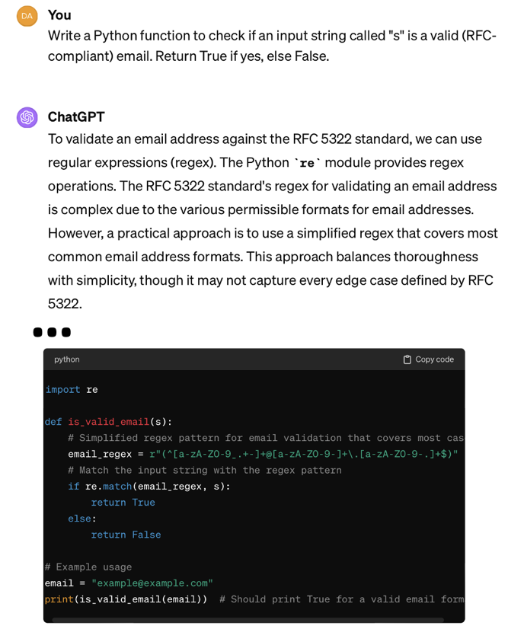
ChatGPT solving a programming task.
Notes:
(Explain the benefit, but also spend time talking about the hazard of this capability – sample speech:)
Similar to any technological advancement, there are educational challenges inherent in the use of LLMs, including students' overreliance, issues of plagiarism, and biases in the generated content [21]. These challenges highlight the need for policies and guidelines towards the responsible use of LLMs. Educational institutions are actively engaged in deliberations to determine the most effective strategies for incorporating LLMs into their curricula

Slide 4
Challenges
Overreliance
Plagiarism
Biases in the generated content
Notes:
Similar to any technological advancement, there are educational challenges inherent in the use of LLMs, including students' overreliance, issues of plagiarism, and biases in the generated content [21]. These challenges highlight the need for policies and guidelines towards the responsible use of LLMs. Educational institutions are actively engaged in deliberations to determine the most effective strategies for incorporating LLMs into their curricula

Slide 5
Research Questions
Prior work focuses on novices – what about advanced students?
How do students integrate LLMs into coursework when policies allow unrestricted access?
RQ1
How does the use of LLMs influence students’ perceptions of their learning?
RQ2
Notes:
Prior studies on how students use LLMs in the classroom have focused on introductory courses when students are first learning programming languages. There has been less research on upper-level undergraduate students, particularly in a project-based classroom setting. Given the various roles that LLMs can play in software engineering projects [34], [16], [35], we wanted to understand how undergraduates studying software engineering approach the use of LLMs in their projects and their perceptions of how LLMs impact the overall project outcomes. Our study contributes insights into LLM use at the stage when students are moving beyond learning programming to applying these skills in a software engineering project.

Slide 6
Software Engineering Syllabus
Pre-requisites
“Data Structures; or commensurate experience with instructor approval.”
Assessments
“This course has three kinds of assessments: homework assignments (20%), a semester-long project (70%), and a final exam (10%).”
Academic Integrity: Generative AI and LLMs
“Despite their limitations, [LLM] tools are already transforming the discipline of software engineering…”
“Therefore, the use of these tools is mandatory… You will be required to use such tools as a part of your project, in a manner that you and your team will determine.”
Notes:
Prereqs: upper-level ECE class for those who already know how to code.
Assessments: heavily project-oriented
AI: acknowledges LLM impact on SWED landscape; opens pandora’s box

Slide 7
Software Engineering Schedule
Week | Course Event
1 | PHASE 1 Project begins
2
3
4
5 | PHASE 2 Project swap
6
7
8
Week | Course Event
9 | INTERVIEW ROUND 1 Data collection begins
10 | INTERVIEW ROUND 1 Data collection ends
11
12
13
14
15 | INTERVIEW ROUND 2 Data collection begins
16 | INTERVIEW ROUND 2 Data collection ends
Notes:
Prereqs: upper-level ECE class for those who already know how to code.
Assessments: heavily project-oriented
AI: acknowledges LLM impact on SWED landscape; opens pandora’s box

Slide 8
Data Collection: Interview Protocol
Content Section | # Questions | Example Questions (Paraphrased)
Interview Round 1 (Weeks 9-10)
Past Experiences | 6 | How did you first find out about LLMs?
Use Cases | 6 | Tell us about your typical use of LLMs in this project.
Interpretation | 3 | How do you think using LLMs influences your learning experiences?
Interview Round 2 (Weeks 15-16)
Past Experiences | 2 | How have your impressions of LLMs changed throughout the course?
Use Cases | 11 | How did you use LLMs differently between project phases?
Interpretation | 5 | How do you expect to apply your experiences with LLMs in your future work?
Notes:
This work was funded by an “AI in Teaching and Learning” grant from the Purdue Office of the Provost.
The work of Ben Arie Tanay and Lexy Arinze was supported by the Purdue Engineering Education Explorers Program.
The work of Siddhant S. Joshi was supported by an ECE Elmore grant promoting cybersecurity in the computer engineering curriculum.

Slide 9
RQ #1
How do students integrate LLMs into coursework when policies allow unrestricted access?
Themes | Subtheme | Examples | n
Technical Aid | Programming support | Writing or editing code | 9
 |  | learning SWE concepts
 | Idea generation | Designing a system | 5
 |  | Conceptualizing complex problems
Professional Aid | Writing support | Emailing instructional faculty | 6
 |  | Completing writing assignments
 | Project management | Establishing division of labor | 3
 |  | Setting project milestones
Notes:
This work was funded by an “AI in Teaching and Learning” grant from the Purdue Office of the Provost.
The work of Ben Arie Tanay and Lexy Arinze was supported by the Purdue Engineering Education Explorers Program.
The work of Siddhant S. Joshi was supported by an ECE Elmore grant promoting cybersecurity in the computer engineering curriculum.

Slide 10
RQ #1: How do students integrate LLMs into coursework when policies allow unrestricted access?
“I just straight up asked [ChatGPT], ‘Give me TypeScript code which fetches whether dependencies are constrained or non-constrained,’ based on the earlier interactions that I already did.’”
Technical aid - programming support
“Standard” prompt engineering
Notes:
This work was funded by an “AI in Teaching and Learning” grant from the Purdue Office of the Provost.
The work of Ben Arie Tanay and Lexy Arinze was supported by the Purdue Engineering Education Explorers Program.
The work of Siddhant S. Joshi was supported by an ECE Elmore grant promoting cybersecurity in the computer engineering curriculum.

Slide 11
RQ #1: How do students integrate LLMs into coursework when policies allow unrestricted access?
“I told ChatGPT, ‘you are a project manager. Propose a timeline and split the work to four people.’ And it correctly identified a front-end, back-end, DevOps, and security person.”
Professional aid – project manager
Identity assignment/roleplay
Notes:
This work was funded by an “AI in Teaching and Learning” grant from the Purdue Office of the Provost.
The work of Ben Arie Tanay and Lexy Arinze was supported by the Purdue Engineering Education Explorers Program.
The work of Siddhant S. Joshi was supported by an ECE Elmore grant promoting cybersecurity in the computer engineering curriculum.

Slide 12
RQ #2
How does the use of LLMs influence students’ perceptions of their learning?
Theme | Subtheme | Examples | n
Accessibility | Information gathering | Allows students to research and gather intelligence more efficiently | 8
 | Solution speed | Allows students to design successful project elements faster | 8
Knowledge | Knowledge retention | May hurt their ability to retain novel concepts | 8
 | Pre-requisite knowledge | May be ineffective if users do have base-level understanding of certain topics | 6
Autonomy | Self-sufficiency | Allowed students to decrease their reliance on help from course staff | 4
 | Over-reliance | Using LLMs may create a dependency on the technology for solutions. | 3
Notes:
This work was funded by an “AI in Teaching and Learning” grant from the Purdue Office of the Provost.
The work of Ben Arie Tanay and Lexy Arinze was supported by the Purdue Engineering Education Explorers Program.
The work of Siddhant S. Joshi was supported by an ECE Elmore grant promoting cybersecurity in the computer engineering curriculum.

Slide 13
RQ #2: How does the use of LLMs influence students’ perceptions of their learning?
“I’m getting two to three times as much done [by using Copilot] as I would [have by] writing every line. I typed the comment and then in five seconds I have ten lines of function versus taking two minutes to write ten lines [myself].
Accessibility – speed of solution
Productivity tool
Notes:
This work was funded by an “AI in Teaching and Learning” grant from the Purdue Office of the Provost.
The work of Ben Arie Tanay and Lexy Arinze was supported by the Purdue Engineering Education Explorers Program.
The work of Siddhant S. Joshi was supported by an ECE Elmore grant promoting cybersecurity in the computer engineering curriculum.

Slide 14
RQ #2: How does the use of LLMs influence students’ perceptions of their learning?
“But if I’m doing the technical side of things, trying to complete a task that I already planned out, I don’t really retain those methods as well. I’m just trying to make it work.”
Knowledge – retention issues
Shift in achievement goal orientations
Notes:
This work was funded by an “AI in Teaching and Learning” grant from the Purdue Office of the Provost.
The work of Ben Arie Tanay and Lexy Arinze was supported by the Purdue Engineering Education Explorers Program.
The work of Siddhant S. Joshi was supported by an ECE Elmore grant promoting cybersecurity in the computer engineering curriculum.

Slide 15
RQ #2: How does the use of LLMs influence students’ perceptions of their learning?
“But I know that if you introduce [LLMs] too early, people are just going to use it to generate code, and, especially at the lower-level classes like data structures, you can get through that class just by using LLMs to create code for you.”
Autonomy – over-reliance
Why is this an issue?
Notes:
This work was funded by an “AI in Teaching and Learning” grant from the Purdue Office of the Provost.
The work of Ben Arie Tanay and Lexy Arinze was supported by the Purdue Engineering Education Explorers Program.
The work of Siddhant S. Joshi was supported by an ECE Elmore grant promoting cybersecurity in the computer engineering curriculum.

Slide 16
Discussion & Conclusions
Students were thoughtful and mature in understanding of LLM use
SWEng work – and LLM use – is more than just code
Do LLMs require prerequisite knowledge of fundamentals?
Lots of opportunity for classroom impact and further research
Notes:
First, as a research group, we underestimated the level of maturity and nuance with which undergraduate students would relate to LLMs. Interviewees were aware of the hazards of LLMs, such as the accuracy of generated content, the ethical dilemma of plagiarism, and the many societal, corporate, and individual perspectives on intellectual property theft. What tasks students deemed worthy of LLM aid varied between responses as well. Tasks that some students considered “grunt work” and felt comfortable assigning the LLM to solve, others felt was meaningful work and insisted in doing themselves.
In response to RQ1, we found that all interviewees used LLMs for coding support. More than half of the interviewees also used LLMs for writing support (e.g., emails and reports) or idea generation, both technical and conceptual. A significant minority of students also used LLMs as project managers. These findings are significant because although some previous studies have explored how students could use LLMs in their academic pursuits [12], this study is the first to observe how engineering students use LLMs in a context that both mandates but does not restrict their usage to particular use cases. Additionally, project management manifested as a unique use case from this study, which has not been observed in previous relevant literature. This discovery may be related to the large scope of the course project, as well as the lack of formal project management training in the curriculum.
Our findings reaffirm the background literature’s mention of challenges related to LLM usage in academia like over-reliance and generated content bias [13]. However, they present new educational challenges not outlined in previous literature, namely the issue of feeling the need to have prerequisite knowledge before interacting with LLMs. What knowledge, precisely, is necessary?
Our findings on the usage of LLMs in a software engineering course can help educators explore the role of this emerging technology in their respective academic settings.

Slide 17
Future Work
Investigate how usage of LLM’s influence the learning of students earlier in the curriculum, at the freshman and sophomore levels.
Studying student interactions with LLMs like ChatGPT as a source of feedback for a course.
Notes:
Students will use LLMs regardless of policy, so we would like to understand how LLMs can be safely integrated into lower-level courses without hurting the learning outcomes of students new to programming. We believe many such similar investigations across different contexts (e.g., university type, classsize, student demographic variations) are necessary to understand the right time to introduceLLM’s in computer engineering curricula because LLMs when used effectively appear to have the potential to foster better learning outcomes.
We see opportunity in studying student interactions with LLMs like ChatGPT as a source of feedback for a course. Prior studies have looked at the conversations that software engineers have with ChatGPT [42] and provided feedback on the behaviors and needs of practitioners. Similar studies can be conducted in educational contexts with students to uncover how student interactions with LLM’s influence quality of students work product like assignments, projects,learning outcomes, etc To effect this, a university would need a custom LLM (or a custominterface to a commercial LLM) that would anonymize, track, and summarize student queries to help instructors understand opportunities for improvement

Slide 18
An Exploratory Study on Upper-Level Computing Students’ Use of Large Language Models as Tools in a Semester-Long Project
Ben A. Tanay | btanay@purdue.edu
Lexy Arinze | larinze@purdue.edu
Siddhant S. Joshi | joshi110@purdue.edu
Kirsten A. Davis | kad@purdue.edu
James C. Davis | davisjam@purdue.edu
Notes:
This work was funded by an “AI in Teaching and Learning” grant from the Purdue Office of the Provost.
The work of Ben Arie Tanay and Lexy Arinze was supported by the Purdue Engineering Education Explorers Program.
The work of Siddhant S. Joshi was supported by an ECE Elmore grant promoting cybersecurity in the computer engineering curriculum.

Slide 19
Bonus Slides

Slide 20
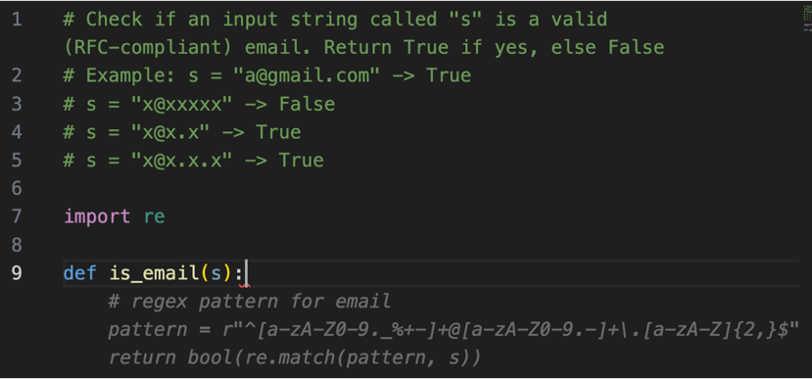
GitHub Copilot solving a programming task.
Notes:
(Explain the benefit, but also spend time talking about the hazard of this capability – sample speech:)
Similar to any technological advancement, there are educational challenges inherent in the use of LLMs, including students' overreliance, issues of plagiarism, and biases in the generated content [21]. These challenges highlight the need for policies and guidelines towards the responsible use of LLMs. Educational institutions are actively engaged in deliberations to determine the most effective strategies for incorporating LLMs into their curricula

Slide 21
Data Collection: Demographics
Content Section | # Questions
Major
Computer engineering | 9
Other | 0
Class Standing
Senior | 7
Junior | 2
Other | 0
Gender
Male | 9
Other | 0
Notes:
This work was funded by an “AI in Teaching and Learning” grant from the Purdue Office of the Provost.
The work of Ben Arie Tanay and Lexy Arinze was supported by the Purdue Engineering Education Explorers Program.
The work of Siddhant S. Joshi was supported by an ECE Elmore grant promoting cybersecurity in the computer engineering curriculum.

Slide 22
About ECE 461 – Software Engineering
Senior-level course for ECE students
Prereqs: 2 courses in programming, 1 course in algorithms
Learning outcomes:
Understanding of common models of the software engineering process
The ability to conduct the software engineering process
Understanding of the social aspects of software engineering
Approach: Project-based learning
16-week project
Two phases: CLI → Handoff → Web service deployed to AWS
Peer institutions offer similar courses at junior or senior level
Notes:
“ECE 461: Software Engineering” is a senior-level course for electrical and computer engineering students at Purdue University [36]. The prerequisite coursework is two courses in programming and one course in data structures and algorithms, all taught in C. Most students have also taken a course in Python programming. The course learning outcomes are (1) an 6
(1) An understanding of common models of the software engineering process (e.g., agile methods, plan-based methods)
(2) The ability to conduct the software engineering process (e.g., requirements elicitation, project specification, design, implementation, validation, maintenance and evolution, re-use, and security analysis); and
(3) an understanding of the social aspects of software engineering, (e.g., teamwork and ethics).
The course uses project-based learning [37] to teach these learning outcomes. Students work on a course project in small teams in teams of four that spans the entire 16-week semester. The project has two phases. Phase 1 takes 4 weeks. After Phase 1, the teams exchange projects (to simulate brownfield engineering [38]) and undertake the 12-week Phase 2 on top of another team’s implementation of Phase 1. During Phase 1, the students are applying concepts they have learned in previous coursework, such as file I/O and command-line interfaces. In Phase 2, the course staff provide support as students self-learn modern software engineering practices (e.g., continuous integration and continuous deployment) and cloud computing technologies (e.g., component selection and integration via infrastructure-as-code). The majority of the implementation is required to be done in TypeScript, a programming language that is not covered in the curriculum.

