Slide 1





Distinguished paper
The Impact of Regular Expression Denial of Service (ReDoS) in Practice
James Davis Christy Coghlan
Francisco Servant Dongyoon Lee
Notes:
ReDoS is an understudied denial of service vector that
takes advantage of the worst-case execution time of the regex engines in most mainstream programming languages.
16:15 - 16:37

Slide 2




Contributions
ReDoS regexes are prevalent in the wild
Heuristics to detect them are inaccurate
Developers (try to) fix them with 3 techniques
Not just one or two
Thousands!
Notes:
1. The key ingredient for ReDoS is a ReDoS regex.
We found that, to our surprise, that...
but thousands of ReDoS regexes used in practice today.
Takehome message
We believe our study shows that:
ReDoS is a very real problem in practice, and that
The practitioner community needs better tools to detect and repair ReDoS regexes.

Slide 3
Background
Notes:
Let me start by introducing some background material.

Slide 4

Regexes
What are they?
Examples
Describe a “language”
Used for
Input validation
Text manipulation
(Poorly tested)
[W&S’18]: Thursday!
/^a+$/ ← Some ‘a’
/\d{1,3}\.\d{1,3}\.\d{1,3}\.\d{1,3}/ ← IPv4
/^[a-zA-Z0-9]+([._]?[a-zA-Z0-9]+)*$/ ← Username
ReDoS regex
Notes:
Language: a subset of all possible strings
This ReDoS regex has worst-case exponential-time behavior.

Slide 5
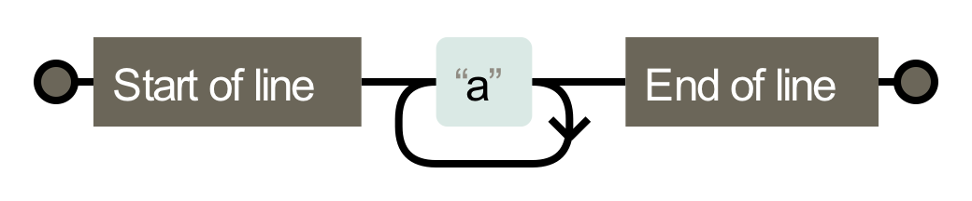

Regex Engines
What are they?
match(regex, string) ← “Does this regex match this string?”
How do they work?
/^a+$/
Simulate on input
“aaa”
Notes:
Now this worst-case exponential-time behavior is
due to how the regex engines in most programming languages are implemented.

Slide 6
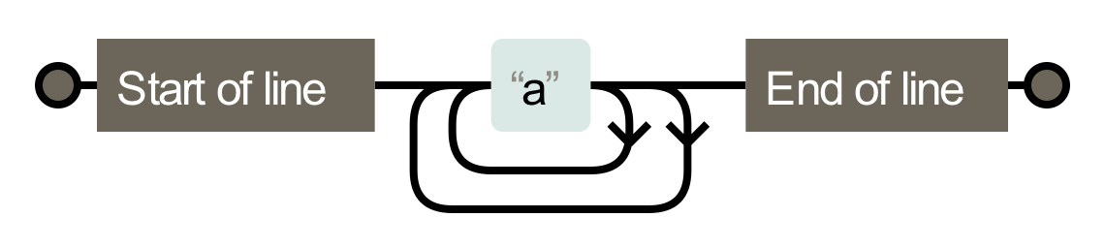
ReDoS Regexes
Simple ReDoS regex /^(a+)+$/
NFA
Malicious input “aaaaaaaaaa…aa!”
Recurrence relation
T(n) = 2*T(n-1)
= 2*(2*T(n-2))
= O(2^{n})
Mismatch
Exponential paths
Notes:
A ReDoS regex is a special kind of regex whose worst-case behavior
Is polynomial or exponential in most regex engines.

Slide 7





Regular Expression Denial of Service (ReDoS)
[C&W ‘03]
/^[a-zA-Z0-9]+([._]?[a-zA-Z0-9]+)*$/
“aaa…aaaa!”
“Susie”
Malicious input injected
[DWL ‘18]
[S&P ‘18]
Notes:
Suppose the server is using Microsoft’s ReDoS regex for usernames that I mentioned earlier.
Killing a server:
Users like Susie are sad.
If this is Outlook mail, then millions of customers can’t check their email.

Slide 8
Research
Notes:
Now you know the basics of ReDoS.
As it turns out, automata theorists and security researchers have spent a lot of time describing the mechanisms of ReDoS.
What the literature is missing is a software engineering perspective:
- Is ReDoS a problem that actually happens in the wild?
- How do developers currently identify ReDoS regexes?
- How do developers fix ReDoS regexes?
The literature is silent!

Slide 9
Theme 1 ReDoS Regexes in the Wild

Slide 10












Collecting Regexes
Module selection
Module regex extraction
45%
35%
565K
125K
Giant list of regexes
“Can clone”
filter
350K
60K
375K
(66%)
70K
(58%)
Notes:
Walk through the flow-chart
GitHub: Anything that was “git clone-able”, which in the vast majority of cases meant the modules were hosted on GitHub
Python
We also repeated this analysis for the Python module ecosystem to see if our findings would generalize to another context.

Slide 11

Analyzing Regexes
350K
60K
1. ReDoS regexes
2. Degree
[R&T ‘14]
[WMBW ‘16]
[WOHD ‘17]
3.6K
(1%)
704
(1%)
13K
(3%)
705
(1%)
Notes:
1. ReDoS Regexes
Talk through flowchart.
From this we learn that ReDoS regexes occur a lot in practice – thousands of ReDoS regexes occurring in over 10K modules.
ReDoS regexes make these modules, as well as any modules and applications that depend on them, potentially vulnerable to ReDoS.
2. Degree
We wanted to know how concerned developers should be about these regexes.
Exponential behavior is rather more problematic than polynomial behavior.
We measured match time on varying-length inputs.
Then we fitted exponential and polynomial curves to the data.
We chose the curve of best fit.

Slide 12
ReDoS Regexes are Usually Quadratic
Notes:
This figure shows...
x-axis: empirical curve
y-axis is percent of ReDoS regexes with that curve
orange is npm, maroon is pypi
Results
Most ReDoS regexes exhibit quadratic behavior as the input length increases.
Exponential-time ReDoS regexes are rare.
Trends similar in npm and pypi.

Slide 13



ReDoS Regexes occur in Prominent Places
1 regex
1 regex
3 regexes
3 regexes
2 regexes
Notes:
These prominent ReDoS regexes have the potential to affect millions of applications.
Transition
In summary, in this theme we used state-of-the-art ReDoS regex detectors to determine the incidence of ReDoS regexes in npm and pypi ecosystems.
But most developers don't use these state-of-the-art tools.
Instead, they rely on heuristics to check whether or not their regexes are safe.

Slide 14
Theme 2 Do Developers’ Heuristics Work?
Notes:
In our second theme we identified these heuristics and examined their effectiveness.

Slide 15
Heuristics Used in Practice
Finding Heuristics
Our Heuristics
Exponential
Reference books
Regex websites
What they said
Star height – safe-regex
“Watch out when different parts of the regex can match the same text”
Star height
(
)
Q.O.D.
(a|a)
Q.O.A.
a
a
Polynomial
Notes:
Finding Heuristics
We reviewed ~10 reputable reference books purchased from Amazon
And the advice given on several prominent websites dedicated to regexes
What they said
Avoid nested stars – this is the root cause of the exponential example we discussed earlier.
This heuristic is widely used; an npm module called “safe-regex” uses it and gets about 20M DL/mo.
Vague language: Operationalize into two heuristics.

Slide 16

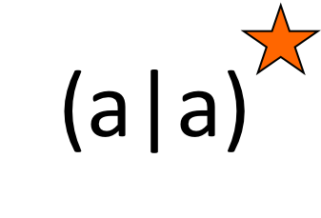

Few false negatives
Many false positives
Developed detectors for these heuristics
Imprecise – modeled on safe-regex (star height)
Notes:
Axes
X-axis: Each heuristic
Y-axis: Percentage
Few false negatives
In total we capture about 81-85% of the ReDoS regexes in our dataset.
High false positives
Speaks to the power of the ReDoS regex detectors we used in the first theme.
We therefore recommend that developers adopt those tools, and to this end have published our drivers on GitHub.

Slide 17
Bringing Research to Practice
I am now the maintainer of safe-regex
Fixed false negatives in star height heuristic
Incorporating (improved) QOD and QOA heuristics
Notes:
Maintainer
20 M DL/month
Last week I published the first release in 4 years, fixing some false negatives in the star height heuristic.
Transition
So,
In the first theme we studied the incidence of ReDoS regexes in the wild,
and in this theme we studied how developers currently detect ReDoS regexes.
We also wanted to know how developers repair ReDoS regexes when they learn about them.

Slide 18
Theme 3 The Repair of ReDoS Regexes
Notes:
Theme 3!

Slide 19
(ReDoS) Regexes Are Hard to Understand
[CWS ‘17]
/^(\+|-)?(\d+|(\d*\.\d*))?
(E|e)?([-+])?(\d+)?$/
/([^\=\*\s]+)(\*)?\s*\=\s*
(?:([^;'"\s]+\'[\w]*\’
[^;\s]+)|(?:\"([^"]*)\")|
([^;\s]*))(?:\s*(?:;\s*)|$)/
/^\S+@\S+\.\S+$/
/^(.*?)([.,:;!]+)$/
/<(\/)?([^ ]+?)(?:(\s*\/)| .*?)?>/
/^([\\s\\S]*?)((?:\\.{1,2}|[^\\\\\\/]+?|)(\\.[^.\\/\\\\]*|))(?:[\\\\\\/]*)$/
/^(\\/?|)([\\s\\S]*?)((?:\\.{1,2}|[^\\/]+?|(\\.[^.\\/]*|))(?:[\\/]*)$/
/\+OK.*(<[^>]+>)/
/\s*#?\s*$/
/^\s*/\*\s*(.+?)\s*\*/\s*$/
Notes:
To give you a taste of the problem faced by developers,
here are some of the ReDoS regexes that we reported.
They are long, and they are complicated.
We wanted to know how developers go about fixing ReDoS vulnerabilities like these ones,
in order to inform future research on automatic ReDoS regex amelioration.

Slide 20
Methodology
Historic
Disclosures & Fixes
Study all ReDoS reports in CVE and Snyk.io DBs
“What do developers prefer when they know all the fix strategies?
Email 284 module maintainers
Vulnerability disclosure
Fix strategies
Notes:
Part 1
CVE: General DB for security vulnerabilities in software
Snyk.io: Module-specific security vulnerability DB that includes npm and pypi modules.
Part 2: We selected modules based on:
- Downloaded >1000 times/month
- Manual inspection for seriousness (potential for ReDoS exploitability)

Slide 21

Fix Strategies For RedoS Regexes
Original /^\S+@\S+\.\S+$/
Fix strategies
Trim TRUNCATE(input, 1000)
Revise /^[^@]+@([^\.@]+\.)+$/
Replace* (Custom parser)
Exactly one @, somewhere in the middle of the string
A ‘.’ to the right of the @
But not immediately to the right
Notes:
This example is taken from a discussion we had with the Django development team.

Slide 22

Fix strategies and correctness
1 incorrect
2 incorrect
“All correct”
Notes:
We observed different trends in the strategies used by developers in the historic data vs. after our disclosures.
Axes
X-axis: Fix strategy
Y-axis: Number of times it was used
In total there are 37 historical fixes, with most in Revise but more than 5 of the others.
Compare that to the 48 fixes resulting from our disclosures.
Decrease in Trim
Developers exposed to all 3 fix strategies opted not to Trim
Correctness
So...fixing ReDoS regexes seems to be pretty hard for developers to do correctly.

Slide 23
Closing Remarks

Slide 24
(Some) Limitations and Future Work
Reachability
Module vs. application?
Why do developers. use regexes? [C&S ‘16]
ReDoS regex == ReDoS?
Scaling up [S&P ‘18]?
Study how modules are used?
Notes:
Of course, our work has some limitations.
I want to highlight two of them.
Reachability
Did not consider reachability of ReDoS regexes, in part for reasons of scale.
This is complicated by the fact that we were analyzing modules rather than applications,
Even if a regex were reachable from a module API that does not tell us how an application will use that module.
Our experience suggests that regexes are commonly used for input validation, but this would be worth revisiting
ReDoS regex == ReDoS?
This is not just about reachability; it concerns deployment.
ReDoS generally requires an application containing a ReDoS regex to be deployed on a server
that handles untrusted input.
It would be interesting to study how modules are used and whether we can predict their usage context based on README, the APIs they use, etc.
Despite these limitations, we believe that having ReDoS regexes in your module or application is a liability, whether or not they are currently reachable by user input, or deployed on a server today.
This is because in our regex corpus we found many examples of regexes that appear to be copy/pasted from one module to another, or derived from StackOverflow.
In one case a ReDoS regex was duplicated over 2000 times.
Thus, a ReDoS regex used in a safe context can easily pollute code used in a sensitive context.

Slide 25
ReDoS regexes are a real problem in practice
Regexes are widely used in JavaScript and Python modules
1% of unique regexes are ReDoS regexes
ReDoS regexes occur in 1-3% of modules
Heuristics are inaccurate
ReDoS regexes are hard to fix
Thank you for your attention
Notes:
Slide, then:
Takehome message
We believe our study shows that:
ReDoS is a very real problem in practice, and that
The practitioner community needs better tools to detect and repair ReDoS regexes.

Slide 26
Bonus material

Slide 27
Subset of all possible SL regexes
We study the sub-class of regexes with super-linear structure
Structure permits redundant state exploration via backtracking
Graph reachability problem
We ignore super-linear regex features
Backreferences, lookaround assertions
Notes:
We are only considering regexes that use linear-time features that happen to be implemented in a super-linear fashion.
Super-linear features are out of scope -- those that describe languages that are not truly “regular”.
(Regexes are not “Regular expressions“ in the automata theory sense)
Constrained graph reachability problem
We ignore super-linear regex features for practical reasons and on a matter of principle.
Practically, there are not detectors for these super-linear features, and this is an empirical study rather than a theoretical one.
On principle, we think developers who use super-linear regex features
“probably know what they’re doing” – these are advanced features
Have opted into something that can’t be done in linear time in general
Contrast that with developers who are using linear-time regex features who happen to be using a regex engine that implements them in super-linear time.
We think this situation is more likely to happen, and more surprising to developers, and thus it is of more concern.

Slide 28
False negatives in the SL regex detectors
The SL regex detectors are using fullMatch semantics
Regex engines sometimes implement partialMatch…unwisely
Thus, and somewhat horrifyingly:
/(a+)b/ may be super-linear
Equivalent to the fullMatch /^.*?(a+)b/ ← QOA

Slide 29
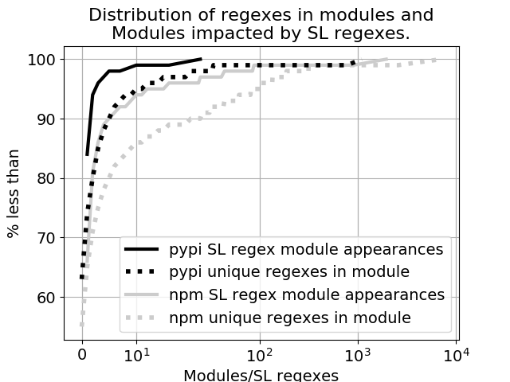
Regex usage in practice
Notes:
Dotted line: Unique regexes in modules
45% of npm and 35% of pypi modules contain at least one regex
15% of npm and 5% of pypi modules contain at least 10 regexes
Solid line: ReDoS regex module appearances
85% of ReDoS regexes in pypi appear in 1 module. The most frequently appearing ReDoS regexes appear in less than 100 modules.
65% of ReDoS regexes in npm appear in 1 module. The most frequently appearing RedoS regexes appear in thousands of modules.

Slide 30
Heuristics
Heuristic | Example | Complexity | Why?
Star height > 1 | (a+)+ | Exponential | 2 choices; each path explores the same states
Q.O. Disjunction* | (a|a)+ | Exponential | ''
Q.O. Adjacency* | .+.+ | Polynomial (earlier example) | 2 choices; 1 path explores …

Slide 31







Domains
Emails
User-agent strings
HTML
URL
Numeric

Slide 32
Regex Domains
Semantic meaning | # in npm | # in pypi
Error message | 22 K | 881
File name | 10 K | 497
HTML | 8 K | 2.5 K
URL | 7 K | 2 K
CamelCase etc. | 4 K | 1 K
Source code | 4 K | 105
User-agent strings | 3 K | 124
Whitespace | 2 K | 441
Number | 762 | 238
Email | 444 | 97
Label rate | 18% | 13%

Slide 33
ReDoS Regexes occur in Different Domains
%
Notes:
To the best of our knowledge this is the first attempt in the literature to characterize what regexes are being used for.
Methodology
Results

Slide 34
Fix strategies
Revising is popular
Fixing ReDoS Regexes is hard
 |  | Total | Trim | Revise | Replace
Historic | Fix approach | 37 | 8 | 18 | 11
 | # Unsafe | 3 | 1 | 2 | 0
New | Fix approach | 48 | 3 | 35 | 15
 | # Unsafe | 0 | 0 | 0 | 0
Notes:
The “total” is the number of patches.
In the “New” fixes, some cases multiple fix strategies approaches were taken (e.g. trim + revise).
We counted them in both

Slide 35
About That Microsoft Regex…
We disclosed ~50 ReDoS regexes to Microsoft
After several months…
Listed me in their July "Security Researcher Acknowledgments"
Would not tell me what changes resulted from my report

Slide 36
More Limitations and Future Work
ReDoS regex dects. → More feature support [SJXYML ‘18]
Reachability → Why do devs. use regexes? [C&S ‘16]
ReDoS regex == ReDoS? → Scaling up [S&P ‘18]?
Generalizability → Trends across langs. / apps.?
Notes:
Reachability
Did not consider reachability of ReDoS regexes.
Our experience suggests that regexes are commonly used for input validation, but this would be worth revisiting
Generalizability: Beyond “scripting” languages?

Slide 37
Why not applications?
Open-source applications may not be representative of code in industry
Module ecosystems are shared by open-source and industry
Modules are sometimes authored by industry as a way to give back to the open-source community

Slide 38
Why git projects instead of artifacts?
Bundling / Obfuscation complicates analysis on registry artifacts

Slide 39
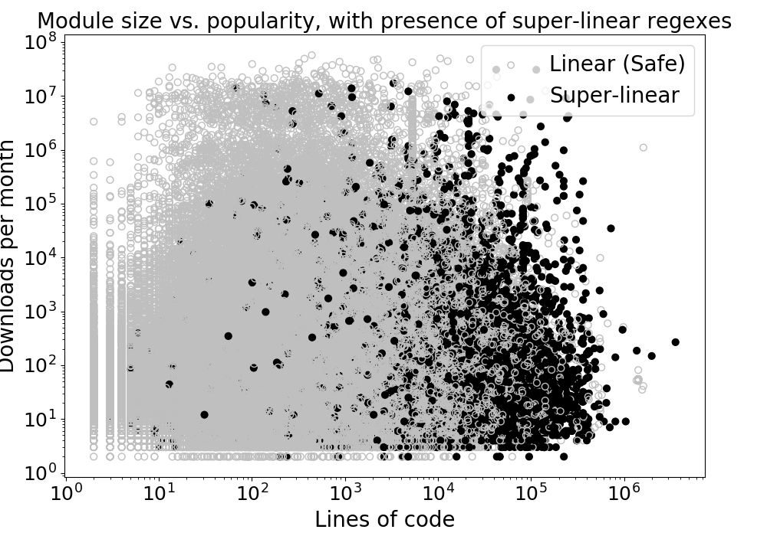
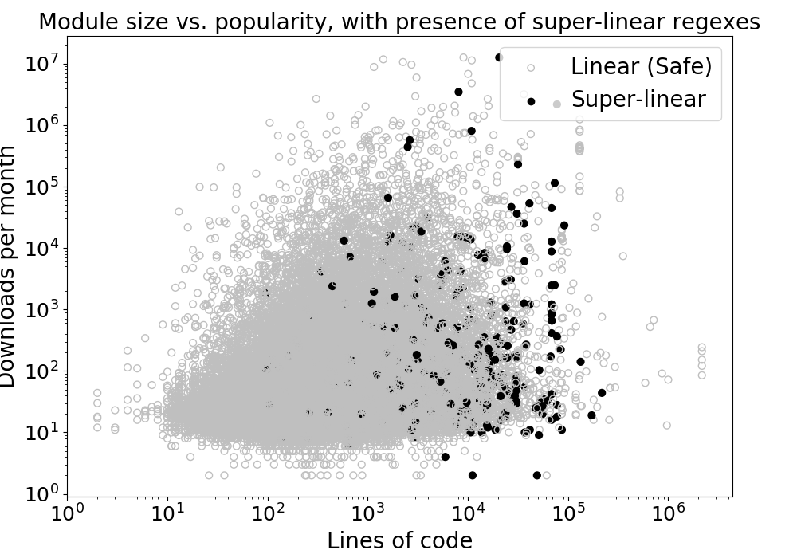
ReDoS Regexes by Size and Popularity
>1000 downloads/month – Especially concerning
Downloads (log)
Lines of code (log)
Notes:
Scales
npm: Downloads and LoC both go into the millions
pypi: Downloads in the millions, LoC in the 100Ks
Similar patterns in pypi, though on a smaller scale.
LoC from the cloc tool, applied to the .js and .py files we considered in our scans.
TODO: Do ReDoS first.

Slide 40
ReDoS Regexes by Size and Popularity
>1000 downloads/month – ReDoS threat
npm
pypi
Downloads (log scale)
Downloads (log scale)
Lines of code (log scale)
Lines of code (log scale)
Huge but few downloads – e.g. open-sourced company frameworks
“Trivial packages” – Abdalkareem et al., FSE’17
Notes:
Similar patterns in pypi, though on a smaller scale.
LoC from the cloc tool, applied to the .js and .py files we considered in our scans.
TODO: Do ReDoS first.

Slide 41
Results (npm)
Developed anti-pattern detectors
Imprecise – modeled on safe-regex (star height > 1)
Anti-pattern | # SL regexes | False positive rate
Star height > 1 | 450 (12%) | 94%
Q.O. Disjunction | 40 (1%) | 97%
Q.O. Adjacency | 2.5K (71%) | 91%
Few false negatives
Good recall
Many false positives
Poor precision
Notes:
Low false negatives -- it appears that these three types of anti-patterns describe most if not all SL regexes captured by the SL regex detectors
High false positives -- speaks to the benefits of the more sophisticated analyses available in the SL regex detectors

Slide 42
How super-linear are the SL regexes?
Degree of vuln. | npm | pypi
Exponential | 245 (7%) | 41 (6%)
Poly: n^2 | 2638 (74%) | 534 (76%)
Poly: n^3 | 535 (15%) | 107 (15%)
Poly: n^4 | 44 (1%) | 5 (1%)
Poly: beyond (exp?) | 100 (3%) | 15 (2%)
Evaluated SL regexes on a range of input lengths
Fit curves for different polynomials and exponentials
Chose the curve of best fit
Notes:
Most SL regexes exhibit quadratic or cubic behavior as the input increases.
Exponential-time SL regexes are rare.

Slide 43
ReDoS Regexes in npm and pypi
Registry | Total modules | Scanned modules | Unique regexes | SL regexes | Affected modules
npm | 565K | 375K (66%) | 350K | 3.6K (1%) | 13K (3%)
pypi | 125K | 70K (58%) | 60K | 700 (1%) | 700 (1%)
More copy/paste in JS?
e.g. 2K are regexes taken from
Node.js core
Notes:
In the paper we describe the breakdown of the SL regexes by type: exponential or polynomial, and by the degree of the polynomial.
Exp-time 6%
n^2 75%
N^3 15%
N^4 1%
N^b>4 2%
Python core*: Similar to the example “comment line” regex from earlier slides

