Slide 1
“If security is required”: Engineering and Security Practices for Machine Learning-based IoT Devices
Nikhil Gopalakrishna* | Dharun Anandayuvaraj* | Annan Detti*
gopalakn@purdue.edu | dananday@purdue.edu | adetti@purdue.edu
Forrest Lee Bland* | Sazzadur Rahaman⁺ | James C. Davis*
fbland@purdue.edu | sazz@cs.arizona.edu | davisjam@purdue.edu
*
Electrical & Computer Engineering
Purdue University
+
Computer Science
University of Arizona
Notes:
Hi everyone! I’m Dharun Anand from Purdue University and today I’ll be presenting our research on engineering and security practices for machine learning based IoT devices.

Slide 2
Contributions
Investigated engineering of ML-enabled IoT devices in industry
ML practices
ML challenges
Security practices
Notes:
Our main contribution is an investigation of the engineering of ML enabled IoT devices in industry. Specifically, we investigated the common ML practices, challenges, and security practices in the industry.
And the main concerns we found were about engineering cost and unverified trust, for which we provide future research directions.

Slide 3
Background and Motivation
Notes:
…And our motivation for the study is…

Slide 4
IoT + ML
Proliferation of IoT (~35 billion devices) w/ ML
Problem:
Concerns about engineering practices due to high profile failures
Industry engineering practices are not well known
Goal:
Investigate engineering process for ML-enabled IoT devices
Practices in industry to develop and manage ML-based IoT devices
Security in industry development life cycles
Notes:
…That ML enabled IoT devices are becoming ubiquitous. And this has the potential to transform many aspects of our world with low latency intelligent decisions. However, the associated threats are substantial, especially the security and privacy risks. To minimize these risks, engineers should adopt ML methods on resource-constrained IoT devices in a secure and privacy-preserving way.
Despite the growing concerns about engineering practices, raised by high profile failures, including cyberattacks on infrastructure, aggressive data collection practices, and botnets exploits, we know relatively little about manufacturers’ engineering practices.
The challenges of real-world adoption and current industry practices have not been studied.
[Click]
So, in order to aid developers with these challenges, we investigated engineering processes for ML-enabled IoT devices. Specifically, we investigated the practices in industry to develop and manage ML-based IoT devices, and the treatment of security in industry development life cycles.

Slide 5
Study Design
Notes:
Now I will present our study design.

Slide 6
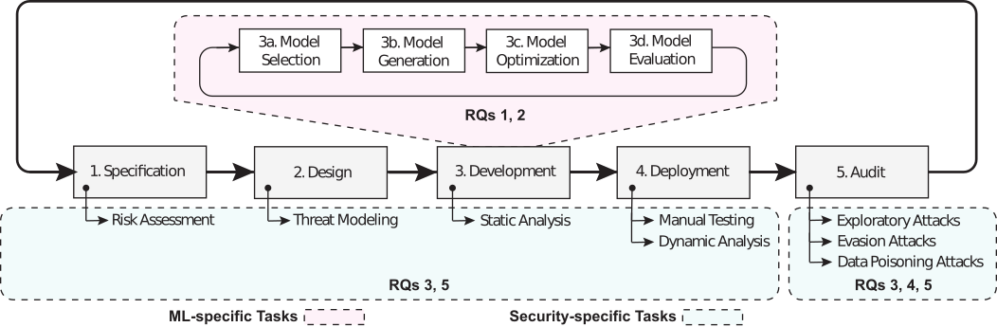
Lifecycle for ML-based IoT system
Notes:
First, from prior studies, we derived a generic engineering lifecycle for ML-based IoT system with a 5-step iterative process, inclusive of specification, design, development, deployment, and audit.
Although this engineering process model for ML-based IoT development is a promising start, the research community still lacks insight into industry practices. This knowledge gap hinders our understanding of industry-wide problems & challenges towards building & maintaining secure ecosystems. This study is a step towards filling that gap.
To address this gap, we investigated two themes.

Slide 7
Applying ML on IoT devices
RQ1: Common ML practices for IoT
RQ2: ML challenges and consequences for IoT
Notes:
First, we examined ML engineering in a resource constrained context, with implications for IoT system trustworthiness.
The ML specific tasks…
[CLICK]
….Such as model selection, generation, optimization, and evaluation, usually take place during the development phase.
[CLICK]
Regarding these tasks, we examined the common practices & the challenges of developing ML software for resource constrained edge devices

Slide 8
Engineering secure IoT systems
RQ3: Incorporating security into IoT engineering
RQ4: Trust in ML-based IoT systems
RQ5: Factors of security practices in IoT engineering
Notes:
Second, we examined security practices for IoT systems.
The security tasks…
[CLICK]
…are incorporated throughout the engineering life cycle, with tasks such as, risk assessment, threat modeling, and program analysis.
However, IoT developers find security, challenging and complicated. Engineering teams feel responsible for security, but often lack a formal security process. And functionality and deadlines are often prioritized over security. This is further exacerbated since adding security to resource constrained devices penalizes power consumption, latency, and throughput.
[CLICK]
So, we investigated how engineers incorporate security, reason about trust, and the factors that affect security practices in IoT engineering.

Slide 9
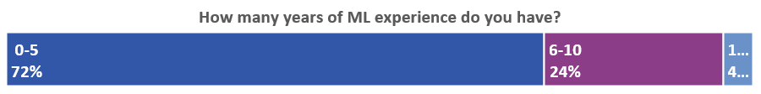
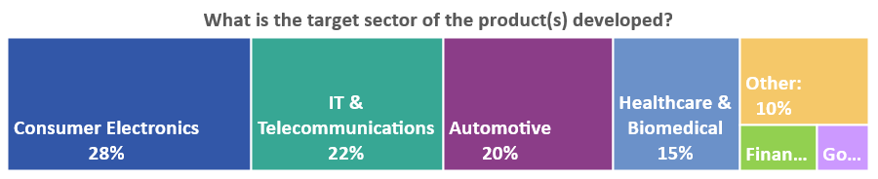
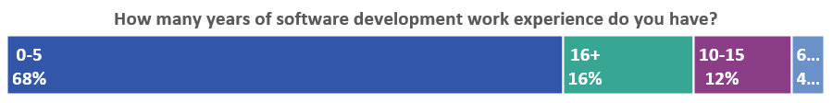
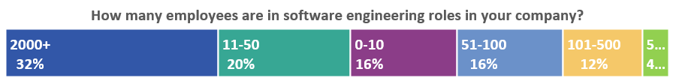
Exploratory study | Survey
25 responses
Notes:
Given our research goals, we conducted an exploratory study by, eliciting coarse data with a survey, and detailed insights using interviews during Spring 2021.
We received 25 responses for our survey. The majority of respondents were in the early stages of the career, with a few years of exposure to ML, working in large to medium sized companies, in the sectors of consumer electronics, IT & telecommunications, automotive, and healthcare.

Slide 10
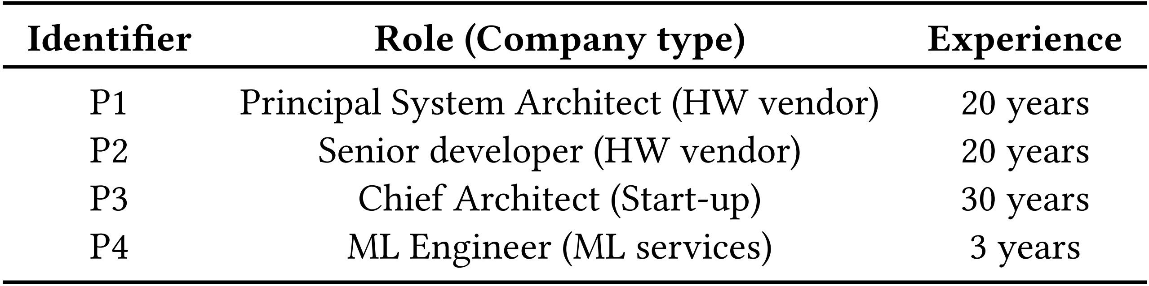
Exploratory study | Interview
Interview Subjects
Notes:
And we also interviewed 4 subjects, who were experts, with a range of positions and professional experience, in sectors including manufacturing, consumer electronics, defense, and medical devices.

Slide 11
Results
Notes:
Now I’ll present our findings, by combining survey data with relevant interview quotes.

Slide 12
Theme 1: Applying ML on IoT devices
RQ1: Common ML practices for IoT
RQ2: ML challenges and consequences for IoT
Notes:
First, we present the common ML practices and challenges we found.

Slide 13
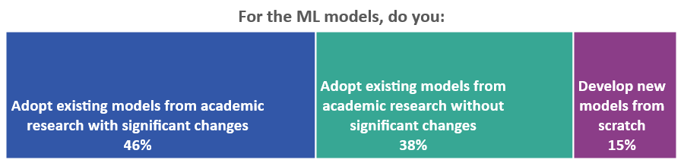
RQ1 | ML modeling
“In the ML world, [if] you don’t read a paper every single day, you are in trouble...IEEE papers and...we also look at results that come out of Google, Facebook, Amazon and Microsoft”
“[My company’s] research team does a lot of research around machine learning, & we...use the frameworks developed by them.”
Notes:
First, we investigated the common practices for bringing ML to resource constrained edge devices.
We first asked survey respondents and interview subjects where their models come from.
Survey respondents said that the rely on academic research, re-using models entirely, or tailoring them to their company’s needs. Notably, none of the survey respondents indicated that they follow product line development - as in reusing models from one product to the next.
Consistent with the survey finding, a interview subject stressed the need to keep up with ML papers from academia and top tech companies.
In addition, companies with deeper expertise also develop models internally, as noted by another interview subject.

Slide 14
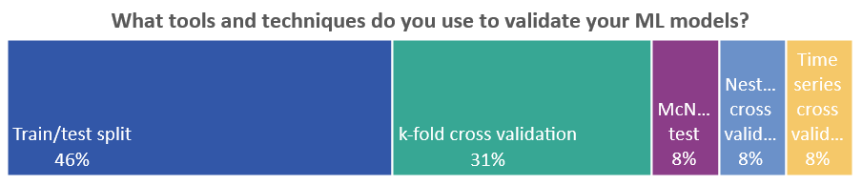
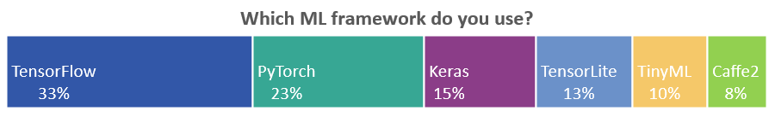
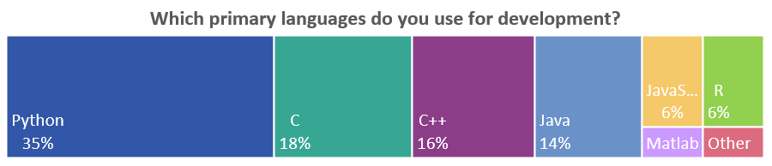
RQ1 | ML development
Notes:
Next, we found that Python and C/C++ were the most popular languages, and that TensorFlow and PyTorch were the most popular modeling frameworks.
We also found that to train and validate models, survey respondents followed standard practices such as, splitting training and testing data or applying K-fold cross validation.

Slide 15
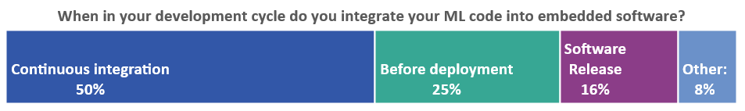
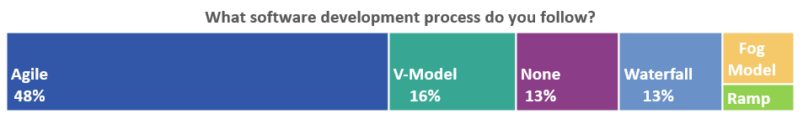
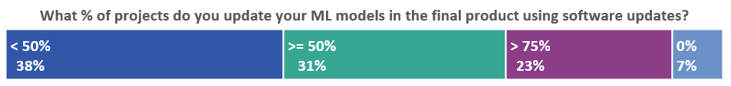
RQ1 | Engineering processes
“We tend to follow agile, 2 years ago we were mostly waterfall, the old-fashioned way...now...95% of...[our] programs [are agile].”
“At every stage of our Agile flow...[we have a] CI/CD based validation flow...as part of the weekly sprints trying to meet accuracy, latency and throughput.”
Notes:
Next, we found that the industry movement towards incremental development and agile methodologies includes IoT systems development. Almost half of the survey respondents report using Agile as their software development process.
Identically, an interview subject reflected that they had moved from waterfall to now agile.
This adoption includes the CICD approach. About, half of the survey respondents said that their teams incorporate ML models into the rest of their IoT systems, during Continuous Integration.
Confirming this, an interviewer said that a CICD based validation flow is used at every stage of the Agile flow.
And, after IoT device deployment, many survey respondents report that they improve the ML models in their products by collecting new data and then sending software updates.

Slide 16
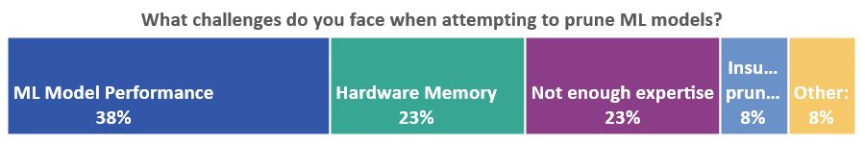
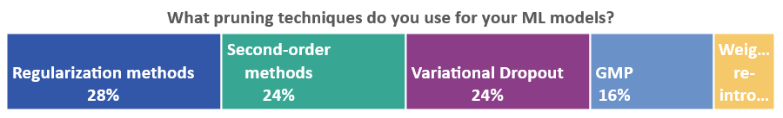
RQ2 | Resource constrained devices
“Inability of standard tools to be able to squash a model into something that fits - with a push of a button.”
“Better [to make a] crude estimate...using Excel...[to] prepare ML algorithms”
Notes:
Next, we investigated the challenges and consequences developers face due to resource limitations in developing ML software for edge devices.
Over 90% of survey respondents said that they meet constraints by changing the software, and not the hardware. And to meet their resource constraints, they said that they mostly use neural network pruning techniques including regularization, second-order methods, and variational dropout.
As they do so, they struggle with decreased model performance, memory constraints, and insufficient expertise.
In addition, an interview subject said that the biggest challenge is the inability of standard tools to squash a model to fit hardware constraints - with a push of a button.
And to estimate the needs of fitting ML models into hardware constraints, another subject said that they preferred to use Excel for making crude estimates, because running emulators/simulators takes time.

Slide 17
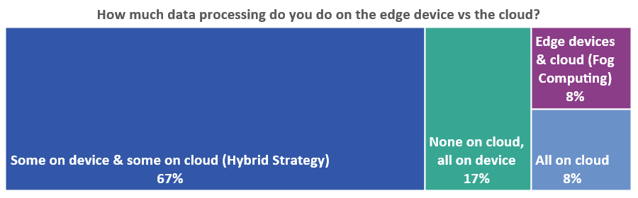
RQ2 | Other challenges & consequences
Working with Customers:
“[Clients] give us validation data, but not test data...Then they validate if it works well on test data. Even slight changes...distortions...give bad accuracy...So if your model should be robust, then you need such data in training data set”
Edge-Cloud collaboration:
Notes:
And among the previously mentioned challenges, an interview subject noted the difficulty in working with customers, where clients would give the validation data set but not the test data set. In the general ML lifecycle, we assume that developers have access to all of the data, but that’s not always the case - as expressed by the subject.
Next, as a consequence of resource constraint challenges, survey respondents described different architectures for data processing. Two-thirds follow a hybrid strategy, with light-weight processing on IoT devices and heavy-weight processing using Fog or Cloud systems. Edge-only processing was the second most common, and Cloud-only processing was rare.

Slide 18
Theme 2: Engineering secure IoT systems
RQ3: Incorporating security into IoT engineering
RQ4: Trust in ML-based IoT systems
RQ5: Factors of security practices in IoT engineering
Notes:
Now, we present how engineers incorporate security, reason about trust, and the factors that affect security practices in IoT engineering.

Slide 19
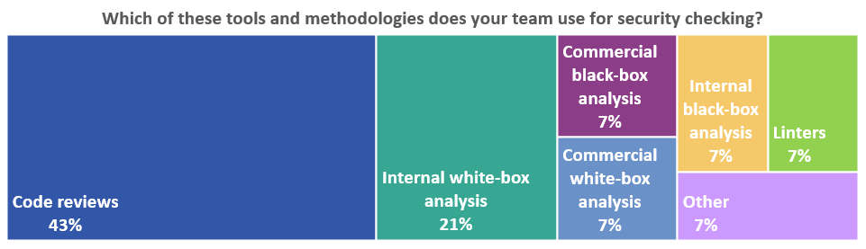
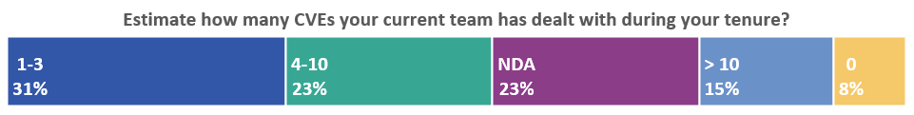
RQ3 | Security analysis
“Not every member in the team is...[a security expert, but] they are [generally] aware of the pitfalls & needs. But...[we ensure that] a few experts are always there in the reviews.”
Notes:
First, we found that more than half of the respondents have experienced a security vulnerability in their current product. One-third have dealt with 1–3 CVEs, and one-third with 4 or more. So, understanding how they incorporate security and reason about trust in their engineering processes may help reduce CVEs.
So, we investigated how engineers incorporate security into the IoT engineering process.
We asked survey respondents to describe the processes their teams follow for security analysis. They said that code review and white-box analyses were the primary ways in which security checks were conducted. Survey respondents and interview participants also described conducting security reviews and creating mitigation plans.
And an interview subject said that during the development process, not everyone on the team is a security expert, but everyone is generally aware of the common pitfalls and requirements. And that they ensure that there are a few experts involved.
We also found that for subjects working in smaller companies, security analysis was a part of every developer’s job. In larger organizations, subjects said that security analysis was done by dedicated security teams. However, developers were still involved and have some familiarity with security analysis methods.

Slide 20
RQ3 | Threats & threat models
“We try to mimic scenarios that can breach security...We are careful about snoop-out transactions.”
“One common area where you can snoop out in hardware is the Memory Management Unit...So if MMU gets compromised, then you...have physical addresses and you can do whatever you want with it. So, secure hardware design become critical.”
“Privacy is the hard problem...it is visible to the market...We are trying to not store any private data that could be...used by hackers. It is really easy to...lose your name, lose your brand.”
Notes:
Next, our subjects said that security threat analysis was a common part of the development process, but with varying priority depending on the company size and available resources.
Our interviewees indicated that the major threat they considered was the loss of intellectual property, as in, reverse engineering of their ML models.
An Interviewee said that the biggest security challenge they face is in-memory re-engineering. The subject emphasized the criticality of secure hardware design, because if a common snoop out transaction occurs in the Memory Management Unit, then access to physical addresses are compromised.
Additionally, IoT devices interact with humans and the physical world which makes privacy a concern for both developers and end-users. An interviewee said that privacy was the most difficult aspect of security analysis, since it is very visible to the market, which means that any failure could lead to a loss to the company brand. So, they described that their company tried to not story any private data that could be used by hackers.

Slide 21
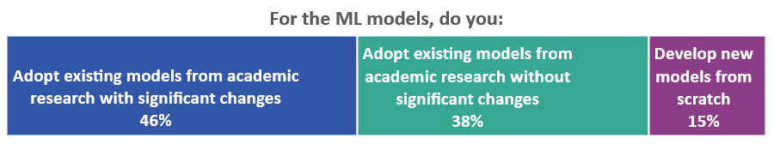
RQ4 | Trust in IoT systems
“We are dependent on...the goodness of the cloud. It's impossible to see what Azure, AWS, etc., are doing under the hood. There's a large level of dependence on their security procedures.”
“We...are not doing analysis on weakness of...tools like TensorFlow. If IDEs & tools chains have security bugs, there is nothing we can do about it.”
“We have to ensure that the [training] data...is from a trusted source, otherwise it becomes a nightmare.”
Notes:
Next, we investigated how engineers reason about trust in ML-based IoT systems.
We found that our subjects identified trust in researchers, vendors, data, and tool chains.
Our survey respondents indicated trust in researchers through the common adoption of research prototypes.
An interview subject described that their company’s ML model training process is dependent on the goodness and on the security features provided by cloud computing platforms.
The interviewee also stated that they did not perform any security analysis, and instead placed trust on developmental tool chains.
Another interviewee stated that it is crucial to ensure the trustworthiness of the training data.

Slide 22
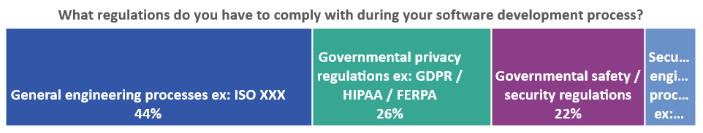
RQ5 | Process requirements & regulations
“We are an ISO company. We rigorously follow ISO standards”
“Once you start working with meta-data, then you don't really need...any private information...so, it becomes much easier.”
“For example, medical data is a very, very tricky situation...[you must] set up proper environment and...ensure that the data is not leaving your trusted network...not just data, but also trends”
Notes:
Next, we investigated other factors that affect security practices in IoT engineering, such as the process requirements and regulations.
First, we asked survey participants about restrictions on their engineering processes and products. About half said that they comply only with general quality processes, such as ISO standards. Other survey respondents comply with governmental safety and security regulations, and with privacy regulations like GDPR, which is a data regulation, and HIPAA, which is a healthcare regulation.
An interviewee stated that at their company, they prefer to work with metadata instead of data because of HIPAA requirements.
Another interviewee emphasized the difficulties of regulatory compliance, for example with the intricacies of working with medical data and trends.

Slide 23
RQ5 | Engineering cost
“Addressing vulnerabilities properly...within the project budget.”
“You must decide if security is required. If you push security to a level that is hard to maintain & it is adding significant value to the bill of materials cost, then it is a question if it will be accepted by the market. I believe, the argument about security is if it will be visible to the user”
“When we do open-source release, we don't worry much about it. Of course, it is not a good thing to release something insecure to open-source. We mainly ensure that previous occurrences of security breaches are tested.”
Notes:
Next, we found that subjects often had to balance between security and engineering cost.
A survey subject stated that the most challenging part of security analysis is addressing vulnerabilities properly and supporting cryptographic functionalities within the project budget.
An interviewee added that user visibility may justify engineering costs. They stated that if security is adding significantly to engineering costs, then its necessity will be decided based on market feedback.
Another interviewee stated that their company invests security resources non-uniformly, with less effort in analyzing software that they release as open-source.

Slide 24
Discussion
Notes:
Now based on our results, we discuss our findings in comparison to prior works, then provide advice for practitioners and suggest future research directions.

Slide 25
Comparison to prior findings
Similarities: Industry-wide tools, iterative development, power/memory/computation constraints, security issues
Differences:
Engineering cost
Reduce security for cheaper production costs
Subjects’ evaluation of security:
Possible - relative to engineering cost
Required - relative to market demand
Unverified trust: open-source code, academic research, development toolchains
Notes:
First, our findings overlapped with prior knowledge in many aspects. Consistent with prior knowledge, our participants followed industry-wide practices, development toolchains, and iterative development processes. Prior works have focused on power, memory, and computational constraints of IoT systems.
The main difference between the research literature and our findings is the discussion of engineering cost. Past research works primarily focus on trade-offs between security and resource costs, such as operation delay and energy. Our work identifies the importance of considering engineering costs, not just the runtime implications. Our participants, especially in consumer electronics, reduced security for cheaper production costs. Unlike researchers' goals of unbreakable systems, our subjects balance how much security is possible - relative to its engineering cost - and required - relative to market demand.
Lastly, the many sources of unverified trust such as, open-source code, academic research, and development toolchains, was greater than what we understood in the literature.

Slide 26
Advice to practitioners
Strengthen cybersecurity workforce development
Address gap between academia & industry
Adopt government guidelines
Automate code analysis
Static analysis, black-box, and grey-box fuzzing
Notes:
Next, our study revealed a significant gap between how the academic community and industry perceive IoT security. This suggests potential value in cybersecurity workforce development.
Outside academia, government guidelines describe secure development lifecycles. For example, NIST recommends a thorough study on the customers, users, expected use cases, security risks, and goals during planning, execution, and post-deployment. However, our subjects did not describe such a process.
Additionally, given the success of automated code analysis methods such as static analysis, black-box, and grey-box fuzzing in identifying system vulnerabilities in IT software, we were surprised by practitioners' continued emphasis on code review and white-box analysis in their IoT systems. We recommend practitioners integrate such methods into their product development process.

Slide 27
Research directions
Cost-aware security processes
Constraints of IoT systems engineering
Practical measurements of cost
Reliable open-source contributions
Careful documentations
Processes for reproducibility & knowledge transfer
Security compliance & regulations
Notes:
Finally, based on the challenges faced by the practitioners we studied, we suggest three directions for future research.
First, the IoT domain is characterized by tight profit margins and low-cost parts. Many of our research subjects were therefore concerned about the engineering cost of securing IoT devices. It would be helpful for researchers to offer cost-aware security processes suited to the constraints of IoT systems engineering, and practical measurements of this cost.
Second, practitioners leverage open science and open-source software for their ML modeling and their development toolchains. This accelerates development but introduces substantial risk. For ML, we recommend that ML researchers carefully document their research prototypes and the limitations of their work. They can achieve broader impact by participating in community efforts to develop exemplary ML models, such as TorchVision and the TensorFlow Model Garden. Additionally, studies of how best to reproduce and transfer ML knowledge will be helpful.
Third, the difficulties experienced by practitioners in following the compliance restrictions and regulations poses a potential research area. For example, researchers could study the impact of security compliance on security outcomes of IoT applications, and the tradeoff with engineering cost.

Slide 28


Conclusions
Provided insight
IoT engineering practices related to ML & cybersecurity
Main challenge
balancing engineering cost, performance, trust, and security
Future
incorporate engineering cost considerations into research works
Thank you for your attention!
Notes:
In conclusion, we attempted to broaden the existing understanding of IoT engineering practices related to machine learning and cybersecurity.
Through our survey and interviews, we found that the main challenge engineers face when creating an IoT product is balancing among engineering cost, performance, trust, and security.
In the future, we recommend that software engineering and cybersecurity researchers incorporate engineering cost considerations into their work.
Thank you! That concludes our presentation, and I would be happy to answer any questions you may have.

Slide 29
Bonus slides

Slide 30
Artifacts
The following artifacts:
Data collection instruments
Survey data
Interview transcripts
Are available at:

Slide 31
Survey Distribution
Online survey via Qualtrics
Distributed via LinkedIn, Reddit, Hackernews, Purdue Announcements, Facebook, and friends & colleagues
Interviewees were identified through the survey

Slide 32
Research questions
Theme 1: Applying ML on IoT devices
1. Common ML practices for IoT
2. ML challenges and consequences for IoT
Theme 2: Engineering secure IoT systems
3. Incorporating security into IoT engineering
4. Trust in ML-based IoT systems
5. Factors of security practices in IoT engineering
Notes:
…investigated two themes.
First, we examined ML engineering in a resource constrained context, with implications for IoT system trustworthiness.
Specifically, we examined the common practices, and the challenges of developing ML software for resource constrained edge devices
Second, we examined cybersecurity practices for these systems.
Specifically, how engineers incorporate security, reason about trust, and the factors that affect security practices in IoT engineering.

Slide 33
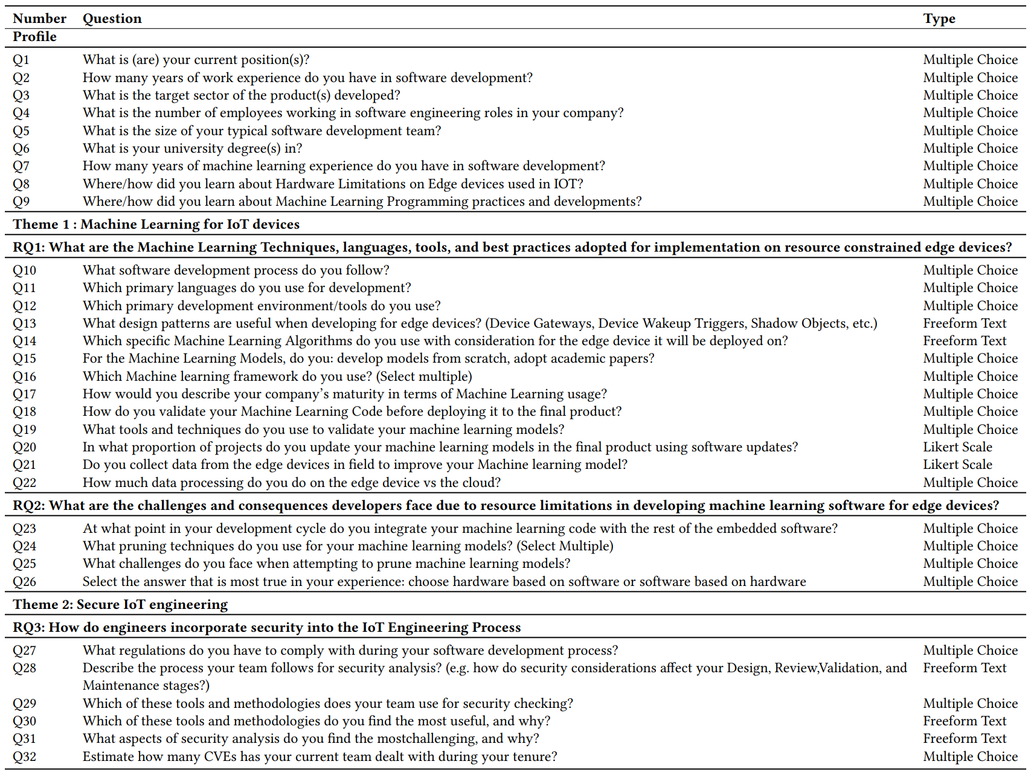
Survey Questions

Slide 34
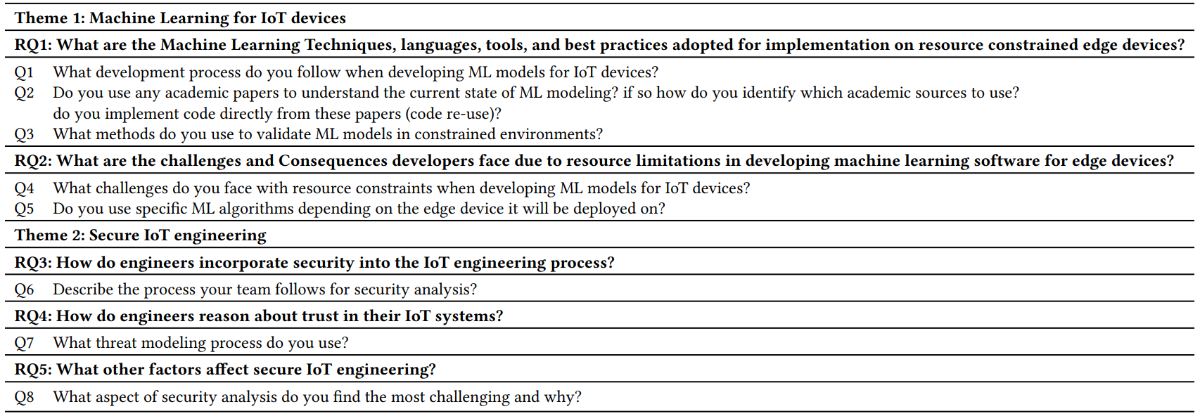
Interview Questions

