Slide 1






Regexes are Hard:
Decision-making, Difficulties, and Risks in Programming Regular Expressions
Louis “Mischa” Michael
James Donohue
James Davis
Dongyoon Lee
Francisco Servant
Notes:
Not only are they hard to read, our participants said that they are hard to search for, hard to validate, hard to document, and hard to master.
Regexes are hard!

Slide 2
REGEX?
“The most difficult thing with regular expressions tends to be defining the problem”
“illegible gibberish”
“If there’s a string function…
I would prefer that over a regex”
“What the hell is that?”
“I need a little cheat sheet”
Notes:
String matching tool for recognizing patterns
Ctr – f is easy but what about if you want to find a pattern
REGEX
Formal language vs matching strings

Slide 3
Motivation
~ 30% of projects
Used in many different languages
Written in different dialects
Security risk (ReDoS)
Cloudflare, Stackoverflow outages
Regex, quantitatively
Feature usage
Testing practices
Evolution
[ISSTA16, FSE18]
[FSE 2019]
[ISSTA16]
[FSE 2018]
[SANER 2018]
Notes:
Anthropology vs Archology
…but we don’t know much today about the process that developers follow when creating regexes, the difficulties that they face, or even whether they are aware of their risks
Critically without understanding the people at the center of this technology we don’t know how to help them or how to improve the process
Prior research regarding regexes has been predominantly quantitative, examining regexes in their role as a software arti- fact. Researchers have empirically examined regex reuse [20], [30], regex test coverage [57], regex evolution [56], regex repair [19], and regex generalizability [21]. Others have pro- posed tools for regex programming, e.g., input generation [5], [36], [42], [48], [54], linters [35], and type checking [50]
Regex are used frequently, and across languages where they have different dialects
Regex miss usage can also have series issues
Some tools have already been developed but little is known about how real developers might use these tools
Properties of regex artifacts have been examined

Slide 4


Slide 5

RESEARCH METHODS
5

Slide 6
Research Questions
RQ1: Perceptions
RQ2: Decisions
RQ3: Difficult
RQ4: Handling
RQ5: Risks

Slide 7
Research Questions
RQ1: Perceptions
RQ2: Decisions
RQ3: Difficult
RQ4: Handling
RQ5: Risks

Slide 8
Framing: Regex Process
Choosing a Solution | Composing | Validating | Documenting
Notes:
4 steps

Slide 9




Survey Development
15 minutes
new Regex(pattern);
Notes:
We wanted to ask a survey
We knew that we needed to keep the survey short developers are busy people
We also wanted to focus on both reuse and non reuse in reguex
We came up with some questions and we piloted them, trying to see if people understood what we were asking and if they got through everything quickly, we weeded out log hard to understand questions
Ended up with two surveys
Emphasize our best efforts to make it short still ended up in two surveys
Goal 15 min

Slide 10





Data Collection
121 Survey Responses
279 Total
17 Interviews
Conducted
Open Coding
158 Survey Responses
Notes:
Survey 1 at one location
Survey 2 specific questions about reuse and distributed on the internet
We learned a lot from our surveys but we still had more we wanted to clarify so we conducted 17 follow up interviews
Open coding was used on the free text of the survey and the transcripts of the interviews

Slide 11
RESULTS
11
Notes:
A theme in our work is that regex are hard
Seen some quotes
What we are going to talk about isn't about just how they are hard but some of our actionable insights for the research community

Slide 12
 | Choosing a Solution | Composing | Validating | Documenting
RQ2: What influences developer decisions when programming regexes?
“If there’s a string function…I would prefer that over a regex”
Problem Complexity
Notes:
context-free grammar or built in string functions

Slide 13
“I’d much rather match too little than too much [to avoid introducing] garbage data”
 | Choosing a Solution | Composing | Validating | Documenting
RQ2: What influences developer decisions when programming regexes?
Problem Complexity
Match too much vs match too little?

Slide 14
“I’ll usually trust re-using an expression more ...[and] skip [some validation phases]”
 | Choosing a Solution | Composing | Validating
RQ2: What influences developer decisions when programming regexes?
Problem Complexity
Match too much vs match too little?
Trust of Reuse

Slide 15
 | Choosing a Solution | Composing | Validating | Documenting
RQ2: What influences developer decisions when programming regexes?
Problem Complexity
Match too much vs match too little?
Trust of Reuse
Personal opinion
Complexity

Slide 16
 | Choosing a Solution | Composing | Validating | Documenting | Cross Cutting
RQ3: What do developers find difficult about programming regexes?
RQ4: How do developers handle those difficulties in programming regexes?
Searching for reuse candidates
Edge Cases
Understanding the Regex
Decomposing the regex
Personal regex library
Generating their own inputs
Testing all the available inputs
Using tool support for visualization/ highlighting
Breaking down regexes

Slide 17
DISCUSSION
17

Slide 18

Choosing a Solution | Composing | Validating | Documenting | Cross Cutting
Mapping the string matching problem space
Metrics-based regex ranking
Semantic based regex search
IDE support
Regex input generation for humans
Automatic regex documentation
Why regex?
Notes:
Why regex?
Are regex the correct way to deal with these kinds of problems
This is a formal languages contract that we use for these issues but its terse syntax makes it hard to understand
There is a lot of opportunities for tools

Slide 19


Summary
 | Choosing a Solution | Composing | Validating | Documenting | Cross Cutting
RQ2: Decisions | Problem Complexity | Match too much vs match to little? | Trust of Reuse | Personal opinion
RQ3: Difficulties |  | Searching for Reuse Candidates | Testing Edge Cases |  | Understanding the Regex
RQ4: Handling |  | Decomposing the regex Personal regex library | Generating their own inputs Testing all the available inputs |  | Using tool support for visualization/ highlighting Breaking down regexes
Artifacts for reproducibility available at: http://doi.org/10.5281/zenodo.3424069
Notes:
We wanted to better understand developers and regex as they relate to developers
We used 2 surveys with a diversity of question some specifically about reuse
We had follow-up interviews
This lead us to insights about Decisions Difficulties and handling
Not only are they hard to read, our participants said that they are hard to search for, hard to validate, and hard to document.

Slide 20
BONUS SLIDES
20

Slide 21
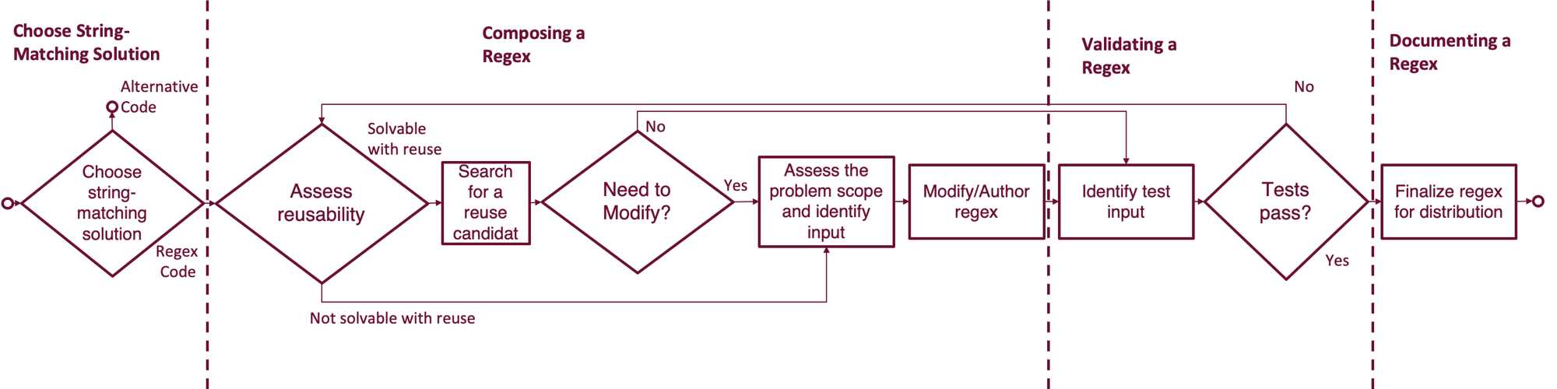

Slide 22
Stage | Decision | RQ2:Factors
Choosing a Solution | Using regex vs non-regex code | Problem complexity, single choice, readability
Composing a Regex | Writing regex vs reusing regex Which regex should I reuse? Match too much vs match too little? | Problem commonality, reliability, time savings Best understanding, feature usage, length Problem domain
Validating a Regex | Am I confident this regex is correct? Am I confident this reused regex is correct? | Choosing input or having sample data, result recipient Trust of reuse
Documenting a Regex | How much documentation is required? | Personal opinion, complexity
Notes:
This slide needs an extra influences column

Slide 23
Stage | Decision | RQ4:Factors
Choosing a Solution | Using regex vs non-regex code | Problem complexity, single choice, readability
Composing a Regex | Writing regex vs reusing regex Which regex should I reuse? Match too much vs match too little? | Problem commonality, reliability, time savings Best understanding, feature usage, length Problem domain
Validating a Regex | Am I confident this regex is correct? Am I confident this reused regex is correct? | Choosing input or having sample data, result recipient Trust of reuse
Documenting a Regex | How much documentation is required? | Personal opinion, complexity
“If there's a string function that says the prefix should be this, I would prefer that over a regex… it's simpler to understand”
vs
“If a regex is complex enough that it's `too complex' to write from scratch, it's probably also too complex a problem to solve with a regex”

Slide 24
Stage | Decision | RQ4:Factors
Choosing a Solution | Using regex vs non-regex code | Problem complexity, single choice, readability
Composing a Regex | Writing regex vs reusing regex Which regex should I reuse? Match too much vs match too little? | Problem commonality, reliability, time savings Best understanding, feature usage, length Problem domain
Validating a Regex | Am I confident this regex is correct? Am I confident this reused regex is correct? | Choosing input or having sample data, result recipient Trust of reuse
Documenting a Regex | How much documentation is required? | Personal opinion, complexity
“If it's a common regex like various form fields I would reuse a regex, but for a more company/business use case specific requirement I would write a custom regex”

Slide 25
Stage | Decision | RQ4:Factors
Choosing a Solution | Using regex vs non-regex code | Problem complexity, single choice, readability
Composing a Regex | Writing regex vs reusing regex Which regex should I reuse? Match too much vs match too little? | Problem commonality, reliability, time savings Best understanding, feature usage, length Problem domain
Validating a Regex | Am I confident this regex is correct? Am I confident this reused regex is correct? | Choosing input or having sample data, result recipient Trust of reuse
Documenting a Regex | How much documentation is required? | Personal opinion, complexity
“I just try and pick the one I have the most understanding of… the one with the fewest special characters”

Slide 26
Stage | Decision | RQ4:Factors
Choosing a Solution | Using regex vs non-regex code | Problem complexity, single choice, readability
Composing a Regex | Writing regex vs reusing regex Which regex should I reuse? Match too much vs match too little? | Problem commonality, reliability, time savings Best understanding, feature usage, length Problem domain
Validating a Regex | Am I confident this regex is correct? Am I confident this reused regex is correct? | Choosing input or having sample data, result recipient Trust of reuse
Documenting a Regex | How much documentation is required? | Personal opinion, complexity
“I'd much rather match too little than too much [to avoid introducing] garbage data”

Slide 27
Stage | Decision | RQ4:Factors
Choosing a Solution | Using regex vs non-regex code | Problem complexity, single choice, readability
Composing a Regex | Writing regex vs reusing regex Which regex should I reuse? Match too much vs match too little? | Problem commonality, reliability, time savings Best understanding, feature usage, length Problem domain
Validating a Regex | Am I confident this regex is correct? Am I confident this reused regex is correct? | Choosing input or having sample data, result recipient Trust of reuse
Documenting a Regex | How much documentation is required? | Personal opinion, complexity
“I just kind of eyeball it… somebody… will probably test the edge cases”

Slide 28
Stage | Decision | RQ4:Factors
Choosing a Solution | Using regex vs non-regex code | Problem complexity, single choice, readability
Composing a Regex | Writing regex vs reusing regex Which regex should I reuse? Match too much vs match too little? | Problem commonality, reliability, time savings Best understanding, feature usage, length Problem domain
Validating a Regex | Am I confident this regex is correct? Am I confident this reused regex is correct? | Choosing input or having sample data, result recipient Trust of reuse
Documenting a Regex | How much documentation is required? | Personal opinion, complexity
“I'll usually trust re-using an expression more… [and] skip [some validation phases]”

Slide 29
Stage | Decision | RQ4:Factors
Choosing a Solution | Using regex vs non-regex code | Problem complexity, single choice, readability
Composing a Regex | Writing regex vs reusing regex Which regex should I reuse? Match too much vs match too little? | Problem commonality, reliability, time savings Best understanding, feature usage, length Problem domain
Validating a Regex | Am I confident this regex is correct? Am I confident this reused regex is correct? | Choosing input or having sample data, result recipient Trust of reuse
Documenting a Regex | How much documentation is required? | Personal opinion, complexity
“something that has two or three levels of parentheses… I will try to break them apart into smaller pieces with more comments”

Slide 30
RQ3:What do developers find difficult about programming regexes?
RQ4:How do developers handle those difficulties in programming regexes?
30

Slide 31
Stage | RQ5:Difficulty | RQ6:Handling Mechanism for Difficulty
Cross-cutting | Understanding the Problem Understanding the Regex | Read data, break down problem Using tool support, breaking down regexes, adding documentation
Composing | Searching for Reuse Candidates Unfamiliar Syntax | Decomposing the regex, searching for similar code, personal regex library Using tool support reading the regex documentation
Validating a Regex | Testing Edge Cases Testing Enough Inputs | Test all available input Work to find or generate more real cases, property testing

Slide 32
Stage | RQ5:Difficulty | RQ6:Handling Mechanism for Difficulty
Cross-cutting | Understanding the Problem Understanding the Regex | Read data, break down problem Using tool support, breaking down regexes, adding documentation
Composing | Searching for Reuse Candidates Unfamiliar Syntax | Decomposing the regex, searching for similar code, personal regex library Using tool support reading the regex documentation
Validating a Regex | Testing Edge Cases Testing Enough Inputs | Test all available input Work to find or generate more real cases, property testing
“The most difficult thing with regular expressions tends to be defining the problem”
“I tried to generalize what I'm looking at and [then] craft the regular expression.”

Slide 33
Stage | RQ5:Difficulty | RQ6:Handling Mechanism for Difficulty
Cross-cutting | Understanding the Problem Understanding the Regex | Read data, break down problem Using tool support, breaking down regexes, adding documentation
Composing | Searching for Reuse Candidates Unfamiliar Syntax | Decomposing the regex, searching for similar code, personal regex library Using tool support reading the regex documentation
Validating a Regex | Testing Edge Cases Testing Enough Inputs | Test all available input Work to find or generate more real cases, property testing
“Illegible gibberish”
“Jetbrains has my back - IDE syntax highlighting”

Slide 34
Stage | RQ5:Difficulty | RQ6:Handling Mechanism for Difficulty
Cross-cutting | Understanding the Problem Understanding the Regex | Read data, break down problem Using tool support, breaking down regexes, adding documentation
Composing | Searching for Reuse Candidates Unfamiliar Syntax | Decomposing the regex, searching for similar code, personal regex library Using tool support reading the regex documentation
Validating a Regex | Testing Edge Cases Testing Enough Inputs | Test all available input Work to find or generate more real cases, property testing
“It's hard to… query the problem you're trying to solve. Sometimes it's so domain specific.”
“refer to the regex section of my personal notebook”

Slide 35
Stage | RQ5:Difficulty | RQ6:Handling Mechanism for Difficulty
Cross-cutting | Understanding the Problem Understanding the Regex | Read data, break down problem Using tool support, breaking down regexes, adding documentation
Composing | Searching for Reuse Candidates Unfamiliar Syntax | Decomposing the regex, searching for similar code, personal regex library Using tool support, reading the regex documentation
Validating a Regex | Testing Edge Cases Testing Enough Inputs | Test all available input Work to find or generate more real cases, property testing
“I need a little cheat sheet that has to outline what each symbol does.”
“there's a bar on the side of [regexr.com]…[You can] click on every sort of regular expression piece of syntax and it'll show you an example.”

Slide 36
Stage | RQ5:Difficulty | RQ6:Handling Mechanism for Difficulty
Cross-cutting | Understanding the Problem Understanding the Regex | Read data, break down problem Using tool support, breaking down regexes, adding documentation
Composing | Searching for Reuse Candidates Unfamiliar Syntax | Decomposing the regex, searching for similar code, personal regex library Using tool support, reading the regex documentation
Validating a Regex | Testing Edge Cases Testing Enough Inputs | Test all available input Work to find or generate more real cases, property testing
“Difficulty in [coming up with] corner case inputs and outputs”
“If the regular expression is… simple enough that thinking about the entire scope of the input space is feasible… It's really the case where it really grows into a massively complex one that [is problematic].”

Slide 37
Stage | RQ5:Difficulty | RQ6:Handling Mechanism for Difficulty
Cross-cutting | Understanding the Problem Understanding the Regex | Read data, break down problem Using tool support, breaking down regexes, adding documentation
Composing | Searching for Reuse Candidates Unfamiliar Syntax | Decomposing the regex, searching for similar code, personal regex library Using tool support, reading the regex documentation
Validating a Regex | Testing Edge Cases Testing Enough Inputs | Test all available input Work to find or generate more real cases, property testing
“an infinite regression problem, to test a regex… would require regexes”
“Testing literally every scenario is unfortunately not a realistic solution… working with the QA and the clients to get a diverse set of real world documents”

Slide 38
RQ5:Are developers aware of portability and security risks when programming regexes?
38

Slide 39
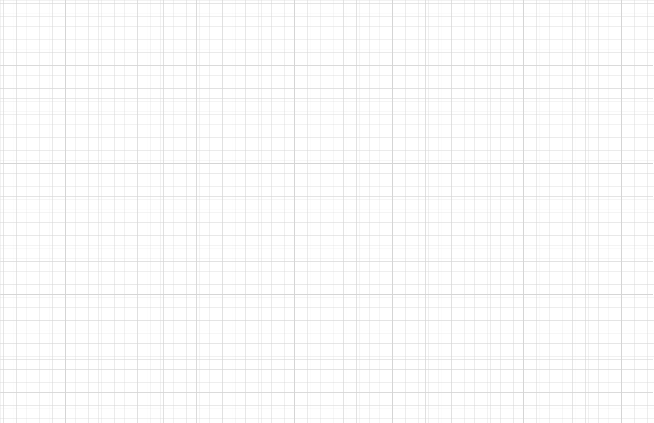
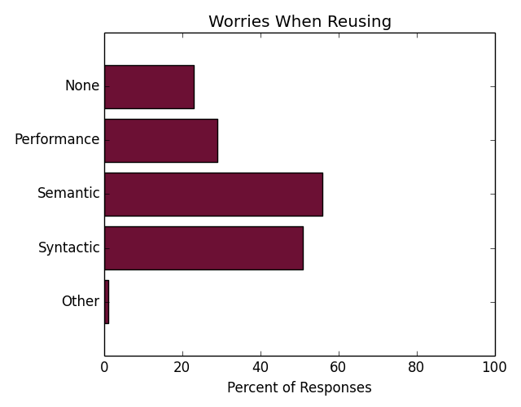
Portability

Slide 40
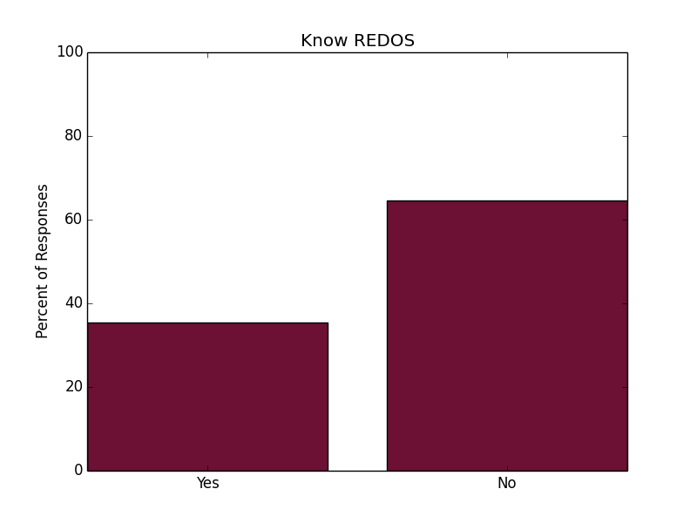

Slide 41
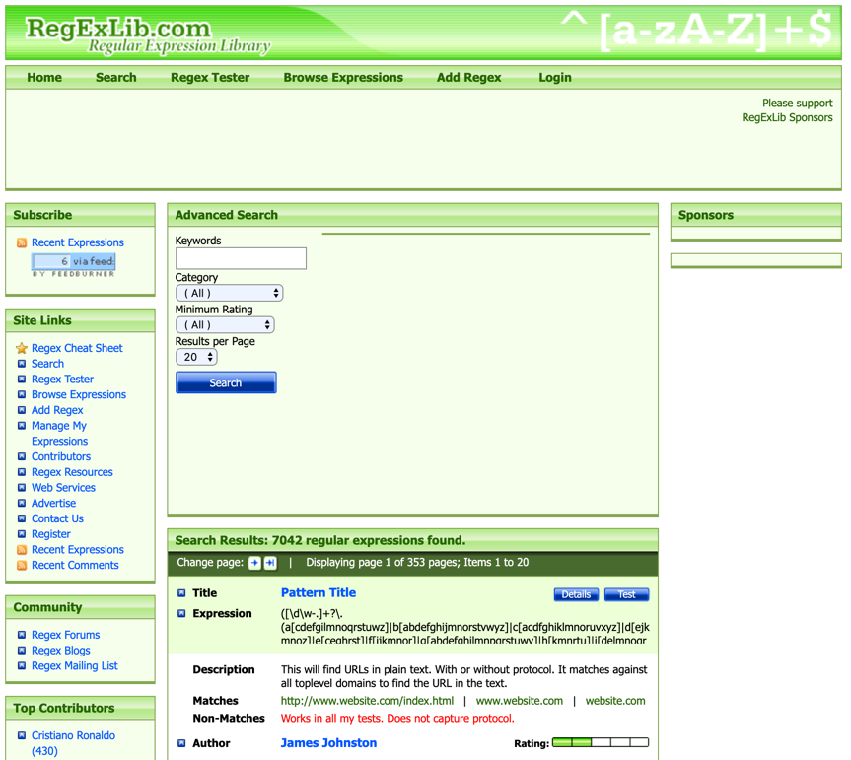
Regex Repositories
Regex are hard
There is a lot we can do to get better
Now we know more about real people
Real problems

Slide 42
Metrics-based Regex Ranking

Slide 43
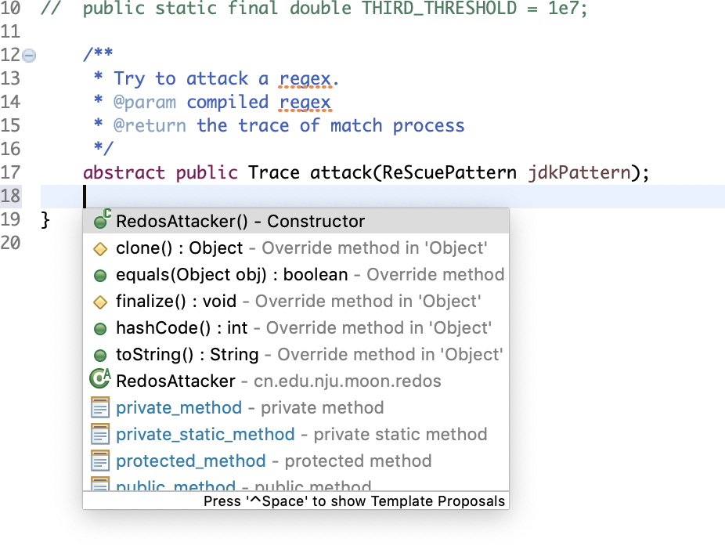
Live Support for Regex Composition

Slide 44
Regex Refactoring
(\d)+
([0-9])+

Slide 45
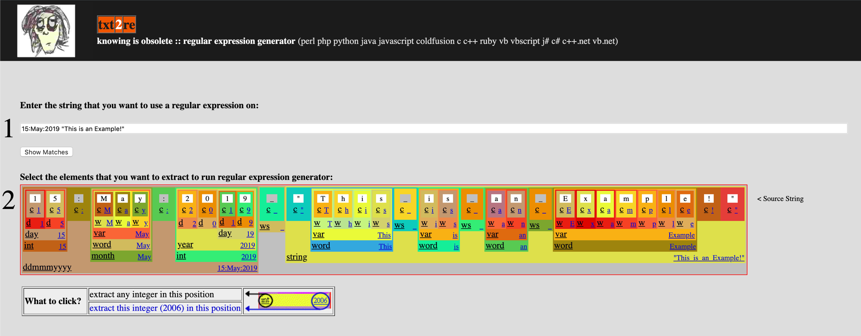
Automatic Regex Composition
Regex are hard
There is a lot we can do to get better
Now we know more about real people
Real problems

Slide 46
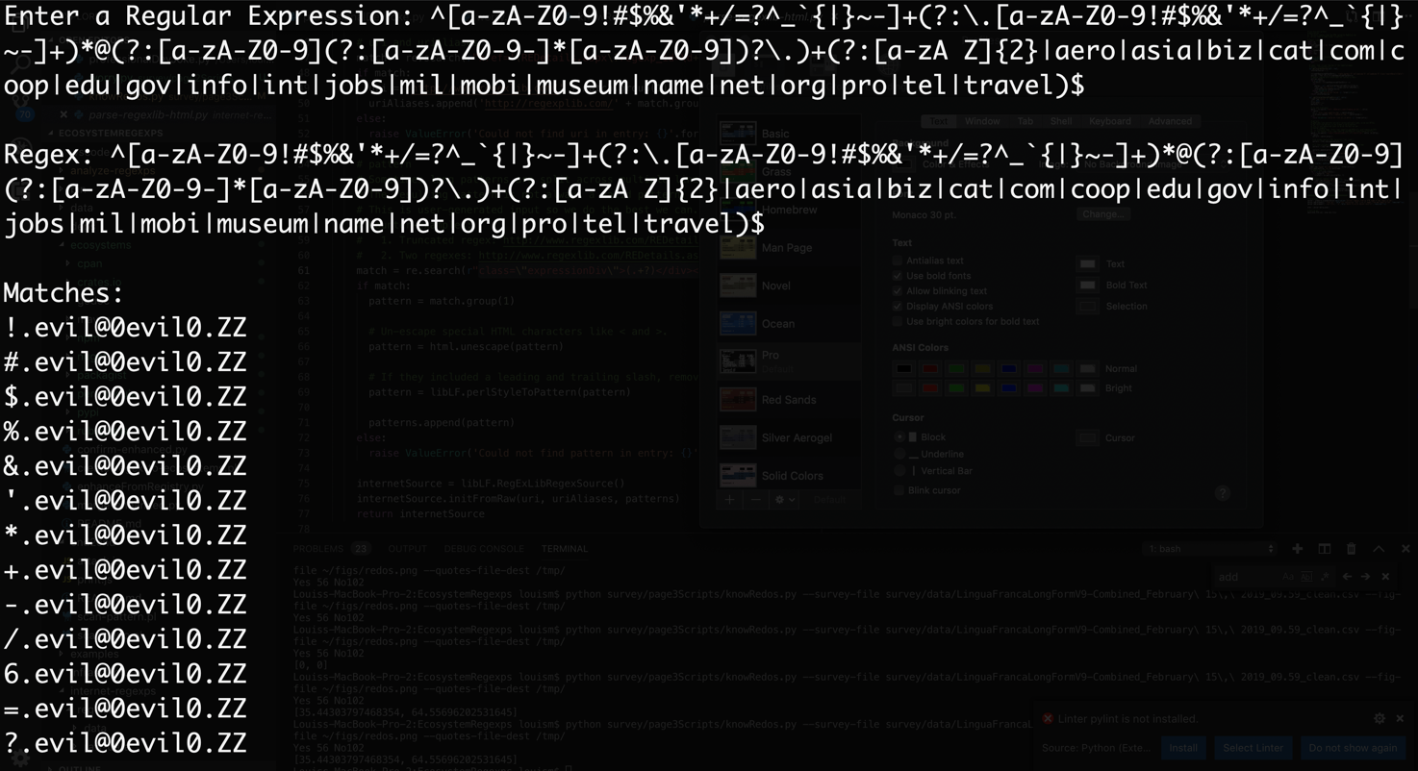
Regex Input Generation for Humans

Slide 47
Boundary Value Analysis for Regex

Slide 48
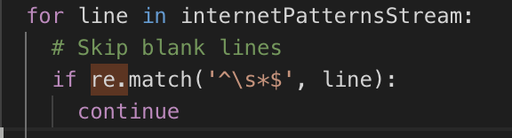
Automatic Regex Documentation

Slide 49
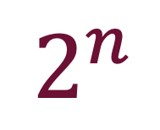
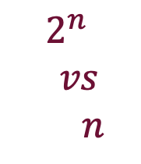

HOW THEY WORK
$$2^{n}$$
$$vs$$
$n$
$$2^{n}$$
$$n$$
SPENCER
THOMPSON
COX

