Slide 1
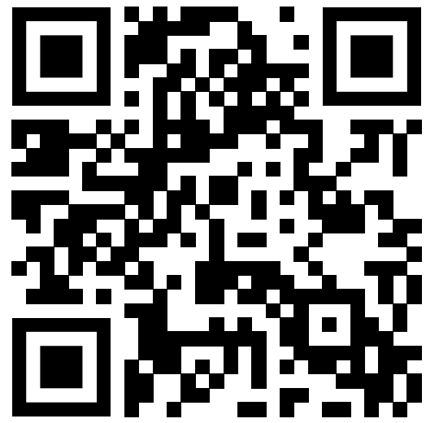
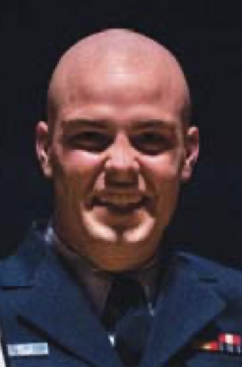
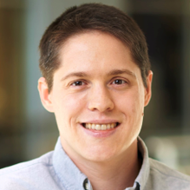
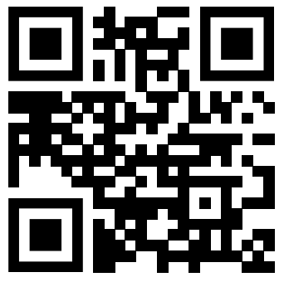
An Interview Study on Third-Party Cyber Threat Hunting Processes in the U.S. Department of Homeland Security
Paper!
To be presented at USENIX Security 2024
William P. Maxam III
US Coast Guard
James C. Davis
Purdue University
Lab website
Notes:
Hi, James Davis. Assistnat professor of ECE @ Purdue University. Work in software engineering and cybersecurity.
Acknowledge Trey, the lead author, who graduated and is now an instructor at the US Coast Guard Academy and couldn’t get back for the symposium ☺.

Slide 2
Talk overview
Threat Hunt and the landscape of cyber ops
Knowledge gaps and research questions
Method
Results
Takeaways

Slide 3
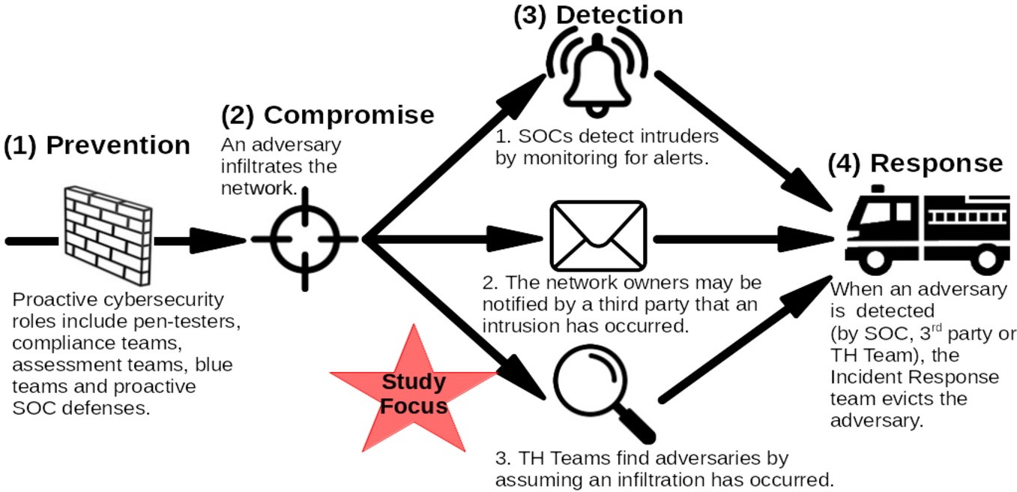
Cybersecurity ops and stages

Slide 4
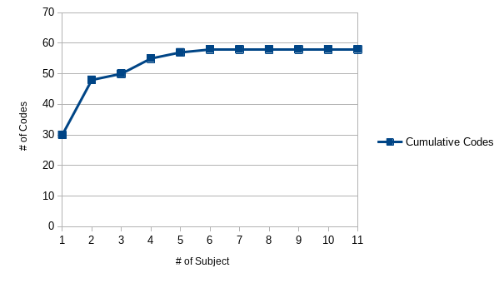
Saturation

Slide 5
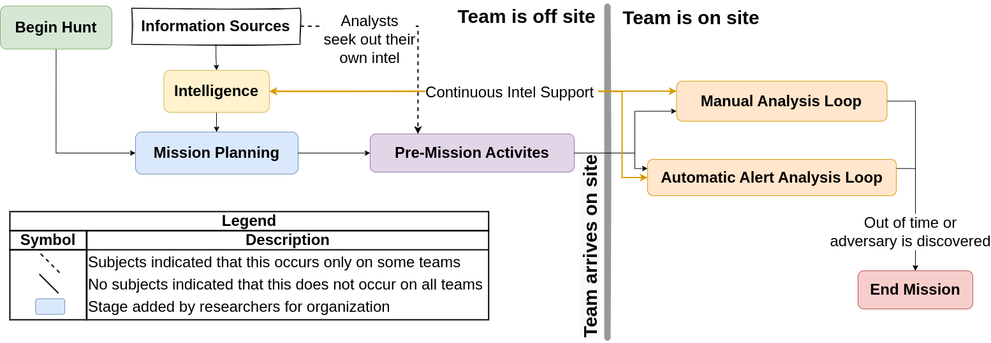
Simplified TH model

Slide 6
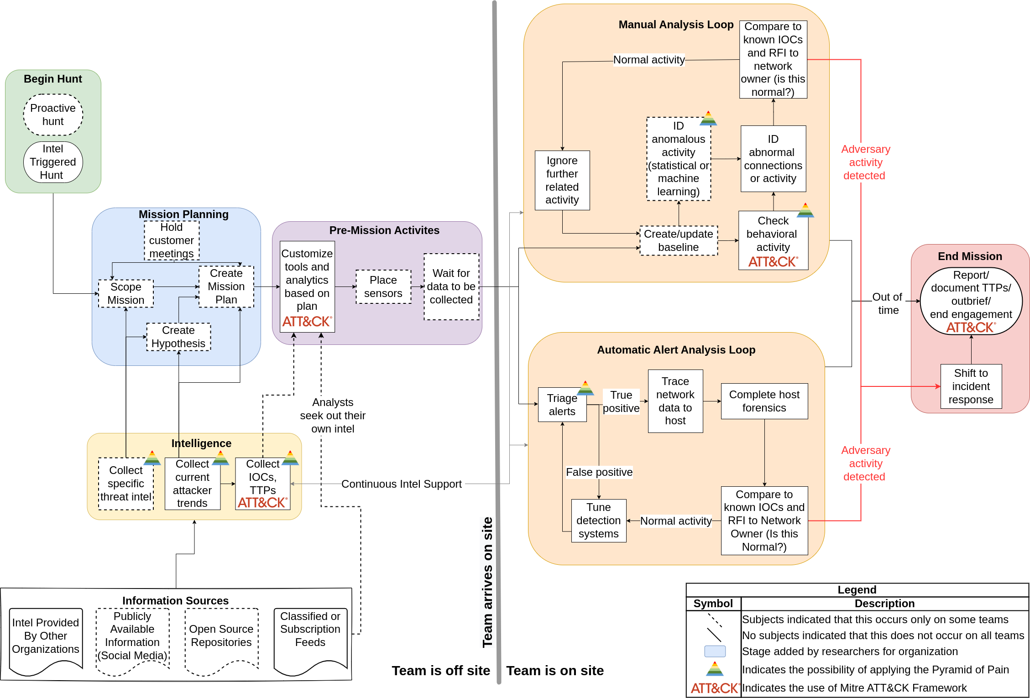
Full TH model

Slide 7
Process challenges
Challenge | # subjects mentioning
Poor measures of expertise | 6
Insufficient automation | 6
Teams need more data | 5
Inappropriate process detail | 4
High turnover | 3

Slide 8
Future directions
We want to know more about the PTM supply chain!
We need more to ensure its security!

Slide 9
Bonus slides

