Slide 1

An Exploratory Study on Upper-Level Computing Students’ Use of Large Language Models as Tools in a Semester-Long Project
Ben Arie Tanay, Lexy Arinze, Siddhant S. Joshi,
Kirsten A. Davis, and James C. Davis
A collaboration between the College of Engineering’s School of Engineering Education and the Elmore Family School of Electrical & Computer Engineering
Notes:
This work was funded by an “AI in Teaching and Learning” grant from the Purdue Office of the Provost.
The work of Ben Arie Tanay and Lexy Arinze was supported by the Purdue Engineering Education Explorers Program.
The work of Siddhant S. Joshi was supported by an ECE Elmore grant promoting cybersecurity in the computer engineering curriculum.

Slide 2
Summary of Contributions
1st interviews of upper-level computing students w.r.t. using LLMs
in conjunction with
Innovation in ECE 461-SWEng: training in and mandating use of LLMs
We found that students…
use LLMs for both technical and logistical work
find LLMs a great aid
are concerned about over-dependence on LLMs
Notes:
Our findings reveal that students used LLMs to assist with technical (e.g., coding) and logistical (e.g., project management) aspects of their projects.
We found that students perceived LLMs to greatly aid in their abilities to locate knowledge, create solutions, and work independently.
However, students also reported to be concerned with developing an overdependence on LLMs thereby weakening their ability to retain knowledge.
Our findings on the usage of LLMs in the software engineering landscape can help educators explore the role of this emerging technology in their respective academic settings.

Slide 3
Background
Industry
Large Language Models (LLMs) are transforming SW Eng practice
Academia
To ban or not to ban?
Notes:
LLMs as transformative
Large Language Models (LLMs) have begun to influence software engineering practice since the public release of GitHub's Copilot and OpenAI's ChatGPT in 2022. Tools built on LLM technology could revolutionize the way software engineering is practiced, offering interactive “assistants” that can answer questions and prototype software. It falls to software engineering educators to teach future software engineers how to use such tools well, by incorporating them into their pedagogy.
Large Language Models (LLMs) are a recent advancement in natural language processing (NLP). These models are trained on large amount of textual data to understand and generate human-like language [7]. While early language models primarily focused on text generation (e.g., advertising copy), LLMs can tackle more complex tasks [1]. One application of interest is in interacting with computer programs, i.e., software, which can be represented with specialized text [14].
Academia:
While some institutions have banned ChatGPT, other institutions have opted to issue guidelines for its use. Additionally, researchers have proposed strategies to address potential issues in the educational and professional use of LLMs. As of yet, there have been few studies that report on the use of LLMs in the classroom. It is, therefore, important to evaluate students’ perception of LLMs and possible ways of adapting the computing curriculum to these shifting paradigms.

Slide 4
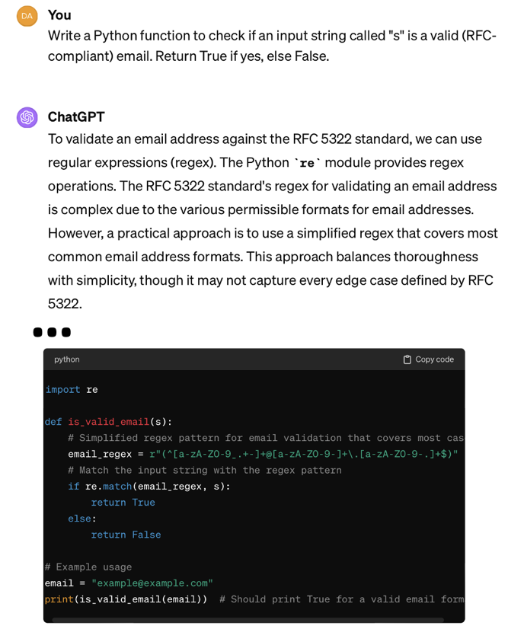
ChatGPT solving a programming task
Notes:
(Explain the benefit, but also spend time talking about the hazard of this capability – sample speech:)
Similar to any technological advancement, there are educational challenges inherent in the use of LLMs, including students' overreliance, issues of plagiarism, and biases in the generated content [21]. These challenges highlight the need for policies and guidelines towards the responsible use of LLMs. Educational institutions are actively engaged in deliberations to determine the most effective strategies for incorporating LLMs into their curricula

Slide 5
Research
Prior work focuses on novices – what about advanced students?
RQ1: How do students integrate LLMs into coursework when policies allow unrestricted access?
RQ2: How does the use of LLMs influence students’ perceptions of their learning?
Notes:
Prior studies on how students use LLMs in the classroom have focused on introductory courses when students are first learning programming languages. There has been less research on upper-level undergraduate students, particularly in a project-based classroom setting. Given the various roles that LLMs can play in software engineering projects [34], [16], [35], we wanted to understand how undergraduates studying software engineering approach the use of LLMs in their projects and their perceptions of how LLMs impact the overall project outcomes. Our study contributes insights into LLM use at the stage when students are moving beyond learning programming to applying these skills in a software engineering project.

Slide 6
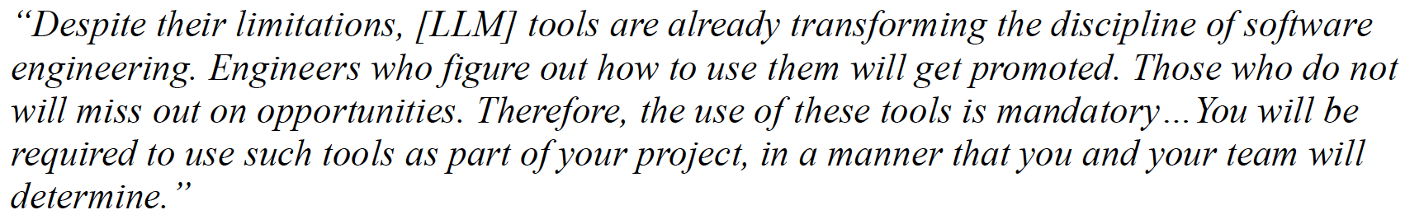
Study Context and Design
Context
ECE 461 – Software Engineering
Syllabus change
Method
Interviews (two rounds): Weeks 9-10 and Weeks 15-16
Thematic analysis
Notes:
ABOUT THE COURSE
“ECE 461: Software Engineering” is a senior-level course for electrical and computer engineering students at Purdue University [36]. The prerequisite coursework is two courses in programming and one course in data structures and algorithms, all taught in C. Most students have also taken a course in Python programming. The course learning outcomes are (1) an understanding of common models of the software engineering process (e.g., agile methods, plan-based methods); (2) the ability to conduct the software engineering process (e.g., requirements elicitation, project specification, design, implementation, validation, maintenance and evolution, re-use, and security analysis); and (3) an understanding of the social aspects of software engineering, (e.g., teamwork and ethics).
The course uses project-based learning [37] to teach these learning outcomes. Students work on a course project in small teams in teams of four that spans the entire 16-week semester. The project has two phases. Phase 1 takes 4 weeks. After Phase 1, the teams exchange projects (to simulate brownfield engineering [38]) and undertake the 12-week Phase 2 on top of another team’s implementation of Phase 1. During Phase 1, the students are applying concepts they have learned in previous coursework, such as file I/O and command-line interfaces. In Phase 2, the course staff provide support as students self-learn modern software engineering practices (e.g., continuous integration and continuous deployment) and cloud computing technologies (e.g., component selection and integration via infrastructure-as-code). The majority of the implementation is required to be done in TypeScript, a programming language that is not covered in the curriculum.
METHODS
With IRB approval, we conducted two rounds of in-person semi-structured interviews, with the same participants in both rounds. All participants consented to participate in the study. We conducted the first round of interviews during weeks 9-10 of the Fall 2023 semester, and the second round of interviews during weeks 15-16 of the same semester. Two researchers collaborated to conduct the interviews; each interview was conducted by one of them. The interviews for our study typically lasted for an hour and were audio recorded
To address our research questions, we used a thematic analysis approach. Thematic analysis is a data analysis technique that is driven by the research questions of the study and aims to identify and report themes emerging from the qualitative data [41]. We first divided the transcripts between two researchers who conducted the interviews. To promote full knowledge of the data, each researcher reviewed the transcripts of the interviews conducted by the other researcher. While reviewing the transcripts, the researchers documented memos of key ideas, common responses, and meaningful quotes. In discussion with the larger research team, these memos were grouped into distinctive buckets and a set of initial codes were generated from the data set. The two researchers who coded the data then met to discuss the codes and come to a consensus on the coding scheme. These researchers then coded the full set of transcripts using the agreed upon codes. After reviewing the quotes aligned with each code, the two coders identified potential themes in response to each research question. These potential themes were discussed by the whole research team to generate a final set of themes and subthemes

Slide 7
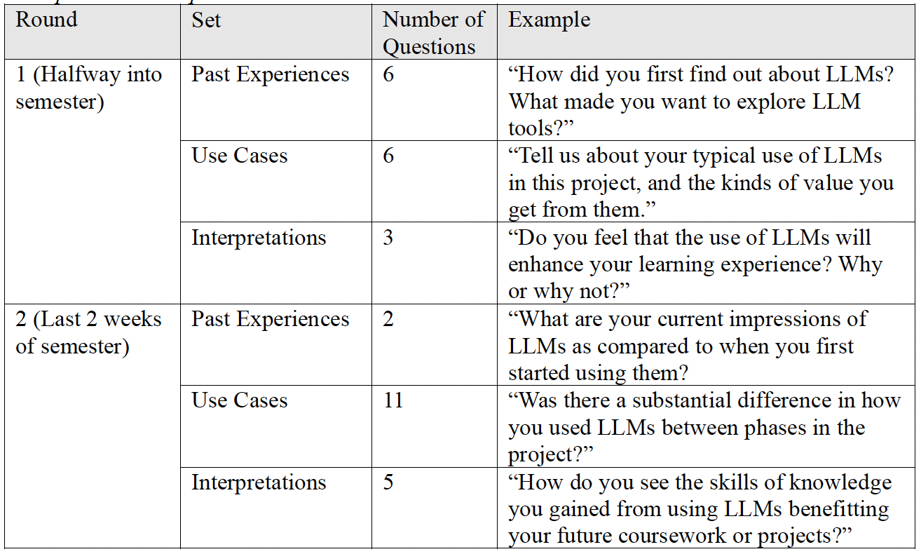
Interview subjects (N=9) and protocol
Notes:
Subjects
There were 9 subjects, representing 7 teams in the course. Each subject participated in both interviews. 7 subjects were seniors; 2 subjects were juniors. All were male (the class was about 95% male).
Survey design
The interview protocol focused on three constructs: (1) participants’ experience with LLMs prior to ECE 461; (2) their experiences in using LLMs in ECE 461 coursework; and (3) their interpretations of how LLMs influenced their coursework and learning. Because we used a two-phase interview design, we varied the interview protocol slightly between the two rounds. The second round of interviews focused more on use cases of LLM’s and experiential interpretations, and less on past experiences. Additionally, we asked the participants to compare their experience with the LLMs between the first and second phase of the course project because the nature of the software engineering tasks changed between the two phases. Table 2 provides examples of the types of questions asked in each round of interviews. Both rounds’ interview protocols will be provided in the appendix.
Protocol development:
To develop the interview protocol, we first identified the main constructs that were of interest to our study. These main constructs were developed based on our literature review of similar previous studies [33], gaps identified from our literature review, and the ECE 461 instructor’s experience on teaching LLM usage in the classroom (they are also a co-author of this work). As such, we decided to focus on three constructs in our interviews (1) past experiences with using LLM’s before entering the course; (2) experience using LLM’s in the ECE 461 course project; and (3) Interpretation of experiences using LLM’s in coursework or projects. Once we identified these constructs, we developed an initial version of our protocol by iteratively discussing the interview questions and receiving feedback from senior members of our research team. Subsequently, one member of the research team conducted a pilot interview with the graduate teaching assistant of the ECE 461 course. This student had previously taken the ECE 461 course. After the pilot interview, the research team reconvened to refine the protocol and determine if the protocol was targeted to answer the research questions. For example, we rephrased questions to eliminate the possibility of one-word answers (e.g, “yes” or “no”). We also added questions to gain more context on students’ relationships with LLMs before enrolling in ECE 461.
Data analysis:
To address our research questions, we used a thematic analysis approach. Thematic analysis is a data analysis technique that is driven by the research questions of the study and aims to identify and report themes emerging from the qualitative data [41]. We first divided the transcripts between two researchers who conducted the interviews. To promote full knowledge of the data, each researcher reviewed the transcripts of the interviews conducted by the other researcher. While reviewing the transcripts, the researchers documented memos of key ideas, common responses, and meaningful quotes. In discussion with the larger research team, these memos were grouped into distinctive buckets and a set of initial codes were generated from the data set. The two researchers who coded the data then met to discuss the codes and come to a consensus on the coding scheme. These researchers then coded the full set of transcripts using the agreed upon codes. After reviewing the quotes aligned with each code, the two coders identified potential themes in response to each research question. These potential themes were discussed by the whole research team to generate a final set of themes and subthemes
===
TODO Ben: I approximated the number of represented teams, please fix this.

Slide 8
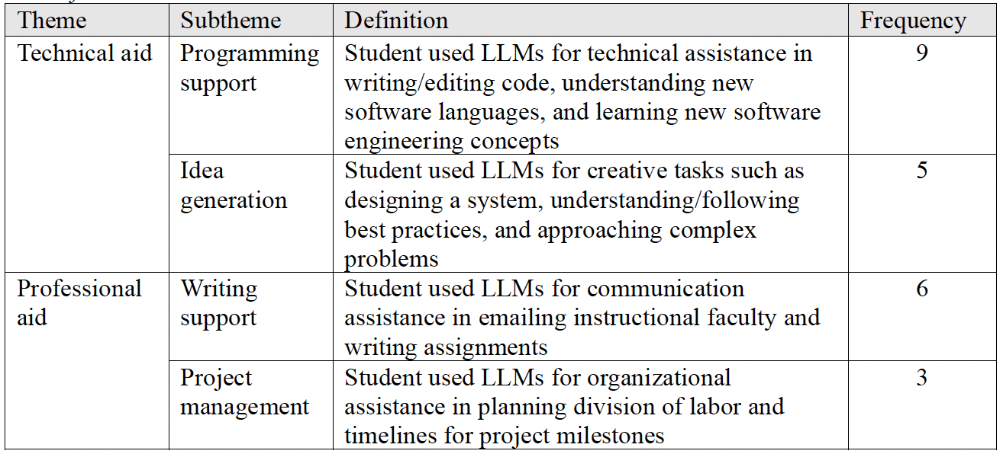
Students use LLMs for technical and professional aid
Notes:
Answer to RQ1: How do students integrate LLMs into coursework when policies allow unrestricted access?

Slide 9
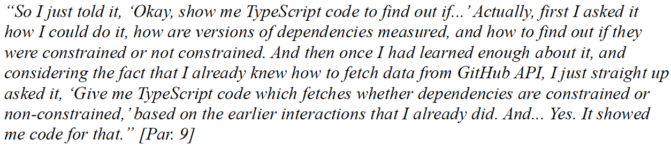
LLM as Technical Aid
Programming support (drafting functions)
Idea generation (system design)
Notes:
Programming support
All nine students used LLMs to help them generate code or modify their pre-existing solutions. In the following example, Participant 9 provides an example of how he interacted with ChatGPT to generate code in TypeScript, a language he had no prior experience with:
In this case, Par. 9 demonstrates a common interaction protocol when interacting with ChatGPT: first, provide the LLM with context for the problem, then request a technical solution by asking a specific prompt. This approach to LLM interactions was first introduced to students by the course instructor as a part of the course materials.
Idea generation
Five students used LLMs to play a creative role throughout their projects
Students demonstrated the use of LLMs for directional decisions, such as this quote from Participant 1
Par. 1 shared his preferences for writing his own code but chose to outsource the scoping of the project to LLMs. Of all the students who used LLMs for idea generation, their use cases could fit into one of two buckets: idea generation for system-level design, or idea generation for debugging and editing their solutions.

Slide 10
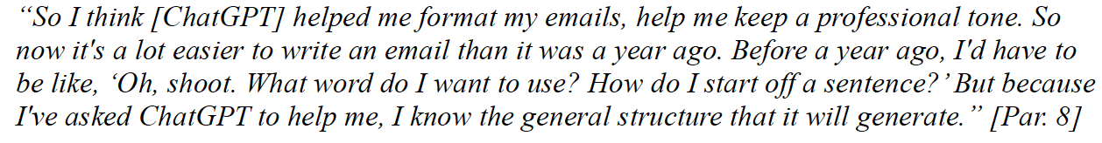
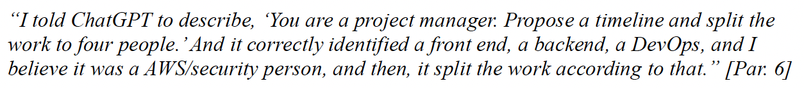
LLM as Professional Aid
Communication aid (drafting emails)
Project management (timeline and division of work)
Notes:
Communication aid
Six students used LLMs to benefit their writing and communication endeavors. This example highlights how ChatGPT was used in such a manner. Most commonly, students cited using LLMs to edit similar correspondences, such as generating emails to the professor or check for grammatical errors on an assignment.
Project management
Three students indicated that they used LLMs to assist in administrative duties, such as project management and organizational planning. The following quote demonstrates how one of the students tasked ChatGPT with generating a timeline and the division for labor of the project at the start of the semester:
Par. 6 gave exact instruction to ChatGPT for generating a project timeline from the perspective of a manager and was interviewee to report doing so. However, other students discussed the role of LLMs for other tasks related to professional skills like organization:

Slide 11
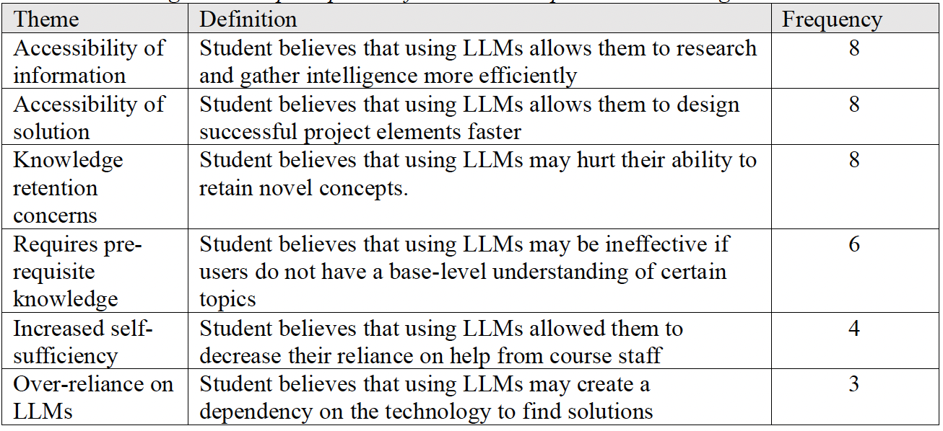


Students felt LLMs helped them, but have concerns
Notes:
Animations highlight rows that are positive (checks) and negative (Xes)
The middle row, unmarked, indicates nuance – maybe don’t try this with novices

Slide 12
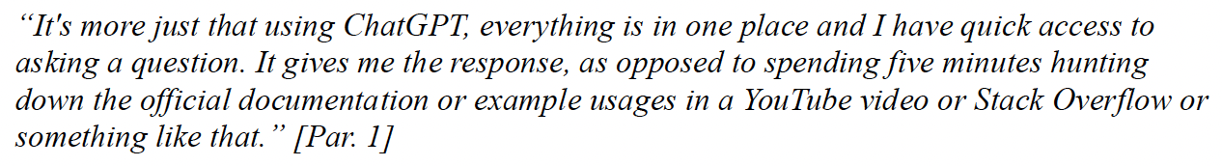
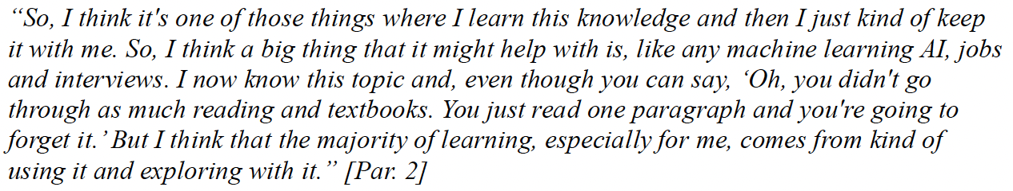
Accessibility of information and solution
Better than Google-ing
Do LLMs accelerate getting to the “experience” part of learning?
Notes:
Eight students cited that using LLMs greatly facilitated the knowledge acquisition process. One of these students made note of his abilities to retain new LLM-provided information in the provided snippet:
Here, Par. 2 is aware of how much nuance LLMs omit when they generate content. He then goes on to explain that being exposed to the new knowledge in the first place and interacting with it via prompt engineering is just as valuable to his learning.
QUOTE 2
Eight students also cited that LLMs played a key role in identifying and implementing software engineering solutions to their projects. The following quote provides insight on how LLMs can be used to reduce the amount of time to find solutions

Slide 13
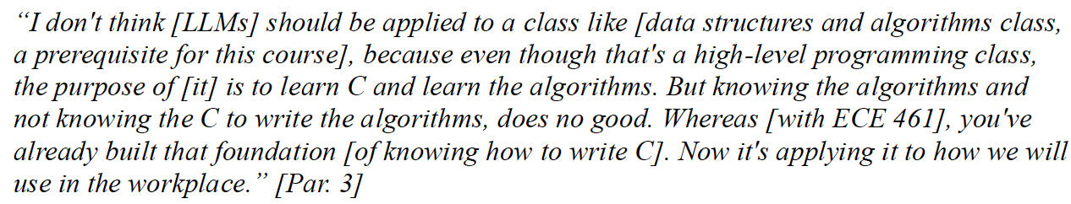
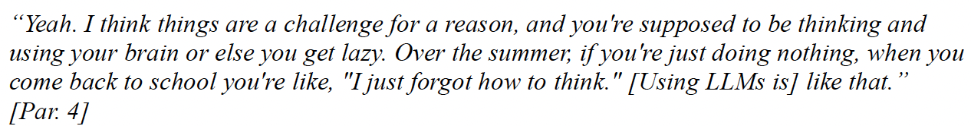
At what level can we introduce these tools?
Useful in an application course, not a foundation course
You have to think and use your brain
Notes:
Six students said that extracting the most value out of LLMs requires a minimum amount of background experience or information relevant to the project. When asked where in their department’s curriculum should students be exposed to LLMs, one student stated the following
Par. 3’s point is that learning algorithms from LLMs without having a foundational working knowledge of the C language can be ineffective. His concern for the mis-adoption of LLMs does not extend to his experience in ECE 461 however, as he believed that the foundations required for ECE 461 have already been built by previous classes. Other participants shared similar concerns towards introducing LLMs to a student before a solid foundation of knowledge can form.

Slide 14
Discussion and Conclusions
Students were thoughtful and mature in understanding of LLM use
SWEng work – and LLM use – is more than just code
Do LLMs require prerequisite knowledge of fundamentals?
Lots of opportunity for classroom impact and further research
Thank you for your attention!
Notes:
First, as a research group, we underestimated the level of maturity and nuance with which undergraduate students would relate to LLMs. Interviewees were aware of the hazards of LLMs, such as the accuracy of generated content, the ethical dilemma of plagiarism, and the many societal, corporate, and individual perspectives on intellectual property theft. What tasks students deemed worthy of LLM aid varied between responses as well. Tasks that some students considered “grunt work” and felt comfortable assigning the LLM to solve, others felt was meaningful work and insisted in doing themselves.
In response to RQ1, we found that all interviewees used LLMs for coding support. More than half of the interviewees also used LLMs for writing support (e.g., emails and reports) or idea generation, both technical and conceptual. A significant minority of students also used LLMs as project managers. These findings are significant because although some previous studies have explored how students could use LLMs in their academic pursuits [12], this study is the first to observe how engineering students use LLMs in a context that both mandates but does not restrict their usage to particular use cases. Additionally, project management manifested as a unique use case from this study, which has not been observed in previous relevant literature. This discovery may be related to the large scope of the course project, as well as the lack of formal project management training in the curriculum.
Our findings reaffirm the background literature’s mention of challenges related to LLM usage in academia like over-reliance and generated content bias [13]. However, they present new educational challenges not outlined in previous literature, namely the issue of feeling the need to have prerequisite knowledge before interacting with LLMs. What knowledge, precisely, is necessary?
Our findings on the usage of LLMs in a software engineering course can help educators explore the role of this emerging technology in their respective academic settings.

Slide 15
Bonus Slides

Slide 16
About ECE 461 – Software Engineering
Senior-level course for ECE students
Prereqs: 2 courses in programming, 1 course in algorithms
Learning outcomes:
Understanding of common models of the software engineering process
The ability to conduct the software engineering process
Understanding of the social aspects of software engineering
Approach: Project-based learning
16-week project
Two phases: CLI → Handoff → Web service deployed to AWS
Peer institutions offer similar courses at junior or senior level
Notes:
“ECE 461: Software Engineering” is a senior-level course for electrical and computer engineering students at Purdue University [36]. The prerequisite coursework is two courses in programming and one course in data structures and algorithms, all taught in C. Most students have also taken a course in Python programming. The course learning outcomes are (1) an 6
(1) An understanding of common models of the software engineering process (e.g., agile methods, plan-based methods)
(2) The ability to conduct the software engineering process (e.g., requirements elicitation, project specification, design, implementation, validation, maintenance and evolution, re-use, and security analysis); and
(3) an understanding of the social aspects of software engineering, (e.g., teamwork and ethics).
The course uses project-based learning [37] to teach these learning outcomes. Students work on a course project in small teams in teams of four that spans the entire 16-week semester. The project has two phases. Phase 1 takes 4 weeks. After Phase 1, the teams exchange projects (to simulate brownfield engineering [38]) and undertake the 12-week Phase 2 on top of another team’s implementation of Phase 1. During Phase 1, the students are applying concepts they have learned in previous coursework, such as file I/O and command-line interfaces. In Phase 2, the course staff provide support as students self-learn modern software engineering practices (e.g., continuous integration and continuous deployment) and cloud computing technologies (e.g., component selection and integration via infrastructure-as-code). The majority of the implementation is required to be done in TypeScript, a programming language that is not covered in the curriculum.

Slide 17
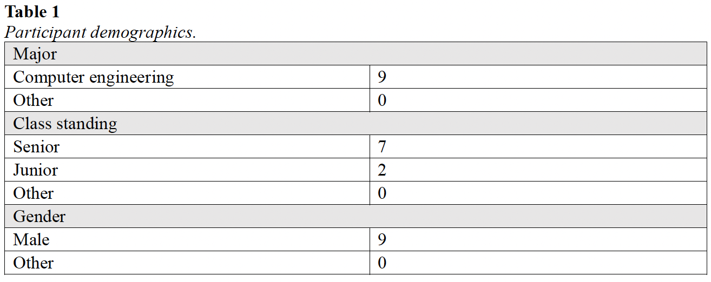
Participant demographics
Notes:
===
TODO: BEN: I’m using an out-of-date version of the paper and these tables have more data in the final version. Please update this screenshot.

