Slide 1
ML PROJECT 1
TEAM MEMBERS
VANSH MAHESHWARI
PARTH PARASHAR

Slide 2

Let’s Import the Data first
Once we import the data, it is important to check its shape and size.
Then check out various columns and see how can we preprocess the data to clean it and make it more usable.
The following figure shows the shape of the data.
Clearly it has way too high dimensionality and must be reduced for better clustering.

Slide 3
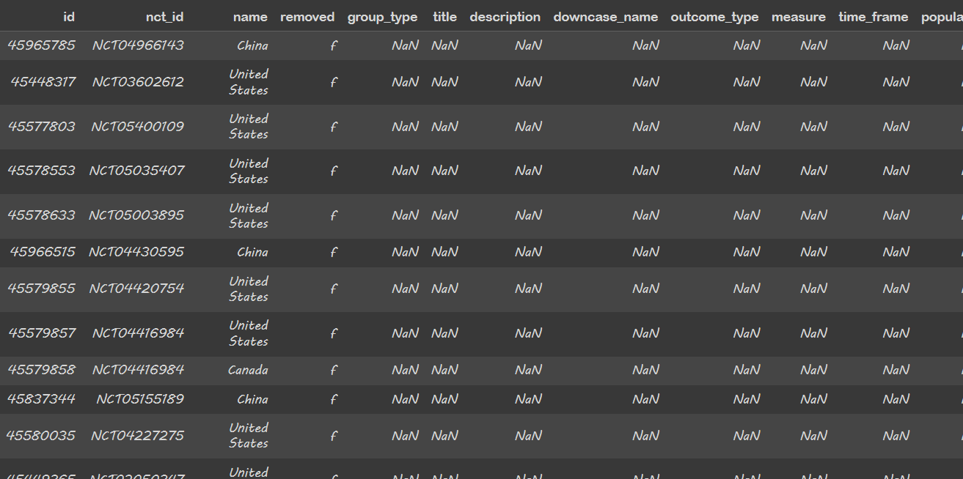

Now since the data has a lot of NaN values we must deal with it separately. The columns having all the values as NaN values must be removed
Now after removing the columns we reduce the columns as seen here.

Slide 4
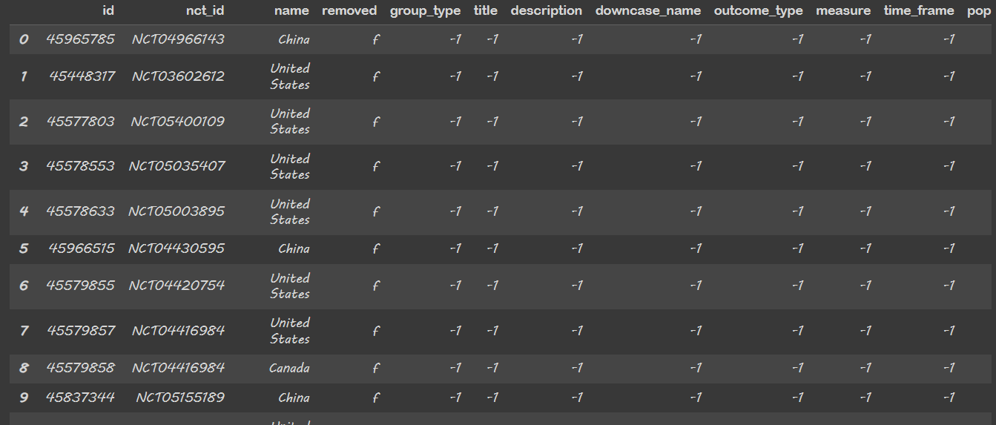
Now let’s change all the NaN values to -1 using the .fillna function. This allows us to give an integer value to all the NaN values which can be later used for regression/clustering.

Slide 5
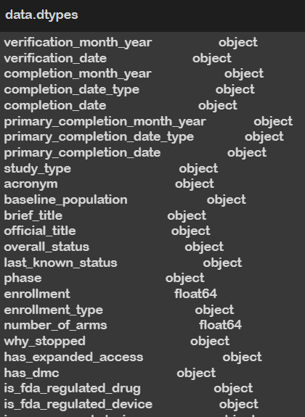
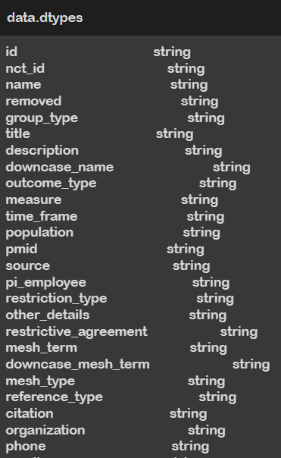
Now, converting all datatypes to string data type. This is done in order to make label encoding easier as during label encoding we need all the values to be of a particular datatype which can be converted to string values all at once.

Slide 6
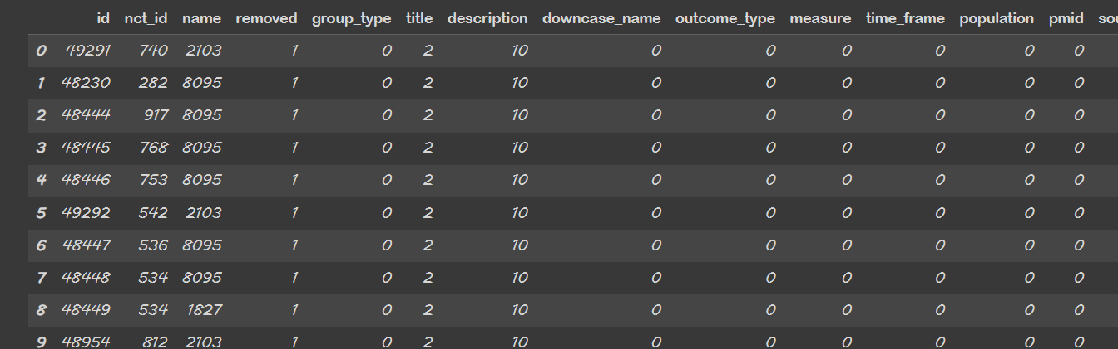
Performing Label encoding
We import the LabelEncoder from sklearn to perform label encoding on our data without which clustering is not possible.

Slide 7

Now it’s time to perform our first clustering. So, in this clustering we haven’t performed any special functionalities to make the result more accurate.
Now clearly this is not a very accurate clustering result. 0.55 is considered to be a very avg silhouette score. Hence, we need to improve it a lot to get anwhere close to what can be considered as good clustering.

Slide 8
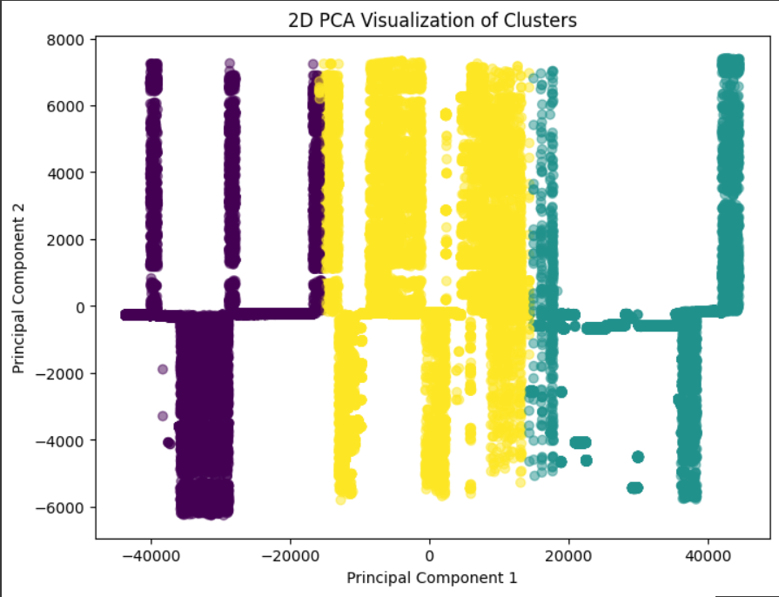
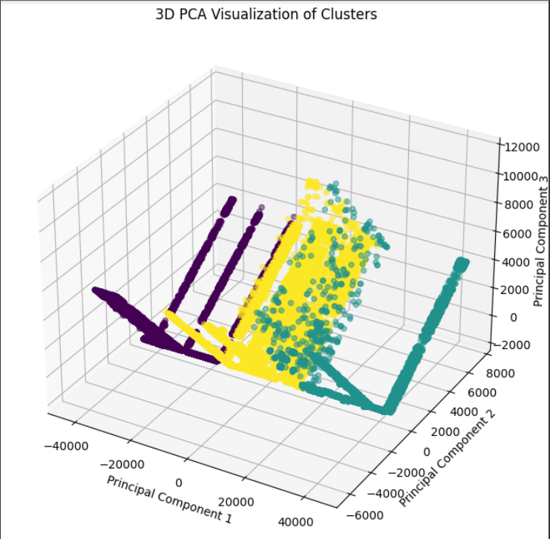
2D and 3D visualization of clusters

Slide 9
Now let’s remove more useless columns
So, we decided to remove all the columns with more than 99% NaN values in order to reduce the useless data.
Turns out over 70 columns were like this and hence couldn’t be removed.
This tells a lot about how the data we are going to use is very unbalanced as very few attributes are filled for each case.

Slide 10

Still let’s perform the analysis after dropping all these columns
As can be observed, there is little to no change in the silhouette score from the last change that we did. This move clearly didn’t do any good to us.
But removing such a massive amount of data without causing any good seemed like a poor trade-off as it might result in the loss of some important data. Hence we decided to skip this step and perform something else.

Slide 11
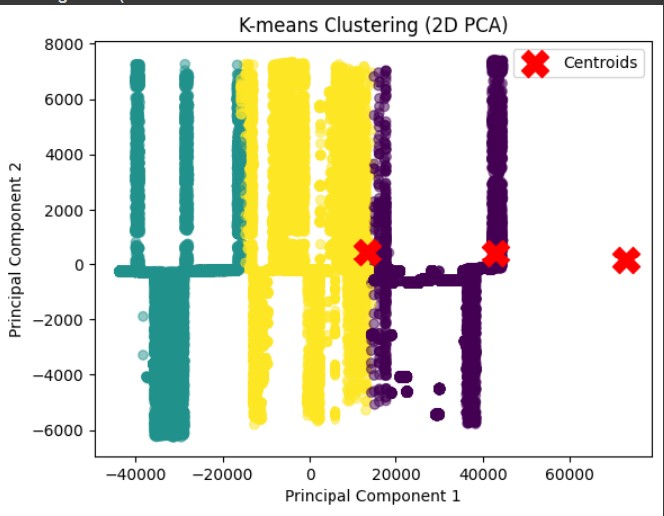
Difference between the clusters formed in 2 cases.
As one can see nearly same clusters were formed and although it assures us that no crucial data was lost. Still, we decided not to include this step to our model.
Before removing
After removing

Slide 12
Now we explore another method to reduce the dimensions
We perform cardinality analysis in our next step to reduce dimensionality.
This means we will check the no. of unique values per column and remove the ones having extremely high cardinality.
This is because during clustering we like to use the columns whose values can be grouped together. Having extremely high unique values gives poor clustering results as it becomes hard to group so many values.

Slide 13
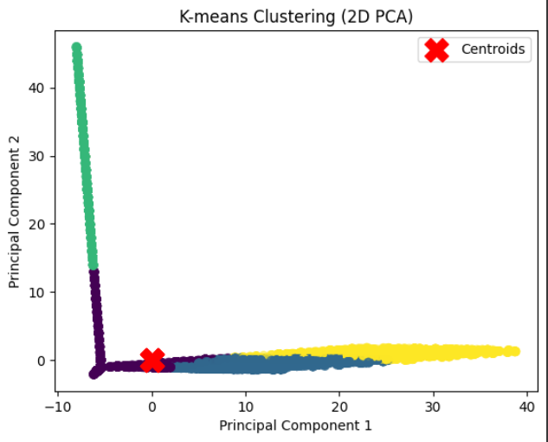
Performing cardinality analysis
We took a random no = 50 above which the column would be discarded. Now let’s perform clustering to it to get an idea if we are moving in the right direction.
A massive 71 columns were dropped.
As one can see, the graph has changed massively , this means some changes have definitely happened in the result.

Slide 14

Performance Evaluation
The silhouette score increases massively telling us that we were indeed looking in the right direction and hence we decide to keep exploring this further in order to get the best code.

Slide 15
So now we will check how clustering changes with change in cardinality.
We run the loop for different cardinality values and check how they perform one by one. We loop through a threshold of 80 and all the way down to 30 with a gap of 5.
Here threshold means the cardinality value above which the columns are not considered in the dataset.
For eg: a threshold of 70 means no columns having more than 70 unique values are to be considered.

Slide 16
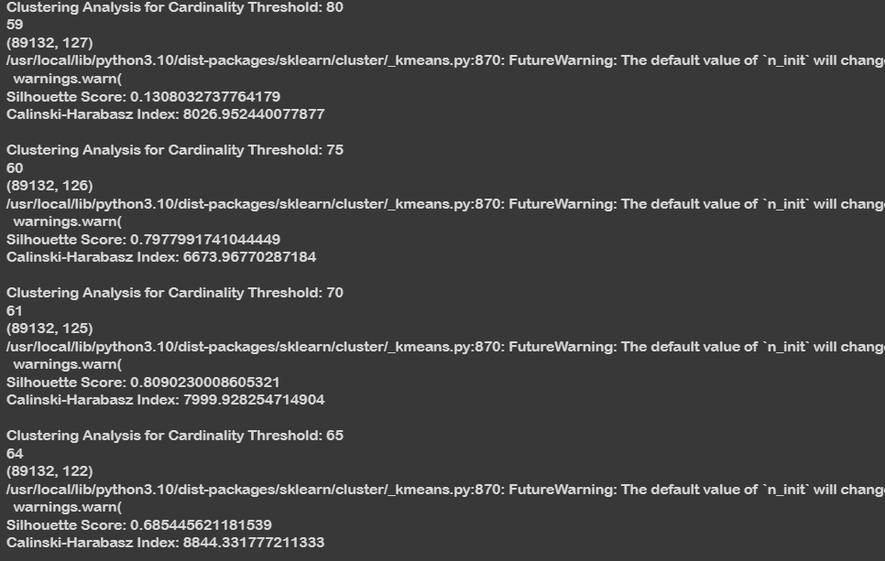
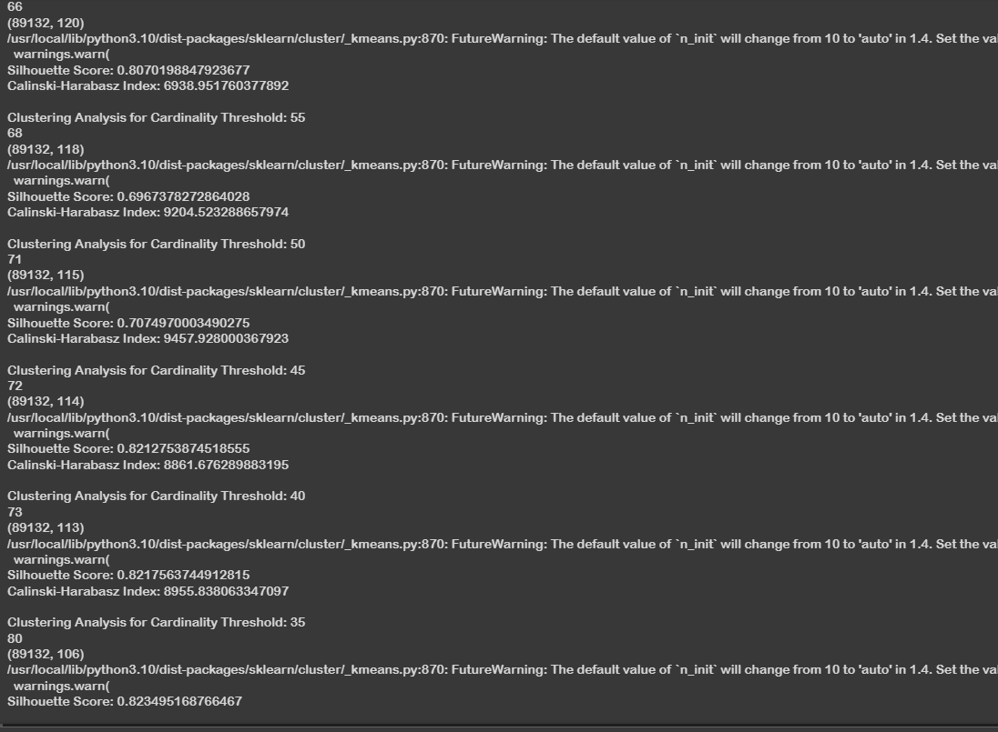
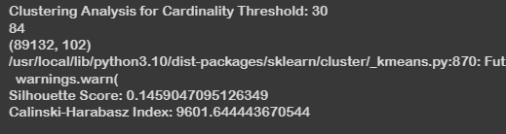

Slide 17
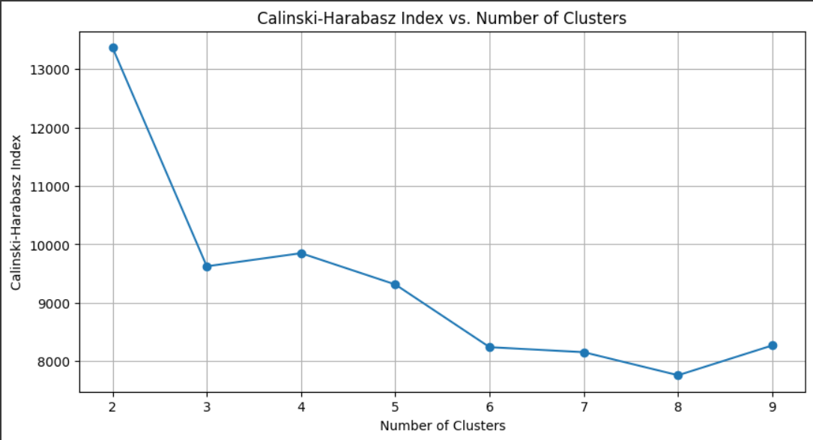
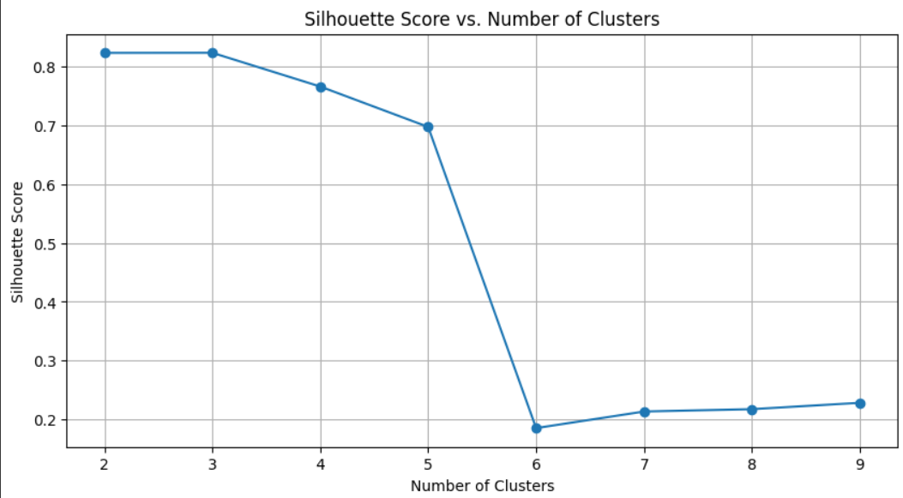
Now it’s time to test our model with different number of clusters.
The model is tested on clusters 2 to 9 and performance is evaluated for the same.

Slide 18
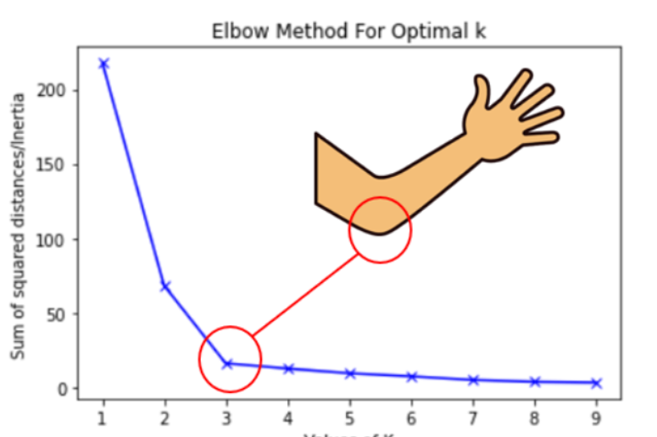
Now let’s find out the best cluster using elbow method.
The elbow method says that the point on the graph which shows like an elbow or the part where the rate of decrease shifts.

Slide 19
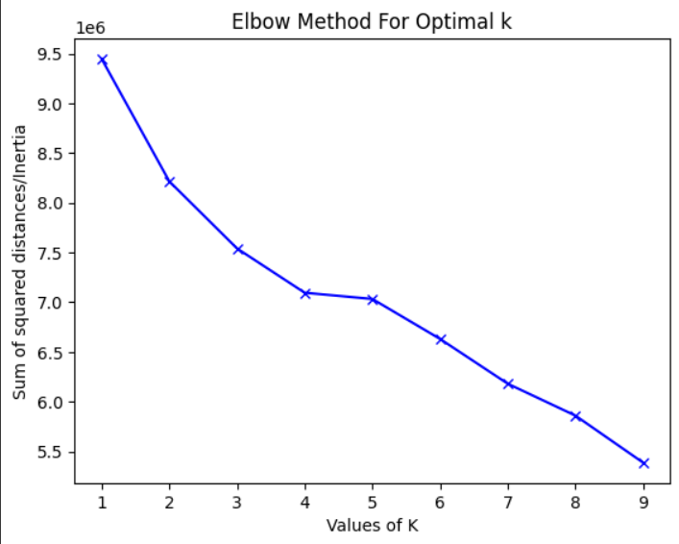
Applying the elbow curve method to our data
Clearly for our data the most optimal no of clusters turns out to be 4.

Slide 20
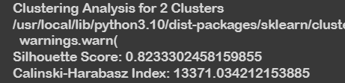

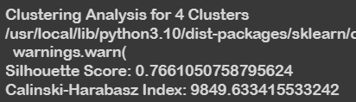
Now adding resampling to our data
We do resampling by using the k-fold cross-validation. Let’s test the code now and see if it changes something
After resampling
After resampling

Slide 21
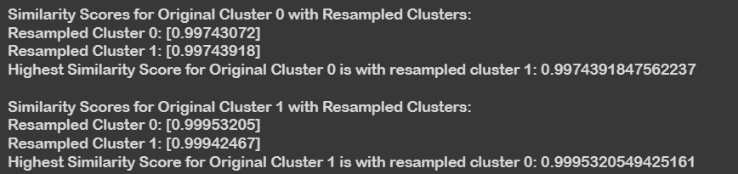
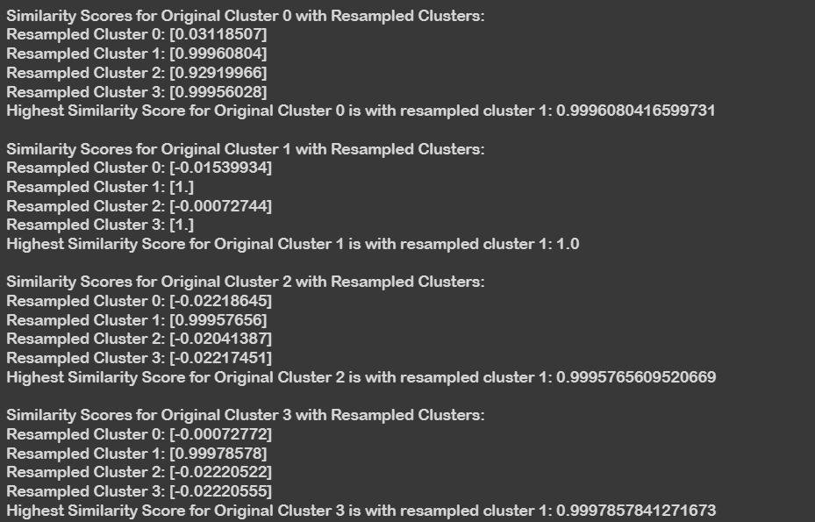
The second part of the question says : For each cluster in the original clustering find the most similar cluster in the clusters produced from the resampled data. So, lets do that!
For 2 clusters
For 4 clusters

Slide 22
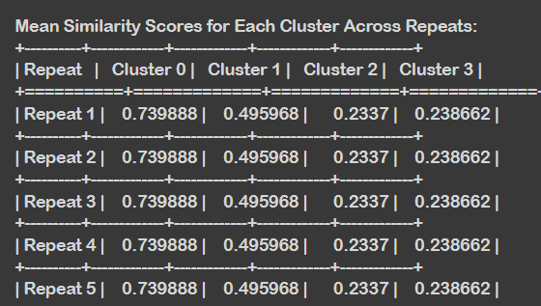
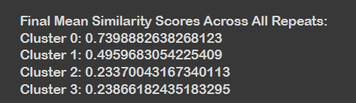
Now for the final part of the project
Repeating the process K times and computing the mean similarity across all resampled sets for each cluster.

