Slide 1


YouTube Master
GRE Vocab Dictionary
”Parth Sharma(211106)
PROJECT [WEB TECH LAB]
By – Aayush Sharma
Node JS , React, HTML , CSS , JS , Rapid API

Slide 2
01
Introduction
02
Website Structure
CONTENTS
03
Why to Use it?
04
Features

Slide 3
05
Website Screenshots
06
Future Work
CONTENTS
07
Conclusion
08
Reference

Slide 4
INTRODUCTION
The Graduate Record Examination, commonly known as GRE, is a standardized test required for admission to graduate and business schools in various countries, including the United States, Canada, and Australia. One of the most challenging parts of the GRE is the vocabulary section, which tests a candidate's knowledge of English words and phrases. The GRE vocabulary section aims to evaluate a candidate's understanding of the English language by measuring their ability to read and comprehend complex texts. The vocabulary section consists of two parts: Text Completion and Sentence Equivalence. In the Text Completion section, a sentence is presented with one, two, or three blanks, and the candidate must select the best answer from a list of possible words or phrases to fill in the blanks. In the Sentence Equivalence section, a sentence is presented with one blank, and the candidate must select two answers from a list of possible words or phrases that would create two sentences with equivalent meanings. The GRE vocabulary section is considered challenging because it requires a broad understanding of complex vocabulary and nuanced meanings. The exam draws from a wide range of subjects, including literature, history, and science, and it is not uncommon for candidates to encounter unfamiliar words. Therefore, it is essential for candidates to develop a strong vocabulary base to perform well on the GRE.
In summary, the GRE vocabulary section is an essential part of the exam, and it measures a candidate's ability to understand complex English words and phrases. To perform well on the exam, candidates should develop a strong vocabulary base by using various resources and reading extensively.

Slide 5
01
HTML
02
CSS
TECHNOLOGIES
03
JAVA SCRIPT

Slide 6

Website structure
1. Structure: The HTML document follows a standard structure with the doctype declaration, `<html>` root element, and head and body sections.
2. Metadata: The `<head>` section contains metadata about the document, including character encoding, viewport settings, and links to external stylesheets and a favicon.
3. Styles: The `<style>` section defines custom styles for elements within the document, such as the heading font family and the `.heading` class.
4. Header: The code includes a header section represented by the `<div class="inner-banner">`. It contains a logo image, navigation menu, and a search bar.
5. Footer: The code include a specific footer section.

Slide 7
Why to Use the GRE Vocab Dictionary?
Boost Your Scores
The GRE Vocab Dictionary provides the knowledge you need to boost your GRE scores and stand out in the competition.
Expand Your Vocabulary
The definition of success is directly proportional to the number of words you know. Master GRE Vocabulary with the GRE Vocab Dictionary.
Learn with Ease
Our unique learning technique makes learning GRE Words easy, quick, and effective.

Slide 8
Features
In my implementation of GRE Vocab Dictionary website there are some features in it
Multi-meaning Words
GRE Vocab Dictionary helps you to learn words that have multiple meanings and uses.
Trending Words
GRE Vocab Dictionary helps you keep up to date with GRE's trending words.
Audio Pronunciation
The dictionary includes an audio pronunciation feature for each word, improving phonetic learning.

Slide 9

GRE Vocab Dictionary Screenshots

Slide 10
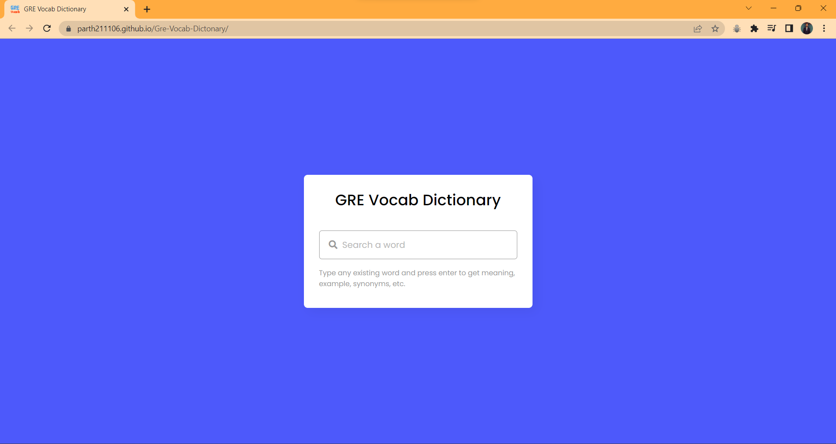

Slide 11
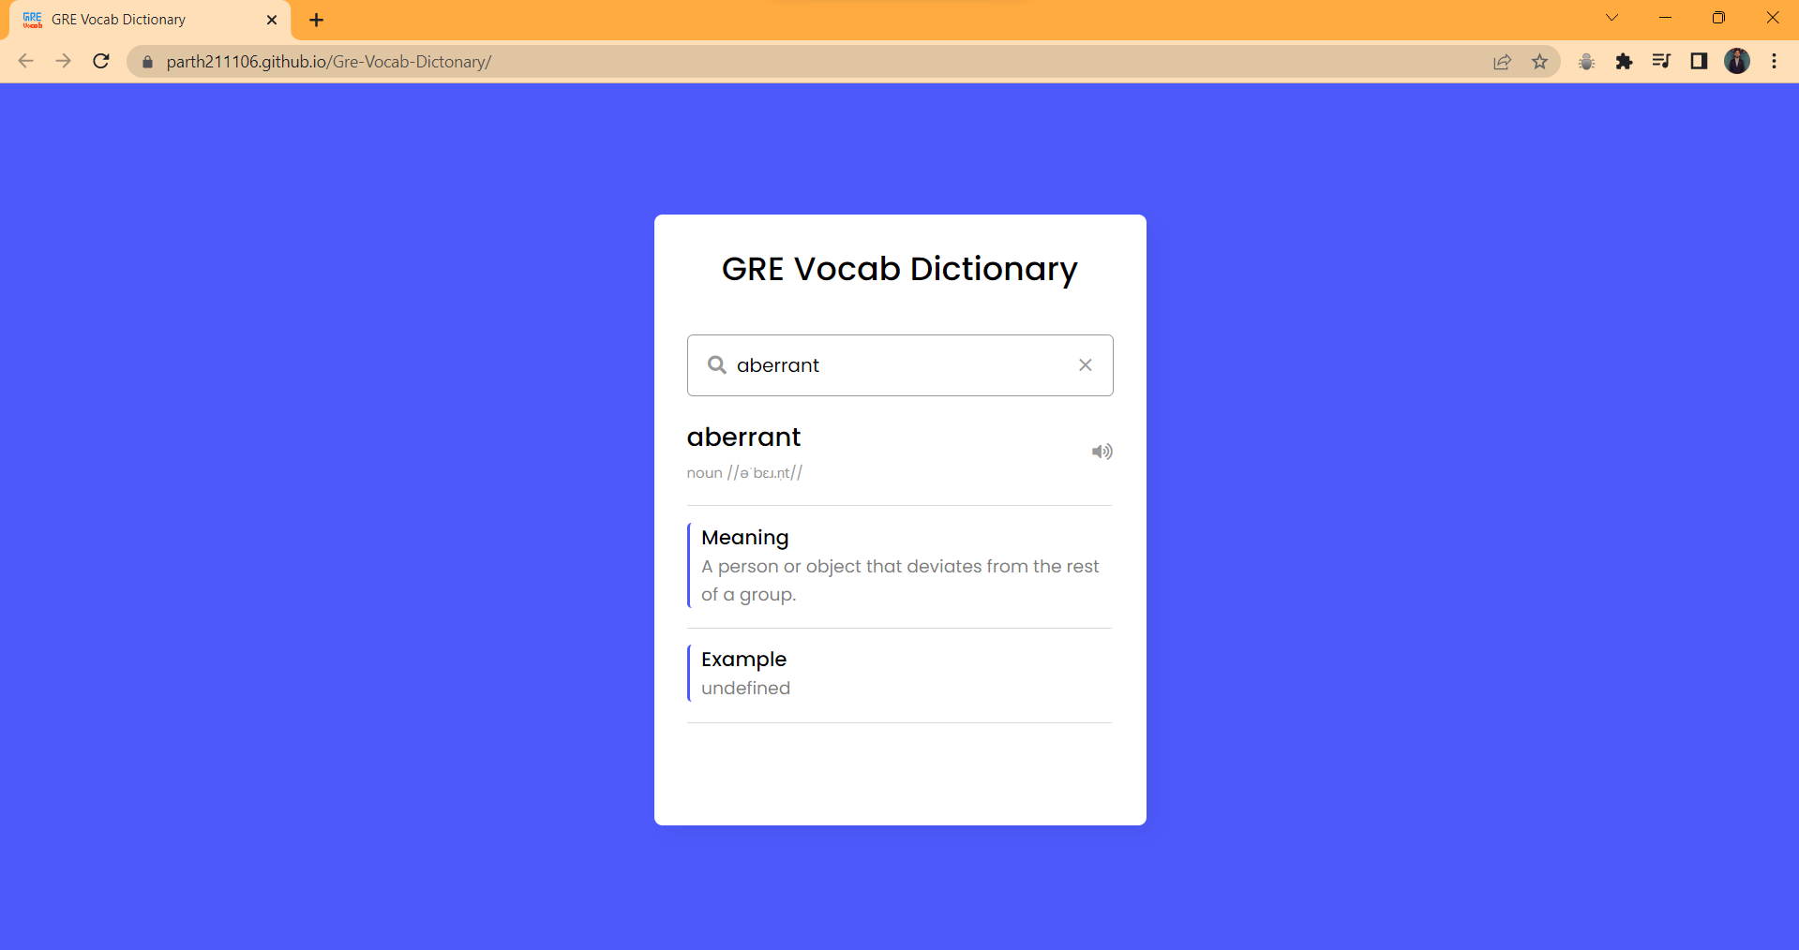
CONTINUED

Slide 12

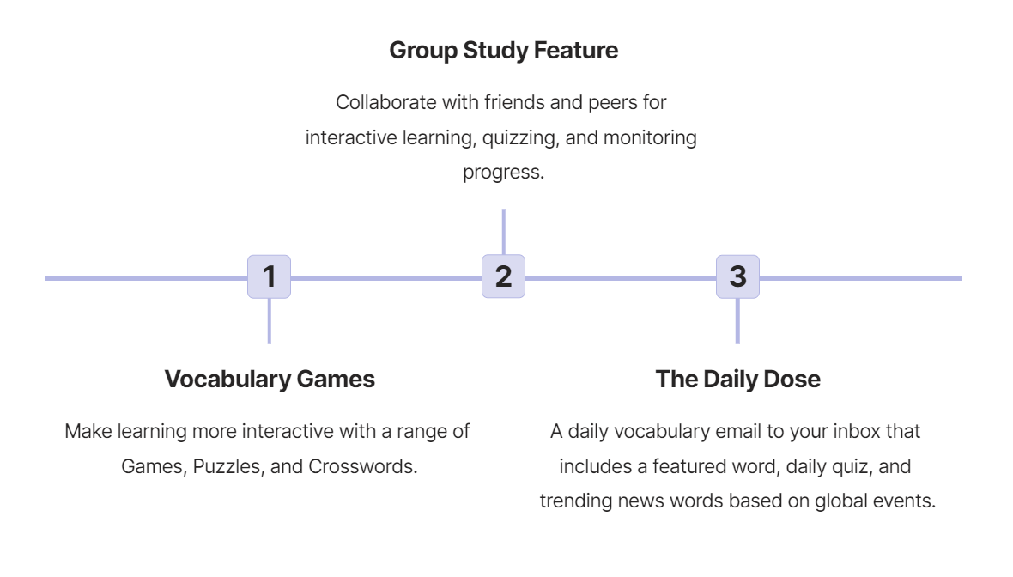
Future Work

Slide 13

Conclusion
Conclusion:
Building this project helped me solidify my knowledge in the main concepts of HTML,CSS and JavaScript. This project successfully creates a functional website for the GRE Aspirants to prepare for GRE Vocabulary Section. It provides a structured layout, appealing design, and interactive elements to enhance user experience.

Slide 14

References
Web Reference:
1. https://developers.google.com/youtube/v3
2. https://scrimba.com/g/glearnreact
3. https://www.techomoro.com/how-to-install-and-setup-a-react-appon-windows-10/
4. https://scrimba.com/g/gintrotojavascript
5. https://reactjs.org/docs/faq-internals.html
6. https://developers.google.com/apis-explorer
7. https://scrimba.com/g/glearnreact

Slide 15
THANK YOU
Thank you

