Slide 1

CASE STUDY

Slide 2



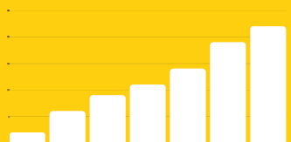
Client: Canara HSBC
Search Engine Optimization
Results
Objectives
Overall Website Visits Increase by 25%
Primary Objective – To Increase organic traffic and improve current website seo structure
Secondary Objective – To increase organic leads and reduce bounce rate of product pages.
Challenges
Keywords Ranking Improvement 65%
Revise existing tags and structure nevigation of the website
Highly competitive insurance companies already owned dominant market share, which leads expensive results.
Core term keywords is too competitive to rank on Google.
Increase organic traffic by 1.5x
Strategy on Google
Increase Domain Authority : In comparison with the competitors website our domain authority and Alexa rank was too low. We identified high authority pages and links those to canarahsbclife website and Improved DA by 5 points and Alexa rank by 12000
No. of First Page Ranking Keywords : We targeted high search volume insurance keywords that generates more website traffic. We Achieved first page ranking for 484 keywords.
We modified web pages for different devices to increase the conversion rate E.g AMP pages for mobile. This also helped us to reduce our Bounce rate
Campaign Period (Jan’22 – Present)

