Slide 1

CASE STUDY

Slide 2


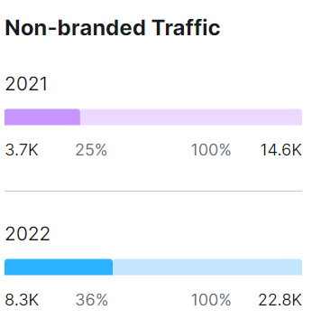
Client: Mastertrust
Search Engine Optimization
Results
Objectives
Website organic new users Increase 35%
Primary Objective – To Increase search visibility and organic traffic of the mastertrust website.
Secondary Objective – To increase organic leads and reduce bounce rate of product pages.
Challenges
Increase Non brand keywords traffic by 11%
Highly competitive Stock/trading companies already owned dominant market share, which leads expensive results.
The Core term keywords is too competitive to rank on Google as many of the websites uses to rank on.
Strategy on Google
To improve visits other competitors websites had sufficient links to rank their keywords on Google, so followed the same strategy to improve the rank on Google.
We added sufficient blogs on website to make sure users stay on our website & come back to read
We connected our website to high DA & PA websites so that those website pass link juice.
Campaign Period (July’21 – July’22)

