Slide 1

CASE STUDY

Slide 2




ABOUT THE CAMPAIGN
50%
Growth in
Revenue
Nivia have launched their new website to give customers enhanced shopping experience. And want to drive maximum b2c sales using the website
Increase in ROI Overall
CHALLENGES
2.5x
E-commerce portal awareness went down as existing website was not working for a long time.
Regain the website awareness and to be present in the top mind of the customers.
Nivia wanted to generate maximum sale through Online platform @ Pan India Level but at the same time, they want to reduce their cost/transaction as well as making aware of their new product through online medium
32%
Growth in
Brand Searches
OUR STRATEGY
Platform Used: Facebook, Google, Affiliate, marketing Automation
We created 5 type of audience persona on Facebook to deliver of our range of products.. And this help us improve the ROI of 2x
Created separate search campaigns for Brand, Core & Product specific & Competitor campaigns & driving them to specific product page which result us to achieved high quality score and maintain top position on google search page
Along with Search, we also stared smart shopping campaigns to increase sale
Display campaigns helped to us to create audience bucket which result us to maximise sale through dynamic remarketing campaigns.
Campaign period Jan’21 to April’21

Slide 3
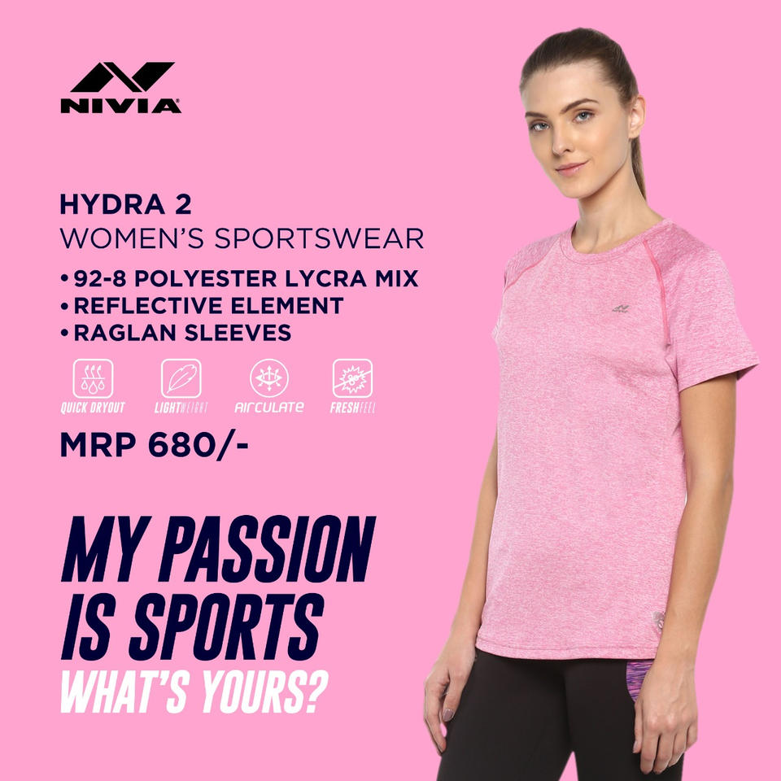
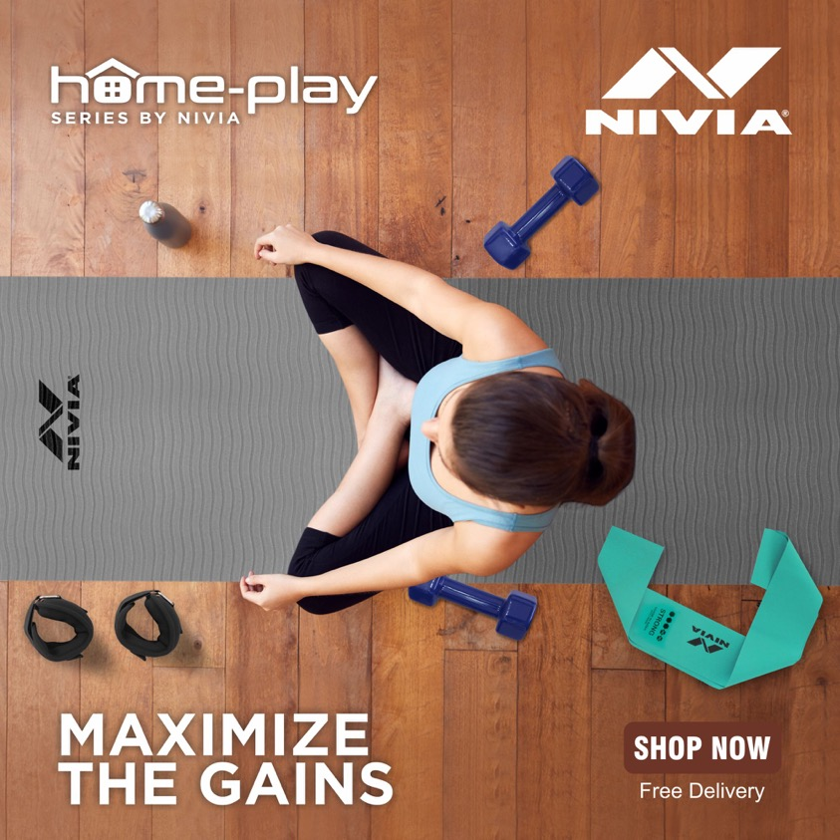
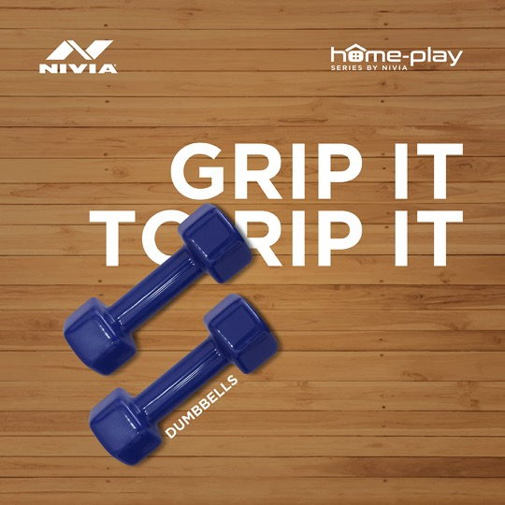
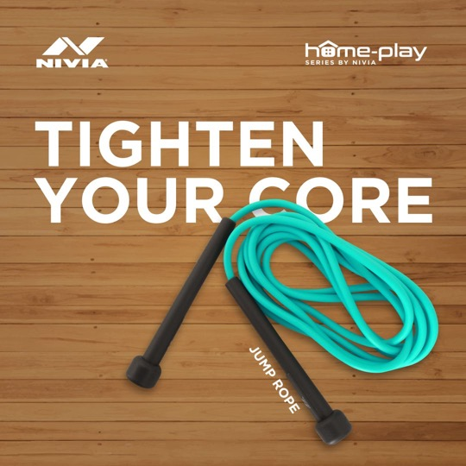
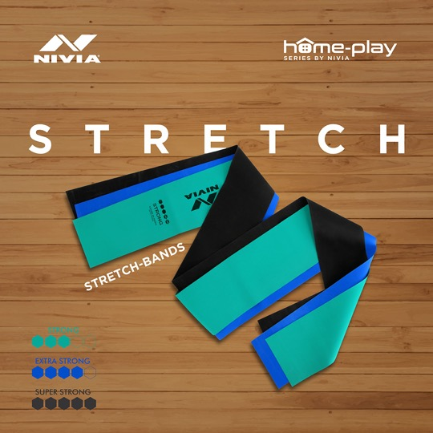
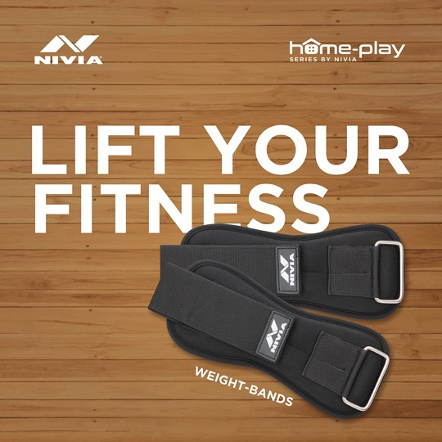
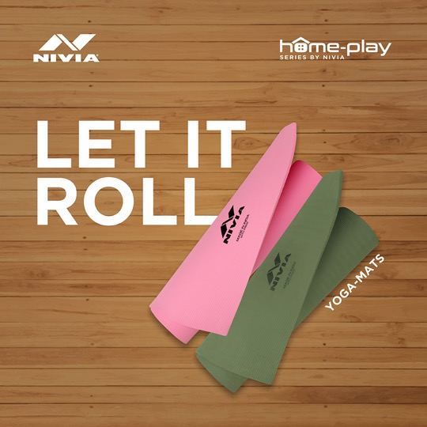
Creatives

