Slide 1


Banking System with Transaction Management
L.J. Institute of Engineering & Technology
Prepared By:-
Student Name: MAHERIYA PARTH HEMANTBHAI(23002170110076)
Batch: D-2 Branch: CE

Slide 2
Project Outline:-
Purpose of the project
ER Diagram
Use case Diagram
Functionalities
Triggers and procedures
Tools used
Merits & Demerits

Slide 3
Purpose of the project
The primary purpose of a Bank Management System developed using Java is to provide a secure, efficient, and user-friendly platform for managing banking operations. This system aims to digitize and automate various banking processes, thereby reducing manual effort, minimizing errors, and enhancing customer experience.

Slide 4
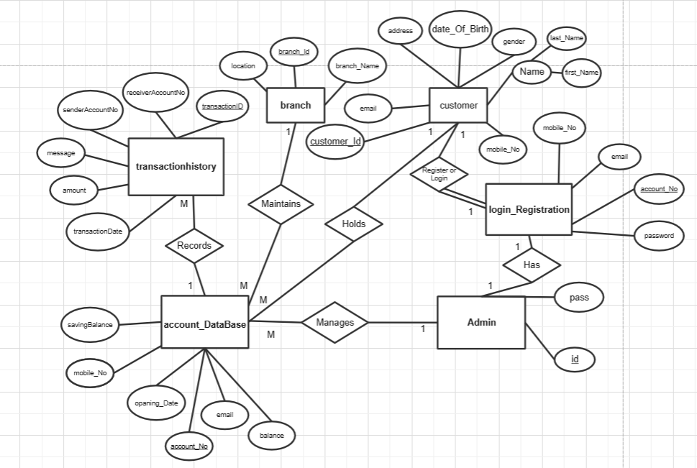
ER Diagram

Slide 5
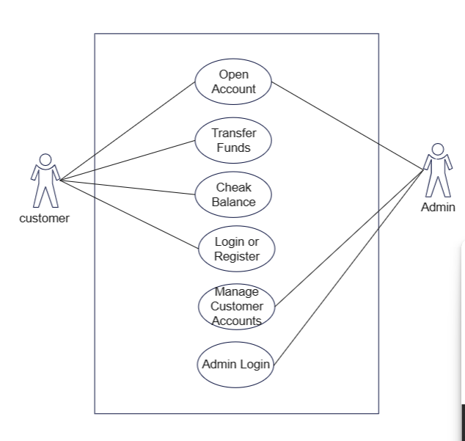
Use case
Check
Balance

Slide 6
Subject wise Functionalities
Data Structures using JAVA | JAVA - II | DATABASE MANAGEMENT
1. Stack for Transaction History | 1. Exceptional Handling | 1.SQL
2. Linked List for link saving Account and checking accounts | 2. JDBC(Java Database Connectivity) | 2. Stored Procedure
 | 3. Packages | 3. Database Triggers

Slide 7
Functionalities
1. Account Management
Create, update, delete, and view customer accounts.
Manage account details like balance, contact information.
2. Transaction Handling:
Perform fund transfers between accounts.
Maintain a history of transactions with timestamps.
3. User Authentication:
Implement secure login for customers.
Differentiate user roles (e.g., admin, customer) and restrict access to certain features.

Slide 8
Functionalities
4. Exception Handling:
Manage errors such as invalid account numbers, insufficient funds.
Provide meaningful error messages to users.
5. Graphical User Interface (GUI):
Design an interactive and user-friendly interface for smooth navigation.
Use Java Swing components like buttons, tables, and text fields for GUI elements.

Slide 9
Triggers and procedures
Triggers
delete account from Login_Registration when deleting account from account_database.
Procedures
insert data about customer.
update balance in account_database when insert data into transactionhistory.
transfer balance between savings account and current account.

Slide 10
Tools used
1.Java Development Kit (JDK):
Provides the essential tools to compile, run, and debug Java applications.
2.Java Swing:
Utilized for building the graphical user interface (GUI) of the bank management system, including forms, buttons, tables, and dialog boxes.
3.JDBC (Java Database Connectivity):
Enables interaction with a database to perform operations like account creation, transaction recording, and retrieving account details.

Slide 11
Merits
Automation: Streamlines banking operations like account management, transactions, and reporting, reducing manual effort and errors.
Faster Transactions: Speeds up processes such as money transfers, balance inquiries, and account updates.
Real-time Updates: Provides up-to-date information on account balances and transaction histories.
Error Reduction: Minimizes human errors in calculations and record-keeping through automated systems.

Slide 12
Demerits
1.High Initial Costs:
Requires significant investment in software development, hardware, and infrastructure.
2.Maintenance Requirements:
Needs regular maintenance and updates to ensure security and compatibility with evolving technologies.
3.Bug Fixes:
May require troubleshooting and resolving software bugs or issues over time.
4.Security Risks:
hacking and cyber-attacks if not properly secured.

Slide 13
Future Scope
1.Online Transaction System:
implement an online transaction system that enables customers to perform transactions via a web or mobile.
2.Loan Management System:
introduce a comprehensive loan management system that allows customers to apply for loan, manage loan, and repay loans.
3.Interest Calculation:
Mechanisms to calculate interest rates based on customer saving account balance.

Slide 14
THANK YOU….

