Slide 1





Customer Shopping Behavior Analysis
Data Analysis Project Using Python, SQL & Power BI
Presented By
Parth Soni

Slide 2




Project Overview
Dataset & Scope
Key Objectives
Analytical Approach
Analyzed 3,900 purchases across multiple product categories, covering demographics, purchase details, and shopping behavior patterns.
Uncover spending patterns, customer segments, product preferences, and subscription behavior to drive data-informed business decisions.
Exploratory data analysis using Python, SQL business queries on PostgreSQL, Power BI visualization, and strategic recommendations.

Slide 3





Dataset Summary
Dataset Structure
Key Variables
Data Quality Note
3,900 rows and 18 columns covering customer demographics, purchase details, and shopping behavior patterns.
Age, Gender, Location, Purchase Amount, Category, Season, Subscription Status, Frequency, and Review Rating.
37 missing values identified in the Review Rating column, handled by imputing the median per product category.

Slide 4





Exploratory Data Analysis
Data Preparation
Load & Explore Data
Handle Missing Values
Standardize Column Names
Loaded the dataset using pandas. Performed initial exploration with df.info() and .describe() to understand structure, data types, and basic statistics across 3,900 rows and 18 columns.
Identified 37 missing values in the Review Rating column. Imputed missing ratings using the median value per product category to preserve data integrity and avoid bias.
Renamed all column headers to snake_case format for consistency and compatibility with Python and SQL workflows. Ensured uniform naming conventions throughout the dataset.

Slide 5
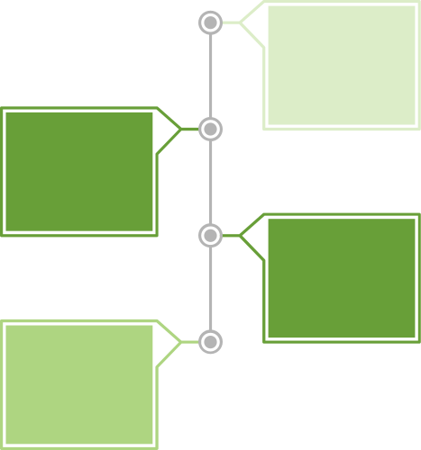




Feature Engineering
& Data Quality
Data Consistency Check
Identified promo_code_used as redundant with discount_applied and dropped the column to streamline the dataset and avoid multicollinearity.
Age Group Segmentation
Created an age_group column to segment customers by age bracket, enabling targeted demographic analysis across purchase behavior patterns.
PostgreSQL Integration
Connected the fully cleaned and engineered dataset to a PostgreSQL database, enabling structured SQL business queries and downstream analysis.
Purchase Frequency Calculation
Calculated purchase_frequency_days to reflect intervals between transactions, providing insight into customer return and buying cadence.

Slide 6




SQL Business Analysis
Revenue & Customer Segmentation
Revenue by Gender
Customer Segments
Subscriber vs Non-Subscriber
Female: $75,191
Male: $157,890
Total combined revenue across all transactions analyzed in the dataset.
Loyal: 3,116 customers
Returning: 701 customers
New: 83 customers
Majority are loyal repeat buyers.
Subscribers: 1,053 customers, $62,645 total ($59.49 avg)
Non-Subscribers: 2,847 customers, $170,436 total ($59.87 avg)

Slide 7



SQL Analysis – Product & Purchase Insights
Top 5 Products by Rating
Discount-Dependent Products
Repeat Buyers & Subscriptions
Gloves (3.86), Sandals (3.84), Boots (3.82), Hat (3.80), Skirt (3.78) — highest-rated items across all categories.
Hat (50%), Sneakers (49.66%), Coat (49.07%), Sweater (48.17%), Pants (47.37%) — nearly half of sales rely on discounts.
Non-subscribers with repeat purchases: 2,518. Subscribers with repeat purchases: 958. Non-subscribers dominate repeat buying behavior.

Slide 8




SQL Business Analysis
Sales Patterns & Shipping
Revenue by Age Group
Shipping Type Revenue
Top Revenue Insight
Young Adult: $62,143
Middle-aged: $59,197
Adult: $55,978
Senior: $55,763
Standard Shipping avg: $58.46
Express Shipping avg: $60.48
Express generates higher revenue per transaction.
Young Adults lead all age groups in total revenue, contributing $62,143. Express shipping customers spend more on average than standard shipping customers.

Slide 9



Power BI Dashboard Overview
Key Metrics at a Glance
Dynamic Filter Controls
Stakeholder Exploration
3.9K customers analyzed, $59.76 average purchase value, and 3.75 average rating — all surfaced through an interactive Power BI dashboard.
Slice data by subscription status, gender, product category, and shipping type for tailored business insights.
The dashboard empowers teams to explore trends dynamically, enabling data-driven decisions without relying on static reports.

Slide 10
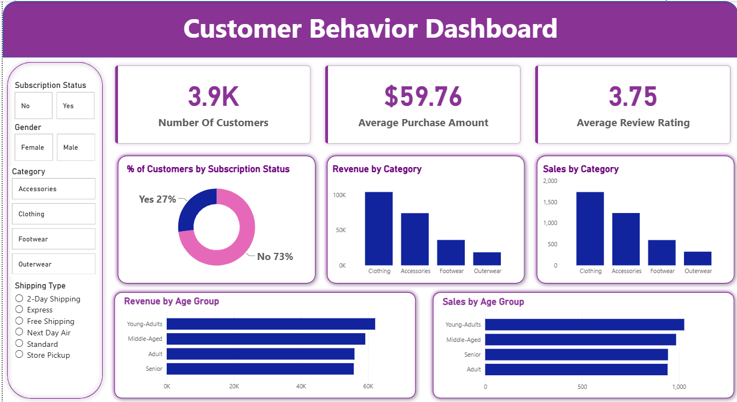
Power BI Dashboard

Slide 11



Power BI Key Visualizations
Subscription Status Breakdown
Revenue by Category & Sales
Revenue & Sales by Age Group
27% of customers are subscribers (Yes), while 73% are non-subscribers (No), highlighting a major opportunity to grow the subscriber base.
Category-level charts reveal top-performing product lines by total revenue and sales volume, guiding inventory and marketing focus.
Young Adults lead with $62,143 in revenue. Age-group breakdowns help target high-value segments with tailored campaigns.

Slide 12




Business Recommendations
Review Discount Policy
Optimize discount strategies for high-dependency products like Hat and Sneakers to balance sales volume with healthy profit margins.
Boost Subscriptions
Promote exclusive membership benefits, early access offers, and retention incentives to convert non-subscribers and grow recurring revenue.
Targeted Marketing
Focus campaigns on high-revenue age groups (Young Adults, Middle-aged) and express-shipping customers to maximize return on marketing spend.
Customer Loyalty Programs
Incentivize repeat buyers with tiered rewards to expand the Loyal segment (currently 3,116) and increase lifetime customer value.

Slide 13





Thank You for Your Attention
We appreciate your time exploring this Customer Shopping Behavior Analysis project covering Python EDA, SQL queries, and Power BI dashboards.
Questions & Discussion
We welcome your questions, feedback, and insights. Let's discuss findings, methodology, or potential next steps together.
Get in Touch
Thank You &
Questions
Feel free to reach out for further details on the analysis, dataset, or dashboard. Open to collaboration and continued data exploration.

