Slide 1



Git Cherry Pick
Presented By-Parth
Intern Knoldus

Slide 2
Content
1.About Git
2.About Cherry-pick
3.How to use cherry-pick
4.Execution
.

Slide 3
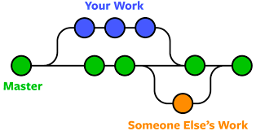
What is Git?
.
Git is the most commonly used version control system. Git tracks the changes you make to files, so you have a record of what has been done, and you can revert to specific versions should you ever need to. Git also makes collaboration easier, allowing changes by multiple people to all be merged into one source.
.

Slide 4
About
Cherry-pick
Git cherry-pick is a powerful command that enables arbitrary Git commits to be picked by reference and appended to the current working HEAD. Cherry picking is the act of picking a commit from a branch and applying it to another. git cherry-pick can be useful for undoing changes. For example, say a commit is accidentally made to the wrong branch. You can switch to the correct branch and cherry-pick the commit to where it should belong.
.

Slide 5
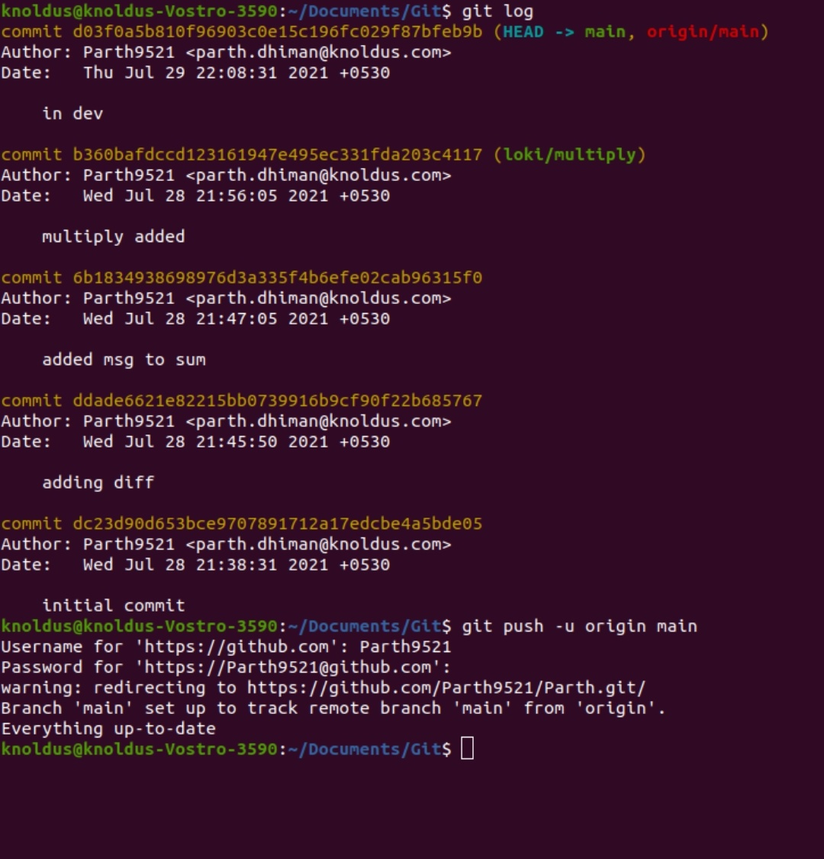
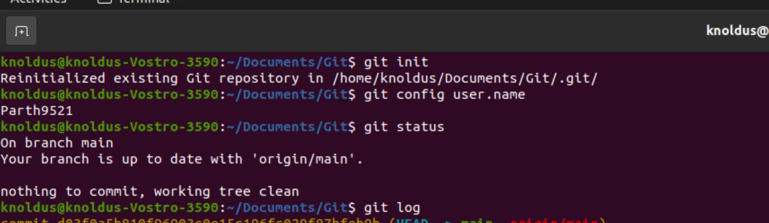
Practical Work

Slide 6
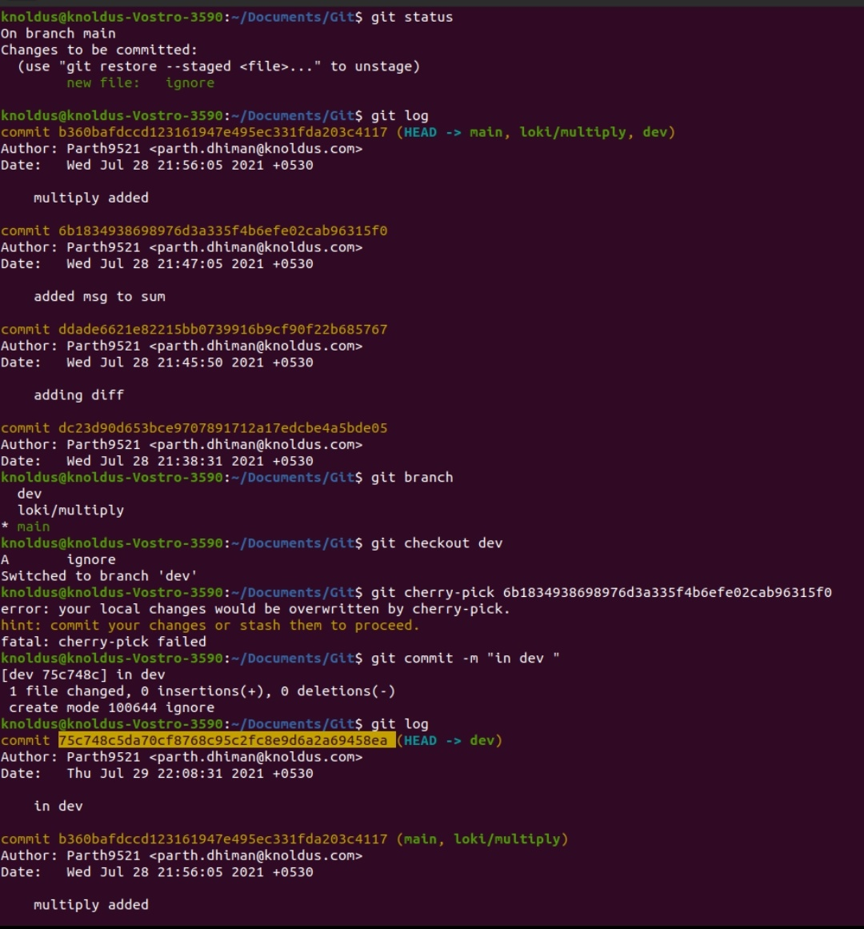
Practical Work

Slide 7
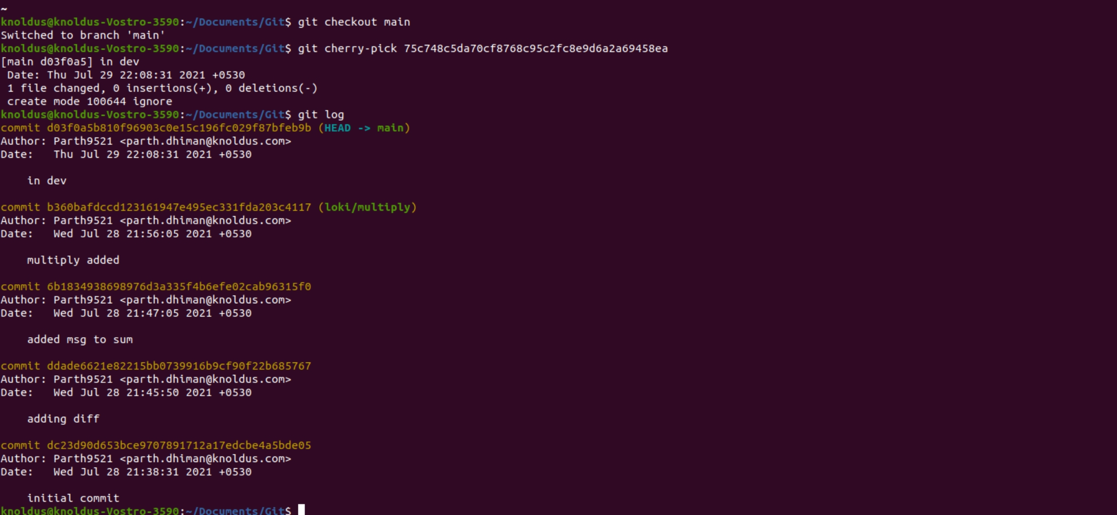
Practical Work

Slide 8
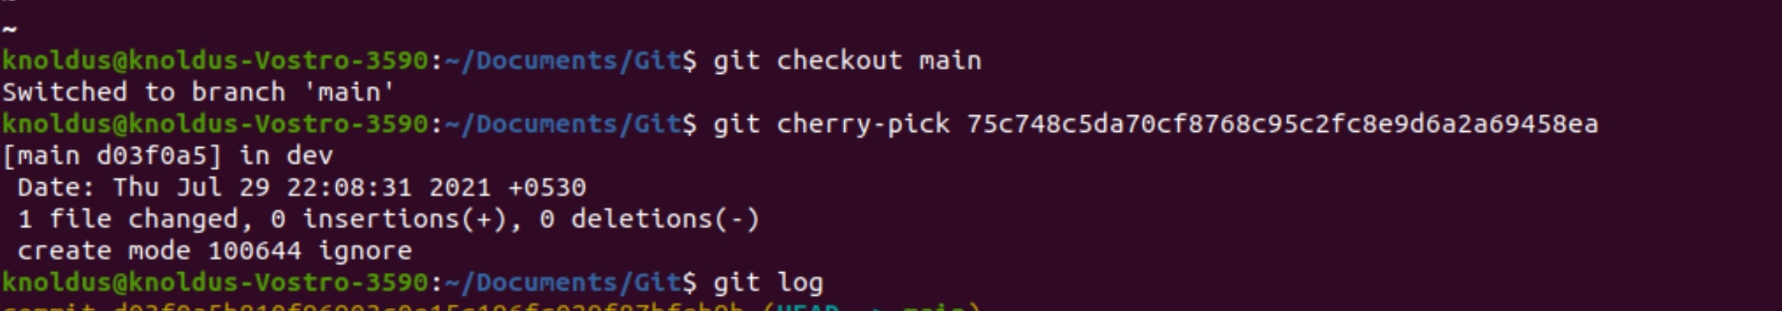
Command for
Cherry-pick
To demonstrate how to use git cherry-pick let us assume we have a repository with the following branch state:
a - b - c - d Main
\
e - f - g Feature
git cherry-pick usage is straight forward and can be executed like:
git cherry-pick commitSha
In this example commitSha is a commit reference. You can find a commit reference by using git log. In this example we have constructed lets say we wanted to use commit `f` in main. First we ensure that we are working on the main branch.
git checkout main
Then we execute the cherry-pick with the following command:
git cherry-pick f
Once executed our Git history will look like:
a - b - c - d - f Main
\
e - f - g Feature
The f commit has been successfully picked into the main branch
.

Slide 9
Git Hub Link
https://github.com/Parth9521/Parth

Slide 10



Thank You!

