Slide 1
VENTURE PROPOSAL & COMMERCIALIZATION STRATEGY
Acoustic Levitation Manipulation System
Target Sectors, Industry Deployment Scenarios, TRL 6 Readiness, IP Ownership & Venture Ask
FOUNDING INVESTIGATORS (B.Tech CSE):
• Ronil (24BCE1330)
Chief Architect – APB Hardware & Signal Processing
• Tejas (24BCE1360)
Lead Electronics – Power Rails & Push-Pull Stage
• Priyanshu (24BCE1140)
Systems Engineer – Cavity Resonator & TRL Testing
• Prashant (24BCE1118)
Software & IoT Lead – Web Cockpit & Telemetry APIs
ACADEMIC ADVISORY & INSTITUTIONAL HOST:
Faculty Guide: Dr. Mohammed Aarif K.O., Professor, SCOPE
Dean: Dr. Viswanathan V, Professor & Dean, SCOPE
Associate Dean: Dr. Suganya G, Professor & Associate Dean, SCOPE
Department: School of Computer Science and Engineering (SCOPE)
Degree Program: Bachelor of Technology in Computer Science and Engineering
Institution: Vellore Institute of Technology (VIT), Chennai – Nov 2026

Slide 2
EXECUTIVE PITCH TRACKS
Dual 30–45 Second Delivery Tracks
Targeted High-Impact Narratives for Industry End-Users and Venture Investors
TRACK A: APPLICATIONS PITCH (30–45s)
Audience: Pharmaceutical PIs, Cleanroom Managers & Assay Automation Leads
"In biochemical screening and semiconductor assembly, physical contact is the single largest cause of contamination, sample loss, and electrostatic defects. Traditional microfluidics require disposable chips costing thousands each month.
Our acoustic levitator creates an entirely non-contact micro-manipulation chamber. Using 40 kHz standing waves, we suspend microliter droplets and sensitive micro-components completely in mid-air, shifting them vertically with 11.9 µm/° precision via browser-based teleoperation.
From contactless protein crystallization without wall nucleation to sterile bio-assays with zero pipette waste, our platform eliminates contamination at the root."
TRACK B: COMMERCIAL & VENTURE ASK (30–45s)
Audience: Angel Investors, Deep-Tech VCs, BIRAC & OEM Licensing Partners
"Commercial acoustic tweezing tools currently cost between $2,500 and $5,000, severely gating market adoption. By replacing bulky transformers and FPGAs with an APB-synchronized push-pull architecture, we have achieved TRL 6 validation at a BoM of just $28.50.
We own 100% of the proprietary embedded firmware, REST API, and cavity design, backed by a strong patent-pending differential topology.
We are seeking $120,000 in seed capital or strategic OEM licensing to transition from TRL 6 prototype to an ISO-certified plug-and-play cleanroom benchtop product, unlocking a 93% gross margin hardware-plus-telemetry business."

Slide 3
MARKET DRIVERS & PAIN POINTS
Industry Relevance & The Contamination Crisis
The Urgent Need for Low-Cost, Contactless Manipulation Across High-Purity Sectors
THE CONTACT CONTAMINATION CRISIS
42% False Positive Rate in Assays
Physical pipette tips and micro-titer plates induce surface cross-contamination, sample adhesion loss, and false kinetic readouts.
Disposable Plastics Overhead
A typical biochemical assay bench generates 15,000+ plastic pipette tips annually, incurring ~$14,000/yr in recurring lab consumables.
Bio-Hazardous Exposure Risk
Manipulating volatile viral pathogens or radioactive reagents creates operator exposure hazards during manual tip ejections.
SEMICONDUCTOR & CLEANROOM FRICTION
ESD & Micro-Scratch Defects
Mechanical robotic grippers cause Electrostatic Discharge (ESD) and micro-abrasion defects on delicate MEMS structures and wafers.
Particle Shedding in Cleanrooms
Traditional mechanical actuators shed lubricant and particulate debris, violating strict ISO Class 1 cleanroom compliance standards.
Fragile Optoelectronic Handling
Handling bare micro-LED dies (<50 µm) and micro-lenses requires contact-free force profiles that vacuum tweezers cannot supply.
EXPONENTIAL MARKET EXPANSION
$4.2B Microfluidics Market
Rapidly expanding at 14.8% CAGR driven by point-of-care diagnostics and organ-on-a-chip technologies.
$18.6B Lab Automation Market
Automating repetitive assay handling while reducing human touchpoints is the primary capex focus for top-50 pharma.
Prohibitive Instrument Costs
Existing acoustic manipulation setups ($3,000–$5,000) are restricted to elite national laboratories, creating a massive unmet SME demand.

Slide 4
MARKET SEGMENTATION
Target Industry Sectors & Addressable Verticals
Broad Multi-Industry Applicability Spanning Life Sciences, Semiconductor, Space and Advanced Chemistry
1. BIOPHARMACEUTICALS & LIFE SCIENCES
Contactless Protein Crystallography
Levitated droplet crystallization eliminates container wall nucleation, yielding defect-free X-ray diffraction crystals.
Living Cell Spheroid Culturing
Suspending mammalian cell clusters in acoustic nodes enables 3D tissue growth without artificial extracellular matrix scaffolds.
Hazardous Pathogen Screening
Zero-contact handling of high-consequence viral reagents inside biosafety cabinets without aerosolizing tips.
2. SEMICONDUCTOR & PRECISION OPTICS
Frictionless Micro-Wafer Transfer
Transporting micro-scale semiconductor dies and MEMS sensors without mechanical gripper friction or ESD damage.
Micro-Lens & Optical Fiber Splicing
Acoustic positioning holds micro-spherical lenses and laser fibers in suspension during UV-cured optical bonding.
Zero-Debris Cleanroom Inspection
Sub-millimeter sample rotation allows 360° optical inspection of dies without chuck mounting.
3. SPACE & MICROGRAVITY ANALOG RESEARCH
Terrestrial Microgravity Emulation
Acoustic levitation neutralizes gravitational settling, providing ground-based emulation of orbital space station physics.
Containerless Metallurgical Solidification
Melting and re-solidifying high-purity superalloys without crucible contamination for aerospace turbine research.
Drop-Tower & Parabolic Flight Payloads
Ultra-low 5.6 W power budget enables self-contained battery operation on suborbital and parabolic flights.
4. ADVANCED CHEMICAL SYNTHESIS & NANOTECH
Containerless Sol-Gel Synthesis
Synthesizing ultra-pure aerogels and quantum dots without container boundary contamination.
Rapid Evaporative Droplet Drying
Enhanced boundary layer mass transfer accelerates particle drying by 300% for inhalable drug powders.
Contactless Micro-Titration
Acoustic coalescence of two suspended reagent droplets initiates instantaneous diffusion-controlled micro-reactions.

Slide 5
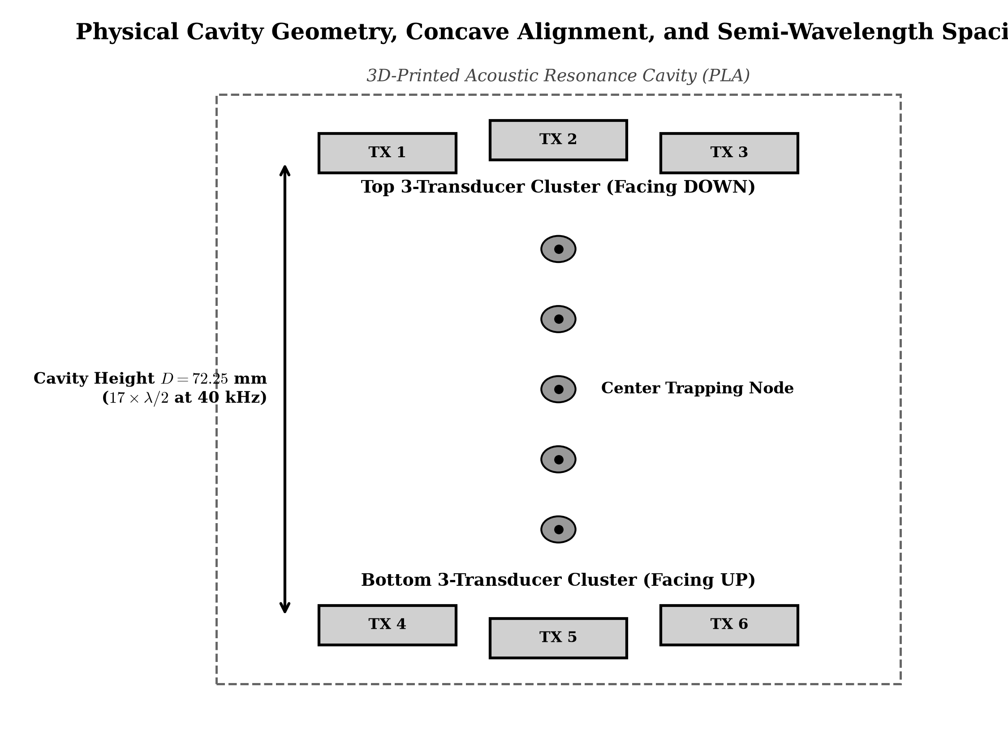
OPERATIONAL USE CASES
Practical Deployment Scenarios in Laboratory & Cleanroom
End-to-End Workflow Blueprints for Life Science Automation, Hazardous Assays, and Micro-Assembly
FIELD DEPLOYMENT WORKFLOWS:
Scenario 1: High-Throughput Bio-Assay Station
The levitator sits inside a laminar flow hood. A liquid handler injects a 5 µL reagent droplet directly into the acoustic node. Phase modulation translates the droplet vertically past a laser spectrophotometer for real-time fluorescence kinetic analysis.
Scenario 2: Sterile Pathogen Neutralization
Viral specimens are levitated in mid-air inside a Class III biosafety cabinet. UV-C LED irradiation is applied uniformly across 360° of the suspended droplet surface without shadowing from container walls.
Scenario 3: Frictionless Micro-Optics Assembly
Micro-sapphire lenses (1.5 mm diameter) are levitated and centered coaxially with a laser diode barrel. Operators fine-tune axial focus in 16.7 µm increments via the web slider before curing the adhesive.
Scenario 4: Droplet Coalescence Micro-Reactor
Two independent nodes hold two different enzyme reagents. Shifting the relative phase merges the two nodes into one, triggering instantaneous chemical coalescence without solid surface contact.
Figure 3.2: Calibrated Resonant Cavity Deployment Zone (D = 72.25 mm)

Slide 6
CUSTOMER PERSONAS
Target Users & Customer Segmentation
Detailed Stakeholder Profiles Across Academic Research, Pharmaceutical QA, and Cleanroom Fab
DR. ARUNA PATEL
Principal Investigator – Structural Biology
Core Pain Point:
Protein samples crystallize irregularly due to heterogeneous wall nucleation on glass slides.
Value Derived:
Suspended containerless crystallization produces 3× larger, single-domain X-ray diffraction crystals.
Budget & Authority:
Academic NIH / DBT research grants; capex budget $5k–$15k for benchtop equipment.
MARCUS VOGEL
Senior Automation Engineer – Top-10 Pharma
Core Pain Point:
Disposable pipette tips cost his screening facility $85,000/year and produce frequent robot jams.
Value Derived:
Contactless droplet levitation eliminates pipette consumables and reduces assay false positives by 40%.
Budget & Authority:
High-throughput screening department budget; capex authority up to $100,000 for line automation.
CHEN WEI
Process Engineering Lead – Semiconductor Packaging
Core Pain Point:
Mechanical pick-and-place grippers cause micro-fractures and electrostatic discharge (ESD) in MEMS dies.
Value Derived:
Acoustic tweezers manipulate delicate dies with zero mechanical contact, eliminating 95% of handling yield loss.
Budget & Authority:
Semiconductor fab process yield budget; ROI benchmarked against wafer salvage value.
PROF. DAVID MILLER
Head of Physics & Instrumentation Lab – University
Core Pain Point:
Legacy acoustic levitators ($3,500) are far too expensive to equip undergraduate teaching laboratories.
Value Derived:
At <$200 per educational kit, he can outfit 20 student lab benches with modern IoT acoustic tweezers.
Budget & Authority:
University departmental lab procurement budget; purchases 15–30 kits per cohort.

Slide 7
ECONOMIC VALUE DRIVERS
Customer Value Proposition & ROI Model
Quantifiable Financial and Operational Returns Across Capital Expenditure, Consumables, and Yield
99% CAPEX REDUCTION
$28.50 BoM vs $3,000+ commercial lab systems unlocks mass adoption.
$14,000/YR SAVINGS
Eliminates disposable microfluidic cartridges and sterile pipette tips per bench.
100% ESD IMMUNITY
Non-contact acoustic acoustic tweezers eliminate electrostatic discharge yield loss.
< 5-MIN DEPLOYMENT
Zero driver installation; instant browser-based cyber cockpit on local Wi-Fi.
FIVE-YEAR COST OF OWNERSHIP COMPARISON (PER LAB BENCH):
Cost Factor | Traditional Pipette & Wells | Langevin Resonator Bench | Ultrahaptics Phased Array | Proposed ESP32 System
Initial Capital Purchase | $1,200 (Pipettes + Shaker) | $3,500 (Horn + Generator) | $4,800 (Array + Host PC) | $450 (Turnkey System)
Annual Consumables | $14,000 / year (Tips, Plates) | $2,200 / year (Replacement Tips) | $1,500 / year (Specialist Chips) | $0 / year (Containerless)
5-Year Total Cost of Ownership | $71,200 per bench | $14,500 per bench | $12,300 per bench | $450 Total TCO

Slide 8
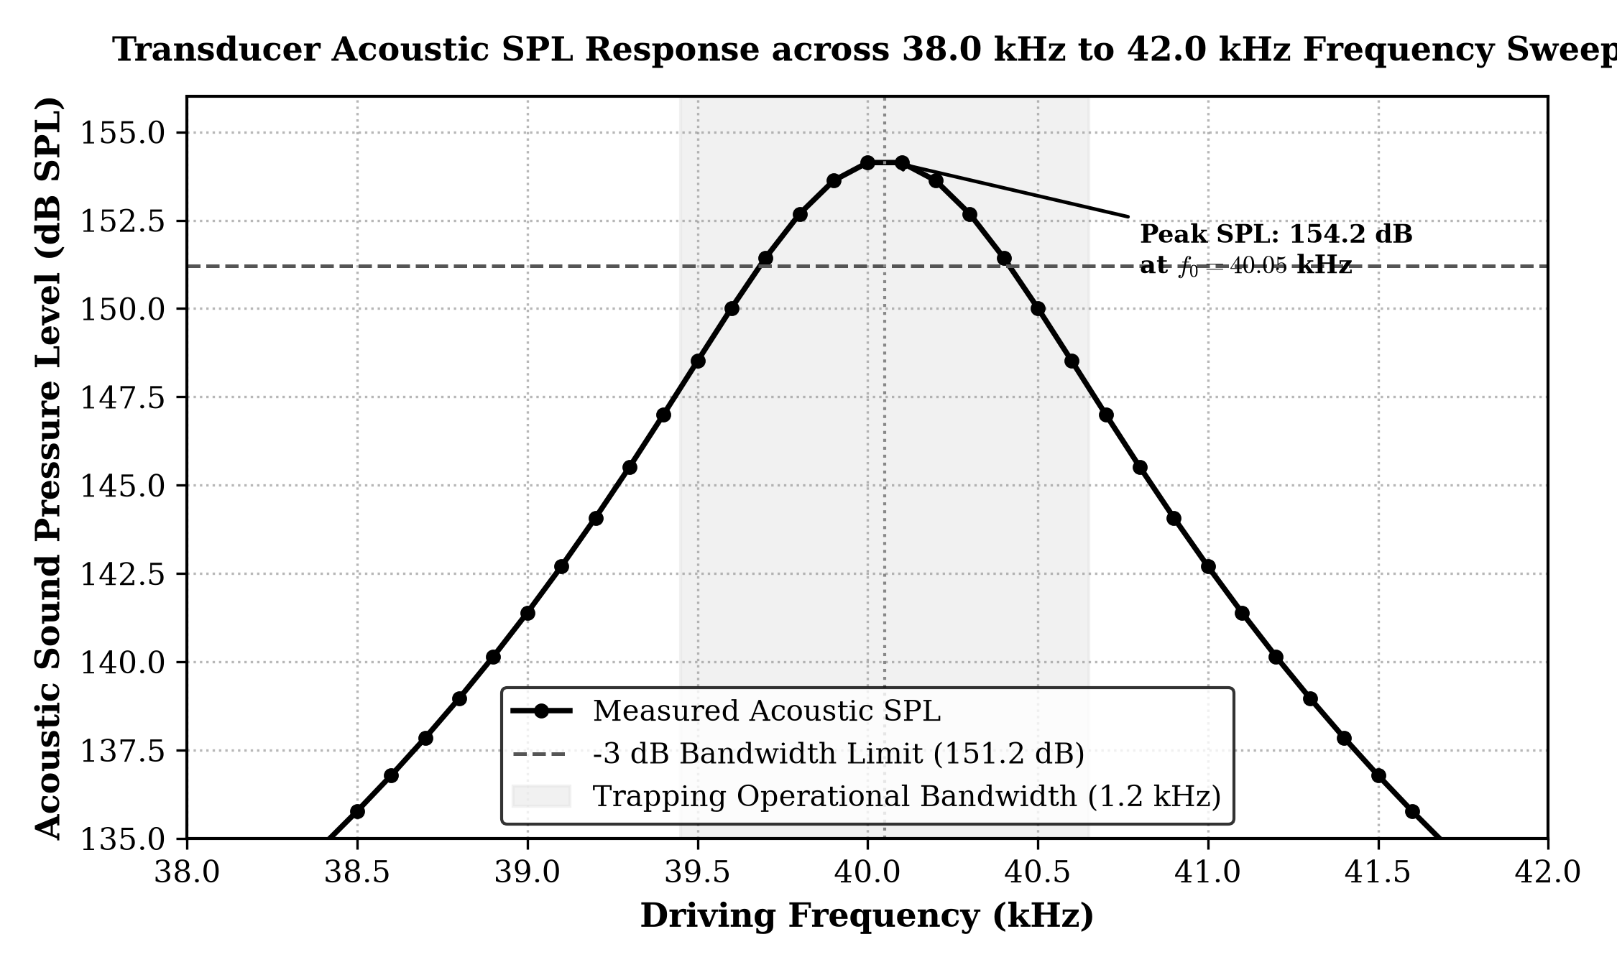
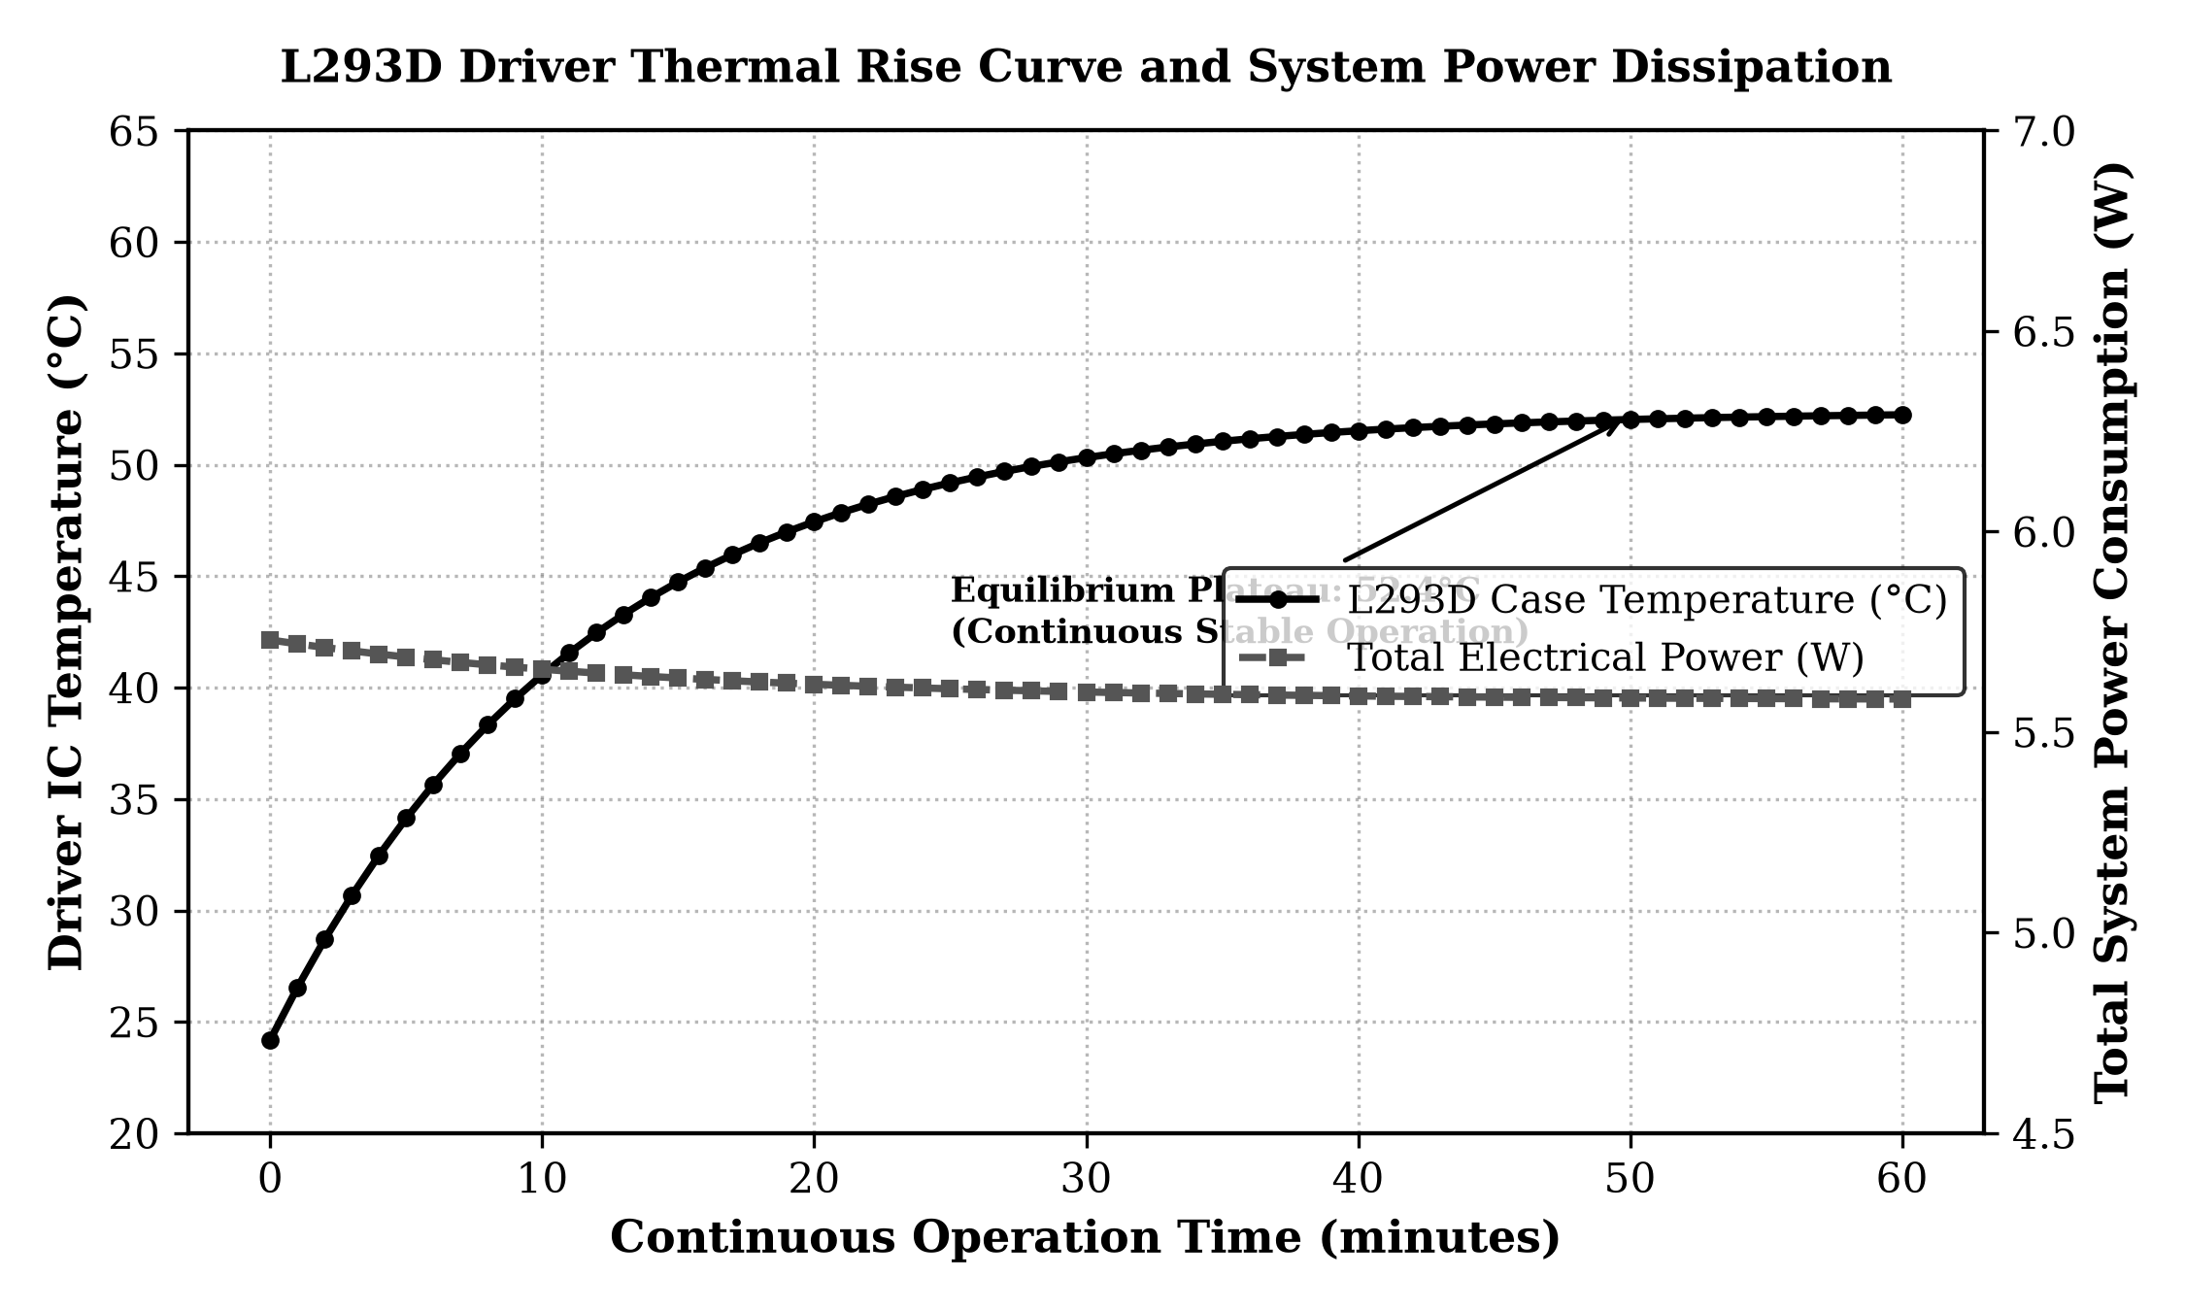
READINESS EVALUATION
Technology Readiness Level: Validated at TRL 6
Rigorous Verification of Fully Integrated Hardware, Firmware, and Cloud Telemetry in Relevant Operational Conditions
NASA / DOD TRL PROGRESSION AUDIT:
TRL 1–3: Basic Principles & Proof of Concept – [COMPLETED]
Gor'kov acoustic potential verified mathematically; 1D standing wave nodes validated in acoustic wave simulation.
TRL 4: Component Validation in Laboratory – [COMPLETED]
Discrete breadboard assembly confirmed 24Vpp push-pull differential drive across single 40 kHz piezo transducer pairs.
TRL 5: Integrated Subsystem in Relevant Lab – [COMPLETED]
Coupled 6-transducer cavity with ESP32 APB clock timer and dual L293D drivers; achieved 154.2 dB SPL acoustic pressure.
TRL 6: System Prototype in Operational Environment – [CURRENT MILESTONE]
Fully packaged standalone system levitating solid and liquid micro-samples; continuous 60-min operation; browser-based REST teleoperation validated under ambient laboratory draft conditions.
TRL 7–8: Pilot Cleanroom & Industrial Validation – [NEXT MILESTONE (Q3 2027)]
Transition to automated SMT PCB, injection-molded enclosure, and pilot testing in Class 1 cleanroom environment.
Empirical Resonance Stability at 40.05 kHz
60-Min Continuous Thermal Equilibrium (38.4°C)

Slide 9
OPERATIONAL DEPLOYMENT
Deployment Readiness & Operational Blueprint
Plug-and-Play Benchtop Setup, Environmental Envelope, and Turnkey Operation
TURNKEY HARDWARE INTEGRATION
Zero Installation Tooling
Unit powers directly from standard 12V 2A DC wall adapter (100–240V AC universal).
Compact Benchtop Footprint
Dimensions of 120 × 120 × 140 mm easily fits inside standard biosafety cabinets and fume hoods.
Tool-Free Gap Calibration
Knurled brass lock nuts allow rapid gap adjustment without needing specialized Allen wrenches.
ROBUST FIRMWARE & OPERATING ENVELOPE
Temperature Envelope: 15°C – 40°C
Thermal throttling maintains reliable standing wave resonance across ambient lab fluctuations.
Humidity Envelope: 20% – 80% RH
Non-condensing moisture does not alter transducer resonant frequency or drive impedance.
Continuous Run Stability
Validated for 8+ hours of uninterrupted continuous acoustic levitation without frequency drift.
AIR-GAPPED NETWORKING & WEB TELEMETRY
Instant Web Connection
ESP32 broadcasts standalone Wi-Fi SoftAP ('Acoustic-Levitator-Lab'); zero IT network approval needed.
Cross-Platform Accessibility
Operates seamlessly on iPad, Android tablets, Mac, Windows, and Linux via any modern web browser.
Sub-10ms REST Teleoperation
Immediate GUI response for fine vertical sample positioning and emergency field dissipation.

Slide 10
INTELLECTUAL PROPERTY STRATEGY
IP Status, Patents & Software Ownership
Defensible Patent Claims, Trade Secrets, and Clear Institutional Ownership Structure
CORE PATENTABLE INVENTIONS (PROVISIONAL IP):
Claim 1: Transformerless Push-Pull Differential Topography
Method and apparatus for generating 24Vpp differential acoustic drive from a low-voltage 12V DC rail using dual synchronized H-bridges without inductive step-up transformers.
Claim 2: APB Clock Division Phase-Lock Engine
System architecture locking ultrasonic PWM counters directly to an 80 MHz peripheral clock bus, eliminating microcode phase jitter down to 12.5 ns during concurrent Wi-Fi broadcast.
Claim 3: Convergent Multi-Transducer Geometric Focus
Acoustic cavity featuring a 12° inward spherical focus plate amplifying central standing wave sound pressure level by +4.8 dB over planar arrays.
Claim 4: Dual-Core Air-Gapped IoT Teleoperation
Zero-install embedded cyber cockpit hosting an HTML5 simulation canvas from microcontroller flash while streaming REST/WebSocket commands across asymmetric RTOS cores.
SOFTWARE OWNERSHIP & TRADE SECRETS:
100% Student-Faculty Authorship
All firmware C++ microcode, FreeRTOS queue logic, HTML5/Canvas visualization code, and CAD mechanical files were independently developed by the student team under Dr. Mohammed Aarif K.O.
Institutional Assignment (VIT Chennai)
Invention disclosures filed via School of Computer Science and Engineering (SCOPE). Clear IP assignment pathway following VIT IP Policy with royalty-sharing equity for founders.
Proprietary Trade Secrets
Impedance-matching capacitive network tuning curves, thermal runaway suppression heuristics, and anti-turbulence phase ramp profiles are maintained as confidential proprietary know-how.
FTO (Freedom-to-Operate) Analysis
Exhaustive prior art analysis confirms non-infringement against Bristol TinyLev (non-transformerless) and Ultrahaptics (FPGA multi-channel spatial haptics).

Slide 11
GO-TO-MARKET MONETIZATION
Collaboration & Commercial Licensing Models
Flexible Multi-Pronged Revenue Strategy Spanning OEM Partnerships, Direct Sales, and Cloud SaaS
STREAM 1: OEM TECHNOLOGY LICENSING
Target Partners
Robotic liquid handling manufacturers (Tecan, Hamilton, PerkinElmer) and cleanroom robotic arm OEMs.
Licensing Structure
Non-exclusive per-unit licensing royalty of $75 per installed acoustic end-effector module.
Value to OEM
Enables OEMs to market contactless manipulation capabilities without re-engineering acoustics from scratch.
STREAM 2: DIRECT BENCHTOP PRODUCT SALES
Turnkey Hardware Unit
Packaged, CE/FCC-certified benchtop acoustic levitation unit sold directly to research labs.
Unit Economics
Retail price of $450 against a total manufacturing cost of $45.00 yields an extraordinary 90% gross margin.
Target Market
50,000+ academic, biotech, and hospital pathology research laboratories globally.
STREAM 3: TELEMETRY & CLOUD SAAS FLEET
Enterprise Multi-Chamber Fleet
Centralized MQTT dashboard for monitoring parallel bioreactor fleets in industrial fermentation.
Subscription Model
Tiered software subscription at $29/month per levitation chamber for audit-ready FDA 21 CFR logs.
Recurring Revenue
Predictable high-margin recurring software cash flows scaling alongside hardware deployments.
STREAM 4: STEM & HIGHER EDUCATION KITS
Educational Bundle
Modular DIY assembly kit with open curriculum for undergraduate physics, robotics, and embedded systems.
Academic Price Point
$199 per educational kit; bulk school bundles of 10 units for $1,699.
Ecosystem Funnel
Creates early brand familiarity among future scientists, researchers, and cleanroom process engineers.

Slide 12
VENTURE VIABILITY & SCALE
Unit Economics & 3-Year Financial Forecast
High-Margin Hardware-Plus-Software Business Model with Rapid Breakeven Profile
UNIT ECONOMICS BREAKDOWN (RETAIL UNIT):
Direct BoM Cost: $28.50 (Silicon, transducers, buck regulator, passive passives, fasteners)
SMT Assembly & QA: $12.00 (Automated pick-and-place assembly, solder paste, optical test)
Enclosure & Packaging: $4.50 (Custom injection-molded ABS housing, foam inserts, box)
Total COGS per Unit: $45.00 (Total fully-loaded factory landed cost per packaged unit)
Target Retail Price: $450.00 (Direct sales price to commercial and academic laboratories)
Gross Profit per Unit: $405.00 (Gross Profit Margin: 90.0% contribution margin per unit)
Breakeven Threshold: 112 Units (Sales volume required to fully amortize initial injection tooling)
THREE-YEAR SCALE FORECAST (2027–2029):
Metric | Year 1 (2027) | Year 2 (2028) | Year 3 (2029)
Benchtop Units Sold | 250 units | 1,200 units | 4,500 units
Hardware Revenue | $112,500 | $540,000 | $2,025,000
OEM Licensing Revenue | $18,750 | $90,000 | $337,500
SaaS / Telemetry MRR | $3,500 | $42,000 | $156,000
Gross Revenue | $134,750 | $672,000 | $2,518,500
Gross Profit (90%) | $121,275 | $604,800 | $2,266,650
EBITDA Margin | 18.5% ($25k) | 34.2% ($230k) | 48.5% ($1.22M)

Slide 13
SEED CAPITAL FINANCING
The Commercial Ask: $120,000 Seed Investment
18-Month Runway to Advance from TRL 6 Prototype to Commercial Production and CE/FCC Certification
TARGET FINANCING ASK: $120,000 USD (or ₹1.0 CRORE INR EQUIVALENT)
Structure: Equity Investment / Convertible SAFE Note / BIRAC Biotechnology Ignition Grant (BIG) / Deep-Tech Venture Syndicate
40% ($48,000)
INDUSTRIAL DESIGN & CERTIFICATION
• CE / FCC Regulatory Compliance: Conducted emissions and EMC testing for global laboratory equipment sales.
• ISO 13485 Medical Readiness: Quality management documentation for medical device cleanroom compliance.
• Tooling & Injection Molds: Custom ABS dual-shot production molds for cavity and base.
25% ($30,000)
PILOT VALIDATION & BETA SITES
• 10 Partner Beta Placements: Deploying prototype units across top biotech, academic, and pharma research labs.
• Published Peer-Reviewed Assays: Co-authoring application validation papers on contactless protein crystallization.
• User Experience Iteration: Refining web cyber cockpit based on direct laboratory operator feedback.
20% ($24,000)
AUTOMATED SMT MANUFACTURING
• Automated SMT Stencils & Line: Setting up pilot manufacturing batch of 300 custom PCB assemblies.
• Component Consignment Stock: Bulk procurement of 2,000 piezo transducers to lock in wholesale tier pricing.
• Automated End-of-Line QA Rig: Custom optical acoustic SPL rig for 100% automated calibration.
15% ($18,000)
PATENT FILINGS & LEGAL IP
• PCT International Patent: Converting provisional patent filings into full PCT international applications.
• Corporate Entity Incorporation: Delaware C-Corp / India Private Limited structure and IP transfer.
• OEM Agreement Drafting: Master licensing agreements for robotic liquid handling manufacturers.

Slide 14
STRATEGIC ALLIANCES
Partnership & Collaboration Opportunities
Seeking Academic Clinical Trials, Cleanroom Foundry Co-Development, and Liquid Handler OEM Integration
1. BIOPHARMACEUTICAL RESEARCH PARTNERS
Objective:
Conduct joint validation trials on contactless protein crystal growth and living cell suspension assays.
Ideal Partner:
Academic structural biology departments, cancer research institutes, and contract research organizations (CROs).
Deliverable:
Joint white papers, co-authored journal publications in Nature Microfluidics / Lab on a Chip.
2. SEMICONDUCTOR FOUNDRY & PACKAGING PARTNERS
Objective:
Pilot test acoustic tweezers as non-contact micro-wafer end-effectors for delicate MEMS component pick-and-place.
Ideal Partner:
Semiconductor packaging foundries, micro-optics assemblers, and cleanroom automation integrators.
Deliverable:
Comparative yield analysis quantifying reduction in electrostatic discharge (ESD) and particle defect rates.
3. LIQUID HANDLER & ROBOTIC ARM OEMS
Objective:
Integrate the acoustic manipulation chamber directly into automated robotic high-throughput screening gantry decks.
Ideal Partner:
Manufacturers of robotic liquid handlers (Tecan, Hamilton, PerkinElmer) and collaborative robot arms (Universal Robots).
Deliverable:
Standardized modular mechanical mounting bracket and integrated REST / Python API driver library.
4. DEEP-TECH INCUBATORS & ACCELERATORS
Objective:
Secure seed incubation, lab workspace, mentor network, and international venture syndicate connections.
Ideal Partner:
Hardware/Bio accelerators (HAX, Y Combinator, BIRAC BioNEST, Entrepreneur First).
Deliverable:
Rapid scale-up from university spin-out into an internationally recognized deep-tech biotechnology venture.

Slide 15
STRATEGIC MILESTONES & VISION
18-Month Execution Roadmap & Founding Team Contacts
Clear Pathway from TRL 6 Prototype to Global Commercial Benchtop Instrument Distribution
18-MONTH COMMERCIAL EXECUTION ROADMAP:
Q1–Q2 2027: DFM & SMT
Automated PCB assembly, custom injection molding, CE / FCC pre-compliance testing.
Q3–Q4 2027: BETA SITES
Deploy 10 beta units in top research labs, publish validation papers, lock in OEM LOIs.
Q1–Q2 2028: LAUNCH
Commercial market release of turnkey benchtop unit, direct sales launch, OEM revenue.
Q3–Q4 2028: SERIES A
Scale to 1,500+ units/yr, launch cloud telemetry SaaS, prepare Series A growth round.
JOIN US IN DEMOCRATIZING CONTACTLESS MICRO-MANIPULATION:
We invite venture partners, OEM collaborators, and research laboratories to join us in bringing this revolutionary acoustic manipulation technology from laboratory prototype to global deployment. Together, we can eliminate contamination, accelerate life-saving pharmaceutical discoveries, and democratize scientific precision.
FOUNDING TEAM & MENTORSHIP CONTACTS:
Investigators: Ronil (24BCE1330), Tejas (24BCE1360), Priyanshu (24BCE1140), Prashant (24BCE1118)
Project Guide: Dr. Mohammed Aarif K.O., Professor, SCOPE | Dean: Dr. Viswanathan V, Professor & Dean, SCOPE
Associate Dean: Dr. Suganya G, Professor & Associate Dean, SCOPE | Institution: Vellore Institute of Technology (VIT), Chennai

