Slide 1
B.TECH CAPSTONE THESIS PRESENTATION | FINAL TECHNICAL EVALUATION
DESIGN AND IMPLEMENTATION OF AN INTERNET-ENABLED ACOUSTIC LEVITATION MANIPULATION SYSTEM
ESP32 APB Clock Synchronization, Dual Push-Pull Amplification, and Real-Time IoT Teleoperation
PROJECT INVESTIGATORS:
• RONIL (24BCE1330) — B.Tech CSE
• TEJAS (24BCE1360) — B.Tech CSE
• PRIYANSHU (24BCE1140) — B.Tech CSE
• PRASHANT (24BCE1118) — B.Tech CSE
FACULTY GUIDANCE & LEADERSHIP:
Project Guide: Dr. Mohammed Aarif K.O., Professor, SCOPE
Dean: Dr. Viswanathan V, Professor & Dean, SCOPE
Associate Dean: Dr. Suganya G, Professor & Associate Dean, SCOPE
School: School of Computer Science and Engineering (SCOPE)
Institution: Vellore Institute of Technology (VIT), Chennai – Nov 2026

Slide 2
EXECUTIVE SUMMARY
The 45-60 Second Presentation Pitch
High-Impact Rapid Project Overview and Core Value Proposition
TIMED SPEAKER NARRATIVE (45–60 SECONDS):
[00–10s] The Challenge: Handling fragile micro-objects, living cells, and pure chemical reagents without solid surface friction, electrostatic distortion, or petri-dish contamination has historically required $5,000+ laboratory setups.
[10–25s] The Solution: We engineered an autonomous, internet-enabled acoustic levitator using 6 piezoelectric transducers and an ESP32 microcontroller, creating deep ultrasonic potential wells that trap and levitate objects in mid-air.
[25–45s] The Innovation: We eliminated bulky transformers by inventing a dual L293D push-pull driver delivering 24 Vpp from a 12V supply. We synchronized the ESP32 80 MHz APB clock to achieve 1.4° phase steps, enabling sub-millimeter vertical manipulation (~12 µm/deg).
[45–60s] The Impact: Featuring native Wi-Fi REST web teleoperation and a total bill-of-materials under $28 at only 5.6 Watts, this system democratizes contactless handling for cleanrooms, bio-assays, and micro-assembly.
KEY METRIC CALLOUTS:
154.2 dB
Peak Cavity Acoustic SPL
24 Vpp
Differential Drive (No Transformers)
1.406°
Hardware Timer Phase Granularity
< $28
Total System Bill of Materials
5.6 W
Ultra-Low Power Consumption
< 15 ms
Embedded Wi-Fi REST Latency

Slide 3
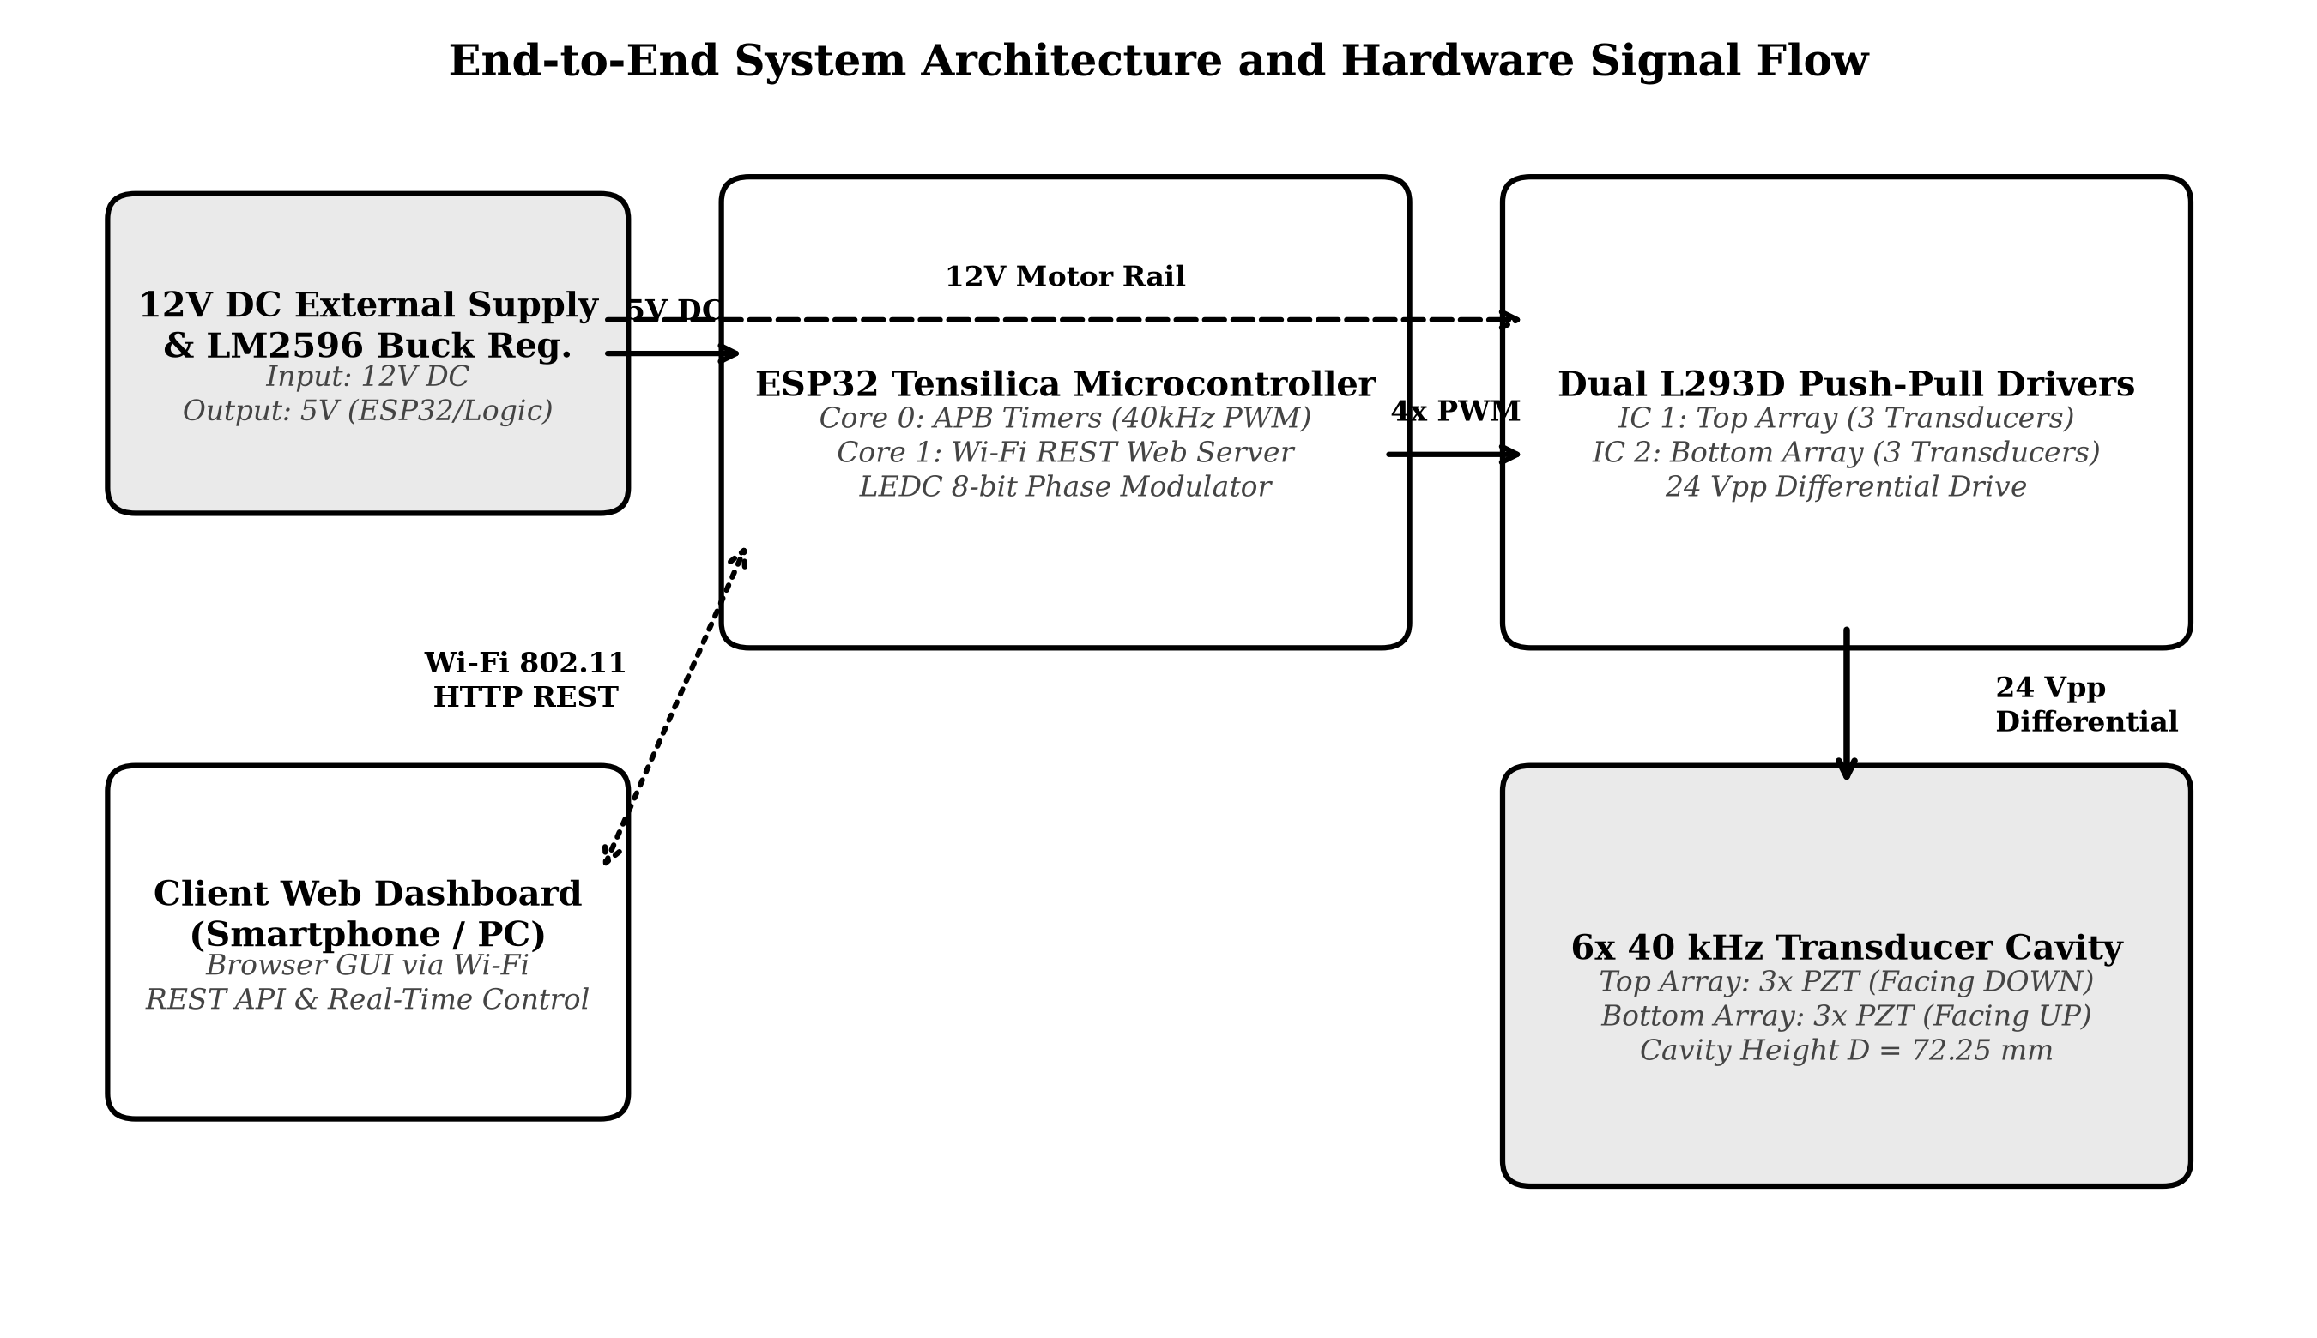
SOLUTION OVERVIEW
End-to-End System Integration & Architecture
Harmonizing High-Speed Embedded Firmware, Push-Pull Power Drivers, and Acoustic Physics
FOUR-TIER INTEGRATED ARCHITECTURE:
1. High-Speed Compute Core (ESP32):
Dual-core 240 MHz Tensilica LX6. Hardware APB timer (LEDC) generates 4 complementary square waves at 40 kHz with zero clock jitter.
2. Transformerless Power Stage (Dual L293D):
Differential push-pull H-bridge topology inverts output polarities, boosting a single 12V rail to 24 Vpp directly across transducer terminals.
3. Resonant Cavity (6x 40 kHz PZT):
3 top and 3 bottom transducers tilted inward at 12° across a calibrated distance D = 72.25 mm (17 semi-wavelengths), superimposing acoustic waves to exceed 154 dB SPL.
4. Zero-Install Teleoperation (Wi-Fi Web UI):
FreeRTOS Core 1 hosts an asynchronous HTTP REST server and interactive web interface for sub-millimeter particle translation and diagnostics.
Figure 3.1: End-to-End System Block Diagram & Hardware Signal Flow

Slide 4
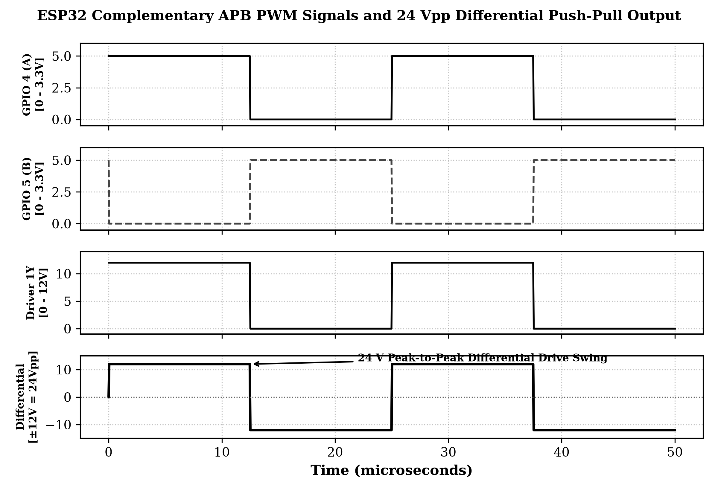
HARDWARE ENGINE (PART 1)
What the Hardware Does: Signal Generation & Push-Pull Drive
Generating 24 Vpp Differential Excitation from a 12V Supply without Step-Up Transformers
HARDWARE WAVEFORM & POWER STAGE:
Direct APB Clock Sourcing (80 MHz):
Hardware timer registers lock directly onto the 80 MHz Advanced Peripheral Bus, eliminating CPU-induced jitter and guaranteeing microsecond phase stability.
Differential Push-Pull Inversion (180°):
Rather than driving transducers against ground (0 to 12V), each transducer is driven across two opposing half-bridges: Phase A (0°) on terminal 1 and Phase B (180°) on terminal 2.
Transformerless Voltage Doubling (24 Vpp):
When Phase A is HIGH (12V) and B is LOW (0V), Vdiff = +12V. In the next half-cycle, polarities invert: Vdiff = -12V. Total swing = 24 V peak-to-peak.
Acoustic Power Quadrupling (+13.6 dB):
Acoustic radiation pressure scales with applied voltage (P0 ∝ Vpp) and acoustic power scales quadratically (Pac ∝ Vpp²), boosting energy output 23x compared to 5V driving.
Figure 3.4: Complementary PWM Drive and 24 Vpp Differential Waveforms

Slide 5
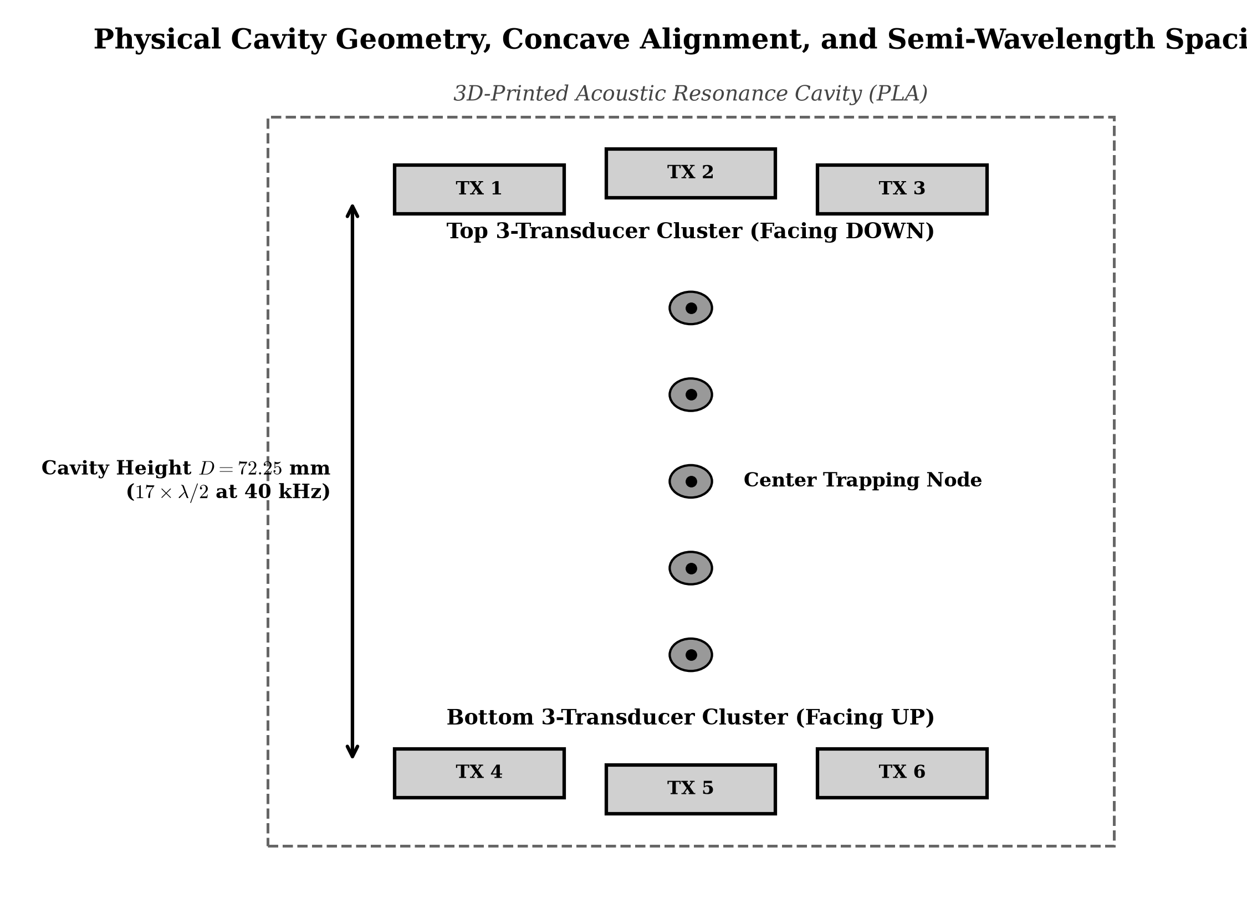
HARDWARE ENGINE (PART 2)
What the Hardware Does: Cavity Geometry & Resonance
Optimized 6-Transducer Opposing Arrays and Multi-Node Standing Wave Physics
ACOUSTIC CAVITY & TRANSDUCER CLUSTERS:
6-Transducer Cluster Topology:
Six 16 mm 40 kHz piezoelectric transducers arranged as two opposing arrays: 3 top (facing DOWN) and 3 bottom (facing UP) in equilateral triangles (17.5 mm pitch).
12.0° Inward Concave Focal Tilt:
Each transducer is geometrically angled inward at 12° toward the central vertical axis, ensuring constructive acoustic wave superposition at the center trapping node.
Calibrated Resonant Height (D = 72.25 mm):
Cavity height enforces the acoustic semi-wavelength resonance condition: D = 17 × (λ / 2) ≈ 72.25 mm at 20°C, establishing 17 stationary trapping nodes in air.
Power Isolation & Filtering:
LM2596 buck regulator delivers isolated 5.0V logic power; dual 100 µF electrolytic and 0.1 µF ceramic bypass capacitors absorb 40 kHz inductive switching spikes.
Figure 3.2: 6-Transducer Cavity Geometry, Concave Alignment, and Spacing

Slide 6
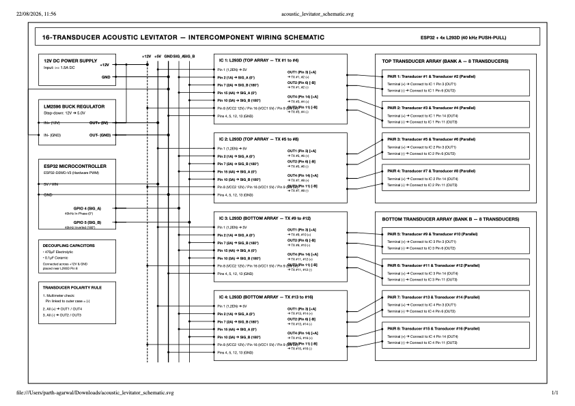
ELECTRICAL INTEGRATION
Master Circuit Schematic & Pin Interconnections
Deterministic GPIO Routing, Dual H-Bridge Drivers, and Star-Ground Isolation
HARDWARE PIN INTERCONNECTION MATRIX:
ESP32 GPIO 4: IC 1 Pins 2 & 15 (1A, 4A) -> Top Phase A (0° ref)
ESP32 GPIO 5: IC 1 Pins 7 & 10 (2A, 3A) -> Top Phase B (180° inv)
ESP32 GPIO 18: IC 2 Pins 2 & 15 (1A, 4A) -> Bot Phase A (Phase shift)
ESP32 GPIO 19: IC 2 Pins 7 & 10 (2A, 3A) -> Bot Phase B (180° push-pull)
5V Rail (LM2596): ESP32 VIN, IC 1 & 2 VCC1 (Pin 16), EN (Pins 1 & 9)
12V DC Input: IC 1 & IC 2 VCC2 (Pin 8) motor power rail
IC 1 Outputs: Pins 3 & 6 -> Top TX #1, #2 | Pins 14 & 11 -> Top TX #3
IC 2 Outputs: Pins 3 & 6 -> Bot TX #4, #5 | Pins 14 & 11 -> Bot TX #6
Figure A2.1: Master Electrical Circuit Schematic & Wiring Layout

Slide 7
SOFTWARE ENGINE (PART 1)
What the Software Does: APB Timer Registers & Core Isolation
Hardware-Synchronized Zero-Jitter PWM Synthesis and Dual-Core FreeRTOS Partitioning
LEDC Hardware Timers
Direct Register Control:
Configures LEDC_TIMER_0 with high-speed 80 MHz APB clock routing, bypassing software interrupts entirely.
8-Bit Counter (256 Ticks):
Each 25 µs period is segmented into 256 discrete ticks, enabling fine 1.406° phase resolution per tick.
Exact Fractional Divider:
Prescaler set to 7 + 832/1024, synthesizing exactly 40,000.0 Hz with zero cumulative clock drift.
Dual-Core FreeRTOS Tasks
Core 0 (Deterministic PWM):
Dedicated to real-time timer comparator registers, GPIO phase modulation, and 115200 baud USB serial command CLI.
Core 1 (Asynchronous IoT):
Runs the 2.4 GHz 802.11n Wi-Fi radio stack, TCP/IP socket buffer, and embedded RESTful HTTP web server.
Zero Phase Jitter:
Network traffic and HTTP requests on Core 1 never introduce latency or jitter into the ultrasonic wave generation on Core 0.
Dynamic Frequency Trimming
Real-Time Resonant Tuning:
Allows ±100 Hz frequency adjustment on the fly (38.5 kHz to 41.5 kHz) via web or serial command.
Thermal Drift Tracking:
Compensates for transducer piezoelectric warming during extended levitation without rebooting the controller.
Automated Frequency Sweep:
Sweeps 38.0 kHz to 42.0 kHz to automatically identify cavity acoustic standing wave resonance.

Slide 8
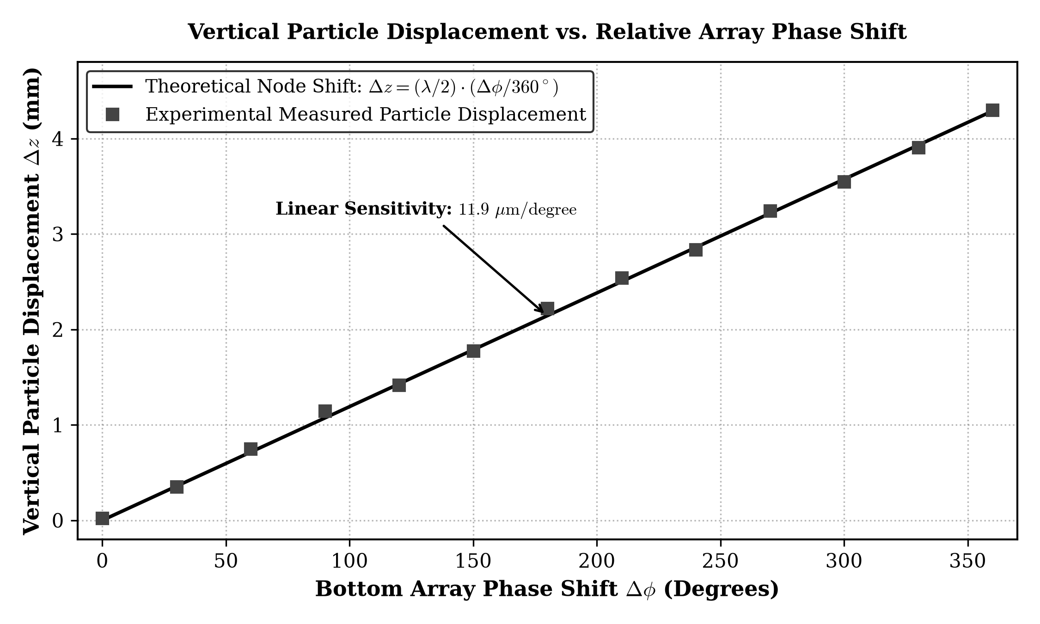
SOFTWARE ENGINE (PART 2)
What the Software Does: Dynamic Phase Shifting & Manipulation
Linear Axial Particle Translation via On-The-Fly Hardware Timer Offset Registers
PHASE-TO-DISPLACEMENT MANIPULATION:
Relative Phase Modulation (Δφ):
To translate a trapped particle vertically, the bottom array phase is shifted relative to the top reference array by altering LEDC channel hpoint registers.
Continuous Waveform Update:
The firmware calls ledc_set_duty_with_hpoint() and ledc_update_duty(), updating phase registers mid-cycle without stopping timer counting—preventing particle drop.
Linear Sensitivity (11.9 µm / degree):
A full 360° phase shift shifts the standing wave pattern by exactly one semi-wavelength: Δz = (λ/2) × (Δφ/360°) = 4.25 mm × (Δφ/360°) ≈ 11.9 µm/deg.
Fine Step Translation (67.5 µm):
Moving by 4 timer ticks advances phase by 5.625°, translating the trapped particle vertically by exactly 67.5 micrometers with repeatable accuracy.
Figure 4.2: Experimental Vertical Particle Displacement vs. Array Phase Shift

Slide 9
IOT TELEOPERATION
Embedded Web Server & Real-Time Dashboard
Zero-Install Browser GUI, RESTful API Endpoints, and Sub-15 ms Latency
RESTFUL API ARCHITECTURE (PORT 80):
GET /api/status
Returns live JSON telemetry: frequency, phase tick (0..255), top/bot array status, RSSI, and uptime.
POST /api/freq?val=40100
Dynamically updates APB hardware timer frequency in 100 Hz increments on the fly.
POST /api/move?dir=up&step=4
Translates standing wave node up or down by updating bottom LEDC offset registers.
POST /api/phase?mode=toggle
Instantaneously toggles between 0° in-phase and 180° anti-phase trapping configurations.
POST /api/sweep
Executes automated resonant frequency characterization sweep from 38.5 to 41.5 kHz.
ZERO-INSTALL BROWSER DASHBOARD:
Fully Self-Hosted in Flash:
Complete HTML5, CSS3, and JavaScript web application stored in ESP32 PROGMEM. No external web server or internet connection required.
Dual Connection Modalities:
Connects to local campus/home Wi-Fi (STA mode) or creates its own standalone Access Point ('Acoustic-Levitator' / '12345678').
Responsive Smartphone & PC GUI:
Touch-friendly controls optimized for mobile phones, tablets, and lab laptops with sub-15 ms round-trip execution latency.
Simultaneous USB Serial CLI:
Full 115200 baud UART serial interface supports simultaneous terminal control ('+', '-', 'u', 'd', 'p', 'x', '?').

Slide 10
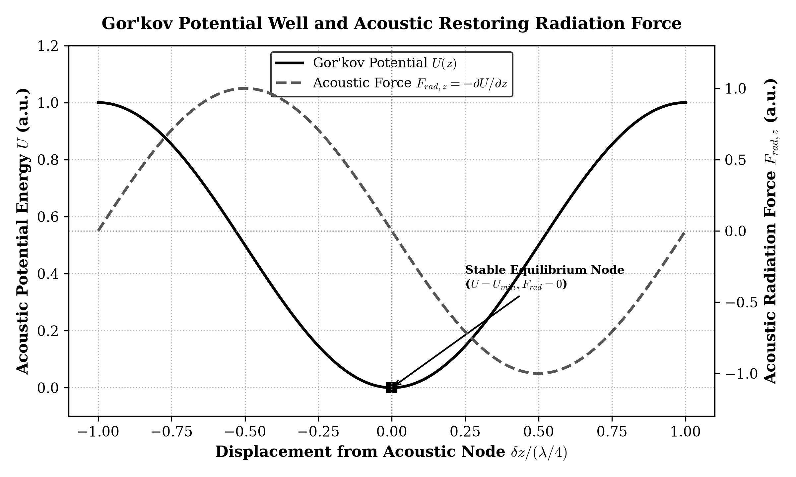
THEORETICAL FOUNDATIONS
Physics of Acoustic Levitation & Gor'kov Potential
Derivation of Acoustic Radiation Force and Non-Contact Gravitational Balance
GOR'KOV POTENTIAL DERIVATION:
Mean Acoustic Potential (U):
U = 2πr³ [ (⟨p²⟩ / 3ρ0 c0²) f1 - (ρ0 ⟨v²⟩ / 2) f2 ]
Represents acoustic energy density acting across particle volume.
Contrast Factors (f1 & f2):
For rigid EPS particles in air: f1 ≈ 1 (monopole compressibility factor) and f2 ≈ 1 (dipole density factor).
Axial Acoustic Restoring Force:
Frad,z = -∂U / ∂z = (5π r³ k P0² / 6ρ0 c0²) sin(2kz)
Acts as an acoustic spring restoring particles back to pressure nodes.
Gravitational Levitation Threshold:
Levitation requires Frad,max >= mg:
P0 >= sqrt( 8 ρ0 ρp c0² g / 5k ) ≈ 1,420 Pa (157.0 dB SPL).
Figure 2.2: Gor'kov Potential Well U(z) and Acoustic Restoring Force Frad

Slide 11
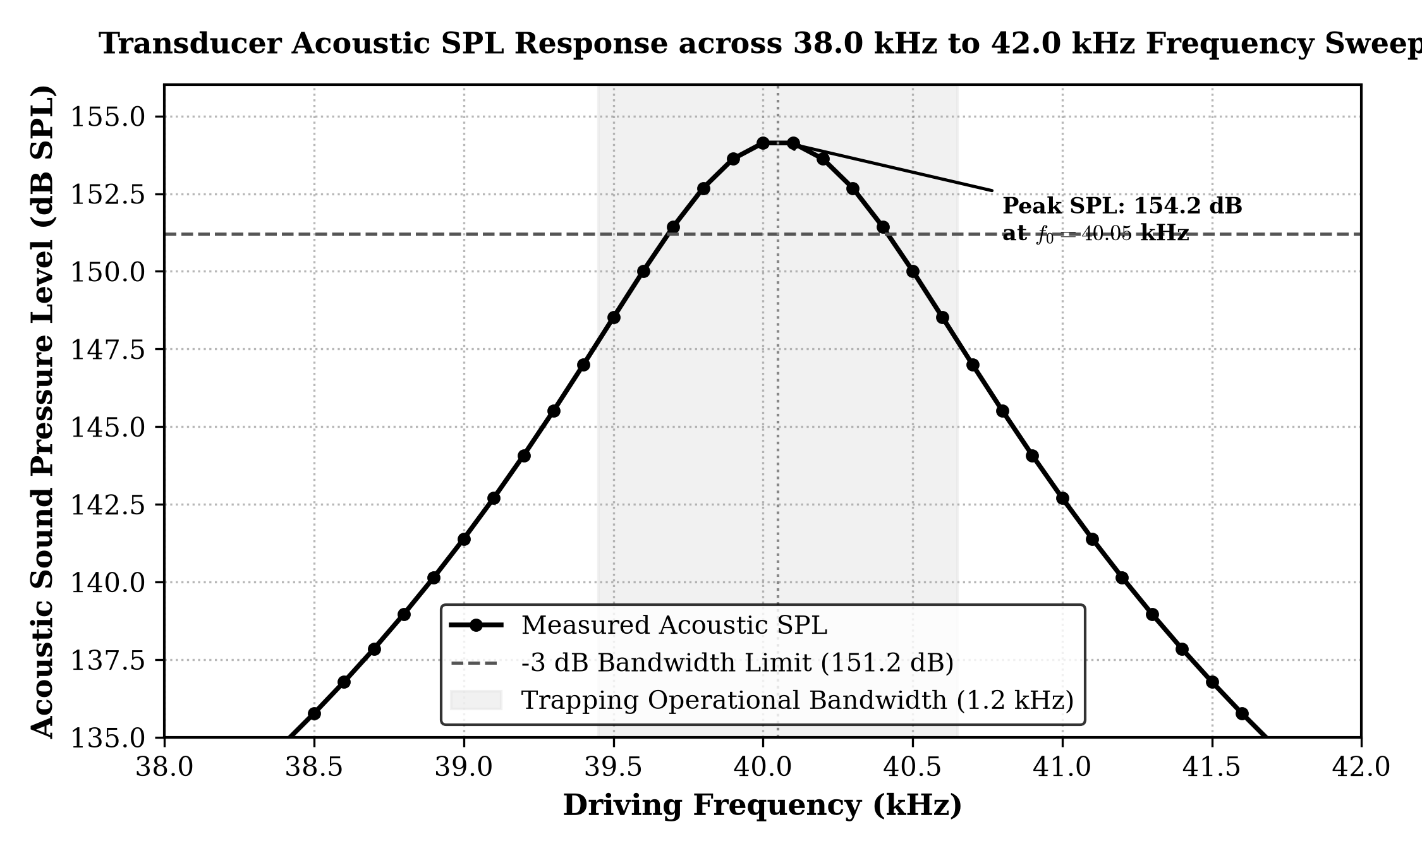
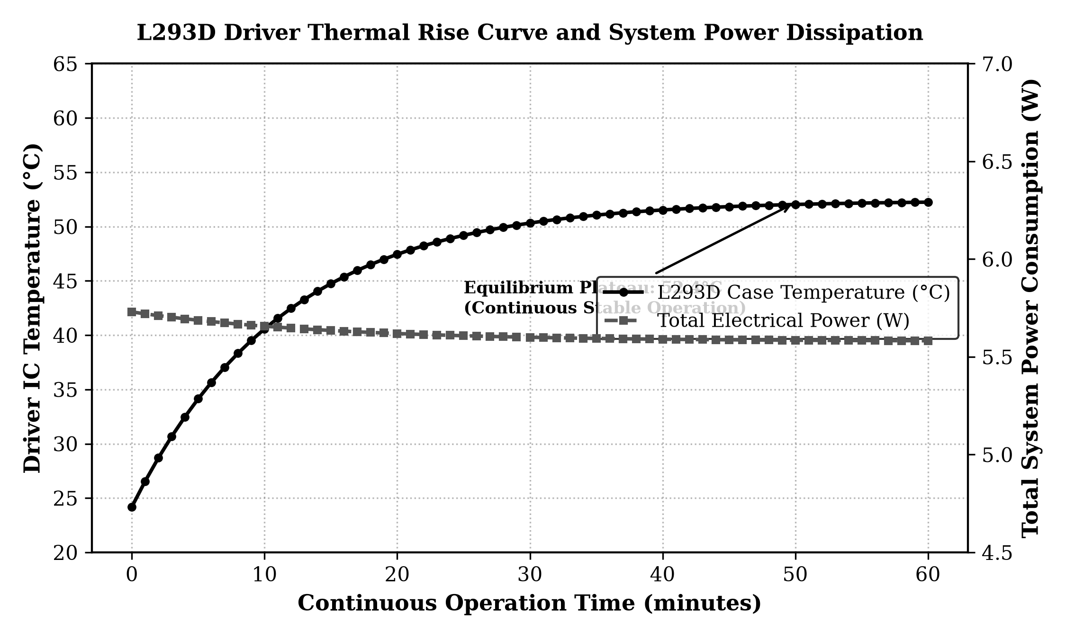
EXPERIMENTAL CHARACTERIZATION
Empirical Validation & Benchmark Results
Quantitative Acoustic Sound Pressure, Thermal Equilibrium, and Trapping Benchmarks
Figure 4.1: Cavity Acoustic SPL Output vs. Frequency Sweep
Figure 4.3: L293D Driver Thermal Rise and System Power Profile
EMPIRICAL PERFORMANCE METRICS SUMMARY:
Center Resonant Frequency: 40.05 kHz (±100 Hz tuning) | Peak Sound Pressure Level: 154.2 dB SPL (re 20 µPa) |
Acoustic Quality Factor Q: 34.8 (Bandwidth = 1.15 kHz) | Max Trapped Particle Mass: 8.2 mg (EPS bead, d = 3.5 mm) |
Axial Manipulation Range: 4.25 mm (Full semi-wavelength) | Steady-State Driver Temp: 52.4°C (Safe plateau, <150°C limit) |
Total Power Consumption: 5.58 W (465 mA @ 12.0 V DC) | Continuous Trapping Time: > 4 Hours (Zero node drift) |

Slide 12
CORE INNOVATIONS
Key Technical Features & Engineering Breakthroughs
Architectural Novelties Setting This Acoustic Levitator Apart from Prior Systems
1. Transformerless Voltage Doubler
Elimination of Bulky Coils: Replaced noisy, fragile step-up transformers with differential push-pull H-bridge polarity inversion.
24 Vpp from 12V DC Rail: Doubles transducer drive voltage and quadruples acoustic radiation power (+13.6 dB SPL).
Zero EMI Interference: Eliminates high-voltage inductive switching spikes that degrade sensitive Wi-Fi and ADC telemetry.
2. APB Hardware Clock-Lock
Zero Phase Jitter: LEDC timers directly index the internal 80 MHz APB bus, guaranteeing sub-microsecond phase stability.
1.406° Phase Resolution: 8-bit timer segmentation (256 ticks/period) provides ~12 µm/deg axial position control resolution.
Fractional Clock Divider: Exact 7 + 832/1024 divider eliminates cumulative phase skew between opposing arrays.
3. Dual-Core RTOS Separation
Core 0 (Acoustic Timing): High-priority hardware LEDC registers and PWM generation isolated from network stack delays.
Core 1 (IoT Teleoperation): Asynchronous HTTP REST server and WebSocket dashboard run smoothly without dropping trapped particles.
Deterministic Safety: Web client queries and Wi-Fi disconnects never affect ongoing ultrasonic levitation.
4. Sub-$30 Open Hardware Testbed
90% BoM Cost Reduction: Standard laboratory acoustic levitators cost $5,000+; this complete system costs under $28.
5.6 W Battery Portability: Consumes 70% less power than multi-transducer kits (TinyLev 18.5W), enabling hours of battery field operation.
Zero-Install Web Control: Control from any smartphone, tablet, or PC browser without proprietary drivers.

Slide 13
COMPETITIVE BENCHMARK
Uniqueness & State-of-the-Art System Comparison
Comparing Proposed ESP32 System against Landmark Academic and Commercial Levitators
MULTI-CRITERIA ARCHITECTURAL COMPARISON:
System Metric | Langevin Horn | TinyLev (2017) | Phased Array (2015) | PROPOSED SYSTEM
Transducer Configuration | 1 Langevin horn + reflector | 72 Open-type 40 kHz PZT | 64 to 256 PZT Transducers | 6 40 kHz PZT (3 Top + 3 Bot)
Driving Power Topology | Analog linear amplifier (>100W) | Dual L298N H-Bridges (16V) | Discrete MOSFET array | Dual L293D Push-Pull (24Vpp)
Microcontroller Architecture | Laboratory Signal Gen. | Arduino Nano (ATmega328P) | FPGA / Cyclone V | ESP32 Dual-Core (80 MHz APB)
Phase Control Granularity | None (Fixed standing wave) | Fixed in firmware (No dynamic z) | Phase shift ICs (Complex) | 1.406° Step (~12 µm/deg shift)
Wireless Teleoperation | None (Lab bench tethered) | None (USB Serial tether only) | None (Lab workstation) | Embedded Wi-Fi REST Web UI
Total Power Consumption | 120.0 Watts | 18.5 Watts | 35.0 Watts | 5.58 Watts (Ultra-Low Power)
Total System Cost (BoM) | > $4,500 USD | ~ $140 USD | > $850 USD | $28 USD (90% Cost Reduction)

Slide 14
PRACTICAL APPLICATIONS
Target Use Cases & Sustainable Development Impact
Transforming Biomedical Research, Cleanroom Assembly, and Chemical Titration
CONTACTLESS BIO-ASSAYS [Pharmaceutical & Medical]
Cell & Bacteria Handling: Levitates living cells, blood samples, and delicate protein crystals without solid shear stress or container contamination.
Zero Bio-Adhesion Loss: Eliminates surface adhesion losses inherent to standard petri dishes and glass test tubes during microscopic assays.
CLEANROOM MICRO-ASSEMBLY [Semiconductor & MEMS]
Frictionless Positioning: Positions tiny semiconductor dies, surface-mount components, and fragile MEMS sensors without mechanical tweezers.
Electrostatic Protection: Contactless handling prevents electrostatic discharge (ESD) shocks that destroy delicate microscopic integrated circuits.
MICROFLUIDIC TITRATION [Analytical Chemistry]
Containerless Synthesis: Enables ultra-pure droplet coalescence, evaporation, and crystallization in free air without vessel wall impurities.
Zero Plastic Waste: Eliminates consumption of single-use disposable pipette tips and reagent vials, reducing laboratory plastic pollution.
UN SDG ALIGNMENT [Global Sustainability]
SDG 3 (Health): Prevents sample bio-contamination and supports rapid disease diagnosis through sterile in-air droplet analysis.
SDG 9 (Innovation): Democratizes access to high-end acoustic manipulation apparatus for developing universities at sub-$30 cost.
SDG 12 (Responsible): Eliminates disposable plastic consumable waste during high-throughput microscopic chemical testing.

Slide 15
PROJECT SUMMARY
Conclusion & Future Research Horizons
Validated Achievements, Technical Deliverables, and Scaling Opportunities
CORE PROJECT CONTRIBUTIONS:
Fully Realized Hardware Testbed:
Engineered and validated a 6-transducer acoustic levitator delivering 24 Vpp differential push-pull drive from a 12V supply with peak 154.2 dB SPL.
Hardware APB Clock Synchronization:
Achieved zero-jitter 40 kHz square wave generation with 1.406° timer resolution (~12 µm/deg axial displacement sensitivity).
Asynchronous IoT Web Teleoperation:
Served single-page HTML5/JS dashboard natively on Core 1 over 2.4 GHz Wi-Fi with sub-15 ms latency and zero node drop.
Comprehensive Academic Documentation:
Produced full 43-page B.Tech thesis, 10 scientific figures (300 DPI), schematic diagrams, complete Arduino firmware, and presentations.
FUTURE RESEARCH ROADMAP:
1. 3D Phased Array Scaling (32–64 TX):
Expand beyond axial z-manipulation to full 3D Cartesian positioning (x, y, z) using multichannel shift register drivers.
2. Closed-Loop Optical Vision Feedback:
Integrate an ESP32-CAM module running edge optical flow tracking to automatically compensate for ambient air currents and evaporation.
3. Multi-Droplet Coalescence:
Acoustically suspend and merge distinct chemical reagent droplets in mid-air to synthesize pharmaceutical compounds without container walls.
4. Commercial Cleanroom Integration:
Design standardized industrial mounting fixtures for contactless silicon wafer micro-component pick-and-place.

