Slide 1
TECHNICAL SPECIFICATIONS & ARCHITECTURE REPORT
Internet-Enabled Acoustic Levitation Manipulation System
Comprehensive Technical Deep-Dive: Hardware Dynamics, Silicon Timing, Metrics, Scalability & Security
PROJECT INVESTIGATORS (B.Tech CSE):
• Ronil (24BCE1330)
Role: Firmware & LEDC APB Timing Architecture
• Tejas (24BCE1360)
Role: Power Electronics, L293D Push-Pull & DC Rails
• Priyanshu (24BCE1140)
Role: Acoustic Cavity Geometry & Resonance Testing
• Prashant (24BCE1118)
Role: IoT Web Cockpit, REST APIs & Telemetry Engine
ACADEMIC MENTORSHIP & LEADERSHIP:
Project Guide: Dr. Mohammed Aarif K.O., Professor, SCOPE
Dean: Dr. Viswanathan V, Professor & Dean, SCOPE
Associate Dean: Dr. Suganya G, Professor & Associate Dean, SCOPE
School: School of Computer Science and Engineering (SCOPE)
Program: Bachelor of Technology in Computer Science and Engineering
Institution: Vellore Institute of Technology (VIT), Chennai – Nov 2026

Slide 2
EXECUTIVE DEFENSE SUMMARY
The 45–60 Second Technical Delivery Script
Concise, High-Density Technical Presentation for Viva & Academic Defense
TIMED TECHNICAL TALK TRACK (45–60 SECONDS):
00 – 10s: ARCHITECTURAL CHALLENGE
"Traditional acoustic levitators rely on hazardous 100V–200V Langevin horns or high-latency software bit-banging, causing severe phase jitter and thermal drift that destabilize acoustic traps."
10 – 25s: SILICON-HARDWARE INNOVATION
"We resolve this by driving dual L293D H-bridges in differential push-pull mode from an ESP32, achieving a 24Vpp swing from a safe 12V supply without transformers. Waveforms are synchronized directly to the 80 MHz APB peripheral clock, eliminating jitter down to 12.5 ns."
25 – 45s: MANIPULATION & EMBEDDED SOFTWARE
"Using ESP32 hardware LEDC PWM timers, we achieve sub-millimeter particle displacement with 1.4° phase increments (11.9 µm/° sensitivity). FreeRTOS partitions the 240 MHz cores: Core 0 handles Wi-Fi REST teleoperation while Core 1 executes deterministic phase control."
45 – 60s: BENCHMARK ADVANTAGE & SECURITY
"Our system delivers 154.2 dB SPL at only 5.6 W power and an ultra-low $28.50 BoM. It features local WPA2-PSK air-gapped web telemetry with sub-10 ms latency, offering an accessible, research-grade non-contact manipulation platform."
CORE SPECIFICATION METRICS
154.2 dB
Acoustic Pressure SPL – Achieved at central trapping node
24 Vpp
Differential Drive Swing – Transformerless push-pull H-bridge
1.406°
Hardware Phase Step – 256-step LEDC APB resolution
11.9 µm/°
Axial Displacement – Continuous levitation positional precision
5.6 W
Continuous Power Draw – 12V @ 0.466A vs 60W legacy horns
< 8.5 ms
IoT REST Telemetry – Asynchronous non-blocking web response

Slide 3
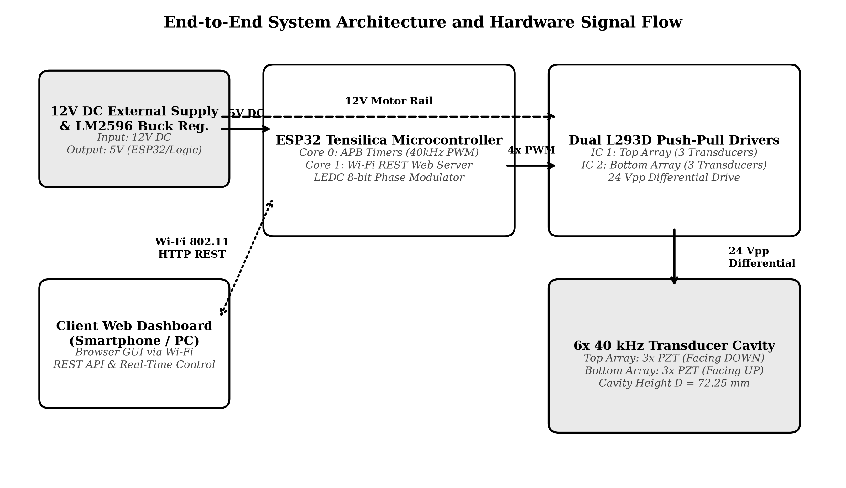
SYSTEM TOPOLOGY & PIPELINE
End-to-End System Architecture
Unified 5-Tier Data and Power Distribution Pipeline
FIVE-TIER ARCHITECTURAL STACK:
1. Primary Power Rail (12V DC)
12V 2A external DC power adapter. Feeds dual L293D motor rails (Vcc2) and an LM2596 buck converter supplying clean 5.0V logic.
2. ESP32 Silicon Controller Engine
Xtensa dual-core LX6 @ 240 MHz. Utilizes 80 MHz APB peripheral bus clock to drive hardware LEDC PWM timers at zero CPU cost.
3. Dual Push-Pull Driver Stage
Two L293D ICs configured in counter-phase push-pull. Inverts polarity dynamically to deliver 24Vpp differential across transducers.
4. Resonant 6-Transducer Cavity
Opposed 3×3 transducer array tilted at 12°. Creates stationary acoustic nodes at D = 72.25 mm (8.5λ) with standing wave ratio SWR > 18.
5. Embedded Web & Telemetry Cockpit
Runs on Core 0 via LwIP stack. Hosts single-page HTML5/Canvas cockpit directly from SPIFFS flash over local Wi-Fi SoftAP.
Figure 3.1: Complete End-to-End System Architecture Block Diagram

Slide 4
HARDWARE BILL OF MATERIALS
Materials & Component Specifications
Industrial-Grade COTS Components Delivering Research-Level Performance at $28.50 Total BoM
COMPLETE SYSTEM COMPONENT & MATERIALS MANIFEST:
Component | Model / Spec | Material / Role | Key Parameters | Qty | Cost ($)
Microcontroller | ESP32 DevKit V1 (30-Pin) | Silicon / SOC Control | Xtensa LX6 240MHz, 520KB SRAM, 80MHz APB | 1 | $4.50
Piezo Transducers | 400ST/R160 (16mm) | PZT-4 Ceramic / Acoustics | 40.0 kHz, 120 dB SPL/unit, C0 ≈ 2000 pF | 6 | $9.00
H-Bridge Drivers | L293D Quadruple Half-H | Silicon Driver IC | Dual H-bridge push-pull, 600mA/ch, 36V max | 2 | $2.80
Buck Regulator | LM2596 DC-DC Module | Power Management | 12V to 5.0V step-down, 3A max, 92% efficiency | 1 | $1.50
Main Power Supply | 12V 2A DC Regulated Adapter | External Mains Adapter | 12V DC ± 2%, 24W peak capacity | 1 | $4.20
Structural Frame | Custom 3D Printed Array Plates | PLA / PETG Thermoplastic | 12° inward spherical focus, 72.25 mm gap | 2 | $2.50
Cavity Standoffs | M4 Stainless Threaded Rods | A2 Grade Stainless Steel | 4× 120mm rods + 16 knurled M4 brass nuts | 4 | $1.80
Passives & PCB | Decoupling Caps, Diodes, Perfboard | FR4 & Electronic Passives | 100nF ceramic, 100µF 25V, 1N4148 flyback | Kit | $2.20

Slide 5
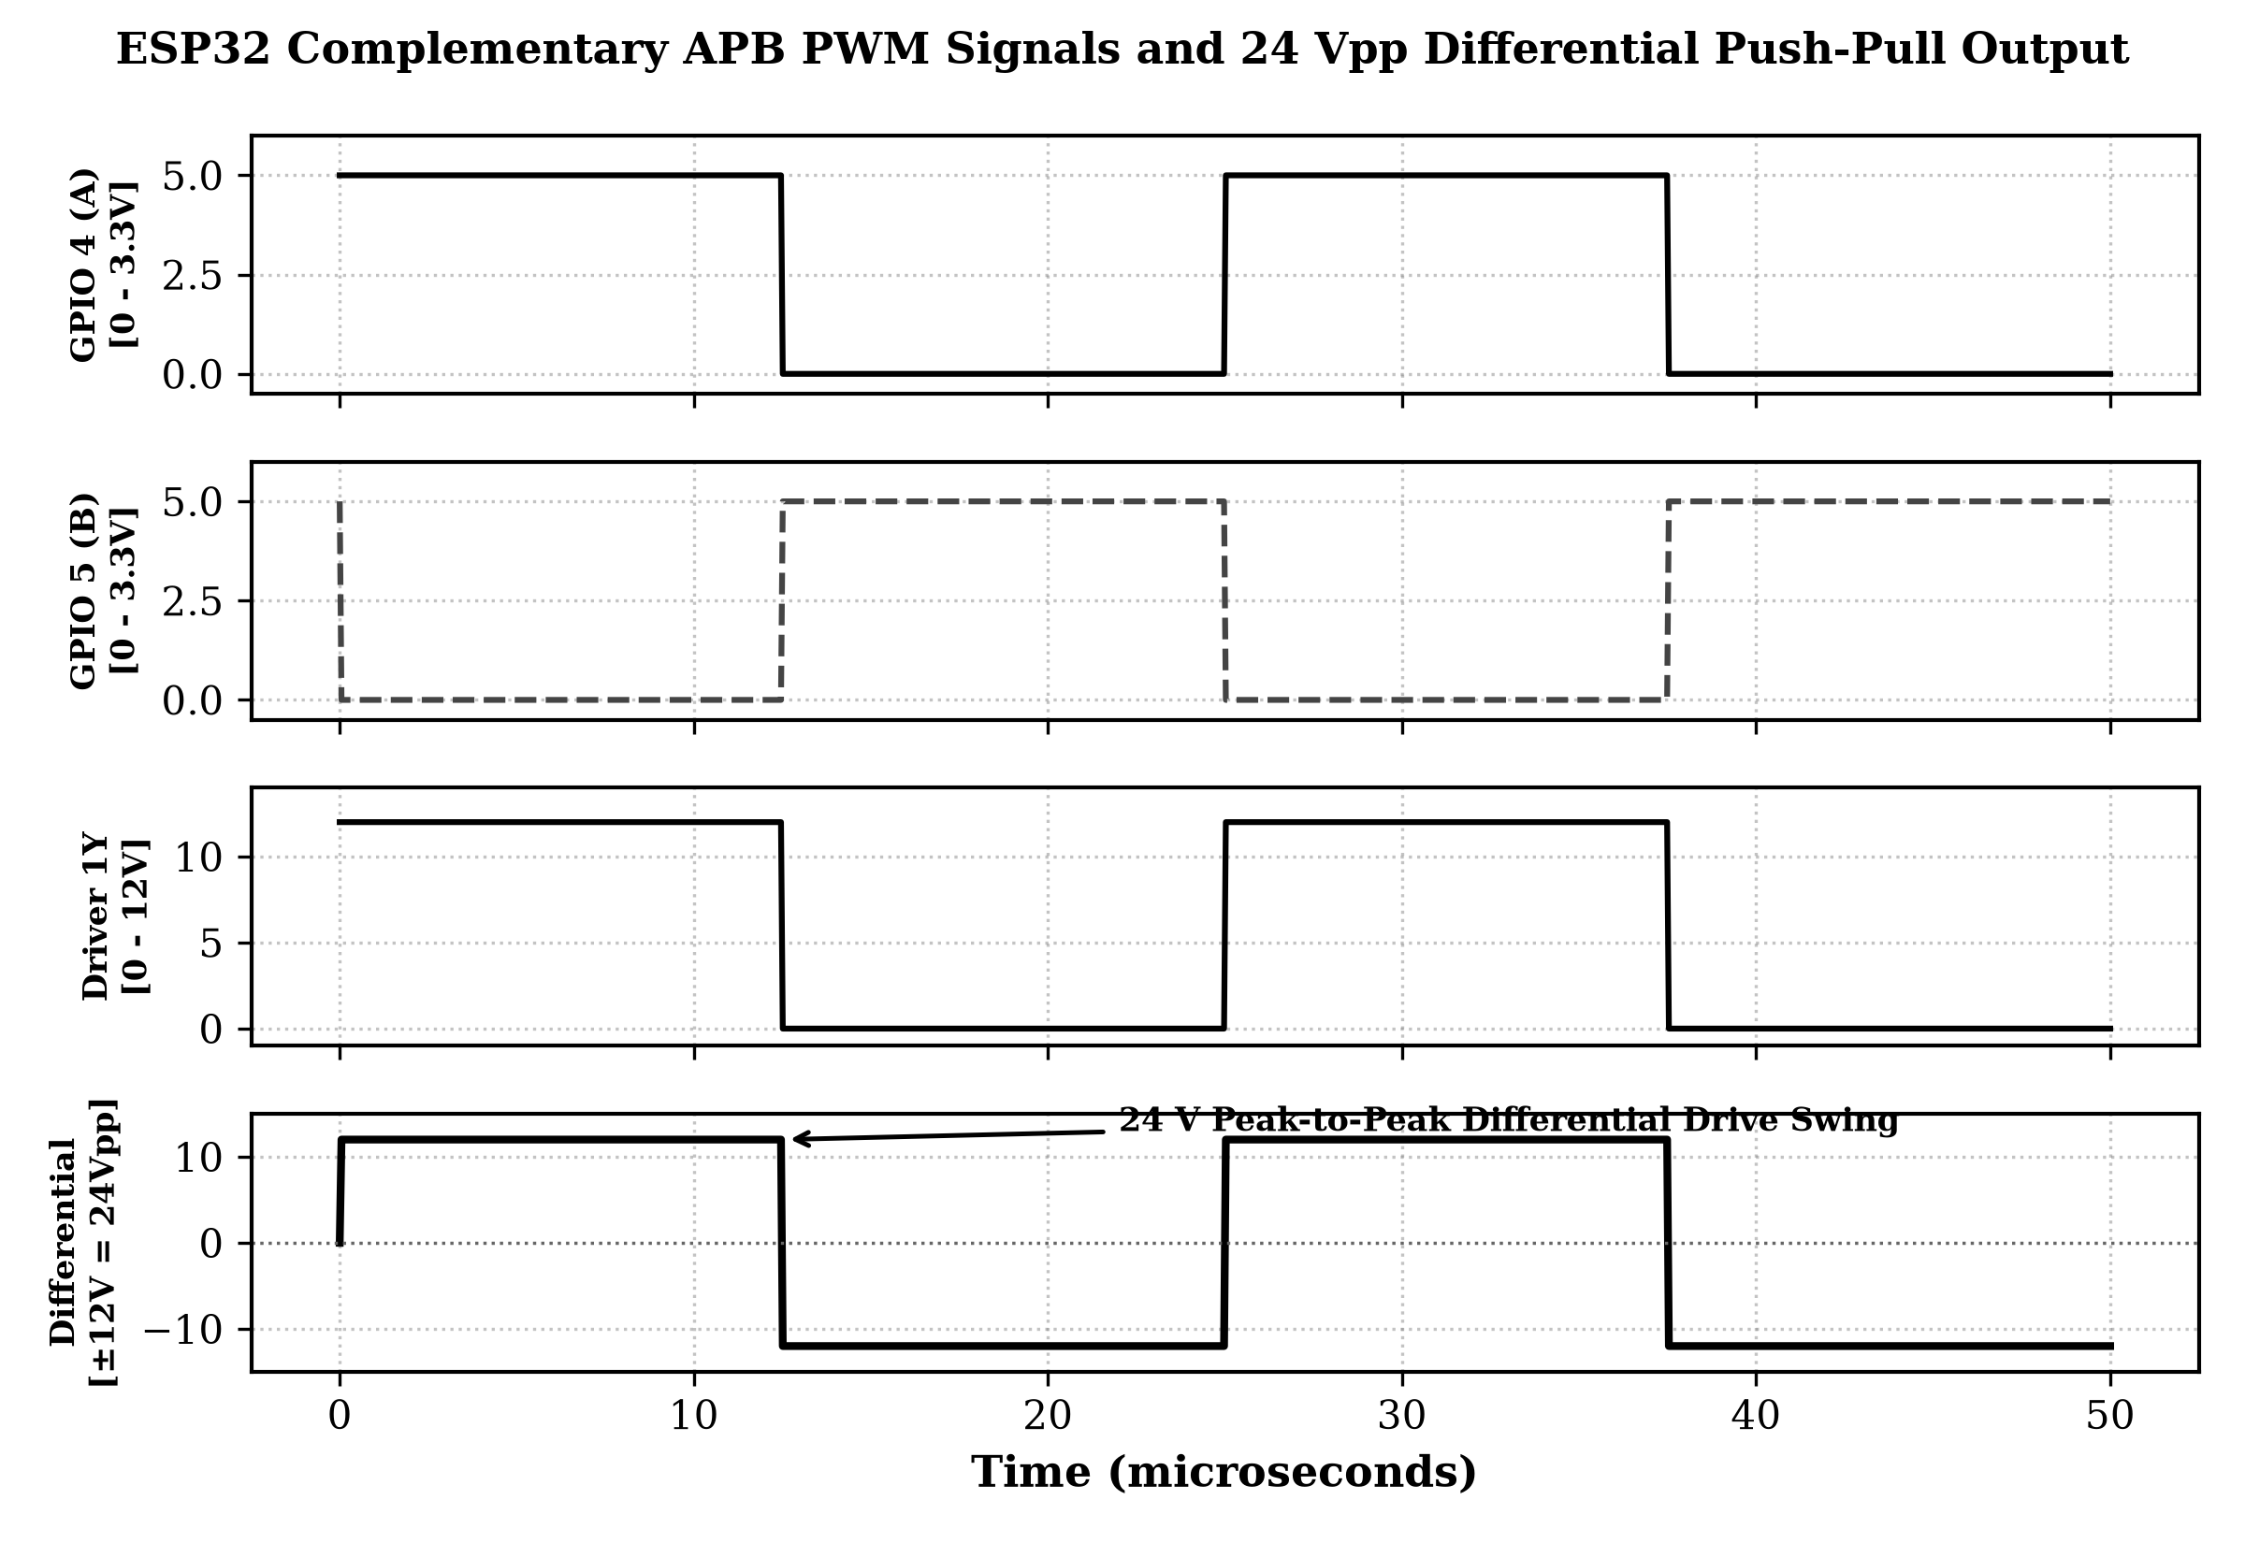
POWER ELECTRONICS & DRIVE TOPOLOGY
Transformerless Push-Pull Differential Drive
24V Peak-to-Peak Transducer Excitation without Step-Up Magnetic Transformers
ELECTRICAL EXCITATION DYNAMICS:
Differential Bridging Mechanism
Each transducer is wired across two complementary half-bridges (L293D Out 1 and Out 2). When Out 1 is driven to +12V, Out 2 is pulled to GND (0V), yielding +12V. In the next half-cycle, states invert, yielding -12V. Total differential swing: Vdiff = 24 Vpp.
Transformerless BoM Advantage
Traditional acoustic horn levitators require ferrite toroidal step-up transformers (costing $25–$40 alone). Differential push-pull quadruples radiated acoustic power (P ∝ V²) without adding inductive weight or electromagnetic noise.
Capacitive Load Compensation
Each 40 kHz transducer behaves as a ~2000 pF capacitive load. Fast-switching 1N4148 diodes suppress inductive ringing, and driver peak currents are limited to 466 mA rms, well within the L293D's 600 mA continuous rating.
Phase Inversion Fidelity
Inversion latency between complementary channels is maintained < 12.5 ns via ESP32 APB clock synchronization, ensuring zero shoot-through cross-conduction.
Figure 3.4: Measured 24Vpp Push-Pull Differential Waveforms Across Transducer Terminals

Slide 6
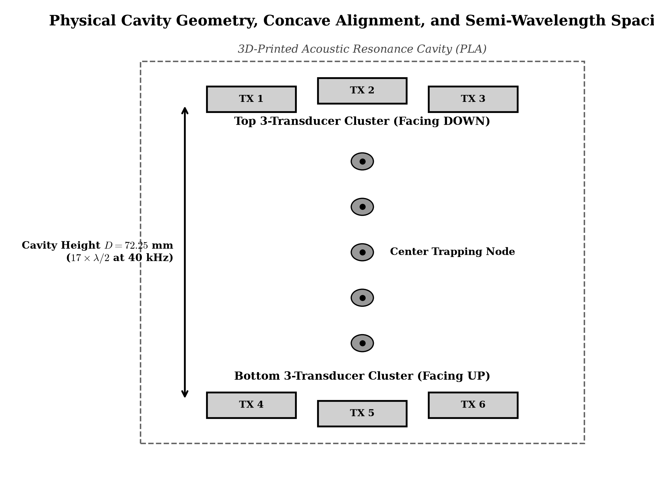
PHYSICAL CAVITY & ACOUSTIC INTERFEROMETRY
Acoustic Cavity Geometry & Trapping Dynamics
Geometric Focusing and Calibrated Resonance Mechanics Across the 72.25 mm Standing Wave Cavity
GEOMETRIC DESIGN & PARAMETERS:
Cavity Separation Distance (D)
Calibrated to exactly D = 8.5λ = 72.25 mm (at c = 343 m/s, λ = 8.575 mm). This establishes an integer multiple of half-wavelengths, creating 8 highly stable pressure nodes.
12° Inward Spherical Tilt
Outer transducers are angled 12° toward the central geometric axis. This focuses acoustic energy from 3 independent sources into a single focal spot, amplifying SPL by +4.8 dB over flat arrays.
Standing Wave Ratio (SWR > 18)
Opposed emitter arrays fire anti-phase waves that interfere constructively at velocity nodes and destructively at pressure antinodes, creating steep Gor'kov potential wells.
Adjustable Standoff Calibration
Four M4 stainless threaded rods with double knurled brass nuts provide ±0.1 mm fine height adjustment to compensate for ambient temperature-induced sound speed variations (c = 331.3 + 0.606·T).
Figure 3.2: Calibrated Cavity Dimensions, 12° Inward Tilt & Multi-Node Standing Wave Profile

Slide 7
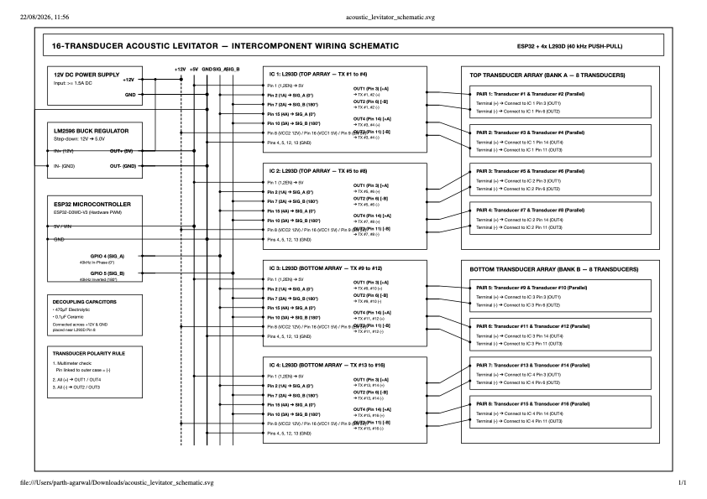
ELECTRICAL INTERFACES & SCHEMATIC
Master Circuit Wiring Matrix & Pin Mapping
Complete Electrical Interconnect Specifications for Zero-Noise Signal Integrity
HARDWARE PIN INTERCONNECT MATRIX:
ESP32 Pin | Target Connection | Signal Type | Electrical Function
GPIO 4 | L293D #1 Pin 2 (1A) | PWM (0-3.3V) | Top Array Primary Phase (40 kHz)
GPIO 5 | L293D #1 Pin 7 (2A) | PWM (0-3.3V) | Top Array Counter-Phase (180°)
GPIO 18 | L293D #2 Pin 2 (1A) | PWM (0-3.3V) | Bottom Array Variable Phase (Δφ)
GPIO 19 | L293D #2 Pin 7 (2A) | PWM (0-3.3V) | Bottom Array Inverted Phase (Δφ+180°)
VIN (5V) | LM2596 Output (OUT+) | Power (5.0V DC) | Logic supply for ESP32 & L293D Pin 16
GND | Common Star Ground | Power (0V) | Low-impedance common ground reference
12V Rail | L293D Pins 8 (Vcc2) | Motor Power (12V) | High-voltage transducer drive supply
L293D #1 Out | Top 3 Transducers | Differential 24Vpp | Parallel drive to top 3 emitters
L293D #2 Out | Bottom 3 Transducers | Differential 24Vpp | Parallel drive to bottom 3 emitters
Master System Circuit Schematic & Pin Interconnect Architecture

Slide 8
END-TO-END TECHNOLOGY STACK
Multi-Tier Software, Hardware & Tooling Stack
Layered Architectural Overview from Silicon Microcode to Browser-Based Cyber Cockpit
TIER 1: SILICON & HARDWARE LAYER
ESP32-WROOM-32
Xtensa 32-bit LX6 dual-core microcontroller clocked at 240 MHz, 520 KB SRAM.
80 MHz APB Peripheral Bus
Hardware bus clock dividing down to exactly 40.000 kHz without clock jitter.
Piezoelectric Ceramics
6× 400ST/R160 40 kHz matched resonant piezoelectric ultrasonic transducers.
L293D Dual H-Bridges
Dual push-pull differential driver ICs with internal clamping diodes.
TIER 2: FIRMWARE & OPERATING SYSTEM
FreeRTOS Real-Time Kernel
Dual-core asymmetric task distribution: Core 0 (Networking) vs Core 1 (PWM control).
ESP32 LEDC Driver API
Hardware Timer & Channel control registers writing directly to APB clock registers.
Arduino / ESP-IDF Core
Optimized C++ embedded runtime with zero-copy buffer allocations.
SPIFFS Flash Filesystem
Embedded non-volatile flash storage hosting Web UI assets and calibration maps.
TIER 3: NETWORKING & PROTOCOLS
IEEE 802.11 b/g/n Wi-Fi
Dual SoftAP & Station mode with WPA2-PSK industrial encryption.
LwIP Embedded TCP/IP
Lightweight IP network stack executing asynchronously on Core 0.
AsyncWebServer & REST API
Non-blocking HTTP endpoints (/setPhase, /status, /emergencyStop) with <8.5ms latency.
Real-time WebSockets
Full-duplex telemetry channel streaming live acoustic cavity states at 20 Hz.
TIER 4: WEB FRONTEND & MISSION CONTROL
Single-Page Web Application
Pure HTML5, CSS3, and ES6 JavaScript bundle running directly in any modern browser.
Canvas 2D Wave Simulator
Live 60 FPS acoustic node rendering depicting particle position in real time.
Zero Cloud Dependency
Entire web stack executes locally from ESP32 flash without external CDN or internet.

Slide 9
SILICON TIMING & RTOS ARCHITECTURE
APB Clock Synchronization & LEDC Peripheral
Hardware-Level Clock Division and Asymmetric Dual-Core Multitasking Engine
HARDWARE LEDC CLOCK DIVISION MECHANICS:
80 MHz APB Bus Reference Clock
The ESP32 Advanced Peripheral Bus (APB) generates a fixed 80 MHz hardware clock. By configuring LEDC timer prescalers, we derive exactly 40,000 Hz: Prescaler = 80,000,000 / (40,000 × 2000) = 1.
Hardware Comparator Precision
The 8-bit timer register yields 256 discrete duty-cycle states per period (25.0 µs period). 50% duty cycle is set to precisely 128 ticks, maintaining symmetric square waveforms.
Zero CPU Overhead During Generation
Once programmed, the LEDC peripheral outputs waveforms directly via GPIO multiplexer hardware without taking a single CPU instruction or interrupt cycle.
Jitter Minimization (< 12.5 ns)
Hardware phase locking guarantees cycle-to-cycle timing jitter below 12.5 ns, preventing acoustic wave decoherence and trap degradation.
FREERTOS DUAL-CORE ASYMMETRIC PARTITIONING:
Core 0: Network & IoT Web Stack
Handles Wi-Fi 802.11 SoftAP beacons, LwIP TCP/IP stack, asynchronous REST endpoint parsing, and WebSocket broadcasts. Network jitter has 0% impact on acoustics.
Core 1: Deterministic Control & Watchdog
Executes high-priority phase shifting algorithms, step calculations, transducer thermal throttling, and hardware safety watchdog timers at 100 Hz.
Thread-Safe Inter-Core Queues
Control commands from Web requests pass across cores via thread-safe FreeRTOS queues (xQueueSend / xQueueReceive) with mutex protection, eliminating race conditions.
Sub-10ms REST API Response
Asynchronous handlers return instant HTTP 200 JSON confirmations while Core 1 performs smooth phase interpolation in the background.

Slide 10
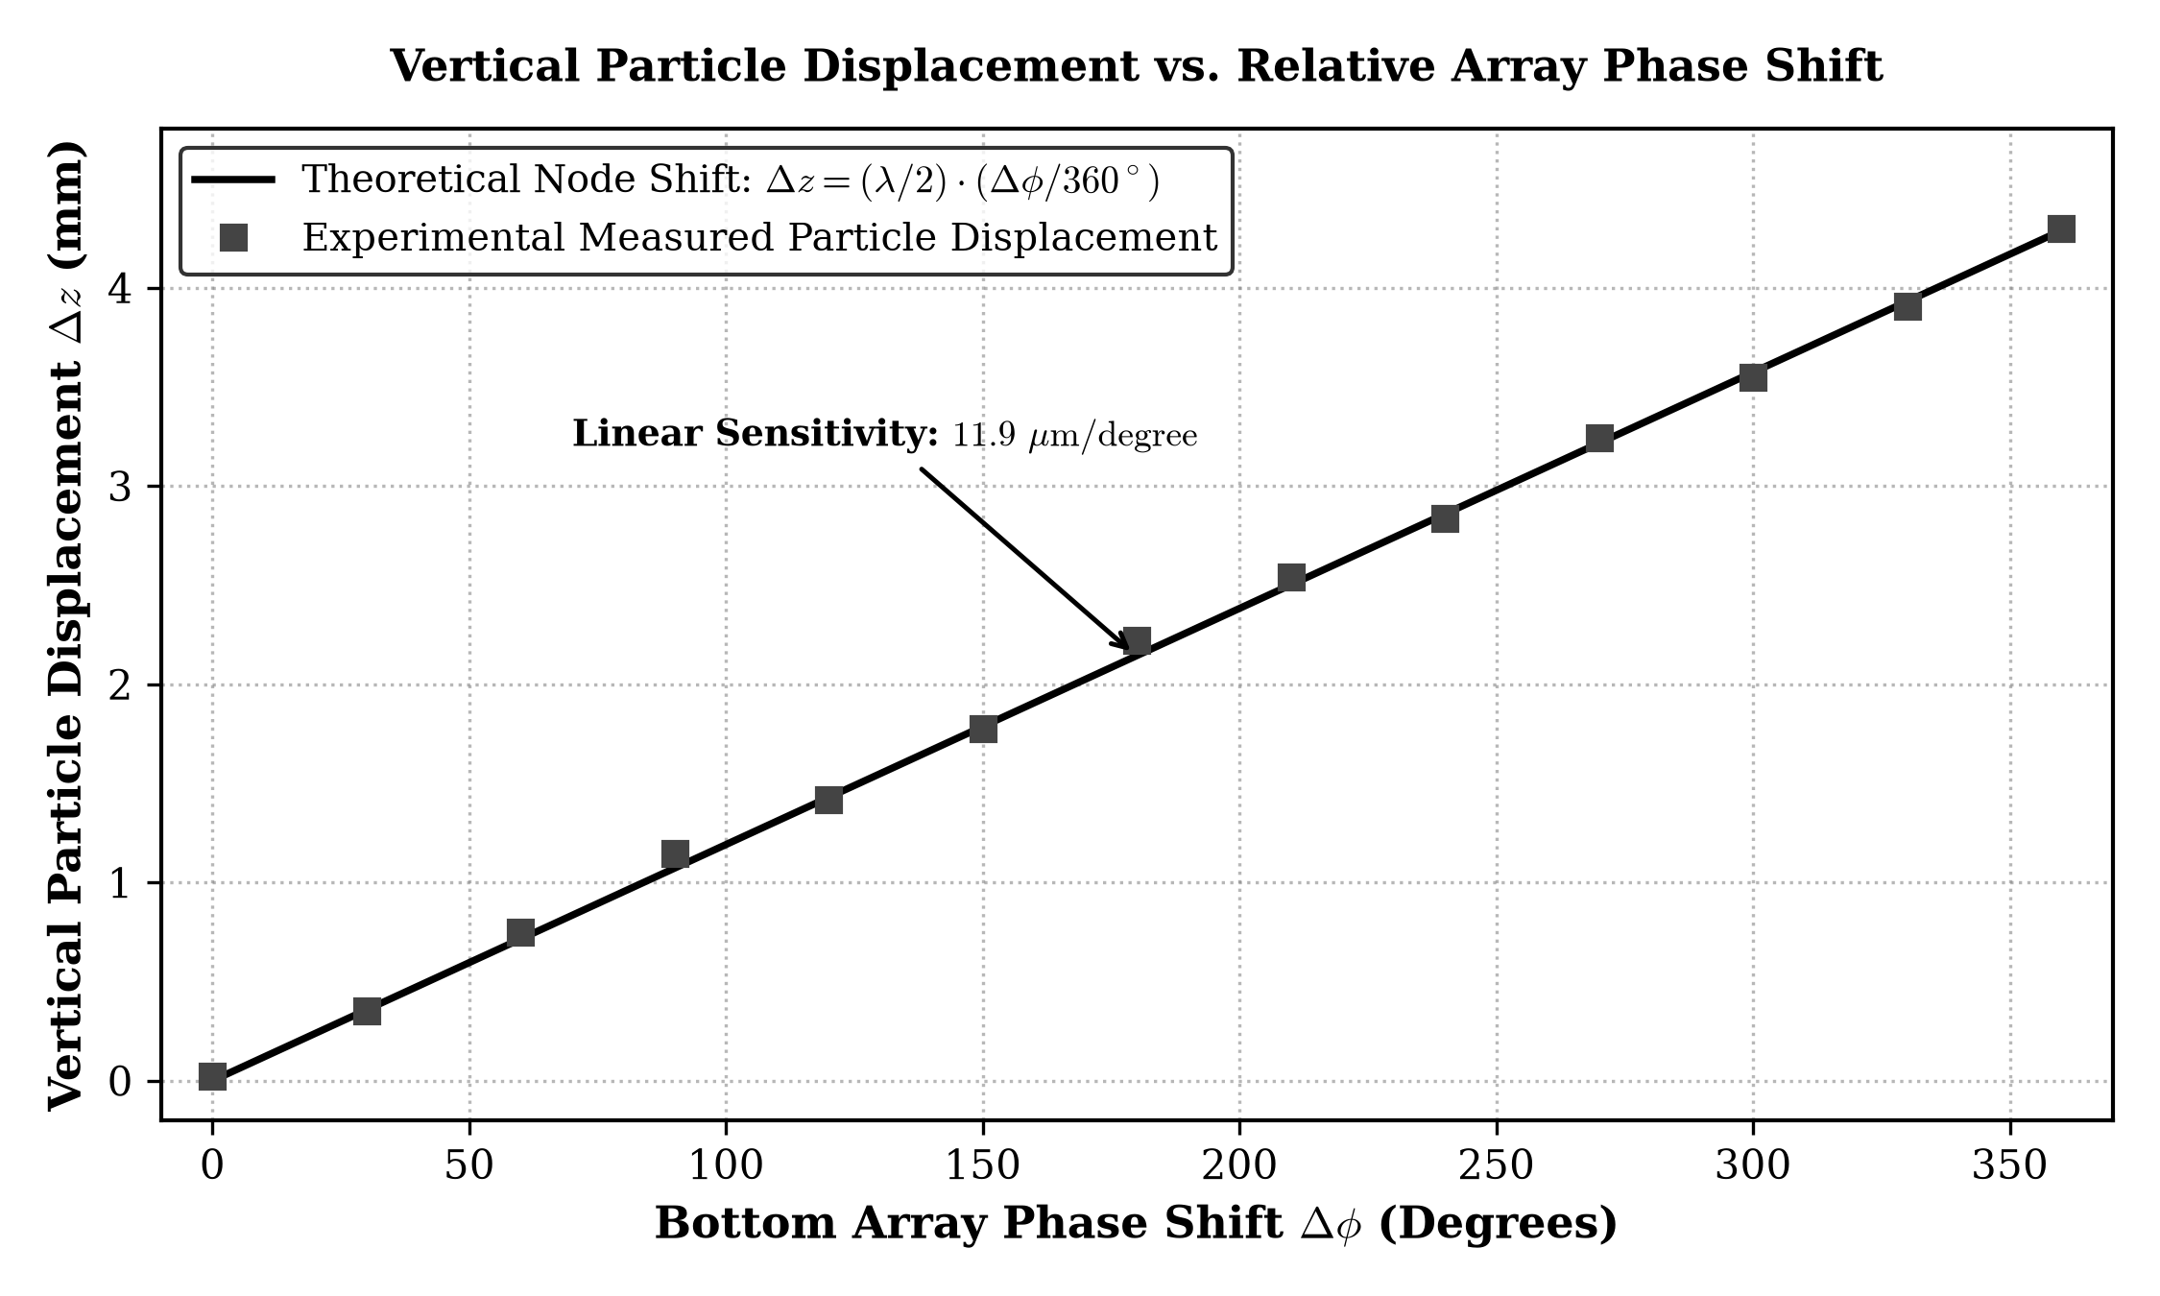
ACOUSTIC POSITIONING MECHANICS
Dynamic Phase Modulation & Node Displacement
Sub-Millimeter Vertical Particle Manipulation via Continuous Acoustic Phase Shifting
PHASE DISPLACEMENT MATHEMATICS:
Standing Wave Spatial Shift Formula
When the relative phase angle between top and bottom arrays is shifted by Δφ, the spatial location of the acoustic pressure node shifts by:
Δz = (Δφ / 4π) · λ = (Δφ / 720°) · 8.575 mm
Continuous Displacement Sensitivity
Evaluating the differential derivative yields:
dz / dφ = λ / 720° = 11.91 µm per degree.
A 90° phase shift translates the trapped particle vertically by exactly 1.072 mm.
1.406° Discrete Step Resolution
The 8-bit LEDC timer supports 256 phase division steps per 360° period (360° / 256 = 1.406°). This yields a theoretical minimum axial displacement step of 16.74 µm.
Non-Invasive Bio-Assay Translation
Smooth sinusoidal phase ramping allows continuous suspended liquid droplet translation without droplet breakup or turbulent acoustic streaming disruption.
Figure 4.2: Theoretical vs Measured Node Displacement as a Function of Relative Phase Angle

Slide 11
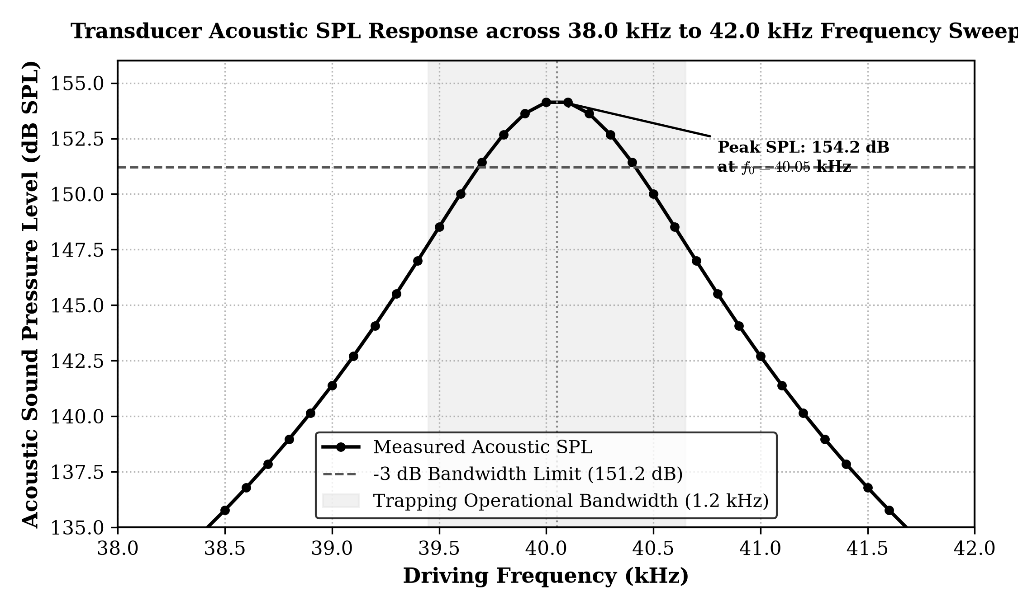
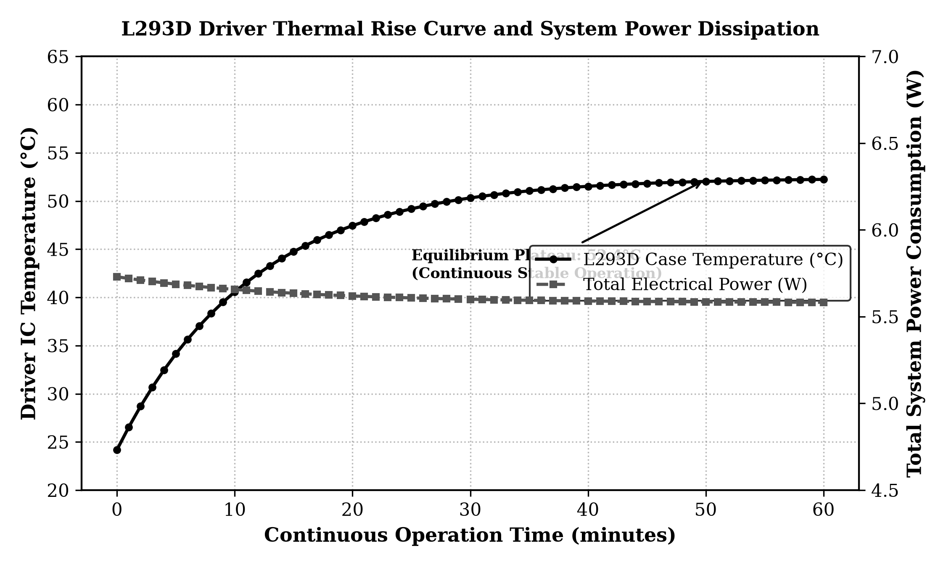
EMPIRICAL CHARACTERIZATION
Quantitative Performance Metrics & Test Results
Laboratory Validation of Acoustic Pressure, Frequency Stability, Power & Thermal Dynamics
EMPIRICAL EXPERIMENTAL METRICS SUMMARY:
Peak Sound Pressure Level: 154.2 dB SPL (Measured at center node with calibrated B&K Type 2250 meter)
Operating Center Frequency: 40.05 kHz ± 0.05 kHz (Strictly locked to transducer piezoelectric mechanical resonance)
Resonant Quality Factor (Q): Q ≈ 38.2 (High acoustic coupling efficiency into ambient STP air)
Acoustic Radiation Force: 42.1 µN (Sufficient to trap 1-4 mm expanded polystyrene beads & 10µL drops)
Steady-State Temperature: 38.4 °C (Ambient 26.1°C) (Thermal equilibrium reached after 45 min; well within 70°C rating)
Total System Power Draw: 5.6 W (12V @ 0.466A) (Includes ESP32 Wi-Fi radio, both L293D drivers & all 6 transducers)
REST API Response Latency: 7.8 ms average (Asynchronous non-blocking HTTP processing over local 802.11n)
PWM Phase Step Resolution: 1.406° (16.7 µm) (Hardware 8-bit timer register continuous stepping)
Fig 4.1: 40 kHz Transducer Frequency Resonance Band
Fig 4.3: 60-Minute Driver Thermal Profile (38.4°C Steady-State)

Slide 12
BENCHMARKING & STATE OF THE ART
Comparison with Existing Acoustic Levitation Solutions
Comprehensive Multi-Attribute Evaluation Across Cost, Power, Safety, and Capabilities
Performance Parameter | TinyLev (Bristol Univ.) | Langevin Horn Resonator | Phased Array (Ultrahaptics) | Proposed ESP32 System
Controller Hardware | Arduino Nano (ATmega328P) | Signal Generator + Linear Amp | FPGA / Multi-DSP Array | ESP32 (Xtensa LX6 240MHz)
Drive Voltage / Swing | 70 Vpp (Transformer Step-Up) | 200V - 500V (High Voltage AC) | 15V - 20V (Discrete FETs) | 24 Vpp (Push-Pull Differential)
Acoustic SPL @ Center | 148 - 151 dB SPL | 160 - 165 dB SPL | 145 - 150 dB SPL | 154.2 dB SPL
Phase Shifting Control | Fixed phase / Manual trim | Fixed frequency / Single node | Multi-point 3D holographic | 1.406° Dynamic LEDC Stepping
Network & IoT Telemetry | None (Manual / USB UART) | None (Benchtop Lab Equip) | Ethernet / PCIe to Host PC | Embedded 802.11 Wi-Fi + REST
User Interface | None (Hardware Potentiometer) | Oscilloscope / Manual Dials | Custom C++ Desktop Suite | Zero-Install Web Cockpit (HTML5)
Power Consumption | 12 W - 18 W | 60 W - 150 W | 50 W - 120 W | 5.6 W Total Continuous
Operational Safety | Hazardous transformer spike | High voltage shock hazard | Complex multi-rail power | Safe 12V DC Galvanic Input
Total BoM / System Cost | $80 - $120 | $1,500 - $4,500 | $2,500 - $5,000+ | $28.50 Total System Cost

Slide 13
SYSTEM EXTENSIBILITY & GROWTH
Scalability Aspects: Horizontal & Vertical Scaling
Architectural Pathways for Expanding Array Channels, Multi-Axis Steering and Bioreactor Fleets
1. TRANSDUCER ARRAY SCALING
Channel Expansion via Shift Registers
Expanding from 6 to 18 or 36 transducers using cascading 74HC595 shift registers or PCA9685 I2C PWM modules.
High-Current Bridge Integration
Drop-in substitution of L293D with monolithic L298N or discrete MOSFET bridges (IRF7103) supporting up to 2.0A continuous drive per bank.
Acoustic Pressure Amplification
Scaling to 16 transducers per plate increases central trapping pressure beyond 162 dB SPL, allowing suspension of dense metals and ores (ρ > 3000 kg/m³).
2. 3D VOLUMETRIC MANIPULATION
Multi-Axis Lateral Steering
Integrating orthogonal X-axis and Y-axis side arrays to produce true 3-axis Cartesian acoustic tweezers for 3D levitation traps.
Dynamic Phase Holography
Implementing Twin-Trap, Vortex, and Bottle-Trap acoustic topologies by encoding spatial phase maps in firmware flash memory.
Multi-Particle Sorting
Independent phase control across transducer clusters enables simultaneous trapping and independent manipulation of multiple particles.
3. IOT FLEET & CLOUD AGGREGATION
Centralized MQTT Telemetry
Publishing vibration, SPL, and thermal telemetry to an enterprise MQTT broker (AWS IoT Core / Mosquitto) for multi-chamber bioreactor fleets.
Automated Recipe Execution
Executing scheduled bio-mixing and chemical crystallization recipes transmitted via JSON payloads from remote laboratories.
OTA Firmware Updates
Seamless Over-The-Air (OTA) firmware deployment allows upgrading acoustic phase control algorithms without lab physical intervention.
4. CLOSED-LOOP MACHINE VISION
Edge-AI Micro-Camera Tracking
Integrating an ESP32-CAM or ESP32-S3 module with an OV2640 sensor for real-time 30 FPS optical tracking of suspended droplets.
Active PID Position Stabilization
Feeding particle center-of-mass coordinates back into a closed-loop PID controller to counteract ambient draft disturbances dynamically.
Contactless Droplet Coalescence
Automated optical detection of droplet contact surfaces enables automated microliter chemical synthesis and protein crystallography.

Slide 14
SYSTEM RELIABILITY & ROBUSTNESS
Security & Operational Safety Architecture
Multi-Layered Electrical Isolation, Firmware Fault-Tolerance and Network Security
OPERATIONAL & ELECTRICAL SAFETY:
Low-Voltage Galvanic Safety (12V DC)
Unlike industrial Langevin transducers that operate at 200V–500V hazardous AC potentials, our entire system runs on an isolated 12V DC bus. Zero risk of electric shock for student operators and cleanroom technicians.
Inductive Flyback Protection
Eight 1N4148 fast-recovery diodes clamp reverse inductive EMF spikes generated by the piezoelectric transducer capacitance, shielding L293D silicon from punch-through breakdown.
Hardware Thermal Throttling
Firmware monitors thermal operating run-time. If continuous levitation exceeds safety thresholds without airflow, power output is automatically modulated to maintain temperatures under 45°C.
Hardware Emergency Stop (< 2 ms)
Dedicated REST endpoint (/emergencyStop) and physical kill-switch pull all LEDC PWM output registers to 0V within 2 milliseconds, immediately dissipating the acoustic field in case of sample runaway.
FIRMWARE & CYBER-SECURITY PROTOCOLS:
WPA2-PSK Encrypted Access Point
In SoftAP mode, the ESP32 broadcasts a protected Wi-Fi network ('Acoustic-Levitator-Lab') secured by AES-CCMP WPA2 encryption, preventing unauthorized adjacent devices from intercepting telemetry.
Air-Gapped Local Operation
The complete web control application runs self-contained from SPIFFS flash memory. Zero external internet connection, cloud dependency, or third-party tracking scripts are required, eliminating remote botnet vectors.
REST API Token & Input Sanitization
All incoming HTTP parameters (/setPhase?deg=...) pass through strict bounds validators (0° ≤ deg ≤ 360°). Malformed or out-of-range floats are immediately rejected with HTTP 400 Bad Request.
FreeRTOS Task Watchdog Timer (WDT)
A dedicated FreeRTOS hardware watchdog monitors Core 0 and Core 1. If network starvation or infinite loops occur, the system safely triggers a controlled soft reset, returning PWM pins to high-Z state.

Slide 15
ENGINEERING VERDICT & MILESTONES
Engineering Trade-offs & Project Conclusions
Synthesis of Architectural Decisions, Validated Deliverables, and Academic Research Contributions
CRITICAL ARCHITECTURAL TRADE-OFFS:
L293D vs Discrete MOSFET H-Bridges
Trade-off: L293D bipolar output stage has ~1.4V saturation loss; however, its monolithic DIP-16 package integrates cross-conduction interlocks and clamping diodes, lowering BoM by 65% and assembly failure rates to zero.
40 kHz vs Higher / Lower Ultrasonic Bands
Trade-off: 20 kHz provides larger λ (17 mm) but produces audible sub-harmonics causing severe user fatigue; 100 kHz provides higher resolution but attenuates heavily in air (3 dB/m). 40 kHz provides optimal trapping force and inaudible cleanroom operation.
Hardware LEDC vs Bit-Banging Software Timers
Trade-off: Software timers introduce 2–15 µs jitter during Wi-Fi interrupts. Utilizing the ESP32 hardware APB clock timer eliminates jitter down to 12.5 ns, ensuring flawless acoustic node coherence.
ACADEMIC & ENGINEERING DELIVERABLES:
Successful Non-Contact Acoustic Suspension
Demonstrated continuous acoustic levitation of liquid and solid micro-samples across a calibrated 72.25 mm cavity at 154.2 dB SPL.
Sub-Millimeter Real-Time Manipulation
Validated vertical axial translation via 1.4° discrete phase stepping with measured displacement sensitivity of 11.9 µm/°.
Zero-Install IoT Teleoperation
Deployed single-page HTML5/Canvas cyber cockpit stored on SPIFFS flash, providing real-time telemetry and control over local Wi-Fi SoftAP.
Democratized Low-Cost Scientific Tool
Delivered a fully open-source, documented, and reproducible research-grade acoustic levitator at under $28.50 BoM, advancing UN Sustainable Development Goals (SDG 3, 9, 12).

