Slide 1
Fake News Detection using Machine Learning
Parth Arole
A00279705

Slide 2
Introduction
Topic undertaken to understand machine learning techniques and algorithms.
Use supervised machine learning to predict authenticity of article.
3 phases:
Exploratory data analysis and data cleaning/ preparation
Building a machine learning model
Utilizing model in UI

Slide 3
Research : ML
ML
Supervised
Unsupervised
Rise of Machine Learning and AI
Solve real world problems
Machine Learning Workflow:
Data Gathering
Data preparation
Choose model
Evaluating
Training
Tuning parameters
Prediction

Slide 4
Algorithms and Libraries
Widely used libraries: keras, tensorflow, pytorch, scikit-learn, pandas, numpy
Supervised Algorithm | Unsupervised Algorithms
Support Vector Machine | K-means
Random Forest Classifier
Naïve Bayes Classifier
Gradient Boosting Classifier KNN

Slide 5




Technologies Used

Slide 6
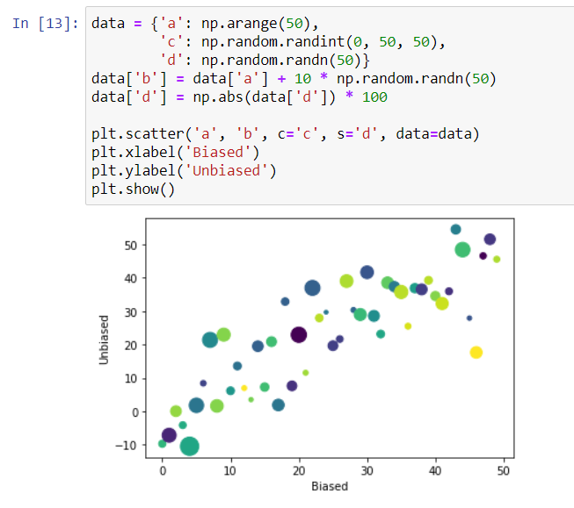
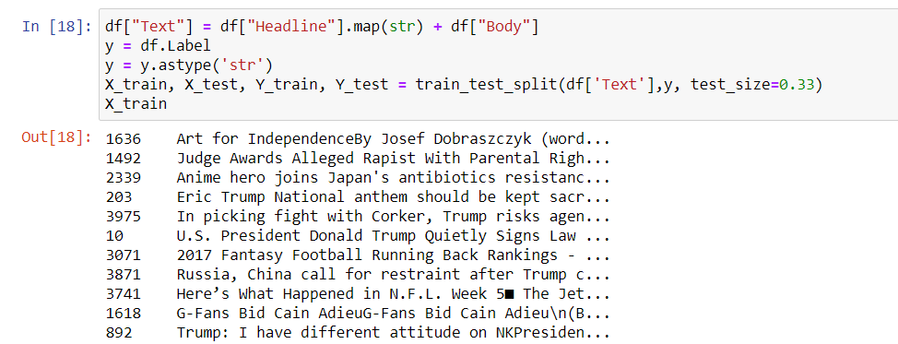
Screenshots

Slide 7
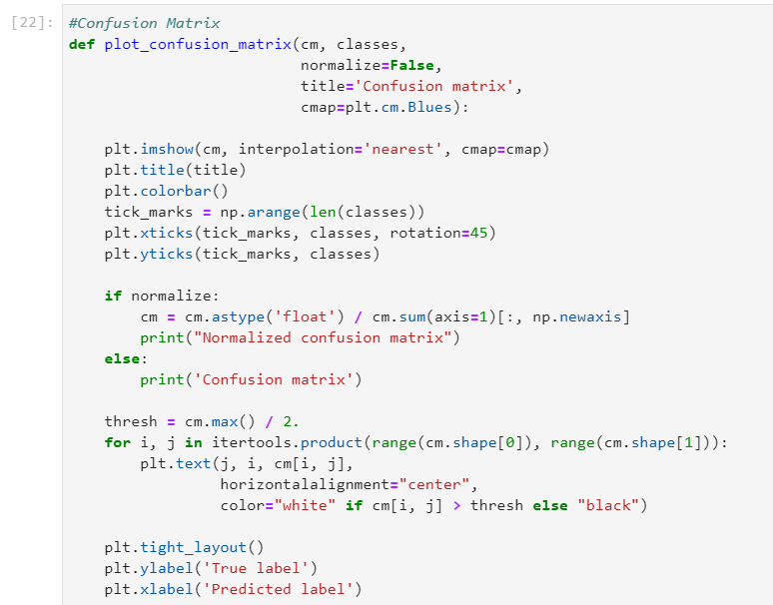
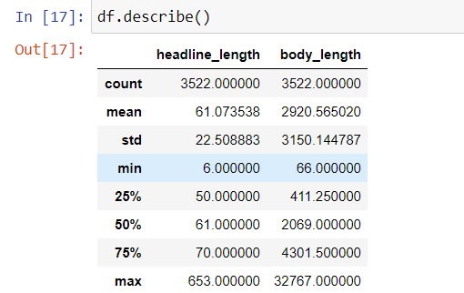
Screenshots

Slide 8
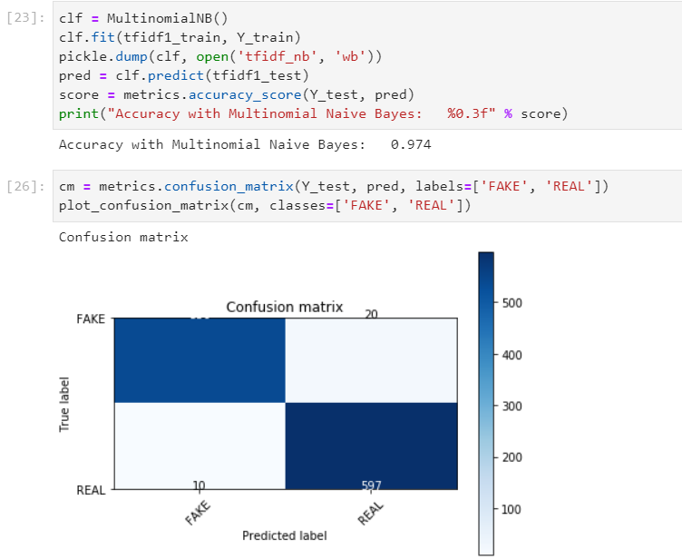
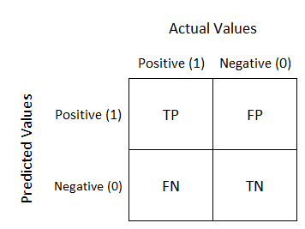
Screenshots

Slide 9
Final Requirements
Functional Requirements:
Accept an article link from the user.
When the user enters an article link, the system will give its prediction on the authenticity of the article.
Non-Functional Requirement:
The prediction accuracy should be as high as possible.
The output should be displayed within 5 seconds.

Slide 10
Thank You

