Slide 1





Scatter Plot

Slide 2
What Is Scatter Plot

Slide 3
A scatter chart, also called a scatter plot, is a chart that shows the relationship between two variables.
They are an incredibly powerful chart type, allowing viewers to immediately understand a relationship or trend, which would be impossible to see in almost any other form.

Slide 4
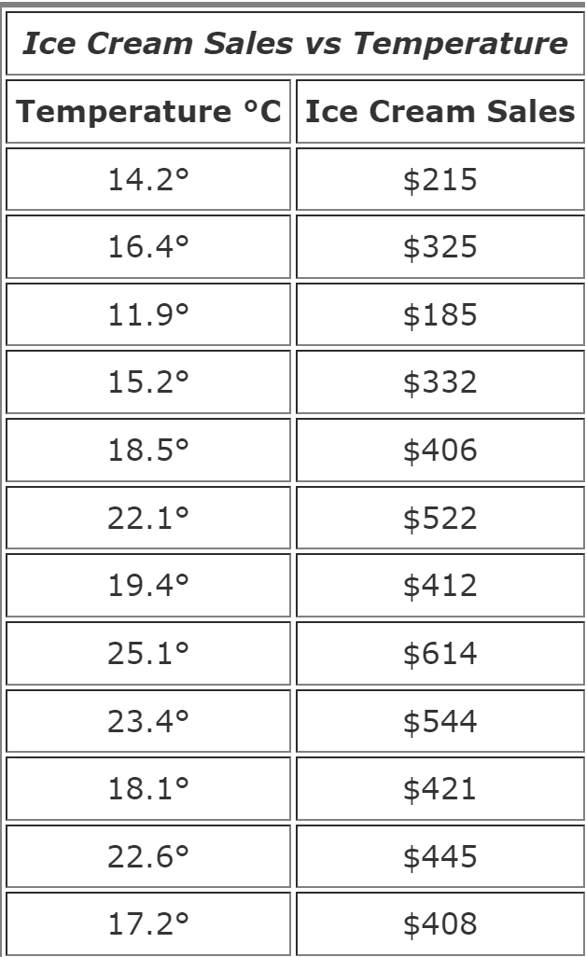
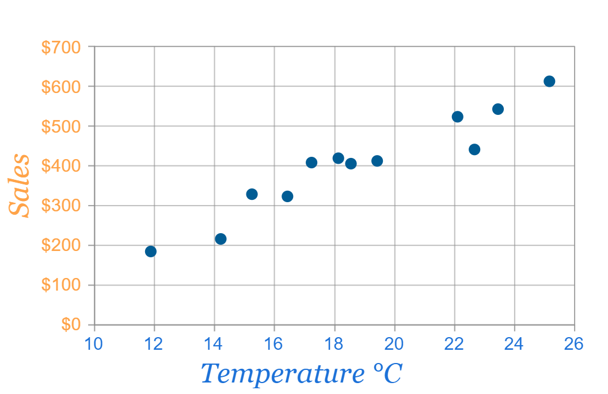
The local ice cream shop keeps track of how much ice cream they sell versus the temperature on that day. Here are their figures for the last 12 days

Slide 5

Types of Scatter plot Correlation
Correlation is a statistical measure of the relationship between the two variables

Slide 6
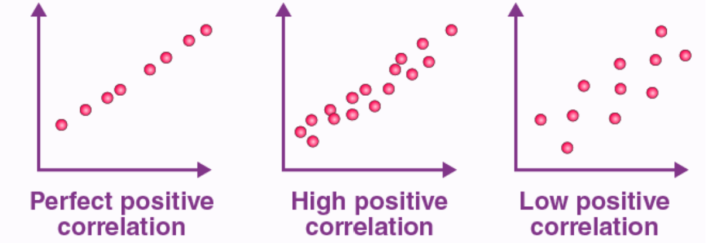
Positive Correlation
When the points in the graph are rising, moving from left to right, then the scatter plot shows a positive correlation. It means the values of one variable are increasing with respect to another. Now positive correlation can further be classified into three categories:
Perfect Positive – Which represents a perfectly straight line
High Positive – All points are nearby
Low Positive – When all the points are scattered

Slide 7
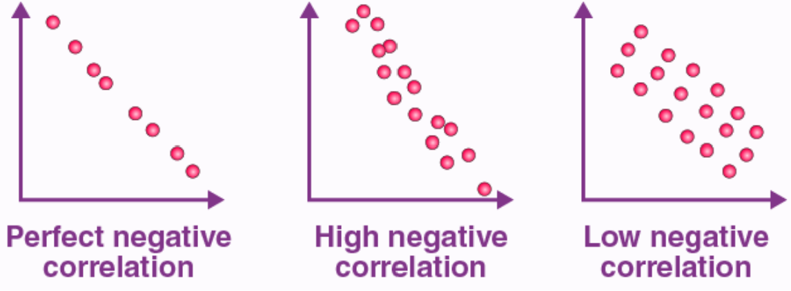
Negative Correlation
When the points in the scatter graph fall while moving left to right, then it is called a negative correlation. It means the values of one variable are decreasing with respect to another. These are also of three types:
Perfect Negative – Which form almost a straight line
High Negative – When points are near to one another
Low Negative – When points are in scattered form

Slide 8
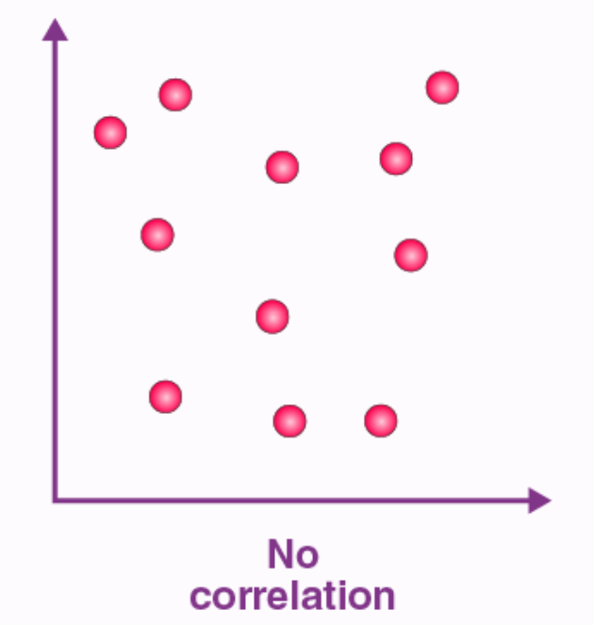
No Correlation
When the points are scattered all over the graph and it is difficult to conclude whether the values are increasing or decreasing, then there is no correlation between the variables.

Slide 9
Analysis of a scatter plot helps us understand the following aspects of the data.
The different levels of correlation among the data points are useful to understand the relationship within the data.
A line of best fit can be drawn for the given data and used to further predict new data values.
The data points lying outside the given set of data can be easily identified to find the outliers.
The grouping of data points in a scatter plot can be identified as different clusters within the data.
What is Scatter Plot Analysis?

Slide 10
Thank You !!

