Slide 1
PBL PRESENTATION
DATA WAREHOUSING & MINING
MARKET MINER
Systematic Stock Trend Analysis via Data Warehousing and Pattern Mining
PROJECT AUTHORS
Veer Jain • Parth Dhoot • Bhavyansh Garewal

Slide 2
OVERVIEW
Introduction to MarketMiner
High Volume Data
Manual Complexity
Stock markets generate vast streams of historical transactional records daily.
Raw market records are too large and complex to analyze manually.
Data Warehousing
Data Mining
Delivers centralized, structured historical storage optimized for queries.
Extracts actionable patterns, trends, and market relationships automatically.
MarketMiner combines Warehousing & Mining for systematic stock analysis.
Core Solution

Slide 3
RESEARCH SCOPE
Problem Statement & Objectives
1
Collect & organize historical market data
2
Clean, transform, and standardize raw fields
Problem Statement
Large stock datasets contain rich financial signal, but identifying recurring trends and market patterns directly from unorganized raw records is exceedingly difficult.
3
Store analytical records in a centralized warehouse
4
Cluster similar stocks & discover frequent patterns
5
Visualize and interpret analytical mining results

Slide 4
ARCHITECTURE
End-to-End System Workflow
Stock Data
Collection
Cleaning
ETL Phase
Warehouse
Features
Data Mining
Insights
INPUT STAGE
STORAGE STAGE
ANALYTICS STAGE
Raw Stock History
Dimensional Schema
Clusters & Patterns

Slide 5
DATA MODEL
Dimensional Warehouse Architecture
Stock Fact Table
Stock Dimension
Date Dimension
Stock ID (FK)
Date ID (FK)
Stock ID (Primary Key)
Date ID (Primary Key)
Symbol (Ticker)
Open / High Prices
Low / Close Prices
Full Date Stamp
Company Name
Trading Volume
Daily Return
Day / Month
Sector / Industry
Quarter / Year
Price Change & Volatility

Slide 6
DATA PIPELINE
ETL Process & Preprocessing
1. EXTRACT
Preprocessing Steps
Collect raw historical stock market records from dynamic data feeds.
2. TRANSFORM
Clean missing values, deduplicate records, compute daily returns & volatility trends.
✓ Missing-value handling & Deduplication
✓ Date conversion & Type standardization
3. LOAD
✓ Return & Price-change calculations
Populate standardized fact & dimension schemas in the analytical warehouse.
✓ Feature selection & Normalization
Rigorous preprocessing directly improves mining quality and model performance.

Slide 7
SEGMENTATION
Stock Trend Clustering (K-Means)
Clustering Feature 1
Clustering Feature 2
Clustering Feature 3
Clustering Feature 4
Average Daily Return
Historical Volatility
Average Trading Volume
Percentage Price Change
K-Means Algorithmic Workflow
Select Features
Normalize Data
Choose K Clusters
Init Centroids
Assign Points
Final Clusters

Slide 8
PATTERN DISCOVERY
Pattern Mining (Apriori Algorithm)
Target Itemset Categories
Apriori Workflow Pipeline
+ Positive Return
- Negative Return
⚡ High Volatility
📊 High Trading Volume
📉 Low Trading Volume
Transaction Itemsets
Stage 1
Support Evaluation
Stage 2
Frequent Itemsets Extraction
Stage 3
Association Rules (Confidence & Lift)
Final Rule Output

Slide 9
TECHNICAL STACK
Implementation & Tech Stack
Core Technologies
Implementation Stages
1.
Load Data: Ingest historical stock market datasets
Python
Pandas
NumPy
Scikit-learn
2.
Clean & Transform: Deduplicate & process records
MLxtend
MySQL / PostgreSQL
Matplotlib / Seaborn
3.
Warehouse Storage: Query structured relational tables
4.
Feature Extraction: Calculate volatility & indicators
5.
Apply Mining: Execute K-Means clustering & Apriori
6.
Visualization: Generate insightful trend charts

Slide 10

UI(User Interface)

Slide 11
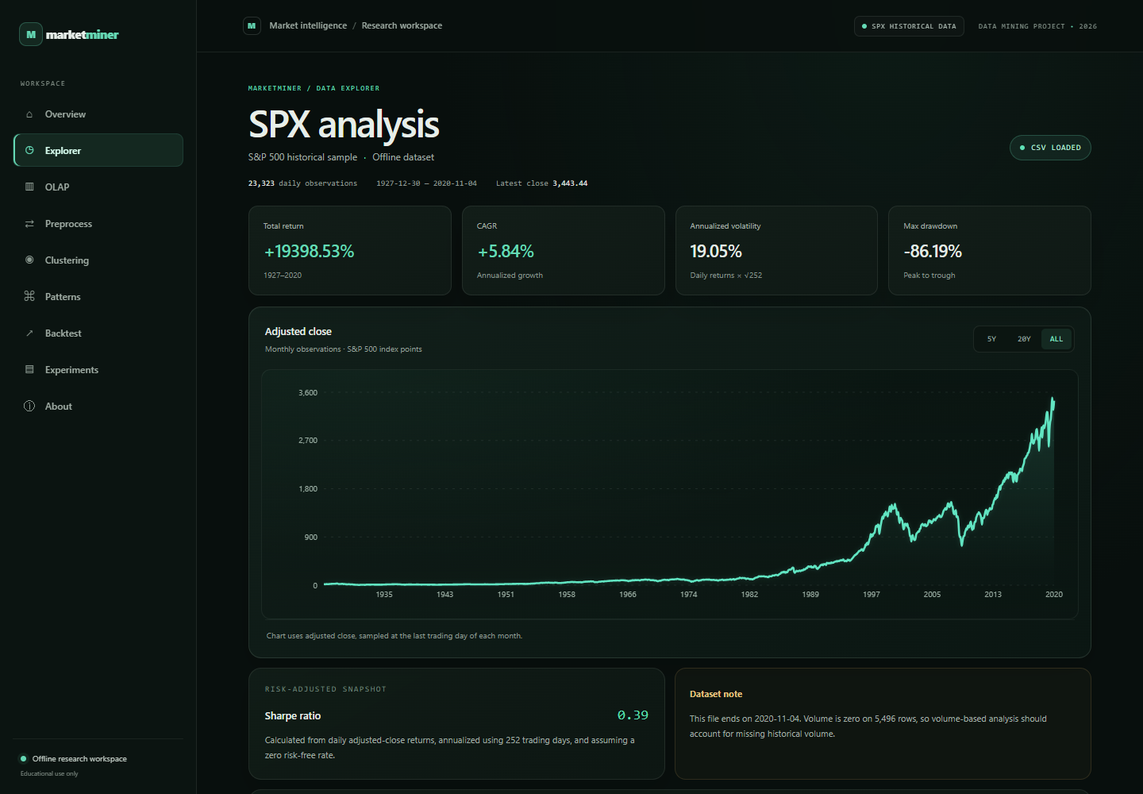
Explorer

Slide 12
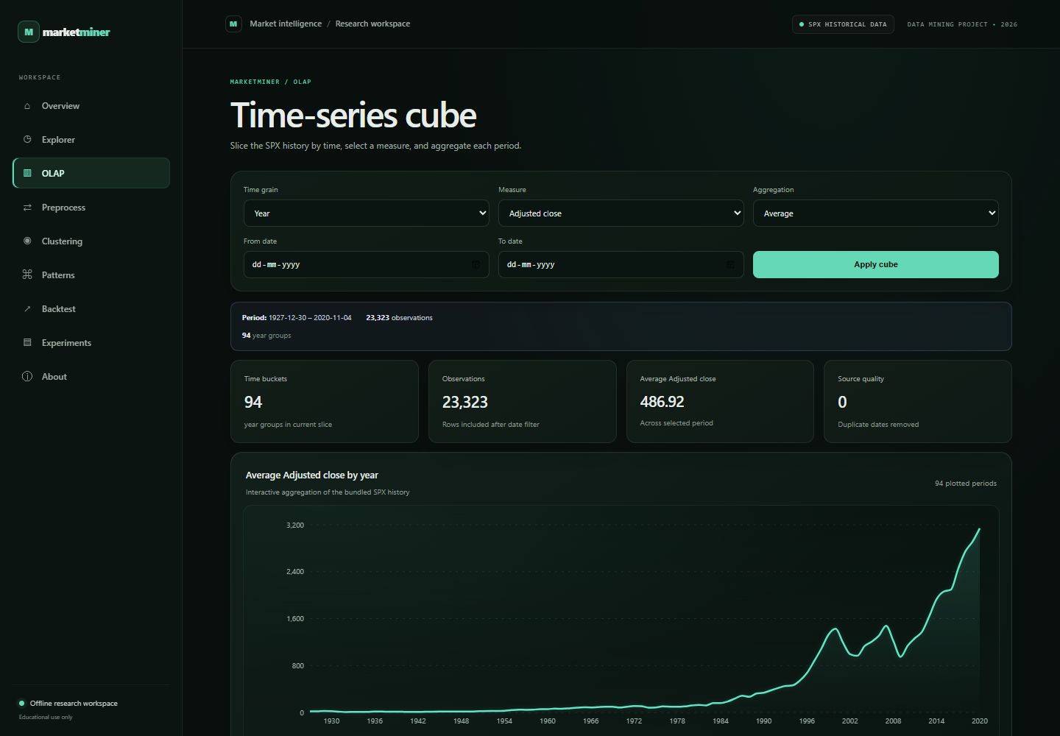
OLAP

Slide 13
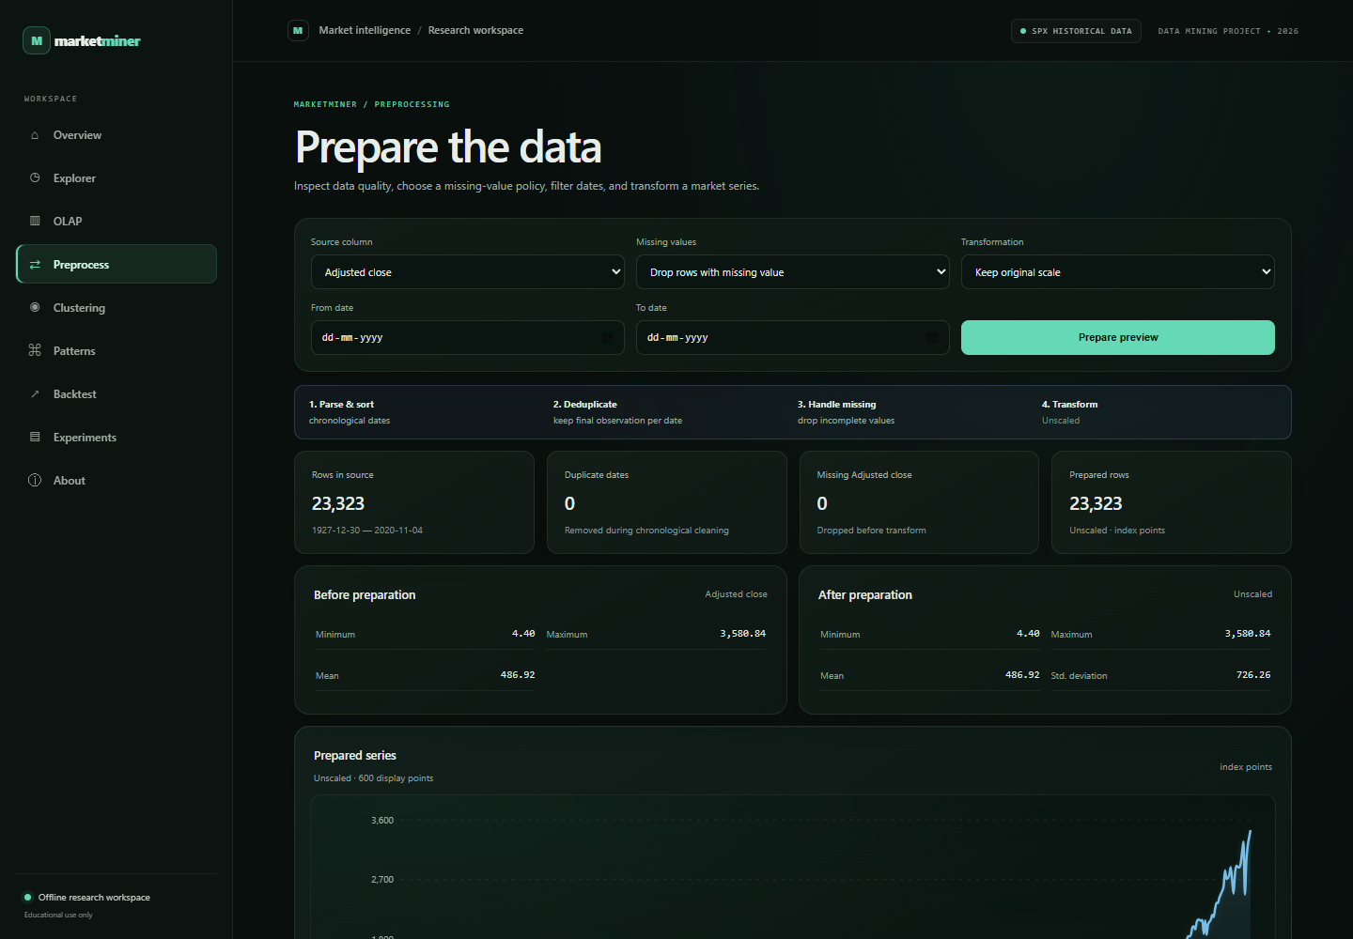
PreProcess

Slide 14
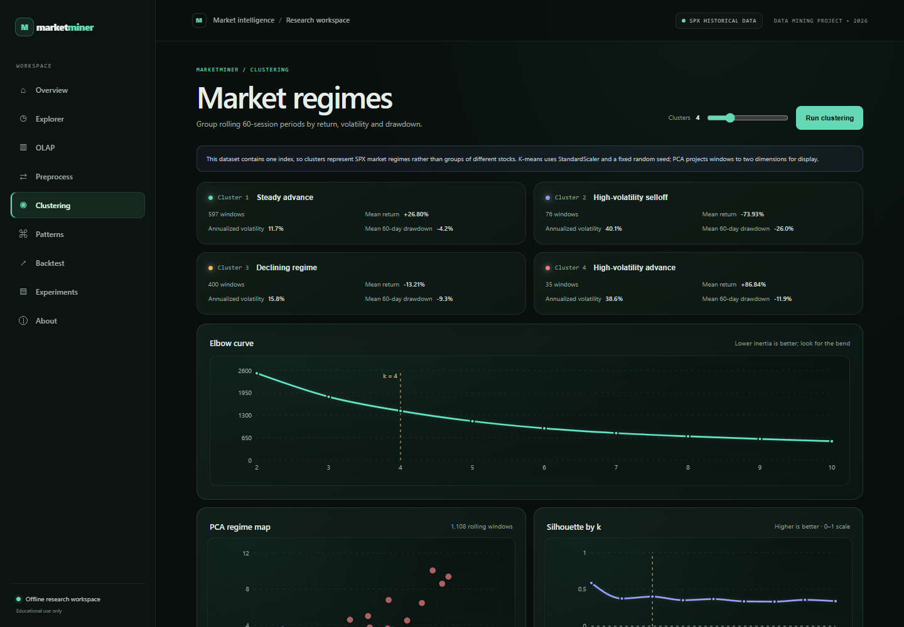
Clustering

Slide 15
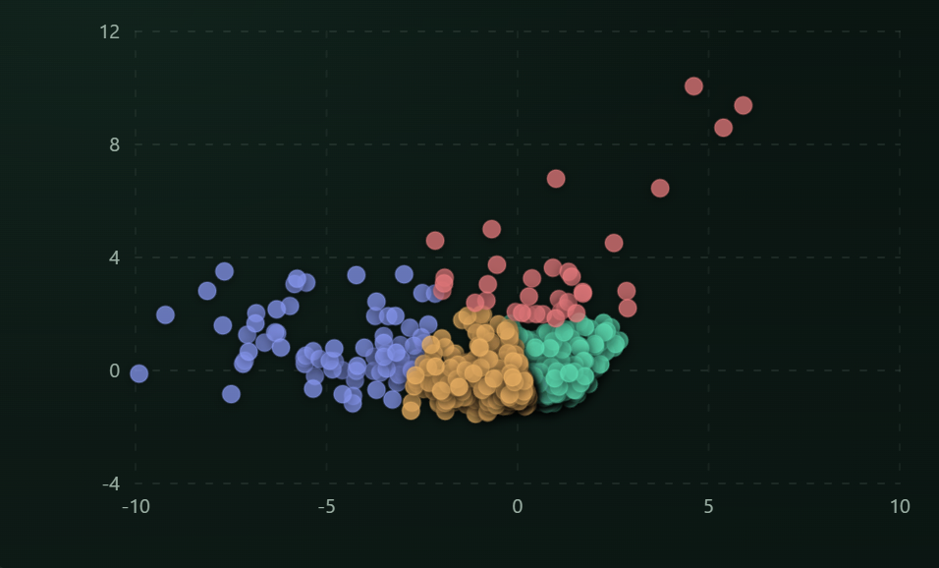
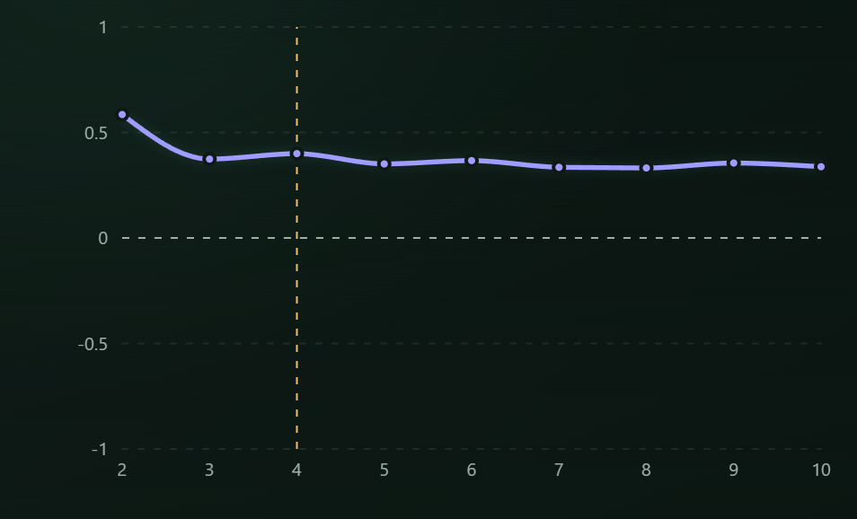
Clustering — regime diagnostics
PCA regime map. Each point is a rolling window, colored by its assigned regime.
Silhouette score by cluster count. Higher values indicate better separation on this diagnostic scale.

Slide 16
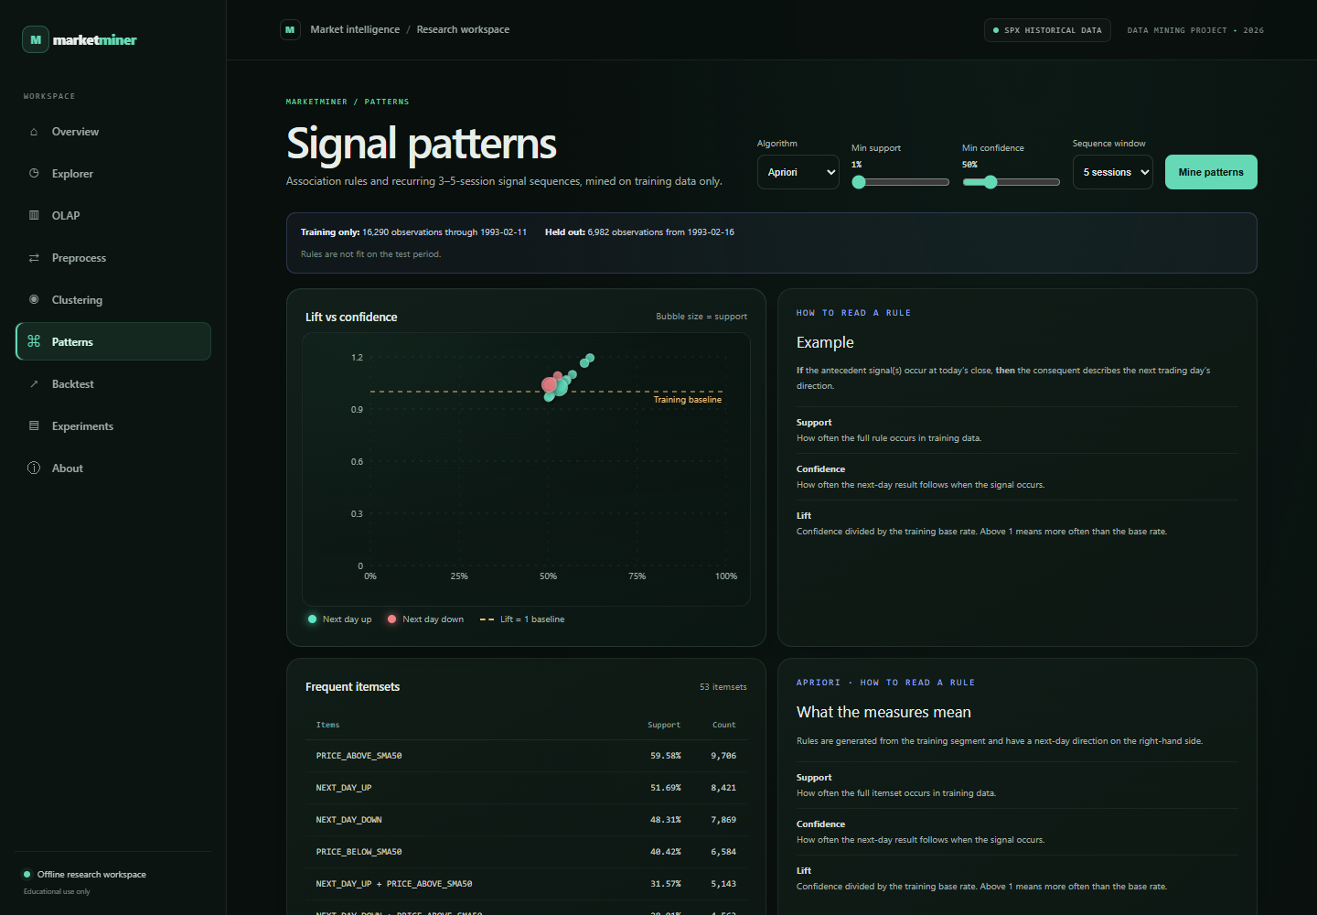
Patterns

Slide 17
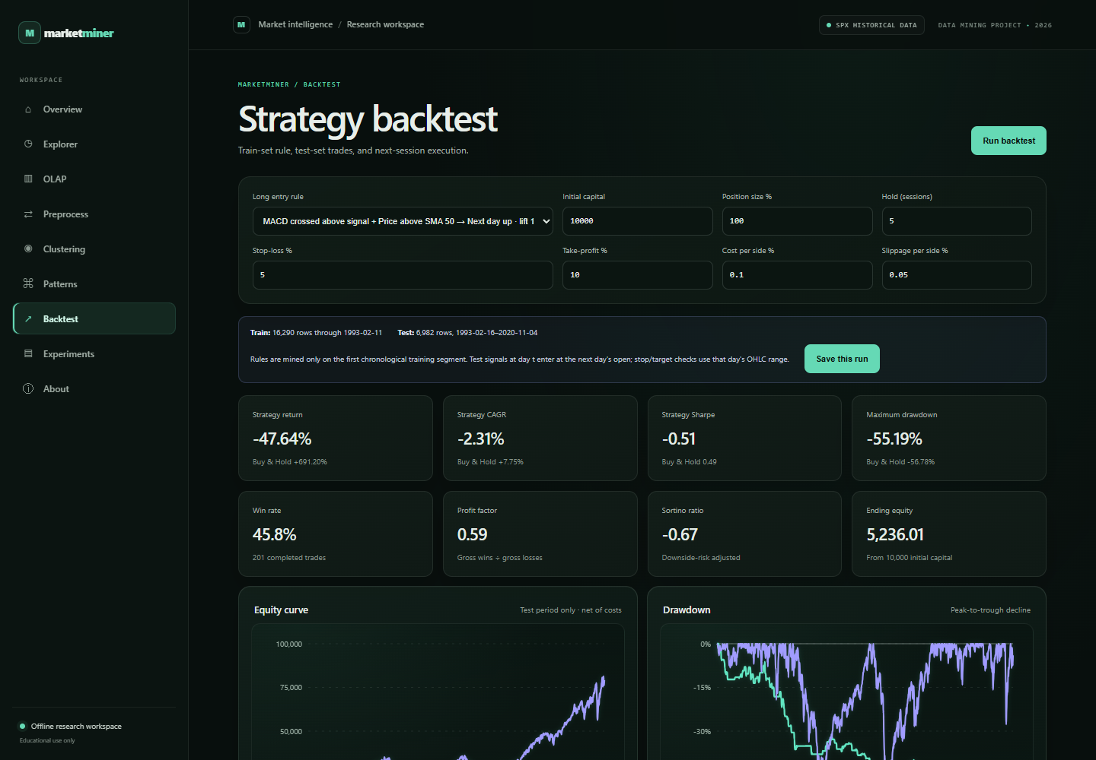
Backtest

Slide 18
VALUE PROPOSITION
Advantages & Applications
Key Advantages
Practical Applications
Organized Historical Storage: Faster analytics
Stock Market Segmentation: Portfolio grouping
Handles Large Datasets: Scalable ETL pipeline
Financial Research: Academic market study
Behavior Identification: Groups similar assets
Decision Support Systems: Data-driven insights
Automated Discovery: Uncovers hidden stock rules
Data Mining Sandbox: Algorithm benchmarking

Slide 19
SUMMARY
Conclusion
Practical Integration
Structured Analytics
Demonstrates practical synergy between Data Warehousing and Data Mining principles.
ETL cleans raw data, transforming unstructured records into query-ready information.
Pattern & Trend Analysis
Academic Scope
Clustering and association rule mining uncover key market relationships.
Designed for educational, research, and analytical evaluation, not guaranteed financial advice.
MarketMiner delivers a end-to-end framework for historical stock analytics.

Slide 20
BIBLIOGRAPHY
Key References
Jiawei Han, Micheline Kamber & Jian Pei – Data Mining: Concepts and Techniques
Ralph Kimball & Margy Ross – The Data Warehouse Toolkit
Official Documentation: Python, Pandas, NumPy, Scikit-learn, & Matplotlib
THANK YOU!
Questions & Answers

