Slide 1

18CSE357E- BIOMETRICS

Slide 2
Learning Resources
Reference Books
Introduction to Biometrics – James Wayman, - Springer
Feature Extraction and Image Processing for Computer Vision – Mark S Necon – Elsevir
Digital Image Processing using Mtalab – Rafael C, - Tata MC Graw Hill
Guide to Biometrics – Rood M Bolie –Springer
Pattern Classification – Richard Oduda – Wiley
Biometrics in Identity Management: Concepts to Applications – Shimon K Modi

Slide 3

UNIT – I Contents
Introduction to Biometric Systems
Biometric Functionalities :Verification and Identification
The Design Cycle of Biometric Systems
Introduction to Unimodel Systems
Introduction to multi-model Biometric Systems
Biometric System Errors & Performance Measures

Slide 4
UNIT – I Contents
Image Processing Basics
First & Second Derivatives
Steps in Edge Detection, Smoothing, enhancement, etc
Robert’s method, Sobel’s method and Perwits Method
Laplacian of Gaussian, Zero Crossing
Low Level Feature Extraction, Describing Image Motion
High Level Feature Extraction, Template Matching
Hough Transforms for Lines, Circles and Ellipses

Slide 5
Session – 1 & 2
Introduction to Biometric Systems
Biometric Functionalities :Verification and Identification
The design cycle of biometric systems
The building blocks of generic biometric systems

Slide 6
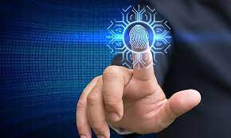
Introduction to Biometric Systems

Slide 7
Introduction to Biometric Systems
What does biometrics mean?
Why biometrics?
What is biometrics used for
What are the types of biometrics?
Who invented biometrics? (History of biometrics)
Is biometrics accurate and reliable

Slide 8
Introduction to Biometric Systems
Biometrics can be defined as the means of identifying and authenticating individuals in a reliable and fast way through unique biological characteristics.
It is the science of establishing the identity of an individual based on the physical, chemical or behavioural attributes of the person.
Biometrics allows a person to be identified and authenticated based on recognizable and verifiable data, unique and specific.

Slide 9
Why Biometrics?
Needs: For large-scale identity management systems whose functionality relies on the accurate determination of an individual's identity in the context of several different applications
The proliferation of web-based services (e.g., online banking)
The deployment of decentralized customer service centres (e.g., credit cards)
The main aim is to prevent impostors from accessing protected resources

Slide 10
History of Biometrics
In the second century B.C., the Chinese emperor Ts'In was a authenticating specific seals with a fingerprint.
Fingerprints were first used in a commercial setting in 1858 by William James Herschel, a British administrator in India. Having been put in charge of building roads in Bengal, he had his subcontractors sign contracts with their fingers.
At the end of the 19th century, Bertillon, a French police officer, took the first steps in scientific policing.
He used physical measurements of specific anatomical characteristics to identify reoffending criminals

Slide 11
Types of Biometrics
There are two types of biometrics:
#1. Physiological measurements
They can be either morphological or biological.
Morphological identifiers mainly consist of fingerprints, the hand's shape, the finger, vein pattern, the eye (iris and retina), and the face's shape.
For biological analyses, DNA, blood, saliva, or urine may be used by medical teams and police forensics.

Slide 12
Types of Biometrics
#2. Behavioral measurements
The most common are:
voice recognition,
signature dynamics (speed of movement of pen, accelerations, pressure exerted, inclination),
keystroke dynamics,
the way we use objects,
gait, the sound of steps,
gestures, etc.

Slide 13
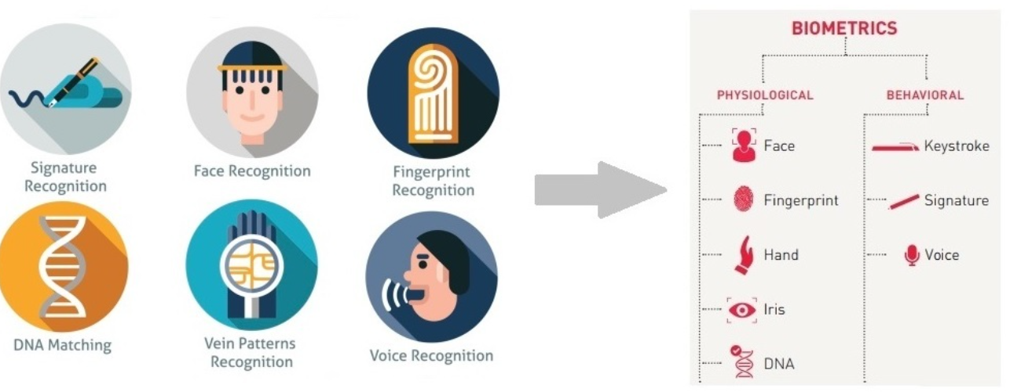
Types of Biometrics

Slide 14
Traditional Methods and Biometrics
Traditional methods of establishing a person's identity
Knowledge- based (e.g., passwords) and
Token-based (e.g., ID cards) mechanisms
Drawbacks: Representations of identity can easily be lost, shared, manipulated or stolen thereby compromising the intended security.
Dual-factor Authentication Scheme:
Biometrics is used to supplement ID cards and passwords thereby imparting an additional level of security.

Slide 15
Biometrics for Identity
Person Recognition in Identity Management
The aim is to establish the association between an individual and his personal identity.
One must be able to determine a person’s identity or verify the identity claim of an individual whenever required
This process is known as person recognition.
A person can be recognized based on
(a) what he knows,
(b) what he possesses extrinsically, and
(c) who he is intrinsically (biometric recognition)

Slide 16
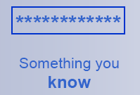
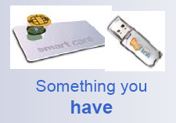
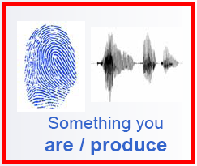
Biometrics for Identity
The three different types of authentication
Something you know [knowledge based system]
password, PIN
Something you have [token based system]
Card key, smart card
Something you are Biometric

Slide 17
Attacks in Authentication Systems
Various types of Malicious Attacks on Authentication Systems
client attack (e.g. guessing passwords, stealing tokens);
host attack (e.g. accessing plain text ¯le containing passwords);
eavesdropping (e.g. shoulder surfing for passwords);
repudiation (e.g., claiming that token was misplaced);
trojan horse attack (e.g., installation of bogus log-in screen to steal passwords); and
denial of service (e.g., disabling the system by deliberately supplying an incorrect password several times).

Slide 18
Biometric Systems Advantages and Disadvantages
Advantages
Uniqueness
No need to remember password and pin
Cannot be lost, stolen or forgotten
Difficult to copy, share and distribute
Person is required to be present for authentication
Disadvantages
Violation of Privacy
Need of significant computational resources
Intra-class variation: Due to change in pose or age
Vulnerable to spoof attacks

Slide 19
Traits, indicators, identifiers or modalities.
Physical/Behavioural Characteristics used in BS
Fingerprint, face, hand/Finger geometry, iris, retina, signature, gait, palm-print, voice pattern, ear, hand vein, odour or the DNA information of an individual to establish identity
These characteristics are referred to as traits, indicators, identifiers or modalities.

Slide 20
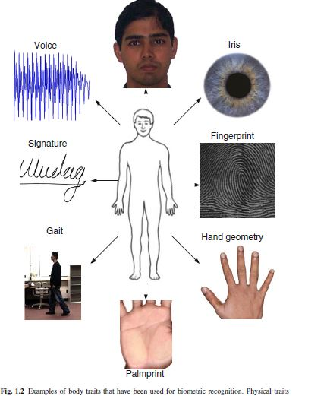
Traits, indicators, identifiers or modalities.
Different Traits

Slide 21
Operation of a Biometric System
A Biometric System is a pattern recognition system that acquires biometric data from an individual, extracts a salient feature set from the data, compares this feature set against the feature set(s) stored in the database, and executes an action based on the result of the comparison.
The main modules are
a sensor module;
a quality assessment
feature extraction module;
a matching module; and
a database module.

Slide 22
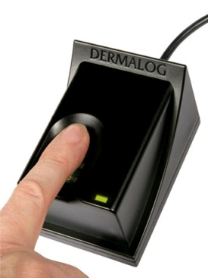
Operation of a Generic Biometric System
A generic biometric system
Database
Enrollment
Enroll/
Match
Preprocessing
Feature
Extraction
Matching
Verification/
Identification
Image Acquisition

Slide 23
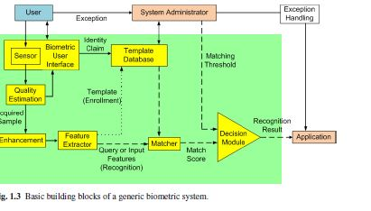
Basic building block of generic Biometric Systems

Slide 24
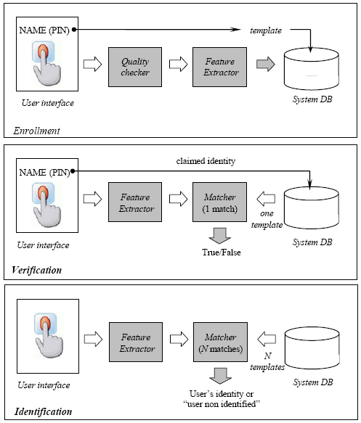
Operation of a Biometric System
Depending upon the application context, system operates in
Verification Mode: (1:1)
Identification Mode: (1:N)

Slide 25
Operation of a Biometric System
Verification Mode
The system validates a person’s identity by comparing the captured biometric data with her own biometric template stored system database
Eg: Does the biometric data belong to Ajay?
Identification mode
The system recognizes an individual by searching the template of all the users in the database for a match.
Eg: whose biometric data is this?

Slide 26
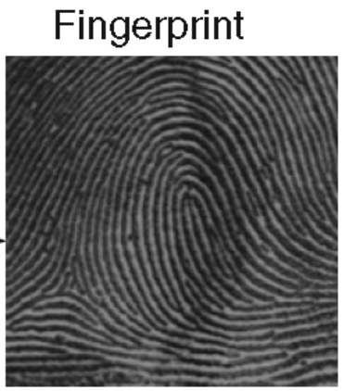
Sensor Module
A suitable biometric reader or scanner is required to acquire the raw biometric data of an individual.
To obtain Fingerprint images, for example, an optical Fingerprint sensor may be used to get the friction ridge structure of the Fingertip.
The sensor module defines the human machine interface

Slide 27
Quality assessment and feature extraction module
The sensor data is assessed in order to determine its suitability for further processing.
Typically, the acquired data is subjected to a signal enhancement algorithm in order to improve its quality.
A set of salient discriminatory features are extracted to represent the underlying trait. For example, the position and orientation of minutia points (local ridge and valley anomalies) in a fingerprint image are extracted by the feature extraction module in a fingerprint-based bio metric system.
During enrolment, this feature set is stored in the database and is commonly referred to as a template

Slide 28
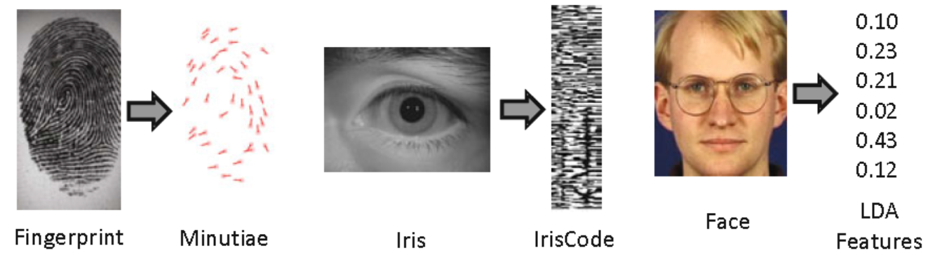
Quality assessment and feature extraction module

Slide 29
System database module
The database acts as the repository of bio-metric information.
Raw biometric sample (i.e., the template) is stored in the database (possibly) along with some biographic information characterizing the user
Some systems store multiple templates in order to account for the intra-class variations associated with a user.
Face recognition systems, for instance, may store multiple templates of an individual, with each template corresponding to a different facial pose with respect to the camera.

Slide 30
System database module
The raw biometric images may also be stored in the database along with the templates during enrolment. Such images are often known as gallery images, reference images, stored images, or enrolment images.
The images acquired during recognition are known as probe images, query images, or input images

Slide 31
Matching and Decision-Making Module:
The extracted features are compared against the stored templates to generate match scores.
In a fingerprint-based biometric system, the number of matching minutiae between the input and the template feature sets is determined and a match score reported.
The match score may be moderated by the quality of the presented biometric data.
The matcher module also encapsulates a decision making module, in which the match scores are used to either validate a claimed identity or provide a ranking of the enrolled identities in order to identify an individual.

Slide 32
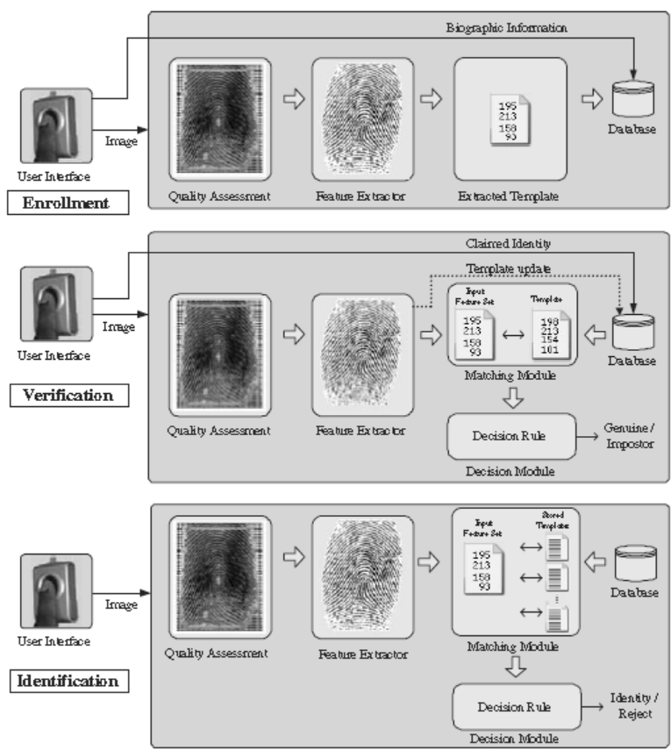
Biometric Functionalities

Slide 33
Biometric Functionalities
A biometric system can provide two types of identity management functionalities, namely, verification and identification
Verification
Here, the user claims an identity and the system verifies whether the claim is genuine, i.e., the system answers the question “Are you who you say you are?”.
In this scenario, the query is compared only to the template corresponding to the claimed identity (a one-to-one match).
Verification is typically used in applications where the goal is to prevent unauthorized persons from using the services
Verification as the two-category classification problem:
Given a claimed identity I and a query feature set x^{A}, we need to decide if (I,x^{A}) belongs to “genuine” or “impostor” class.

Slide 34

Biometric Functionalities
Let x Ͼ I be the stored template corresponding to identity I. Typically, x^{A} is compared with x Ͼ I and a match score s, which measures the similarity between x^{A} and x Ͼ I , is computed.
The decision rule is given by
where η is a pre-defined threshold
When the identity claim is deemed to be “genuine”, the user is allowed to access the services provided by the system

Slide 35
Biometric Functionalities
Identification
Identification functionality can be further classified into positive and negative identification.
In positive identification, the user attempts to positively identify himself to the system without explicitly claiming an identity.
A positive identification system answers the question “Are you someone who is known to the system?” by determining the identity of the user from a known set of identities.
In contrast, the user in a negative identification application is considered to be concealing his true identity (either explicitly or implicitly) from the system.
Negative identification is also known as screening and the objective of such systems is to find out “Are you who you say you are not?”.

Slide 36
Biometric Functionalities
The purpose of negative identification is to prevent a single person from using multiple identities.
Hence, screening can be used to prevent the issue of multiple credential records (e.g., driver’s licence, passport) assigned to the same person or to prevent a person from claiming multiple benefits under different names
In both positive and negative identification, the user’s biometric input is compared with the templates of all the persons enrolled in the database and the system outputs either the identity of the person whose template has the highest degree of similarity with the user’s input.

Slide 37
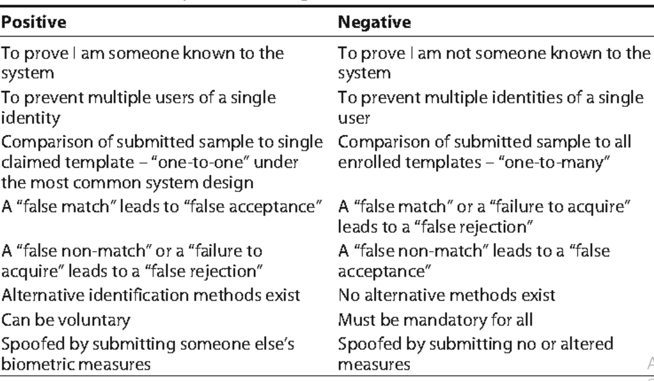
Biometric Functionalities
Differences between “Positive” & “Negative” Identification

Slide 38
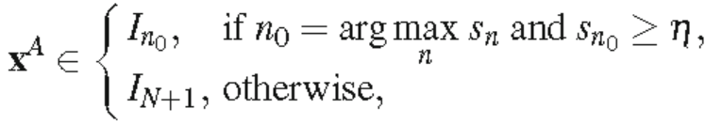
Biometric Functionalities
Formally, the problem of identification can be stated as follows:
Given a query feature set x^{A}, we need to decide the identity I of the user, where I ∈ {I1, I2, · · · , IN, IN+1}. Here, I1, I2, · · · , IN correspond to the identities of the N users enrolled in the system and IN+1 indicates the case where no suitable identity can be determined for the given query. If x Ͼ In is the stored template corresponding to identity In and sn is the match score between x^{A} and xEIn, for n = 1,2, · · · ,N, the decision rule for identification is,
where η is a pre-defined threshold.
The above decision rule is commonly known as open set identification

Slide 39
Biometric Functionalities
It is also possible to force the system to return one among the N enrolled identities, irrespective of the value of sn0 . Such a scenario is called closed set identification.
In some practical biometric identification systems (e.g., latent fingerprint matching), identification is semi-automated.
A semi-automated biometric system outputs the identities of the top t matches (1 < t Ͼ N) and a human expert manually determines the identity (among the t selected identities) that best matches the given query.
The value of t could be determined based on the availability and throughput of the human expert(s).

Slide 40
The Design Cycle of Biometric Systems
Major activities in the design of BS (Iterative)
Understanding the nature of the application and the performance requirements
Choosing the right biometric trait(s) for the application in hand
Collect biometric data from a subset of target population
Design or train the core biometric modules, including the feature extractor and the matcher
Evaluation procedure to ensure that it meets the requirements of the application

Slide 41
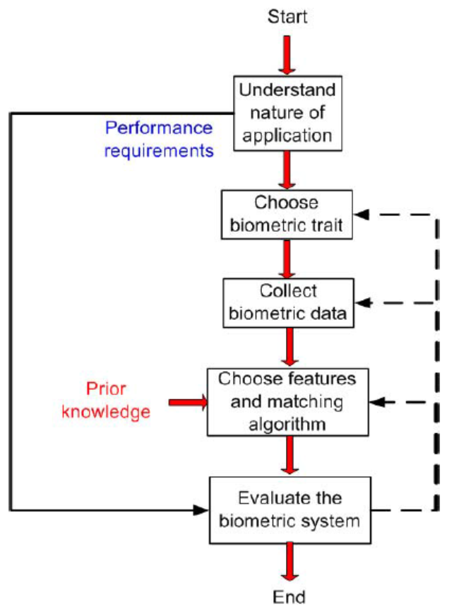
The Design Cycle of Biometric Systems

Slide 42
A Taxonomy of Application Environments
The variations in the application environment had a significant impact on the way the devices performed.
In fact, accurate characterization of the operational environment is primary in selecting the best biometric technology and in predicting the system’s operational characteristics.
Depending on the application context, we may need to choose between the verification and identification functionalities

Slide 43
Factors influencing the Nature of the Application
1. Nature of the application
Biometric applications can also be classified based on the following issues (Nature of the App).
Cooperative versus non-cooperative user
Overt versus covert deployment
Habituated users versus non-habituated users
Attended versus unattended operation
Controlled versus uncontrolled operation
Open versus closed system

Slide 44
Factors influencing the Nature of the Application
Cooperative versus non-cooperative users
Eg. (Cooperative) - E-Banking
Eg. (Non-cooperative) – Terrorist’s behaviours in airport screening application
Overt versus Covert deployment
If the user is aware that he is being subjected to biometric recognition, the application is categorized as overt (Finger Print Verification System)
If the user is unaware, the application is called covert (Facial Recognition)

Slide 45
Factors influencing the Nature of the Application
Habituated users versus non-habituated users
If the enrolled users interact with the biometric system quite frequently, they tend to get habituated in providing their biometric data. (Login App in Computer Network)
A driver’s license application typically has non-habituated users since a driver’s license is renewed only once in a period of several years.
The familiarity of users with the system can affect recognition accuracy

Slide 46
Factors influencing the Nature of the Application
Attended versus unattended operation
It refers to whether the process of biometric data acquisition in an application is observed, guided, or supervised by a human (e.g., a security officer).
An application may have an attended enrollment operation but unattended recognition operation
For example, a banking application may have a supervised enrollment when an ATM card is issued to a user, but the subsequent uses of the biometric system for the ATM transaction are not attended

Slide 47
Factors influencing the Nature of the Application
Controlled versus uncontrolled operation: In a controlled environment, ambient environmental conditions such as temperature, pressure, moisture, lighting conditions, etc. can be moderated during the operation of a biometric system.
Typically, indoor applications such as computer network login operate in a controlled environment, whereas outdoor applications such as keyless car entry or parking lot surveillance operate in an uncontrolled environment.
This classification is also important for the system designer as a more rugged biometric sensor is needed for an uncontrolled environment

Slide 48
Factors influencing the Nature of the Application
Open versus closed system: If a person’s biometric template can be used across multiple applications, the biometric system can be considered as open.
For example, a user may use a fingerprint-based recognition system for entering secure facilities, computer network login, electronic banking, and bank ATMs.
When all these applications use separate templates (databases) for each application, the system is considered closed.
A closed system may be based on a proprietary template whereas an open system will need standard data formats and data compression methods to exchange and compare information between different systems

Slide 49
Factors influencing the Biometric Traits
2. Choice of biometric trait
Each biometric trait has its pros and cons and, therefore, the choice of a biometric trait for a particular application depends on a variety of issues.
In general, seven factors must be considered to determine the suitability of a physical or a behavioural trait to be used in a biometric application.

Slide 50
Factors influencing the Biometric Traits
Universality: It determines the failure to enroll (FTE) rate of the biometric system
Uniqueness: The given trait should be different across individuals comprising the user population. Otherwise, the false match rate (FAR or FPIR) of the biometric system would be high
Permanence: The biometric trait of an individual should be invariant over a period of time with respect to the matching algorithm, else, it will lead to a high false non-match rate (FRR or FNIR).

Slide 51
Factors influencing the Biometric Traits
4. Measurability: It should be possible to acquire and digitize the biometric trait using suitable devices that do not cause inconvenience to the individual.
This factor significantly impacts the frequency of FTE and FTA failures and the recognition accuracy
5. Performance: The computational resources required to achieve that accuracy and the throughput requirements
6. Acceptability: Individuals in the target population that will utilize the application should be willing to present their biometric trait to the system

Slide 52
Factors influencing the Biometric Traits
7. Circumvention: This refers to the ease with which the trait of an individual can be imitated using artifacts (e.g., fake fingers), in the case of physical traits, and mimicry, in the case of behavioural traits.
It also refers to the process of obfuscation, where a user deliberately alters his biometric trait to evade recognition
No single biometric is expected to effectively meet all the requirements (e.g., accuracy, practicality, cost) imposed by all applications (e.g., forensics, access control, govet benefits, etc.)

Slide 53
Commonly used biometric characteristics
Fingerprint
Palm print
Iris
Face
Hand Geometry (Shape)
Gait
Ear
Voice
Keystroke
Signature
DNA
Facial, hand, and hand vein infrared thermograms
Odour
Retinal Scan

Slide 54
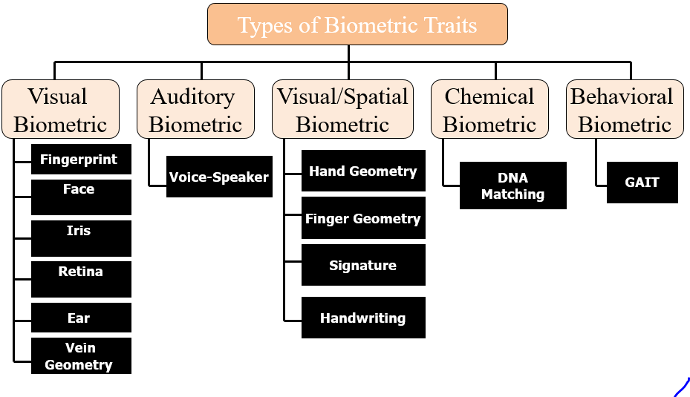
Types of Commonly used Biometric Characteristics

Slide 55
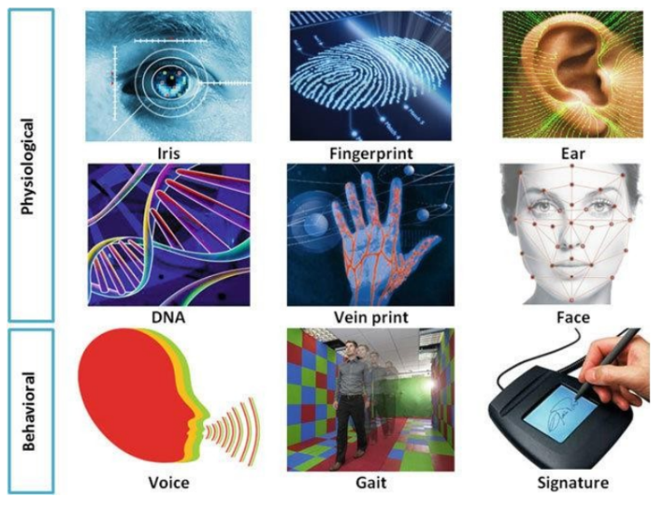
Taxonomy of Commonly used Biometric Characteristics

Slide 56
The advantages of Physiological based biometric authentication mechanisms
Physiological biometrics:
It does not take more than a few seconds to authenticate a person’s identity by fingerprint, face or voice.
One does not need to remember complex passwords, keys, tokens or smart cards to validate his identity.
The characteristics of this mechanism do not change e.g. Iris, fingerprint, DNA etc.
99% accuracy and reliability are being provided via distinctness in recognition.
Social acceptance of using this mechanism is high.
Hacking chances via using this are very less.

Slide 57
The advantages of using Behavioral based biometric authentication mechanisms
Behavioral biometrics:
Behavioral biometric authenticate the users without the need to do some specific action.
It collects the data for authentication dynamically.
By using it, user can maintain privacy and avoid social awkwardness.
It prevent identity theft and minimize the risk of online fraud.
It is very authentic scheme and based on the user experience and individual skills.
90% accuracy is provided by this in recognition

Slide 58
The disadvantages of using these biometric authentication mechanisms
Physiological biometrics:
Physiological Biometric authentication equipment is costly.
People have to wait in line to get scanned to gain access which can cause delays.
Slightly change in facial expression or obstruction due to hat, glasses or your finger is hurt or the voice is affected by cold couldn’t be recognized by the system.
Dry, wet or dirty fingers can oscillate performance

Slide 59
The disadvantages of using these biometric authentication mechanisms
Behavioral biometrics:
Behavioral biometric data can be used by people who want to steal them.
It has some effects on the privacy of individuals.
Sometimes have problem in input methods such as phonetic may suffer from language problem.
It would be difficult to identify the gesture if the movement slightly varies.
It provides the less reliability than physiological bio metric behavior

Slide 60
The rationale for choosing Behavioral vs physiological biometric authentication mechanisms
Behavioral biometrics:
Behavioral biometric authentication is preferred because the behavioral biometric system database is dynamic, making it more secure.
It has less chance of being copied, stolen or reused by unauthorized personnel, unlike physiological biometrics.
It does not require any specialized hardware that makes it economic friendly. These characteristics make behavioral biometrics a good option in high-security situation

Slide 61
The rationale for choosing Behavioral vs physiological biometric authentication mechanisms
Physiological biometrics:
Physiological biometrics are hardware-dependent, unlike biometric behavior.
Physiological biometric authentication provides accurate results compared to the behavioral mechanism.
Keeping these key points in mind, it is a better alternative to use physiological biometrics if the behavioral mechanism does not authenticate the user.
Physiological biometrics should be sufficient in environments where high protection is not required

Slide 62
The social issues in Biometric Authentication mechanism
The biometric-based authentication system can be attacked by Insider attacker and stranger
A scammer can make various attempts to spoof a legitimate user's biometric trait to bypass system security.
The biometric data obtained by a person during the authentication process can vary significantly from the data used to produce the template during enrollment. That can have a big effect on the matching process.

Slide 63
Multi-Biometric Systems
One way to improve the accuracy of biometric systems is to use more than one biometric trait in a recognition application.
For example, the face and iris traits, or the fingerprints from all the ten fingers of an individual may be used together to resolve the identity of an individual.
Such systems are known as multi-biometric systems.
These systems are expected to be more accurate and reliable due to the availability of multiple pieces of evidence

Slide 64
Data Collection
The collection of biometric data from a subset of the targeted population.
This data is required both for designing the feature extraction and matcher modules as well as for the evaluation of the designed biometric system.
Due to the involvement of human subjects, legal and privacy issues must also be considered and approval of organizations like the Institutional Review Board (IRB) is mandatory in many countries.
This makes biometric data collection a time-consuming, relatively expensive, and cumbersome process

Slide 65
Data collection
Choice of features and matching algorithm
Another important factor affecting the choice of features and matching algorithm is the interoperability between biometric systems
For eg, it challenging to compare voice samples originating from two different handset
The performance of face recognition algorithms is severely affected when the images used for comparison are captured using different camera types.

Slide 66
Evaluation
It requires experts from a variety of fields, including statistics, computer science, engineering, business, and psychology, as well as system designers and the end user community
In order to understand the performance of a biometric system, one must address the following questions
What are error rates of the given Biometric System for a given application?
What is the reliability, availability and maintainability of the system?
What are the vulnerabilities in the system? And so on

Slide 67
Evaluation
The evaluation requires an independent third party to design, administer, and analyze the test.
We can divide the matching performance evaluation of a biometric system into three stages
Technology evaluation – Compares different algorithms like Fingerprint Verification Competitions (FVC), the Fingerprint Vendor Technology Evaluation (FpVTE), the Face Recognition Vendor Tests (FRVT), the Face Recognition Technology (FERET) program, and the NIST Speaker Recognition Evaluations (SRE)
These algorithms are examples of biometric technology evaluations.

Slide 68
Evaluation
2. Scenario evaluation - the testing of the prototype biometric systems is carried out in an environment that closely resembles the real-world application
3. Operational evaluation - is used to ascertain the performance of a complete biometric system in a specific real-world application environment on a specific target population.

Slide 69
Applications of Biometric Systems
Commercial applications such as
computer network login,
electronic data security,
e-commerce, Internet access,
ATM or credit card use,
physical access control,
mobile phone, PDA,
health record management,
distance learning, etc.

Slide 70
Applications of Biometric Systems
Government applications such as
national ID card,
managing inmates in a correctional facility,
driver’s license,
social security,
welfare-disbursement,
Border control,
passport control, etc

Slide 71
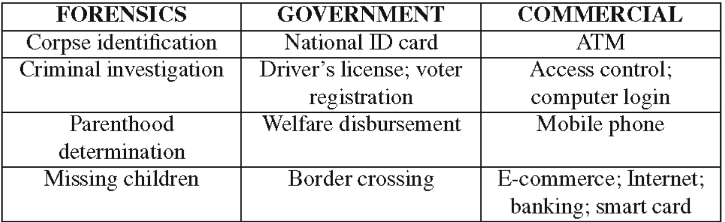
Applications of Biometric Systems
Forensic applications such as
Corpse identification,
Criminal investigation,
Missing children,
parenthood determination, etc.

Slide 72
Session 3 and 4
Introduction to Uni-model System
Introduction to Multi-model Biometric System
Biometric System Errors
Performance Measures

Slide 73
Categories of Biometrics Systems
Biometric System are basically categorized as
Unimodal
Multimodal

Slide 74
Uni-modal Systems
Biometric systems that operate using any single biometric characteristic
Less expensive and simple
Unimodal Systems
Face
Fingerprint
Iris
Ear
Signature
Gait

Slide 75
Unimodal
Limitations of Unimodal Biometric System:
Susceptibility of biometric sensor to noisy or bad data.
The captured biometric trait might be distorted due to imperfect acquisition conditions.
(Eg: In fingerprint recognition where a scanner is unable to read dirty fingerprints clearly and leads to false database match.)

Slide 76
Limitations
It might not be compatible with certain groups of population
(fingerprint images might not be properly captured for the elderly and young children because of faded fingerprints or underdeveloped fingerprint ridges.)
Within a large population ,uni-modal biometrics is prone to inner class similarities
(eg: facial recognition may not work correctly for identical twins as the camera might not be able to distinguish between two subjects leading to inaccurate matching.)

Slide 77
Limitations
Unimodal biometrics systems are vulnerable to spoof attacks where the data can be imitated or forged.
(fingerprint recognition systems can be easily spoofed using rubber fingerprints)

Slide 78
In a Nutshell, the Limitations are
Noisy Data
Leads to false rejection
Inter-class similarity
For Identical twins face recognition system will not work
Incompatible for subset of population
Hard workers have poor fingerprint pattern
Vulnerable to spoofing
Data can be imitated or forged
Example: Latent fingerprints
Accuracy

Slide 79
Multimodal Biometric System
A biometric system that uses more than one
Classifier/ Algorithm
Sample
Sensor
Trait

Slide 80
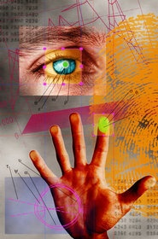
Need of Multimodal Biometrics
Reduces error rates of Unimodal
System
A secondary means of authentication
Poor quality sample from the sensor
Non-availability of data
Combat spoof attacks such as fake fingers

Slide 81
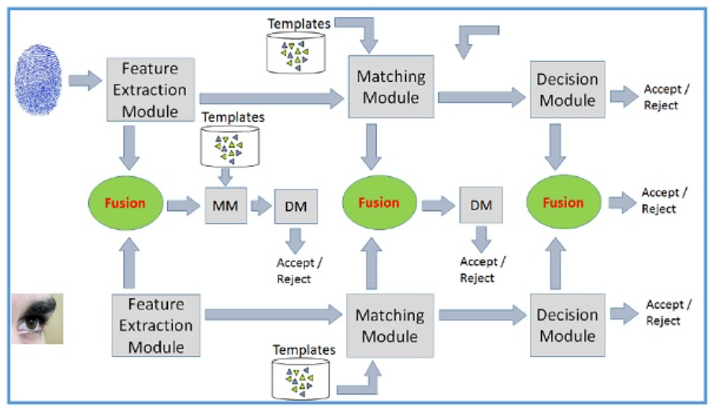
Multimodal Biometric System

Slide 82
Multimodal Biometric System
Merge two or more biometric technologies such as facial recognition ,fingerprint, iris scanning, hand geometry, voice recognition etc.
Systems take input from single or multiple sensors for measuring two or more different biometric characteristics.
Improving recognition rate, combining two or more biometric modalities might be more appropriate for different applications.

Slide 83
Integration Scenarios
Multiple Sensors
Multiple Biometrics
Multiple units of same biometrics
Multiple snapshots of same biometrics
Multiple Classifiers

Slide 84
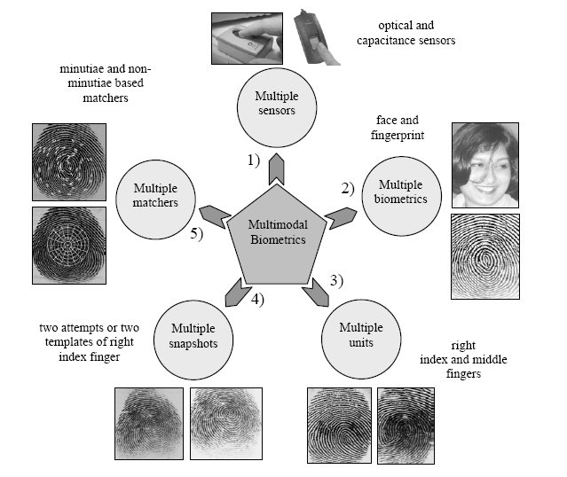

Slide 85
Types of Multimodal Biometric System
Multi algorithmic biometric system: System take a single sensor and then process it using two or more different algorithms.
Multi instance biometric systems: Systems use one or more sensors to capture samples of two or more different samples of same biometric trait.(Capturing images of multiple fingers)

Slide 86
Multi Sensorial Biometric Systems
Multi sensorial biometric systems: system use two or more distinctly different sensors to capture the same instance of a biometric trait.
Captured samples are then processes using single algorithm or combination of algorithm
( eg: same facial image is captured using visible light camera and infrared camera fixed with particular frequency)

Slide 87
Fusion Strategies
Multimodal biometric system requires integration of data of different modalities like face, fingerprint, retina, voice, iris, etc
It can be done through a process called “Fusion”
There are different fusion methods or strategies used in the mult-modal Biometric Systems

Slide 88
Different Fusion Strategies
Fusion prior to matching
Sensor level fusion
Feature level fusion
Fusion after matching
Match score fusion
Rank level fusion
Decision level fusion

Slide 89
Different Fusion Strategies (cont.)
Sensor level fusion
We fuse the biometric traits coming from the different sensors such as fingerprint scanner, iris scanner, video camera etc. to form a merged biometric trait and process.
Raw data from the sensor(s) are combined.
This is referred to as image level or pixel level fusion.
Sensor level fusion can benefit multi-sample systems which capture multiple snapshots of the same biometrics.
For example, 2D face images of an individual obtained from several cameras can be combined to form a 3D model of the face.

Slide 90
Different Fusion Strategies (cont.)
Feature level fusion: signals coming from different biometric channels are first processed after which the feature vectors are extracted separately from each biometric trait.
It refers to combine different feature sets extracted from multiple biometric sources.
When feature sets are homogeneous, a single resultant feature vector can be calculated as a weighted average of the individual feature vector
When the feature set are non-homogeneous , we can concatenate to form a single feature vector.

Slide 91
Different Fusion Strategies (cont.)
Match score fusion: individual matching score isfound,we then fuse the matching level to find composite matching score which will be used for classification.
Scores generated from different matching modules are combined to produce a single score.
Final decision is taken by considering the fused score.
Normalization and Similarity/ Dissimilarity Score
There are various approaches possible for combining the individual scores.
Product rule
Sum rule
Weighed sum rule
Max rule and median rule

Slide 92
Different Fusion Strategies (cont.)
Rank level fusion
For identification, output is the ranks of enrolled identities.
This fusion scheme is to consolidate the ranks of individual biometric systems to derive a fused rank for each identity.
It reveals less information than match scores. However, unlike match scores, the ranking output by multiple biometric systems are comparable.
No normalization is needed and this makes the rank level fusion schemes simpler to implement compared to the score level fusion techniques.
Highest rank method
Logistic regression method

Slide 93
Different Fusion Strategies (cont.)
Decision level fusion: Each biometric trait is first pre classified separately
Individual trait is first captured and then features are extracted from the captured trait.
Decision level fusion is the highest level fusion of biometric evidences.
Fusion is carried out at the abstract or decision level when only the decisions output by the individual biometric matchers are available.
It logically combines accept/reject matching decisions of different matchers.
“AND” and “OR” rule
Majority voting
Weighted majority voting
Bayesian decision fusion

Slide 94
Advantages of Multimodal Biometric Systems
Multimodal biometrics can reduce data distortion.
Multimodal biometric systems are very difficult to spoof as compared to unimodal systems.
Multimodal biometric systems are most robust, reliable and accurate as compared to unimodal systems.
Multimodal systems overcome the various limitations of unimodal systems and hence are suitable to many industries such as healthcare, civil id and financial industries.

Slide 95
Biometric System Errors
Uniqueness and permanence of the underlying biometric trait are the fundamental premises of BS
Biometric identifier is said to be unique only if any two persons in the world can be differentiated based on the given identifier.
A biometric trait is permanent if it does not change over the lifetime of an individual.
Biometric systems rely only on the digital measurements of the body characteristics, and not the real physical traits.
This process of measurement (sensing) introduces variations in the samples of the same biometric trait of a user obtained over a period of time.

Slide 96
Biometric System Errors
The variability observed in the biometric feature set of an individual is known as intra-user variations or intra-class variations.
This variability may be due to reasons like imperfect sensing conditions (e.g., noisy fingerprint due to sensor malfunction), alterations in the user’s biometric characteristics, changes in ambiant conditions (e.g., inconsistant illumination levels in face recognition applications), and variations in the user’s interaction with the sensor (e.g., occluded iris)
An ideal biometric feature set must exhibit small inter-user similarity and small intra-user variations

Slide 97
Biometric System Errors
Two types of errors, namely, false non-match and false match
When the intra-user variation is large, two samples of the same biometric trait of an individual (mate samples) may not be recognized as a match, and this leads to a false non-match error.
A false match occurs when two samples from different individuals (non-mate samples) are incorrectly recognized as a match due to large inter-user similarity.

Slide 98
Performance measures
The basic measures of the accuracy of a biometric system are False Non-Match Rate (FNMR) and False Match Rate (FMR).
FNMR refers to the expected probability that two mate samples (samples of the same biometric trait obtained from the same user) will be falsely declared as a non-match.
FMR is the expected probability that two non-mate samples will be incorrectly recognized as a match
A FNMR of 5% indicates that on average, 5 in 100 authentication attempts by genuine users will not succeed.
A False Match Rate of 0.02% indicates that on average, 1 in 5,000 authentication attempts by random impostors are likely to succeed

Slide 99
Performance measures
Verification system error rates
In the context of biometric verification, FNMR and FMR are generally referred to as False Reject Rate (FRR) and False Accept Rate (FAR), respectively
A match score is termed as a genuine or authentic score if it indicates the similaritybetween two mate samples.
An impostor score measures the similarity between two non-mate samples
Given a set of genuine and impostor match scores, FRR can be defined as the proportion of genuine scores that are less than the threshold η and
FAR can be defined as the fraction of impostor scores that are greater than or equal to η.

Slide 100
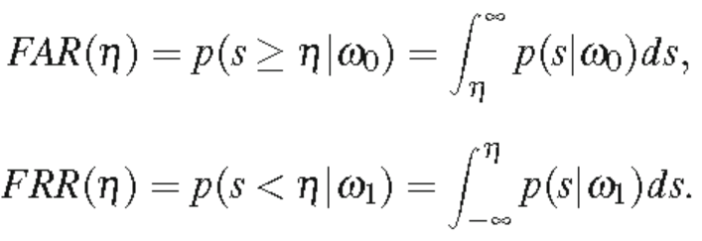
Performance measures
we will use the labels ω0 and ω1 to denote the impostor and genuine classes, respectively. Let p(s|ω1) and p(s|ω0) be the probability density functions of the genuine and impostor scores, respectively
The FAR and FRR of the biometric system are given by
If the threshold is increased, FAR will decrease but the FRR will increase and vice versa.
Hence, for a given biometric system, it is not possible to decrease both these errors simultaneously by varying the threshold.

Slide 101

Performance measures
The Genuine Accept Rate (GAR) or True Accept Rate (TAR) can be used as an alternative to FRR
Four categories of users are usually defined in the biometrics (Doddington’s zoo)
Sheep represent users whose biometric feature sets are very distinctive and exhibit low intra-class variations. Therefore, these users are expected to have low false accept and false reject errors.
Goats refer to users who are prone to false rejects. The biometric feature sets of such users typically exhibit large intra-class variations

Slide 102
Performance measures
Lambs are users whose biometric feature set overlaps extensively with those of other individuals.
The biometric feature sets of these users have high inter-user similarity.
Thus, a randomly chosen user (from the target population) has a higher probability of being accepted as a lamb than as a sheep.
The false accept rate associated with these users is typically high

Slide 103
Performance measures
Wolves indicate individuals who are successful in deliberately manipulating their biometric trait (especially behavioural traits) in order to impersonate legitimately enrolled users of a system.
Since the wolves make a concerted effort to adopt the identity of another user, such an effort is often referred to as an adversary attack and it can increase the FAR of a system
Examples include forging the signature of another user or mimicking someone else’s voice

Slide 104
Performance measures
The Failure to Enroll (FTE) rate denotes the proportion of users that cannot be successfully enrolled in a biometric system
This necessitates the design of robust and efficient user interfaces that can assist an individual both during enrollment and recognition
The fraction of authentication attempts in which the biometric sensor cannot capture the sample presented to it is known as Failure to Capture (FTC) or Failure to Acquire (FTA) rate
Thus, periodic sensor maintenance is instrumental for the efficient functioning of a biometric system

Slide 105
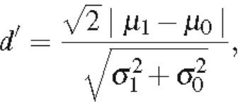
Performance measures
The performance of a biometric system may also be summarized using other single-valued measures such as the Equal Error Rate (EER) and the d-prime value
The EER refers to that point in a Detection Error Tradeoff- DET (or) Receiver Operating Characteristic - ROC curve where the FAR equals the FRR; a lower EER value, therefore, indicates better performance.
The d-prime value (d) measures the separation between the means of the genuine and impostor probability distributions in standard deviation units and is defined as

Slide 106
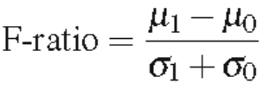
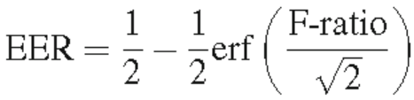
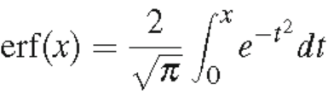
Performance measures
where μ1 (μ0) and σ1 (σ0) are the mean and standard deviation, respectively, of the genuine (impostor) score distributions.
A higher d-prime value indicates better performance.
Another single valued performance measure is known as the F-Ratio, which is defined as
If the genuine and impostor distributions are Gaussian, then the EER and F-ratio are related according to the following expression where

Slide 107
Performance measures
Identification system error rates
Suppose that a biometric identification system, with N identities enrolled, outputs a set of identities corresponding to the top t matches (1 ≤ t N).
The identification rank is defined as the rank of a user’s correct identity in the top t matches returned by the identification system.
There are two types of identification system errors. A false positive identification occurs when an identity is returned for a user not enrolled in the system.
This is analogous to the false match case in biometric verification

Slide 108
Performance measures
The expected proportion of identification transactions by users not enrolled in the system, where an identity is returned, is known as the false positive identification rate (FPIR).
The FPIR depends both on the size of the enrollment database (N) and the threshold (η)
False negative identification refers to a scenario where the transacting user is enrolled in the database, but his correct identity is not among those returned by the system.

Slide 109
Performance measures
The expected proportion of identification transactions by users enrolled in the system in which the user’s correct identity is not returned is called the false negative identification rate (FNIR).
FNIR depends on the size of the enrolment database (N), the threshold (η) used for the match scores, and the number of identities t returned by the identification system.
A quantity related to the FNIR is the true positive identification rate (TPIR), which is the expected proportion of identification transactions by users enrolled in the system, where the user’s correct identity is among the t identities returned by the system. Therefore, FNIR = 1− TPIR

Slide 110
End of Part 1 (UNIT 1)

