Slide 1
UNIT 3
MULTIBIOMETRICS

Slide 2
Multibiometrics
Biometric systems can also be designed to recognize a person based on information acquired from multiple biometric sources.
Such systems, known as multibiometric systems, are expected to be more accurate compared to unibiometric systems that rely on a single piece of biometric evidence

Slide 3
ADVANTAGES
Availability of multiple biometric sources provides redundancy and fault-tolerance in the sense that the recognition system continues to operate even when certain biometric acquisition modules fail.
Alleviate the non-universality problem and reduce the failure to enroll errors. (For example, if a person cannot be enrolled in a fingerprint system due to worn-out ridge details or missing fingers he can still be identified using his other traits like face or iris.)
Increase the resistance to spoof attacks. This is because it becomes increasingly difficult to circumvent(avoid) multiple biometric sources simultaneously

Slide 4
DISADV
It is more expensive than unibiometric systems due to the need for additional hardware (computational or storage resources) and larger enrollment and recognition times.

Slide 5
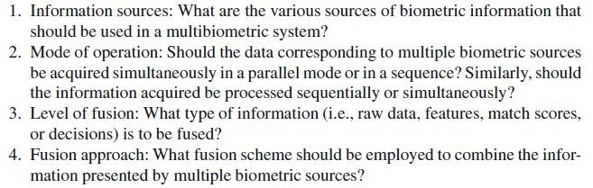
FOUR DESIGN Functions

Slide 6
Sources of Multiple Evidence
Based on the sources of evidence, multibiometric systems can be classified into
multi-sensor,
multi-algorithm,
multi-instance,
multi-sample, and
multimodal systems.

Slide 7
First four scenarios, multiple pieces of evidences are derived from a single biometric trait (e.g., fingerprint or iris), while in the fifth scenario (also called multimodal biometric system) multiple biometrictraits (e.g., fingerprint and iris) are used.
UID(Unique Identification Authority) system in India uses all ten fingers and two irides, it is both multi-instance and multimodal. Such systems are called hybrid multibiometric systems.

Slide 8
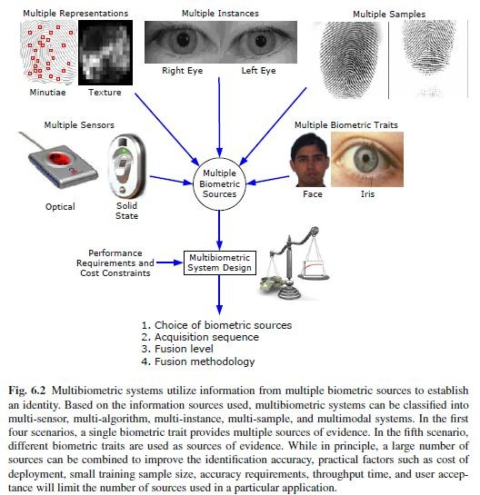

Slide 9
MULTI ALGORITHM
In these systems, the same biometric data is processed using multiple algorithms. For example, a texture-based algorithm and a minutiae-based algorithm can operate on the same fingerprint image in order to extract diverse feature sets that can improve the performance of the system.
This kind of system does not require the use of new sensors and, hence, is cost-effective.

Slide 10
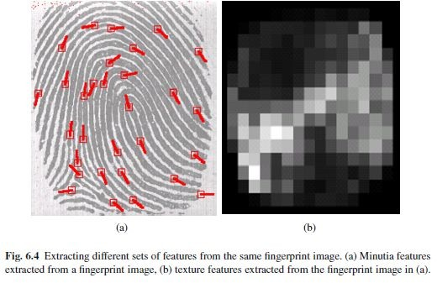
MULTI ALGORITHM
The main limitation of multi-algorithm systems is that since the different sources of evidence are obtained from the same raw data (e.g., right index fingerprint image), the multiple sources tend to be correlated

Slide 11
multi-algorithm system can use multiple feature sets (i.e., multiple representations) extracted from the same biometric data or multiple matching schemes operating on a single feature set.
Another example of a system using multiple feature sets is a face recognition system that employs different feature extraction schemes like Principal Component Analysis (PCA), Independent Component
Analysis (ICA), and Linear Discriminant Analysis (LDA) to encode (i.e., represent) a single face image.

Slide 12
Multi-instance systems
These systems use multiple instances of the same body trait and are also sometimes referred to as multi-unit systems
For example, the left and right index fingers, or the left and right irides of an individual may be used to verify an individual’s identity.
Automated Fingerprint Identification Systems (AFIS), that obtain tenprint information from a subject, can benefit from sensors that are able to rapidly acquire impressions of all ten fingers in three stages as shown in Figure 6.6.

Slide 13
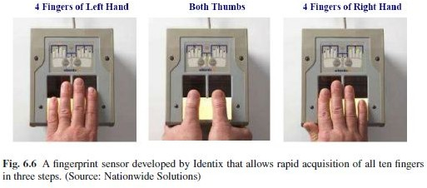

Slide 14
Multi-sample systems
A single sensor may be used to acquire multiple samples of the same biometric trait in order to account for the variations that can occur in the trait, or to obtain a more complete representation of the underlying trait.
A face system, for example, may capture (and store) the left and right profile images along with the frontal image of a person’s face in order to account for variations in the facial pose

Slide 15
MULTIMODAL SYSTEMS
Multimodal systems combine the evidence presented by different body traits for establishing identity. Some of the earliest multimodal biometric systems utilized face and voice features to establish the identity of an individual.
The cost of deploying multimodal biometric systems is substantially more due to the requirement of multiple sensors and, consequently, the development of appropriate user interfaces

Slide 16
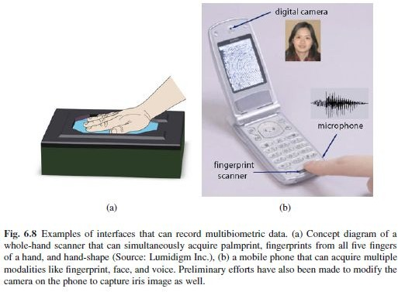

Slide 17
Acquisition sequence
The acquisition sequence in a multibiometric system refers to the order in which the various sources of evidence are acquired from an individual (in the case of multi-algorithm systems, only a single biometric sample is required and, therefore, the acquisition methodology is not an issue).

Slide 18
Serial mode
In the serial or cascade mode, the processing of information takes place sequentially. In Figure, the fingerprint information of the user is first processed; if the fingerprint sub-system is unable to determine the user’s identity, then the data corresponding to the face biometric is processed.

Slide 19
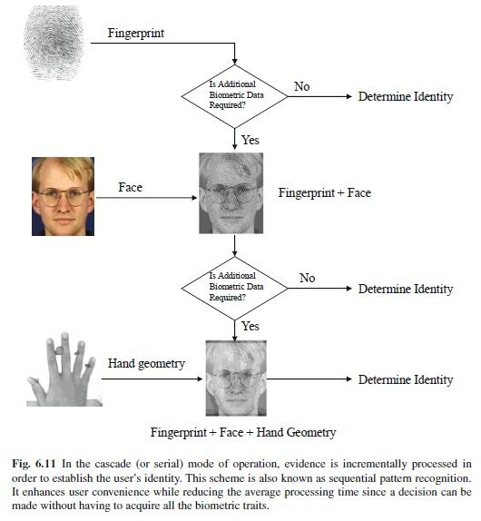
Serial mode of operation

Slide 20
Parallel
In the parallel mode, each uni-biometric system processes its information independently at the same time and the processed information is combined using an appropriate fusion scheme
A multi-biometric system designed to operate in the parallel mode generally has a higher accuracy because it utilizes more evidence about the user for recognition.
Most practical multi-biometric systems have a parallel architecture because the primary goal of multi-biometric system designers has been to reduce the error rates of biometric systems and not necessarily the throughput and/or processing time.

Slide 21
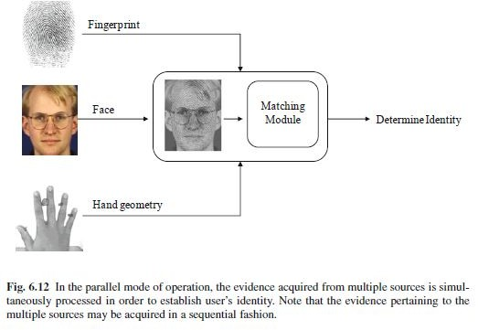
PARALLEL MODE OF OPERATION

Slide 22
FUSION LEVELS
A fundamental issue in the design of a multi-biometric system is to determine the type of information that should be consolidated by the fusion module.
In a typical biometric system, the amount of information available to the system gets compressed as we proceed from the sensor module to the decision module (see Figure).

Slide 23
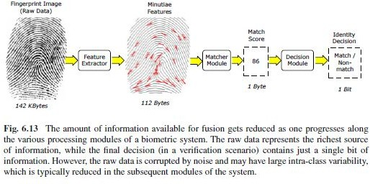
SIZE OF THE DATA IS REDUCED

Slide 24
BIOMETRIC FUSION
Multi-biometric system, fusion can be accomplished by utilizing the information available in any of the four biometric modules (sensor, feature extractor, matcher, and decision modules).
Figure shows the various levels of fusion possible in a multi-biometric system.
Biometric fusion can be broadly classified into
(a) fusion prior to matching, and
(b) fusion after matching.

Slide 25
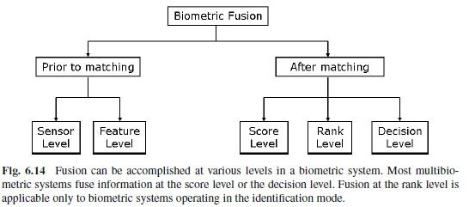
BIOMETRIC FUSION

Slide 26
Different Fusion Strategies
Fusion prior to matching
Sensor level fusion
Feature level fusion
Fusion after matching
Match score fusion
Rank level fusion
Decision level fusion
9/3/2010
Phalguni Gupta, Biometrics Lab, IIT Kanpur
41

Slide 27
Different Fusion Strategies (cont.)
Sensor level fusion
Raw data from the sensor(s) are combined.
This is referred to as image level or pixel level fusion.
Sensor level fusion can benefit multi-sample systems which capture multiple snapshots of the same biometrics.
For example, 2D face images of an individual obtained from several cameras can be combined to form a 3D model of the face.
Another example of sensor level fusion is the mosaicing of multiple fingerprint impressions of a subject in order to construct a more elaborate fingerprint image.
9/3/2010
Phalguni Gupta, Biometrics Lab, IIT Kanpur
42

Slide 28
Sensor level fusion
Sensor level fusion can benefit multi sample systems which capture multiple snapshots of the same biometric.
Small fingerprint sensor may capture two or more impressions of a person’s fingerprint and create a composite fingerprint image that reveals more of underlying ridge structure. This process is known as mosaicing.
Stiching algorithm is required to integrate various slices.
Mosaicing has been attempted by researchers in face recognition where multiple 2D images representing different poses are stitched to generate a single image

Slide 29
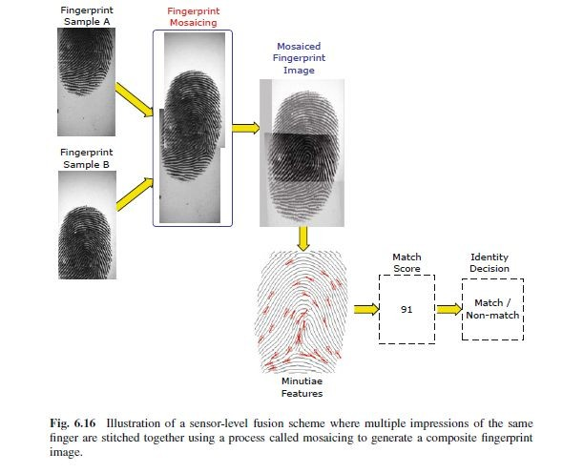
Sensor level Fusion

Slide 30
Different Fusion Strategies (cont.)
Feature level fusion
It refers to combine different feature sets extracted from multiple biometric sources.
When feature sets are homogeneous, a single resultant feature vector can be calculated as a weighted average of the individual feature vector
When the feature set are non-homogeneous , we can concatenate to form a single feature vector.
Sometime concatenation may not be possible (Fingerprint minutiae and Eigen-face coefficient)
9/3/2010
Phalguni Gupta, Biometrics Lab, IIT Kanpur
46

Slide 31
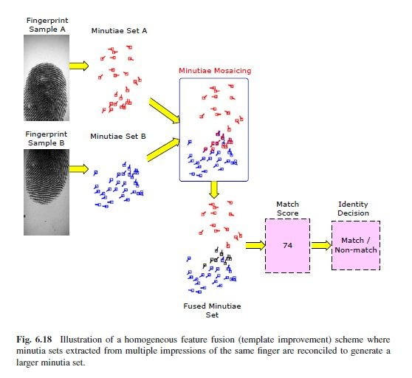
Homogenous feature fusion

Slide 32
Different Fusion Strategies (cont.)
Features are normalized
Feature selection schemes are employed to reduce the dimension size of the feature vector
Principal Component Analysis (PCA)
Linear Discriminant Analysis (LDA)
9/3/2010
Phalguni Gupta, Biometrics Lab, IIT Kanpur
57

Slide 33
Different Fusion Strategies (cont.)
Score level fusion
Scores generated from different matching modules are combined to produce a single score.
Final decision is taken by considering the fused score.
Normalization and Similarity/ Dissimilarity Score
9/3/2010 Phalguni Gupta, Biometrics Lab, IIT Kanpur
58

Slide 34
Score level
When match scores output by different biometric matchers are consolidated in order to arrive at a final recognition decision, fusion is said to be done at the score level.
This is also known as fusion at the measurement level or confidence level.
After the raw data and feature vectors representations, the next level of fusion is based on match scores.
It is relatively easy to access and combine the scores generated by different biometric matchers.
Consequently, score-level fusion is the most commonly used approach in multibiometric systems

Slide 35
Score-level fusion methodologies will vary depending on whether the multibiometric system operates in the verification or identification mode.
Score fusion in a multibiometric verification system can be considered as a two-class pattern classification problem, where the goal is to determine whether the query corresponds to a “genuine” user or an “impostor”.

Slide 36
Different Fusion Strategies (cont.)
Rank level fusion
For identification, output is the ranks of enrolled identities.
This fusion scheme is to consolidate the ranks of individual biometric systems to derive a fused rank for each identity.
It reveals less information than match scores. However, unlike match scores, the ranking output by multiple biometric systems are comparable.
No normalization is needed and this makes the rank level fusion schemes simpler to implement compared to the score level fusion techniques.
Highest rank method
Logistic regression method
9/3/2010
Phalguni Gupta, Biometrics Lab, IIT Kanpur
62

Slide 37
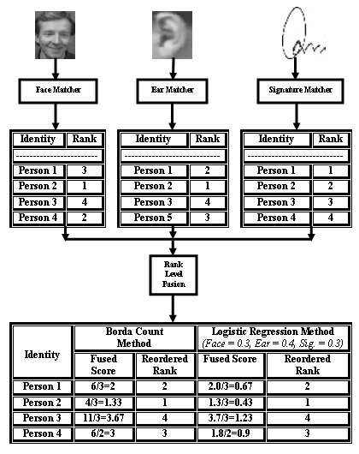

Slide 38
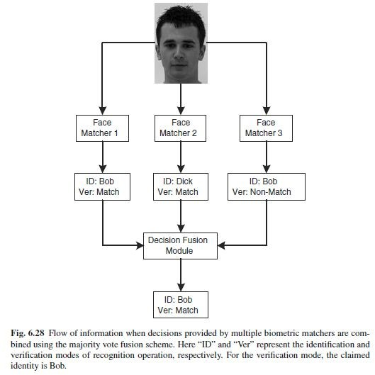
MAJORITY VOTING

Slide 39
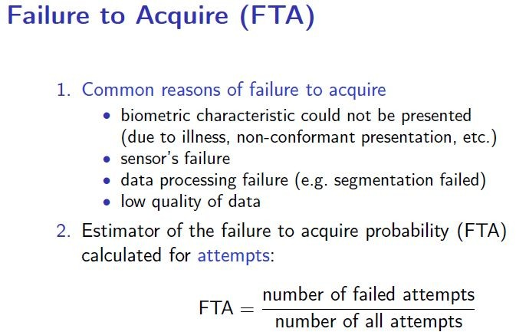
Errors

Slide 40
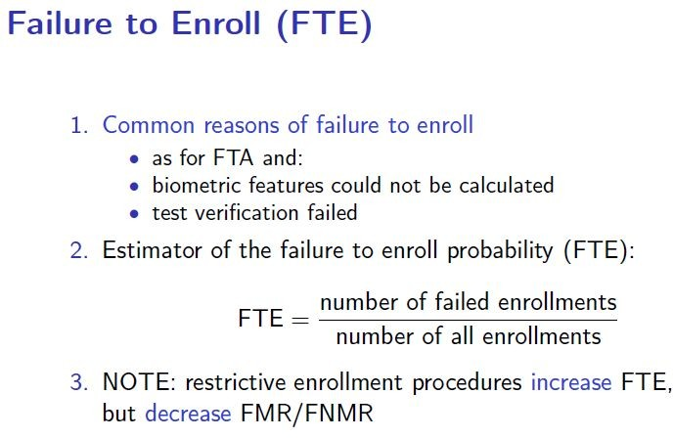

Slide 41
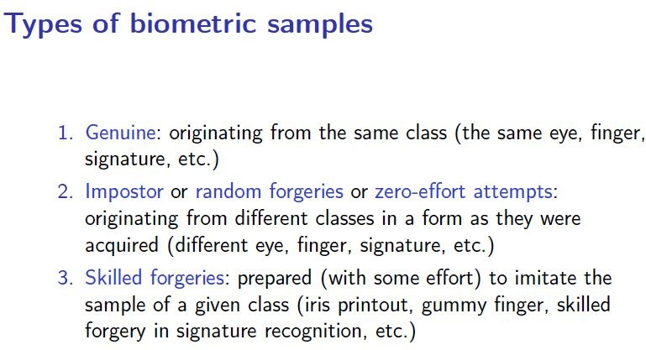

Slide 42
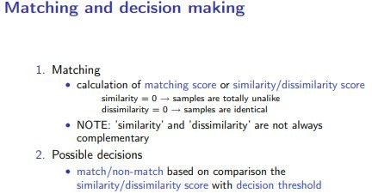

Slide 43
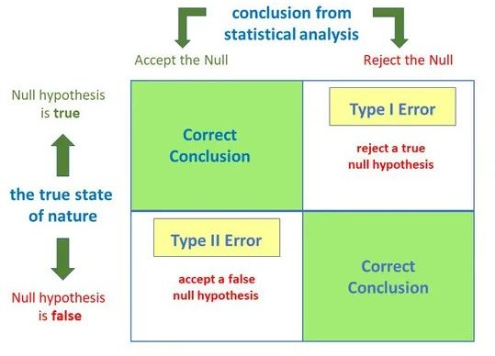
Type 1 False Positive Type 2 False negative

Slide 44
Type 1
The acceptance of H1 when H0 is true is called a Type I error.
The probability of committing a type I error is called the level of significance and is denoted by alpha.

Slide 45
Type 2
Failure to reject H0 when H1 is true is called a Type II error.
The probability of committing a type II error is denoted by beta.

Slide 46
Feature Matching and Decision Making

Slide 47
Matching
Matcher is a system that takes two samples of biometric data and returns a score that indicates their similarity and dissimilarity
Similarity and dissimilarity measures highly depends on
data acquisition device
precision of representation of biometric samples
degree of uniqueness of the samples over time etc

Slide 48
Kinds of errors
Given two biometric samples we can have two possible hypothesis
-Null hypothesis H0 => two samples are matching
Alternative hypothesis H1 => two samples are not matching
Definition of hypothesis depends on biometric applications.
different application can have different definition of errors.
But matching engine decides whether H0 is true or H1 is true.

Slide 49
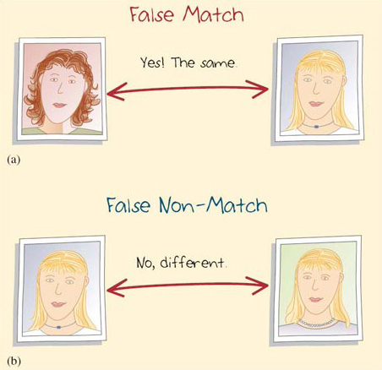
Terminology
A biometric verification system makes two types of errors:
(i) mistaking biometric measurements from two different persons to be from the same person (called false match),
(ii) mistaking two biometric measurements from the same person to be from two different persons (called false
non-match).
These two types of errors are often termed as false accept and false reject, respectively.

Slide 50
Terminology
The frequency with which this False Match occurs is called False match rate (FMR) or False Acceptance rate (FAR) or Type – I error.
The frequency with which this False Non Match occurs is called False non match rate (FNMR) or False rejection rate (FAR) or Type – II error.

Slide 51
Terminology
The system performance at all the operating points (thresholds, t) can be depicted in the form of a Receiver Operating Characteristic (ROC) curve.
A ROC curve is a plot of FMR against (1-FNMR) or FNMR for various threshold values, t

Slide 52
Mathematically the errors in a verification system can be formulated as follows. If the stored biometric template of the user I is represented by XI and the acquired input for recognition is represented by XQ, then the null and alternate hypotheses are:
H0: input XQ does not come from the same person as the template XI;
H1: input XQ comes from the same person as the template XI.
The associated decisions are as follows:
D0: person is not who she claims to be;
D1: person is who she claims to be.
The decision rule is as follows: if the matching score S(XQ, XI) is less than the system threshold t, then decide D0, else decide D1.

Slide 53
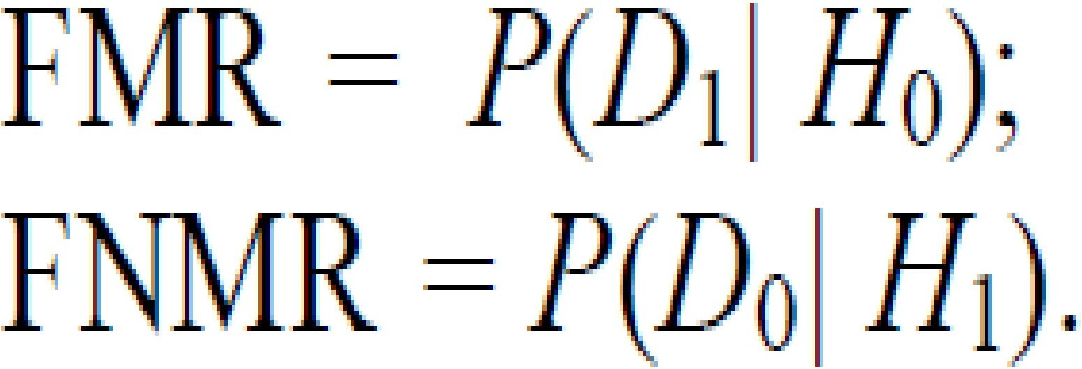
Type I: false match (D1 is decided when H0 is true);
Type II: false non-match (D0 is decided when H1 is true).
FMR is the probability of type I error (also called significance level in hypothesis testing) and FNMR is the probability of type II error:
The expression (1-FNMR) is also called the power of the hypothesis test.

Slide 54
Match Score distribution
If S is the similarity measure between two biometric samples, then we decide H0 is True if S > t (threshold), otherwise H1 is true.
Decision becomes sometimes very hard as there is no scope to tell “do not know” or “too close”.
This is known as decision making without exception handling
Reliability of the score is influenced by many factors :
Variations in sensors
Variations in data acquisition
Variations in data representation

Slide 55
Observations
Even though two samples are from identical biometric, the similarity score is rarely 1, unless two samples are copies of each other. But the score is usually high (i.e) Match score or genuine score for identical individual tend to be high.
Even though two samples are from different individuals, the score is not ZERO. But the score is usually low . (i.e) Non match score or imposter scores for two different individuals tend to be low.

Slide 56
Error rates
To evaluate the accuracy of a fingerprint biometric system, one must collect scores generated from multiple images of the same finger (the distribution p(S(XQ, XI)|H1)), and scores generated from a number of images from different fingers (the distribution p(S(XQ, XI)|H0))

Slide 57
Error rates
For biometric application, Match score distribution and non match score distribution always overlap.
It is not possible to select a t (threshold) such that FMR = 0 and FNMR = 0.
it should be selected in a such a way that system operates in optimal fashion.
FMR and FNMR are inversely related.
There is a trade-off between false match rate (FMR) and false non-match rate (FNMR) in every biometric system.
In fact, both FMR and FNMR are functions of the system threshold t; if t is decreased to make the system more tolerant to input variations and noise, then FMR increases.
On the other hand, if t is raised to make the system more secure, then FNMR increases accordingly.

Slide 58
Receiver Operating Curve
Suppose the integrals can be computed for any t.
Then, FMR(t) and FNMR(t) give error rates when the match decision is made at some t
These errors can be plotted against each other as a two dimensional curve
– ROC(t) = (FMR(t),FNMR(t))
That is, FMR and FNMR behaviour is expressed in terms of ROC curve.

Slide 59
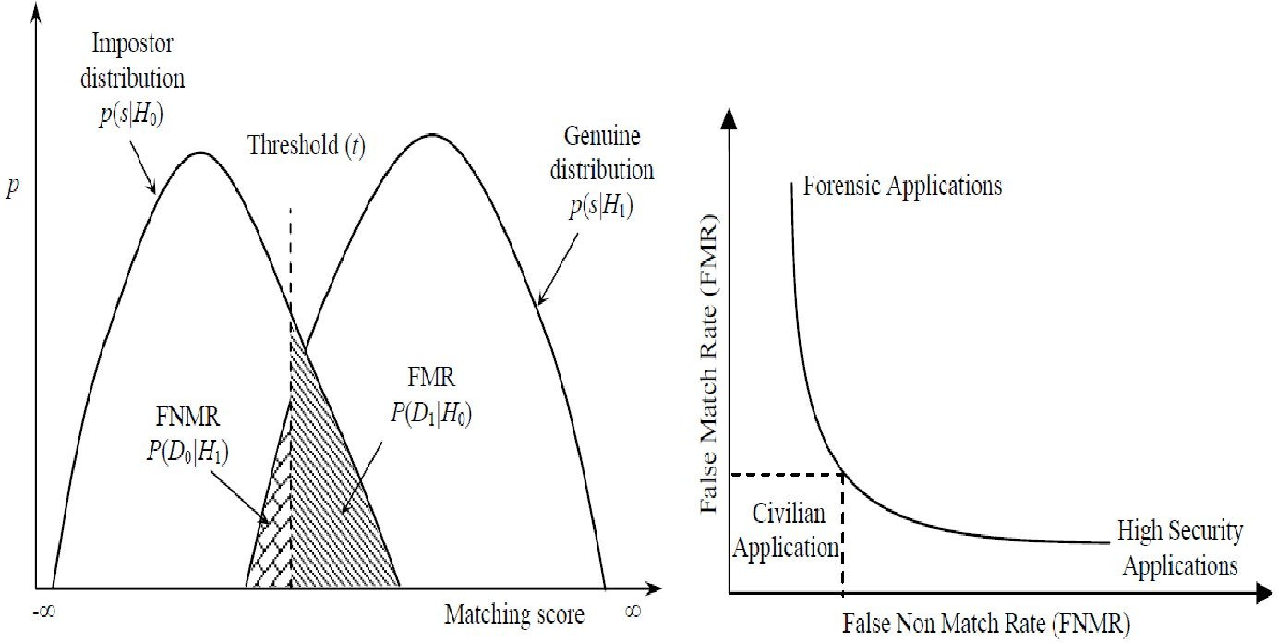
ROC curve and FAR/FRR curve

Slide 60
ROC
When t is set low, FMR is high and FNMR is low; conversely when t is high FNMR is high and FMR is low
Thus the matcher can be operated using any threshold t which defines a point on ROC. This is known as Operating Point of the matcher.
The operating point can be specified by choosing any one of t, FMR and FNMR.

Slide 61
Variations of ROC
There are number of variations of ROCs that are used expressing the information
One way is already shown.
Others can be obtained by plotting one or both the probabilities on a logarithmic scale.
Sometimes one plots Correct Match Rate [ i.e 1-FNMR] against FMR. This is called Detection Error Trade-off (DET) curve.
Along y-axis we have [1-FNMR] which is correct detection rate and along x-axis we put FMR [False Alarm Rate]
Detection rate goes to 1 when false alarm rate goes to 1..

Slide 62
1
T -> -
∞
Detection Rate
T ->
∞
0
1
False Alarm Rate

Slide 63
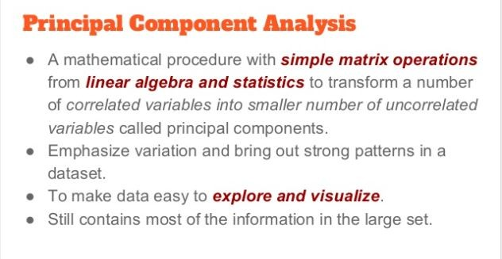

Slide 64
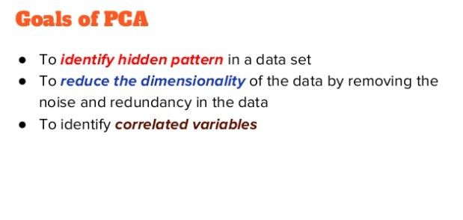
PCA

Slide 65
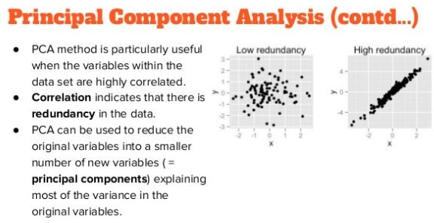

Slide 66
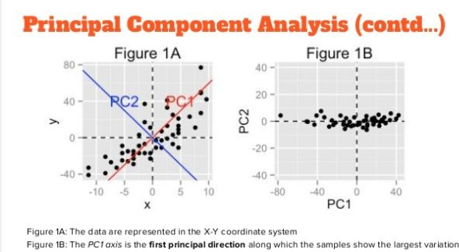

Slide 67
PCA finds a new set of dimensions (or a set of basis of views) such that all the dimensions are orthogonal (and hence linearly independent) and ranked according to the variance of data along them.
It means more important principle axis occurs first.
(more important = more variance/more spread out data)

Slide 68
How does PCA work
Calculate the covariance matrix X of data points.
Calculate Eigen vectors and corresponding Eigen values.
Sort the Eigen vectors according to their Eigen values in decreasing order.
Choose first k Eigen vectors and that will be the
new k dimensions.
Transform the original n dimensional data points into k dimensions.

Slide 69
The goal of PCA
Find linearly independent dimensions (or basis of views) which can losslessly represent the data points.
Those newly found dimensions should allow us to predict/reconstruct the original dimensions.
The reconstruction/projection error should be minimized.

Slide 70
Steps in PCA
Standardize the data.
Compute the covariance matrix of the features from the dataset.
Perform Eigen Decompositon on the covariance matrix.
Order the eigenvectors in decreasing order based on the magnitude of their corresponding eigenvalues.
Determine k, the number of top principal components to select.
Construct the projection matrix from the chosen number of top principal components.
Compute the new k-dimensional feature space.

Slide 71
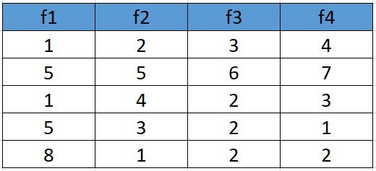
1. Standardize the Dataset
Assume we have the below dataset which has 4 features and a total of 5 training examples.
Data standardization is about making sure that data is internally consistent; that is, each data type has the same content and format

Slide 72
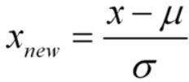
First, we need to standardize the dataset and for that, we need to calculate the mean and standard deviation for each feature.

Slide 73

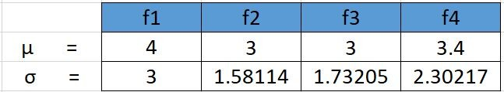

Slide 74
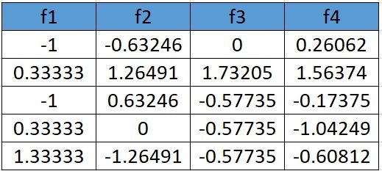
After applying the formula for each feature in the dataset is transformed as below:

Slide 75
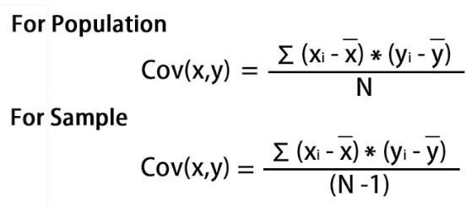
Calculate the covariance matrix for the whole dataset

Slide 76
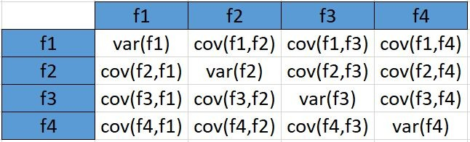
the covariance matrix for the given dataset will be calculated as below

Slide 77
Since we have standardized the dataset, so
the mean for each feature is 0 and the standard deviation is 1.
var(f1) = ((-1.0-0)² + (0.33-0)² + (-1.0-0)² +(0.33–0)²
+(1.33–0)²)/5
var (f1) = 0.8
cov(f1,f2) =
((-1.0–0)*(-0.632456-0) +
(0.33–0)*(1.264911-0) +
(-1.0–0)* (0.632456-0)+
(0.33–0)*(0.000000 -0)+
(1.33–0)*(-1.264911–0))/5
cov(f1,f2 = -0.25298

Slide 78
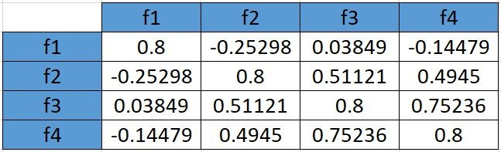
In the similar way be can calculate the other covariances and which will result in the below covariance matrix

Slide 79
Calculate eigenvalues and eigen vectors.
An eigenvector is a nonzero vector that changes at most by a scalar factor when that linear transformation is applied to it.
The corresponding eigenvalue is the factor by which the eigenvector is scaled.
Let A be a square matrix (in our case the covariance matrix), ν a vector and λ a scalar that satisfies Aν = λν, then λ is called eigenvalue associated with eigenvector ν of A.
Rearranging the above equation,

Slide 80

Aν-λν =0 ; (A-λI)ν = 0
Since we have already know ν is a non- zero vector, only way this equation can be equal to zero, if
det(A-λI) = 0

Slide 81
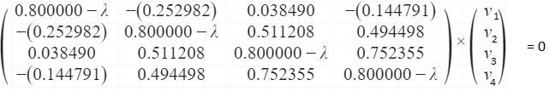
Solving the above equation = 0
λ = 2.51579324 , 1.0652885 , 0.39388704 ,
0.02503121
Eigenvectors:
Solving the (A-λI)ν = 0 equation for ν vector with different λ values:

Slide 82
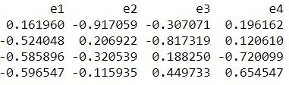
Going by the same approach, we can calculate the eigen vectors
for the other eigen values. We can from a matrix using the eigen vectors.
For λ = 2.51579324, solving the above equation using Cramer's rule, the values for v vector are
v1 = 0.16195986 v2 = -0.52404813
v3 = -0.58589647
v4 = -0.59654663
eigenvectors(4 * 4 matrix)

Slide 83
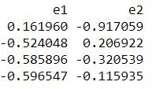
4. Sort eigenvalues and their corresponding eigenvectors.
Since eigenvalues are already sorted in this case so no need to sort them again.
5. Pick k eigenvalues and form a matrix of eigenvectors f we choose the top 2 eigenvectors, the matrix will look like this:
Top 2 eigenvectors(4*2 matrix)
Feature matrix * top k eigenvectors = Transformed Data

Slide 84
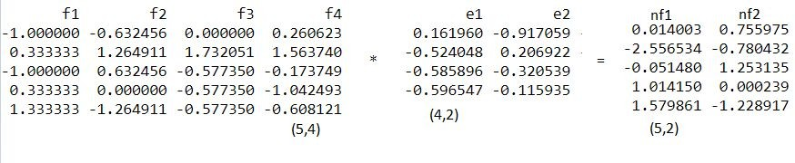
6. Transform the original matrix.
Feature matrix * top k eigenvectors = Transformed Data

Slide 85
Eigenvectors and eigenvalues
The eigenvectors and eigenvalues of a covariance (or correlation) matrix represent the “core” of a PCA: The eigenvectors (principal components) determine the directions of the new feature space, and
the eigenvalues determine their magnitude.
Deduce the Eigen:
Suppose we have plotted a scatter plot of random variables, and a line of best fit is drawn between these points.
This line of best fit, shows the direction of maximum variance in the dataset.
The Eigenvector is the direction of that line, while the eigenvalue is a number that tells us how the data set is spread out on the line which is an Eigenvector.

Slide 86
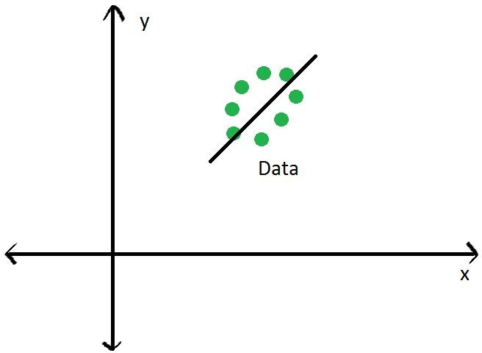

Slide 87
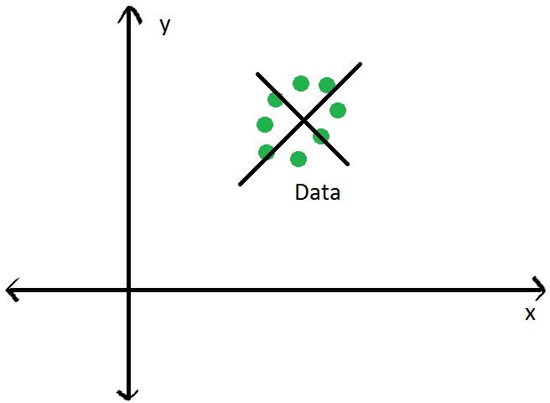
The main principal component, depicted by the black line, is the first Eigenvector. The second Eigenvector will be perpendicular or orthogonal to the first one. The reason the two Eigenvectors are orthogonal to each other is because the Eigenvectors should be able to span the whole x-y area. Naturally, a line perpendicular to the black line will be our new Y axis, the other principal component.

Slide 88
We are going to rotate our data to fit these new axes. But what will the coordinates of the rotated data be?
To convert the data into the new axes, we will multiply the original X, Y data by Eigenvectors, which indicate the direction of the new axes (principal components).
But first, we need to deduce the Eigenvectors (there are two — one per axis). Each Eigenvector will correspond to an Eigenvalue, whose magnitude indicates how much of the data’s variability is explained by its Eigenvector.
From the definition of Eigenvalue and Eigenvector: [Covariance matrix].[Eigenvector] = [Eigenvalue].[Eigenvector]

Slide 89
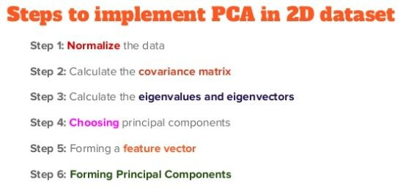

Slide 90
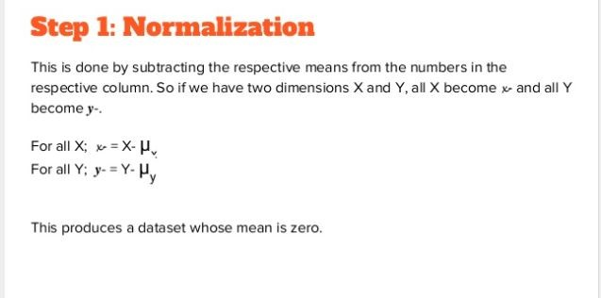

Slide 91
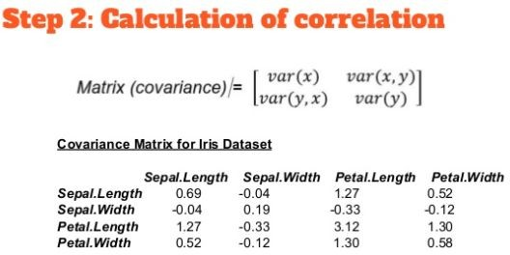

Slide 92
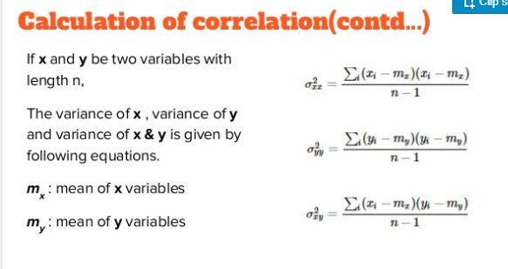

Slide 93
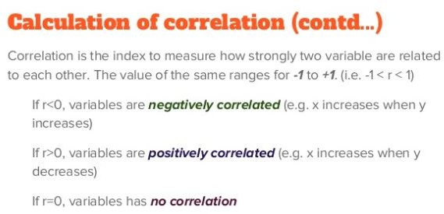

Slide 94
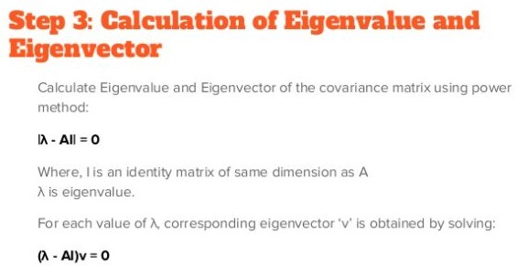

Slide 95
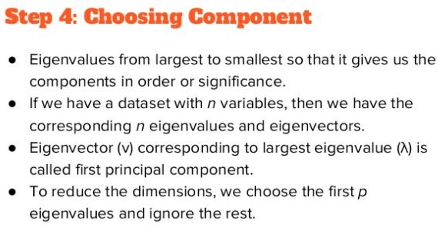

Slide 96
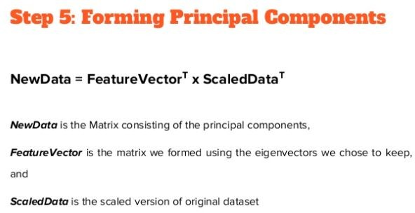

Slide 97
Linear Discriminant Analysis

Slide 98
Introduction
Linear Discriminant Analysis or LDA is a dimensionality reduction technique.
It is used as a pre-processing step in Machine Learning and applications of pattern classification.
The goal of LDA is to project the features in higher dimensional space onto a lower-dimensional space in order to avoid the curse of dimensionality and also reduce resources and dimensional costs.

Slide 99
Both LDA and PCA are linear transformation techniques:
LDA is a supervised whereas PCA is unsupervised – PCA ignores class labels.
In contrast to PCA, LDA attempts to find a feature subspace that maximizes class separability

Slide 100
Dimensionality Reduction
The techniques of dimensionality reduction are important in applications of Machine Learning, Data Mining, Bioinformatics, and Information Retrieval.
The main agenda is to remove the redundant and dependent features by changing the dataset onto a lower-dimensional space.
In simple terms, they reduce the dimensions (i.e. variables) in a particular dataset while retaining most of the data.

Slide 101
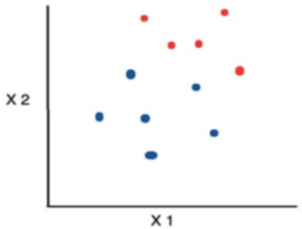
Practical approach to an LDA model
Consider a situation where you have plotted the relationship between two variables where each color represents a different class. One is shown with a red color and the other with blue.

Slide 102
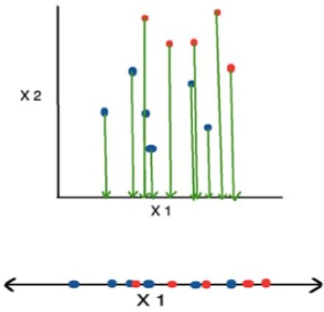
Practical approach to an LDA model
If you are willing to reduce the number of dimensions to 1, you can just project everything to the x-axis as shown below:
This approach neglects any helpful information provided by the second feature. However, you can use LDA to plot it.

Slide 103
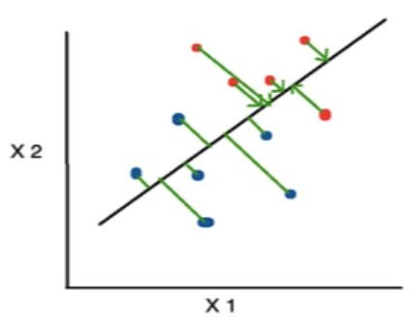
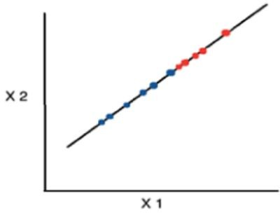

Practical approach to an LDA model
The advantage of LDA is that it uses information from both the features to create a new axis which in turn minimizes the variance and maximizes the class distance of the two variables.

Slide 104


How it works
LDA focuses primarily on projecting the features in higher dimension space to lower dimensions. You can achieve this in three steps:
Firstly, you need to calculate the separability between classes which is the distance between the mean of different classes. This is called
the between-class variance.
Secondly, calculate the distance between the mean and sample of each class. It is also called the within-class variance.

Slide 105

How it works
Finally, construct the lower-dimensional space which maximizes the
between-class variance and minimizes
the within-class variance. P is considered as the lower-dimensional space projection, also called Fisher’s criterion.
•

Slide 106
How does an LDA model make predictions?
LDA models use Bayes’ Theorem to estimate probabilities.
They make predictions based upon the probability that a new input dataset belongs to each class.
The class which has the highest probability is considered the output class and then the LDA makes a prediction.
The prediction is made simply by the use of Bayes’ Theorem which estimates the probability of the output class given the input.

Slide 107
How does an LDA model make predictions?
They also make use of the probability of each class and the probability of the data belonging to each class:
P(Y=x|X=x) = [(Plk * fk(x))] / [(sum(PlI * fl(x))] Where x = input, k = output class.
Plk = Nk/n or base probability of each class observed in the training data.
It is also called prior probability in Bayes’ Theorem. fk(x) = estimated probability of x belonging to class k.

Slide 108
How does an LDA model make predictions?
The f(x) is plotted using a Gaussian Distribution function and then it is plugged into the equation above and the result we get is the equation as follows:
Dk(x) = x∗(mean/Σ²) – (mean²/(2*Σ²)) + ln(PIk)
The Dk(x) is called the discriminant function for class k given input x, mean, Σ² and Plk are all estimated from the data and the class is calculated as having the largest value, will be considered in the output classification.

Slide 109
What is decision theory?
Decision theory is theory about decisions.
The subject is not a very unified one.
To the contrary, there are many different ways to theorize about decisions, and therefore also many different research traditions.
This text attempts to reflect some of the diversity of the subject. Its emphasis lies on the less (mathematically) technical aspects of decision theory.

Slide 110
Decision theory (or the theory of choice not to be confused with choice theory) is the study of an agent's choices.
Decision theory can be broken into two branches:
normative
descriptive

Slide 111
Two types
normative decision theory, which analyzes the outcomes of decisions or determines
the optimal decisions given constraints and
assumptions
descriptive decision theory, which analyzes how agents actually make the decisions they do.

Slide 112


Slide 113


Slide 114


Slide 115


Slide 116


Slide 117


Slide 118


Slide 119


Slide 120


Slide 121


Slide 122


Slide 124


Slide 125


Slide 126


Slide 127


Slide 128


Slide 129


