Slide 1

Unit IV

Slide 2
Biometric system Authentication
The primary purpose of using biometrics is to provide non-repudiable authentication.
Authentication implies that
only legitimate or authorized users are able to access the physical or logical resources protected by the biometric system
impostors are prevented from accessing the protected facilities or information.
Non-repudiation ensures that an individual who accesses a certain resource cannot later deny using it. Thus, the integrity of a biometric system is determined
by its ability to guarantee non-repudiable authentication.

Slide 3
Identification vs. Authentication
Identification | Authentication
It determines the identity of the person. | It determines whether the person is indeed who he claims to be.
No identity claim Many-to-one mapping. Cost of computation ∝ number of record of users. | Identity claim from the user One-to-one mapping. The cost of computation is independent of the number of records of users.
Captured biometric signatures come from a set of known biometric feature stored in the system. | Captured biometric signatures may be unknown to the system.

Slide 4



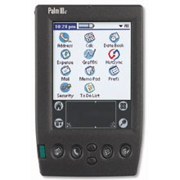
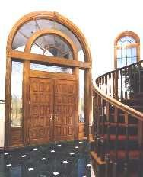


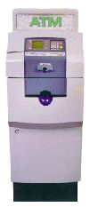


Biometrics-enabled Authentication Applications
Cell phones, Laptops, Work Stations, PDA & Handheld device set.
Door, Car, Garage Access
3. ATM Access, Smart card
Image Source : http://www.voice-security.com/Apps.html

Slide 5
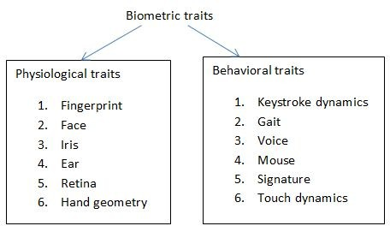
Classification Of biometrics

Slide 6
Physiological traits
Fingerprint
Fingerprint biometric technique is widely accepted as cost is low and gives high efficiency. A fingerprint sensor captures the image of the fingerprint of the person. Image enhancement is done followed by the feature extraction and template protection. Ridges (minutiae points), valley, island, lake are the features extracted from the fingerprint image. Feature vectors are acquired from the acquired image. Many sensors like capacitive sensors, thermal sensors, and ultrasound sensor are used to acquire the fingerprint image.
Iris
Iris biometric system is considered to be the most accurate system. Iris image is collected and feature extraction is done by filters to extract the features. From the image, features like eyelids, eyelashes are extracted. Image acquisition is done by infrared illuminations, the steps in iris image processing is Image segmentation, image normalization, feature extraction and finally classification

Slide 7
Physiological traits
Face
Face recognition system is commonly used system for many commercial applications related to public security. The image captured from sensors will have noise, blur and the quality of the image may be weak. To enhance the quality of image, enhancement techniques like pre-processing is done. Fisher discriminant analysis is done for the feature extraction process and feature vectors are generated for recognition process. The features extracted from face are eyes, nose, and mouth.
Palm print
Palm print recognition uses a scanner to capture the features of palm in human. Thermal or optical scanners may be used. Ridges, wrinkles are the features extracted. The methods used for feature extractions are line based, subspace based (PCA, LDA) and statistical (mean, standard deviation). Neural network is been deployed for classification of final decision.

Slide 8
Behavioral biometrics
Gait
The emergence of computer vision has paved the way for smart surveillance system. Gait recognition is mostly used for the surveillance applications. Gait biometrics records the way the person walks, cyclic motion. The background subtraction method is used to find the object in motion. As huge amount of data is involved and hence machine learning techniques are adopted for training the data.
Voice
Voice print is the unique voice of individual to identify and verify the system. A spectral feature from the voice is measured. It is a pattern recognition approach which uses the speech signal to extract the features. Mel-frequency cepstral coefficients, Linear Prediction cepstral coefficients are the few techniques adopted for feature extraction. Modelling the voice is done by neural network
Handwriting
Handwriting biometrics helps in identifying the person by his written text. It is extraction of textural features of an individual handwriting and involves various parameters like segment counts, number of pen ups events, number of pens down events, duration of writing, pressure, spatial coordinate etc. The data acquisition is done by digital tablet.

Slide 9
SOFT BIOMETRICS
Personal attributes like gender,age,height,weight,eye color,marks and moles.

Slide 10
Hard biometrics
The hard ones are also considered classic or traditional, such as faces, fingerprints or signatures

Slide 11
Hidden biometrics
The hidden ones, called also intrinsic, are based on medical data, as bio signals, MRI images or X-Ray images

Slide 12
Security breach
When the biometric system fails to meet these objectives, the security of the system is said to be
breached.
This breach of security can be in the form of denial-of-service to legitimate users, intrusion by unauthorized users, repudiation claims by authorized users, or misuse of the biometric data
for unintended purposes.

Slide 13
A natural question that arises in biometric recognition is which biometric system is “best” suited for a particular application.
Of course, the answer to this question depends not only on technical merits and limitations of the biometric system (e.g., matching accuracy and throughput), but also on other socio-economic factors like user acceptability and system cost

Slide 14
SECURITY THREAT
A security threat in a biometric system refers to the possibility of system failure.
Depending on the type of failure, these security threats can be classified into four major classes.
Denial-of-service (DoS):
Intrusion
Repudiation

Slide 15
Denial-of-service (DoS):
Legitimate users are prevented from obtaining access to the system or resource that they are entitled to, thereby causing inconvenience to genuine users. Attackers achieve this by sending more traffic than the target can handle, causing it to fail—making it unable to provide service to its normal users. Examples of targets might include email, online banking, websites, or any other service relying on a targeted network or computer.

Slide 16
Intrusion
An unauthorized user gains illegitimate access to the system.
Since intrusion affects the basic integrity of a biometric system, it is generally considered the most serious security threat

Slide 17
Repudiation:
A legitimate user denies using the system after having accessed it.
Corrupt users may deny their actions by claiming that illegitimate users could have intruded the system using their identity.

Slide 18
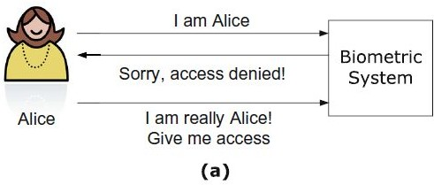
DOS

Slide 19
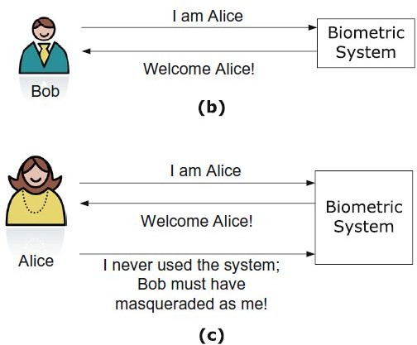
INTRUSION AND REPUDIATION

Slide 20
THREAT MODEL
The first step in analyzing the security of biometric systems is to define a threat model, which identifies the various threat agents and attacks.
threatagent can be defined as a person or a thing that can, or has the power to subvert the intended operation of a system.

Slide 21
Intrinsic limitations:
Even in the absence of any external attacks, a biometric system may fail due to its intrinsic limitations. As discussed in Chapter 1, all biometric systems are prone to two types of
errors, namely, false match and false non-match.
A biometric device may also fail to capture or acquire a sample of the biometric identifier presented to it by the user, leading to failure to enroll and failure to capture errors.
Since these errors are caused due to intrinsic limitations of various modules in a biometric system like sensor, feature extractor, and matcher, and not by any deliberate attack, the resultant failure or security breach is known as a
zero-effort attack.

Slide 22
Adversaries:
A biometric system may also fail due to manipulation by adversaries, who could either be insiders or external entities.
An insider is an authorized user of a biometric system, which includes both system administrators (super-users) and any other person enrolled in the biometric system.
External entities can be classified as impostors and attackers.
While the term impostor refers to any individual who intentionally or inadvertently tries to impersonate another enrolled person, an attacker is one who attempts to subvert the operation of a biometric system.

Slide 23
ATTACK
An attack refers to the actual mechanism or path that can be used to circumvent a biometric system.
A taxonomy of attacks that can be mounted against a biometric system is shown in Figure 7.2. Based on the threat agent used in the attack, the attack mechanisms can be broadly categorized as those caused by intrinsic limitations(zero-effort attacks) and the ones caused by adversaries.

Slide 24
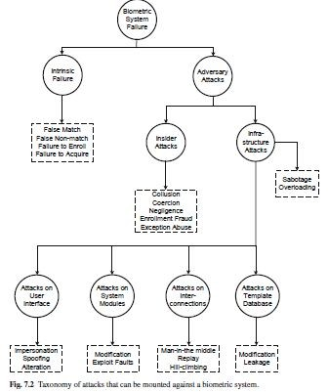

Slide 25
CONSEQUENCES OF ZERO EFFORT ATTACK
The consequences of a zero-effort attack will depend on the application. For instance, in a biometric verification system, a false non-match error will lead to denial-of-service and inconvenience to genuine users.(Dos)
On the other hand, in a negative recognition application such as screening, a false non-match will lead to intrusion and a false match will lead to denial-of-service.
Since failure to enroll and failure to capture errors necessitate the operators to fall back on traditional (possibly unreliable) authentication mechanisms like ID cards, the effect of these errors is similar to that of a false non-match.
The intrinsic limitations of a biometric system also make it hard to defend against repudiation claims.

Slide 26
METRICS
These metrics include
false match rate (FMR),
false non-match rate (FNMR),
failure to enroll rate (FTER),
failure to capture rate (FTCR),
false positive identification rate(FPIR), and false negative identification rate (FNIR).

Slide 27
Insider attacks
It is important to emphasize that the term “insider attacks” not only covers cases where an authorized user himself turns malicious and intentionally subverts a biometric system, but also includes cases where an external adversary circumvents the biometric system through direct or indirect involvement of an insider.

Slide 28
five ways to breach the security of a biometric system.
These human interactions can be exploited in the following five ways to breach the security of a biometric system.
Collusion
Coercion
Negligence
Enrollment Fraud
De Duplication

Slide 29
Collusion
This refers to the scenario where an authorized user willingly turns malicious and attacks the biometric system either individually or in collaboration with external adversaries (possibly in return for monetary gain).
Such an attack may lead to serious security breaches, especially if the attacker is a system administrator.
Since the administrator typically has the status of a super-user with powers to modify or control most modules of the biometric system, it could be extremely difficult to guard against this attack.

Slide 30
To avoid collusion
The only safeguard against such an attack is to enforce responsible behavior among authorized users through proper training, rigorous monitoring, and auditing of all authentication transactions in order to detect any unusual pattern of activity, and penalizing those who do not conform to the rules.

Slide 31
Coercion:
A coercion attack is similar to collusion, the only difference being that a coerced user does not carry out the attack willingly.
Rather the authorized user is forced to turn malicious, possibly through a physical threat (e.g., at gunpoint) or blackmail.
It is desirable to reliably detect instances of coercion without putting the genuine users at a greater risk from the adversaries.

Slide 32
Negligence:
External attackers can also exploit the negligence of authorized users in order to circumvent the biometric system.
A typical example is the failure of authorized users to properly log out of the system after completing their transaction.
Propping a door open or permitting tailgating in physical access control scenarios can also be considered as negligence, if the intent of the authorized user is not malicious.
Negligence can be minimized by periodically training the authorized users and constantly reminding them about the guidelines to be followed

Slide 33
Enrollment Fraud:
The adversary may enroll himself into the biometric system illegally (under a false identity) by producing his biometric traits along with false
credentials (e.g., fake passports and birth certificates). The reason for including
this vulnerability under insider attack is that it is primarily caused by a flaw in the biometric system design, namely an over-reliance on existing (legacy) identity management systems for enrollment.

Slide 34
De duplication
The solution to prevent enrollment fraud is to match the biometric traits of a new user against the traits of all enrolled users in order to detect a duplicate identity even before the new user is added to the system.
This process is called de-duplication, which is a challenging problem because the number of enrolled users can be extremely large.

Slide 35
ATTACKS
Attacks that are common to any security system such as sabotage and overloading can also be mounted against a biometric system.

Slide 36
SABOTAGE
Sabotage usually involves physical damage to one or more components of the infrastructure such that the whole biometric system is rendered useless.
Examples of sabotage include disabling the power supply, damaging the sensor surface or introducing excessive noise (interference) that prevents the normal operation of the system.

Slide 37
OVERLOADING
Overloading is an attempt to defeat the system by overwhelming it with authentication requests.
The motivation for these attacks is typically to deny access to genuine users.
But it may also be used as a ploy to force the operator to rely on afall-back mechanism that may be easier to circumvent.

Slide 38
ATTACKS AT THE USER INTERFACE
Impersonation
This refers to the situation where an impostor attempts to intrude the system by posing himself as another authorized user.
Obfuscation – to make something difficult to understand. Obfuscation techniques include voice distortion, disguises (such as hats, wigs, and makeup), and even plastic surgery to avoid a biometric system from detecting a user's true identity
Spoofing – Get access to our systems

Slide 39
Countermeasure
While traditional password-based authentication systems work under the assumption of secrecy (i.e., only the legitimate user knows his password), such an assumption is generally not required for a biometric system to work.
In contrast, the strength of biometric authentication is derived from the fact that the biometric characteristic is linked to the user physically.
Though an attacker may get hold of a legitimate user’s fingerprint pattern, it would not be of much use to the attacker if the sensor can ensure that the scanned fingerprint comes directly from the finger of a live user.
Therefore, the solution to counter spoof attacks is to incorporate liveness detection capability in the biometric sensor.

Slide 40
Spoof Detection
Spoof detection can be broadly defined as differentiating a real biometric trait presented by a live person from a biometric trait presented through any other source.
Spoof detection typically involves checking for signs of human vitality or liveness (e.g., blood pulse), a process known as liveness detection.

Slide 41
SPOOF DETECTION
The susceptibility of a biometric system to a spoof attack depends both on the biometric modality and the specific sensor used to capture the biometric trait.
For example, a two-dimensional photograph of a human face may be sufficient to fool a camera used in a face recognition system.
However, it is usually very difficult to circumvent an optical or capacitive fingerprint sensor by using a 2-D reproduction of a fingerprint because such sensors inherently depend on capturing the 3-D variations in the ridge-valley structures.

Slide 42
SPOOF DETECTION
Firstly, almost all spoof detection solutions increase the cost of the biometric system.
This is because of the need to have additional hardware to capture new information (e.g., spectral or thermal properties)
a software module to process the biometric data already collected and distinguish between a spoof and a live trait.
This additional processing also increases the biometric acquisition time, thereby reducing the throughput of the biometric system

Slide 43
SPOOF DETECTION
Though there are a number of biometric spoof detection algorithms, they can be classified into three main groups based on the mechanism employed for thwarting a spoof attempt.
Spoof detection based on physiological properties

Slide 44
THREE APROACHES
The first approach involves measuring the physiological properties of a live person, which includes blood pulse/pressure, perspiration, spectral/optical properties of the human skin/tissues, electrical/thermal characteristics, and deformation of the muscles/skin.
The second approach is based on identifying voluntary or involuntary human behavioral actions like fluctuations in pupil size, blinking, and pupil/eye/head/body movements.
The third category is known as the challenger esponse mechanism, where the system presents a challenge to the user and measures whether the user responds to the challenge correctly.

Slide 45
EXAMPLE OF CHALLENGE
Examples of challenges include prompting a user to recite a randomly generated phrase/text, asking the user to change his or her facial expression (e.g., smile or frown), and requesting the user to present multiple biometric traits in a randomly generated sequence

Slide 46
Spoof detection based on physiological properties
biometric systems are based on physiological characteristics that are unique to each individual (e.g., fingerprint, iris, face), spoof detection algorithms tend to use characteristics that can easily distinguish a human body from innate materials (e.g.,
silicone gel for fingerprints) used for spoofing.

Slide 47
Pulse rate/ Blood pressure
This property is generally applicable to biometric traits such as fingerprint and palm print that require the user to be in physical contact with the sensor.
While the pulse rate is a good vitality sign, special hardware may be needed to record this trait.
Moreover, the pulse rate and blood pressure vary significantly from one person to another and also within the same person on his physical activity and emotional state at the time of acquisition.
Furthermore, a single pulse measurement may take up to five seconds. Finally, if a wafer-thin silicone rubber is glued to a real finger, the heartbeat of the underlying finger will result in the detection of a pulse.

Slide 48
Perspiration
Perspiration refers to the sweating process of a live finger. Live fingers exhibit sweating over a period of time whereas fake fingers will not exhibit the sweating process.
The perspiration phenomenon starts at the sweat pores on a fingerprint and spreads along the ridge lines, while the valleys do not change.
Due to the sweating process in live fingers, the regions around sweat pores can be seen to enlarge over time in a sequence of fingerprint images (see Figure 7.7).
One limitation of this procedure to detect a spoof finger is that to observe the sweating process, the finger needs to stay on the fingerprint scanner for a few seconds.
The perspiration-based methods are also expected to have some difficulty in dealing with varying amounts of moisture content occurring in live human fingers.

Slide 49
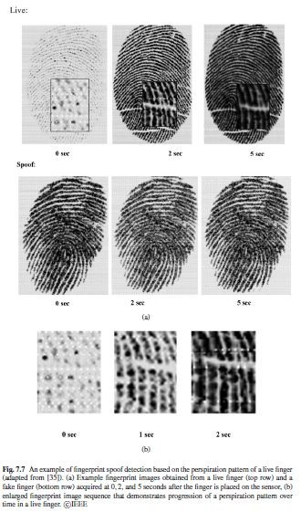

Slide 50
Spectral/optical properties of the human skin
This is one of the most common characteristics that has been successfully used for spoof detection in many biometric systems, including fingerprint, palmprint, face, and iris.
The optical properties that may be measured include the absorption, reflection, scattering, and refraction properties under different illumination conditions (such as wavelength, polarization, coherence)

Slide 51
In the case of fingerprints, multi-spectral analysis may be used to measure the surface properties as well as sub-surface properties of a finger since components of blood (oxygenated and deoxygenated hemoglobin) absorb different wavelengths of light.
Similarly, the tissue, blood, fat, and melanin pigments in the eyes absorb differentwavelengths of light.
These properties can be leveraged for liveness detection in fingerprint (see Figure 7.8) and iris recognition systems.

Slide 52
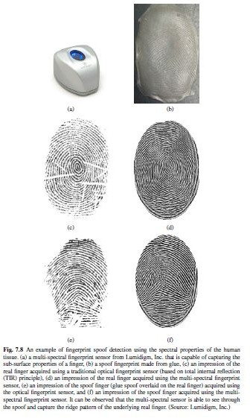

Slide 53
Electrical characteristics:
The electrical conductivity of human tissue differs from conductivity of many other synthetic materials such as silicone rubber and gelatin.
The conductivity of the material presented to the fingerprint sensor can be measured to differentiate a live finger from a fake finger.
However, the conductivity of live fingers varies a lot depending on environmental conditions such as humidity and temperature. If water or saliva is added to a fake finger, its conductivity may be indistinguishable from that of a live finger

Slide 54
Skin deformation:
The deformation pattern of the human skin can be used for differentiating live fingers from fake fingers.
Skin is more flexible than most other materials and the ridges and valleys in a fake finger do not deform like a live fingertip.
Real live skin deforms only in a certain way because the skin is anchored to the underlying derma and the deformation is influenced by the position and shape of the finger bone.
But measuring these deformation patterns is not easy because it requires capturing a video of the fingerprint at a high frame rate as the finger moves on the sensor surface.
This is problematic because most fingerprint sensors are designed for single-touch fingerprint acquisition and the users are trained not to move the finger during capture; excessive deformation will affect the matching accuracy of the system.

Slide 55
One of the common criticisms of the liveness detection algorithms employed in commercial biometric systems is that they are based solely on the principle of se curity through obscurity.
In other words, biometric vendors do not generally reveal the algorithm or implementation details about their liveness detection methodology because if the specifics of the spoof detection techniques are revealed, the system can be circumvented easily.
Experience in cryptographic systems has shown that this approach does not provide satisfactory results over a period of time.
Once an attacker identifies a possible vulnerability and successfully carries out a spoof attack, the complete system falls apart. Therefore, one should assume that the attacker has knowledge about the physiological properties used by the system for detecting spoofs

Slide 56
Attacks on Biometric Processing
The signal processing and pattern matching algorithms that form the crux of automated biometric recognition are implemented in the sensor, feature extractor, matcher, and decision modules.
Thus, an attacker can subvert the biometric processing either by directly undermining the core functional modules of the biometric system or by manipulating the communication between these modules.
Though the template database is also one of the modules in the biometric system, the motivation and consequences of an attack on the template database are different compared to the other modules. Therefore, the attacks on the template database will be considered separately.

Slide 57
Attacks on the system modules
Attacks on the core functional modules can be mounted either through unauthorized modification or by exploiting the faults in their implementation.
The motivation of these attacks could be to cause denial-of-service to legitimate users or facilitate intrusion.
Unauthorized modification
Exploitation of faults

Slide 58
Unauthorized modification
The hardware and software components of a biometric system can be modified by attackers.
A classic example is the modification of an executable program in a module through a Trojan horse attack.
A Trojan horse is malicious software that appears to perform a desirable function for the user, but instead performs some other function that usually facilitates intrusion by unauthorized users.
The Trojan horse can disguise itself as one of the modules, bypass that module, and output the values desired by the adversary as input to the subsequent modules.

Slide 59
For instance, a Trojan horse program can bypass the feature extractor and send the false features determined by the attacker to the matching module (see Figure 7.10).
Similar attacks can also be carried out at the sensing, quality estimation, matching, template database,and decision modules.

Slide 60
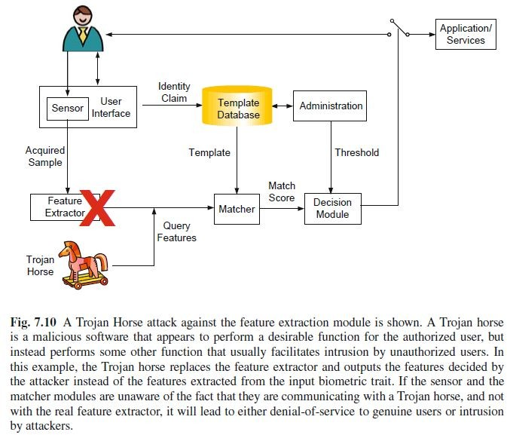
Torjan horse attack

Slide 61
One method to overcome this attack is to employ a trusted biometric system.
A trusted biometric system is one in which the different modules are bound together physically and/or logically using mutual authentication between the modules.
Mutual authentication implies that the trust is established both ways between two communicating parties. This is usually achieved through public key cryptographic protocols and digital signatures.
In addition to mutual authentication, secure code execution practices or specialized tamper-resistant hardware that can enforce secure execution of software can be used to avoid modification of the module functionalities.

Slide 62
Exploitation of faults
The attacker may identify and exploit the loopholes in the implementation of the biometric algorithms or insecure configuration to circumvent the biometric system.
As an example, consider a matching module in which a specific input value, say b0, is not handled appropriately, and whenever b0 is input to the matcher, it always out puts a “match” decision.
This vulnerability might not affect the normal functioning of the system because, in practice, the probability of b0 being generated from a real biometric data may be negligible.
However, an adversary can exploit this loophole to easily breach the security without being detected.

Slide 63
Exploitation of faults
the attacker may need to bypass one or more modules in the biometric system to exploit such implementation faults.
This attack is also closely linked to the obfuscation attack, because knowledge of the faults in the biometric implementation will allow the attacker to circumvent the system through appropriate alterations of his/her biometric trait.
This attack can be prevented by using well-tested biometricalgorithms.

Slide 64
Attacks at the interconnections
The following three attacks are possible when an adversary gains control of the communication interfaces between different modules of the biometric system.
While the man-in-the-middle and replay attacks are common to the communication channel between any two modules in a biometric system, the hill-climbing attack is specific to the link between the sensor and feature extractor or the link between the feature extractor and matcher.

Slide 65
Man-in-the-middle attack
In cryptography, a man-in-the-middle attack is a form of active eavesdropping, where the attacker establishes independent connections between two entities already in communication and relays messages between them.
The victims are led to believe that they are directly communicating with each other, when in fact the entire conversation is controlled by the attacker.

Slide 66
Man-in-the-middle attack
In biometric systems, a man-in-the-middle attack can be carried out against any two biometric modules and its effect is the same asa Trojan horse attack on a system module,
i.e., it allows the attacker to inject false values into the biometric system.
Mutual authentication between biometric modules is required to counter this attack.

Slide 67
Replay attack
If the channels between the biometric modules are not secured physically or cryptographically, an adversary may intercept the data being transferred and replay it at a later time.
The raw biometric data or extracted features can be intercepted and replayed.
Replay attacks are possible even if the data is encrypted.
A countermeasure against this attack is to use time-stamps or a challenge/responsemechanism.
Mutual authentication between the modules and use of one-time session keys during every transaction could also mitigate replay attacks.

Slide 68
Hill climbing attack
Hill-climbing attacks are possible
when (a) the adversary has the ability to inject raw biometric sample data or features directly through a Trojan-horse attack or a
man-in-the-middle attack, and
(b) the attacker can obtain the match score output by the matcher (see Figure 7.11).
Here, the goal of the attacker is to determine a biometric sample or feature set that matches with that of a targeted identity for the specified biometric algorithm.

Slide 69
This leads to the hill-climbing attack, where an artificially generated biometric sample or feature set is first introduced into the system and the response (match score) is noted.
The adversary then perturbs the initial sample or feature set, submits it to the system, and records the new match score.
If the match score in the second iteration is higher than the first one, the changes are retained; else, they are discarded. The above process is iterated several times until the match score exceeds the threshold set by the system administrator.
In each iteration where the match score is higher than before, the artificially generated sample or feature set becomes more similar to the template that is being targeted

Slide 70
One can easily see that a hill-climbing attack is more difficult to implement than a Trojan horse or a man-in-the-middle attack.
The reason for this difficulty is that not only access to match scores is needed, the attacker also needs to have some knowledge of the feature/sample distribution to synthetically generate features/samples in such a way that higher match scores can be obtained in the successive iterations.

Slide 71
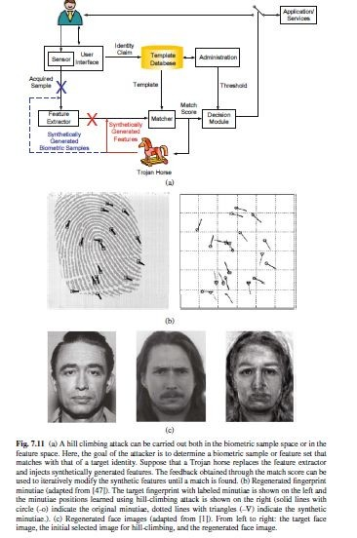
HILL CLIMBING

Slide 72
Attacks on the Template Database
Two kinds of attacks are possible on the biometric template database

Slide 73
FIRST ATTACK
First, the templatedatabase could be hacked or modified by an adversary to gain unauthorized access or to deny access to legitimate users.
This unauthorized template modification can be carried out irrespective of the storage location, be it a central server, a remote client (e.g., personal computer, mobile phone, etc.), or a smart-card
Similar attack is also possible in password-based authentication systems.
The common technique used to mitigate such a threat is to have strict control on database access.

Slide 74
SECOND ATTACK
Second, the stored biometric template information may become available to an adversary.
Such an attack is referred to as leakage.
Leakage is not a serious issue in password-based authentication, because only a cryptographic hash of the password is typically stored in the database, and the adversary gains no useful information from learning this hashed password.
However, leakage is a serious problem in biometric systems

Slide 75
There are four ways in which the biometric information of a user can be gleaned,namely,
collusion or coercion,
(b) covert acquisition,
(c) brute-force or hillclimbing attacks, and
(d) template leakage.

Slide 76
Among these four possibilities, the first two require the attacker to be in close physical proximity to the user or get the user’s cooperation.
The third method requires the attacker to breach the security of the biometric system and mount a successful intrusion attack. F
The attacker needs to expend significant effort in the first three methods to acquire knowledge about a single user.
In contrast, if an attacker can hack into a large biometric database, a task that can be done from a remote location while remaining anonymous, he can easily obtain the biometric information about a large number of users along with their biographic information (such as name, address, etc.).

Slide 77
The leaked biometric information will lead to intrusion because the attacker can either reverse engineer the template to create a physical spoof or replay the stolen template to gain unauthorized access.

Slide 78
leakage of biometric templates violates the data confidentiality requirement of a biometric system.
unlike passwords and tokens, it is not possible to replace compromised biometric traits.
Once the biometric information falls into the hands of an adversary, it is lost forever and cannot be reissued, updated, or destroyed.

Slide 79
Thus, the irrevocable nature of biometric traits, which is one of the strengths of biometric recognition, can also be considered a weakness.
leaked biometric templates can be used for secondary purposes like cross-matching across different databases to covertly track a person without his/her consent, thereby resulting in a function creep.
leakage attack is not only a serious security threat, but also undermines the user’s privacy.

Slide 80
Countermeasure: biometric template security
The problem of biometric template security is quite similar to the problem of storing passwords securely, it is natural and intuitive to consider reusing the same techniques developed for password security in order to protect biometric templates.

Slide 81
Techniques for securing passwords
One possible approach for securing passwords is to encrypt them using well-known cryptographic techniques (e.g., Advanced Encryption Standard (AES), Rivest-Shamir- Adleman (RSA) algorithm, etc.) and store only the encrypted password.
During authentication, the same encryption algorithm can be applied to the input password and directly matched to the stored encrypted password.

Slide 82
Since an encrypted password can be decrypted if the decryption key is known, the security of encryption depends on the secrecy of the decryption key.
It is well-known that key management (secure generation, distribution, and storage of cryptographic keys) is probably the most challenging issue in the practical implementation of cryptosystems.
Even if the decryption key is held securely, an attacker can choose some arbitrary passwords and obtain the corresponding encrypted passwords

Slide 83
The second alternative is referred to as password-based key generation.
the password is never stored anywhere in the system.

Slide 84
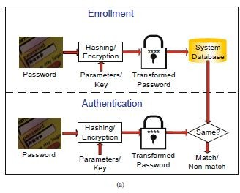
Password encryption or hashing

Slide 85
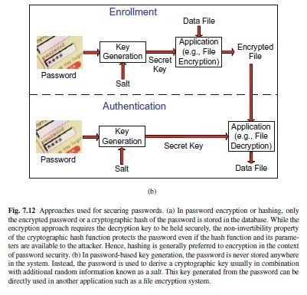
Password based key Generation

Slide 86
The password is directly used to derive a cryptographic key usually in combination with additional random information known as a salt.
Another application such as a file encryption system can directly use the key derived from the password for symmetric key cryptography.
While this approach is beneficial in the sense that the password need not be stored anywhere, it can be used only in applications where the authentication is implicit. For instance, one can decrypt an encrypted file and read its contents only if the right password is presented.

Slide 87
THIRD APPROACH
The third approach used in most modern password-based authentication systems is to apply a cryptographic hash function to the plaintext password and store only the hashed password.
When the user enters the password during authentication, the same hash function is applied to the input password and the resulting hash value is directly matched with the stored hash value

Slide 88
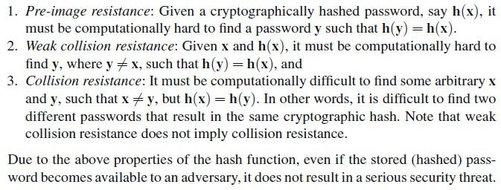
CRYPTOGRAHIC HASH FUNCTION

Slide 89
Challenges and requirements in biometric template security
password-based authentication relies on an exact match between the passwords entered during enrollment and authentication, biometric recognition is based on inexact match between the enrollment and authentication samples.

Slide 90
There can be large intra-user variability in multiple acquisitions of the same biometric trait and handling these intra-user variations is the most important challenge in designing a biometric template protection scheme

Slide 91
The term “protected” or “secure” template will be used to refer to those templates that are obtained after the application of a biometric template security algorithm to the “unprotected” or “original” template.

Slide 92
THREE PROPERTIES OF TEMPLATE
A biometric template protection scheme should have the following three properties.
Cryptographic security
Performance
Revocability

Slide 93
Cryptographic security
Cryptographic security refers to the pre-image resistance property that is typically satisfied by cryptographic hash functions.
The concept of pre-image resistance is also related to one-way or noninvertible mathematical functions.
A function f is referred to as a one-way function if it is “easy to compute” (in polynomial time) but “hard to invert” (given f(x), the probability of finding x in polynomial-time is small)

Slide 94
A non-invertible template protection scheme implies that it will be computationally hard to obtain the original biometric features from the secure template.
This prevents an adversary from creating a physical spoof of the biometric trait and intruding another biometric system that makes use of the same biometric trait.
Thus, a secure template must be pre-image resistant and non-invertible.

Slide 95
Performance: The biometric template protection scheme should not degrade the recognition performance (FMR and FNMR) of the biometric system.

Slide 96
Revocability: It is desirable to have a template protection scheme that can generate multiple secure templates from the same biometric data.
These multiple secure templates must be such that even if an adversary obtains two or more of them, it must be computationally hard to
(a) identify that they are derived from the same biometric data and
(b) obtain the original biometric features of the user.

Slide 97
This revocability or cancelability property ensures that cross-matching across biometric databases is not possible, thereby preserving the user’s privacy.
Revocability also makes it straightforward to discard a compromised template and reissue a new one based on the same biometric data.
the template protection scheme should satisfy all the three requirements at the same time

Slide 98
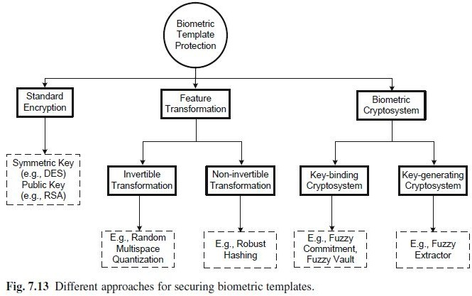
DIFFERENT APPROACHES FOR TEMPLATE PROTECTION

Slide 99
Standard encryption
multiple acquisitions of the same biometric trait do not result in the same feature set. Typically,
standard encryption functions are not smooth functions and a small difference in the values of the feature sets extracted from the raw biometric data would lead to very large difference in the resulting encrypted features (see Figure 7.16)

Slide 100
Standard encryption
The main advantage of the standard encryption approach is that the recognition performance of the biometric system is not affected at all.
Since the matching actually takes place in the decrypted domain, there is no need to
re-design or modify the available matching algorithms

Slide 101
Standard encryption
However, it must be emphasized the encryption solution is secure and revocable only under ideal conditions (key is kept secret and matching is done at a trusted location).
If practical issues such as key management or susceptibility to template theft during a matching attempt are taken into account, the standard encryption technique is not good enough for securing biometric templates.

Slide 102
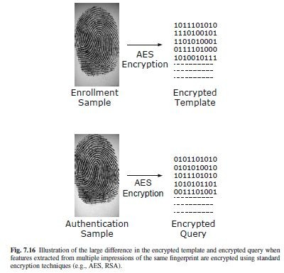

Slide 103
feature transformation approach and
biometric cryptosystem
To overcome this problem, a number of techniques have been proposed, which are specifically designed for biometric template
security, keeping
in mind the unique this domain such as
characteristics of
intra-user variations.
These techniques can be roughly classified as feature transformation approach and biometric cryptosystem.

Slide 104
hybrid biometric cryptosystem.
When a template security scheme clearly involves elements from both the basic approaches, (feature transformation approach and biometric cryptosystem)it is referred to as a hybrid biometric cryptosystem.

Slide 105
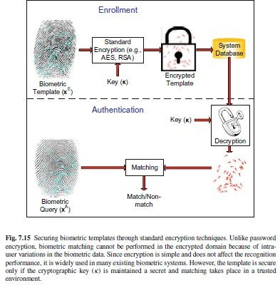
Standard encryption

Slide 106
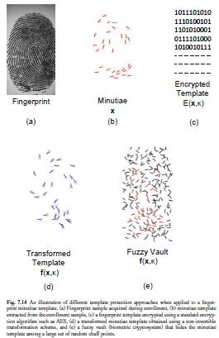

Slide 107
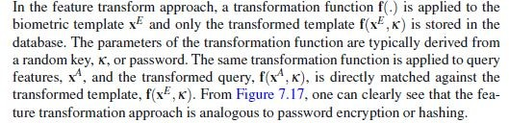
Feature transformation approach

Slide 108
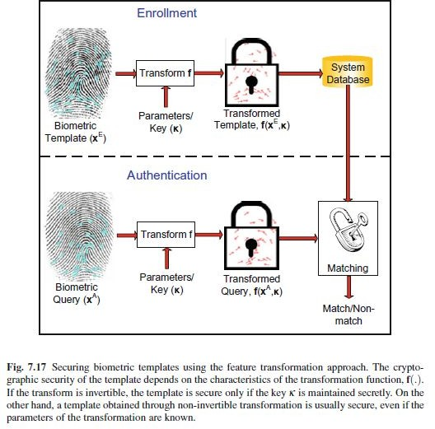

Slide 109
FEATURE TRANSFORM
The feature transform schemes can be further categorized as
invertible
non-invertible transforms

Slide 110
Invertible transformation
When the transformation function, f(.), is invertible², the security of the transformed template is based on the secrecy of the key κ .
In other words, if an adversary gains access to the key and the transformed template, he can recover the original biometric template (or a close approximation of it).
Thus, a template protected using the invertible feature transformation approach is similar to an encrypted password.

Slide 111
A well-known example of invertible feature transformation approach is the random multi-space quantization technique (see Figure 7.18). This scheme can be used to transform a fixed-length (and typically
real-valued) biometric feature vector.

Slide 112
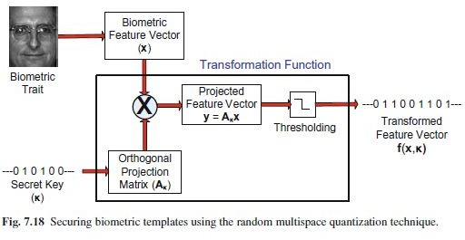
Random multispace quantization

Slide 113
The security in this scheme is provided by the user-specific random projection matrix Aκ .
If an adversary gains access to this matrix, then the scheme is neither pre-image resistant nor non-invertible.
Even though the matrix Aκ does not have an exact inverse because its rank is less than d, one can easily obtain a
pre-image by computing the pseudo-inverse of Aκ .
Further, it may also be possible to recover a close approximation of the original biometric features (some information is lost due to binarization) through a
hill-climbing attack.
Finally, an attack similar to the chosen plaintext attack may be used to recover the random projection matrix directly.

Slide 114
Non-invertible transformation:
Non-invertible transformation schemes typically apply a one-way function on the template, and it is computationally hard to invert a transformed template even if the key is known.
Ideally, one should employ a transformation function that is both pre-image resistant and non-invertible.
If such a transform can be applied, then non-invertible transformation is equivalent to a password hashing scheme.
Since it is hard to recover the original biometric template even when the parameters of the transformation are compromised, this scheme provides better security than the invertible transformation approach.
By selecting user-specific transform parameters, this approach can also allow revocability

Slide 115
The main drawback of this approach is the trade-off between discriminability (recognition performance) and non-invertibility (security) of the transformation function.
The transformation function should preserve the discriminability (similarity structure) of the feature set, i.e., just like in the original feature space, features from the same user should have high similarity in the transformed space and features from different users should be quite dissimilar after transformation.
On the other hand, the transformation should also be non-invertible, i.e., given a transformed feature set, it should be hard for an adversary to obtain the original feature set (or a close approximation of it). It is difficult to design transformation functions that satisfy both the discriminability and non-invertibility conditions simultaneously.
one needs to choose an appropriate transformation function based on the characteristics of the biometric features employed in a specific application.

Slide 116
Examples of non-invertible functions that have been proposed for the purpose of transforming fingerprint minutiae include cartesian, polar, and functional transformations.
In cartesian transformation, the minutiae space (fingerprint image) is tessellated into a rectangular grid and each cell (possibly containing some minutiae) is shifted to a new position in the grid corresponding to the translations set by the key κ .
The polar transformation is similar to cartesian transformation with the difference that the image is now tessellated into a number of concentric shells and each shell is divided into sectors.

Slide 117
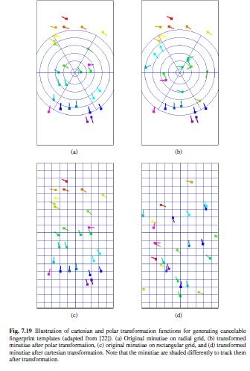

Slide 118
Biometric cryptosystems
Biometric cryptosystems are somewhat similar to password-based key generation systems because they were originally developed for the purpose of either securing a cryptographic key using biometric features or directly generating a cryptographic key from biometric features.
Since the biometric features available during enrollment and authentication are different, these features cannot be directly used for generation of cryptographic keys.
In order to facilitate key generation, some public information about the biometric features is stored in the database during enrollment.
This public information is usually referred to as helper data or secure sketch and hence, biometric cryptosystems are also known as helper-data-based methods.
The secure sketch is used during authentication to extract a cryptographic key from the query biometric features through a process known as the recovery mechanism.
Matching is performed indirectly by verifying the validity of the extracted key or by directly using the key in another application.

Slide 119
Key binding and key generation
Biometric cryptosystems can be further classified as key binding and key generation systems depending on how the secure sketch is obtained.
When the secure sketch is obtained by binding a cryptographic key (that is independent of the biometric features) with the biometric template, it is referred to as a key binding biometric cryptosystem.
If the helper data is derived only from the biometric template and the cryptographic key is directly generated from the helper data and the query biometric features, it leads to a key generation biometric cryptosystem

Slide 120
Thus, biometric cryptosystems solve the challenging problems of cryptographic key management and biometric template protection simultaneously.
Due to this reason, this topic is under active research in both the biometric and cryptographic communities.

Slide 121
Key binding cryptosystem
key binding cryptosystem, the biometric template is secured by monolithically binding it with a secret key within a cryptographic framework. As shown in Figure 7.20,
a single entity that embeds both the key and the template is stored in the database as the secure sketch.
This secure sketch does not reveal much information about the key or the biometric template, i.e., it is computationally hard to decode the key or the template without any knowledge of the user’s biometric data.
Matching in a key binding system involves recovery of the key from the helper data using the query biometric features and verifying the validity of the key.

Slide 122
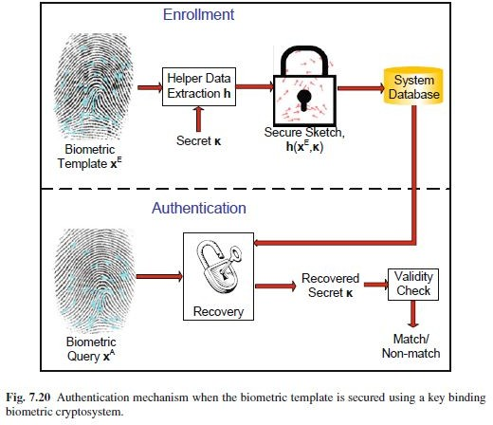
Key binding

Slide 123
Fuzzy commitment scheme
One of the earliest and most well-known key binding biometric cryptosystems is the fuzzy commitment scheme.
Suppose that the enrollment template x^{E} is a binary string of length d bits. During enrollment, an error correcting codeword c of the same length (d bits) is selected.
This codeword is uniquely indexed by a secret key κ of length m bits (there is a one-to-one correspondence between c and κ ). Here, m is less than d and the parameter (d −m) is a measure of the redundancy in the error-correction code.
The codeword c is then committed (bound) to the biometric feature vector xE to generate the secure sketch.
The secure sketch or helper data consists of the fuzzy commitment (x^{E} ⊕c) and g(κ), where g(.) is a cryptographic hash function and ⊕ represents exclusive-or (XOR) operation (modulo-2 addition).

Slide 124
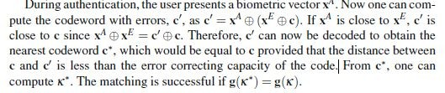

Slide 125
Key generating biometric cryptosystem:
Direct cryptographic key generation from biometrics is an attractive proposition, but it is a difficult problem because of two reasons:
the intra-user variability of the biometric features, and
the non-uniform nature of the probability distribution of biometric features.
The concept of secure sketch or helper data can be used to solve the first issue.
In this scenario, the secure sketch is derived using only
the biometric template and the recovery mechanism facilitates exact reconstruction of the template when presented with a query that is close to the template as illustrated in Figure 7.21.

Slide 126
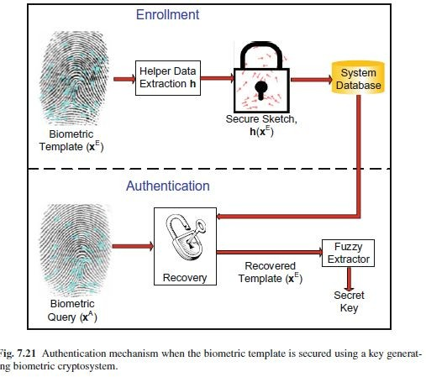

Slide 127
Early biometric key generation schemes employed user specific quantization schemes.
Information on quantization boundaries is stored as helper data, which is used during authentication to account for intra-user variations.
It is also possible to make use of error correction coding schemes to generate the secure sketch from the biometric features.

Slide 128
