Slide 1

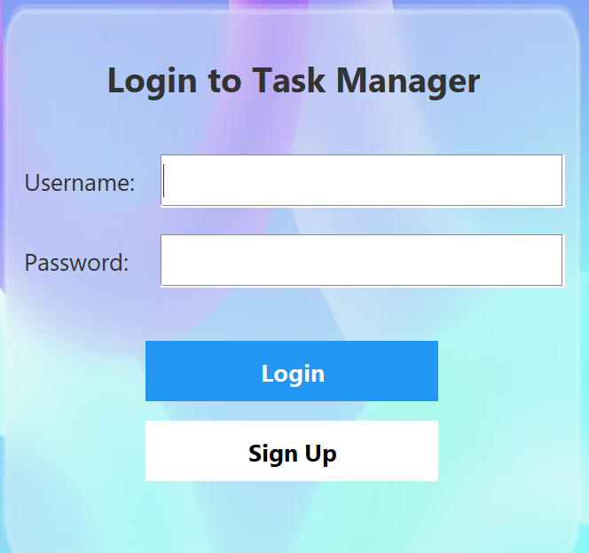
Task Manager App: Java Swing, JDBC, Maven, Git
This presentation explores a Task Manager app built with robust Java technologies. It covers the app’s features and development tools ensuring efficient task handling, database integration, and version control.

Slide 2
Java Swing UI Framework
Why Java Swing?
Event Handling
Offers rich desktop UI components and flexibility. Ideal for cross-platform apps.
Uses ActionListener and MouseListener to handle user actions smoothly.
Key components include JFrame, JPanel, JTable, and JButtons for user interaction.
Example: Dialog for creating tasks, and lists displaying all tasks dynamically.

Slide 3
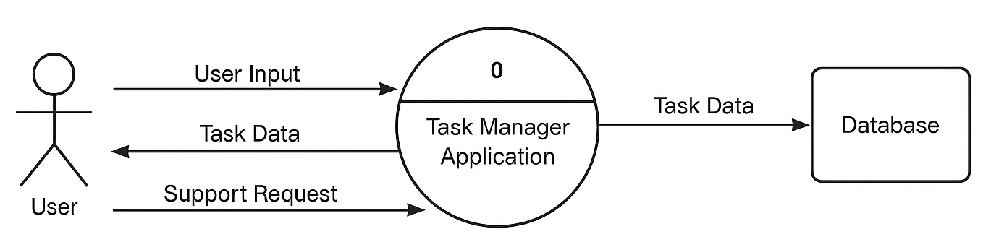
JDBC Database Connectivity
Database Connection
Supports SQLite for persistent task storage.
CRUD Operations
Create, read, update, and delete tasks efficiently via SQL queries.
User Safety & Performance
Prepared statements prevent SQL injection; connection pooling boosts speed.
Error Handling
Robust try-catch blocks manage SQL and connection exceptions gracefully.

Slide 4
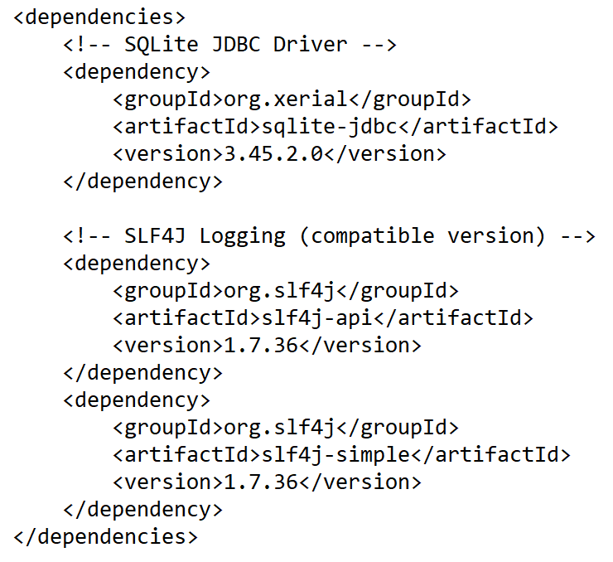
Maven Dependency Management
Project Setup
pom.xml defines dependencies, plugins, and build configurations.
Dependencies
Manages Swing, JDBC drivers, and necessary external libraries seamlessly.
Build Lifecycle
Handles compile, test, package, and install phases automatically.
Plugins
Uses compiler, jar, and assembly plugins for efficient builds.

Slide 5
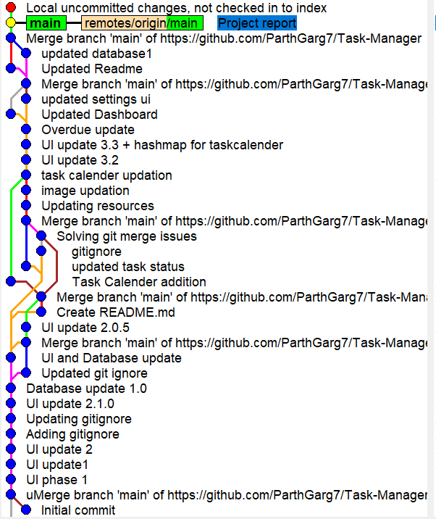




Git Version Control
Branching Strategy
Commit Messages
Merge Conflicts
Feature branches, develop and main branches streamline parallel work.
Clear, concise commits facilitate understanding and tracking.
Effective resolution strategies to maintain code integrity.
Benefits
Enables collaboration, version tracking, and easy rollback.

Slide 6
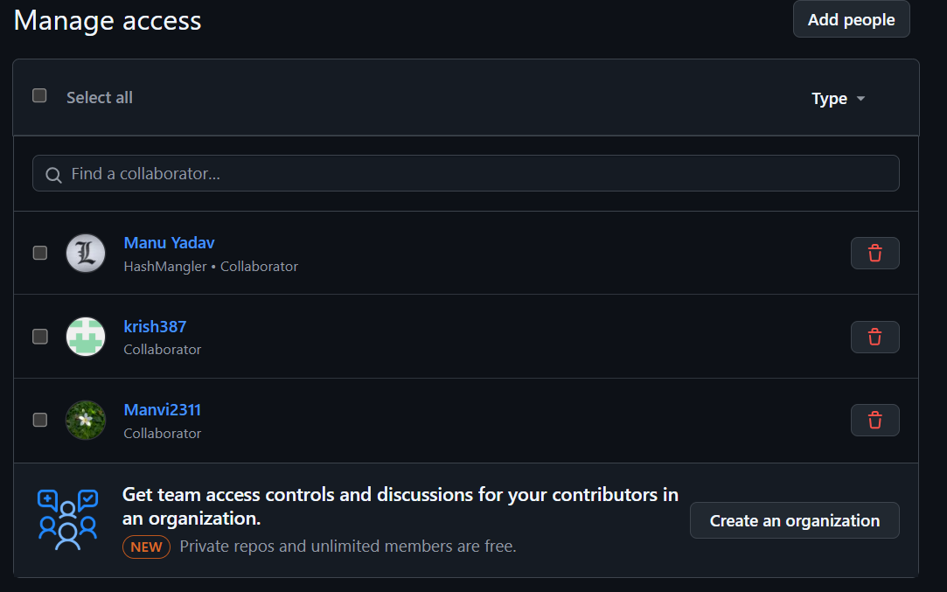
GitHub Collaboration
Project Hosting
Central repository on GitHub for accessible project management.
Pull Requests
Structured code reviews for quality assurance.
Issue Tracking
Manages bug reports and feature requests transparently.
CI/CD with Actions
Automates build and testing for continuous integration and deployment.

Slide 7






Application Architecture
View
Swing UI components handle display and user input.
Model
Task classes manage data and database interactions.
Controller
Handles user events and business logic.
This MVC pattern ensures clean code, maintainability, and ease of testing.

Slide 8
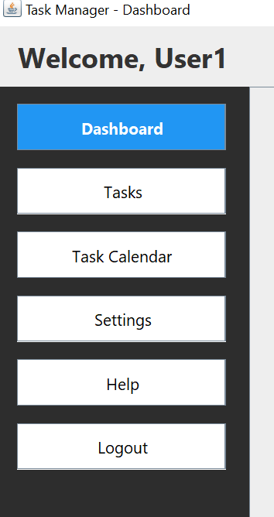
Key Features Demo
Task Creation
Specify title, description, due date, and priority.
Task Management
Sort, filter, search, update status, or priority.
Deletion & Persistence
Remove tasks with database updates to keep data current.

Slide 9
Challenges and Solutions
UI Responsiveness
Security
Use background threads to prevent UI blocking.
Implement password protection and encrypt sensitive data.
Data Sync
Scalability
Handle concurrent database access safely.
Design database and UI for large task volumes.
Robust error handling ensures smooth recovery from issues.

Slide 10
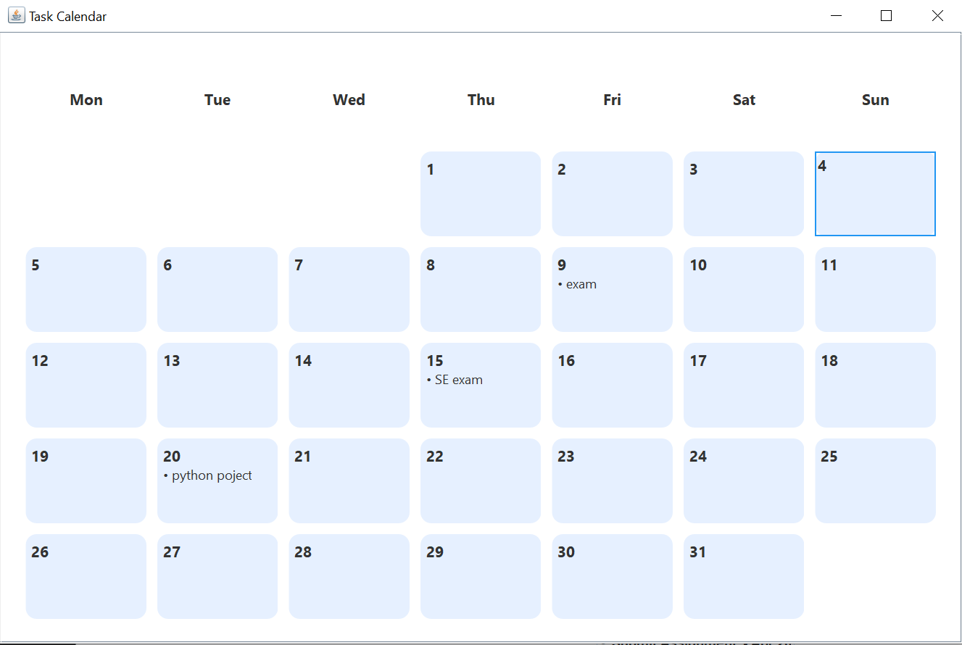
TASK CALANDER

Slide 11
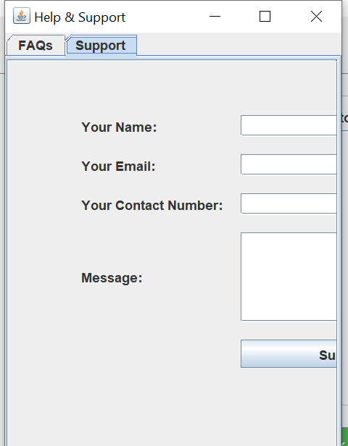

Conclusion and Future Enhancements
Summary
Successful integration of Java Swing, JDBC, Maven, Git, and GitHub.
Future Features
<number>
Add user accounts, task notifications, and reporting tools.
Open Source
Inviting collaborators to contribute via GitHub repository.
Q&A
Ready to answer questions and gather feedback.

