Slide 1
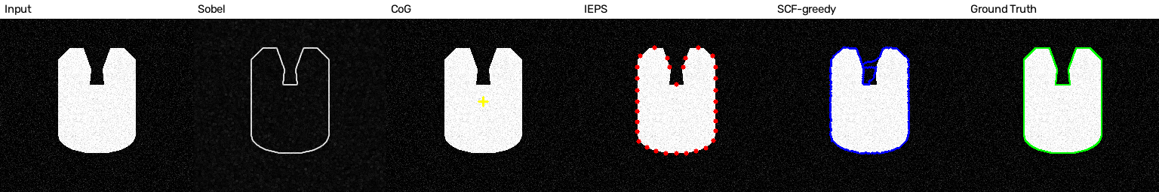
COMPUTER VISION - ASSIGNMENT 3 | DEGGENDORF INSTITUTE OF TECHNOLOGY | SUMMER 2026
Reimplementation and Validation of IEPS + SCF
for Object Contour Extraction
A Traditional Computer Vision Reproducibility Study
Assigned paper
Presenter
R. C. Hsu, P.-W. Kao, W.-J. Lai, and C.-T. Liu, "An initial edge point selection and segmental contour following for object contour extraction," Proc. IEEE ICARCV, 2010.
Parth Goswami
7-minute presentation | Python + NumPy + OpenCV
Generated by this implementation: input, Sobel gradient, center of gravity, IEPS points, SCF contour, ground truth

Slide 2
THE AUTHORS' PROBLEM
Closed object contours without manual initialization
Contour extraction must be automatic, accurate, and cheap enough for industrial inspection on low-level processors.
Edge detectors
Active contours (Snake)
Automatic initialization
Gradient operators such as Sobel find strong edges efficiently, but a closed contour is not guaranteed - edges stay fragmented.
Kass-style snakes produce closed contours, but the initial snaxels must be placed manually near the object, and the optimization is computationally heavy.
Yuen's fixed-angle scan lines select initial points automatically, but lack flexibility on concave or polygonal shapes and are easily disturbed by noise.
Goal of Hsu et al.: select initial edge points automatically (IEPS), then trace the contour segment by segment (SCF) using gradient + a gravity-like pull toward the next point - a closed contour at low computational cost.
Evaluation in the paper: man-made circle and U-shape images (clean + white Gaussian noise, down to SNR 20.3 dB) with known true edges, plus a real vase image.
IEPS + SCF reproducibility study | Parth Goswami | 02 / 11
Hsu et al., ICARCV 2010 [1]

Slide 3
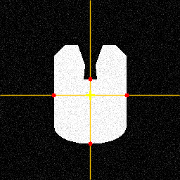
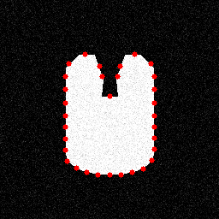
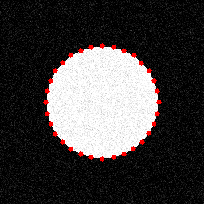
PAPER SOLUTION 1/2
IEPS - Initial Edge Point Selection
Radiating scan lines from the center of gravity, then iterative midpoint refinement; every equation below is implemented in src/ieps.py and src/geometry.py.
Center of gravity - Eq. (1)-(2)
m_ij = SUM_x SUM_y x^i y^j f(x,y) G = ( m10 / m00 , m01 / m00 )
Initial scan lines - Eq. (3)
N = 4 rays with equal angle 2*pi/N from G. Along each ray, keep the pixel farthest from G whose 3x3 Sobel gradient exceeds T = 64; otherwise drop.
Iterative refinement - Eq. (5)-(6)
4 rays from the CoG + first points
32 IEPS points after 3 iterations
Midpoint M_i of neighbors (S_i, S_i+1) seeds a new scan line normal to S_i S_i+1 (slope m1 = -1/m2). One new point is inserted between every pair.
Why it matters
Good initial points are the whole game: SCF only connects neighbors, so IEPS quality bounds the final contour.
Shrinking search + point budget - Eq. (7), (4)
Scan distance halves every iteration: d = D / 2^(p-1). Total points N_total = N * 2^p = 4 * 2^3 = 32.
Noisy circle: 32/32 on true edge
IEPS + SCF reproducibility study | Parth Goswami | 03 / 11
Hsu et al., ICARCV 2010 [1]

Slide 4
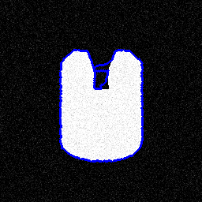
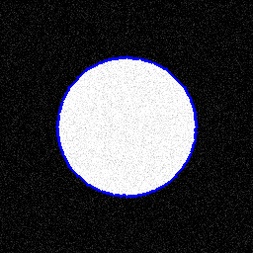
PAPER SOLUTION 2/2
SCF - Segmental Contour Following
Between every neighboring IEPS pair, a 3-candidate operating mask walks pixel by pixel, pulled by a gravity-like force toward the target point.
Related direction - Eq. (8), Table I
Dx = x_i+1 - x_i, Dy = y_i+1 - y_i. The sign pair (Dx, Dy) selects one of 9 states: E, SE, S, SW, W, NW, N, NE, or linked.
Operating mask - Fig. 4
Each state maps to a mask with three candidate pixels A, B, C around the current point, oriented toward the target.
Force of gravity - Eq. (9)
SCF trace, noisy U-shape
SCF trace, noisy circle
F(p) = grad_f(x,y) / sqrt(dx^2 + dy^2). Gradient magnitude acts as mass; distance to the target supplies the attraction.
Paper's claims to validate
IEPS beats Yuen's fixed-angle initialization (Table II); SCF beats Chen's gradient-only tracing (96-98% vs ~80% true-positive ratio, Table IV); whole pipeline runs in tens of milliseconds (Table V).
Closure - Fig. 2
The candidate with the largest F(p) becomes the next contour point and the new origin; segments repeat until the contour is closed.
IEPS + SCF reproducibility study | Parth Goswami | 04 / 11
Hsu et al., ICARCV 2010 [1]

Slide 5
OWN WORK 1/2
A reproducibility study of IEPS + SCF
Agreed with the professor: validate the authors' own method instead of drifting into a broad Canny / preprocessing comparison.
Research question: Can IEPS + SCF be reimplemented from the paper description alone and validated on author-style circle and U-shape images, including noisy cases, while identifying the missing implementation details needed to reproduce the behavior?
Under-specified in the paper
Why it changes the result
Rule fixed in this implementation
'Closed contour?' stop rule
a flow-chart diamond is not code
stop when distance to target <= 2 px
Candidate tie-breaking
several pixels score alike on flat edges
score, then gradient, then target distance
Loop prevention
greedy tracing can revisit pixels
visited set per segment + max 3x distance steps
Weak-gradient candidates
noise breaks edges; mask can go blind
fall back to the candidate closest to the target
Scan-line discretization
which pixels lie on a ray / normal line
integer sampling; public points stay (x, y)
Missing edge on a scan line
threshold can fail on a whole line
max-gradient fallback instead of silent drop
True-positive tolerance
paper reports ratios without a radius
2 px tolerance, distance-transform based
Contribution: every rule above is made explicit, implemented, and then measured - the extension is a parameter study inside IEPS + SCF, not an external method.
IEPS + SCF reproducibility study | Parth Goswami | 05 / 11
Hsu et al., ICARCV 2010 [1]

Slide 6
OWN WORK 2/2
Implementation and validation design
Hand-coded IEPS, SCF, geometry, and metrics in Python/NumPy; OpenCV only for Sobel, the secondary Canny baseline, and image I/O.
Synthetic images
Sobel gradient
CoG + IEPS
SCF
Validation
circle + U-shape, clean and sigma=20 noise, fixed seeds
3x3 magnitude, normalized 0..255
4 rays, 3 iterations, T=64, 32 points
mask + gravity score per segment
point accuracy, precision/recall/F1, runtime
Design decision
Choice used (and measured)
Metrics
Gravity score
grad / (d^2 + 1): bounded at d = 0; gradient-only vs gradient/distance compared
IEPS accuracy (points within 2 px of true contour), neighbor spacing mean/std, tolerance-based precision / recall / F1, and IEPS + SCF runtime per case.
Point ordering
topological insertion order (angle sort chords across the notch)
Refinement rule
farthest-from-center, consistent with the initial rays
Parameter study (extension)
Center of gravity
contrast-weighted moments; raw moments biased by non-zero background
Threshold 40/64/90; 4 vs 8 rays; 2 vs 3 iterations; stop tolerance 1-3 px; score formula; point order; refinement rule; three noise levels.
Closure
trace every neighboring pair, including last -> first
Everything is regenerated by one command (python main.py --run all); slides and report read the same CSV tables.
IEPS + SCF reproducibility study | Parth Goswami | 06 / 11
Hsu et al., ICARCV 2010 [1]

Slide 7
CODE 1/2
IEPS core: rays, then midpoint-normal refinement
Condensed from src/ieps.py - the loop structure mirrors the paper's equations directly.
# 1) Initial rays: farthest strong-gradient pixel on each of N = 4 scan lines
for i in range(initial_scan_lines):
angle = 2.0 * math.pi * i / initial_scan_lines
ray = sample_ray_from_center(center, angle, image.shape)
candidates = [p for p in ray if gradient[p[1], p[0]] >= threshold] # Eq. (3)
if candidates:
points.append(max(candidates, key=lambda p: distance(p, center)))
# 2) Refinement: insert one new point between every neighboring pair
for iteration in range(1, iterations + 1): # p = 1 .. 3
radius = max(3.0, default_scan_distance / 2.0 ** iteration) # Eq. (7)
next_points = []
for idx in range(len(points)):
p1, p2 = points[idx], points[(idx + 1) % len(points)]
mid = midpoint(p1, p2) # Eq. (5)
normal = normal_vector(p1, p2) # Eq. (6)
scan = sample_line_through_point(mid, normal, image.shape, radius)
selected = select_edge_candidate(scan, gradient, threshold, fallback)
next_points.append(p1)
if selected is not None:
next_points.append(selected) # new point stays between its parents
points = unique_preserve_order(next_points) # N * 2**p -> 32 points
Insertion order is preserved (topological): a refined point remains between the pair that created it, which keeps SCF segments short and local.
IEPS + SCF reproducibility study | Parth Goswami | 07 / 11
Hsu et al., ICARCV 2010 [1]

Slide 8
CODE 2/2
SCF core: masked greedy tracing with a gravity score
Condensed from src/scf.py - every rule the paper leaves open is an explicit line of code here.
def trace_segment_greedy(gradient, start, target, tol=2.0):
max_steps = max(5, math.ceil(3.0 * distance(start, target))) # step guard
current, path, visited = start, [start], {start}
for _ in range(max_steps):
if distance(current, target) <= tol: # explicit stop rule
break
cands = directional_candidates(current, target) # 3-pixel mask, Fig. 4
cands = [p for p in cands if p not in visited] or cands # no loops
if max(grad(p) for p in cands) < 1.0: # broken edge?
best = min(cands, key=lambda p: distance(p, target)) # fallback
else:
best = max(cands, key=lambda p: (
grad(p) / (distance(p, target) ** 2 + 1.0), # gravity ~ Eq. (9)
grad(p), # tie-break: gradient
-distance(p, target))) # tie-break: distance
current = best
path.append(best)
visited.add(best)
return path
# closed contour: trace every neighboring pair, including last -> first
for i in range(len(points)):
contour += trace_segment_greedy(grad, points[i], points[(i + 1) % len(points)])
With these rules fixed, all 32/32 segments reach their target on every main case - the 'closed contour?' diamond of the paper becomes a measurable property.
IEPS + SCF reproducibility study | Parth Goswami | 08 / 11
Hsu et al., ICARCV 2010 [1]

Slide 9
RESULTS
Circles reproduce perfectly; the U-shape stresses the assumptions
All values from results/tables/*.csv, regenerated by main.py; tolerance 2 px, fixed noise seeds.
Case
IEPS pts
IEPS acc
Precision
Recall
F1
IEPS+SCF time
circle_clean
32
100.0%
100.0%
100.0%
100.0%
9.5 ms
circle_noisy
32
100.0%
100.0%
100.0%
100.0%
8.4 ms
u_shape_clean
32
100.0%
92.8%
95.4%
94.1%
8.2 ms
u_shape_noisy
32
100.0%
93.3%
96.4%
94.8%
9.5 ms
Noisy U-shape F1 under implementation choices
Sensitivity finding
paper defaults
94.8%
Threshold 40/64/90 and stop tolerance 1-3 px shift F1 by < 0.3 pts - robust. Iteration count dominates: 2 instead of 3 iterations drops F1 by ~13 pts. Point count and placement matter more than tuning.
2 iterations
82.2%
8 scan lines
96.7%
angle ordering
97.3%
Honesty notes
graph SCF (ext.)
99.1%
Yuen/Snake/Chen comparisons are labeled approximations; on these synthetic shapes they tie or nearly tie (Chen = proposed SCF at every SNR), so they are context, not evidence of the paper's reported gaps. The real-image test follows on the next slide.
improved IEPS (ext.)
99.9%
Extensions stay inside the authors' method: graph-search SCF 99.1% (81.9 ms) and interior-seed improved IEPS 99.9% on the noisy U-shape.
IEPS + SCF reproducibility study | Parth Goswami | 09 / 11
Hsu et al., ICARCV 2010 [1]

Slide 10
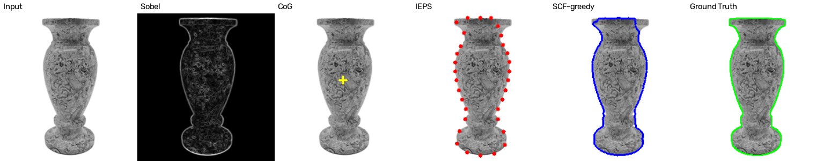
RESULTS - REAL IMAGE
Real vase: the paper's qualitative test
data/vase.png with an Otsu-estimated proxy mask - metrics are qualitative support, not ground-truth evaluation.
Paper-mode pipeline on the real vase: input, Sobel gradient, center of gravity, 32 IEPS points, SCF contour, proxy ground truth
Configuration
IEPS acc
F1 (proxy)
IEPS+SCF time
Reading
paper IEPS + greedy SCF
96.9%
93.8%
8.9 ms
31/32 IEPS points sit on the vase edge; greedy SCF closes the contour in ~15 ms - consistent with the paper's low-complexity claim (Table V: 37 ms vs 363 ms for Snake). The improved-IEPS extension does not transfer here (F1 25%) - reported, not hidden.
paper IEPS + graph SCF (ext.)
96.9%
94.5%
124.1 ms
improved IEPS + greedy SCF (ext.)
29.3%
25.0%
18.8 ms
IEPS + SCF reproducibility study | Parth Goswami | 10 / 11
Hsu et al., ICARCV 2010 [1]

Slide 11
CONCLUSION
The method reproduces - once the missing rules are written down
The reproducibility audit is the contribution: assumptions were made explicit, implemented, and measured.
1 - Reproduced
2 - Under-specified
3 - Extension inside the method
Full IEPS + SCF pipeline from the paper description: circles reach F1 100%, the noisy U-shape 94.8% with 32/32 initial points on the true edge and ~10 ms runtime.
Behavior hinges on rules the paper omits: SCF stopping, tie-breaking, loop prevention, fallbacks, tolerances. Each was fixed explicitly and its effect quantified in the parameter study.
An interior distance-transform seed with denser coverage lifts the noisy U-shape to 99.9% while preserving circles - scoped to synthetic concave shapes (it does not transfer to the vase proxy).
References (IEEE style)
[1] R. C. Hsu, P.-W. Kao, W.-J. Lai, and C.-T. Liu, "An initial edge point selection and segmental contour following for object contour extraction," in Proc. IEEE Int. Conf. Control, Automation, Robotics and Vision (ICARCV), 2010, pp. 1632-1637.
[2] P. C. Yuen, G. C. Feng, and J. P. Zhou, "A contour detection method: Initialization and contour model," Pattern Recognition Letters, vol. 20, no. 2, pp. 141-148, 1999.
[3] M. Kass, A. Witkin, and D. Terzopoulos, "Snakes: Active contour models," International Journal of Computer Vision, vol. 1, no. 4, pp. 321-331, 1988.
[4] B. D. Chen and P. Siy, "Forward/backward contour tracing with feedback," IEEE Trans. Pattern Analysis and Machine Intelligence, vol. 9, no. 3, pp. 438-446, 1987.
[5] K. S. Fu and J. K. Mui, "A survey on image segmentation," Pattern Recognition, vol. 13, pp. 3-16, 1981.
Evidence: src/ieps.py, src/scf.py, src/geometry.py, main.py | results/tables/*.csv | docs/RESEARCH_REPORT.md - all regenerable with python main.py --run all
IEPS + SCF reproducibility study | Parth Goswami | 11 / 11
Hsu et al., ICARCV 2010 [1]

