Slide 1

Optimizing Sales and Profitability for a Multi-Category Retail Superstore
IITM Online BS Degree Program
Name: Parth Kacha
Roll No: 23f1002650
Program: IITM Online BS Degree Program
Institution: Indian Institute of Technology, Madras
Course: Business Data Management (BDM) Capstone Project

Slide 2
About the Organisation (Superstore)
Superstore is a multi-category retail company operating across the United States
It sells products under three major categories:
Furniture
Office Supplies
Technology
Customers belong to Consumer, Corporate, and Home Office segments.
Operations span four regions: East, West, Central, and South.
The dataset used is a publicly available sample dataset from Kaggle.

Slide 3
Business Problems Addressed
Identify which product categories and sub-categories generate profit and which cause losses.
Analyze how discounts and shipping modes affect sales and profitability.
Study regional and customer segment performance to identify business growth opportunities.

Slide 4
Data Description (Metadata & Descriptive Stats)
Source: Kaggle – Superstore Dataset
Total records: 9,994 transactions
Time period: 2014–2017
Key variables:
  Sales, Profit, Discount, Quantity
  Category, Sub-Category
  Region, State
  Customer Segment, Ship Mode
Descriptive Statistics :
Average sales per order ~ $230
Average profit per order ~ $29
Discounts go up to 80%, which leads to losses

Slide 5
Data Preparation & Methodology
Data Preparation & Initial Analysis
No Missing value found
No data cleaning was required as the dataset had no missing values in key fields
Descriptive statistics calculated for Sales, Profit, Discount, Quantity
Category, Region, Segment, and Ship Mode level aggregations performed
Correlation heatmap showed:
  Huge discount resulted negatively correlation with Profit
Top loss-making products identified to highlight risk areas
Methodology
Descriptive statistics to understand data distribution
Group wise analysis by category, region, and customer segment
Correlation analysis to study discount-profit impact
Visualisation based interpretation using dashboards

Slide 6
Analysis Approach & Tools
Tableau
Interactive dashboards
Category, region, customer, shipping analysis
Python (Colab)
Pandas & NumPy for statistics
Correlation analysis (discount vs profit)
Loss-making product identification
Methods Used
Descriptive statistics
Correlation analysis
Category & region comparison
Trend analysis

Slide 7
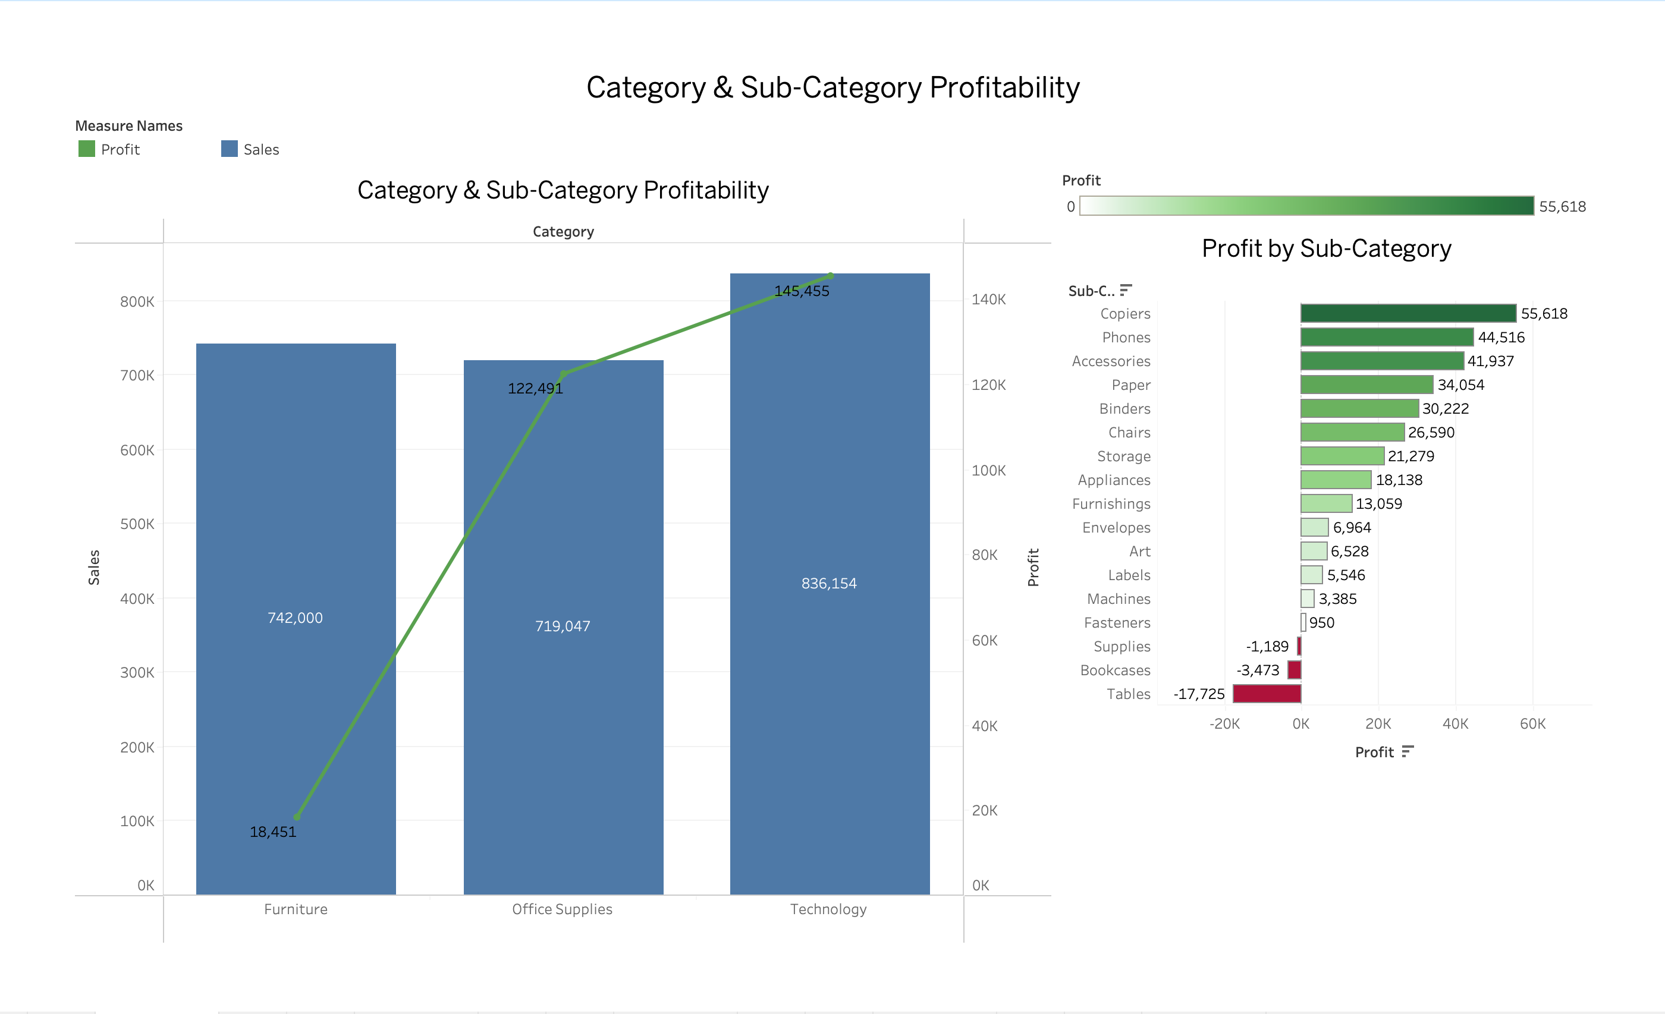
Key Analysis – Product & Category Performance
Category & Sub-Category Insights
Technology:
  Highest sales (~$836K)
  Highest profit (~$145K)
  Phones and Accessories are top contributors
Office Supplies:
  Stable sales (~$719K)
  Good profit (~$122K)
Furniture:
  High sales (~$742K)
  Very low profit (~$18K)
  Tables and Bookcases cause heavy losses
Key Learning:
High sales do not always mean high profit.

Slide 8
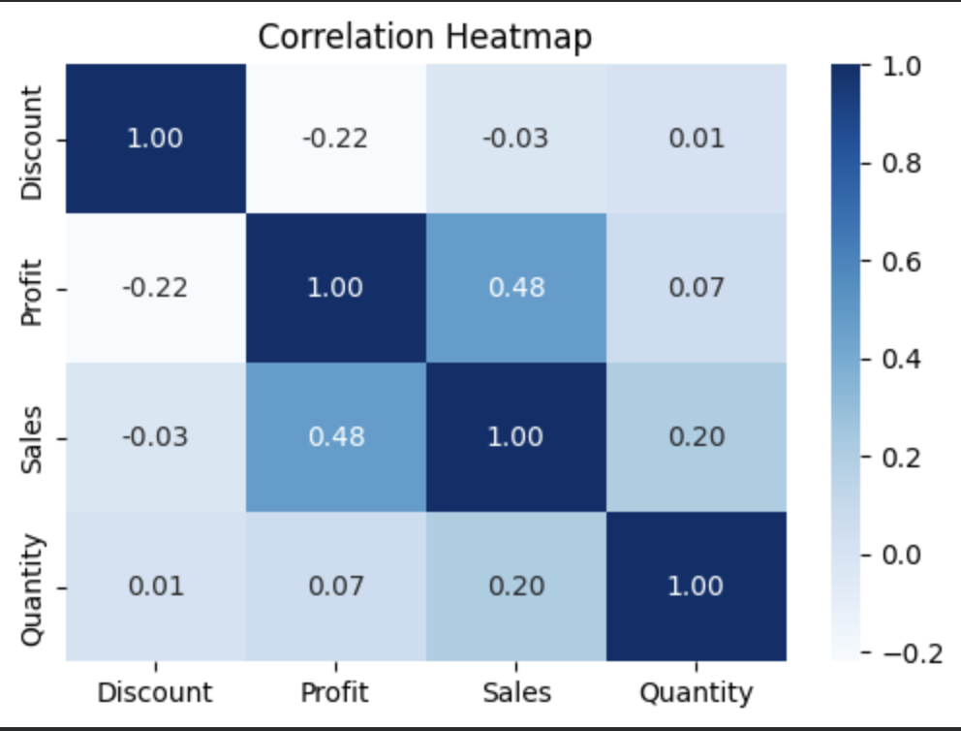
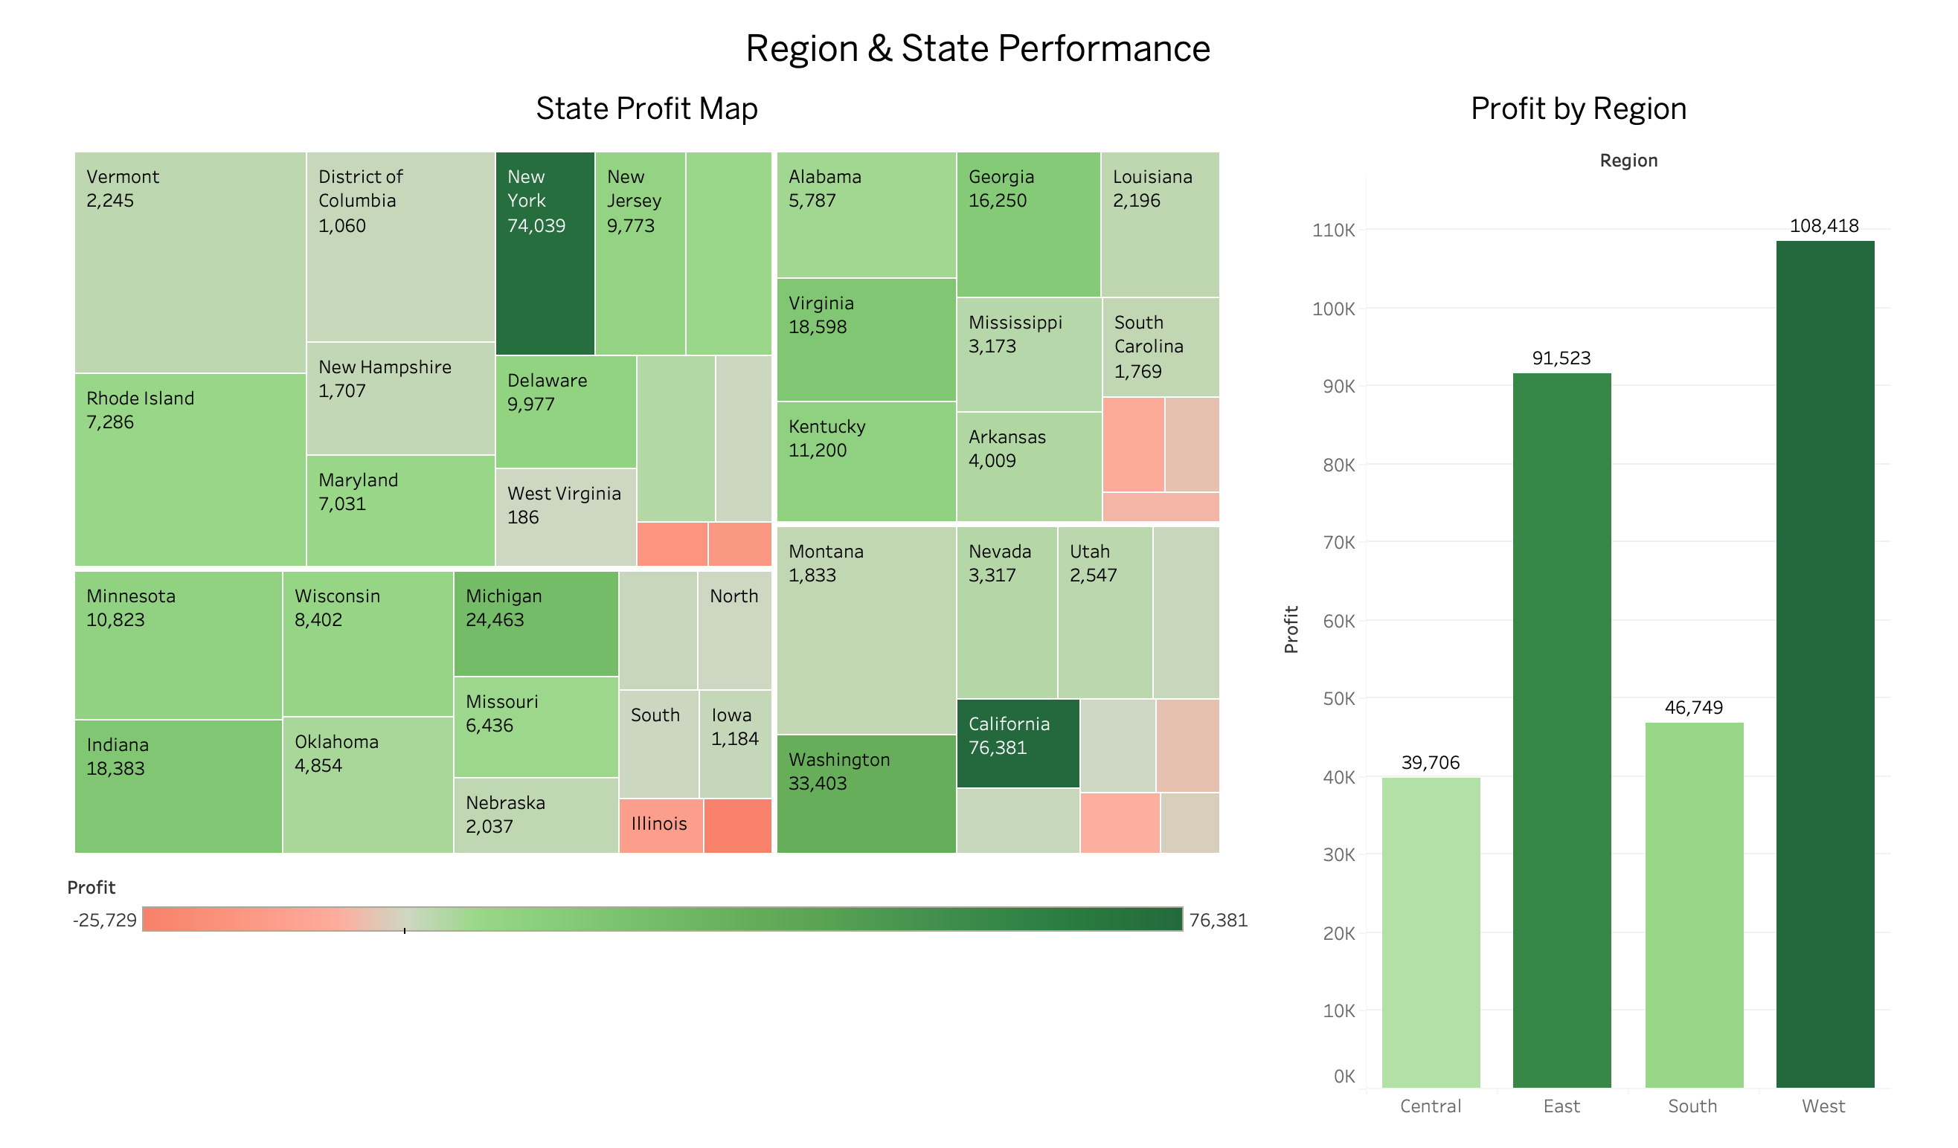
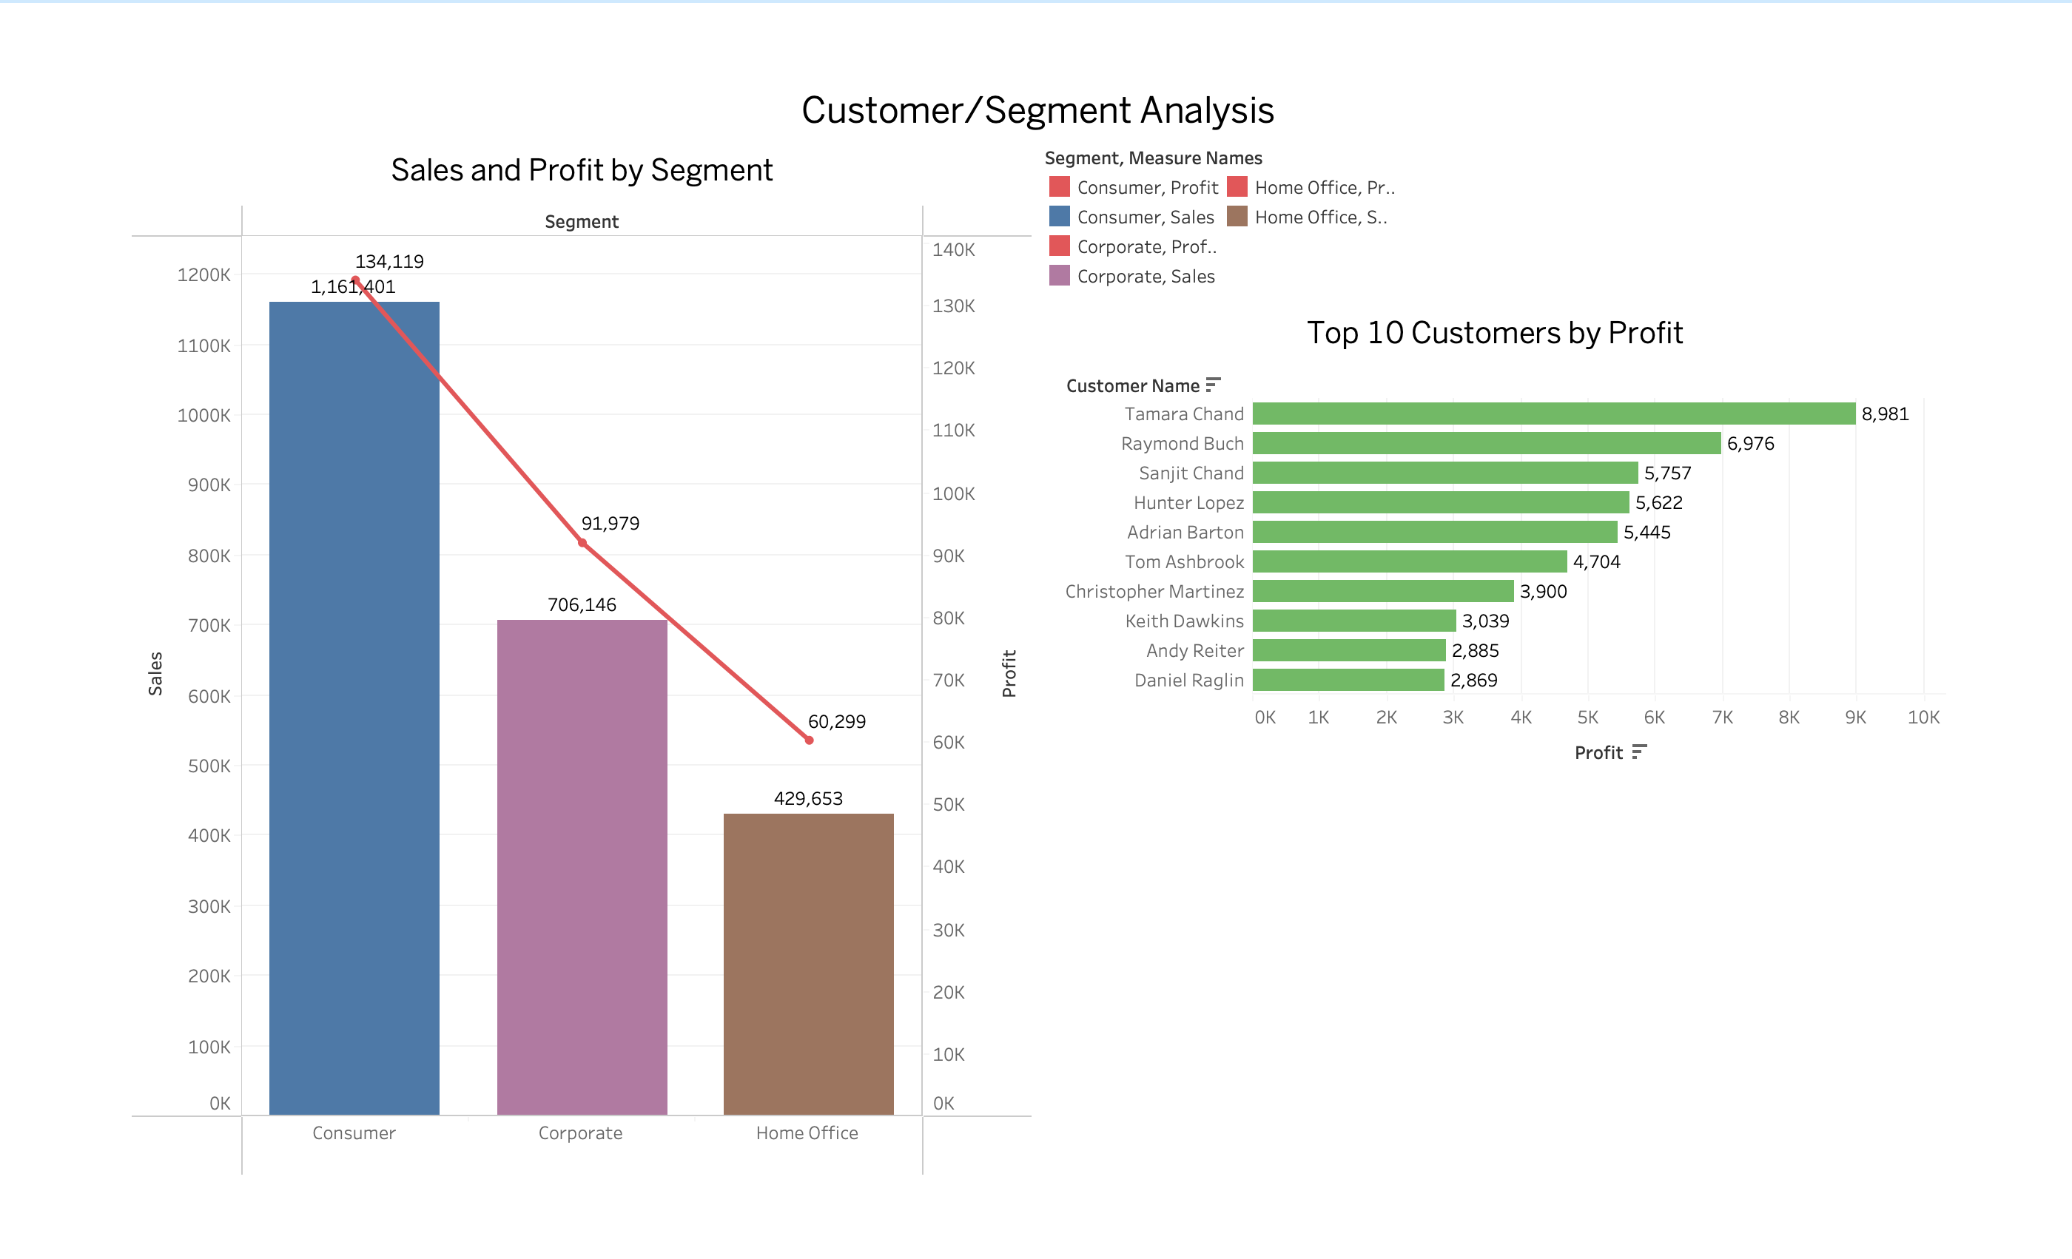
Profit is affected more by pricing decisions than by how much is sold. When discounts increase, profit drops quickly, even if sales remain high. This shows that heavy discounting directly weakens margins.
Most of the profit comes from only a few strong regions like the East and West. Other regions contribute much less, which means the business should not follow the same strategy everywhere and instead plan region-specific actions.
A small number of high value customers generate more profit than of low margin orders. Focusing on quality customers is more beneficial than only increasing order volume.

Slide 9
Key Findings & Business Recommendation
Key Findings
High sales do not always result in high profit.
Excessive discounts strongly reduce profitability.
Furniture category shows frequent losses despite good sales.
Corporate and Home Office customers generate higher profit per order.
East and West regions perform better than Central and South.
Business Recommendations
Limit discounts to selected products and loyal customers.
Review pricing and shipping costs for Furniture items.
Promote profitable products like Phones and Accessories.
Apply region-specific strategies instead of a single uniform approach.

Slide 10
Conclusion
This study applied exploratory data analysis and visual analytics using Python and Tableau to evaluate sales performance, profitability drivers, customer behaviour, and strategy building in a multi-category retail superstore. The analysis highlights that profitability is strongly influenced by discounting decisions, product mix, shipping modes, and regional demand patterns. While overall sales show consistent growth, profit does not increase at the same pace due to margin leakage from excessive discounts, costly logistics, and loss making product categories. The findings clearly demonstrate that data driven decision making is essential for achieving sustainable and profitable business growth.
Key Points:
High discounts (above 20%) significantly reduce profit, especially for Furniture and Technology products.
Technology and Office Supplies contribute most to profitability.
Corporate and Home Office customers generate higher profit per order compared to the Consumer segment.
East and West regions are strong profit contributors, whereas Central and South regions need some planned strategies.
Data-driven insights enable better control over pricing, product focus, and regional planning, leading to improved long term business performance.
Thank You

