Slide 1
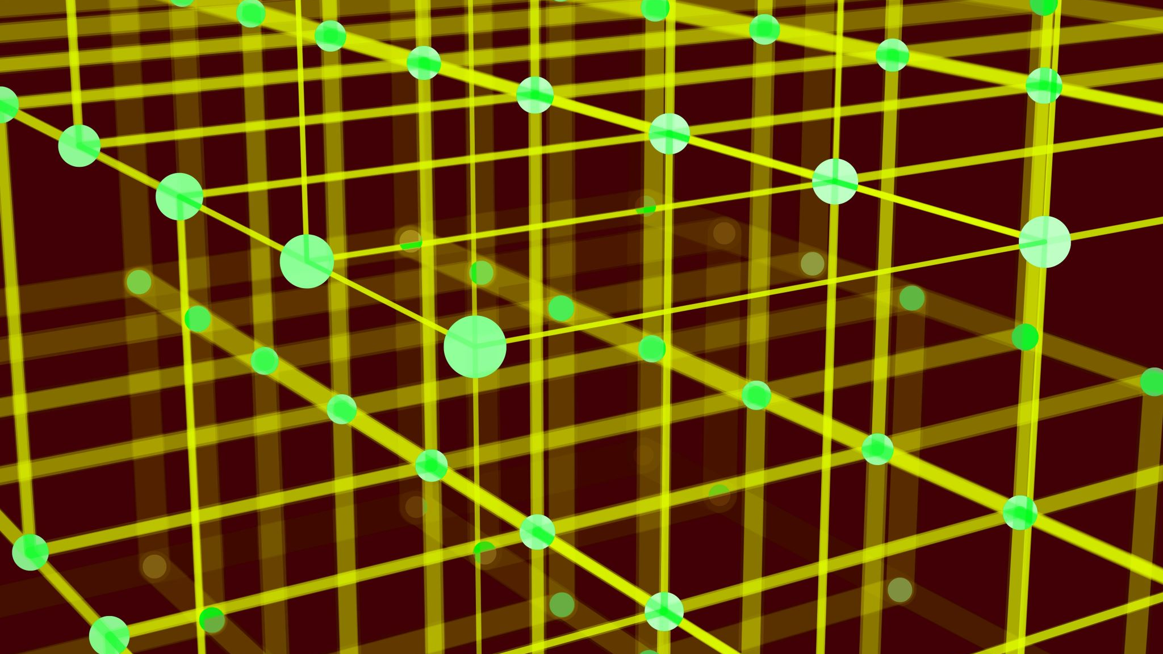
Clustering
INFO 6105

Slide 2

Problem Statement
Implement Hierarchical Clustering on Play Dataset and Concentric Circles
Implement k-means clustering on Boston housing dataset

Slide 3

Technical Approach for Hierarchical Clustering
Import Play Data
Process Data (insert dummies)
Create Dendograms for 3 cases (single, complete & average)
Generate concentric circle dataset
Implement Agglomerative Clustering (single, complete & average)
Plot the Dataset and Clustering results

Slide 4
Technical Approach for Kmeans Clustering on Boston Housing Data
Import Boston Housing Data
Process Data (insert dummies)
Identify correlation matrix (to drop irrelevant columns)
Implement K-means clustering
Plot the graph and identify the Knee
Plot the graph

Slide 5
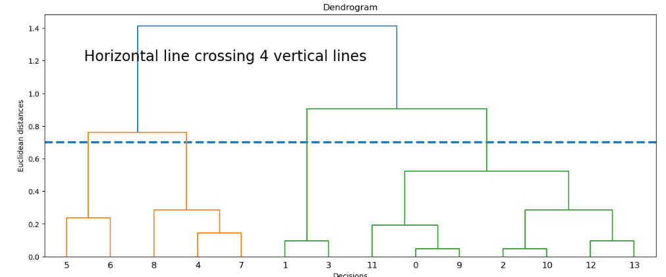
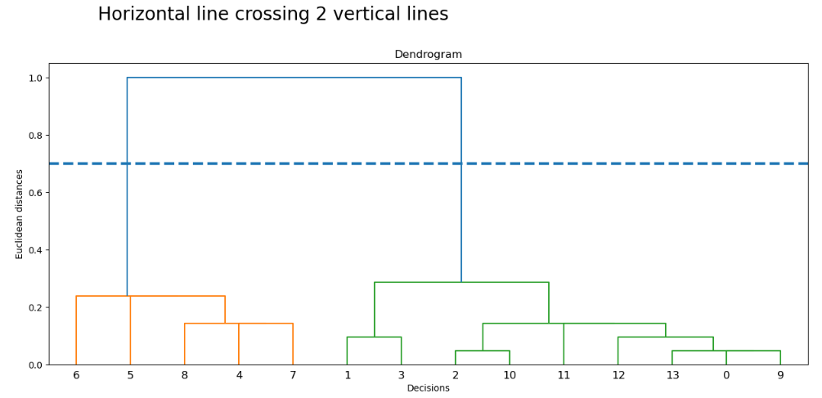
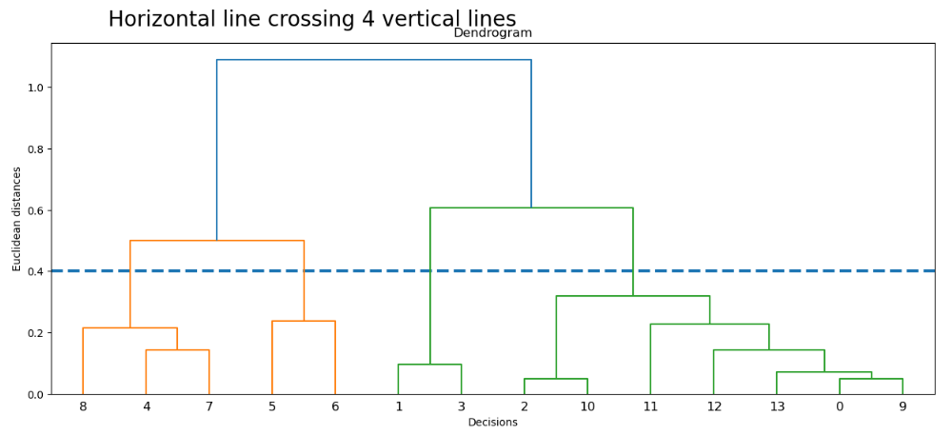
Results
Complete Linkage
Single Linkage
Average Linkage

Slide 6
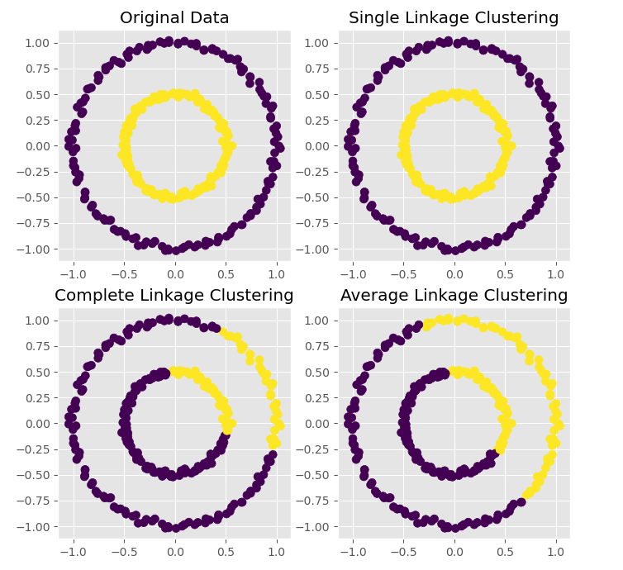
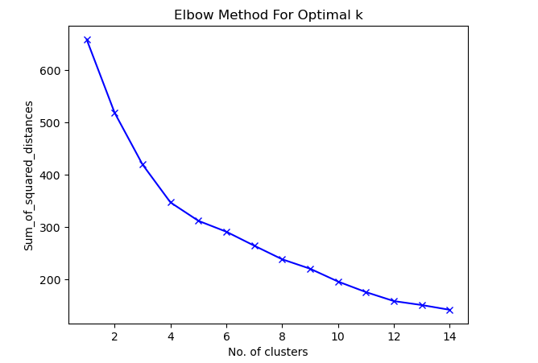
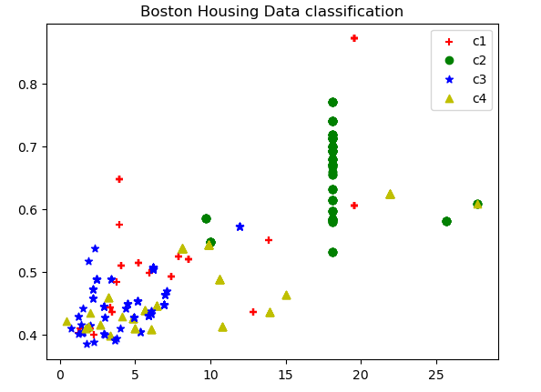
Results
Concentric Circles
Graph of Sum of Squared Distances
Scatter Plot

Slide 7
Conclusion
By this assignment, we came across Hierarchical Clustering for Single, multiple and average linkages.
We also implemented the same for Concentric Circles Data.
Then, we implemented k-means clustering on Boston Housing Data.

